Slide 1
A FEW SELECTED
BREEDS OF
GOATS
__Stephen R Schafer, EdD __ 2008 __University of Nevada-Reno__

Slide 2

Partially Funded By
Ag Council of Nevada
4 Hall Lane
Yerington, NV 89447
This presentation was developed for use as an educational resource and is provided as an educational service. User/purchase fees are not associated with this presentation.

Slide 3
Information Development
Much effort and time was devoted to:
developing accurate/current information
incorporating appropriate pictures/graphics
providing proper credit of pictures/graphics
obtaining copyright/educational permission
Any and/or all errors, omissions, etc.
are purely unintentional/accidental.

Slide 4
Information Sources
Clemson University (Meat Goat Breeds)
Cornell University (Meat Goat Breeds)
Earthlink.net/~lureynolds/breeds (Breeds of Goats)
Fias Co Farm {internet} (Breed of Goats)
Goats4h.com/Dairy Goats (Info on Dairy Goats)
National 4-H/4HCCS (4-H Sheep Manuals)
Oklahoma State University (Goat Breed Ident)
University of Maryland (Sheep & Goat Breeds)
University of Wyoming (4-H Goat Manuals)

Slide 5



TYPICAL OR COMMON
BREEDS OF GOATS
Author
Dr. Steve Schafer, University of Nevada-Reno
Reviewers
Dr. Barney Cosner, Nebraska State Fair
Dr. Terry Dumas, Louisiana State University
Dr. Susan Kerr, Washington State University
Notes:
The horse that I drew out was the Quarter Horse. The Quarter Horse was the First All American horse and is considered the “most popular horse of all time”

Slide 6
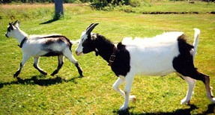
Alpine
Originated in the Alps, moved from Switzerland to France & on to US
Production traits were stressed, so there is no distinct color pattern
Excellent milkers with large & well-shaped udders
Have erect ears, & tend to have shorter hair
They are medium in size
Photo: Crystal D’Eon,
Oklahoma State University

Slide 7
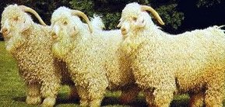
Angora
Originated in the Angora District of Asia Minor
Considered as picturesque
Both sexes are horned
Ears are droopy & heavy
Are a medium sized breed
Valued for mohair fleece
Less prolific than most other breed of goats
Photo: Oklahoma State University

Slide 8
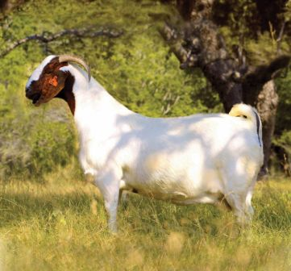
Boer
Originated in South Africa
Ears are long & droopy
It is a horned breed
Typical color pattern is a white body with darker (black or brown) head
Value is as a meat goat
Build thick & strong
It is a heavy breed
Photo: Unknown Source

Slide 9
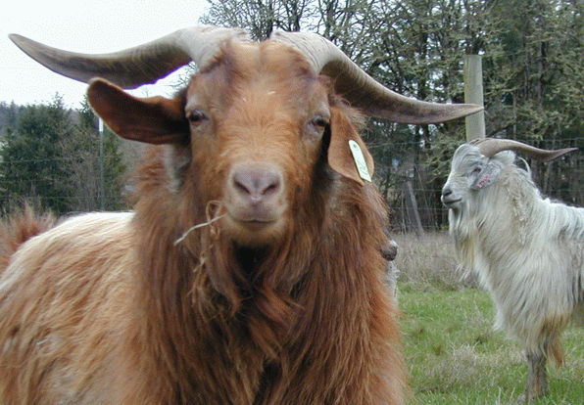
Cashmere
Originated in Middle East (Iran, Iraq, Afghanistan)
Has a regal appearance, due to long coat & the long, sweeping horns
Both sexes are horned
Healthy & hardy breed
Do not tend to jump
Valued for cashmere fleece
Photo: Paul Johnson, Oregon, USA

Slide 10
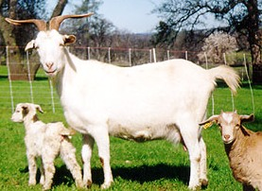
Kiko
Originated in New Zealand
Purposely developed & bred for meat production
Kiko…means meat or flesh
Both sexes are horned
The horns have a distinct outward & “v” flare
Are hardy & adaptable
Are intermediate in size
Photo: Dr. An Peischel,
Oklahoma State University

Slide 11
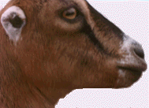
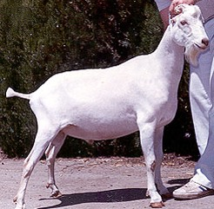
LaMancha
Originated in Oregon, USA
Most distinguishing feature is the shortness of ear length
Gopher Ear has a maximum length of one inch, but it is preferable to be non-existent
Elf Ear has a maximum length of two inches & curved ends
Hair is short, fine, & glossy
Any color/colors is acceptable
Photo:
www.goats4h.com/DairyGoats
Photo: Karen Lee,
Oklahoma State University

Slide 12
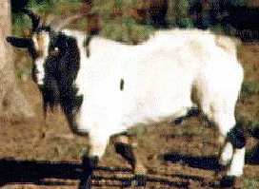
Myotonic
Originated in Tennessee
They are also called Stiff Leg, Wooden Leg, and/or Tennessee Fainting Goat
Typically, they are black & white, but other colors are not uncommon
Considered as easy kidders & as good mothers
A thicker & heavier goat
Valued for meat production
Photo: Oklahoma State University

Slide 13
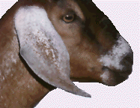
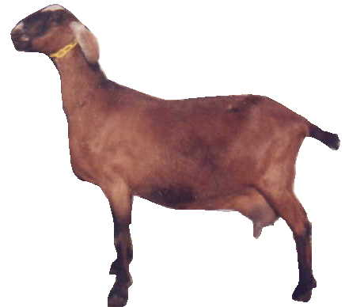
Nubian
Originated in England
Also called Anglo-Nubian
Distinguished by its royal or aristocratic appearance
Its appearance is dominated by its very long, drooping, graceful, & curving ear
Any color is acceptable
It is a larger framed breed
It is a multi-purpose breed
Photo: www.goats4h.com/DairyGoats
Photo: Unknown Source

Slide 14
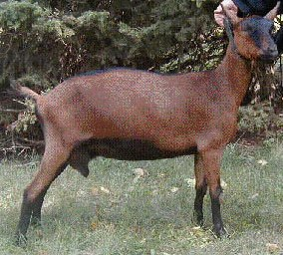
Oberhasli
Originated in Switzerland
The color is chamois, which is like the bay color of a horse
Markings: two black stripes down the face, a nearly all black forehead, black dorsal stripe, black legs below the knees, hocks, & black belly
Developed as a dairy goat
It is a medium sized breed
Photo: Dave Battjes

Slide 15
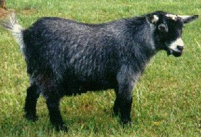
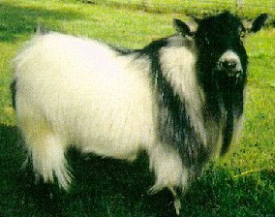
Pygmy
Originated in many countries in area of western Africa
The hair may be any color, agouti (top picture) is the most predominate
Markings: the muzzle, eyes, ears, & forehead must be a lighter color/tone; the lower legs & dorsal stripe are a darker color/tone
Developed as a meat breed
It is very small framed
Photos: Oklahoma State University

Slide 16
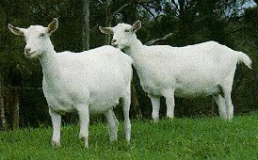
Saanen
Originated in Switzerland
White/light cream in color
Hair is short & fine, with fringe along spine & thigh
Ears: erect & point forward
Sensitive to sunlight & do best in cool conditions
Medium to large in size
They are heavy milkers
Photo: Oklahoma State University

Slide 17
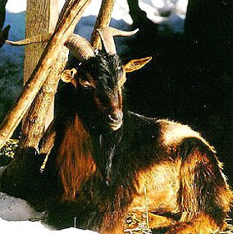
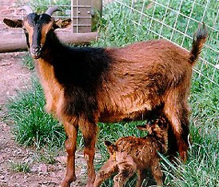
San Clemente
Originated off the coast of California on island of San Clemente
Color is mostly red or tan with black markings
Both sexes are horned
They are a small breed (almost dwarf size)
They are fine boned
They are meat goat breed
Photos: Oklahoma State University

Slide 18
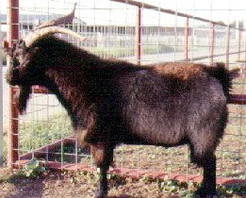
Spanish
Originated in US, goats brought by Spanish
They developed in the wild
As a result; size, ear type, hair length, horns, etc are not standardized
Also, developing in the wild resulted in a small to medium sized goat and one with a smaller udder (to avoid damage by rocks, cactus, etc)
Considered a meat goat
Photo: Oklahoma State University

Slide 19
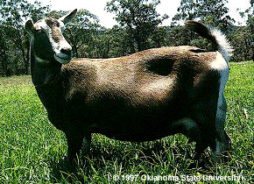
Toggenburg
Originated in Switzerland
The color is light fawn to dark brown
Ears are erect & white, with dark in middle
A white stripe runs down each side of the face
Legs are white below the knee/hock & a white triangle by tail attach
Oldest known dairy breed
Photo: Oklahoma State University

Slide 20
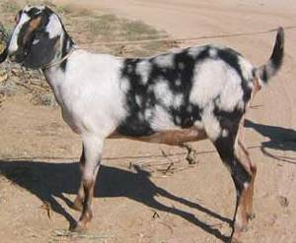
Identify…
Photo: Unknown Source
Nubian

Slide 21
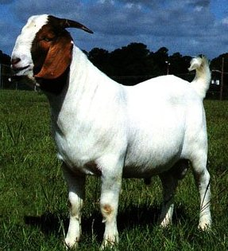
Identify…
Photo: Oklahoma State University
Boer

Slide 22
Identify…
Photo: Dr. An Peischel,
Oklahoma State University
Kiko

Slide 23
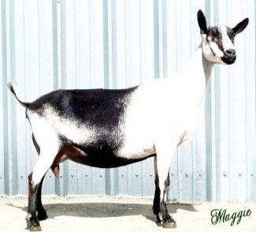
Identify…
Photo: Unknown Source
Alpine

Slide 24
Identify…
Originated in Switzerland
The color is chamois, which is like the bay color of a horse
Markings: two black stripes down the face, a nearly all black forehead, black dorsal stripe, black legs below the knees. hocks, & black belly
Developed as a dairy goat
It is a medium sized breed
Oberhasli

Slide 25
Identify…
Originated in Oregon, USA
Most distinguishing feature is the shortness of ear length
Gopher Ear has a maximum length of one inch, Elf Ear has a max length of two inches
Hair is short, fine, & glossy
Any color/colors is acceptable
LaMancha

Slide 26
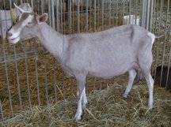
Identify…
Photo: Fias Co Farm
Toggenburg

Slide 27
Identify…
Photo: Oklahoma State University
Saanen

Slide 28
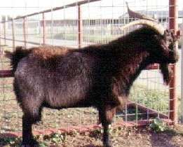
Identify…
Photo: Oklahoma State University
Spanish

Slide 29
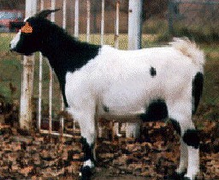
Identify…
Photo: Oklahoma State University
Myotonic

Slide 30
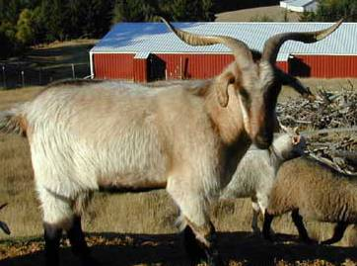
Identify…
Photo: Paul Johnson, Oregon, USA
Cashmere

Slide 31
Identify…
Photo: Oklahoma State University
San Clemente

Slide 32
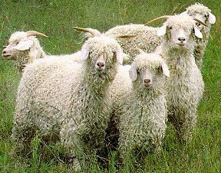
Identify…
Photo: Oklahoma State University
Angora

Slide 33
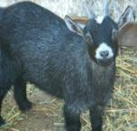
Identify…
Photo: Unknown Source
Pygmy

Slide 34
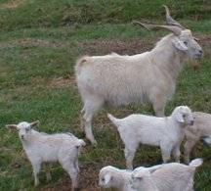
Identify…
Photo: Teresa Freeman
Kiko

Slide 35
Identify…
Originated in England
Distinguished by its royal or aristocratic appearance
Appearance is dominated by its very long, drooping, graceful, & curving ear
Any color is acceptable
It is a larger framed breed
It is a multi-purpose breed
Nubian

Slide 36
Identify…
Originated in Switzerland, & color is fawn to brown
Ears are erect & white, with dark in middle; & a white stripe runs down each side of the face
Legs are white below the knee & hock
Oldest known dairy breed
Toggenburg

Slide 37
Identify…
Originated in Switzerland
White/light cream in color
Hair is short & fine, with fringe along spine & thigh
Ears: erect & point forward
Sensitive to sunlight & do best in cool conditions
Medium to large in size
They are heavy milkers
Saanen

Slide 38
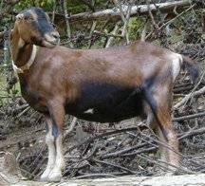
Identify…
Photo: Fias Co Farm
LaMancha

Slide 39
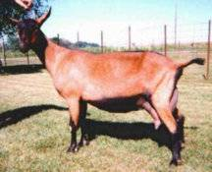
Identify…
Photo: Fias Co Farm
Oberhasli

Slide 40
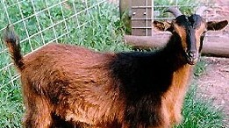
Identify…
Photo: Oklahoma State University
San Clemente

Slide 41
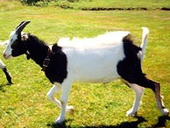
Identify…
Photo: Oklahoma State University
Alpine

Slide 42
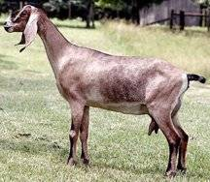
Identify…
Photo: Fias Co Farm
Nubian

Slide 43
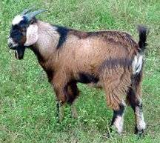
Identify…
Photo: Sharon Reeves
Spanish

Slide 44
Identify…
Originated in Asia Minor
Considered as picturesque
Both sexes are horned
Ears are droopy & heavy
Are a medium sized breed
Valued for mohair fleece
Less prolific than other breeds
Angora

Slide 45
Identify…
Originated in Middle East (Iran, Iraq, Afghanistan)
Has a regal appearance, due to long coat & the long, sweeping horns
Both sexes are horned
Healthy & hardy breed
Valued for their fleece
Cashmere

Slide 46
Identify…
Originated in Tennessee
They are also called Stiff Leg, Wooden Leg, and/or Fainting Goat
Typically, they are black & white, but other colors are not uncommon
Considered as easy kidders & as good mothers
A thicker & heavier goat, & they are valued for meat production
Myotonic

Slide 47
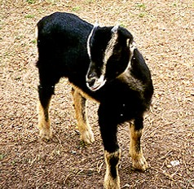
Identify…
Photo: Carolyn Futrell,
Oklahoma State University
LaMancha

Slide 48
Identify…
Originated in Western Africa
The hair may be any color, but agouti is the most predominate
Markings: the muzzle, eyes, ears, & forehead must be a lighter color/tone; the lower legs & dorsal stripe are a darker color
Developed as a meat breed, but is very small framed (dwarf-type)
Pygmy

Slide 49
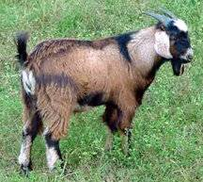
Identify…
Photo: Sharon Reeves
Spanish

Slide 50
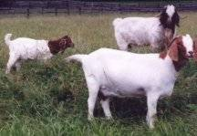
Identify…
Photo: Fias Co Farm
Boer

Slide 51
Identify…
Photo: Dave Battjes
Oberhasli

Slide 52
Identify…
Originated in New Zealand
Purposely developed & bred for meat production, its name actually means meat or flesh
Both sexes are horned, & the horns have a distinct outward & “v” flare (front view)
They are hardy & adaptable, and are intermediate in size
Kiko

Slide 53
Identify…
Originated in the Alps, moved from Switzerland to France & on to US
Production traits were stressed, so there is no distinct color pattern
They are excellent milkers with large & well-shaped udders
They have erect ears, & they tend to have shorter hair
They are medium in size
Alpine

Slide 54

Identify…
Photo: Unknown Source
Pygmy

Slide 55
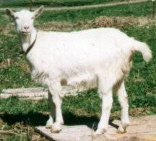
Identify…
Photo: www.goats4h.com/DairyGoats
Saanen

Slide 56
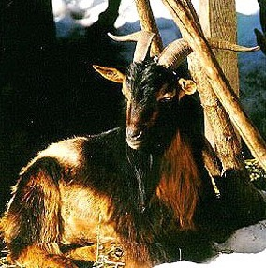
Identify…
Photo: Oklahoma State University
San Clemente

Slide 57
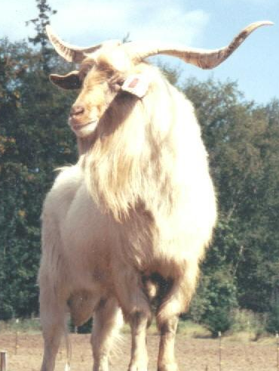
Identify…
Photo: Breezy Meadow Farm
Cashmere

Slide 58
Identify…
Photo: Oklahoma State University
Myotonic

Slide 59
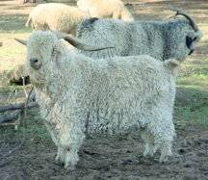
Identify…
Photo: Fias Co Farm
Angora

Slide 60
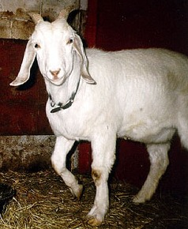
Identify…
Photo: Crystal D’Eon,
Oklahoma State University
Nubian

Slide 61
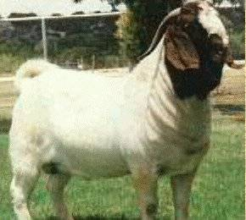
Identify…
Photo: Unknown Source
Boer

Slide 62
Identify…
Photo: Karen Lee,
Oklahoma State University
LaMancha

Slide 63
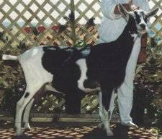
Identify…
Photo: Fias Co Farm
Alpine

Slide 64
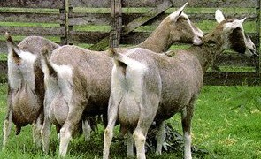
Identify…
Photo: Oklahoma State University
Toggenburg

Slide 65
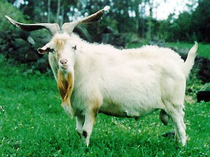
Identify…
Photo: Dr. An Peischel,
Oklahoma State University
Kiko

Slide 66
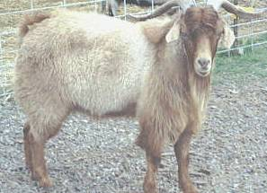
Identify…
Photo: Ol West Farms
Cashmere

Slide 67
Identify…
Photo: Oklahoma State University
Pygmy

Slide 68
Identify…
Originated off California
Color is mostly red or tan with black markings
Both sexes are horned
They are a small breed (almost dwarf size)
They are fine boned
They are meat goat breed
San Clemente

Slide 69
Identify…
Originated in the US, & they naturally developed in the wild
As a result; size, ear type, hair, horns, etc are not standardized
Developing in the wild resulted in a small to medium sized goat & one with a small udder (to avoid injury from rocks, cactus, etc)
Considered a meat goat
Spanish

Slide 70
Identify…
Originated in South Africa
Ears are long and droopy
It is a horned breed
Typical color pattern is a white body with darker (black or brown) head
Value is as a meat goat
It is built thick & strong
It is a heavy breed
Boer

Slide 71
Identify…
Photo: Oklahoma State University
Angora

Slide 72
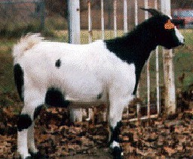
Identify…
Photo: Oklahoma State University
Myotonic

Slide 73
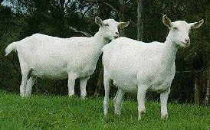
Identify…
Photo: Oklahoma State University
Saanen

Slide 74
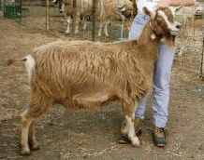
Identify…
Photo: www.goats4h.com/DairyGoats
Toggenburg

Slide 75

Identify…
Photo: Fias Co Farm
Oberhasli

Slide 76
Other Breeds
There are many other breeds that could have been included in this presentation; and maybe some of them should have been included, and maybe some of those that were included should have been excluded.
Regardless of your thoughts and opinions concerning the inclusion/exclusion of the various breeds, it can be agreed that it would be very difficult to reach agreement.

Slide 77
Other Breeds
Given the thoughts stated in the previous slide, the following breeds are listed as breeds for additional review and study.
Altai Mountain Corsican Norwegian
Grisons Striped Kinder Australian
Nigerian Dwarf Damascus Carpathian
Golden Guernsey Appenzell Tauernsheck
Conducting an internet search for goat breeds is an excellent starting point.

