Slide 1



The Butterfly
Lifecycle
START

Slide 2
next

Slide 3


next

Slide 4
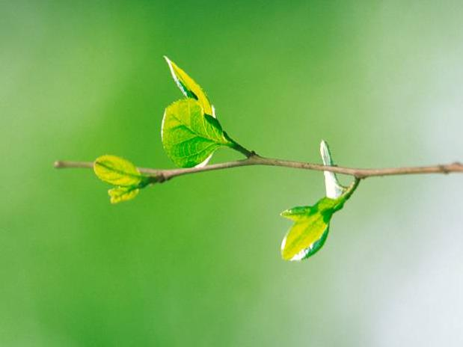

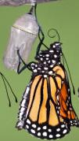



next

Slide 5
next

Slide 6
quiz

Slide 7



Where do butterflies lay their eggs?
leaves
flowers
grass
trees

Slide 8
That’s right!
Butterflies lay their eggs on leaves.
next question

Slide 9

Woops, wrong answer!
Try again
go back

Slide 10
How long before the butterfly egg hatches?
5 days
10 days
15 days
20 days

Slide 11
That’s right!
The egg hatches after about 10 days.
next question

Slide 12
Woops, wrong answer!
Try again
go back

Slide 13

What do caterpillars eat?
fruit
vegetables
leaves
chocolate

Slide 14
That’s right!
Caterpillars eat leaves to grow.
next question

Slide 15
Woops, wrong answer!
Try again
go back

Slide 16


What creatures like to eat caterpillars?
spiders
bees
cats
birds
wasps
beetles

Slide 17
That’s right!
Spiders like to eat caterpillars.
find another
next question

Slide 18
That’s right!
Birds like to eat caterpillars.
find another
next question

Slide 19
That’s right!
Wasps like to eat caterpillars.
find another
next question

Slide 20
Woops, wrong answer!
Try again
go back

Slide 21
How long does the caterpillar stay inside the pupa for?
1 week
2 weeks
3 weeks
4 weeks

Slide 22

That’s right!
A caterpillar stays in the pupa for about 3 weeks.
next question

Slide 23
Woops, wrong answer!
Try again
go back

Slide 24
How long do butterflies live?
1-2 months
2-3 months
3-4 months
4-5 months

Slide 25
That’s right!
Butterflies can live between 4-5 months.
next

Slide 26
Woops, wrong answer!
Try again
go back

Slide 27

Well Done!
You answered all the questions correctly.
finished

