Slide 1
The human circulatory system
This system is one of the most important in the body.
It is made up of 3 main parts:
The heart
The Lungs
The blood vessels.
This system is also known as the cardiovascular system.

Slide 2
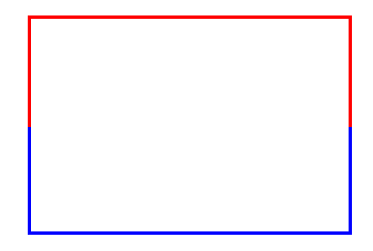

The human circulatory system
Heart
Blood pumping
Lungs
Body
Heart

Slide 3
The human circulatory system
Heart
Blood pumping
Lungs
Body
Heart
The heart pumps blood to the lungs

Slide 4
The human circulatory system
Heart
Blood pumping
Lungs
Body
Heart
The lungs remove the carbon dioxide from the blood and refill it with oxygen.

Slide 5
The human circulatory system
Heart
Blood pumping
Lungs
Body
Heart
The heart then pumps the blood around the body.

Slide 6
The human circulatory system
Heart
Blood pumping
Lungs
Body
Heart
The blood is transported all around the body, where oxygen is taken and replaced with carbon dioxide.

Slide 7
The human circulatory system
Heart
Blood pumping
Lungs
Body
Heart
The blood is cleaned in the kidneys to remove all the waste before it returns to the heart.

Slide 8
The human circulatory system
Heart
Blood pumping
Lungs
Body
Heart
The cycle starts again

Slide 9
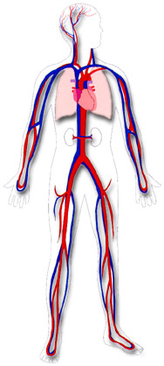
The human circulatory system
The blood vessels run throughout the body supplying oxygen to every cell in the body.
They are made up of 3 types – arteries, veins and capillaries.

Slide 10
The human circulatory system
Arteries are thick blood vessels that you can easily feel in the form of a pulse.
They transport oxygenated blood to the cells.
As they are full of oxygen, they appear to be a deep red colour.

Slide 11
The human circulatory system
Veins are thick blood vessels.
They transport blood back to the heart from the cells.
As they have little oxygen, they appear to be more a blue colour than red.

Slide 12
The human circulatory system
Capillaries are thin blood vessels.
They allow oxygen and nutrients to pass to the cells, and waste products and carbon dioxide to be removed from them.
They are small to allow them to reach every cell in the body.

