Slide 1
WALT to find out about Collective nouns

Slide 2
Collective nouns
The name used for a group of things
It can be animals like squirrels
or elephants
It can be things like tables or trees

Slide 3
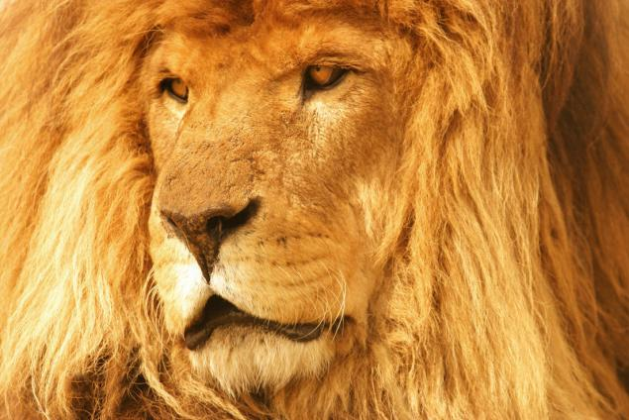
Collective nouns
A lion

Slide 4
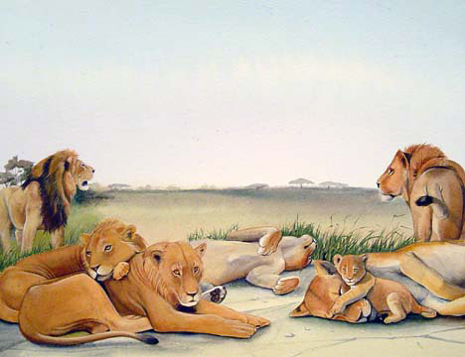
A pride of lions

Slide 5
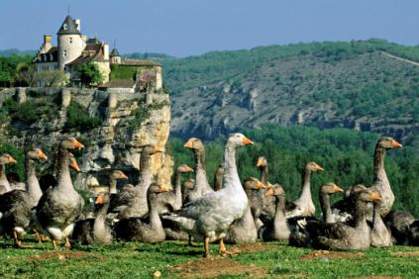
A goose
A flock of geese

Slide 6
One hedgehog
A prickle of hedgehogs

Slide 7
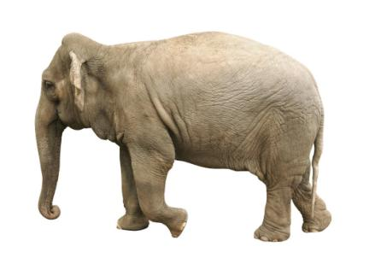
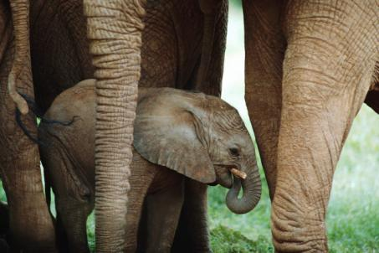
An elephant
A herd of elephants

Slide 8
One Hippopotamus
A bloat of Hippopotami

Slide 9
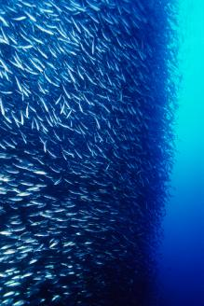
A fish
A school of fish

Slide 10
A squirrel
What do you think would be a
good name for a group
of squirrels?

Slide 11
Some more collective nouns
A wolf
A whale
A bee
A puppy
A pack of wolves
A pod of whales
A swarm of bees
A litter of pups

Slide 12
What could you call these things?
A group of soldiers
A large group of people
A group of footballers
A group of schoolchildren
An army
A crowd
A team
A class

Slide 13
WALT to find out about Collective nouns
There are lots of places to find out more collective nouns, using the internet
Try this website
http://rinkworks.com/words/collective.shtml

