Slide 1
“This Magnificent African Cake…”* Conquest and Partition
*metaphor attributed to King Leopold II during the 1984-5 Berlin Conference, reference being to the partitioning of the continent between the various European powers.

Slide 2
Conquest and Partition
Themes:
The nature of the ‘scramble’ - Issues of Conquest
Resistance and Co-operation
How to Govern?
Constructing the Knowledge of Colonialism

Slide 3
The ‘Scramble’
No single moment or movement:
brought to a head by French-British competition, played out in Egypt-Sudan: Fashoda (1880s, 1896)
‘A place in the sun’: Germany entered the game
Berlin Conference 1884-85: established ‘rules of the game’ to claim Africa – must have ‘foothold’ (settlement, treaty)

Slide 4
Pre-cursors of the Scramble:
South Africa: ‘Mineral Revolution’ shaped by Diamonds and Gold - Dutch established way station Capetown 17th century - settlers joined by Germans, French: “Afrikaners” or “Boers” - British ‘won’ Cape Colony 1805/6 Napoleonic Wars - moved inland annexing territory including Natal, Lesotho

Slide 5
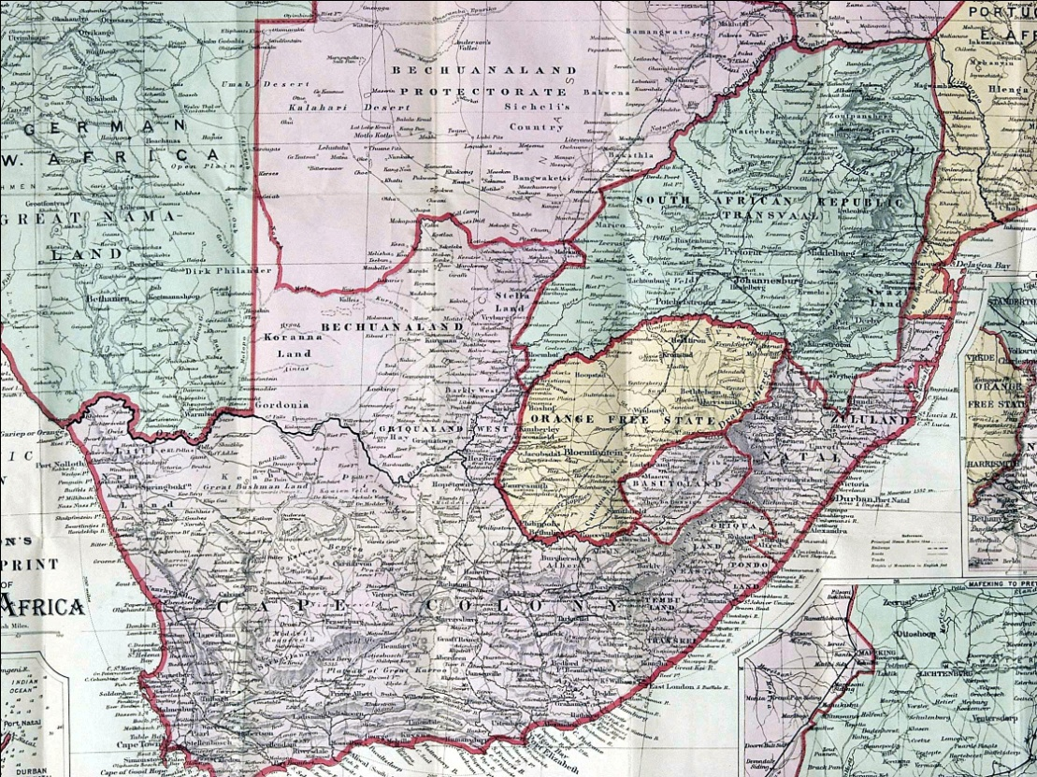
South Africa (cont.)
The 19th Century:
saw British colonization of the Cape and the Eastern frontier regions

Slide 6
South Africa (cont.)
- Boers trekked north to settle on both sides of Vaal and Orange rivers (established independent Republics by mid-century)
Same era as Zulu ‘mfecane’, drove many other groups into the interior (e.g., the Ndebele who established Matebeleland)
led to competition over land, resources

Slide 7
South Africa (cont.)
- Diamonds discovered Kimberly, 1867
- Gold at Johannesburg, 1886
Both needed: - external labour (poor Europeans and Africans)
- foreign capital investment
- Both lay in Boer territories

Slide 8
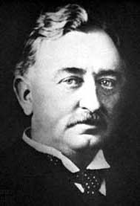
South Africa and Rhodes
Cecil Rhodes:
- made initial fortunes in Kimberly Diamonds and established monopoly of De Beers Co.
- invested in Rand goldmines but could not monopolize (because of Boer laws and regulations)
http://en.wikipedia.org/wiki/Image:CecilRhodes.jpg

Slide 9
South Africa and Rhodes
looked northwards to region ‘fabled’ for gold
tricked Lobengula into signing over land
1890s sent ‘Pioneer Column’to colonize
established farms but no gold
- Later named (Southern) Rhodesia

Slide 10
South Africa and Rhodes
But:
Rhodes’ dream of “Boer and Briton” working together:
- to control wealth of Southern Africa
-to expand ‘from Cape Town to Cairo’
-blocked by resistant Boer rulers of Transvaal Republic

Slide 11
South Africa and Rhodes (cont.)
Cecil Rhodes and the Boer War:
- with tacit backing of British Goverment Rhodes organized ‘Jameson Raid’, 1896
Jameson (one of ‘Pioneers’) led overnight raid into Transvaal,
hoped to incite internal uprising among foreigners
huge failure
regarded as ‘act of war’ by Boers

Slide 12
South Africa: the ‘Boer War’
1899-1902: ‘The Boer War ‘
- Also ‘South African War of Independence’:
Britain’s largest colonial war
involved African and Colonial troops (eg from Canada, Australia) - Guerilla warfare effective against British
drew British into using similar tactics
establishment concentration camps
starvation, disease wore down Boers and their African allies

Slide 13
South Africa: the ‘Boer War’
1902, Boers surrendered
‘Bitter Enders’ said anti-colonial resistance to British should continue
- Black Africans used as troops by both sides
- thousands died from disease, hunger; others in battle
- Union of South Africa 1910: created White South African state

Slide 14
North Africa
North Africa : - conquest of Algeria by the French - began in 1830 (Algiers), taken from Ottomans - ended 1879 in mountains and Sahara desert of interior -rapidly attracted French settlers

Slide 15
North Africa:
1881 French declared protectorate over Tunisia to block Italian interests - direct challenge to Ottoman empire in which Tunisia was a province
1882 British drawn into Egypt to put down Islamic revolt against government - established control over territory - Suez canal remained under French control - beginning of ‘showdown’ at Fashoda

Slide 16
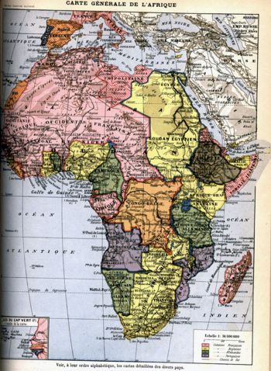
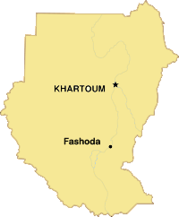
Chronology of the Scramble:
French and British face-off at Fashoda. French backed down rather than risk war.

Slide 17
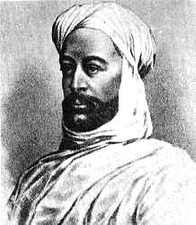
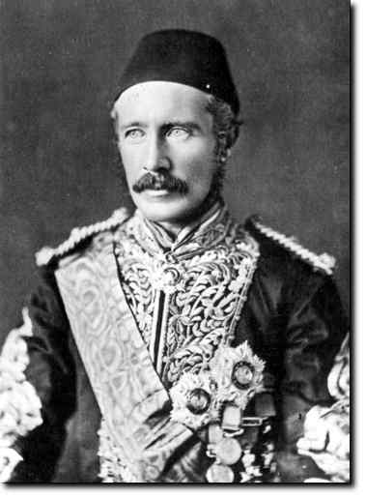
Chronology of the Scramble:
British decided to re-conquer Sudan: 1898 forces of the successor to the Muslim ‘Mahdi’ (ruler of Sudan) routed by British-Egyptian army at Omdurman (near Khartoum)
Muhammad Ahmad Al-Mahdi, led resistance to the British. Died 1885
British General Charles Gordon, beheaded by the Mahdi at Khartoum, 1885

Slide 18
Chronology of the Scramble:
French also developing equatorial Africa (from Gabon), pushing inland to Lake Chad basin - from there aimed at Upper Nile region (1897 the Marchand Mission set out)
- Germany claimed coastal footholds in South West Africa, Togo, Cameroons and East Africa

Slide 19
The ‘Scramble’:
Berlin Conference intended to resolve competing interests:
- special attention to river basins (Niger, Nile, Congo) - emphasis on existing ‘claims’ (settlements, treaties, trading relations) as basis for pieces of the partition
-ultimately accelerated competition between Europeans and between Africans

Slide 20
The Many Faces of Conquest
‘Conquest’ was multi-faceted, by no means uniform:
- the means of conquest differed;
- reactions to conquest differed;
- the consequences of conquest differed according to European colonial force and African indigenous reactions

Slide 21
North Africa
North Africa was distinct: - most of North Africa (excepting Morocco) part of Ottoman empire - became part of the dynamics of the scramble. - eg Turks reasserted ties with Tripoli in 1881 strengthening their garrison (eventually lost control to Italy when remains of Ottoman Empire partitioned under in 1923)

Slide 22
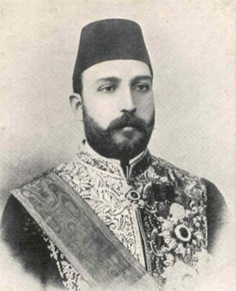
North Africa
- Tunisia and Egypt were strongest: they saw increasing ties (commercial, political) with Europe as means of achieving independence from Turkish control.
Tewfik Pasha, Khedive of Egypt 1879-92. The British supported him in his struggle with the army for control of Egypt thus strengthening their influence and control in the region.

Slide 23
North Africa (cont.)
Morocco:
Strategic, commercial, diplomatic importance to Spanish, British, French
- Sultan played one off against the other, retained independence until Germany intervened, 1905 and 1911.
Britain agreed to French/Spanish partition in exchange for free hand in Egypt
Germany ‘bought off’ with French Congo.

Slide 24
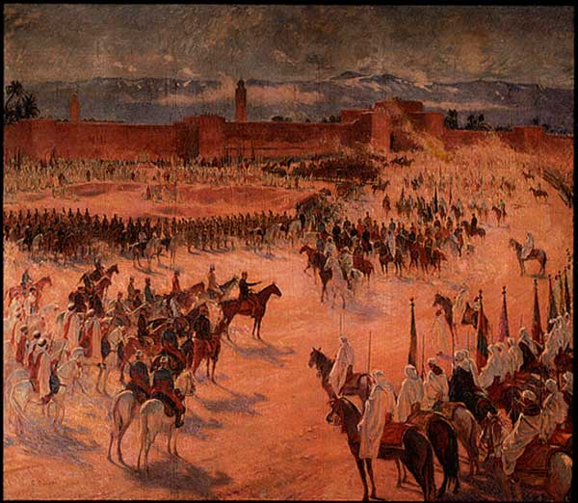
The French Conquest of Morocco
General Lyautey meets Colonel Mangin in front of the walls of Marrakesh in 1912.
[D. Porch, The Conquest of Morocco (London, 1982) Cover Plate]

Slide 25
West, Central and East Africa
European Powers (especially British and French) had longstanding commercial interests
Portuguese still had foothold along Zambesi and lower Congo.
- Missionary interests were also established in coastal regions.
- Each ‘used’ to legitimate, extend claims to territory latter part of the 19th c.

Slide 26
West and Central Africa
Treaty Making:
- principal means of ‘conquest’: treaties established with local chiefs
Congo epitomized this process with Belgian ‘explorer’ Stanley competing against French ‘explorer’ de Brazza
West Africa, trading companies like the Royal Niger Company acted as Government agents

Slide 27
West and Central Africa (cont.)
‘Gunboat Diplomacy’:
- Where local chiefs or successful African merchants would not co-operate, gunboats were deployed (eg Niger Delta).
- In other areas, ground troops were used (eg Asante of Gold Coast).

Slide 28
West and Central Africa (cont.)
Composition of ‘Colonial’ Troops:
- Initially, many were former slaves
other Africans attracted by promise of a salary, sustenance, ’booty’ of war
- Senegalese ‘tirailleurs’ (French)
- Hausa Troops (later West African Frontier Force – British)
- African armies limited economic and political ‘costs ‘to European Governments - ‘face’ of conquest often African!

Slide 29
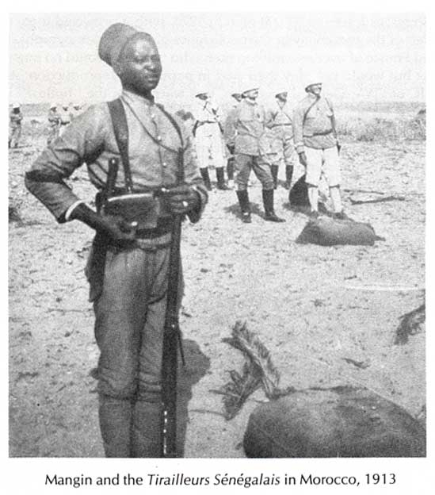
Senegalese ‘Tirailleurs”
Colonel Mangin and the Tirailleurs Senegalese in Morocco, 1913.
[Myron Echenberg, Colonial conscripts (Portsmouth NH, 1991):31]

Slide 30
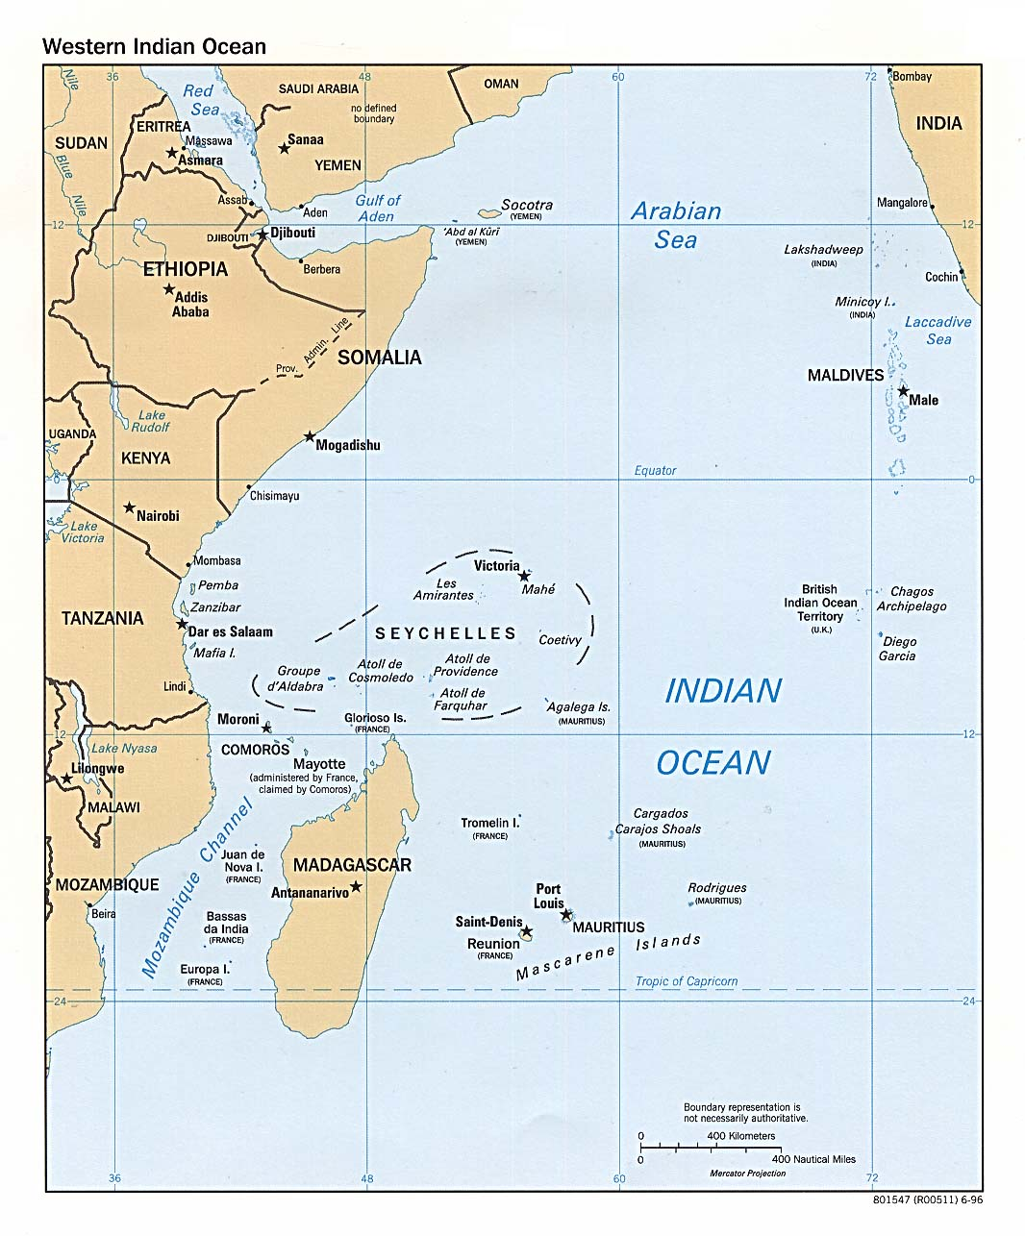
East Africa
As in North Africa, there was another ‘empire’ present: the Omanis of Arabia
as in South Africa, Omani Arabs part of the economic and political life since 17th century
settled ‘colonized’ in 19th century

Slide 31
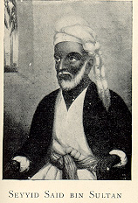
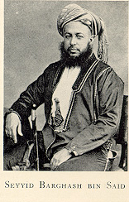
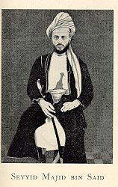
East Africa
1840 Seyyid Said bin Sultan, the ruler of Oman moved his capital to Zanzibar. Commerce and settlements developed along coast and into the heart of Africa (Congo). Carried on by sons Seyyid Majid and Seyyid Barghash until British Rule in 1890.

Slide 32
East Africa
- Trade in ivory, slaves drew different groups into “scramble” for East Africa.
- Prazeros, descendants Portuguese, Africans
- Yao working North East of Zambezi.
- Makua East of Yao, closer to coast.
Nyamwezi further north (Lake Tanganyika -Msiri and Mirambo, 1850s)
trading, raiding states linked up with the Ovimbundu (modern Angola)

Slide 33
East Africa
British negotiated with Omanis, especially with regard to ending Slave Trade
competed with Germans for claim to mainland (Kenya, Tanganyika, Uganda).
- East African partition gave Tanganyika to the Germans.
- Here too ‘British African’ troops used: Slaves numbered highly among soldiers (eg Rashid bin-Hassani)

Slide 34
African Rulers: Allies in Conquest
Important to remember: - almost everywhere Europeans had long been part of the local trading economy
Many regions also involved in politics, and even military adventures - many rulers used European trading friends (men, ships, weapons) against African enemies
saw new agreements in same light: mutual benefits

Slide 35
“Mission of the Gun”
Contrast ‘Victorian Image of Conquest’ with reality of Zulu massacre [video excerpt, “Africa”, Basil Davidson, ‘The Bible and the Gun’
slide show showed British victories as Victorian Britain wished to imagine it
symbolic of contradiction between ‘imagining’ empire and ‘creating’ it

Slide 36
“Mission of the Gun”
Contradictions of empire building:
earlier victory of Zulu over British could neither be imagined nor accepted - massacre could not be seen: romanticizing of conquest
how important was military technology?
“Whatever happens – we have got
The Maxim Gun – and they have not!”

Slide 37
The Europeans Come to Stay
- The ‘white settler’: Rhodes’ claim to Matabeleland for exploitation minerals and colonization by settlers
- His vision for Africa also a vision for White, settler ruled Africa
- ‘Pacification’ created security, potential for prosperity – for white, not black, ‘Africans’

Slide 38
“This Earth Shall be English”
Story of Rhodes and Ndebele chief Lobengula also story of colonialism’s inherent contradictions
- allegory of ‘the chameleon and the fly’:
“and I, said Lobengula, am the fly”
– epitomized nature of conquest

Slide 39
“This Earth Shall be English”
Missionaries were central to process: ‘friends’ to the Africans?
- Lobengula similar to other African chiefs: believed in power of Queen Victoria to protect Africans
- similar also in being disappointed

Slide 40
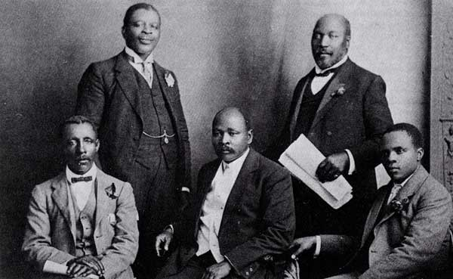
ANNC Delegation to England, 1914
[Jurgen Schadeberg, ed. Nelson Mandela and the Rise of the ANC, London, 1990):14]
South African Native National Congress (later ANC) delegation to London urged British Government to intervene in proposed Native’s Land Act, 1913. They failed.

Slide 41
How to Govern?
Difficulties facing all European Powers :
- lack of manpower in Africa (even in settler areas, Africans always in vast majority)
- need to establish legitimacy of ‘rulers’
- need to pay for government: tax collection
- need to have acceptable face of government at local level
- need to retain public support at home (exception being Portuguese)

Slide 42
How to Govern?
“Indirect Rule”:
-French and British used local chiefs and ‘notables’ (elites) as intermediaries [see ‘Additional Readings’: Archinard, Lugard]
Collected taxes, assured labour recruitment
Where they did not exist (or would not ‘co-operate), they were created
Problem: ‘created rulers’ had no legitimacy, were not effective

Slide 43
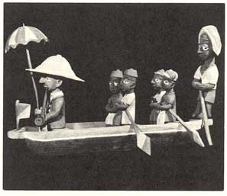
District Officer on Tour (Nigeria)
Thomas Ona’s wood carving:
‘an African’s view of a Colonial Officer’ (photo)
[Phyllic Martin & Patrick O’Meara, eds., Africa (Bloomington, 1977): 137

Slide 44
How to Govern?
Islamic Regimes:
Emirs, Sultans left if they ‘collaborated’: tax-collecting bureaucracy in place
Issue: how much credibility could Muslim leader retain if seen to ‘co-operate’ with Christians (eg. Algeria, Mauritania)?
- if Emir without immediate presence of Europeans, illusion of ‘nothing has changed’ maintained (eg Northern Nigeria)

Slide 45
How to Govern?
South Africa, Settler Regimes:
- ‘local government’ in Union of South Africa - government in hands British-Boer ‘settlers’
- governments ruled huge numbers ‘black’ Africans: mostly controlled with segregationist legislation – limited movements, housing, land accessible to Blacks
- often at odds with European Colonial government and demands of Blacks

Slide 46
How to Govern?
Portuguese Colonies:
Guinea Bissau, Angola, Mozambique: old, mestizo populations Africanized Christians
‘Overseas Territories’ to absorb poor Portuguese peasants, unskilled workers
provided mineral, agricultural wealth
administered like mainland Portuguese provinces
local officials, police were Africans

Slide 47
How to Govern?
Congo Free State:
- exceptional: personal ‘fiefdom’ King Leopold II until taken over by Belgium parliament 1908
- turned over to Charter Companies for development
purely commercial venture
‘government’ per se was non-existent

Slide 48
Resistance to Colonialism
Whether Colonial Rule established through military conquest, negotiation with local chiefs, treaties or some combination thereof, within a few years all Colonial regimes faced resistance:
- Samori Touré in French West Africa--Islamic jihad—1882 - 1898
- Herero--German South West Africa, 1905/6
- Maji Maji--German Tanganika, 1906

Slide 49
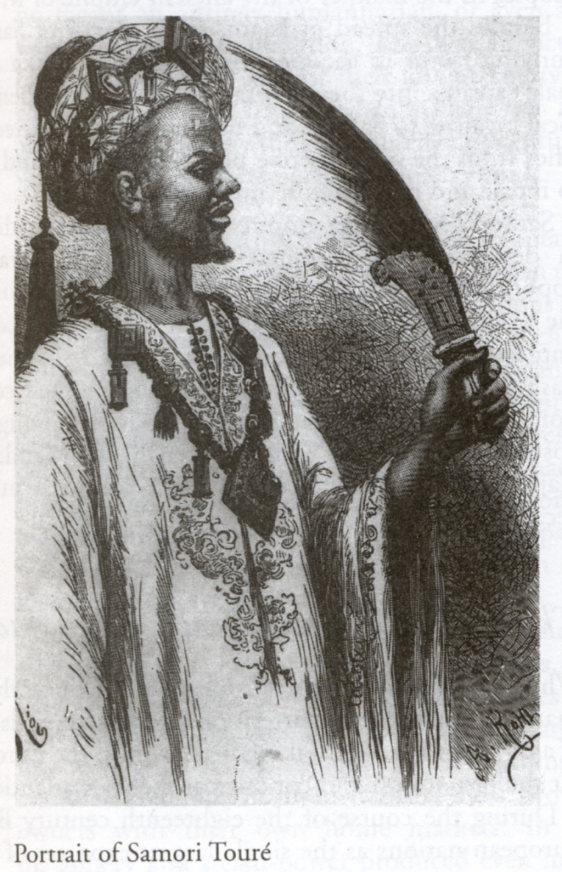
Resistance to Colonialism
Shillington, History of Africa, 229.

Slide 50
Resistance to Colonialism
- Tuareg Revolt French West Africa 1917
- ‘Women’s War’--Southern Nigeria 1929
Pende Rising--Belgian Congo 1931
Abd al-Qadir -- Algeria
Mirambo, Tippu Tip in Central Africa
Shona, Ndebele 1896-7 – Southern Rhodesia

Slide 51
Resistance to Conquest
Shona and Ndebele resistance: - drew on powers Christians sought to undermine: traditional spirits, prophets, magic
- Xhosa ‘Cattle Killings’ South Africa: millenarian movement 1857
- Bambatha (Zulu) South Africa 1906: armed resistance to ‘poll' tax in South Africa.

Slide 52
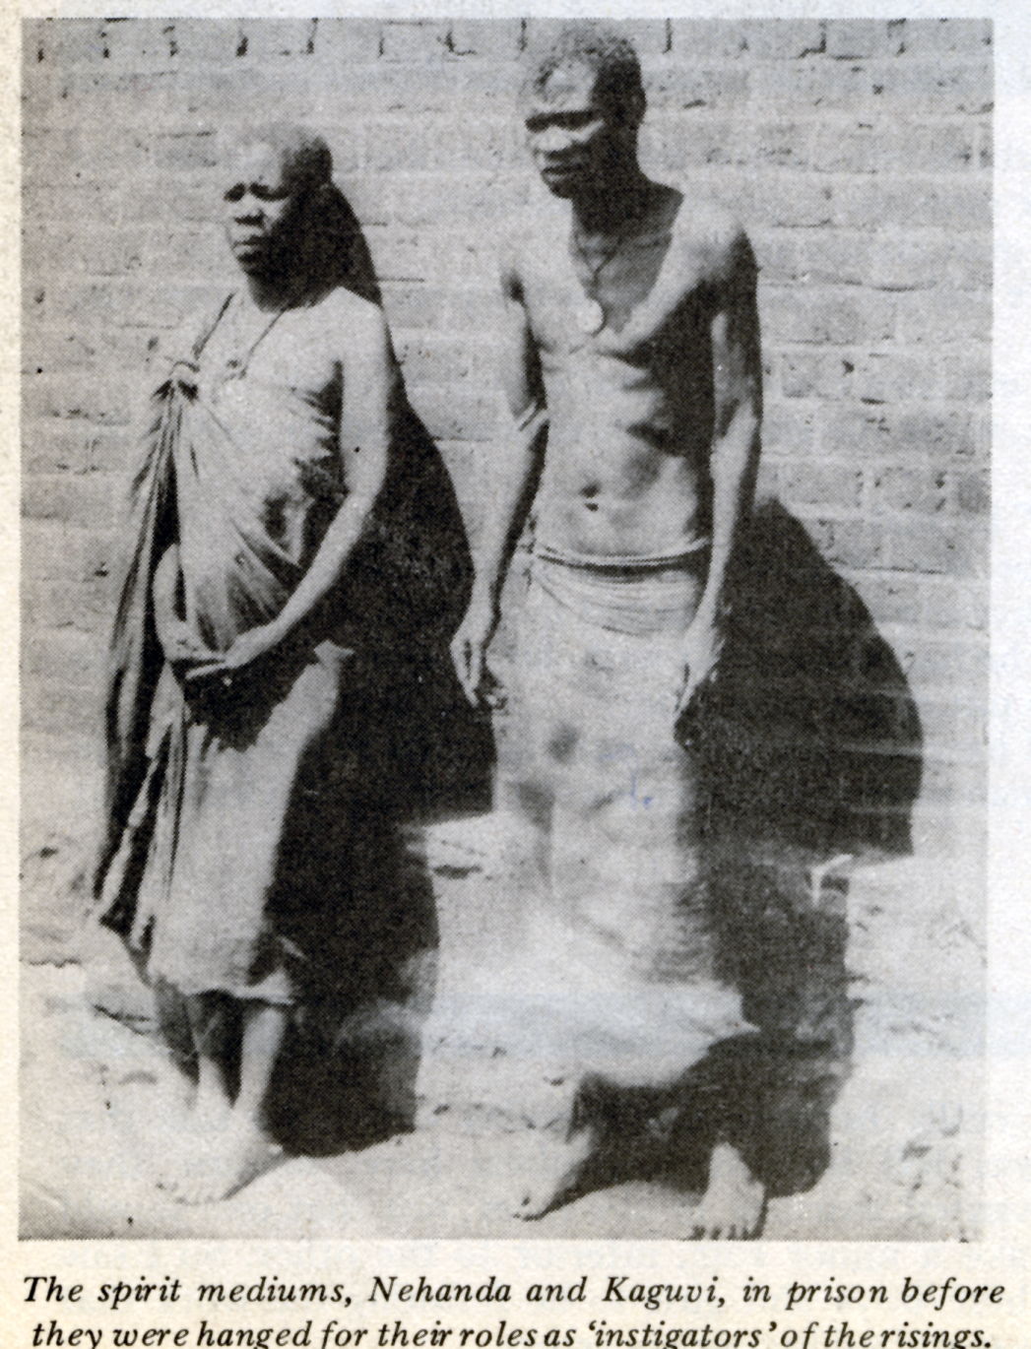
Resistance to Conquest
Frederikse, None but Ourselves, 42.

Slide 53
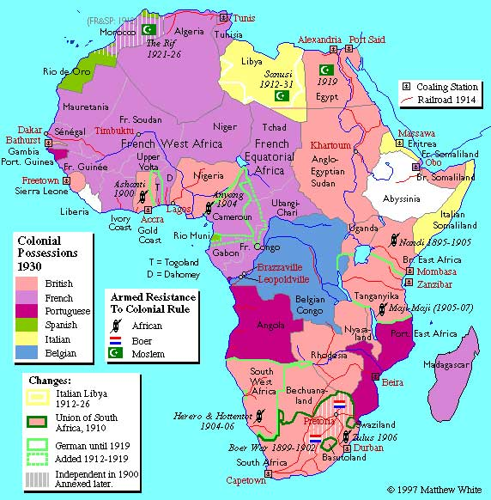
Colonial Africa Post WWI
Map Shows post-WWI changes and sites of armed resistance to Colonial Authority.
[http://users.erols.com/mwhite28/afri1914.htm]

Slide 54
Faces of Colonialism: Conclusion
no single colonial conquest or rule
experience of ruling, being ruled varied:
- how European power asserted
- how Africans perceived power
- how ‘dialogue’ between parties proceeded
- presence or absence ‘white settlers’
- nature local resistance, reactions to it

Slide 55
Faces of Colonialism: Conclusion
Role of ‘Colonial Knowledge’:
Orality gave way to European ‘writing’
histories created by local elites (political, religious – eg Christians Buganda, Nigeria)
ethnicities needed histories
alternative to resistance: creation, manipulation ‘knowledge’ consolidated positions in Imperial project

Slide 56
Faces of Colonialism: Conclusion
Role of ‘Colonial Knowledge’:
-Europeans needed ‘knowledge’ on which to build colonialism: myth and legend not sufficient
Those who put forward ‘acceptable’ histories acquired important role in new administrations
- 1880s – 1920s: Colonial ‘classes’ and ‘tribes’ in the making

