Slide 1
Chapter 33
The Building of Global Empires

Slide 2
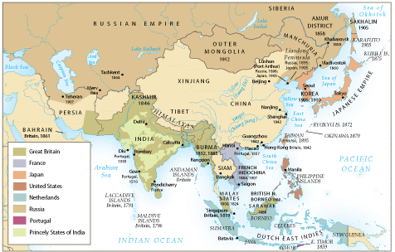
Imperialism in Asia, ca. 1914

Slide 3
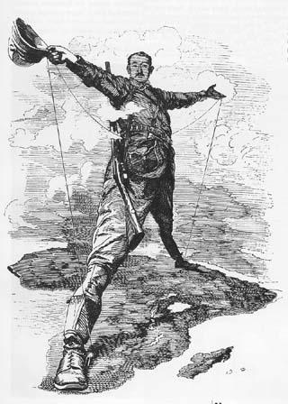
The Idea of Imperialism
Term dates from mid-19th century
In popular discourse by 1880s
Military imperialism
  Later, economic and cultural varieties
  US imperialism

Slide 4
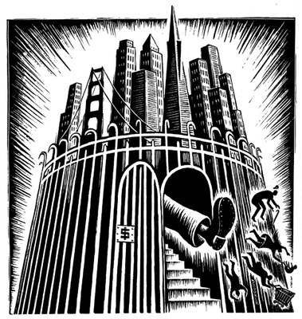
Motivation for Imperialism
Military
Political
Economic
  European capitalism
Religious
Demographic
  Criminal populations
  Dissident populations

Slide 5
Manifest Destiny
Discovery of natural resources
Exploitation of cheap labor
Expansion of markets
  limited

Slide 6
The “White Man’s Burden”
Rudyard Kipling (1864-1936)
  Raised in India, native Hindi speaker
  Boarding school in England, then return to India (1882)
French: mission civilisatrice
Notes:
Take up the White Man's burden--
Send forth the best ye breed--
Go, bind your sons to exile
To serve your captives' need;
To wait, in heavy harness,
On fluttered folk and wild--
Your new-caught sullen peoples,
Half devil and half child.
Take up the White Man's burden--
In patience to abide,
To veil the threat of terror
And check the show of pride;
By open speech and simple,
An hundred times made plain,
To seek another's profit
And work another's gain.
Take up the White Man's burden--
The savage wars of peace--
Fill full the mouth of Famine,
And bid the sickness cease;
And when your goal is nearest
(The end for others sought)
Watch sloth and heathen folly
Bring all your hope to nought.
Take up the White Man's burden--
No iron rule of kings,
But toil of serf and sweeper--
The tale of common things.
The ports ye shall not enter,
The roads ye shall not tread,
Go, make them with your living
And mark them with your dead.
Take up the White Man's burden,
And reap his old reward--
The blame of those ye better
The hate of those ye guard--
The cry of hosts ye humour
(Ah, slowly!) toward the light:--
"Why brought ye us from bondage,
Our loved Egyptian night?"
Take up the White Man's burden--
Ye dare not stoop to less--
Nor call too loud on Freedom
To cloak your weariness.
By all ye will or whisper,
By all ye leave or do,
The silent sullen peoples
Shall weigh your God and you.
Take up the White Man's burden!
Have done with childish days--
The lightly-proffered laurel,
The easy ungrudged praise:
Comes now, to search your manhood
Through all the thankless years,
Cold, edged with dear-bought wisdom,
The judgment of your peers.

Slide 7
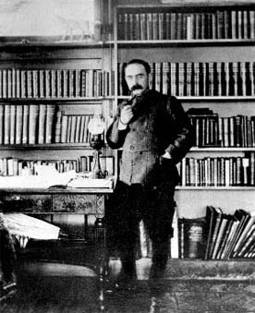
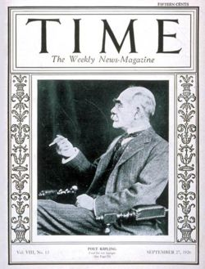
Rudyard Kipling
1895
Aged 60, 1926

Slide 8
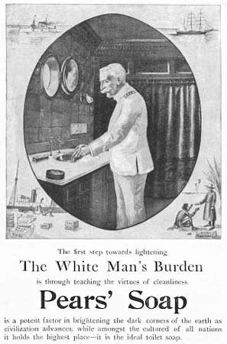
The “White Man’s Burden”?

Slide 9
“White Man’s Burden” by Rudyard Kipling
“Take up the White Man's burden—
Send forth the best ye breed—
Go, bind your sons to exile
To serve your captives' need;
To wait, in heavy harness,
On fluttered folk and wild—
Your new-caught sullen peoples,
Half devil and half child.”

Slide 10
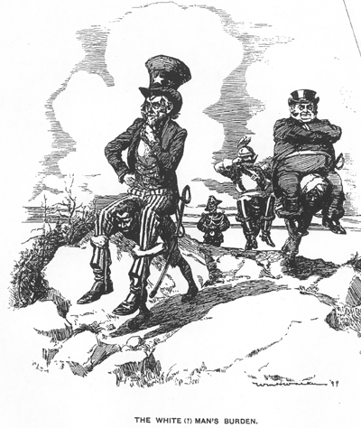

Slide 11
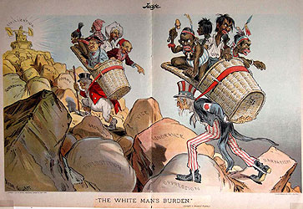

Slide 12
Geopolitical considerations
Strategic footholds
  Waterways
  Supply stations
  Imperial rivalries

Slide 13
Domestic Political Considerations
Crises of industrialism
Pressure from nascent Socialism
Imperial policies distract proletariat from domestic politics
  Cecil Rhodes: imperialism alternative to civil war

Slide 14
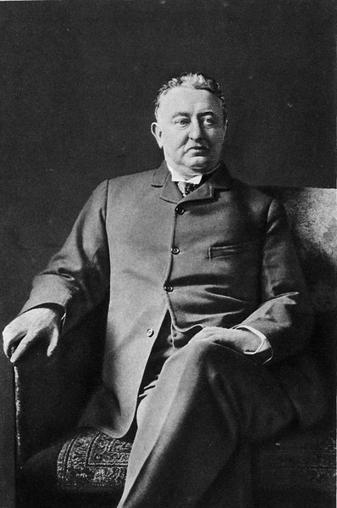
Cecil John Rhodes - July 5, 1853 – March 26, 1902
British-born South African businessman, mining magnate, and politician.
Founder of the diamond company De Beers, which today controls 60% of the world's diamonds and at one time controlled 90% of the world's diamonds.
He was also the colonizer of the state of Rhodesia, which was named after him..

Slide 15
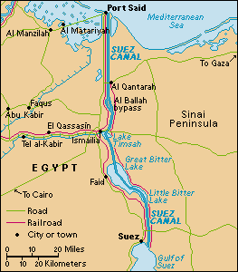
Technology and Imperialism
Transportation
  Steamships
  Railroads
Infrastructure
  Suez Canal (1859-1869)
  Panama Canal (1904-1914)

Slide 16
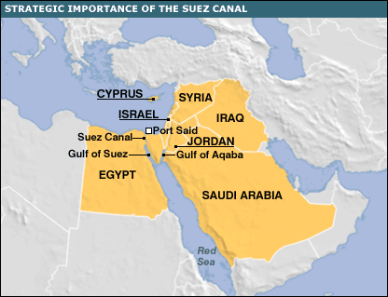

Slide 17
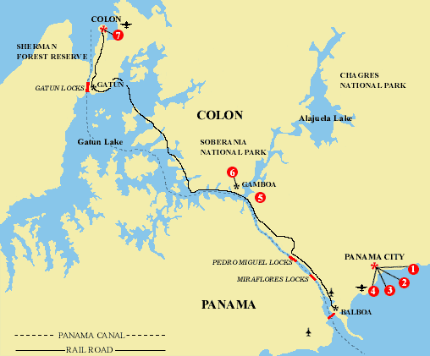

Slide 18
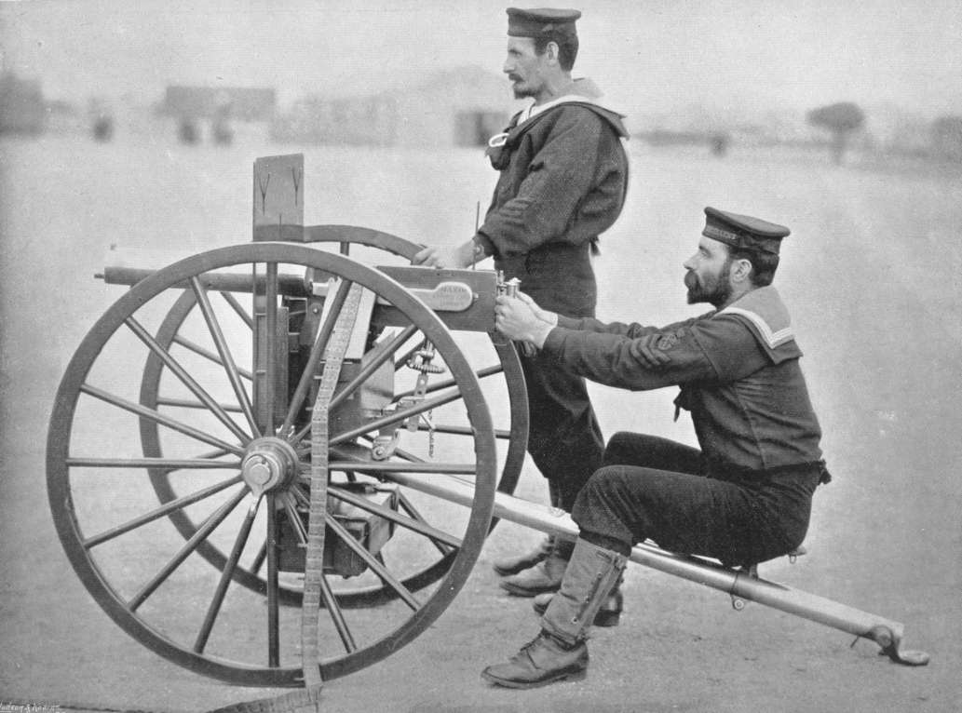
Weaponry
Muzzle-loading muskets
Mid-century: breech-loading rifles
  Reduce reloading time
1880s: Maxim gun, 11 rounds per second

Slide 19
The Military Advantage
Battle of Omdurman (near Khartom on Nile), 1898
  Five hours of fighting
British: six gunboats, twenty machine guns, 368 killed
Sudanese: 11,000 killed

Slide 20
Communications
Correspondence
  1830 Britain-India: 2 years
  After Suez Canal, 2 weeks
Telegraph
  1870s, development of submarine cables
  Britain-India: 5 hours

Slide 21
The Jewel of the British Crown: India
East India Company
Monopoly on India trade
Original permission from Mughal emperors
Mughal empire declines after death of Aurangzeb, 1707

Slide 22
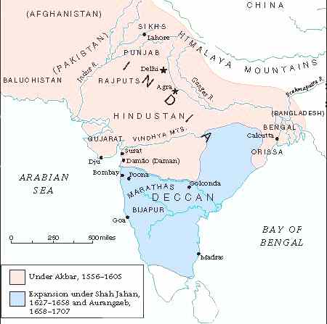
Mughal Empire

Slide 23
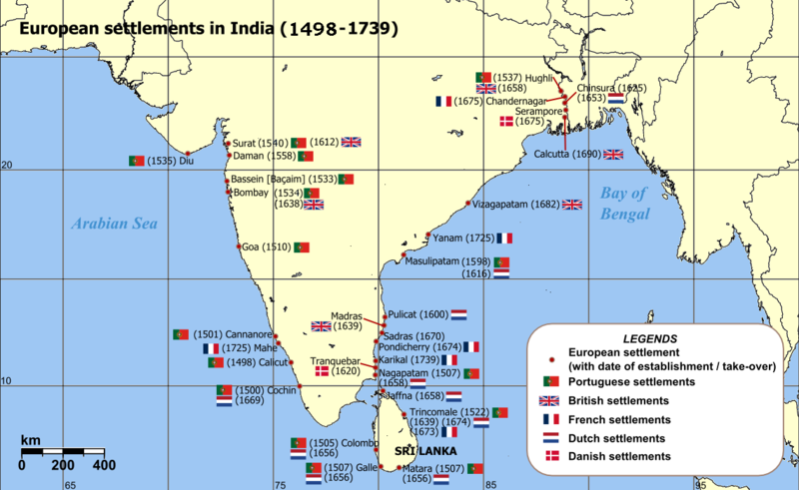

Slide 24
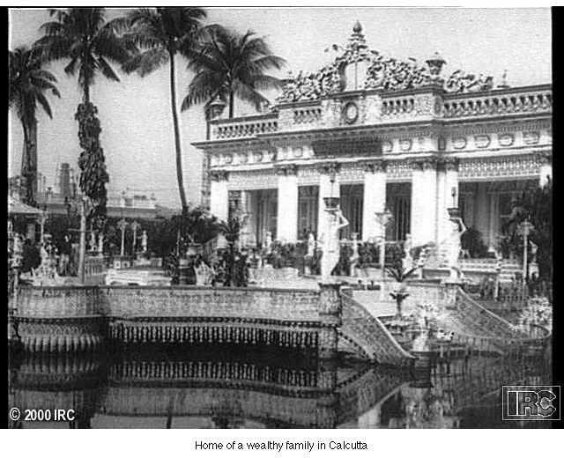
Home of a Wealthy Family in Calcutta

Slide 25
British Conquest
Protection of economic interests through political conquest
British and Indian troops (Sepoys)

Slide 26
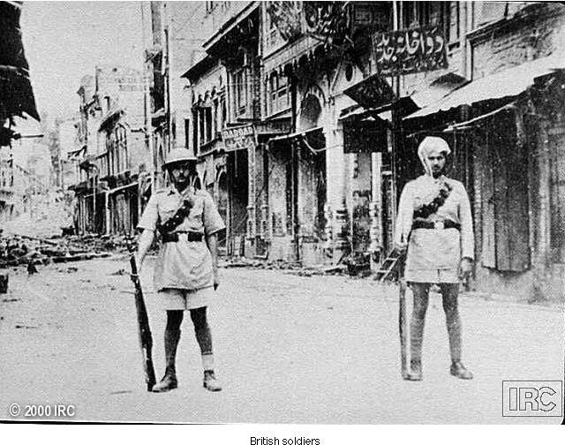
British Colonial Soldiers

Slide 27
Sepoy Revolt, 1857
Enfield rifles
Cartridges in wax paper greased with animal fat
  Problem for Hindus: beef
  Problem for Muslims: pork
Sepoys capture garrison
  60 soldiers, 180 civilian males massacred (after surrender)
Two weeks later, 375 women and children murdered
British retake fort, hang rebels

Slide 28
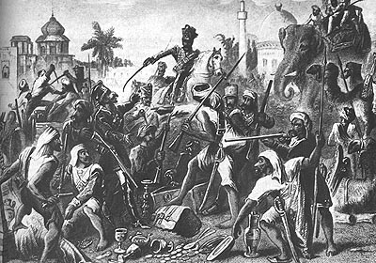
Sepoy Indian troops dividing the spoils after their mutiny against British rule

Slide 29
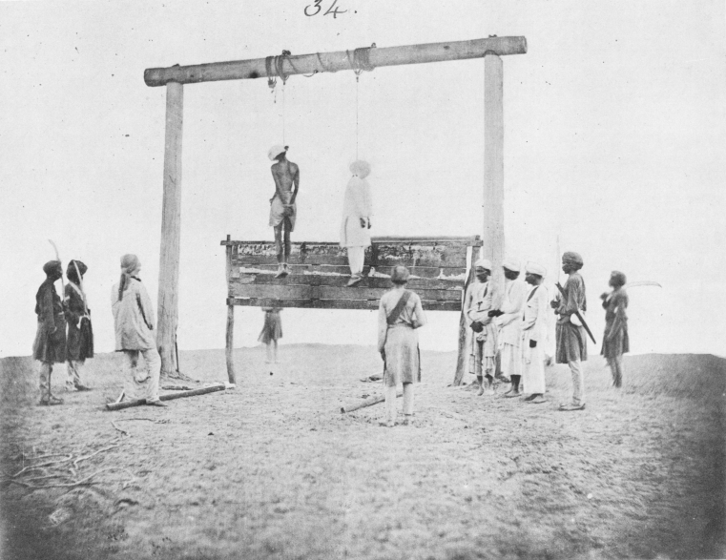
The hanging of two participants in the Indian Rebellion of 1857

Slide 30
Britain establishes direct rule
Pre-empts East India Company
Established civil service staffed by English
Low-level Indian civil servants

Slide 31
British Rule in India
Organization of agriculture
  Crops: tea, coffee, opium
Stamp of British culture on Indian environment
Veneer on poor Muslim-Hindu relations

Slide 32
Imperialism in Central Asia
British, French, Russians complete for central Asia
  France drops out after Napoleon
  Russia active after 1860s in Tashkent, Bokhara, Samarkand, and approached India
The “Great Game”: Russian vs. British intrigue in Afghanistan
  Preparation for imperialist war
  Russian Revolution of 1917 forestalled war

Slide 33
Imperialism in Southeast Asia
Spanish: Philippines
Dutch: Indonesia (Dutch East Indies)
British establish presence from 1820s
  Conflict with kings of Burma (Myanmar) 1820s, established colonial authority by 1880s
  Thomas Stamford Raffles founds Singapore for trade in Strait of Melaka
    Base of British colonization in Malaysia, 1870s-1880s
French: Vietnam, Cambodia, Laos, 1859-1893
  Encouraged conversion to Christianity

Slide 34
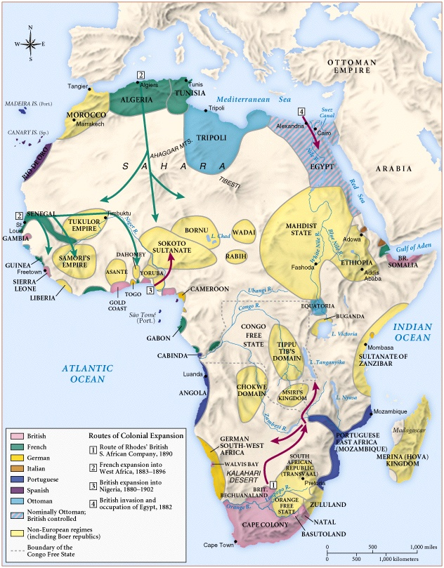
Africa
1890

Slide 35
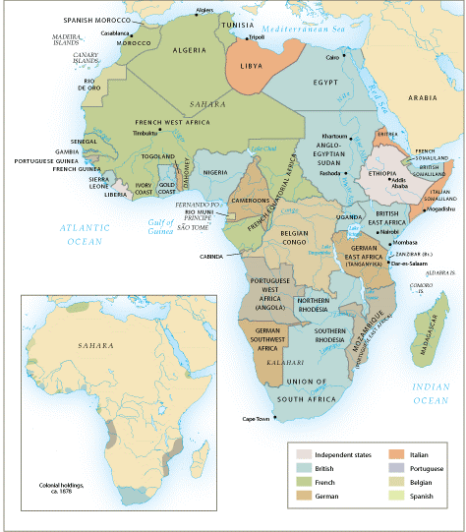
Imperialism
in Africa, ca.1914

Slide 36
European
Nationalism
Source for
Raw
Materials
Industrial
Revolution
Missionary
Activity
European
Motives
For Colonization
Markets for
Finished
Goods
Military
& Naval
Bases
Social
Darwinism
European
Racism
Places to
Dump
Unwanted/
Excess Popul.
Humanitarian
Reasons
Soc. & Eco.
Opportunities
“White
Man’s
Burden”

Slide 37
The Scramble for Africa (1875-1900)
French, Portuguese, Belgians, and English competing for “the dark continent”
Britain establishes strong presence in Egypt, Rhodesia
  Suez Canal
  Rhodesian gold. diamonds

Slide 38
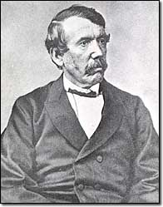
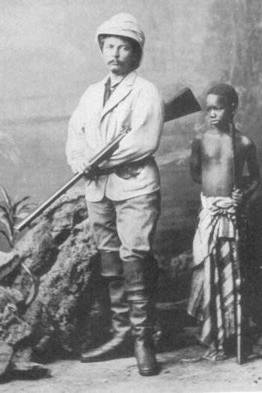
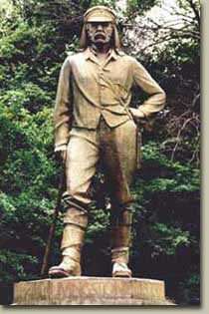
Where Is Dr. Livingstone?
Doctor
Livingstone,
I Presume?
Sir Henry Morton Stanley
Dr. David Livingstone

Slide 39
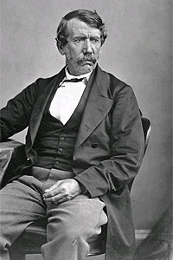
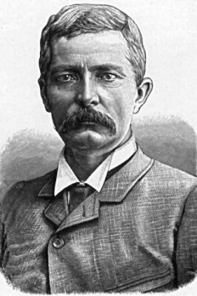
Henry Stanley
Journalist & Explorer
“Dr. Livingstone, I presume?”
Dr. David Livingstone
Missionary & Explorer

Slide 40
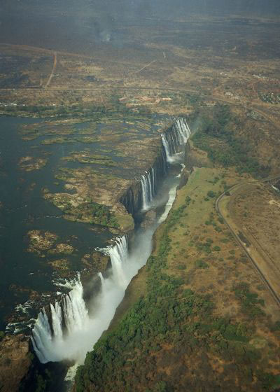
Victoria Falls

Slide 41
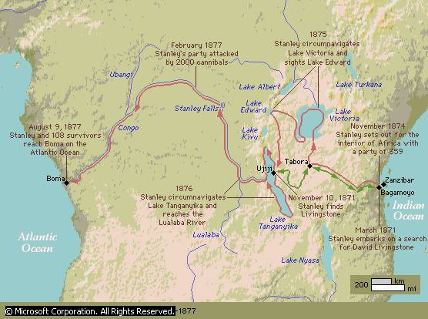
European Explorations in mid-19c:
“The Scramble for Africa”

Slide 42
Rewriting African History
Ancient Africa
Implications for justification of imperialist rule
European exploration of rivers (Nile, Niger, Congo, Zambesi)
  Information on interior of Africa
  King Leopold II of Belgium starts Congo Free State, commercial ventures
  Takes control of colony in 1908, renamed Belgian Congo

Slide 43
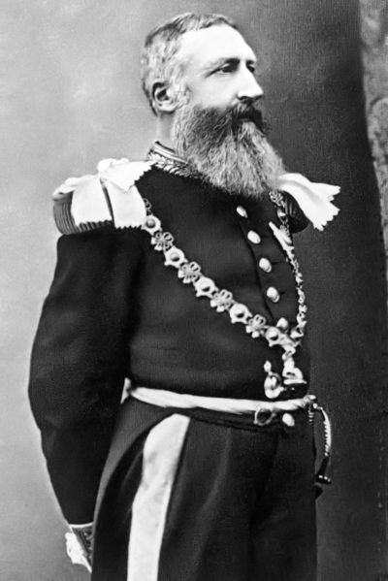
King Leopold II of Belgium

Slide 44
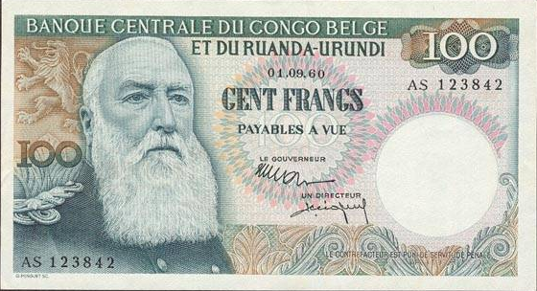
King Leopold II:
(r. 1865 – 1909)

Slide 45
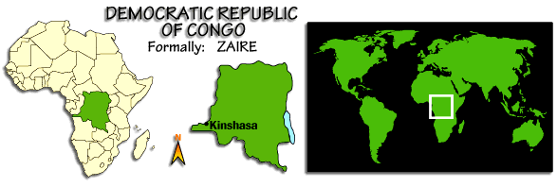
The Congo Free State
or
The Belgian Congo

Slide 46
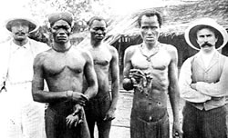
Congolese men hold severed hands during the Belgian occupation

Slide 47
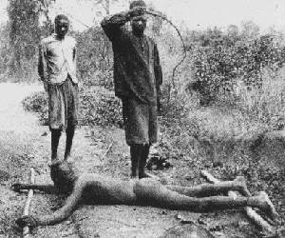
Punishing “Lazy” Workers

Slide 48
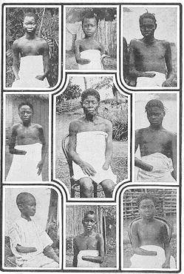
5-8 Million Victims! (50% of Popul.)
It is blood-curdling to see them (the soldiers) returning with the hands of the slain, and to find the hands of young children amongst the bigger ones evidencing their bravery...The rubber from this district has cost hundreds of lives, and the scenes I have witnessed, while unable to help the oppressed, have been almost enough to make me wish I were dead... This rubber traffic is steeped in blood, and if the natives were to rise and sweep every white person on the Upper Congo into eternity, there would still be left a fearful balance to their credit. -- Belgian Official

Slide 49
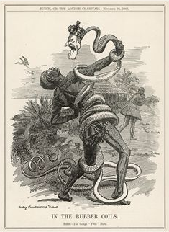
Belgium’s Stranglehold on the Congo

Slide 50
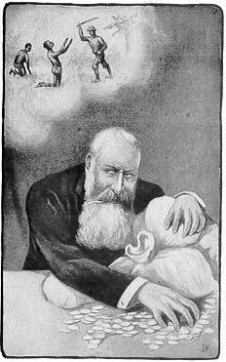
Leopold’s Conscience??

Slide 51
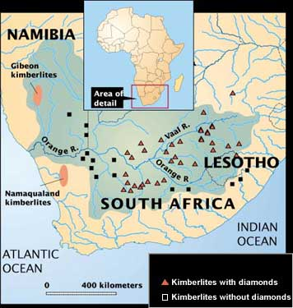
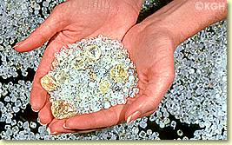
Diamond Mines
Raw Diamonds

Slide 52

Cecil Rhodes (1853-1902)
“The Colossus of Rhodes”

Slide 53
South African (Boer) War 1899-1902
Dutch East India establishes Cape Town (1652)
  Farmers (Boers) follow to settle territory, later called Afrikaners
  Competition and conflict with indigenous Khoikhoi and Xhosa peoples
British takeover in 1806, slavery a major issue of conflict
  Afrikaners migrate eastward: the Great Trek, overpower Ndebele and Zulu resistance with superior firepower
  Establish independent Republics

Slide 54
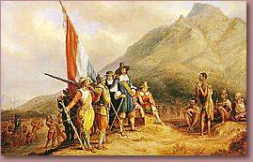
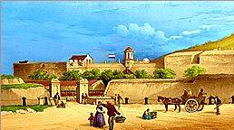
Dutch Landing in 1652

Slide 55
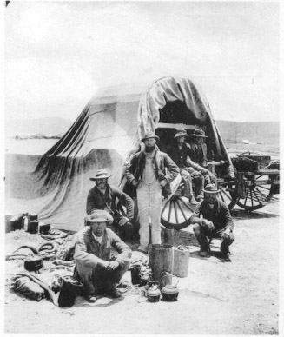
South African (Boer) War 1899-1902
The Boers spoke Afrikaans.
British tolerate this until gold is discovered
White-white conflict, black soldiers and laborers
Afrikaners concede in 1902, 1910 integrated into Union of South Africa

Slide 56
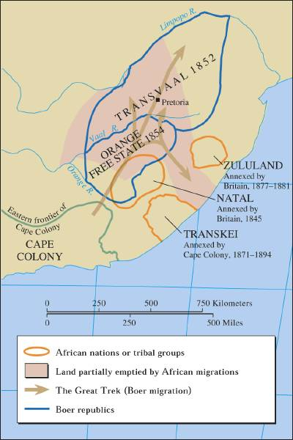
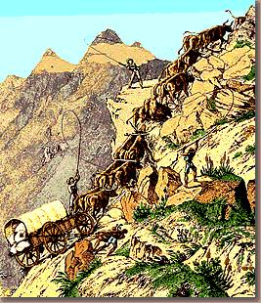
The Great Trek, 1836-38
Afrikaners

Slide 57
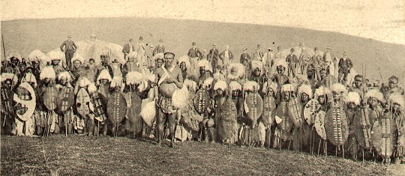

Zulu Warriors, late 19th century, postcard

Slide 58
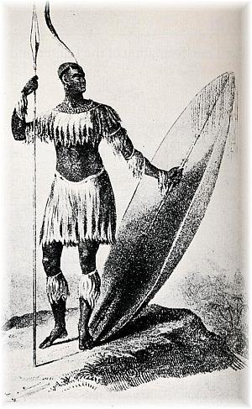
Only known drawing, from the time period, of Shaka standing with the long throwing assegai and the heavy shield in 1824 - four years before his death

Slide 59
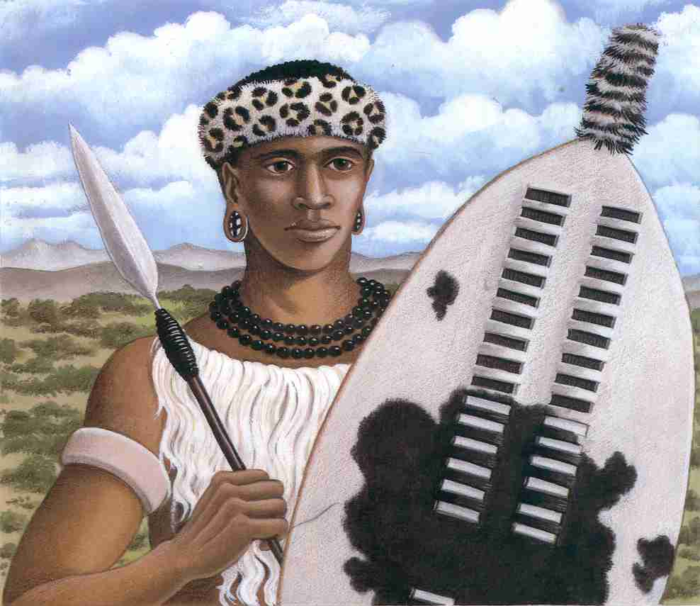
Shaka Zulu (1785 – 1828)

Slide 60
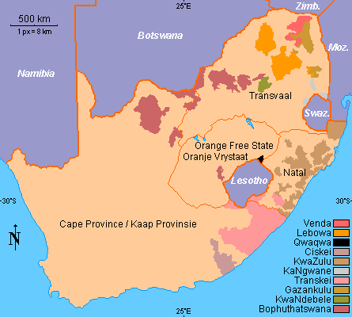
The Struggle for South Africa

Slide 61
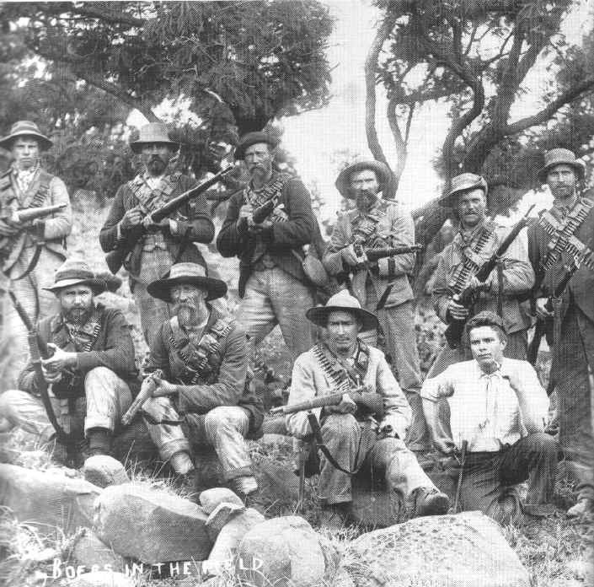
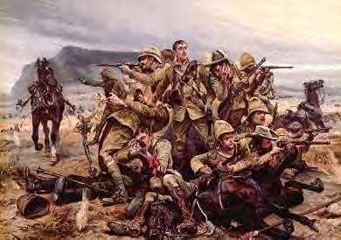
The Boer War: 1899 - 1900
The British
The Boers

Slide 62
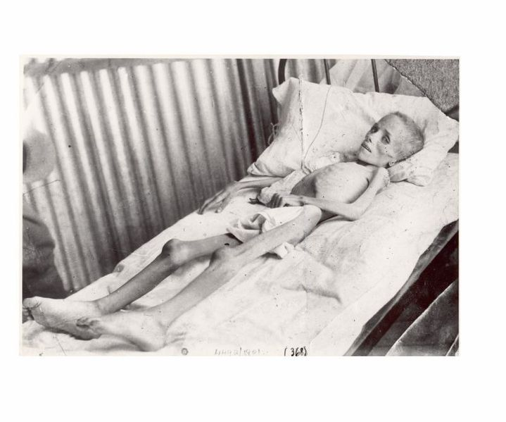
Lizzie van Zyl in a British concentration camp

Slide 63

A Future British Prime Minister
British Boer War Correspondent,
Winston Churchill

Slide 64
The Berlin West Africa Conference (1884-1885)
Fourteen European states, United States
  No African states present
  Rules of colonization: any European state can take “unoccupied” territory after informing other European powers
European firepower dominates Africa
  Exceptions: Ethiopia fights off Italy (1896); Liberia a dependency of the US

Slide 65


Berlin Conference of 1884-1885
Another point of view? →

Slide 66
Systems of Colonial Rule
Concessionary companies
  Private companies get large tracts of land to exploit natural resources
  Companies get freedom to tax, recruit labor: horrible abuses
  Profit margin minimal
Direct Rule: France
  “civilizing mission”
  Chronic shortage of European personnel; language and cultural barriers
  French West Africa: 3600 Europeans rule 9 million

Slide 67
Indirect Rule
Frederick D. Lugard (Britain, 1858-1945)
  The Dual Magnate in British Tropical Africa (1922)
Use of indigenous institutions
Difficulty in establishing tribal categories, imposed arbitrary boundaries

Slide 68

Imperialism in Oceania, ca. 1914

Slide 69
European Imperialism in Australia and New Zealand
English use Australia as a penal colony from 1788
Voluntary migrants follow; gold discovered 1851
Smallpox, measles devastate natives
Territory called “terra nullus”: land of no one
New Zealand: natives forced to sign Treaty of Waitangi (1840), placing New Zealand under British “protection”

Slide 70
European and Native Population in Australia and New Zealand

Slide 71
European Imperialism in the Pacific Islands
Commercial outposts
  Whalers seeking port
  Merchants seeking sandalwood, sea slugs for sale in China
  Missionaries seeking souls
British, French, German, American powers carve up Pacific islands
  Tonga remains independent, but relies on Britain

Slide 72
US Imperialism
President James Monroe warns Europeans not to engage in imperialism in western hemisphere (1823)
  The Monroe Doctrine: all Americas a U.S. Protectorate
1867 purchased Alaska from Russia
1875 established protectorate over Hawai’i
  Locals overthrow queen in 1893, persuade US to acquire islands in 1898

Slide 73

US Marine force at the time of the overthrow of the Hawaiian monarchy, January 1893.

Slide 74

Spanish-Cuban-American War
(1898-1899)
US declares war in Spain after battleship Maine sunk in Havana harbor, 1898
  Takes possession of Cuba, Puerto Rico, Guam, Philippines
  US intervenes in other Caribbean, Central American lands, occupies Dominican Republic, Nicaragua, Honduras, Haiti
Filipinos revolt against Spanish rule, later against US rule
The sunken USS Maine

Slide 75

Uncle Sam: “The Colossus
of the Pacific” (A Parody)

Slide 76
The Panama Canal
President Theodore Roosevelt (in office 1901-1909) supports insurrection against Colombia (1903)
Rebels win, establish state of Panama
U.S. gains territory to build canal, Panama Canal Zone
Roosevelt Corollary of Monroe Doctrine
  U.S. right to intervene in domestic affairs of other nations if U.S. investments threatened

Slide 77
Early Japanese Expansion
Resentment over Unequal Treaties of 1860s
1870s colonized northern region: Hokkaido, Kurile islands, southern Okinawa and Ryukyu islands as well
1876 Japanese purchase warships from Britain, dominate Korea
Sino-Japanese War (1894-1895) over Korea results in Japanese victory
Russo-Japanese War (1904-1905) also ends in Japanese victory

Slide 78

The Russo-Japanese War:
1904-1905
The Battle of Tsushima:
The results startled the world!

Slide 79

Painting of Admiral Togo on the bridge of the Japanese battleship Mikasa, before the Battle of Tsushima in 1905.

Slide 80


Manchuria
Battlefields of the Russo-Japanese War

Slide 81

Japanese soldiers' corpses in a trench, with Russian soldiers looking on.

Slide 82

President Teddy Roosevelt
Mediates the Peace
The Treaty of Portsmouth, NH ended the Russo-Japanese War.

Slide 83

Japan Annexes Korea

Slide 84

Japan Is a Player in China

Slide 85
Economic Legacies of Imperialism
Colonized states encouraged to exploit natural resources rather than build manufacturing centers
Encouraged dependency on imperial power for manufactured goods made from native raw product
  Indian cotton
Introduction of new crops
  Tea in Ceylon

Slide 86

Imperialism and migration during the nineteenth and early twentieth century

Slide 87
Labor Migrations
Europeans move to temperate lands
  Work as free cultivators, industrial laborers
  32 million to the US 1800-1914
Africans, Asians, and Pacific islanders move to tropical/subtropical lands
  Indentured laborers, manual laborers
  2.5 million between 1820 and 1914

Slide 88
Colonial Conflict
Thousands of insurrections against colonial rule
  Tanganyika Maji Maji Rebellion against Germans (1905-1906)
  Rebels sprinkle selves with magic water (maji maji) as protection against modern weapons; 75000 killed
“Scientific” Racism developed
  Count Joseph Arthurd de Gobineau (1816-1882)
  Combines with theories of Charles Darwin (1809-1882) to form pernicious doctrine of Social Darwinism

Slide 89
Nationalism and Anti-colonial Movements
Ram Mohan Roy (1772-1883), Bengali called “father of modern India”
Reformers call for self-government, adoption of selected British practices (e.g. ban on sati)
  Influence of Enlightenment thought, often obtained in European universities
Indian National Congress formed 1885
  1906 joins with All-India Muslim League

Slide 90

Emperor Menelik II of Ethiopia
(August 17, 1844 – December 12, 1913)

