Slide 1
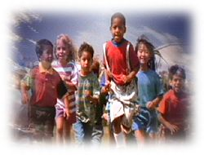
CONFLICT RESOLUTION
Jennifer Matlick
A11543082
CEP 841 Classroom & Behavior in the Inclusive Classroom
Elementary Education Teacher
July 27, 2002

Slide 2
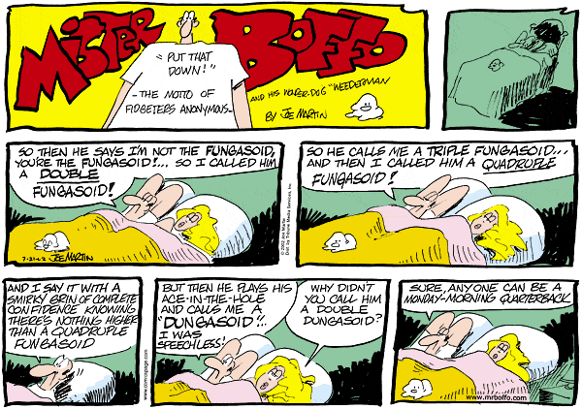
Everyone faces conflict in their lives on a daily basis. It is an accepted and expected part of life.

Slide 3
In the words of William Kreidler, well-known author of Creative Conflict Resolution, “If you take time to teach conflict resolution, you’ll eventually have more time to teach.”
(Porro)

Slide 4
Students are arriving at school less prepared to meet the daily social challenges they must face in the classroom. Teachers, from Kindergarten through Twelfth Grade, have reported an increase in the amount of time they spend dealing with behavior problems on a daily basis.

Slide 5
SOCIAL BEHAVIOR PROBLEMS
Impulse control
  Shouting out answers
  Grabbing items
  Assaulting other students
Communication skills
  Expressing needs
  Expressing wants

Slide 6
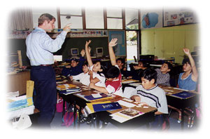
NEEDS
Student
  Develop interpersonal skills
  Techniques to foster communication
  Reinforcement of social skills
  Safe Environment
Teacher
  Class on task and orderly

Slide 7
In the early to mid 1980s the concept of Conflict Resolution (CR) was developed. It was initially designed to resolve conflicts in the workplace. Over the years these theories were refined and implemented in the school setting.

Slide 8
Conflict Resolution education models and teaches, in developmentally relevant and culturally appropriate ways, a variety of processes, practices, and skills designed to address individual, interpersonal, and institutional conflicts, and to create safe and welcoming learning environments. These skills, concepts, and values help individuals to understand conflict dynamics, and empower them to use communication and creative thinking to build healthy relationships and manage and resolve conflicts fairly and nonviolently.
(Carter)

Slide 9
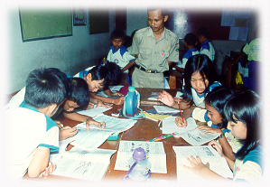
Conflict resolution is designed to provide students with a neutral, yet safe, environment where they can express their point of view and discuss issues in a mutually satisfactory manner.

Slide 10
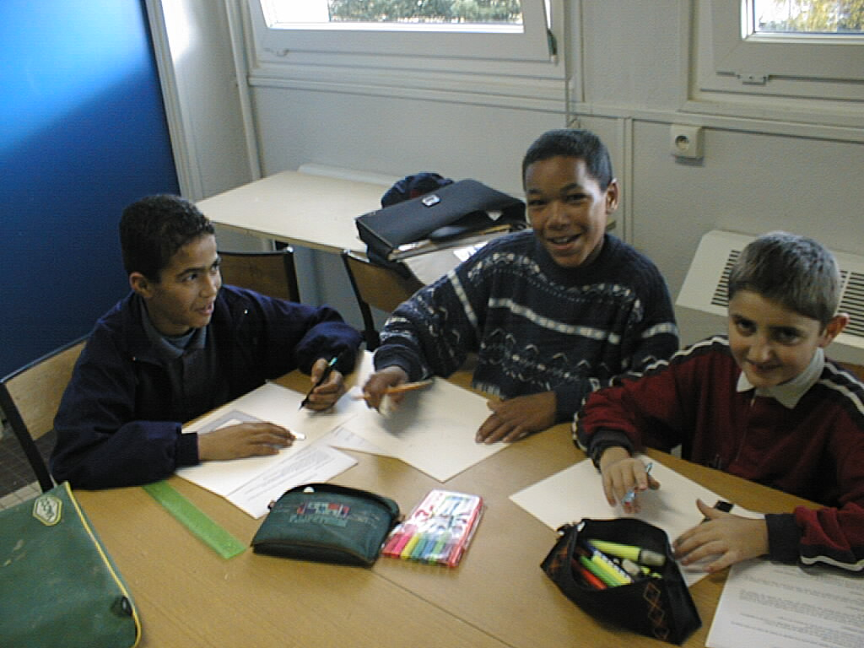
There are three levels involved in CR
Negotiating - two individuals sit down and work out a resolution together
Mediation – a third party assists individuals in finding a solution
Arbitration – involves a third party and is instituted when negotiations and mediations fail
(Savage)

Slide 11
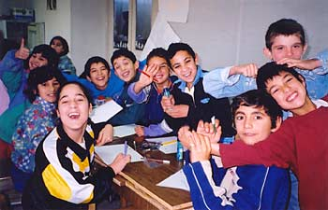
Over the last ten years there has been a significant increase in the number of schools that are implementing CR Programs.

Slide 12
Said a fourth grade mediator from Wilmette, Illinois, “We help kids who are fighting talk about their problems. Some people think kids can’t help other kids solve their problems. But we can.”
(Education World)

Slide 13
The goal of this program is to have students progress
FROM
control or permissiveness
power over
retributive discipline/punishment
teacher-centered learning
TO
collaborative problem solving
power with
Restorative/positive discipline
Student-centered learning
(NCIP)

Slide 14
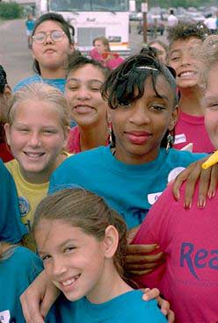
The facts are that CR
Creates respectful and caring surroundings by formulating a safe school environment
Provides students with control over situations
Uses PBIS techniques to modify a child’s behavior by focusing on the positives.
Promotes shared learning experiences

Slide 15
In May of 1998, Metis Associates of Atlanta conducted a study of three elementary, one middle, and one high school to determine if CR was successful. It was determined that:
64% of teachers reported less violence in the classroom
75% of teachers reported an increase in student cooperation
92% of students felt better about themselves
Over 90% of parents reported an increase in their own communication and problem solving skills
The in-and-out-of-school suspension rates at the middle school decreased significantly, while non-CR middle school rates increased during the same period
The dropout rate at the CR high school decreased significantly while non-CR school rates increased during the same period
(ESR National)

Slide 16
Ways to implement a Conflict Resolution Program
Construct a set of circumstances in the curriculum, integrating conflict resolution and a variety of subjects to amplify the lesson
Construct a multi-disciplinary teaching approach that utilizes central themes as the focal points
Instill conflict resolution strategies into every aspect of the day to day working of the room
Teach a course solely dealing with conflict resolution strategies
Teach conflict resolution strategies within one subject area
School policies should include principles and practices of conflict resolution

Slide 17
Where does CR apply?
Conflict
Resolution
and the
CLASSROOM
SCHOOL
COMMUNITY

Slide 18
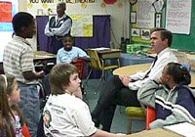
Strategies to apply CR in the Classroom
Class meetings
Design posters with CR slogans
Conflict Resolution Corners
Collaborative decision making
Curriculum Infusion
Curriculum Integration
PBIS-Positive Discipline
Modeling and skill training
Visible reminders (posters, quotes, student work)

Slide 19
Strategies to apply CR in the School for Staff
Involve all staff members: teachers, administrators, secretaries, custodians, Cafeteria workers, and bus drivers
Use as a tool to help students realize negative behaviors in suspension situations
Develop an Information packet for all students
Work with students to develop the new program
Provide teachers ways to incorporate one new strategy into the classroom at every staff meeting
In-services on bullying, communication skills, understanding conflict, etc.
Staff Coordinator who is available for support and monitoring of CR Program
Develops a CR library for students, staff and parents
Align strategies with Standards and Benchmarks

Slide 20

Strategies to apply CR in the School for Students
Involve all staff members: teachers, administrators, secretaries, custodians, Cafeteria workers, and bus drivers
Bulletin board showing students caught being polite
Cultural Awareness Programs
Peer Mediation
Alternatives to suspension
Healing circles
Cooperative Grouping
Journaling
Paired sharing
Role-playing
Creative controversy
Service learning projects
Case studies
Community Service Programs

Slide 21

Strategies to apply CR in the Community
Infuse Conflict Resolution principles into Mission Statement
Provide Speakers at P.T.O. Meetings
Organize a Peace Party
Train school volunteers
Parent training

Slide 22
It can take years for students and teachers to fully understand and integrate conflict resolution strategies on a daily basis. The time and effort put into such a program, enables teachers to, “empower children to use problem solving skills.”
(Colorado)

Slide 23
"Conflict is the gadfly of thought. It stirs us to observation and memory. It instigates invention. It shocks us out of sheep-like passivity, and sets us at noting and contriving conflict is a 'sine qua non' of reflection and ingenuity."
John Dewey

Slide 24
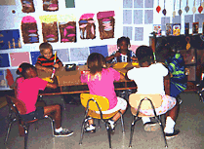
Remember, results from the Conflict Resolution Program can be seen immediately or over a period of time.

Slide 25

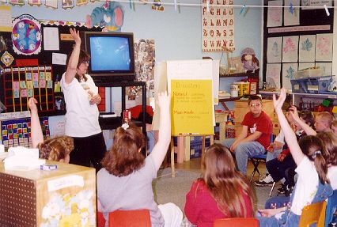
Final Thought:
At a time on our country where violence, either at school or in the workplace, is seen as a national problem, why are more schools not adopting Conflict Resolution Programs? What other strategies, if any, are they employing? How do alternate programs compare to the Conflict Resolution strategies?

Slide 26
BIBLIOGRAPHY
American Nurses Association. 600 Maryland Avenue, SW Suite 100 West Washington, D.C. 20024. 1-800-274-4ANA.
Ashwill, Jean Weiler & Droske, Susan Colvert. (1997). Nursing Care of Children Principles and Practice. Philadelphia: W.B. Saunders Company.
Association for Conflict Resolution. 1527 New Hampshire Ave., NW Washington D.C. 20036. (202) 667-9700.
Bettmann, E.H., & Moore, P. (1994). Conflict Resolution Programs and Social Justice. Education and Urban Society, 27 (1), 11-21.
Carter, Artemus, & et al. Recommended Guidelines for Effective Conflict Resolution Education Programs in K-12 Classrooms, Schools, and School Districts. Acre Solutions. www.acresolution.org
Compton, Randy. Infusing and Integrating Conflict Resolution into the School Curriculum and Culture. Acre Solutions. www.acresolution.org/research.nsf/articles
Conflict Resolution. (1996). Creating Safe and Drug-Free Schools: An Action Guide, (97).
Conflict Resolution Education Network. Recommended Standards. www.crenet.org
Education World. Education World Executive Headquarters. 1062 Barnes Road
Suite 301 Wallingford, CT. 06492. www.education-world.com

Slide 27
Importance of Teaching Conflict Resolution. www.csmp.org
Larivee, Barbara. (1999). Authentic Classroom Management: Creating a Community of Learners. Needham Heights, MA: Allyn and Bacon.
“National Curriculum Integration Project.” The Colorado School Mediation Project. 2885 Aurora Ave. Suite 13 Boulder Co. 80303. (303) 444-7671.
NCIP. Mission, Goals and Beliefs. www.NCIP.org
Ohio Commission on Dispute Resolution & Conflict Management. www.state.oh.us/cdr/schools/smgranteeupdate2001.htm
Porro, Barbara. (1996). Talk it out: Conflict Resolution in the Elementary Classroom. Alexandria, VA: Association for Supervision and Curriculum Development.
RCCP Evaluation Results. www.esrnational.org/about-rccp.html
Savage, Tom V. (1999). Teaching Self-Control through Management and Discipline. Needham Heights, MA: Prentice Hall
Tappen, Ruth & et al. (2001). Essentials of Nursing Leadership and Management. Philadelphia: F.A. Davis Company.
The Promise of Integrating Conflict Resolution into the Classroom. (1998). The Forum, National Institute for Dispute Resolution, (35).

