Slide 1
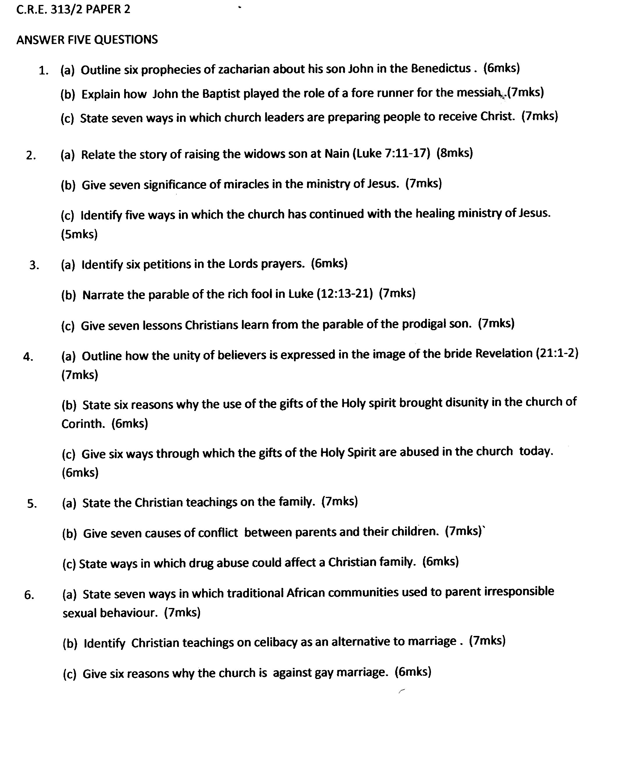
TRIAL ONE EVALUATION TEST
C.R.E. PAPER 2
1 of 1 Trial One Exam 2019 C.R.E Paper 2

