Slide 1

Which plants grew best?

Slide 2
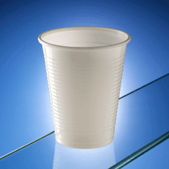
We grew the cress in cups.
How did we make it fair?
We used three cups all the same size.

Slide 3
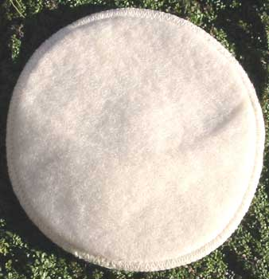
We grew the seed on a cotton wool pad
How did we make it fair?
We put the same amount of cotton wool in each cup

Slide 4
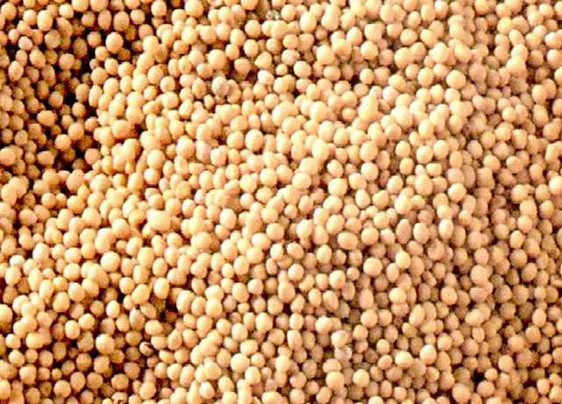
We put some seed in the cups
How did we make it fair?
We put the same amount of seed in each cup.

Slide 5


We put one cup in a light place with one spoon of water.

Slide 6
We put one cup in a light place with no water.

Slide 7
We put one cup in a dark place with one spoon of water.

Slide 8






What did the plants look like after one week?
………………………

Slide 9
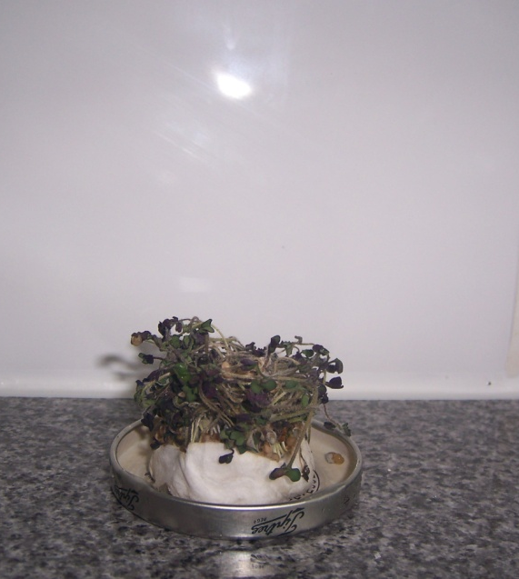
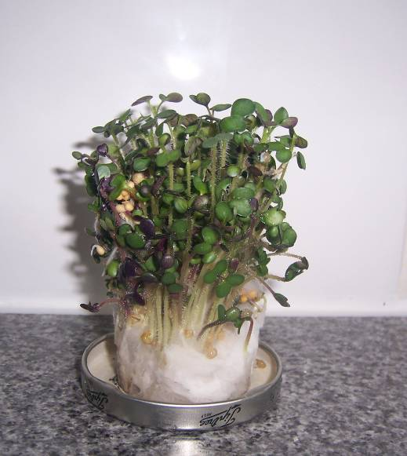
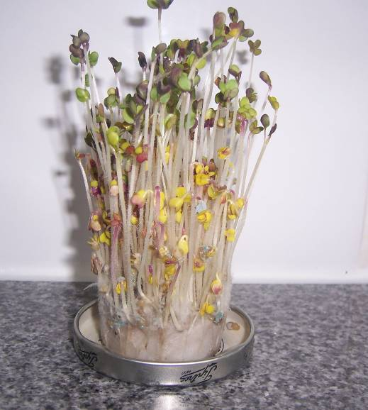
Which plants are which?

Slide 10
No water

Slide 11
Water and light

Slide 12
No light

Slide 13
Can you draw the different plants?
Water and light
No water
No light

