Slide 1
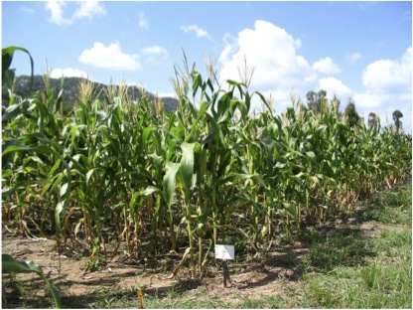
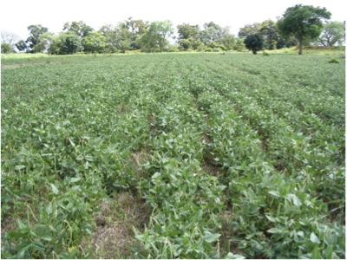
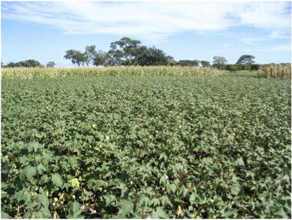
The Importance of Rotations and Green Manure Cover Crops in CA
Walter Mupangwa

Slide 2
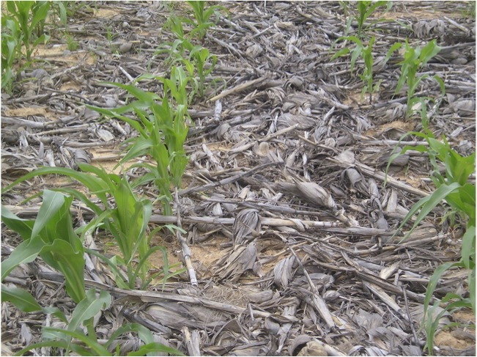
Principles of Conservation Agriculture
  Minimum soil disturbance
  Residue retention
  _____________________
  Crop rotation
  Green manure cover crops

Slide 3
Difference between crop rotations and monoculture
Crop rotation
A repetitive sequence of crops in the same place following a defined order.
Monoculture
The repeated planting of the same crop or crops in the same place year after year. Each year, the same crop or crops are sown in the same field.

Slide 4
Problems associated with monocultures
Reduction of crop diversification
Decrease in plant nutrients due to the continuous exploration of the same soil zone
Decrease in root development
Change in biological activity of the soil

Slide 5
Earthworm counts in the top 30 cm in Monze, Zambia, Feb 2007
120
a
Earthworms
100
)
a
²
80
a
Earthworms
ab
a
a
counts per m
60
(
40
20
b
0
Conventional
Direct
Basin
planting,
maize
Direct
Direct
Direct
Direct
ploughed,
seeding,
seeding,
seeding,
seeding,
seeding,
maize
maize
cotton after
maize after
sunnhemp
maize after
maize
cotton
after cotton
sunnhemp
Treatments
Source: Nhamo ( 2007) unpublished

Slide 6
Problems associated with monocultures contd…
Increase in soil-born diseases and crop specific pests
Increase in specific weeds (generally of the same class)
Accumulation of allelopathic toxins
Monoculture leads to degradation

Slide 7
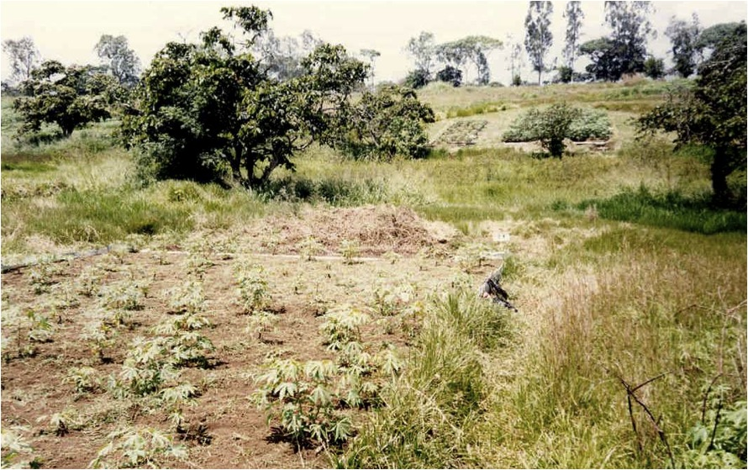
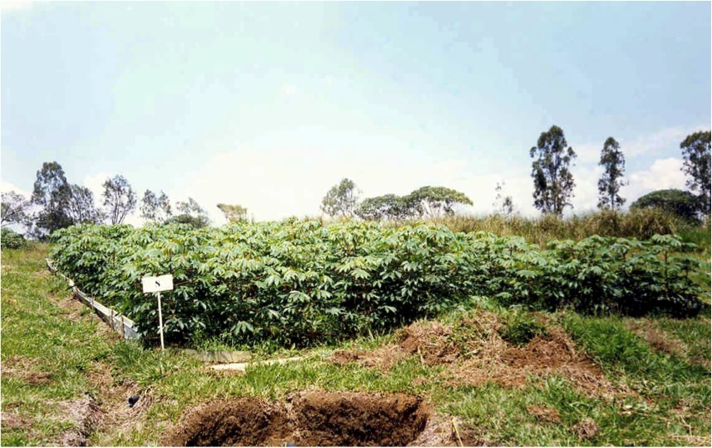
Cassava in monoculture over 14 years
Cassava in rotation with improved fallow

Slide 8
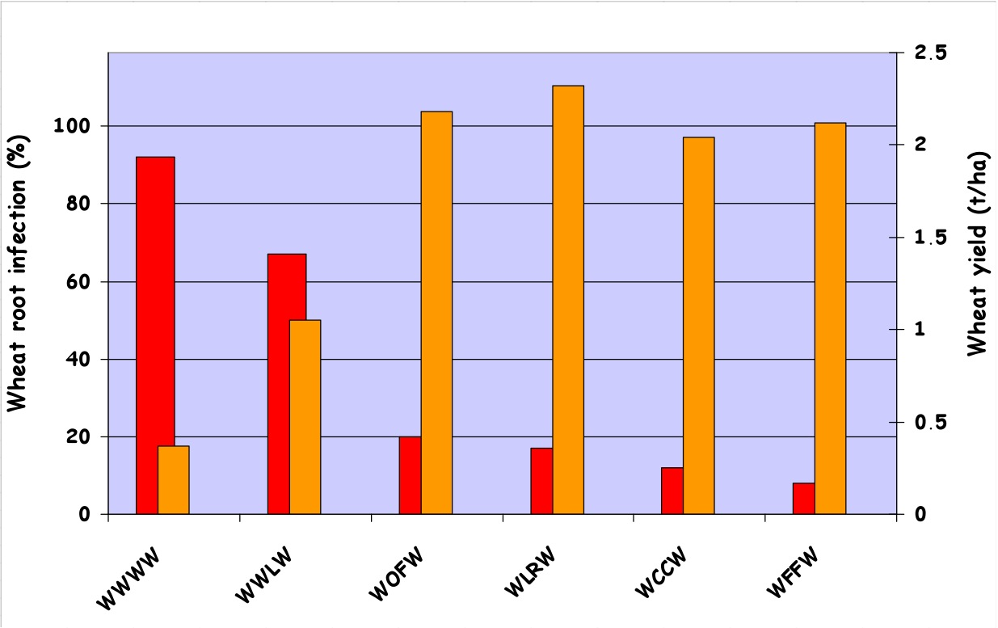
Effects of rotation on fungal root diseases in wheat
Root infections
Wheat yield
W - Wheat
L - Lupines
O – Oats
F - Fallow
Source: Reis et al., 1983

Slide 9
Basic principles of crop rotations
A rotation is better than monoculture no matter if there is a legume included in the rotation (i.e. maize-wheat, maize-cotton)
We can expect the best return if we include a legume in the rotation
The rotation of crops is not sufficient in tropical areas to maintain productivity – extracted nutrients have to be replaced

Slide 10
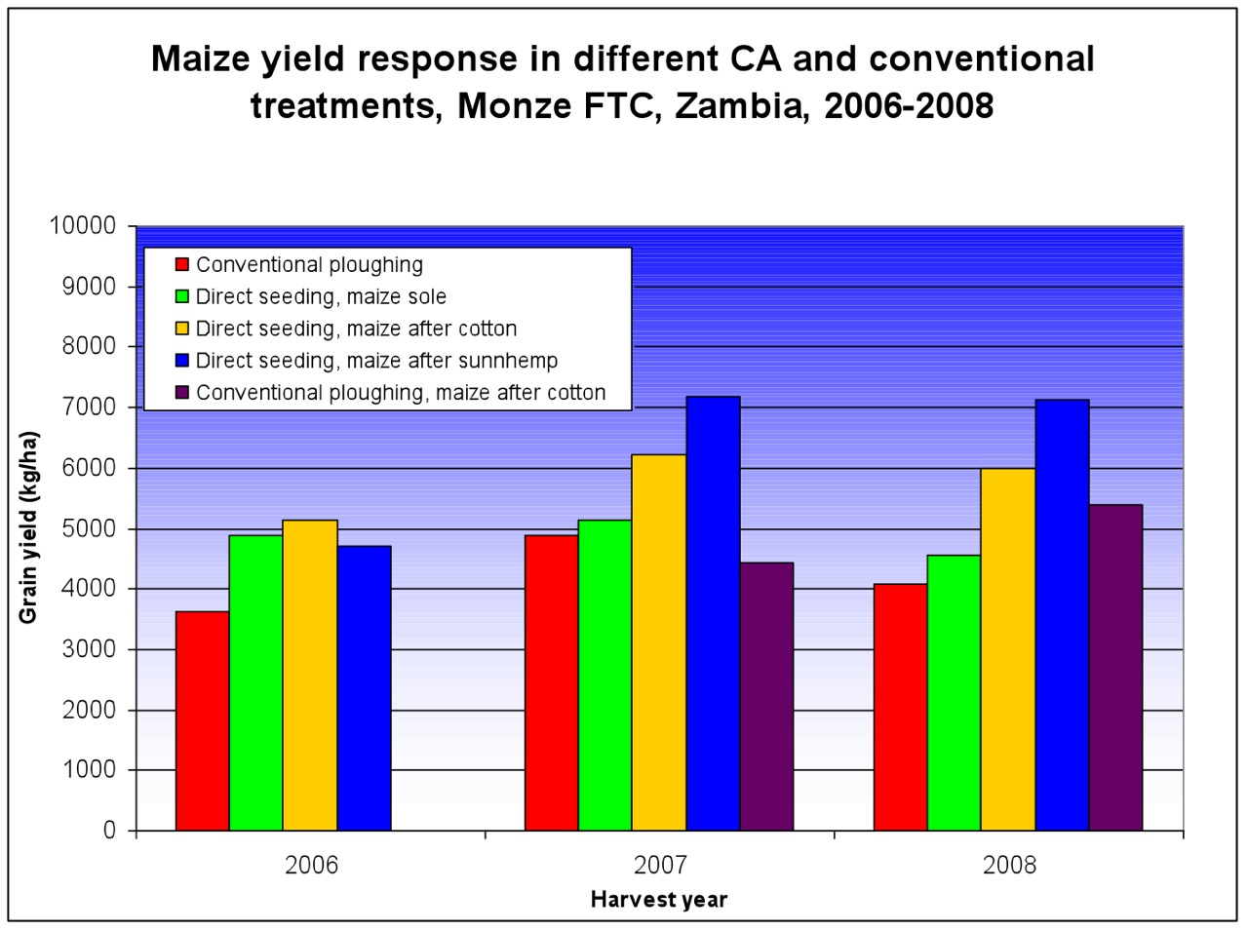

Slide 11
Comparative advantages of rotations
Pest and disease control
Weed control
Increase in biological activity
Soil improvement (structure, organic matter)
Positive effects of rotations on succeeding crops
Higher overall yields

Slide 12
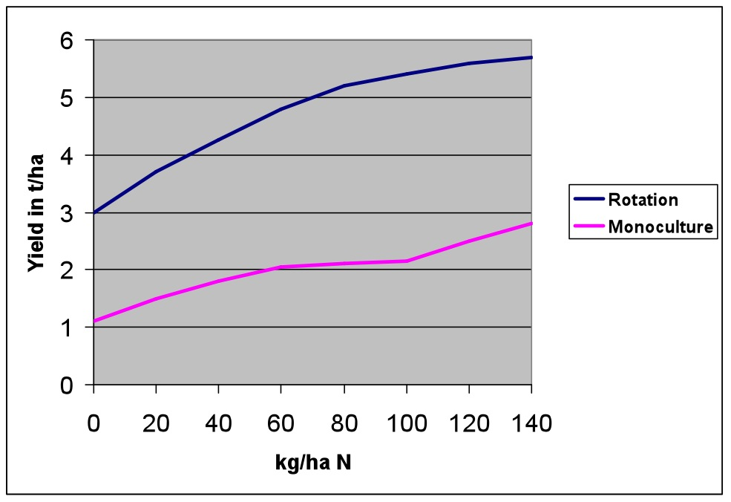
Influence of increasing levels of N on wheat yield cultivated in long-term monoculture and crop rotation
Source: Boguslawski, 1981; Rothamsted, England (since 1852)

Slide 13
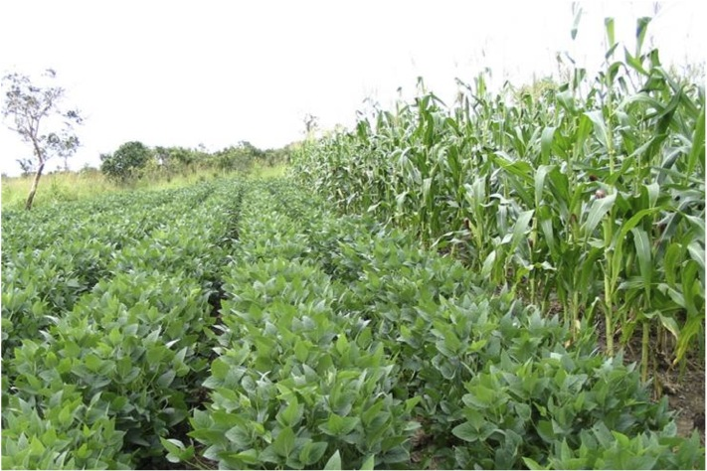
Rotations are site-specific!
Rotations depend on:
Environment i.e. climate, soils, altitude
Socioeconomic preferences
Markets and trade-offs
Risk involved
Tradition

Slide 14
Some maize-based crop rotations on small-holder farms in Southern Africa
Typical rotations in the region:
Maize - Cotton
Maize – Cotton – Soyabean
Maize – Groundnut
Maize - Soyabean
Other possibilities:
Maize – Cotton - Sunhemp
Maize – Cotton – Cowpea
Maize – Sunflower - Beans

Slide 15
Factors to take into account in designing a crop rotation
Effects on the succeeding crop:
  Water
  Nitrogen
  Weeds
  Pests and diseases
  Allelopathic toxins
  Root type and distribution
  Residue amount for subsequent crop
Seeding and harvest times
Crop prices and productivity in the medium term
Risk involved in each crop

Slide 16
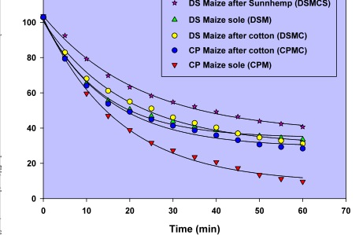
Effects of different rotation both in CA and CP on infiltration rate

Slide 17
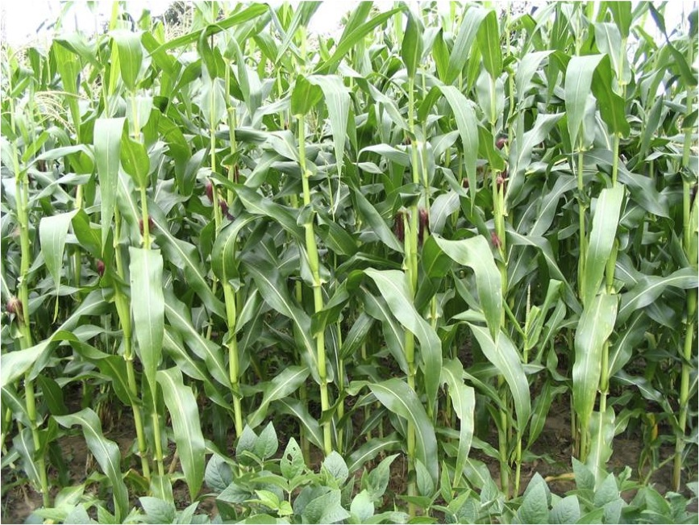
Potential crops in rotations in ESA...
Maize (Zea mais)

Slide 18
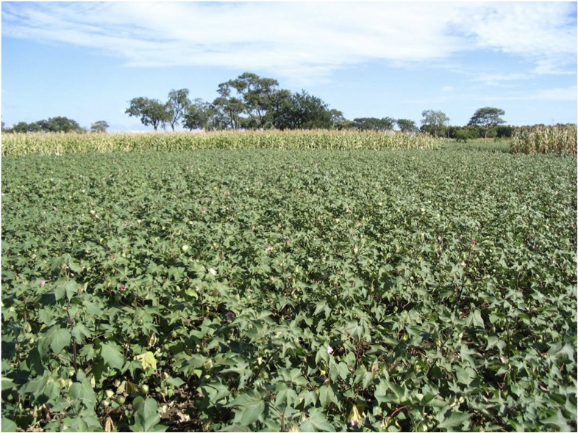
Potential crops in rotations in ESA...
Cotton (Gossypium herbaceum)

Slide 19
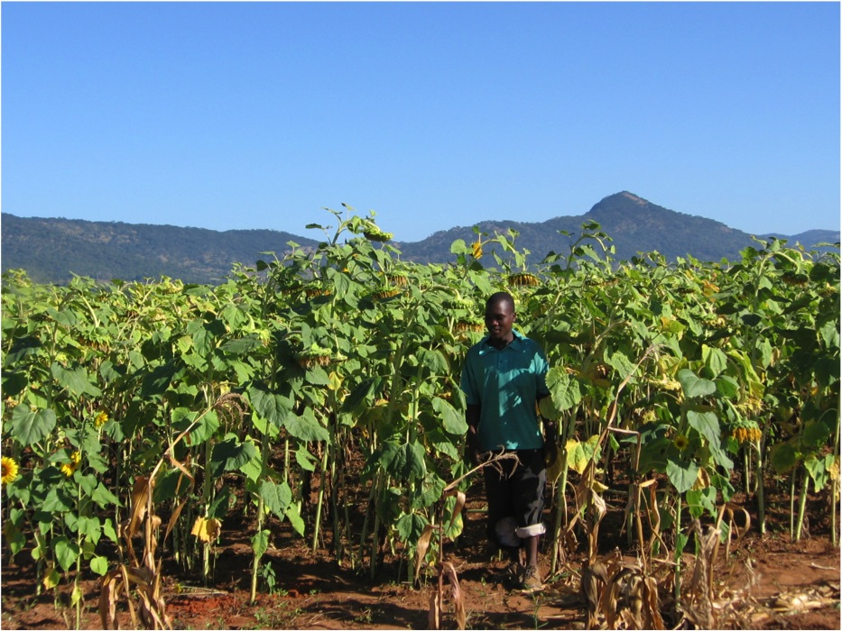
Potential crops in rotations in ESA...
Sunflower

Slide 20
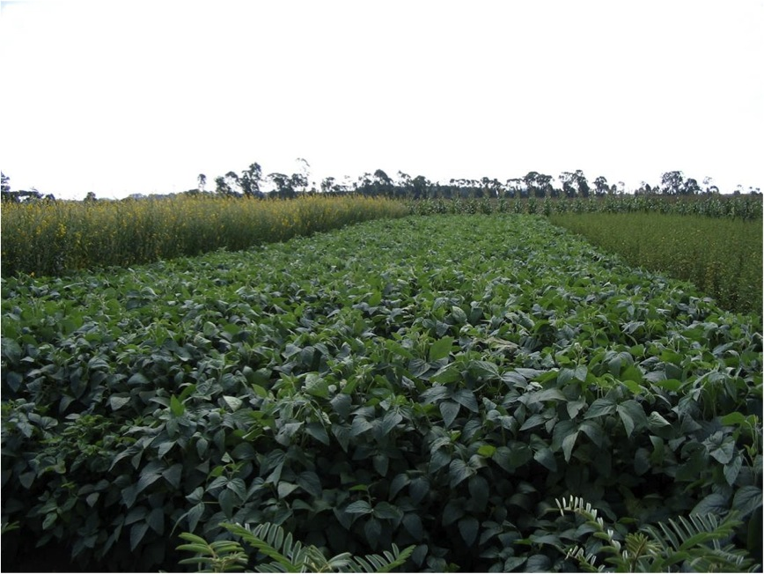
Potential legumes in rotations...
Soybean (Glycine max)

Slide 21
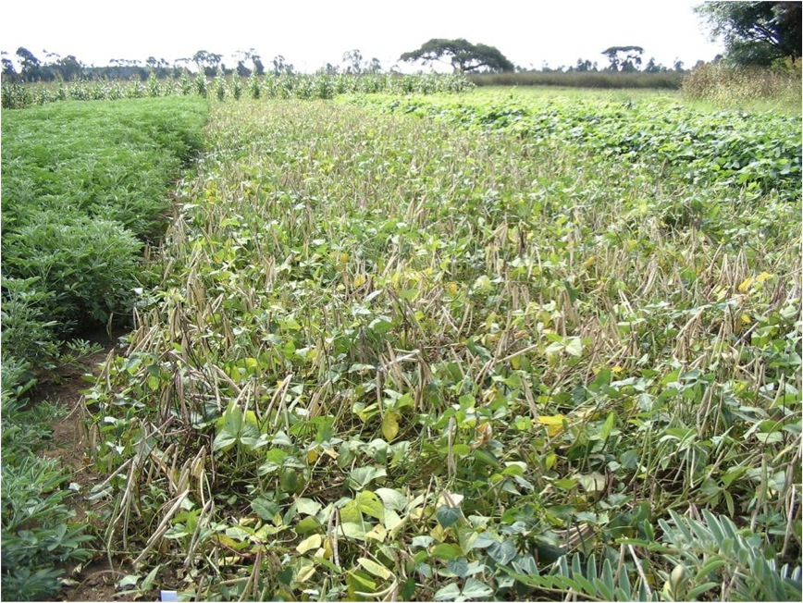
Potential legumes in rotations...
Cowpea (Vigna unguiculata)

Slide 22
What are Green manure cover crops?
Green manure cover crops
Crops that are normally planted as inter- or relay crops for the sake of accumulating nitrogen in the soil, producing residues and ground cover. GMCCs are not primarily planted to generate additional incomes (seed or grains).

Slide 23
Reasons for taking green manure cover crops (GMCC‘s)
To produce nitrogen (legumes)
To control weeds (replacing fallow periods)
To produce mulch during non-crop periods
To cycle soil nutrients
Other positive effects on succeeding crops

Slide 24
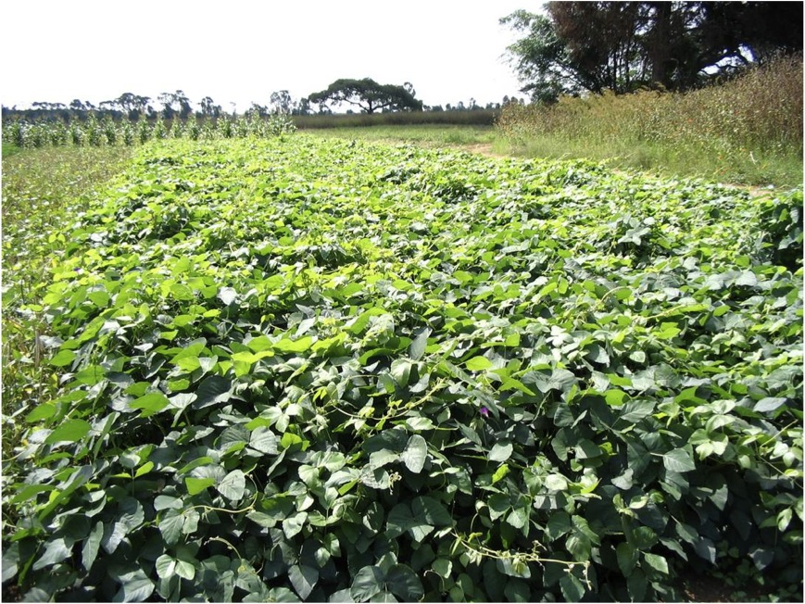
Typical green manure cover crops in Southern Africa
Velvet beans (Mucuna pruriens)

Slide 25
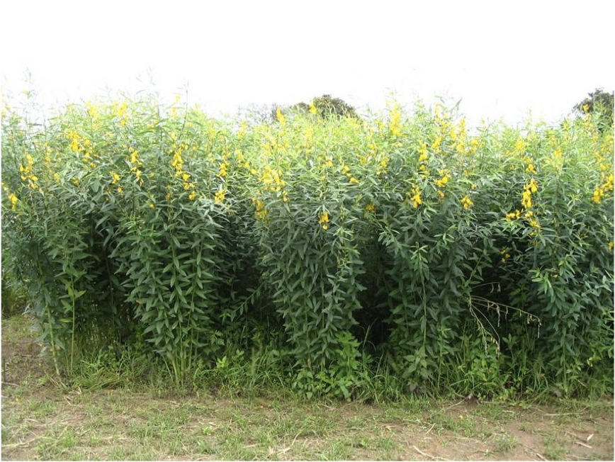
Typical green manure cover crops in Southern Africa cont..
Sunhemp (Crotalaria juncea)

Slide 26
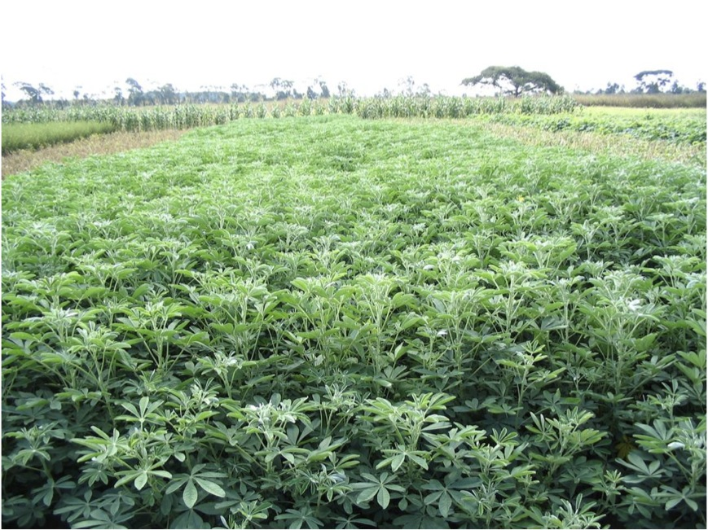
Typical green manure cover crops in Southern Africa cont..
Crotalaria grahamiana

Slide 27
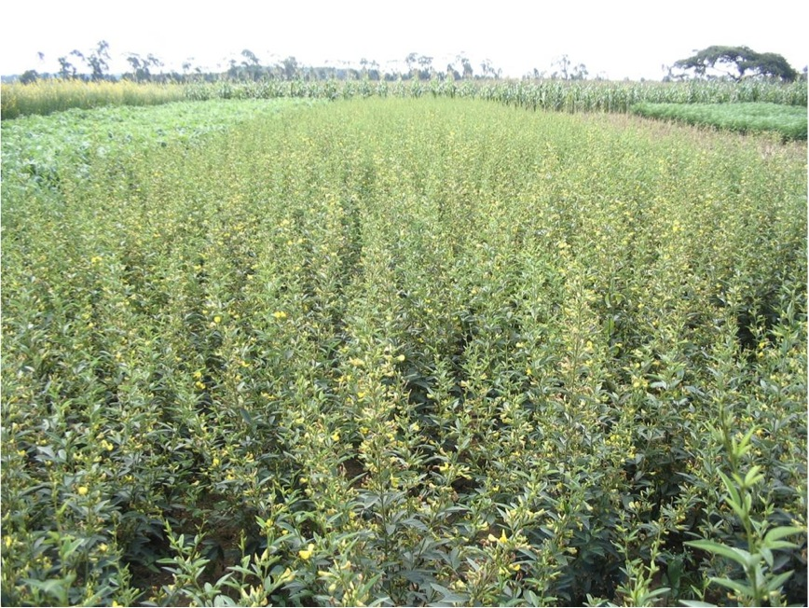
Typical green manure cover crops in Southern Africa cont..
Pigeon pea (Cajanus cajan)

Slide 28
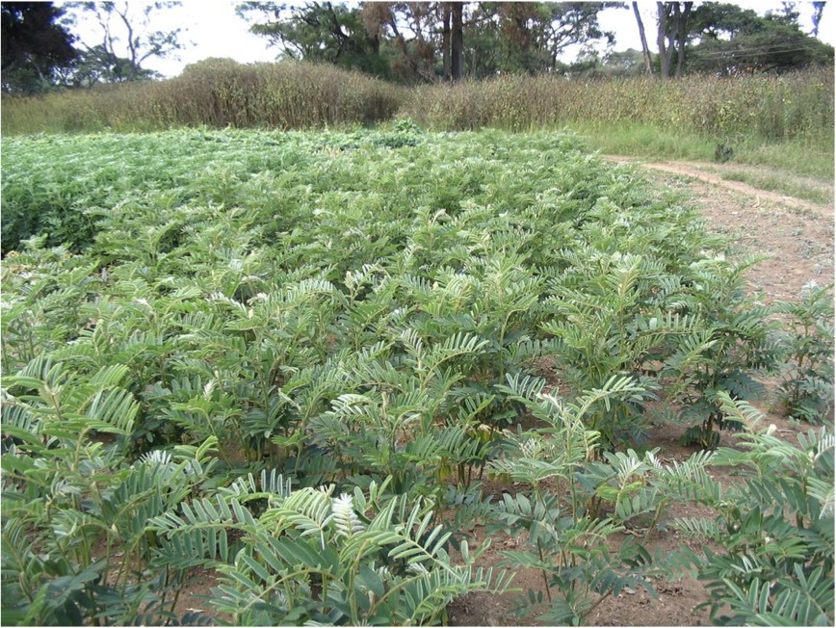
Typical green manure cover crops in Southern Africa cont..
Tephrosia vogelii

Slide 29
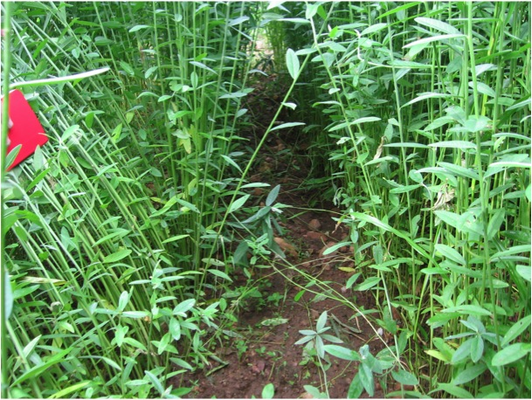
Considerations before selecting GMCC‘s
Yield effects on succeeding cash crops
Rapidity of growth and ground cover
Nitrogen content and C/N ratio
Ability to produce yields without fertilizer applications
Influence on weeds
Resistance to diseases and pests

Slide 30
Effects of GMCC‘s on weed establishement after 12 and 27 days
Source: Derpsch et al, 1991

Slide 31
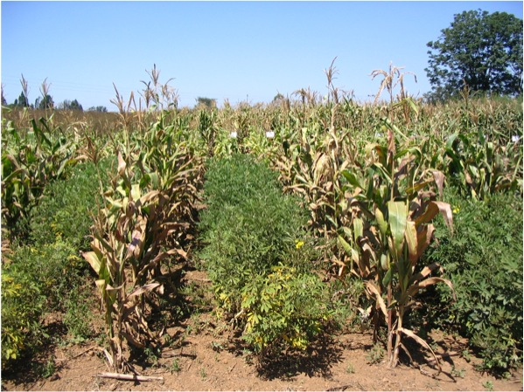
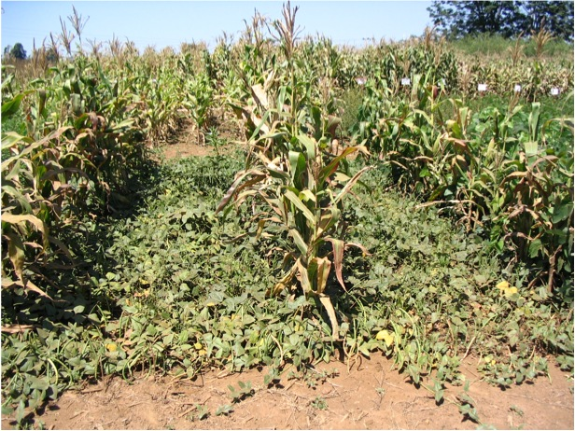
GMCCs in practice – as sole crops or intercropped
Maize – Crotalaria grahamiana intercropping
Maize – Cowpea intercropping

Slide 32
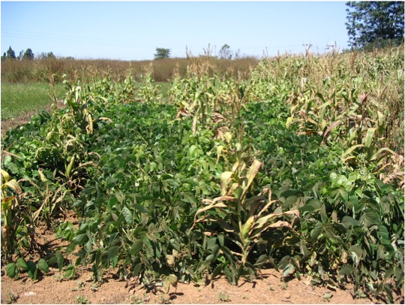
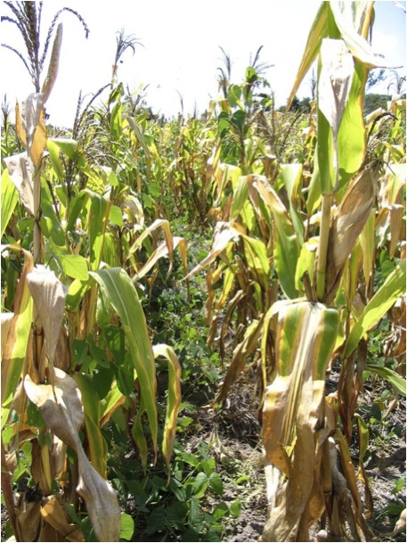
GMCCs in practice – the importance of timing
Maize – Velvet bean intercropping planted at the same time
Maize – Velvet bean intercropping, planted six weeks after maize

Slide 33
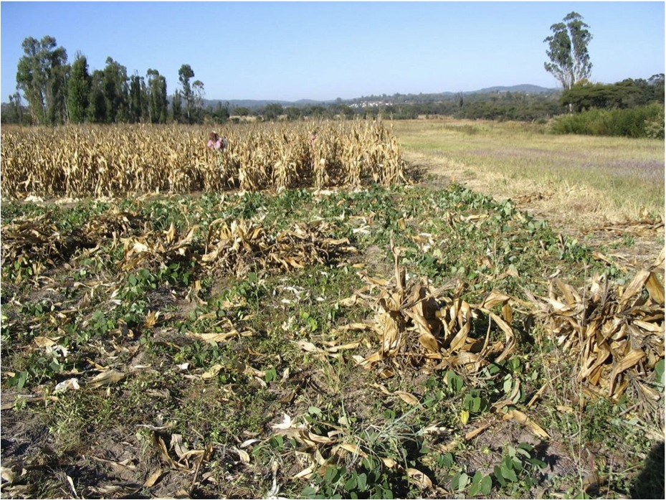
Post-harvest Management
Intercropped Mucuna can continue growing after harvest

Slide 34
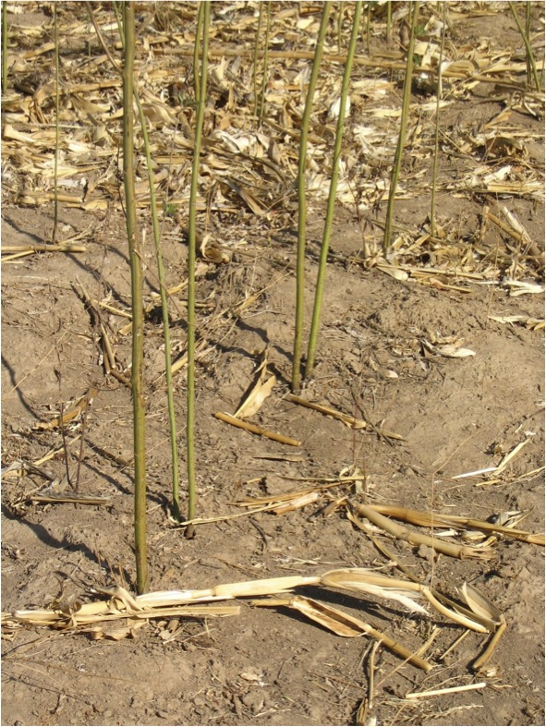
Benefits of deep rooting legumes
Deep rooting Pigeon Pea (Cajanus cajan) intercropping to break hardpans

Slide 35
When is it useful to plant green manure cover crops (GMCC‘s)?
When there is not enough water for a cash crop
When there is a free period between crops and enough moisture available or at the end of the maize cropping season
When additional residues need to be generated (termites)
When producing a cash crop is not profitable or too risky

Slide 36
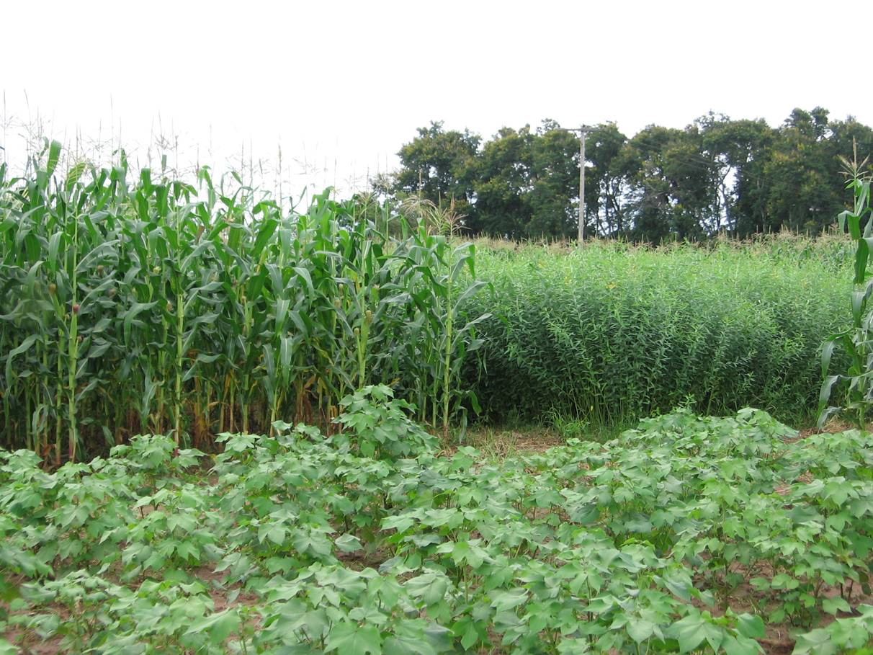

Thank you very much!
Thank you very much!
Thank you very much!

