Slide 1
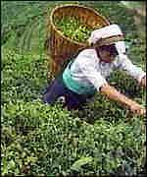
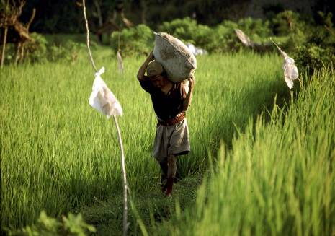
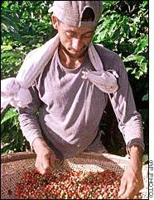
What types of crops are produced in Chembakolli?
People in Chembakolli grow vegetables and grains and collect honey. They also grow tea, rice, coffee and pepper which they sell.

Slide 2
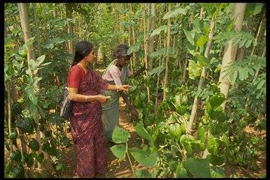
Forests
At one time the forest provided a living as they could make money from selling things from the forest. Now they are not allowed to enter. Instead they have planted forest plants around the village, which they use for food and medicine. They collect dead wood for fuel.

Slide 3
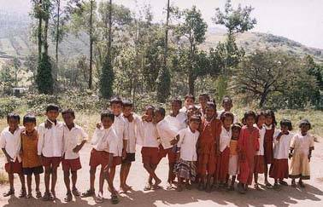
How and when do they plant their crops?
They farm organically
They plant their crops before the monsoon season, which begins in June.
Children help with farming

Slide 4
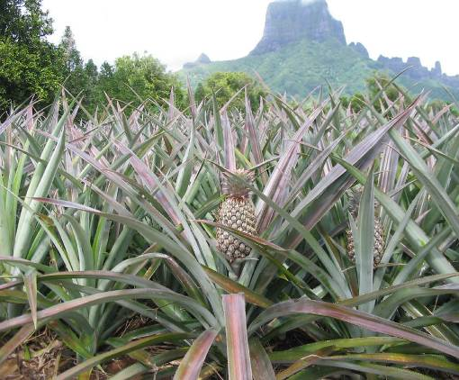
What else do they grow in Chembakolli?
Banana, coconut, papaya, pineapple and mango trees grow around the house.
Villagers keep cows for milk, chickens for meat and eggs and dogs to protect their crops.

Slide 5
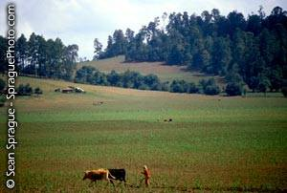
What can you remember?
What crops do they grow?
What fruit do they grow?
When do they plant their crops?
Which animals do they keep?

Slide 6
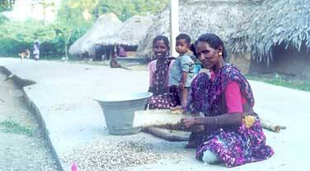
A day in the life of Chanda
Chanda is a woman who lives in Chembakolli with her family. This is her daily routine. We are going to compare this with a day in the life of your Mum, so watch and listen carefully.

Slide 7
Chanda
5am Chanda wakes up, lights the cooking fire and prepares breakfast.
6.30am Chanda goes to the well to clean the dirty pots and collects water for the rest of the day.
7.30am Sweeps around her house.
8am Begins to cook rice and vegetables for lunch.
9am Takes her children to the doctors.
10am Goes to work on the tea fields.

Slide 8
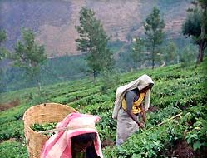
10.30am Chanda plants tea seedlings and picks the ripe tea leaves.
3pm Returns home and feeds her family. She then collects firewood for the evening meal.
6pm She returns home to cook the evening meal. It is rice, pulses and vegetables.
8pm Chanda sets up the family's bed.

Slide 9
Today's work
Crops grown around Chembakolli – write 8 crops and fruits that are grown in Chembakolli.
Write down 5am, 6.30am, 8am, 10am, 3pm and next to these times of day write what Chanda does.
Using some of the photos, draw a picture of a woman at work in the tea fields.

