Slide 1
Bullying Prevention/Intervention: Strategies and Resources
Samantha Sims
Co-Enrollment and Multiage (3-5th)
Miles ELC

Slide 2
Agenda
Drawing on our own experiences
Strategies for prevention/intervention with resources and practice
Feedback, question/response

Slide 3
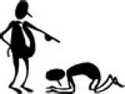
Teachers Were People, Too
Moving past symptoms to contributing factors
On the spectrum of bullying

Slide 4
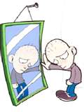
Coming to a Common Definition of Bullying
If there is no victim, there is no bully

Slide 5
Strategies—Prevention Classroom Climate
Messages from you!
Mindset Carol Dweck

Slide 6
Strategies—Prevention Classroom Climate
Skillful Teacher
Wait time p. 310
Attribution retraining p. 304-320

Slide 7
Strategies—Prevention Classroom Climate
Discussion Moves
Restating
Revoicing
Adding on
Agree/disagree with explanation
Think time

Slide 8
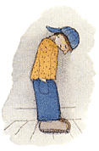
Strategies—Prevention Classroom Climate
Messages from you!
Discipline
No shaming
Matching (Skillful Teacher)
Positive Classroom Discipline
Love and Logic

Slide 9
Strategies—Prevention Classroom Climate
Communicating with Assertiveness
Everyday communication

Slide 10
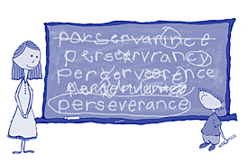
Strategies—Prevention Classroom Climate
Expected Behaviors—Lifeskills
Lifeskills skits
Lifeskills for the refrigerator

Slide 11
Strategies—Prevention Classroom Climate
Cooperative Learning
Learning to Play, Playing to Learn
Stay with injured
Settle disagreements outside game

Slide 12
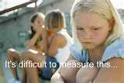
Strategies—Prevention Classroom Climate
Problem Solving
Class meeting (Tribes)
Peer mediator
Class Five model

Slide 13
Strategies—Prevention Classroom Climate
Appreciations
Enforces lifeskills
Catches them doing right thing
Positive behavior
Positive attention
Feel good

Slide 14
Strategies—Prevention Classroom Climate
Proactive Relationship-Building (parents, kids, principal)
Newsletter
Website
Positive phone calls home

Slide 15
Strategies—Prevention Curricular Applications Juvenile Literature
Hoot Carl Hiaason (intermediate/middle)
Joshua T. Bates: In Trouble Again
Susan Shreve (intermediate)
Marvin Redpost: Why Pick on Me Louis Sachar (primary)
Wringer Jerry Spinelli (middle)

Slide 16
Strategies—Prevention Curricular Applications
Internet:
One stop shopping for lessons, movie list, books, educational videos, cyberbulling

Slide 17
Internet Resources

Slide 18
Strategies—Prevention Movies
Karate Kid
Mighty Ducks 2
Max Kleeble’s Big Move
Your ideas here

Slide 19
Strategies—Intervention
Messages from you!
Teacher
Positive Classroom Discipline
Love and Logic
Counselor
Peers-BYSTANDERS!
student
teacher
peers
counselor

