Slide 1
Descriptive Writing
Lesson Objectives: 1 Explore ways to make writing descriptive.
2 Be able to write descriptively.
A noun is…
a) An action or doing word
b) A type of Indian bread
c) A person, place or thing
Key words:
Noun phrase
Verb
Vocabulary
A verb is…
a) An action or doing word
b) Something that makes your pizza taste better
c) A person, place or thing
Vocabulary is…
a) word choice
b) sentence length
c) The way you speak

Slide 2
1 Explore ways to make writing descriptive
Noun phrases
Copy these noun phrases and underline the noun:
White wedding
Big, bad wolf
Bare long essay
Three little pigs
Verbs
Copy these sentences and underline the verb:
It was covered in mud.
He walked alone through the house.
Katie looked at her mother.
These nouns are PRE-MODIFIED – they have extra information in front of them.
Now think of a more interesting synonym for each verb. Use a thesaurus if you wish.
Q: Why do you think nouns are pre-modified? What is the effect?

Slide 3
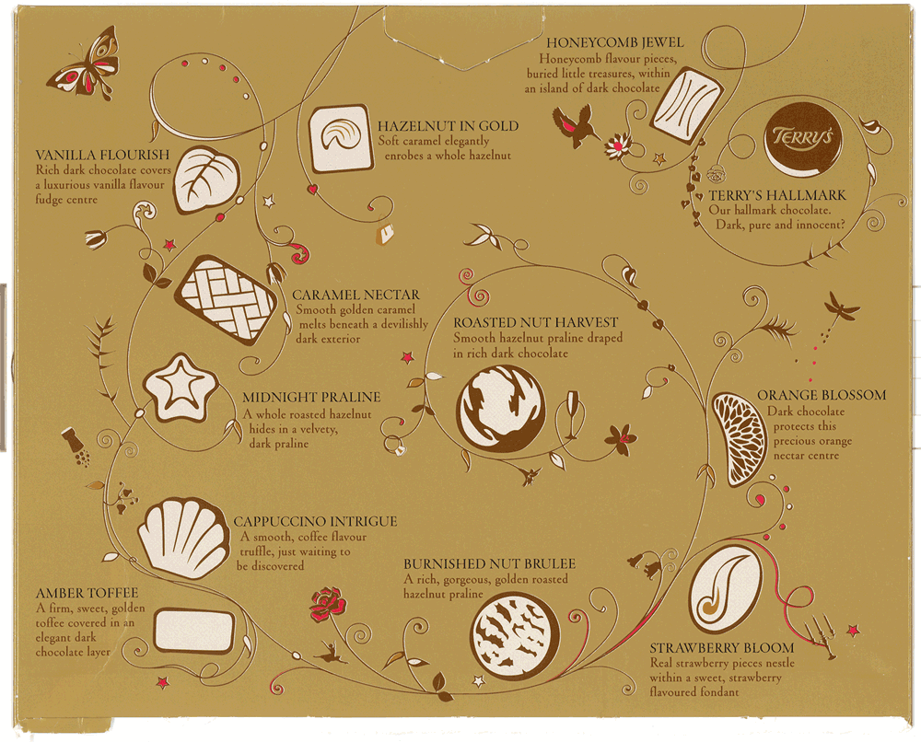
Pre-modified nouns
Generally exciting vocabulary, mostly relating to riches, elegance and sophistication
Exciting verb choices; some personification

Slide 4
2 Be able to write descriptively
You are going to receive your own chocolate. Eat the chocolate, and then write your own description of it. Be as expressive as possible, and try to use:
Pre-modified nouns
Exciting verbs
Suitable vocabulary
Adjective bank:
Soft
Smooth
Rich
Divine
Verb bank:
Wrapped
Swathed
Draped
Use these words to help you, or even better, find your own – use a thesaurus!

Slide 5
2 Be able to write descriptively
Many of the characters in ‘Of Mice and Men’ are lonely and depressed. Write one paragraph about a lonely and depressed character in today’s society.
Tell us:
Possible reasons for loneliness / depression:
Racism – homelessness – bullying – poverty – or your own idea!
What they look like
Where they live
Why they are lonely and depressed
You must be as descriptive as possible, using the skills from today’s lesson.
You could use figurative language: similes, metaphors, personification…

Slide 6
Homework
Finish your descriptive paragraph.
Due:

Slide 7
Pre-modified nouns
Exciting verb choices; some personification
Generally exciting vocabulary, mostly relating to riches, elegance and sophistication
TASK: Draw a line from each box pointing to an example of the language feature…

Slide 8
This powerpoint was kindly donated to www.worldofteaching.com
http://www.worldofteaching.com is home to over a thousand powerpoints submitted by teachers. This is a completely free site and requires no registration. Please visit and I hope it will help in your teaching.

