Slide 1
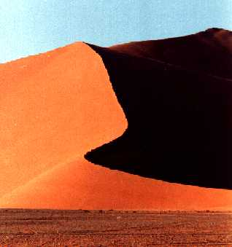
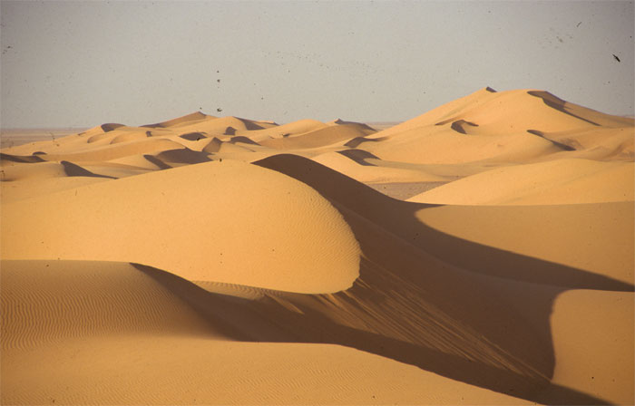
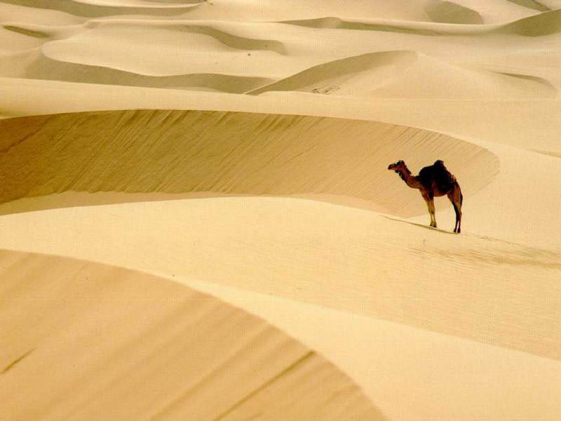
Deserts

Slide 2
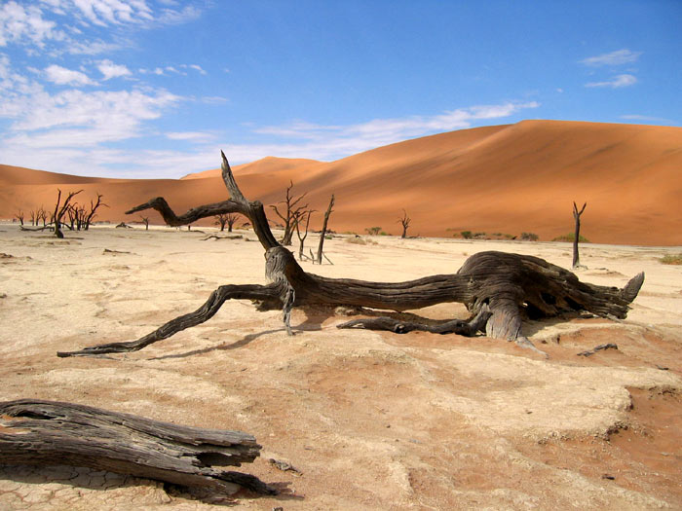
What is a desert?
The desert is a land of extremes: extreme heat and extreme dryness; sudden flash floods and cold nights. Because deserts are such a difficult places to live in they often have names likes "Death Valley," "the empty quarter," and "the place from where there is no return."

Slide 3
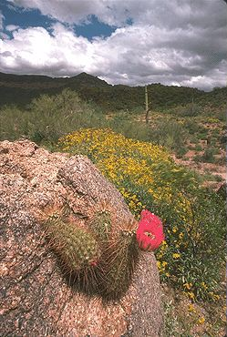
How dry is a desert?
Deserts are usually very, very dry. Even the wettest deserts get less than ten inches of rain a year.
In most places, rain falls steadily throughout the year. But in the desert, there may be only a few periods of rains per year with a lot of time between rains. When it does rain, there may be quite a downpour! After the rain, desert flower bloom

Slide 4
Is it always hot in a desert?
Everyone knows that during the day many deserts are hot, very hot. Temperatures can get as high as 100 degrees fahrenheit are not uncommon. Yet at night, the same deserts can have temperatures fall into the 40s or 50s? With no clouds or plant life to keep the heat in, it begins to cool as soon as the sun goes down.

Slide 5
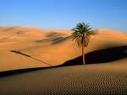
Types of desert
Believe it or not, deserts come in two varieties: hot and cold.
The Antarctic is actually the Earth’s largest desert. The main form of precipitation in a cold desert is snow -- but only ten inches or less per year.
The Sahara is the largest hot desert. These are covered in sand and rock.

Slide 6
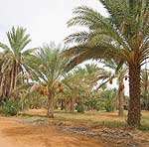
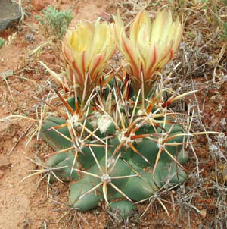
Can any plants grow in a desert?
Deserts are the home to many living things.
Plants that grow in a desert have to be especially adapted to the dry conditions. They must be able to: collect and store water and reduce water loss.
Desert plants look quite different to plant that grow in other places.

Slide 7
Which animals live in the desert?
Animals in the desert must survive the intense heat, searing sun, and lack of water. Animals that live in the hot desert have many adaptations. Some animals never drink, but get their water from seeds (some can contain up to 50% water) and plants. Many animals are nocturnal, sleeping during the hot day and only coming out at night to eat and hunt. Some animals rarely spend any time above ground.

Slide 8
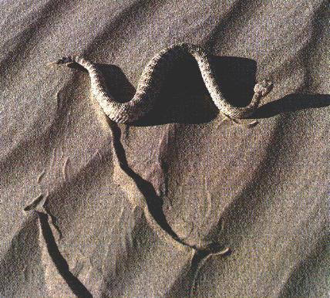
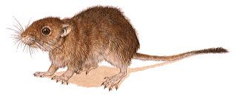
Some of the animals that live in the desert.
A sidewinder is a small agile snake. It is mainly nocturnal and takes shelters from the heat of the day in the burrow of another animal or under a bush.
The fat sand rat overcomes the problem of the unpredictability of desert food supplies by laying down a thick layer of fat all over its body when there is plenty of food It then lives off this fat when food is short. Active day and night, this gerbil darts about collecting seeds which it carries back to its burrow.

