Slide 1
Dehorning, Castrating and Docking
4-H Veterinary Science
Extension Veterinary Medicine
Texas AgriLife Extension Service
College of Veterinary Medicine and Biomedical Science
Texas A&M System
http://aevm.tamu.edu

Slide 2
Objectives
Describe dehorning techniques for calves
Describe castrating techniques for calves, lambs and pigs
Describe tail docking techniques for lambs
Discuss benefits of dehorning, castrating and docking

Slide 3
Dehorning
Dehorning
  The process of removing or preventing the growth of horns
Benefits
  Improve appearance
  Reduce injuries
  Increase feeder space
  Improve value
Two methods
  Non-invasive
  Invasive

Slide 4
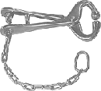
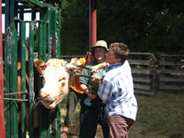
Restraint
Very important
Remember safety
Restrain head
Nose Tongs
Dehorning a Calf

Slide 5
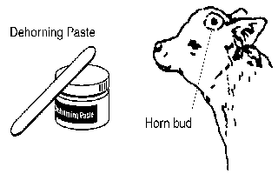
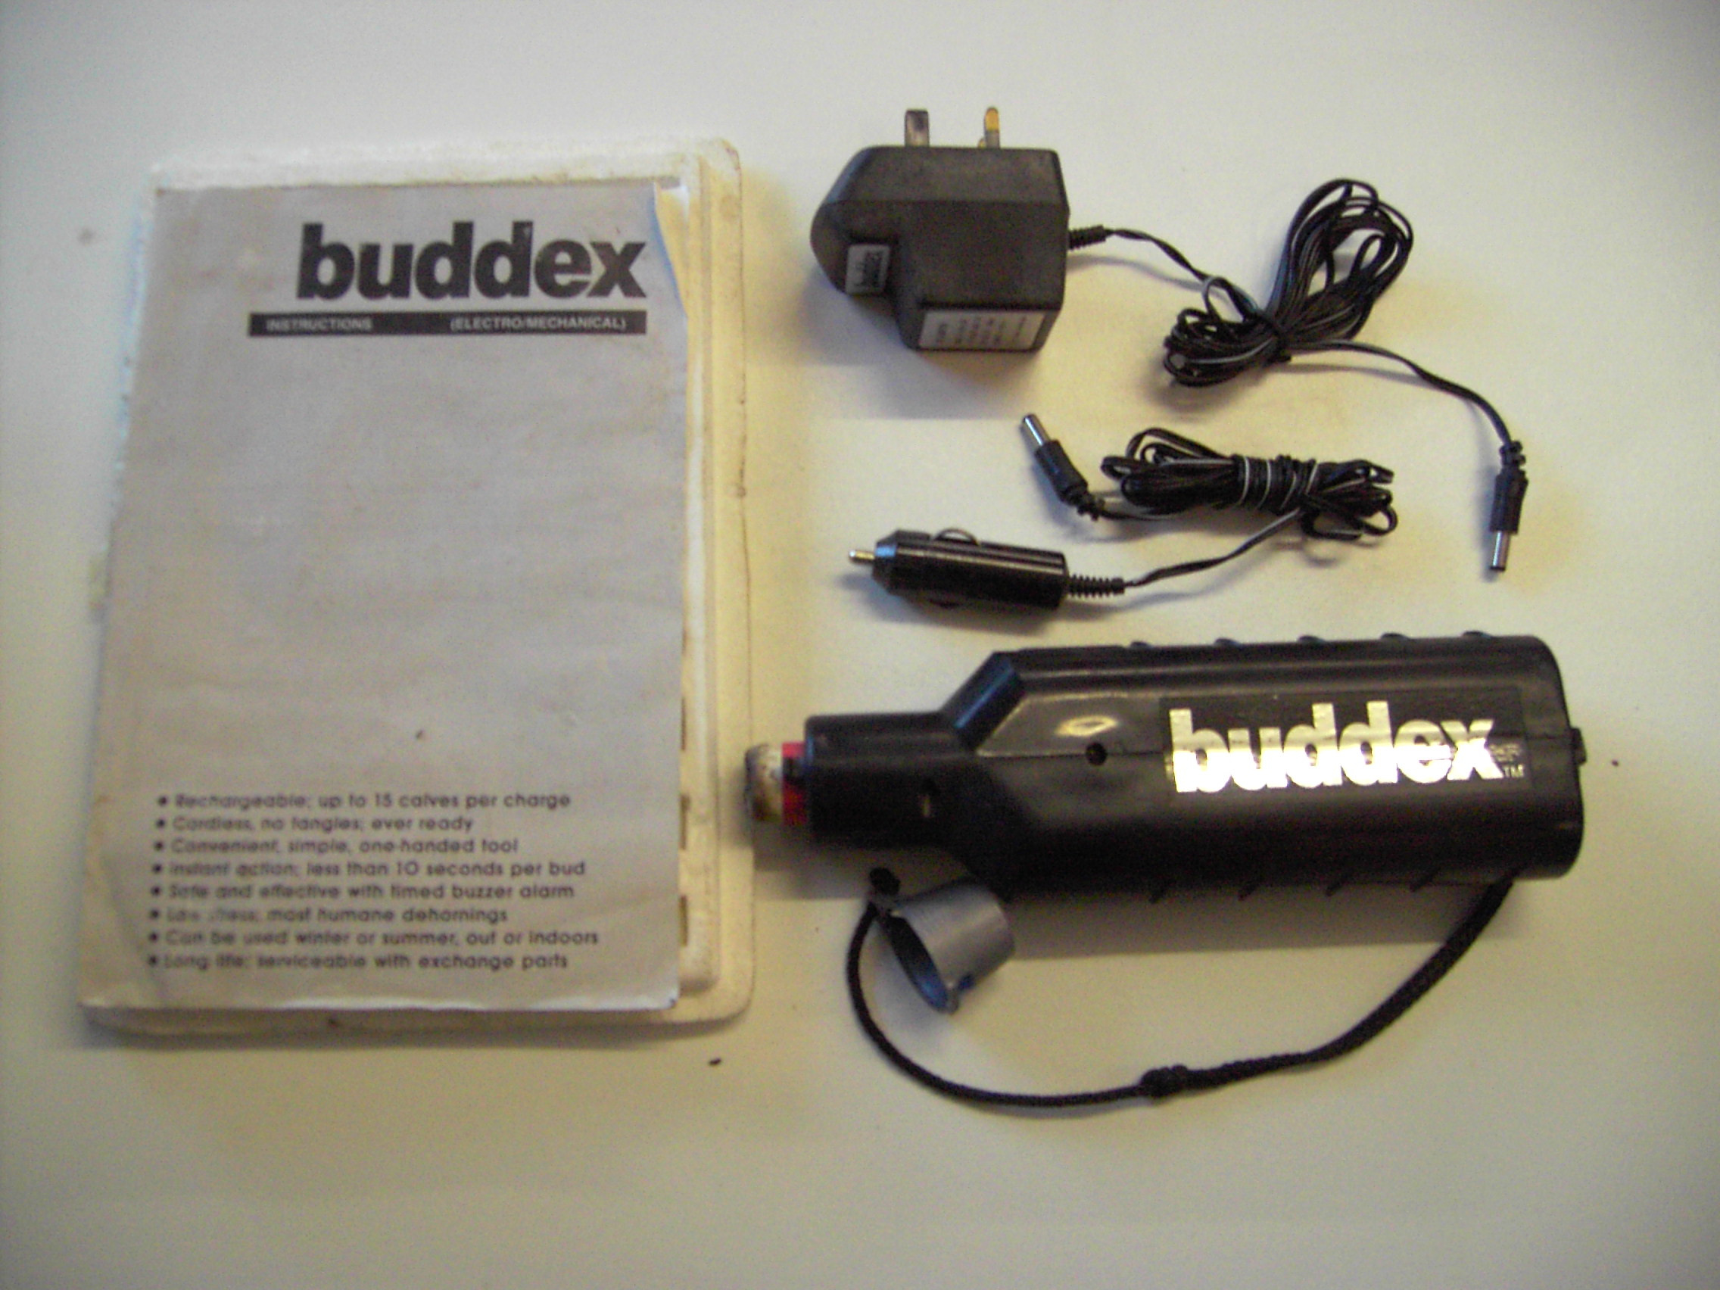
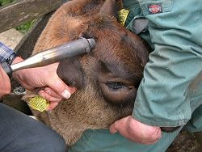
Non-Invasive
Bloodless
Young animals
Types
  Chemical paste
  Hot iron
Electronic Horn Budder

Slide 6

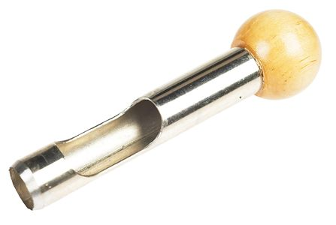
Invasive
Blood flow
Older animals
Involves cutting or scooping the horn off of the animals skull
Types
  Barnes’ dehorner
  Scoop dehorner

Slide 7
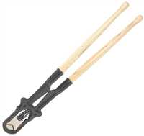
Keystone dehorner

Slide 8
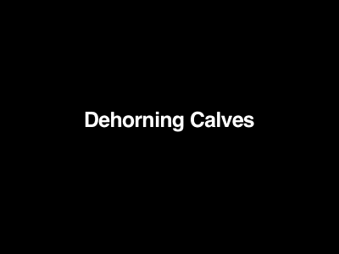
Dehorning Videos

Slide 9
Castrating
Castration
  The process of removing the testicles from a male
Benefits
  Prevents mating or fighting
  Improves carcass quality
  Gentles them
Two methods
  Non-invasive
  Invasive

Slide 10
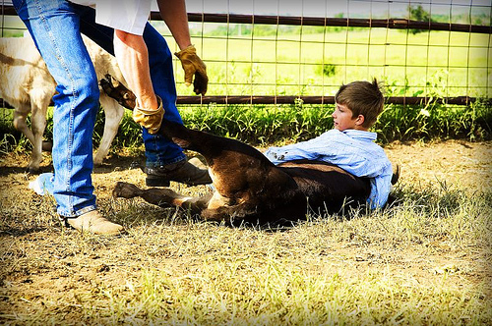
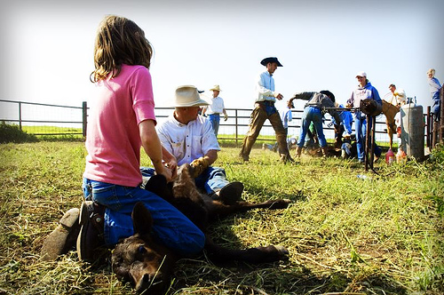
Restraint
Calves
  On side
Older bull calves
  In chute
Young lambs and kids
  On back
  Assistant’s arms
  V-shaped table

Slide 11
Non-invasive
Bloodless
Tetanus antitoxin
Crimps or constricts arteries – testicles die
Young calves or weanlings
Types
  Burdizzo
  Elastrator
  Calicrate bander
  Short-scrotumed
  Chemical castration

Slide 12
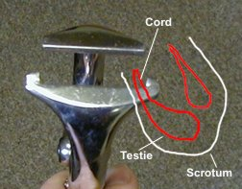
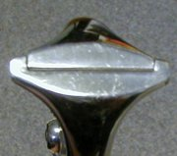
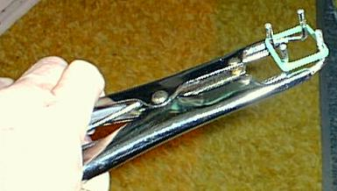
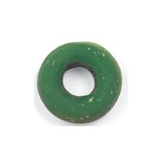
Burdizzo
Elastrator

Slide 13
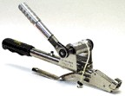
Calicrate smart bander

Slide 14
Invasive
Blood flow
Sanitation is key
  Do not reach into the wound because it could cause infection
Types
  Knife/scalpel
  Emasculator

Slide 15

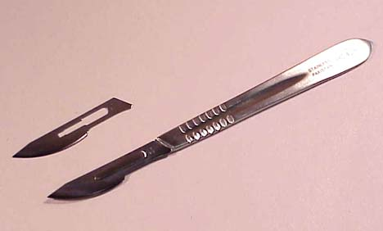
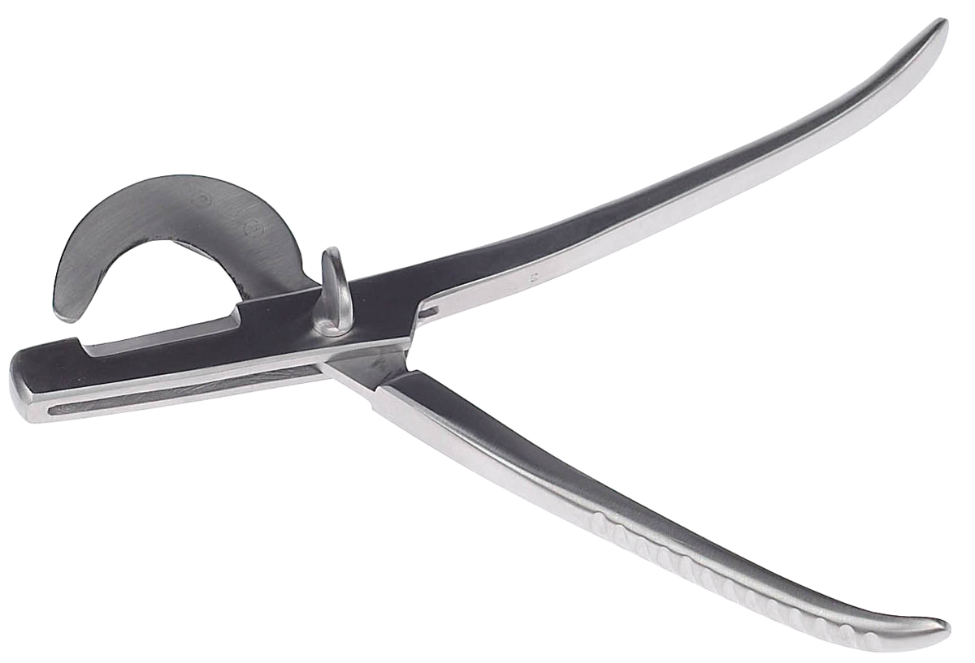
Knife
Scalpel
Emasculator

Slide 16
Calf Castration
Non-invasive
  Tetanus antitoxin
Invasive
  Remove 1/3-1/2 scrotum with knife
  Extract testicles
  Sever spermatic cord
    Knife scrape
    Pull
    Emasculator

Slide 17
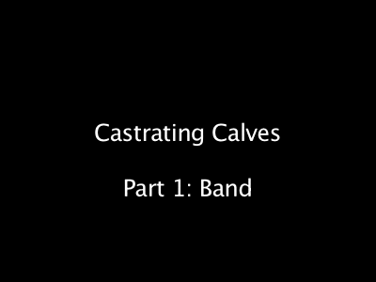
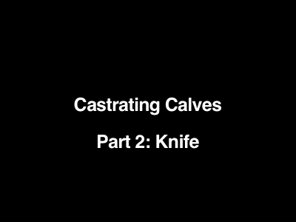
Castration Video

Slide 18
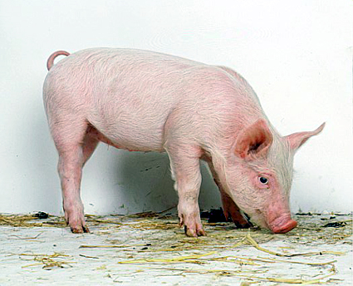
Swine Castration
Invasive
  Make slits on scrotum and tunic
    Knife, scalpel
  Extract testicles
  Sever spermatic cord
    Knife scrape
    Pull
    Emasculator

Slide 19
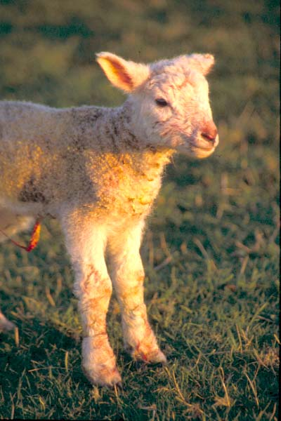
Lamb and Kid Castration
Non-invasive or invasive
Tetanus antitoxin
Same as calves

Slide 20
Docking
Docking
  The practice of cutting the tail off an animal
Benefits
  Improve appearance
  Increase hygiene (sheep)
  Reduce tail biting (pigs)
  Keep tails out of harnesses (draft horses)
Two methods
  Non-invasive
  Invasive
Varies among species

Slide 21
Restraint
Young lambs and pigs
  On back
  Assistant’s arms
  V-shaped table

Slide 22
Non-invasive
Bloodless
Types
  Elastrator
  Burdizzo

Slide 23
Invasive
Blood flow
Sanitation is important
Types
  Knife
  Scalpel
  Shears
  Emasculator
  Hot, sharp iron

Slide 24
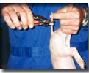
Swine Docking
Cut tail 1 inch from base with a blade
Don’t cut into the base
Invasive

Slide 25
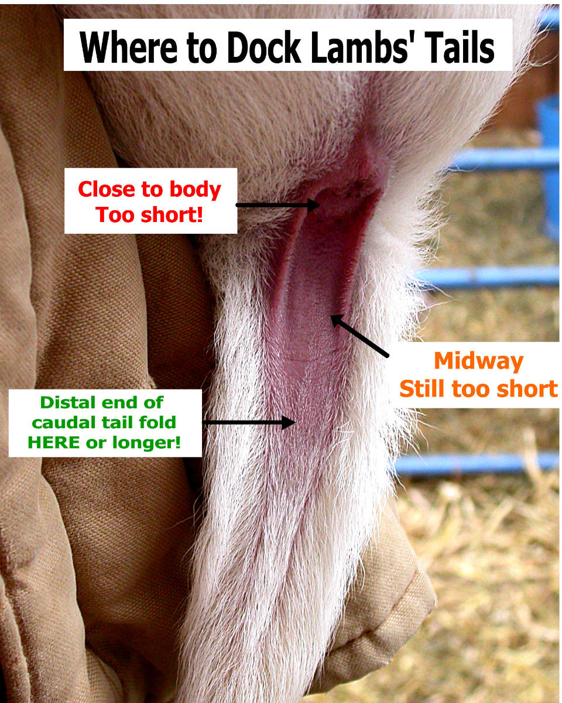
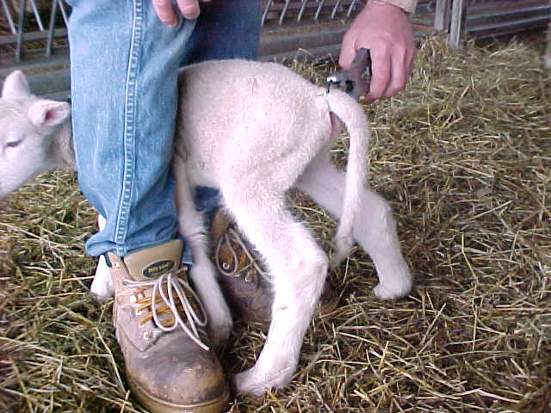
Sheep Docking
Cut two inches away from base
Non-invasive
Invasive
Tetanus antitoxin

