Slide 1
The Story of Early Man
Hunting, Gathering, and
Cave Painting

Slide 2
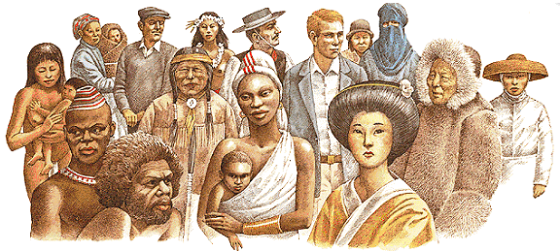
Homo Sapiens

Slide 3
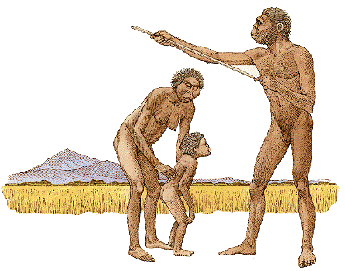
An Early Family

Slide 4
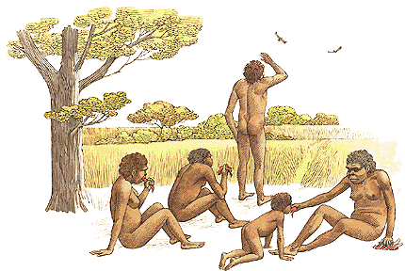
Home Base

Slide 5
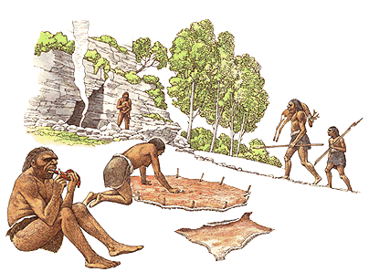
Human Society

Slide 6
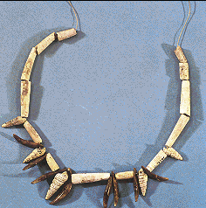
Decorative Objects

Slide 7
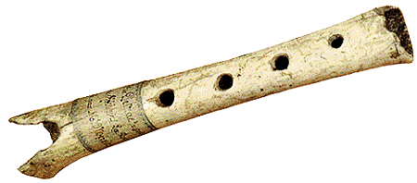
Music with a Bone Flute

Slide 8
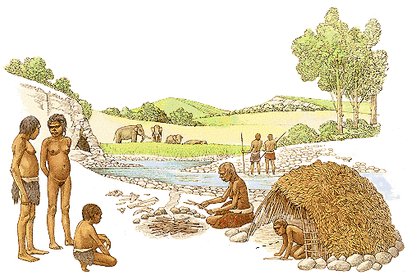
Shelters

Slide 9
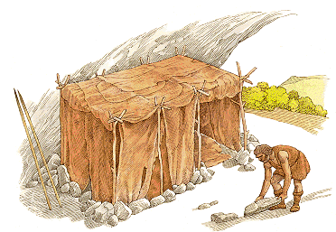
Huts and Caves

Slide 10
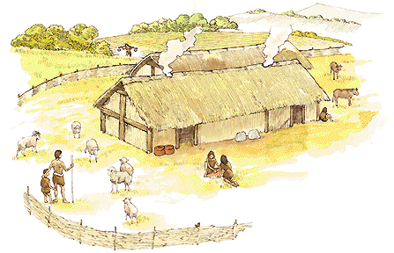
Agriculture

Slide 11
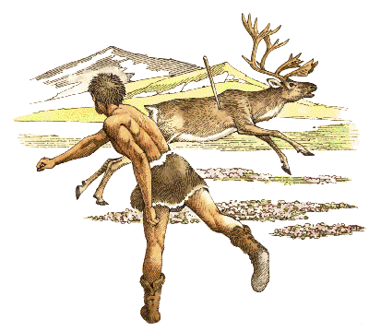
Hunting

Slide 12
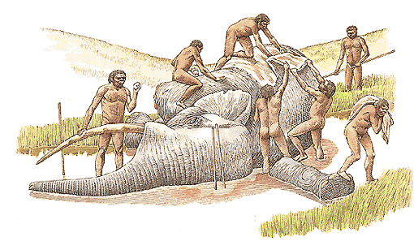
Big Game Hunting

Slide 13
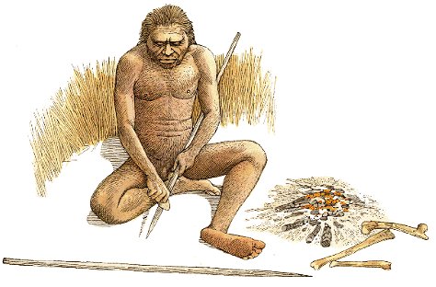
Tools

Slide 14
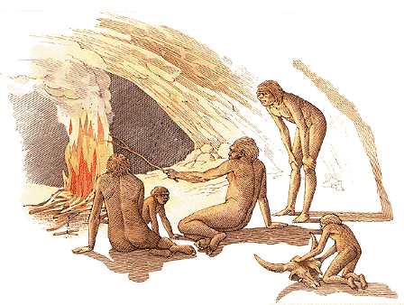
Taming Fire

Slide 15
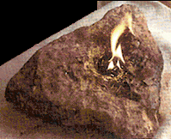
Stone Lamps

Slide 16
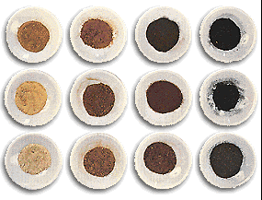
Color Pigments

Slide 17
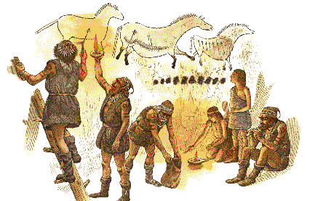
Ritual Painting

