Slide 1
The Earth and Beyond

Slide 2
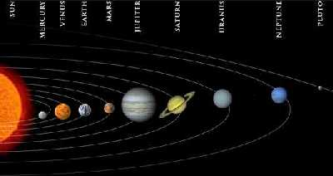
The Sun is the star at the centre of our solar system.
Here is a useful mnemonic to help remember their order:
My Very Easy Method Just Shows Us the Names of Planets.
The nine planets orbit the sun.

Slide 3
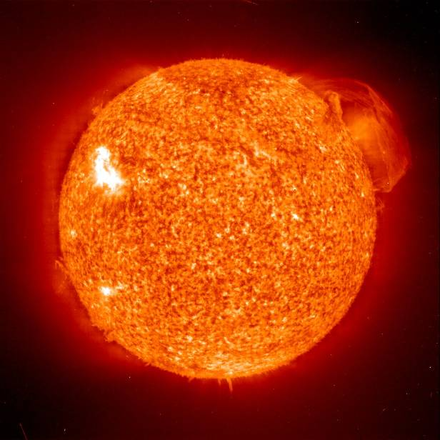
But what do we know about the Sun?
The Sun is 150 million kilometres away from us.
It has a massive diameter of 1,393,000 km.
Our Sun was probably formed from a large cloud of gas about 5,000 million years ago.

Slide 4
The moon orbits the Earth...
Sun
Earth
moon
...as the Earth orbits the Sun.

Slide 5

As the Earth orbits around the Sun, it also spins on its own axis; which is tipped, like a globe’s.

Slide 6

At any time, half of the Earth faces the sun and therefore receives light.
This part is in day.
This part is in night.
The other half faces away from the Sun, and so receives very little light.

Slide 7
What causes the Earth’s seasons?
As the Earth orbits the Sun, when its axis tips towards the Sun, the weather gets warmer. When it tips away, the weather gets colder, causing the Earth’s seasons.

Slide 8
In the northern hemisphere:
spring here
winter here
autumn here
summer here
summer here
autumn here
winter here
In the southern hemisphere:
spring here

Slide 9


The Earth rotates on its axis at c 900 miles an hour! As it rotates, the Earth is also orbiting the Sun at a speed of c 67,500 miles an hour!
But, don’t worry! Thanks to the Earth’s gravity and atmosphere, we won’t fall off.

Slide 10
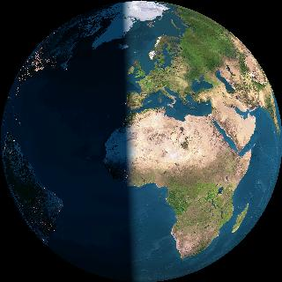
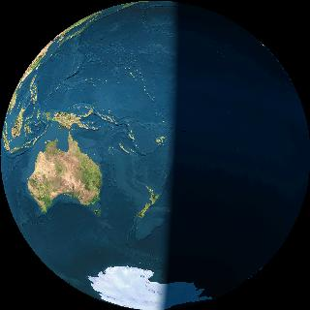
So, when the Sun ‘rises’ in Great Britain, on the other side of the world, it’s about to ‘set’.
Great Britain
New Zealand

Slide 11
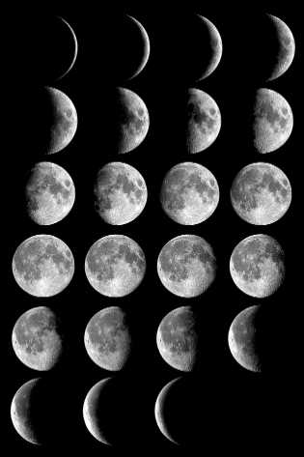
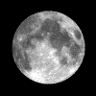
Now, with your partner, discuss these ideas about the moon:
It’s some sort of a cycle!
I think the moon is a light source?
I think it keeps changing shape?

Slide 12
Why does the moon appear to change shape?
moon
Earth
moon
moon
moon
new moon
moon
full moon
It takes the moon 28 days to orbit the Earth.
For 27 days out of this cycle, the Sun cannot shine on the whole of the surface, facing the Earth.
The light from the Sun can only shine on the whole surface for one night in each cycle: a full moon.
On one night, no light from the Sun can reach the moon at all: a new moon.

Slide 13

Do you know...
how long it takes the Earth to spin round once?
which direction the Earth turns?
how long it takes the Earth to orbit the Sun once?
which direction the Earth orbits the sun?
It takes 24 hours.
It turns anti-clockwise.
It takes 365¼ days.
It turns anti-clockwise.

Slide 14



Did you know?
One day on Venus lasts 117 Earth days.
Jupiter whips around in just 9 hours and 57 minutes.
One day on Mars is about the same as one day on Earth.

Slide 15

Now, explain to your partner:
Why, if is it day in New Zealand, it is night in England?
How long does it take for the Earth to turn once?
Why does the moon appear to change shape?
Why does the Sun appear to rise and set?
In which direction does the Earth orbit the Sun?
In which direction does the Earth spin on its axis?

