Slide 1
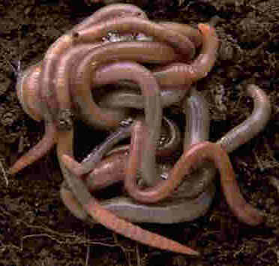
Earthworms

Slide 2
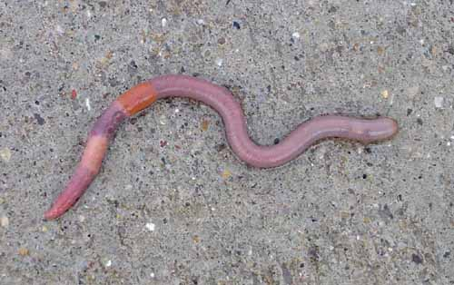
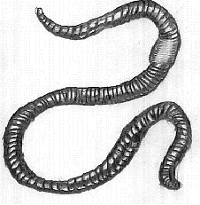
What do worms look like?
soft, slimy and pink and its body is divided up into rings or segments.
pointed at both ends.
Earthworms do not have eyes or hands so they use their skin to feel with.

Slide 3
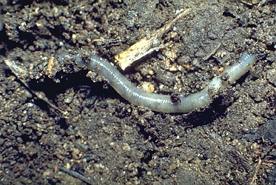
Where do worms live?
Most worms that live on land live in burrows
Worms cover the openings to their burrows with sticks, leaves or mud to keep out the cold and rain and to stop the burrow drying out in the hot weather.

Slide 4
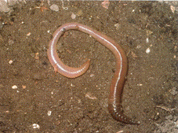
What do worms eat?
soil, sand or mud as they tunnel through it.
dead leaves and other bits of plants.

Slide 5
Do worms have enemies?
frogs
birds
people

Slide 6
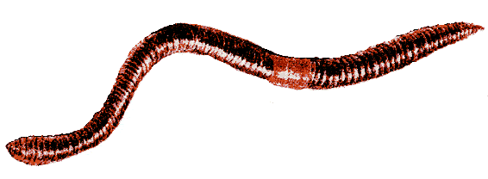
How do worms move?
It has tiny little hairs sticking out underneath its body. The earthworm uses these bristles to cling to the ground as it moves.

Slide 7
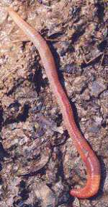
Worms and tunnels
Worms spend their days tunnelling through soil. Worms usually tunnel at least 20cm everyday.

