Slide 1
Science
WILF: To know how to use electricity safely
I know that electricity can be dangerous and am beginning to understand how to keep safe!

Slide 2
DANGER!!!!!
If not used properly electricity can be dangerous.
Follow the safety rules!!!!

Slide 3
Number 1
Do not have wires where people can trip over them…

Slide 4

Number 2
Never stick your fingers into a plug socket…

Slide 5
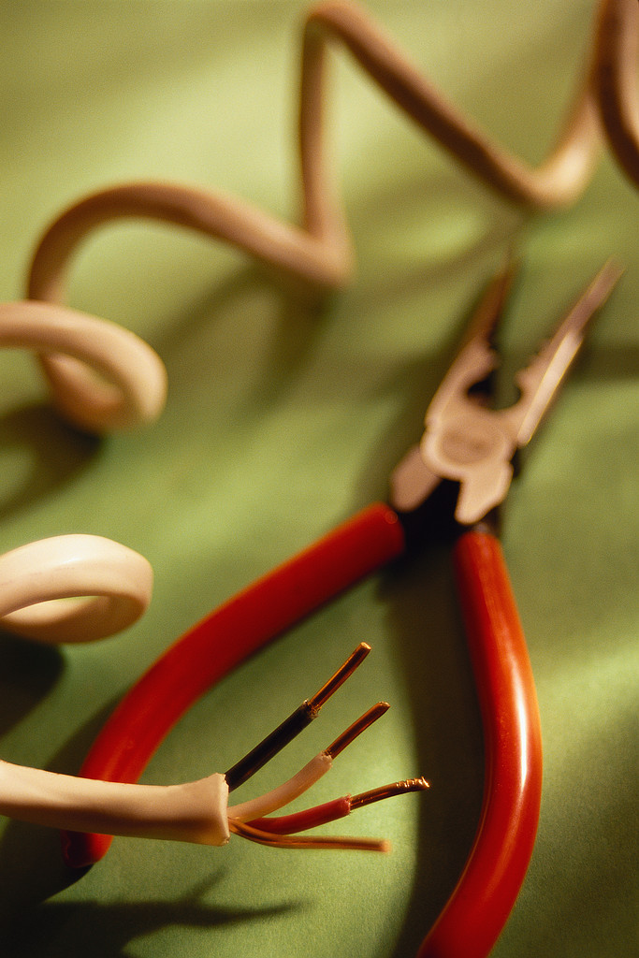
Number 3
Never use electrical appliances with frayed wires …

Slide 6

Number 4
Never touch a socket with wet hands …

Slide 7
Number 5
Never overload a plug socket …

Slide 8
Number 6
Never use electrical appliances with broken plugs …

Slide 9
Number 7
Always make sure an adult fixes broken electrical appliances …

Slide 10
Can you make a safety poster for using electricity?

Slide 11
As long as electricity is used in the correct way it will be safe.
What safety rules can you remember?
Do not have wires where people can trip over them.
Never stick your fingers into a plug socket.
Never use electrical appliances with frayed wires.
Never touch a socket with wet hands.
Never overload a plug socket.
Never use electrical appliances with broken plugs.
Always make sure an adult fixes broken electrical appliances.

