Slide 1
Science
Keywords
Danger
Electricity
Wires
Plug
Socket
Wet
Overload
L.O: To know how to use electricity safely
I know that electricity can be dangerous and am beginning to understand how to keep safe!
Starter:
Think and write down any Electricity safety rules you know already.
Electricity lesson 1

Slide 2
DANGER!!!!!
If not used properly electricity can be dangerous.
Follow the safety rules!!!!

Slide 3
Number 1
Do not have wires where people can trip over them…

Slide 4

Number 2
Never stick your fingers into a plug socket…

Slide 5
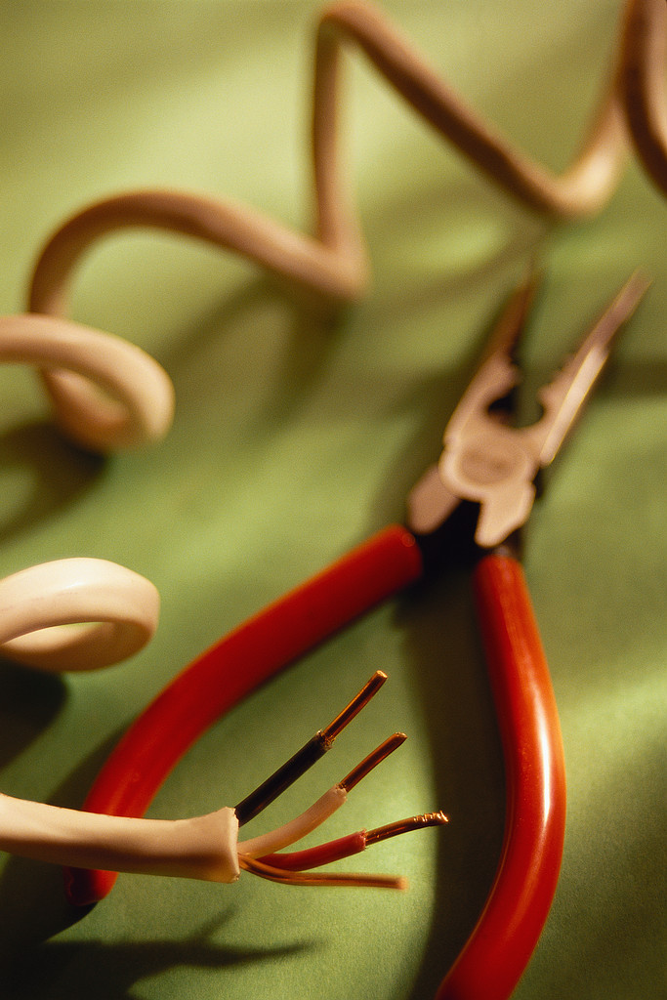
Number 3
Never use electrical appliances with frayed wires …

Slide 6

Number 4
Never touch a socket with wet hands …

Slide 7
Number 5
Never overload a plug socket …

Slide 8
Number 6
Never use electrical appliances with broken plugs …

Slide 9
Number 7
Always make sure an adult fixes broken electrical appliances …

Slide 10
Can you make a safety poster for using electricity?

Slide 11
As long as electricity is used in the correct way it will be safe.
What safety rules can you remember?
Do not have wires where people can trip over them.
Never stick your fingers into a plug socket.
Never use electrical appliances with frayed wires.
Never touch a socket with wet hands.
Never overload a plug socket.
Never use electrical appliances with broken plugs.
Always make sure an adult fixes broken electrical appliances.

Slide 12
Main Task
You now have ten minutes to complete your task.

Slide 13
3

Slide 14
2

Slide 15
1

Slide 16
GO!

Slide 17

(CLICK FOR 10 MIN TIMER)

Slide 18
Plenary
Discuss with your learning partner what you have learnt today and then have a class discussion about it.
Remember:
Keywords
Danger
Electricity
Wires
Plug
Socket
Wet
Overload

Slide 19
CLASS IS OVER!
PowerPoint Made By Sam Rolfe

