Slide 1
Energy
Without energy nothing happens.

Slide 2
Energy does work!
Work is done when objects are moved or heated.
Energy is never ‘used up’ it is simply converted from one form to another. Can you think of some sources of energy?
Fuels and food are sources of energy.
Can you think of any examples when energy is converted from one form to another?

Slide 3
Converted Energy
Fuels for generating electricity.
There are 3 main classes of fuel which can be used to generate electricity:
Fossil fuels, renewable fuels and nuclear fuels.
What are fossil fuels?
What are renewable fuels?
How are these fuels used to generate electricity?

Slide 4
Energy is released from the fuel.
Fossil fuels such as gas, coal and oil and renewable fuels such as wood are burnt and heat is generated.
This heat is used to boil water and the steam that is created is used to turn large propellers called turbines.
These turbines then turn electrical generators.

Slide 5
In addition to these fuels there are other energy sources used to generate electricity.
Can you think of any?

Slide 6
Other energy sources
Solar power: converts the energy of the sun into electricity.
Wind power: Moving air can be used to turn propellers.
Hydroelectric power: using water. The higher the drop and the greater the drop, the more energy can be created.
Wave power: wind causes waves to form on the water and the motion of these waves can be used to turn generators.

Slide 7
What have we learnt?
Energy does work.
Energy is never ‘used up’ it is simply converted from one form to another.
Fuels and food are sources of energy.
There are 3 main classes of fuel which can be used to generate electricity: Fossil fuels, renewable fuels and nuclear fuels.
Fossil fuels such as gas, coal and oil and renewable fuels such as wood are burnt and heat is generated.
This heat is used to boil water and the steam that is created is used to turn large propellers called turbines.
These turbines then turn electrical generators.
There are other sources of energy such as: Solar power, wind power, hydroelectric power and wave power.

Slide 8
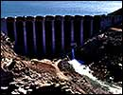


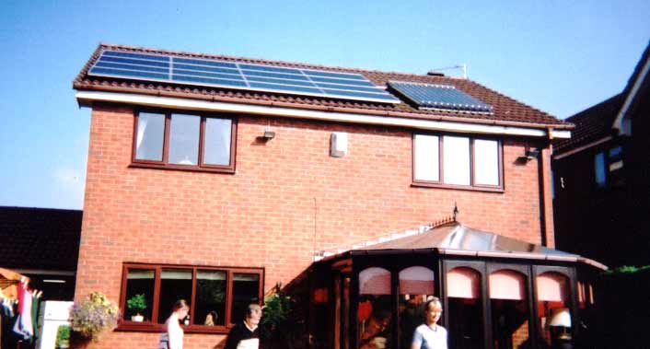
These photographs show ways of getting energy from four different energy sources, can you name them?

