Slide 1
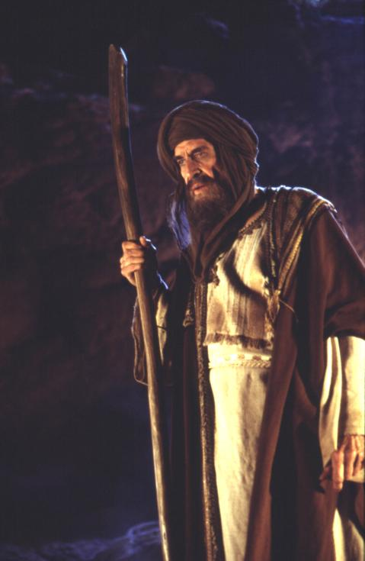
Abraham – Father of Faith
Part 1 – Background & Call

Slide 2
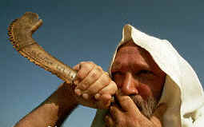
Abraham’s Family Background
Genesis 11:25 – 12:9 NKJV 25 After he begot Terah, Nahor lived one hundred and nineteen years, and begot sons and daughters. 26 Now Terah lived seventy years, and begot Abram, Nahor, and Haran. 27 This is the genealogy of Terah: Terah begot Abram, Nahor, and Haran. Haran begot Lot. 28 And Haran died before his father Terah in his native land, in Ur of the Chaldeans. 29 Then Abram and Nahor took wives: the name of Abram’s wife was Sarai, and the name of Nahor’s wife, Milcah, the daughter of Haran the father of Milcah and the father of Iscah. 30 But Sarai was barren; she had no child.

Slide 3
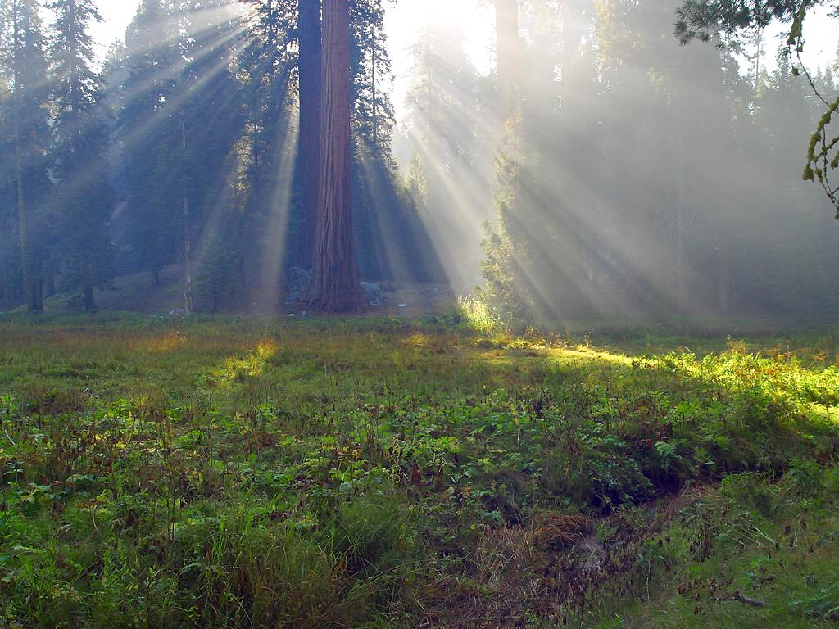
The Pilgrims Set Out
Genesis 11:31,32 And Terah took his son Abram and his grandson Lot, the son of Haran, and his daughter-in-law Sarai, his son Abram’s wife, and they went out with them from Ur of the Chaldeans to go to the land of Canaan; and they came to Haran and dwelt there. 32 So the days of Terah were two hundred and five years, and Terah died in Haran.

Slide 4
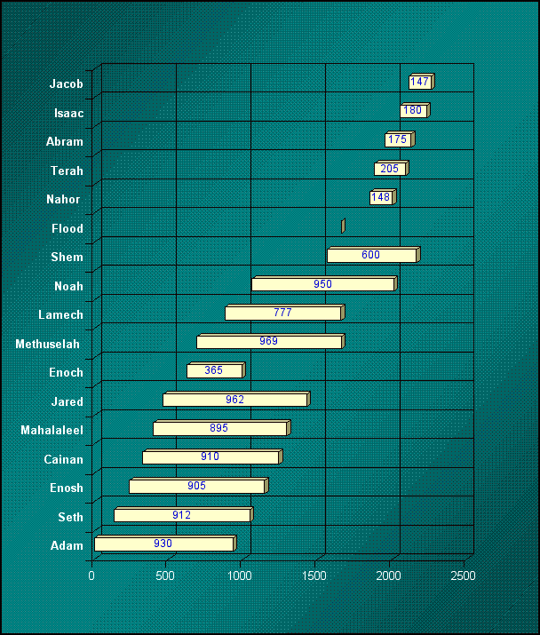
Timeline
Birth: 2161 BC
Life overlapped with Noah & Shem
Entrance Into Canaan: 2086 BC

Slide 5
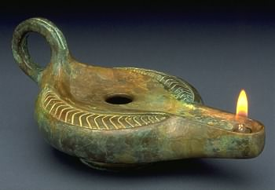
The Abrahamic Religions
Islam, Judaism and Christianity all honor Abraham
For Jews he is Father Abraham.
For Christians - Father of Faith.
In the Koran, God says, “I will make thee an Imam to the Nations,” or leader to all people
All three religions claim to the the “religion of Abraham”.
Today’s political problems revolve around the question “who are the true children of Abraham” ?

Slide 6
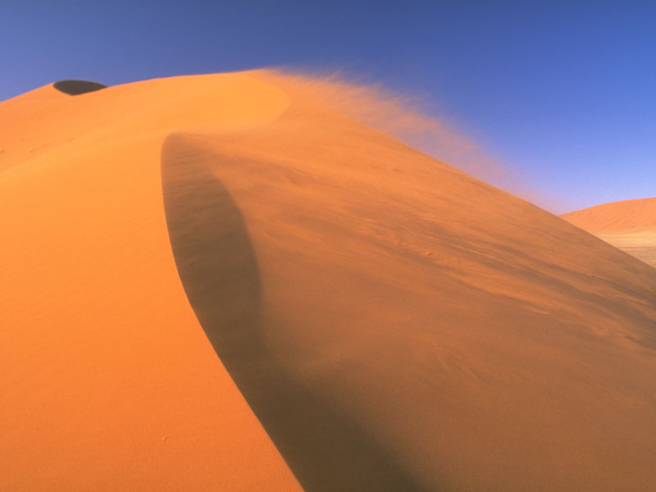
Abraham – The First Monotheist
Monotheist – believes in just one God who created all things and judges all things.
Does not worship idols
Abraham was very opposed to idols and would destroy them.

Slide 7
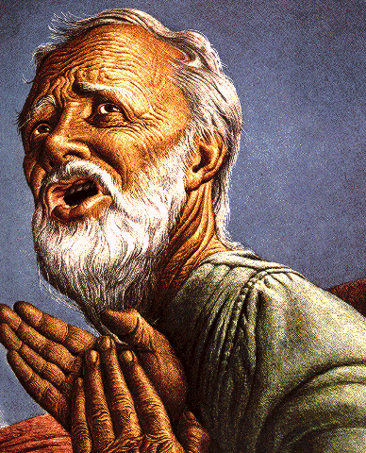
The Calling Of Abraham
Genesis 12:1-3 Now the LORD had said to Abram: Get out of your country, from your family and from your father’s house, to a land that I will show you.
I will make you a great nation; I will bless you and make your name great; and you shall be a blessing.
I will bless those who bless you, and I will curse him who curses you; and in you all the families of the earth shall be blessed.”

Slide 8
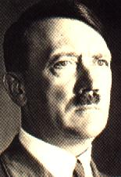
Nations Rise & Fall On How They Treat The Jews
Babylonians
Assyrians
Napoleon
Nazi Germany
Czarist Russia
Communist Russia
Rise & Fall Of British Empire

Slide 9
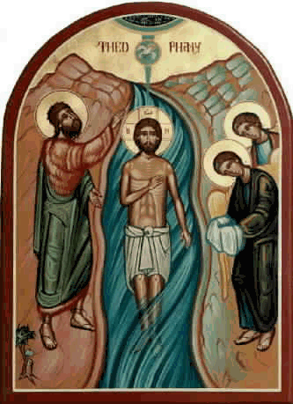
The Blessings of Abraham
Galatians 3:6-9, 28,29 MKJV Even as Abraham believed God, and it was counted to him for righteousness. (7) Therefore know that those of faith, these are the sons of Abraham. (8) And the Scripture, foreseeing that God would justify the nations through faith, preached the gospel before to Abraham, saying, "In you shall all nations be blessed." (9) So then those of faith are blessed with faithful Abraham….

Slide 10

Heirs Of Abraham
Galatians 3:28,29 There cannot be Jew nor Greek, there is neither bond nor free, there is no male nor female; for you are all one in Christ Jesus. (29) And if you are Christ's, then you are Abraham's seed and heirs according to the promise.

Slide 11
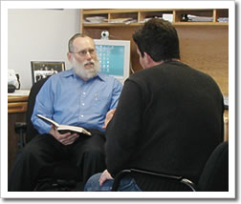
Christians & Abraham
We inherit the blessings of Abraham
The Holy Spirit is God’s greatest blessing to us.
Galatians 3:14 MKJV so that the blessing of Abraham might be to the nations in Jesus Christ, and that we might receive the promise of the Spirit through faith.

Slide 12
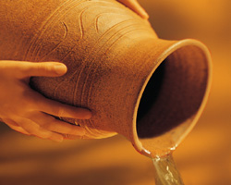
Blessings
Change Reality To Be In Our Favor
Be Fruitful!
Multiply!
Have Dominion!

Slide 13
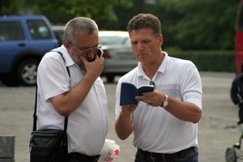
Blessed To Be A Blessing!
Abraham was blessed so he could be a blessing to all the nations of the earth.
Christians are blessed so they can bless those around them.
Sharing the gospel, acts of mercy and grace, kindness, giving, prayer, intercession

Slide 14
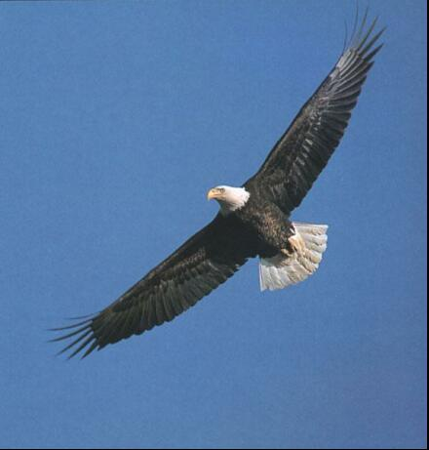
Abraham’s Obedience
Genesis 12:4,5 4 So Abram departed as the LORD had spoken to him, and Lot went with him. And Abram was seventy-five years old when he departed from Haran. 5 Then Abram took Sarai his wife and Lot his brother’s son, and all their possessions that they had gathered, and the people whom they had acquired in Haran, and they departed to go to the land of Canaan. So they came to the land of Canaan.

Slide 15
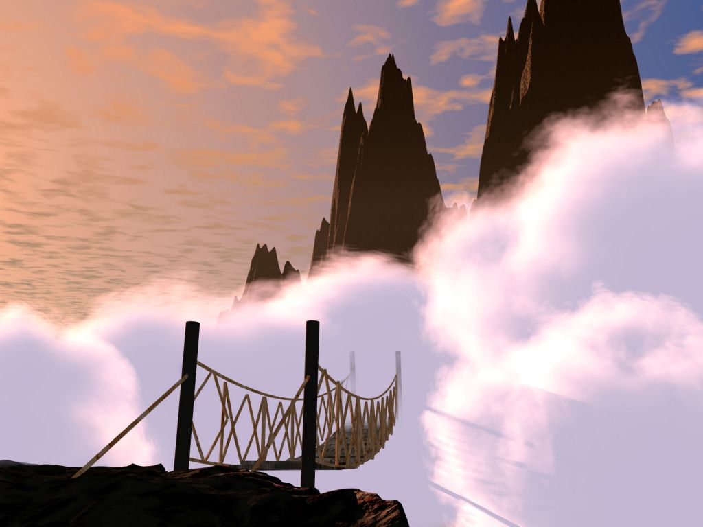
The Obedience Of Faith
Hears God
Obeys God
Accepts Risk
Does Not Ask For Everything To Be Perfectly Clear

Slide 16
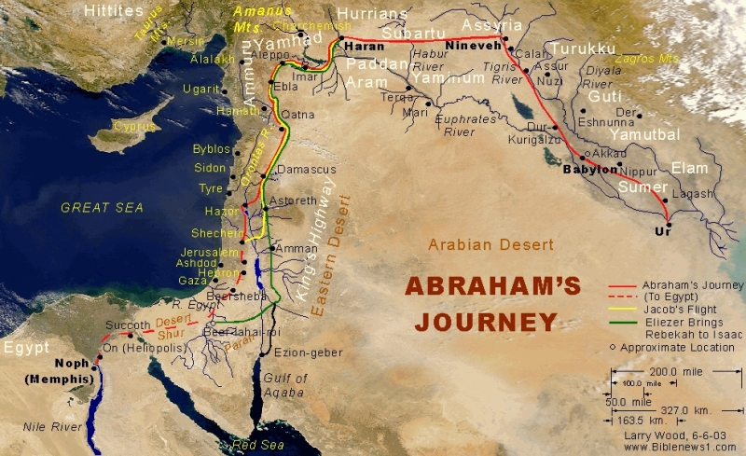
Abraham’s Journey

Slide 17
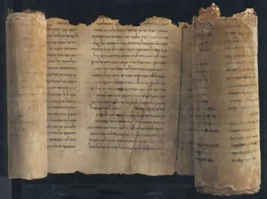
To Your Descendants…
Genesis 12:6-9 6 Abram passed through the land to the place of Shechem, as far as the terebinth tree of Moreh. And the Canaanites were then in the land. 7 Then the LORD appeared to Abram and said, “To your descendants I will give this land.” And there he built an altar to the LORD, who had appeared to him. 8 And he moved from there to the mountain east of Bethel, and he pitched his tent with Bethel on the west and Ai on the east; there he built an altar to the LORD and called on the name of the LORD. 9 So Abram journeyed, going on still toward the South.

Slide 18
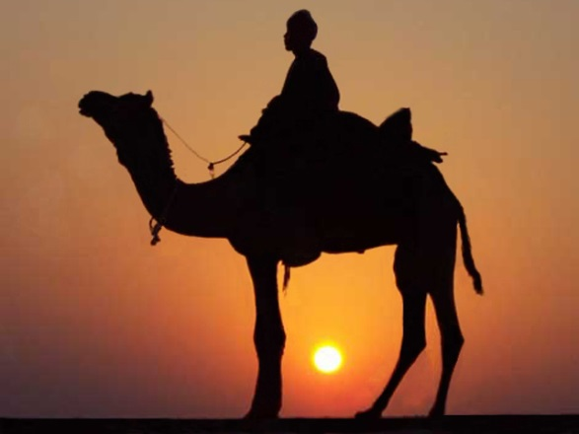
Israel Was Given To The Jews
Genesis 13:14-18 MKJV Lift up your eyes now and look from the place where you are northward and southward, and eastward and westward. (15) For all the land which you see I will give to you, and to your seed forever. ..Rise up and walk through the land, in the length of it and in the breadth of it, for I will give it to you.

Slide 19

God Responds To Faith
God gave all these things to Abraham because Abraham had faith.
According to your faith be it unto you…
(Matthew 8:5-10, 9:29)
God’s promise gives rise to faith.
Faith pleases God who commands a blessing.
Patience inherits the blessing.

Slide 20

Abraham’s Positive Focus
Abraham did not FIGHT the many false religions around him.
Abraham did not FLEE and live in a monastery.
Abraham focused on God and FOLLOWED Him and attained mastery over his life and situation.
Abraham focused on being a blessing!

