Slide 1
African Religions

Slide 2
Guiding Questions
What type of religious beliefs do native Africans generally have?
In what types of gods and spirits do they believe?
What are some common rituals that native African religions include?
Why have some African Americans attempted to get back to these traditions?

Slide 3
Background
Second largest continent
3,000 ethnic and linguistic groups
Over 700 million people
19th and early 20th centuries --- carved into colonies (Age of Imperialism)
Last 50 years, colonialism has nearly vanished

Slide 4
Significance
African nations control many valuable natural resources that industrialized nations need.
Leaders of industrialized nations must learn to understand and work with Africans on political and business levels if there are to be peace and prosperity in the world.
African Americans have acquired powerful voices in their own societies.
Increasing interested in their African heritage.

Slide 5
Native Religions of Africa
Not able to speak with authority about a single religion, theology, or ritual system.
Few written records; oral tradition passed on by griots (singing, story tellers).
The religious beliefs and customs of one group are not universally shared by others.
Great variety of beliefs and practices in African tradition

Slide 6
The High God
Belief in a Supreme High God who created the world and then withdrew from active participation in it is common in polytheistic religions around the world
Belief shared by many African people
Most African religions are polytheistic in day-to-day practice
Beyond all minor gods, goddesses, spirits and ancestors, exists one High God, who created and in some sense still governs the universe.

Slide 7
High God Continued
Most believe that this God is too distant and has limited contact with daily operation of human life
Can be appealed to in times of great crisis
Yoruba tribe of West Africa – Olorun (High God) – He assigned creation to his eldest son Obatala, who failed to complete the task. Olorun passed it on to Odudua, but he failed too. Olorun oversaw creation himself by assigning smaller tasks to various orisha, lesser deities. Olorun then retired to the heavens and has little contact with people.

Slide 8
Nuer Tribe of Sudan: Exception with the High God
Kwoth Nhial (High God) continues to play an active role in the lives of humans
He rewards the just, punishes the wicked, and blesses those who uphold the moral values of the Nuer people
He loves and cares for His creation and is asked for blessing and assistance

Slide 9
High God
Most Africans believe the High God is too powerful to be appealed to for daily problems. He really isn’t interested.
Lesser deities or orishas control day-to-day occurrences
Even Nuer have a host of lesser deities

Slide 10
The Lesser Spirits
Earth, water, and sky contain spiritual life similar to human kind
Mountains, forest, rivers and streams, many plants and animals
Storms, lightening, thunder
Spirits can be beneficial or harmful
They are influenced by prayer, flattery, and sacrifice.
They have a direct influence on human life so Africans seek to understand them and seek their favor

Slide 11
Lesser Spirits Continued
They can be male or female.
Earth is regarded as a mother goddess.
Ex. Ashanti prayer for the Earth Mother:
Earth, while I am yet alive,
“It is upon you that I put my trust
Earth who receives my body,
We are addressing you,
And you will understand.”

Slide 12
Water: A Sacred Element
Water sacred to many cultures.
When life depends on water in the form of rainfall, rivers, and streams, water takes on a life of its own.
Africans use water for rituals such as the washing of the newborn and the dead. It must come from a source of sacred, living water. It must not be heated or boiled, or treated with chemicals as that would kill the spirit in it.

Slide 13
Ancestors
Most commonly recognized spiritual forces in Africa
Continue to live on in the spirit world and unlike the High God take an active interest in the well-being of those who live in the world.
Ancestors are consulted before the birth of a child, beginning of an agricultural season, prior to battle, or political conflicts.
In some tribes, no one may eat the first fruit of the harvest until it has been offered to the ancestors.

Slide 14
Ancestors Continued
While in China and Japan ancestors are loved and respected, in Africa they are feared.
They can be capricious (do whatever they want, fickle) and unpredictable.
Ancestors can do whatever they want.
Despite many offerings, they can turn on you or the community.
May cause sickness, death, childlessness (a major curse)
Ancestors more than the gods are the enforcers of the moral codes of the tribe.

Slide 15
Ancestors Continued
Gifts and sacrifices offered to them
Belief that ancestors own the land and its products
Portion of harvest must be offered to them
When animals are born, some must be slaughtered and offered to ancestors to ensure their blessings.
Modern Africans living in cities, return to their native villages to offer sacrifices

Slide 16
Communication with Ancestors
They can speak to you in dreams
They can send signs to you in nature that can be interpreted with the help of diviners, spiritual specialists
Signs are sometimes interpreted by looking at the organs of sacrificed animals
Diviners can also contact ancestors for help with knowing the future.

Slide 17
Tallensi Tribe: Example of Pleasing Ancestors
Tallensi man named Pu-eng-yii left his family and settled with a rival group to earn more money.
Auto accident, serious leg injury
Diviner told him that ancestors were angry; told him that his ancestors had intended to kill him but failed to follow through on the plan.
Solution: He had to make restitution (monetary compensation) for leaving his family, severe ties with newly adopted family, and return home.

Slide 18
Sacrifice
Pouring our a bit of their drinks or tossing away bits of their food (similar to when you drop a hot dog at a BBQ – an offering to the backyard gods).
Simple act that pleases spirits and ancestors
Sacrifice of animals for more serious occasions – dogs, birds, sheep, goats and cattle

Slide 19
Animal Sacrifice and Other Sacrifice to Appease Gods
Blood poured out on ground or altar
Before a battle or election campaign or when there’s a serious drought or in times of illness
Prior to engaging in a dangerous hunt
Ogun – Yoruba god of iron. In modern day, he is a god of machinery.
People who drive automobiles in dangerous streets decorate their cars with his symbols

Slide 20
Partaking in the Sacrifice: Communion with Spirits
After animal is sacrificed, a portion is cut and roasted or boiled and offered to the deity. A portion is consumed by those in the sacrifice. This unites them with the spirits.
A long tradition with world religions to build spiritual bond
Consider Christianity and Holy Communion

Slide 21
Rituals and Rites of Passage
Important parts of life marked with rituals
Rites of passage regulated by religious functionaries
Birth of child – time for great rejoicing; great blessing from the world of the spirits
Twins – not a blessing, dangerous and evil. Sometimes, regarded that women had two men and each were the fathers
Occasionally, one or both are killed

Slide 22
Rituals and Rites of Passage continued
In many African societies, including the Ashanti, children are not named for the first week of life.
Because of high infant mortality, African tribes believe that it may be a trickster god who wants to trick people into loving it only to leave them
After they make it through a week, then much love is lavished on the child

Slide 23
Rituals and Rites of Passage
After naming the child, there is a ceremony of gently throwing the child in the air and introducing it to the moon, which is deity (The Gu of the Benin)
The Basuto of South Africa say: “There is your father’s sister.”
Circumcision is sometimes done after child birth
Most of the time, it is reserved for puberty

Slide 24
Circumcision
Circumcision is a religious requirement for Jews and Muslims and is significant to many Christians
For Africans, circumcision is reserved for when young men reach puberty
Severity can vary from a minor cuts that have no major threat to genital mutilation which can be life threatening
Usually no anesthetic

Slide 25
Circumcision
The man who performs the ceremony may wear a mask representing the ancestors. Represents passage into adulthood
Initiate is expected not to flinch or cry out in pain
Female circumcision is practiced in some African societies although there is growing opposition around the world
As with male circumcision, no major medical reason for doing it but supposed to control their erotic desire

Slide 26
Rituals and Rites of Passage
Adulthood – responsibilities and privileges
Leaving the family home
Marriage is very important; so is bearing children; a childless couple will go to great lengths to discover why they are childless with the help of a diviner
Death – rituals to make the deceased comfortable; fear that their ghosts will return to haunt the living; widows fear that husbands will return to cause their wombs to die

Slide 27
Marriage Rituals
Virginity is highly prized especially among young women
Some tribes sew part of the female genitalia when the girls are small for the future husband
Frequently, husband may not have sexual relations with wife while she is pregnant and nursing, which altogether may be two years.
Polygamy is practiced by elites of many traditional African tribes. Several wives and separate houses

Slide 28
Rituals for the Dead
Africa’s warm climate ---dead buried quickly
Sometimes embalming and mummification; occasionally offered to hyenas
Burial with objects that will make their time in spirit world more enjoyable
In some African societies, illness, misfortune, death don’t just happen. Often the result of witchcraft or foul play
In past, dead were allowed to identify their killers. If their hands, dropped as they passed someone in the community or if they fell near someone as they were being carried, that person would have to defend his/her innocence.

Slide 29
Death and World of Spirits
Most tribes do not have a system of eschatology or concepts of judgment and retribution after death.
Dead simply move into the world of the spirits and continue to be interested in the world of the living.
LoDagaa people of Ghana – exception
Crossing a river with a ferryman (similar to Greek idea of River Styx and Hades), easy if you were good, difficult and up to three years if you were bad, making up for your evil

Slide 30
Religious Leaders
Not a major need for religious leaders; many activities can be performed by individuals – offerings of food and drinks to ancestors
No complex theology or rituals like in Hinduism, Judaism, or Christianity
No requirement of a priesthood and temples are very rare
Some communities in West Africa do have temples and altars; people trained in African mythology, taboos, and rituals to prepare them

Slide 31
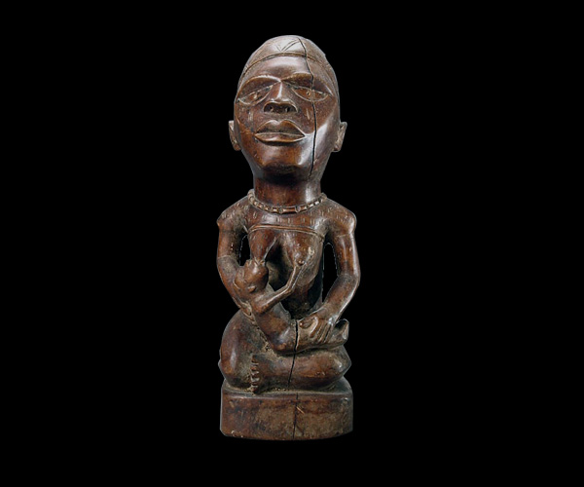
Mother and Child
Mother and Child
Kongo people

Slide 32
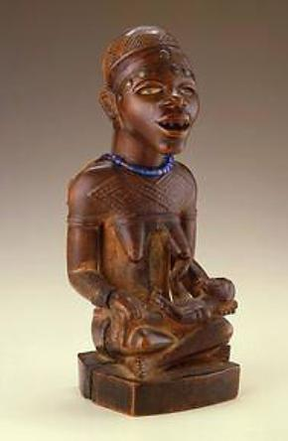
What does this represent?
Why is it significant?

Slide 33
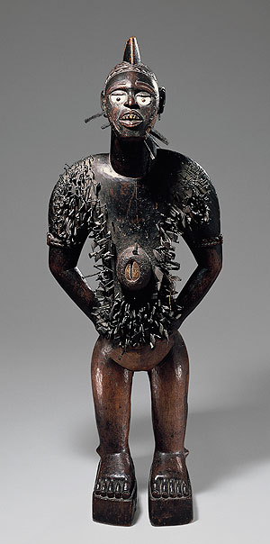
Nail Figure (Nkisi N’Kondi)

Slide 34
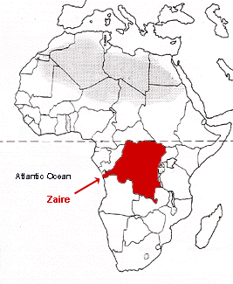
Nkisi Nkondi
Nkisi – spirit
Nkondi – the figure itself, derived from the the word konda “to hunt”
Maintains the well-being of a Kongo village
Curing illnesses, protecting villages, sealing agreements, destroying enemies.

Slide 35
Nkisi Nkondi
Opening in the mouth or stomach for sacred objects (herbs, animal fur, bones, etc.)
Spiritual specialist determines what to put in
Inserting nail or blade like signing agreement
Mirrors for eyes and to cover opening – reflects the person before it

Slide 36
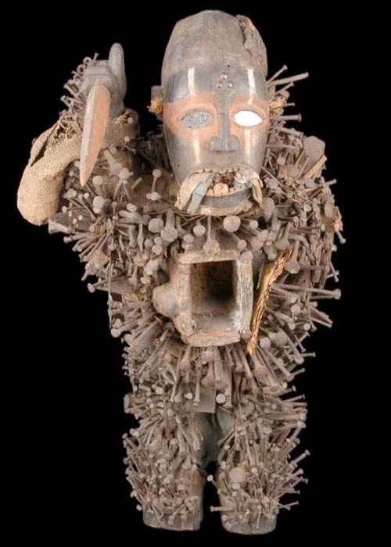
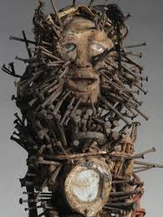

Slide 37
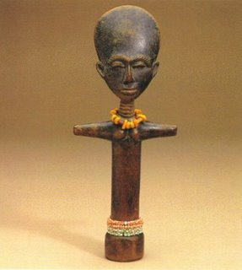
Akua’ba
By Osei Buson
Used to help women who are having difficulty conceiving

Slide 38
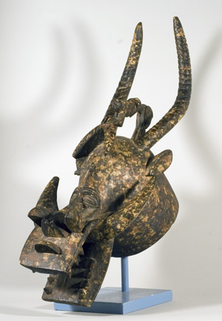
Senufo masks
Used by masqueraders during funeral processions
Guide the spirit of the deceased toward the land of the spirits
What animal images can you see?

Slide 39
Guiding Questions
What type of religious beliefs do native Africans generally have?
In what types of gods and spirits do they believe?
What are some common rituals that native African religions include?
Why have some African Americans attempted to get back to these traditions?

Slide 40
Non-Native African Religions

Slide 41
African Religions Today

