Slide 1
Worship Heavenly Father Diligently

Slide 2
Elijah and the False Prophets of Baal
“Lesson 34: Elijah and the False Prophets of Baal,” Primary 6: Old Testament, (1996),149

Slide 3
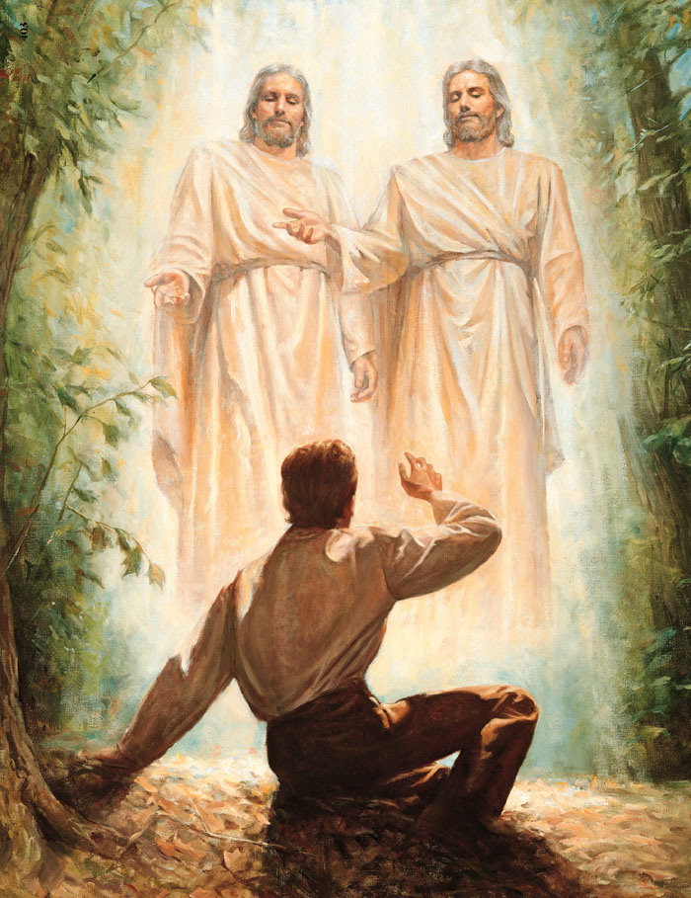
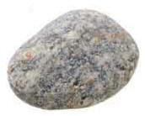
Who do you pray to when you need help with a problem?
Why wouldn’t you pray to a rock?

Slide 4

When Joseph Smith needed help, he prayed to our Heavenly Father in the name of Jesus Christ, and his prayer was answered.

Slide 5
Like Joseph Smith, we should pray to Heavenly Father in the name of his Son, Jesus Christ.
Heavenly Father has the power to hear our prayers and answer them.

Slide 6
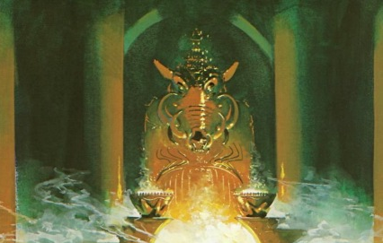
A rock cannot hear or answer prayers. It has no power, no life, no personality, and no feelings, and it cannot give or show love.
We will learn about how Elijah tried to teach the Israelites to worship and pray to Heavenly Father instead of nonliving objects or graven images.

Slide 7
Elijah and the False Prophets of Baal

Slide 8
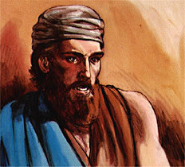
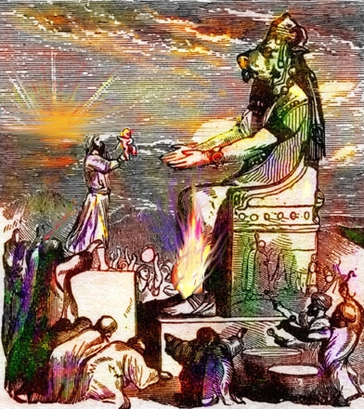
Elijah was a prophet of God. He had the power of the priesthood and the power of God.
Many wicked people in the kingdom of Israel worshiped an idol named Baal. There were 850 priests of Baal. They were wicked priests.

Slide 9
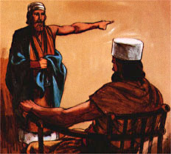
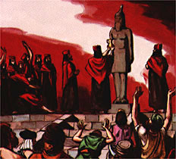
The prophet Elijah talked to King Ahab. He told Ahab to bring all his people to a mountain. Elijah wanted the wicked priests of Baal to come, too.
Elijah said they must choose to worship God or Baal. They could not worship both. It is wicked to worship idols.

Slide 10
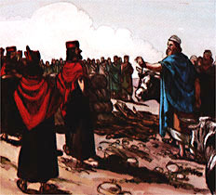
Elijah wanted to show the people that idols have no power. He asked for two bulls for a sacrifice and some wood.
Elijah gave a bull and some of the wood to the priests of Baal. He kept a bull and some wood for his sacrifice.

Slide 11
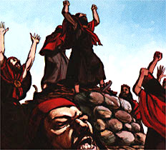
Elijah told the priests not to burn the sacrifice. He told the priests to pray to their idol. He said Baal must burn the sacrifice.
The wicked priests prayed to Baal all morning. They jumped on the altar and shouted. Baal did not answer. Baal was only an idol.

Slide 12
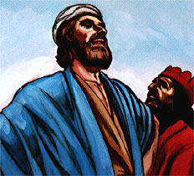
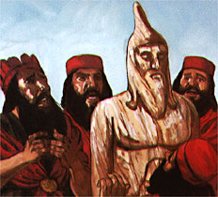
Elijah told the priests to pray louder. He made fun of them. He said their idol must be sleeping.
The wicked priests prayed louder and louder. They prayed all day. Baal did not answer. The priests’ sacrifice did not burn.

Slide 13
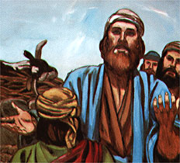
Elijah told the people to come close to him. Elijah told them he would pray to God.
He said God would send fire down from heaven. God would burn his sacrifice.
Elijah built an altar of stones. He dug around the altar. Elijah put the bull and some wood on the altar.

Slide 14
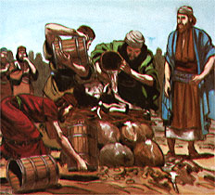
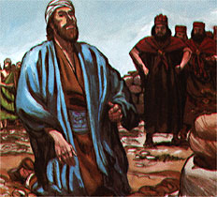
Elijah asked men to bring twelve barrels of water. He told them to pour the water on the sacrifice. They poured the water on the sacrifice.
Elijah prayed to God. Elijah wanted the people to worship God. He asked God to help him.

Slide 15
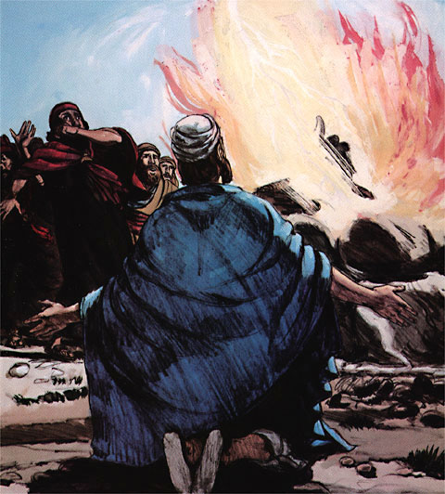
God sent fire down from heaven. The fire burned Elijah’s sacrifice. It burned the wood and the stones. It dried up all the water.
The people saw the power of God. They knew the idols had no power. All the wicked priests of Baal were killed.

Slide 16
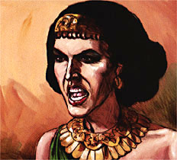
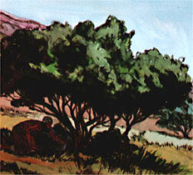
King Ahab had a wicked wife named Jezebel. Jezebel heard what Elijah did. She sent a man to Elijah. The man said Jezebel would kill Elijah.
Elijah went into the wilderness so Jezebel could not kill him. He found a place to hide and slept under a tree.

Slide 17
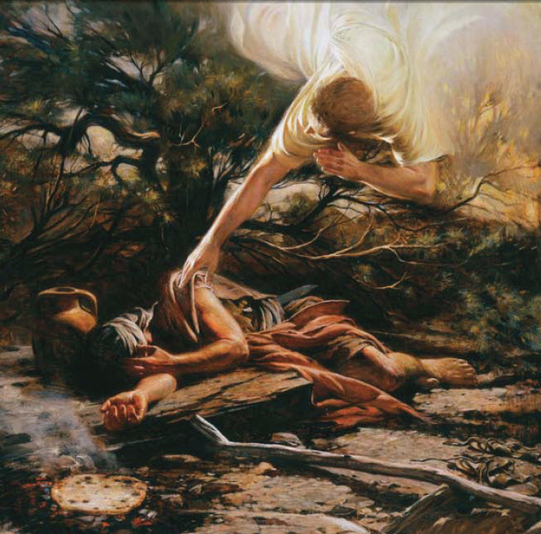
An angel came to Elijah and gave him food and water. Elijah ate and lay down again.
The angel came again. He told Elijah to eat more and said Elijah would travel a long way. Elijah ate and drank again.

Slide 18
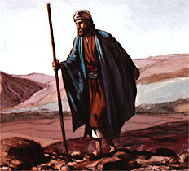
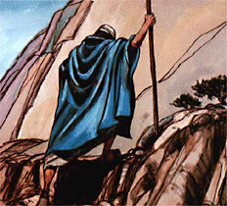
Elijah traveled 40 days and 40 nights. He fasted. He did not eat or drink.
Elijah went to the mountain where Moses had seen the burning bush.

Slide 19
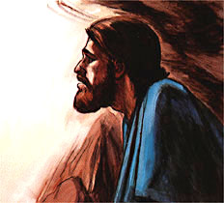
Elijah lived in a cave in the mountain. God asked him what he was doing there. Elijah said the people did not obey God’s commandments.
They killed God’s prophets. Elijah was the only prophet who had not been killed. The people wanted to kill him, too.

Slide 20
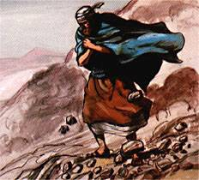
God told Elijah to stand on the mountain. A strong wind blew. It was so strong it broke rocks into pieces.
After the wind there was an earthquake. Then there was a fire.
After the fire Elijah heard a quiet voice. He knew it was the voice of Jesus Christ.

Slide 21
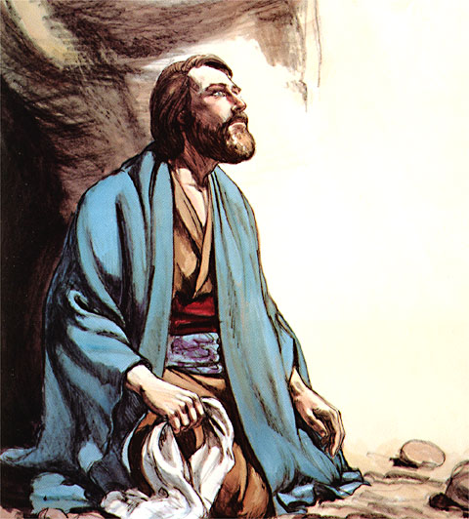
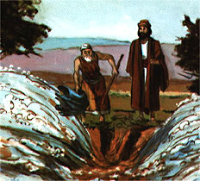
Jesus came to Elijah and talked to him.
Jesus said he would choose a new prophet named Elisha. Elisha had followed Elijah for many years.
Elijah and Elisha went to the Jordan River.
Elijah hit the water with his coat. The water divided. They walked through on dry land.

Slide 22
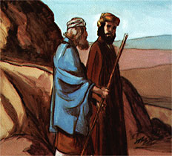
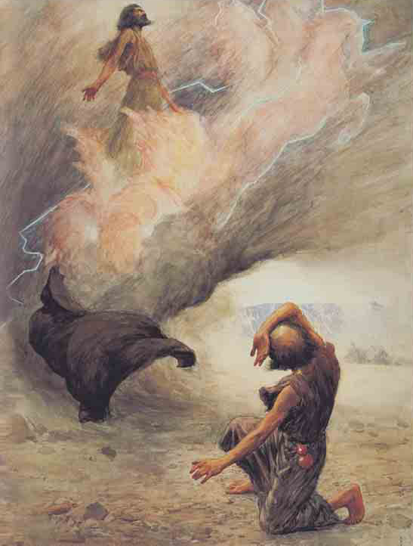
Elijah and Elisha walked and talked together. Elisha wanted the Holy Ghost to be with him.
Elisha became the prophet. He had the power of the priesthood. He had the power of God.
As Elijah went to heaven, he dropped his coat on the ground. Elisha picked it up.

Slide 23
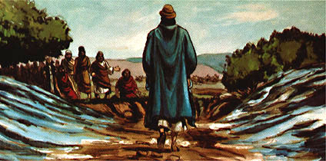
Elisha went back to the Jordan River.
He hit the water with Elijah’s coat. The water divided. Elisha walked through on dry land.
Some righteous Israelites met him. They knew Elisha was the new prophet.

Slide 24
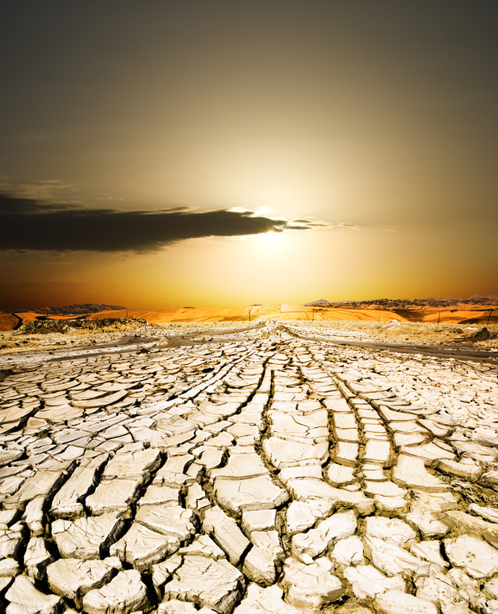
The prophet Elijah had sealed the heavens so it would not rain. Whom did Ahab blame for the drought?
Let’s read 1 Kings 18:17
What did Elijah say was the cause of the drought?
Let’s read 1 Kings 18:18

Slide 25
Ahab and his wife, Jezebel, had led the Israelites away from Heavenly Father and were worshiping a false god, an idol named Baal (see “Baal” in the LDS Bible Dictionary [p. 617]).
The drought had caused a great famine in the land, and Ahab and his people were having a hard time finding water for their crops and animals.

Slide 26
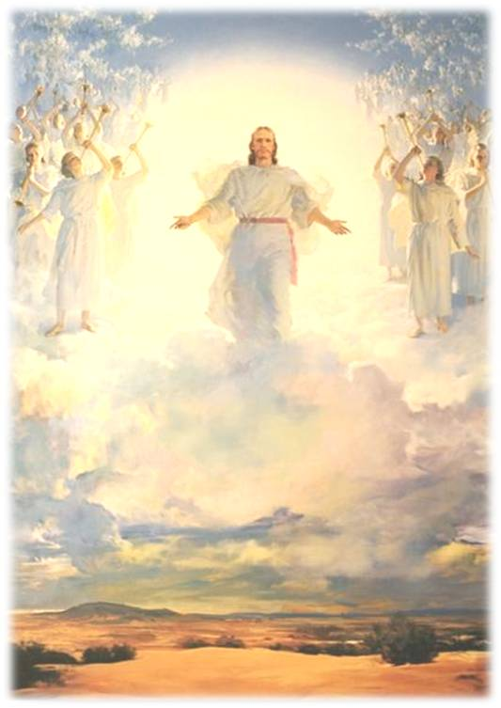
Why does the Lord sometimes allow drought and other natural disasters to happen?
Sometimes bad things are a normal part of life, but they may also warn us to repent and worship Heavenly Father.
They may also be signs that warn us to prepare for the Second Coming.

Slide 27
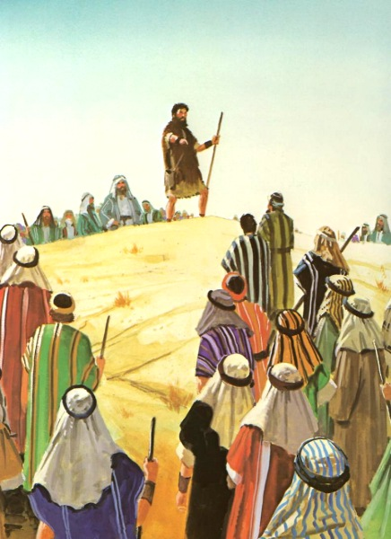
After Elijah had gathered together the people of Israel and the false prophets, what question did he ask the people?
Let’s read 1 Kings 18:21
What did Elijah want the people to do?
He knew they could not serve both Baal and the Lord and that he wanted the Israelites to decide whom they were going to worship.

Slide 28
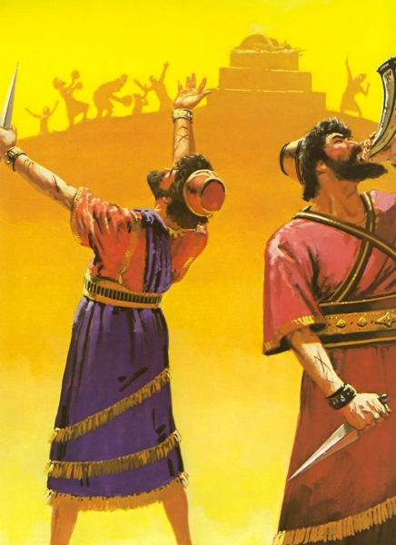
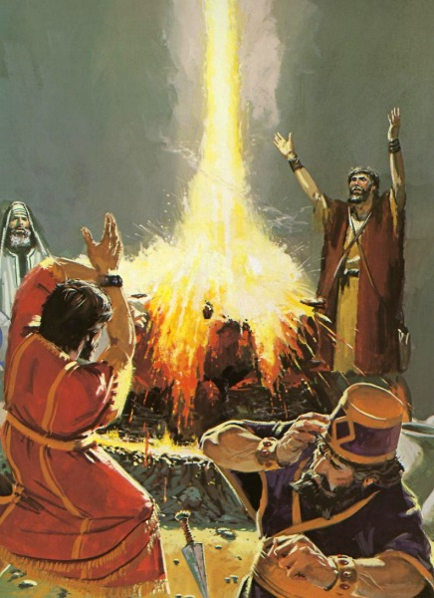
Role Play Time!
Let’s role play the story of Elijah and the priests of Baal.
Enrichment Activity #1

Slide 29
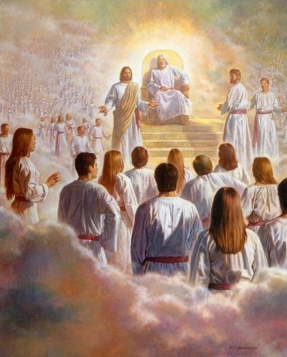
Why is it important for us to decide now to worship Heavenly Father?
How do we worship Heavenly Father?

Slide 30
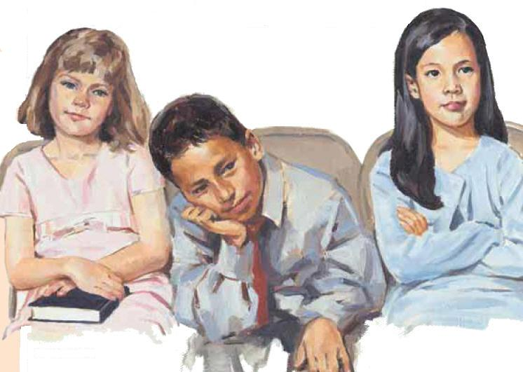
Let’s divide the class into groups with two or three in each group.
You will have two or three minutes to write down as many things as you can to answer the following question: “What are some things we do to worship Heavenly Father?”
What ideas did you come up with?
Enrichment Activity #2

Slide 31
Why is it important to worship Heavenly Father every day and make him an important part of our lives?
Write down some of these ideas on a piece of paper to take home and share with your family.
Enrichment Activity #2

Slide 32
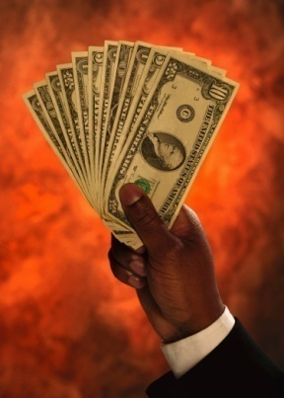
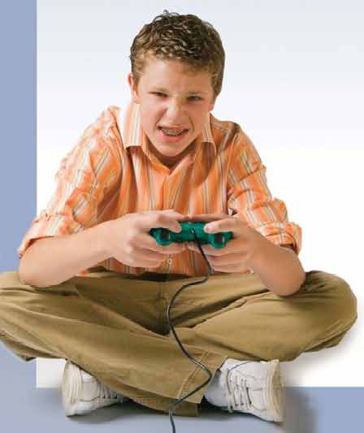
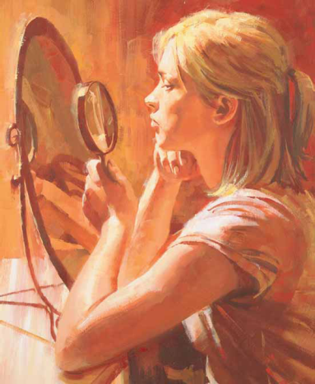
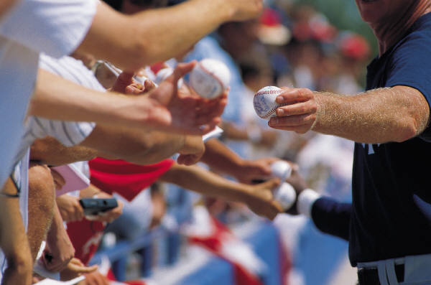

What do people worship today, perhaps without even realizing they are doing so?

Slide 33
I’m going to draw a big rock on the board.
Take turns choosing one of the word strips and attach it to the rock.
How do some people place too much value on such things?
What can we do to avoid worshiping worldly things or making them too important in our lives?
Enrichment Activity #5

Slide 34
How can we put Heavenly Father and what he wants us to do first in our lives?
Let’s memorize a part of 1 Kings 18:21: “How long halt ye between two opinions? if the Lord be God, follow him.”
Is it important to decide now to always worship Heavenly Father and to not allow other things to pull us away from him?
Enrichment Activity #5

Slide 35
We worship what is most important to us.
This is why the Savior said, “Wherefore, seek not the things of this world but seek ye first to build up the kingdom of God, and to establish his righteousness” (Matthew 6:33, footnote a).
We should place Heavenly Father first in our lives so we will worship him. If anything else is more important to us, it is an idol or false god.

Slide 36
What contest did Elijah suggest to prove to the people whom they should worship?
Let’s read 1 Kings 18:23–24
How many prophets of the Lord were there that day?
How many prophets of Baal?
Let’s read 1 Kings 18:22
Why did Elijah have more power than the prophets of Baal, even though he was outnumbered?

Slide 37
What happened when the false prophets called upon Baal?
Let’s read 1 Kings 18:29
Why didn’t Baal answer the false prophets’ prayers and send down fire?

Slide 38
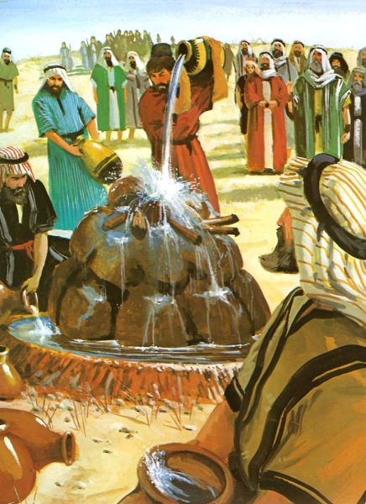
When it was Elijah’s turn, why do you think he made it more difficult for the sacrifice to burn?
Let’s read 1 Kings 18:32–35
He wanted to prove without question the power of God.

Slide 39
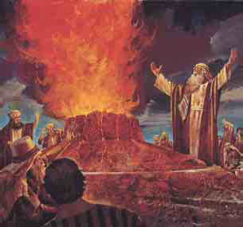
What happened when Elijah prayed to Heavenly Father?
Let’s read 1 Kings 18:36–38
What happens when we pray to Heavenly Father?
He hears our prayers and answers them according to our faith and his will but our answers do not usually come as dramatically as Elijah’s.

Slide 40
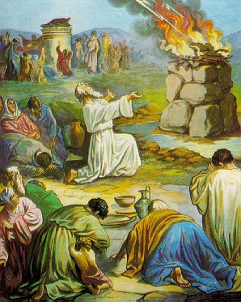
What did the people do when the contest was over?
Let’s read 1 Kings 18:39

Slide 41
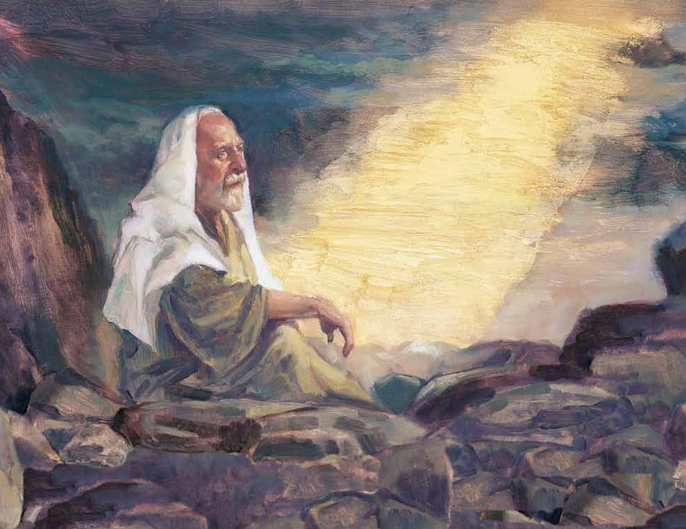
Although it began to rain and the drought was over, Jezebel was angry with Elijah and vowed to kill him (see 1 Kings 19:2).
Elijah fled into the wilderness, and while he was there the Lord spoke to him. How did the Lord talk to Elijah?
Let’s read 1 Kings 19:11–13

Slide 42
How do we receive messages from the Lord?
We pray to Heavenly Father in the name of Jesus Christ, and our answers come through the Holy Ghost, usually as a peaceful thought in our minds or a warm feeling in our hearts.
By praying to Heavenly Father and listening for and obeying the still, small voice of the Holy Ghost, we are worshiping our Heavenly Father.

Slide 43
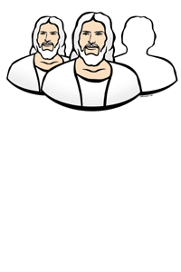
The First Article of Faith
We believe in God, the Eternal Father, and in His Son, Jesus Christ, and in the Holy Ghost.
Enrichment Activity #3

Slide 44
The members of the Godhead are three separate personages but that they work together as one to help us.
Heavenly Father is the Father of our spirits. Before we were born on earth, Heavenly Father presented to us the plan of salvation so we could live on earth and become like him. He directed the creation of the earth. We pray to Heavenly Father.

Slide 45
Jesus Christ is the Only Begotten Son of Heavenly Father. He created the earth under the direction of Heavenly Father.
He directs the work of Heavenly Father on the earth through living prophets. Jesus is the head of our Church. In the Old Testament, Jesus is known as Jehovah or the Lord.

Slide 46
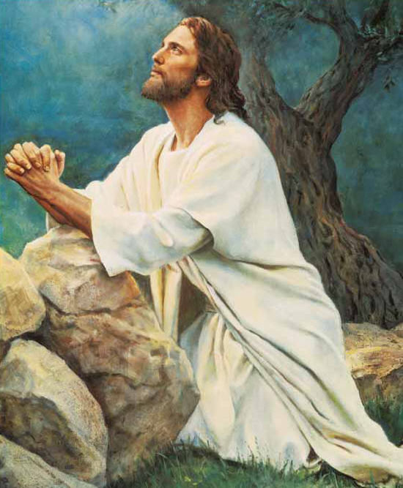
Through the Atonement of Jesus Christ, we will be resurrected and have the opportunity to repent and return to Heavenly Father. We pray to Heavenly Father in the name of Jesus Christ.

Slide 47
The Holy Ghost is a personage of spirit. He does not have a physical body.
When we are baptized, we receive the gift of the Holy Ghost, which is the right to have his constant help and comfort in our lives. If we are worthy, Heavenly Father answers our prayers and speaks to us through the Holy Ghost. The Holy Ghost speaks in a still, small voice to our hearts and minds.

Slide 48

Heavenly Father
Jesus Christ
Holy Ghost
Let’s review the roles of the three members of the godhead.
I’m going to put their titles up on the board.
Choose a wordstrip with a role on it and put it under the correct personage.
Enrichment Activity #4

Slide 49
Heavenly Father
Jesus Christ
Holy Ghost
Savior
Father of our spirits
Still, small voice
Jehovah
Presented the plan of salvation
Created the earth
Comforter
Directed the creation of the earth
Atoned for our sins
Testifier
Head of the church
God to whom we pray
Spirit of truth
Perfect example
Enrichment Activity #4

Slide 50
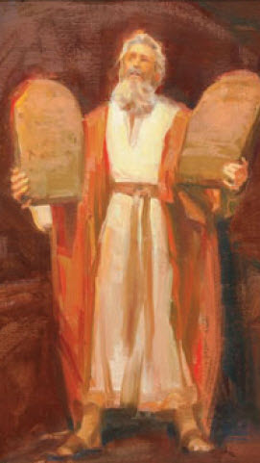
The first three of the Ten Commandments given by the Lord to Moses tell us how we should worship the only true God (see Exodus 20:3–7).
Enrichment Activity #6

Slide 51
Let’s read the following commandments:
How can following each commandment help us worship Heavenly Father?
  “Thou shalt have no other gods before me” (Exodus 20:3).
Enrichment Activity #6

Slide 52
Let’s read the following commandments:
How can following each commandment help us worship Heavenly Father?
  “Thou shalt not make unto thee any graven image, or any likeness of any thing that is in heaven above, or that is in the earth beneath, or that is in the water under the earth. Thou shalt not bow down thyself to them, nor serve them” (Exodus 20:4–5).
Enrichment Activity #6

Slide 53
Let’s read the following commandments:
How can following each commandment help us worship Heavenly Father?
  “Thou shalt not take the name of the Lord thy God in vain” (Exodus 20:7).
Enrichment Activity #6

Slide 54
During his life on earth Jesus Christ summarized the Ten Commandments into two great commandments, to love God and to love others.
Let’s read and discuss the first great commandment:
“Thou shalt love the Lord thy God with all thy heart, and with all thy soul, and with all thy mind. This is the first and great commandment” (Matthew 22:37–38).
Enrichment Activity #6

Slide 55
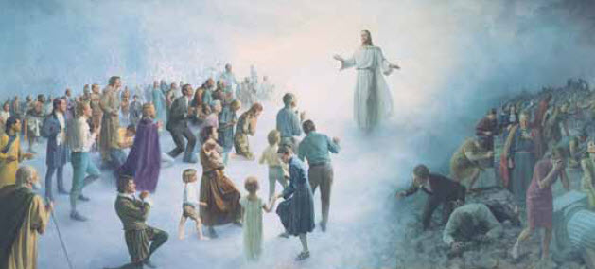
What do all of these commandments tell us about the importance of worshiping Heavenly Father?
Enrichment Activity #6

Slide 56
I Lived in Heaven
1. I lived in heaven a long time ago, it is true;
Lived there and loved there with people I know. So did you.
Then Heav’nly Father presented a beautiful plan,
All about earth and eternal salvation for man.
2. Father said he needed someone who had enough love
To give his life so we all could return there above.
There was another who sought for the honor divine.
Jesus said, “Father, send me, and the glory be thine.”
3. Jesus was chosen, and as the Messiah he came,
Conquering evil and death through his glorious name,
Giving us hope of a wonderful life yet to be—
Home in that heaven where Father is waiting for me.
Words and music: Janeen Jacobs Brady, b. 1934
© 1987 by Janeen Jacobs Brady. This song may be copied for incidental, noncommercial church or home use.
Enrichment Activity #7

Slide 57
I am grateful for the privilege of worshiping Heavenly Father and of praying to him.
I encourage each of you to decide now to worship Heavenly Father.
I challenge you to beware of worshiping false gods and to not let anything become more important than worshiping and obeying Heavenly Father and Jesus Christ.

Slide 58
Images and clipart are from lds.org, sugardoodle.net, Microsoft Office, and other websites indicating the images were in the public domain. The hymns, scripture story and lesson are primarily from www.lds.org.
Please do not use this presentation for commercial use. Feel free to alter the presentation for use in church or home to suit personal preference.
The presentation is intended to supplement, not replace, the lesson manual or scriptures. Teachers should refer to the manual, scriptures and other resources when preparing and conducting the lesson.

