Slide 1
HARMFUL TRADITIONAL PRACTICES AFFECTING THE HEALTH OF CHILDREN
a GROUP E PRESENTATION.

Slide 2
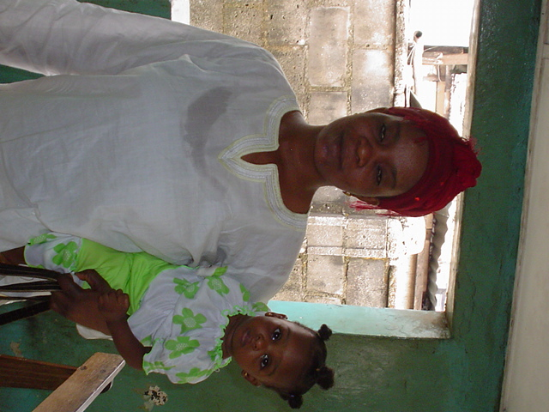
The african child
Who will save the African child
When tradition raises its head to ensnare
Who will save the African child
Since culture dictates what is right & wrong
Who will save the African child
When even mother cannot save herself
Who will save the African child….
Atoyebi Dolapo [2005]

Slide 3
outline
INTRODUCTION
TYPES OF HTPs
IMPLICATION
THE NIGERIAN SCENARIO
EFFORTS SO FAR
LESSONS LEARNED
RECOMMENDATIONS
CONCLUSION

Slide 4
INTRODUCTION
Harmful traditional practices are customary practices which are transgenerational, aimed at preserving cultural identity but which tend to have adverse consequences in terms of health and psychology of the recipient of such practices.
Hx of HTPs predates religion
Majority of cases in developing countries.

Slide 5
REASONS FOR PERSISTENCE OF HTPs
So deeply rooted
Take an aura of morality
No knowledge and understanding about risks of practice
Near absent/total lack of concern by government
Further ingrains the economic and political subordination of women and their inferior status

Slide 6
POSITIVELY IMPACTING TRADITIONAL PRACTICES
Healthy postpartum practices:
- Rest
- Cleanliness
- Love
- Good nutrition (Nigeria & Korea)
Long periods of breastfeeding in many parts of Africa, Latin America & Asia

Slide 7
TYPES OF HTPs
Female genital cutting
Early marriage & Dowry
Son preference
Withholding colostrum from newborn
Violence against the girl child
Nutritional taboos
Traditional birth practices
Severely restricted wt. gain in pregnancy
Primarily Africa
Africa, Asia, Middle East
Asia, Africa
China, Guinea Bissau
Africa, Asia
Africa
Africa
Philippines, France

Slide 8
TYPES OF HTPs
Postpartum nutritional restrictions
Facial scarring
Low levels of breastfeeding
Unfair widowhood rites
Dry vaginal practices & vaginal tightening
Stoning to death of abused child
Latin America
Africa
USA, France, other European countries
Kano (Nigeria)

Slide 9
FEMALE GENITAL CUTTING
All procedures (however crude) involving removal of part or all of the female external genitalia or other injury to the genital organs for cultural and non therapeutic reasons

Slide 10
REASONS FOR FGC
“Coming of age” of the girl child
Controlling of female sexuality ensuring virginity before; and chastity after marriage

Slide 11
PUBLIC HEALTH BURDEN
2 Million girls estimated to be at risk annually.
Practiced in at least 28 of 43 African countries + ethnic groups in Arabian peninsula, Malaysia and immigrant populations in Australia, Canada, England, France…
Prevalence varies from 98% in Somalia to 5% in Uganda
Risk of HIV/AIDS Amplified.

Slide 12
FORMS OF FGC
CIRCUMSICION OR SUNNA
EXCISION / CLITORIDECTOMY
INFIBULATION/PHARAONIC CIRCUMCISION
VARIANT – PITTA PATTA ABORIGENES

Slide 13
WHO 1995 CLASSIFICATION
TYPE I | Excision of clitoral hood with/without removal of part/all of clitoris
TYPE II | Removal of clitoris + part/ all of the labia minora
TYPE III | Infibulation – removal of part/all of the external genitalia + stitching or narrowing of vaginal opening leaving small hole for urine & menstrual flow
TYPE IV | Unclassified: all other operations in the female genitalia including pricking, piercing, stretching, cauterization, scraping (angurya cut), gishiri cut…

Slide 14
PROCEDURE
Payment prior in cash/kind to excisor
Typically lasts 10-30mins depending on type
No anaesthetic administered
Child is held down by 3-4 women
Wound is treated by applying mixtures of local herbs, earth, cow dung, ash or shea butter
In infibulation, child’s legs are bound together for up to 40 days in some cases
THE PARADOX OF FGC
Any complications arising from the procedure (including death) is attributed to evil spirits, the child’s ill fate etc – NOT THE EXCISORS RESPONSIBILITY!!!

Slide 15
EARLY MARRIAGE & DOWRY
Many begin from betrothal at birth
As young as 9-12 yr olds given in marriage
Dowry price is child’s exchange value in cash, kind or any other agreed form.

Slide 16
SON PREFERENCE
Values and attitudes manifested with major features being preference for the male child with concomitant daughter neglect/discrimination
Influences extent of involvement in girl child’s development
Perpetrated to preserve family lineage, certain TPs, religious functions.

Slide 17
NUTRITIONAL TABOOS
Deprivation of essential nutrients
Children on receiving end commonly suffer from Fe & protein deficiency
Steeped mainly in superstition

Slide 18
VIOLENCE AGAINST THE GIRL CHILD
Global phenomenon
Takes covert & overt forms [physical & mental abuse]
Entails FGC, wife burning, dowry related violence, rape, incest, wife battering, female feticide, infanticide, female trafficking and prostitution
Violates article 6 of CRC

Slide 19
TRADITIONAL BIRTH PRACTICES
Mainly occurs in developing countries
Delivery supervised by TBAs who learn by apprenticeship backed by generational knowledge
Laboring female expected to deliver by herself if she has been faithful
Forceful massage/ human pressure
Gishiri cut
Zurzur
Use of herbal mixture

Slide 20
IMPLICATIONS/CONSEQUENCES OF HTPs
Multifaceted with grave consequences bordering on health, psychological, socioeconomic problems in the immediate time frame or long term

Slide 21
HEALTH
Hemorrhage
Infection
Tetanus
Death
Amplification of blood transmitted infections (HIV/AIDS)
Infertility
Anemia
PEM
Obstetric complications – fistulae, uterine rupture, risk of operative delivery
Keloid formation
Damage to contiguous genital/abdominal organs
Stunted physical growth
LBW

Slide 22
PSYCHOLOGICAL
Low self esteem
Infertility
Neglect & discrimination
Social exclusion/ostracization
Conflict of values
Depression/anxiety/transference of inferiority complex to female child

Slide 23
SOCIOECONOMIC
Decreased levels of productivity
Decreased access to education, health care, recreation, work opportunities
Negative socioeconomic development of women and society

Slide 24
NIGERIAN SCENARIO

Slide 25
NIGERIAN SCENARIO

Slide 26
NIGERIAN SCENARIO

Slide 27
What has been done so fAr
GLOBAL EFFORTS BY UN ORGANIZATIONS/AGENCIES i.e. ECOSOC, WHO, UNICEF
NATIONAL: Government formulation of legislation against FGC
NGOs: IAC, FORWARD Intl., CAMS, Babiker Babi scientific association, others
Local efforts
IAC [Nigeria] MWAN, FOMWAN

Slide 28
RECOMMENDATIONS
More concerted efforts to promote alternatives to these HTPs [Kenya]
Prevention: using behavioral change communication to improve health
Integrating cultural based health systems with use of “cultural brokers”
Advocacy/policy oriented research/technical cooperation

Slide 29
RECOMMENDATIONS contd.
INTERNATIONAL LEVEL
Ratification and effective implementation of resolution addressing human rights standards
NGO LEVEL
Intensification of present efforts at eliminating HTPs, but additionally advocating a change in social attitude so that victims don’t suffer continuing disability, feelings of guilt and low self esteem
Community mobilization towards HTPs

Slide 30
RECOMMENDATIONS contd.
NATIONAL LEVEL
Legislation and programs prohibiting practices with adverse effects on health of children
Formal training for TBAs and community members to promote attitudinal change
Nutrition education programs to address special needs of the child
Promotion of positive image of girl child
Implementation of universal basic education to further aid gender equality
Introduction of social security system

Slide 31
CONCLUSION
HTPs in their entirety are largely seen as a violation of the girl child, perpetrated by females for the benefit of males. And as a result of ignorance of human rights, acceptance and consequently perpetration of such practices is ensured. Vital to any process of change, and to stamp out HTPs is - EMPOWERMENT of the girl child…life owes her that much!

Slide 32
A SURVIVOR’S STORY
“MYTHS OF FEMALE CIRCUMCISION”
Testimony cited in Raza 2001
Extracted from Children’s and Women’s Rights in Nigeria: A wake up call
Situation assessment analysis 2001
“In my village circumcision for the girls takes place every…”

Slide 33
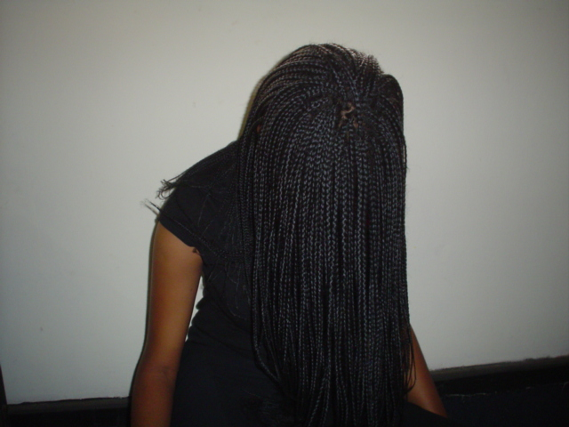
Her story……

Slide 34
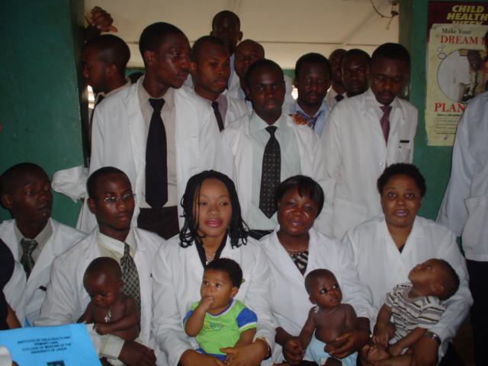
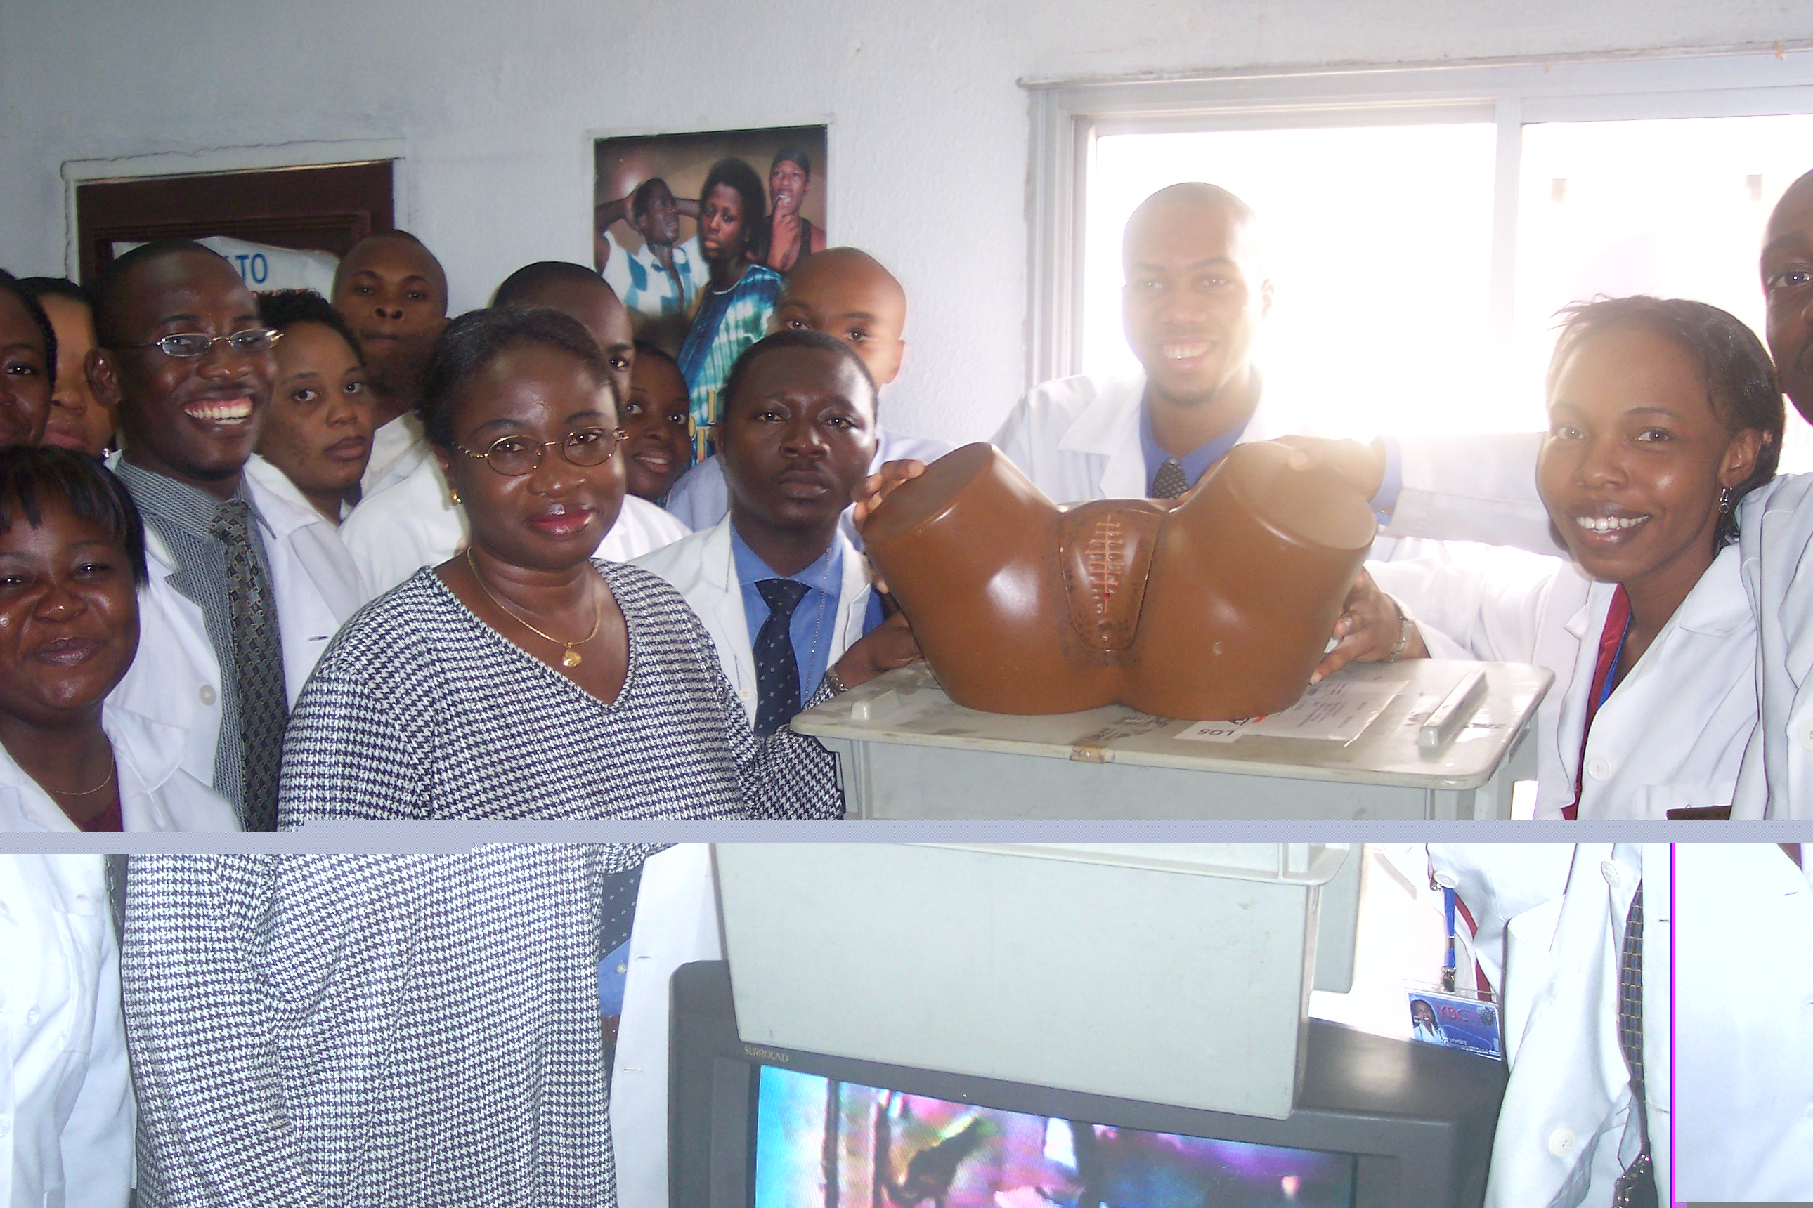
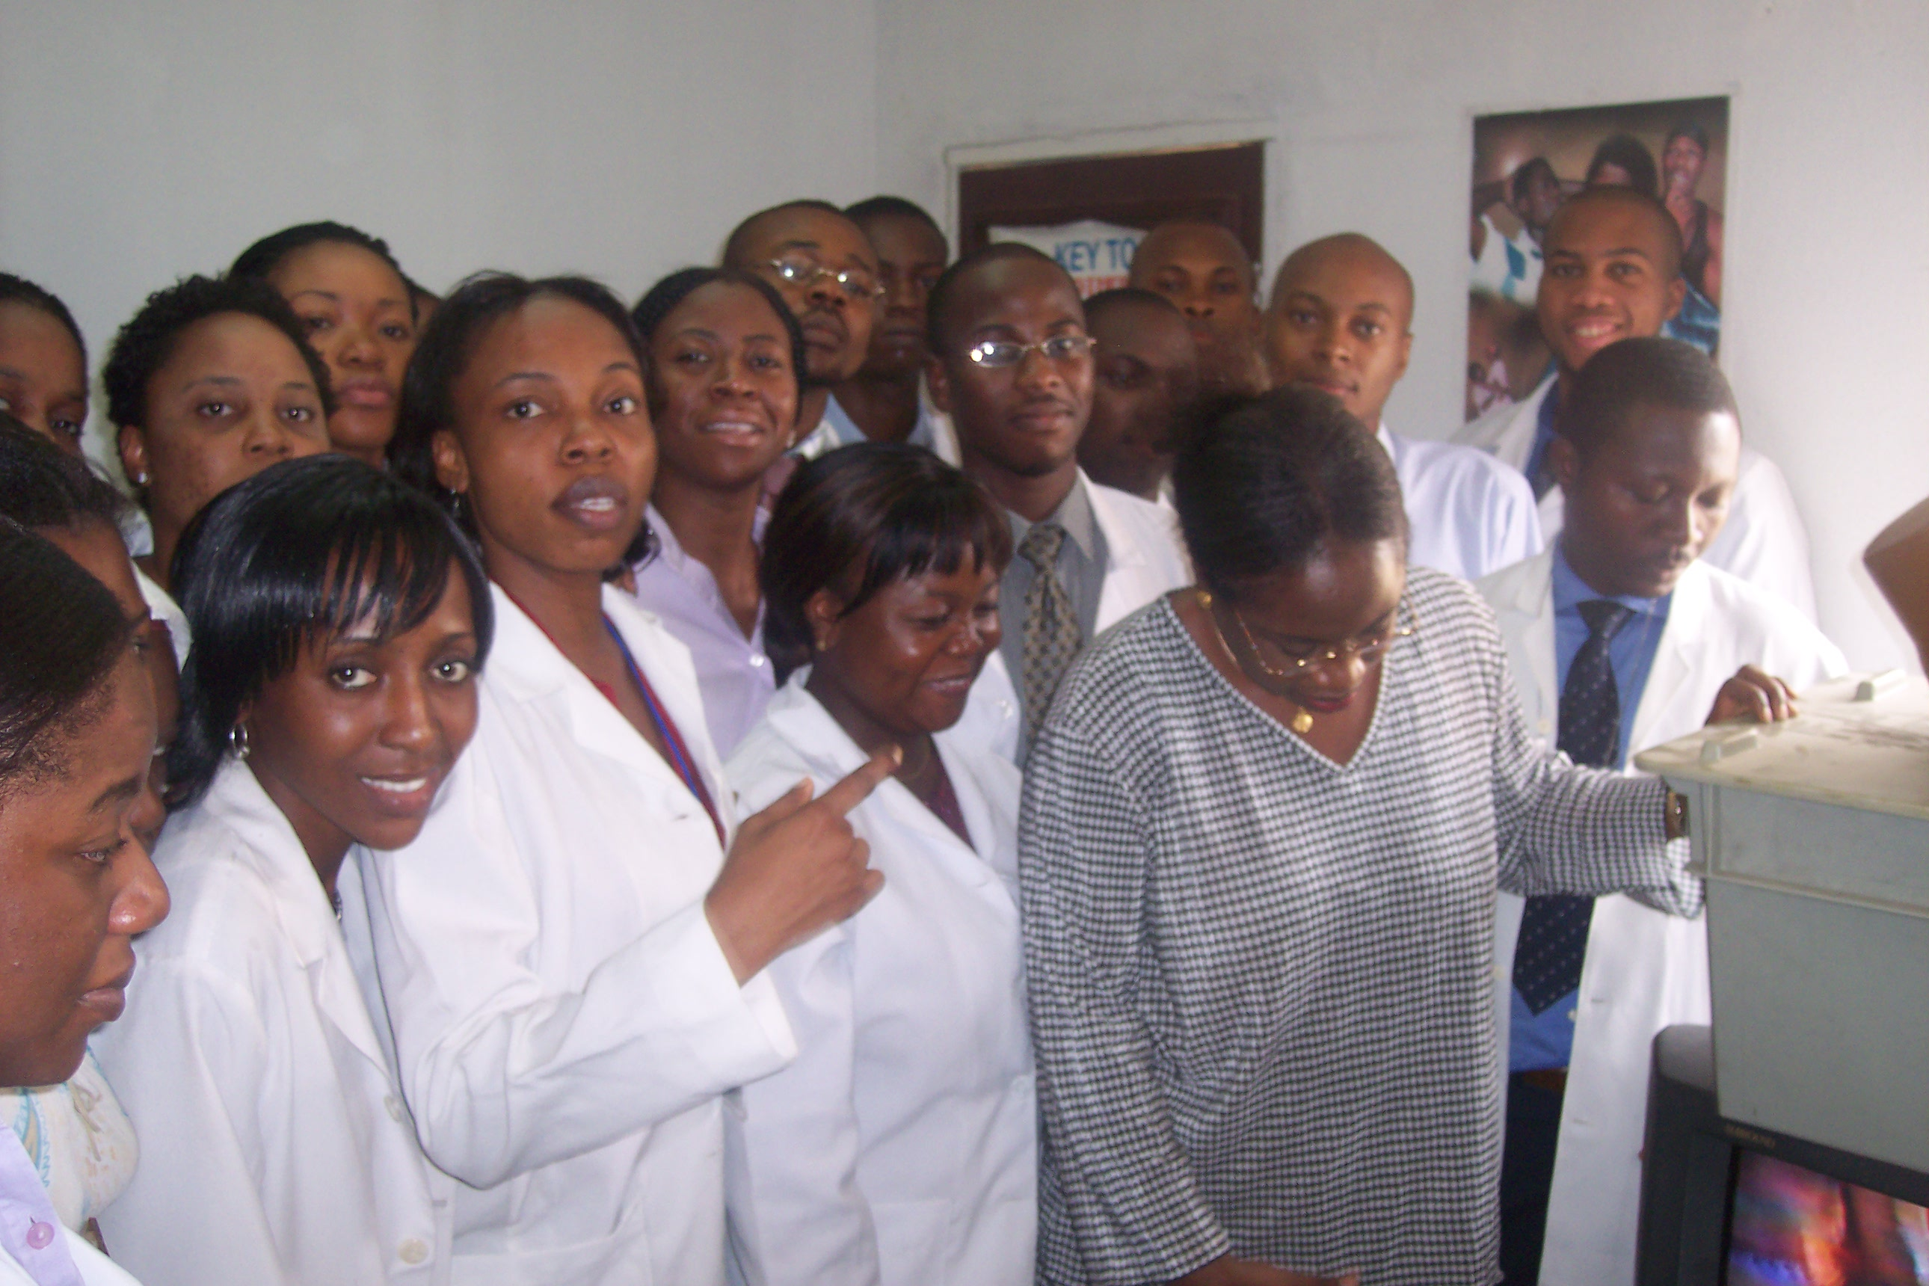
THANK YOU TO IAC NIGERIA

