Slide 1
The Exodus
Author: Moses
Date of writing: c. 1446-1406 BC
Key truths:
  The Lord authorized Moses as Israel’s leader to bring the blessings of the deliverance from Egypt
  The covenant laws given by Moses were divinely authorized to lead to blessings for God’s people
  Moses’ regulations for worship at the tabernacle were divinely ordained to lead to blessings for God’s people
Approximate date of the Exodus: 1440 BC
Notes:
Looking back at the Book of Genesis: Creation – the Fall of man – God’s punishment (the Flood) – man fills the earth – God’s call of Abraham to Canaan – “Blessed to be a Blessing” – the Chosen People – delivered from Famine by Joseph – Genesis 50:20 – “You intended to harm me, but God intended it for good to accomplish what is now being done, the saving of many lives.”

Slide 2
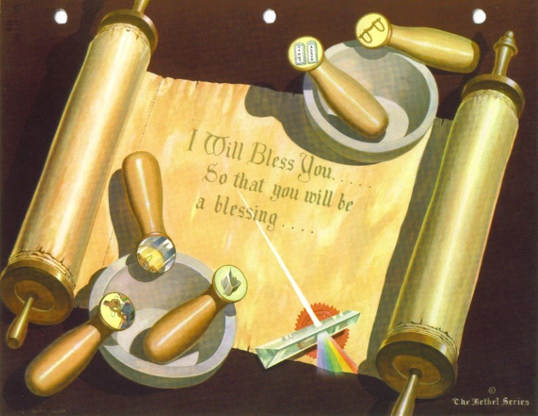
United into a people
Notes:
Israel was united into a people in pursuit of common purpose by specific historical experiences. Those uniting factors were:
the rite of circumcision;
Separation – ethnic, within family, geographical
Israel’s common hopes and dreams for a meaningful future
the opposition under the Pharaoh
the law received at Mount Sinai
Unified, Israel moved forward toward the realization of it’s destiny “to be a blessing.”

Slide 3
The Exodus
The Hebrews lived 400 years in Egypt, were fruitful, and prospered
Notes:
Genesis 46:26-27 – Israel came to Egypt from Canaan to escape the famine. Counting Joseph and his two sons, there were a total of 70 direct descendants of Jacob in the land. After 400 years “..the Israelites were fruitful and multiplied greatly and became exceedingly numerous, so that the land was filled with them.”
Exodus 1:1-7 – 1 These are the names of the sons of Israel who went to Egypt with Jacob, each with his family: 2Reuben, Simeon, Levi and Judah; 3 Issachar, Zebulun and Benjamin; 4 Dan and Naphtali; Gad and Asher.5 The descendants of Jacob numbered seventy in all; Joseph was already in Egypt. 6 Now Joseph and all his brothers and all that generation died, 7 but the Israelites were fruitful and multiplied greatly and became exceedingly numerous, so that the land was filled with them.

Slide 4
The Exodus
The Hebrews lived 400 years in Egypt, were fruitful, and prospered
A new Pharaoh made them slaves
Notes:
A new Pharaoh came into power, one who didn’t know Joseph. He saw the numbers of the Israelites, feared them, and made them slaves in the land.
Exodus 1:8-14 – 8 Then a new king, who did not know about Joseph, came to power in Egypt. 9 "Look," he said to his people, "the Israelites have become much too numerous for us. 10 Come, we must deal shrewdly with them or they will become even more numerous and, if war breaks out, will join our enemies, fight against us and leave the country."
11 So they put slave masters over them to oppress them with forced labor, and they built Pithom and Rameses as store cities for Pharaoh. 12 But the more they were oppressed, the more they multiplied and spread; so the Egyptians came to dread the Israelites 13 and worked them ruthlessly. 14 They made their lives bitter with hard labor in brick and mortar and with all kinds of work in the fields; in all their hard labor the Egyptians used them ruthlessly.

Slide 5
The Exodus
The Hebrews lived 400 years in Egypt, were fruitful, and prospered
A new Pharaoh made them slaves
The Hebrews were ordered to kill their male children at birth
Notes:
Exodus 1:15-22 – 15 The king of Egypt said to the Hebrew midwives, whose names were Shiphrah and Puah, 16 "When you help the Hebrew women in childbirth and observe them on the delivery stool, if it is a boy, kill him; but if it is a girl, let her live." 17 The midwives, however, feared God and did not do what the king of Egypt had told them to do; they let the boys live. 18 Then the king of Egypt summoned the midwives and asked them, "Why have you done this? Why have you let the boys live?"
19 The midwives answered Pharaoh, "Hebrew women are not like Egyptian women; they are vigorous and give birth before the midwives arrive."
20 So God was kind to the midwives and the people increased and became even more numerous. 21 And because the midwives feared God, he gave them families of their own.
22 Then Pharaoh gave this order to all his people: "Every boy that is born you must throw into the Nile, but let every girl live."

Slide 6
The Exodus
The Hebrews lived 400 years in Egypt, were fruitful, and prospered
A new Pharaoh made them slaves
The Hebrews were ordered to kill their male children at birth
Moses, a Levite, was born, hidden, then found and raised by the daughter of Pharaoh (Exodus 2)
Notes:
Exodus 2:1-10 – 1 Now a man of the house of Levi married a Levite woman, 2 and she became pregnant and gave birth to a son. When she saw that he was a fine child, she hid him for three months. 3 But when she could hide him no longer, she got a papyrus basket for him and coated it with tar and pitch. Then she placed the child in it and put it among the reeds along the bank of the Nile. 4 His sister stood at a distance to see what would happen to him. 5 Then Pharaoh's daughter went down to the Nile to bathe, and her attendants were walking along the river bank. She saw the basket among the reeds and sent her slave girl to get it. 6 She opened it and saw the baby. He was crying, and she felt sorry for him. "This is one of the Hebrew babies," she said.
7 Then his sister asked Pharaoh's daughter, "Shall I go and get one of the Hebrew women to nurse the baby for you?"
8 "Yes, go," she answered. And the girl went and got the baby's mother. 9 Pharaoh's daughter said to her, "Take this baby and nurse him for me, and I will pay you." So the woman took the baby and nursed him. 10 When the child grew older, she took him to Pharaoh's daughter and he became her son. She named him Moses, saying, "I drew him out of the water."

Slide 7
The Exodus
The Hebrews lived 400 years in Egypt, were fruitful, and prospered
A new Pharaoh made them slaves
The Hebrews were ordered to kill their male children at birth
Moses, a Levite, was born, hidden, then found and raised by the daughter of Pharaoh
When he grew up, Moses killed an Egyptian and had to flee
Notes:
Exodus 2:11-15 – 11 One day, after Moses had grown up, he went out to where his own people were and watched them at their hard labor. He saw an Egyptian beating a Hebrew, one of his own people. 12 Glancing this way and that and seeing no one, he killed the Egyptian and hid him in the sand. 13 The next day he went out and saw two Hebrews fighting. He asked the one in the wrong, "Why are you hitting your fellow Hebrew?" 14 The man said, "Who made you ruler and judge over us? Are you thinking of killing me as you killed the Egyptian?" Then Moses was afraid and thought, "What I did must have become known."
15 When Pharaoh heard of this, he tried to kill Moses, but Moses fled from Pharaoh and went to live in Midian, where he sat down by a well.

Slide 8
The Exodus
The Hebrews lived 400 years in Egypt, were fruitful, and prospered
A new Pharaoh made them slaves
The Hebrews were ordered to kill their male children at birth
Moses, a Levite, was born, hidden, then found and raised by the daughter of Pharaoh
When he grew up, Moses killed an Egyptian and had to flee
Moses fled to Midian, married and had a son
Notes:
The year is circa 1486 BC.
Exodus 2:16-20 – 16 Now a priest of Midian had seven daughters, and they came to draw water and fill the troughs to water their father's flock. 17 Some shepherds came along and drove them away, but Moses got up and came to their rescue and watered their flock. 18 When the girls returned to Reuel their father, he asked them, "Why have you returned so early today?“ 19 They answered, "An Egyptian rescued us from the shepherds. He even drew water for us and watered the flock.“ 20 "And where is he?" he asked his daughters. "Why did you leave him? Invite him to have something to eat."
Exodus 2:21-25 - 21 Moses agreed to stay with the man, who gave his daughter Zipporah to Moses in marriage. 22 Zipporah gave birth to a son, and Moses named him Gershom, saying, "I have become an alien in a foreign land."
23 During that long period, the king of Egypt died. The Israelites groaned in their slavery and cried out, and their cry for help because of their slavery went up to God. 24 God heard their groaning and he remembered his covenant with Abraham, with Isaac and with Jacob. 25 So God looked on the Israelites and was concerned about them.

Slide 9
The Exodus
The Hebrews lived 400 years in Egypt, were fruitful, and prospered
A new Pharaoh made them slaves
The Hebrews were ordered to kill their male children at birth
Moses, a Levite, was born, hidden, then found and raised by the daughter of Pharaoh
When he grew up, Moses killed an Egyptian and had to flee
Moses fled to Midian, married and had a son
The Lord appeared to Moses in a burning bush, calling him to rescue the Hebrews from Egypt (Exodus 3)
Notes:
Exodus 3:1-6 – 1 Now Moses was tending the flock of Jethro his father-in-law, the priest of Midian, and he led the flock to the far side of the desert and came to Horeb, the mountain of God. 2 There the angel of the LORD appeared to him in flames of fire from within a bush. Moses saw that though the bush was on fire it did not burn up. 3 So Moses thought, "I will go over and see this strange sight—why the bush does not burn up." 4 When the LORD saw that he had gone over to look, God called to him from within the bush, "Moses! Moses!"
And Moses said, "Here I am."
5 "Do not come any closer," God said. "Take off your sandals, for the place where you are standing is holy ground." 6 Then he said, "I am the God of your father, the God of Abraham, the God of Isaac and the God of Jacob." At this, Moses hid his face, because he was afraid to look at God.

Slide 10
The Exodus
The Hebrews lived 400 years in Egypt, were fruitful, and prospered
A new Pharaoh made them slaves
The Hebrews were ordered to kill their male children at birth
Moses, a Levite, was born, hidden, then found and raised by the daughter of Pharaoh
When he grew up, Moses killed an Egyptian and had to flee
Moses fled to Midian, married and had a son
The Lord appeared to Moses in a burning bush, calling him to rescue the Hebrews from Egypt
God demonstrated His power, and overcame Moses’ objections
Notes:
Exodus 3:7-4:17 – God revealed His plan to Moses, who was fearful to return to Egypt. God revealed his powers to Moses, who “had never been eloquent.”

Slide 11
The Exodus
The Hebrews lived 400 years in Egypt, were fruitful, and prospered
A new Pharaoh made them slaves
The Hebrews were ordered to kill their male children at birth
Moses, a Levite, was born, hidden, then found and raised by the daughter of Pharaoh
When he grew up, Moses killed an Egyptian and had to flee
Moses fled to Midian, married and had a son
The Lord appeared to Moses in a burning bush, calling him to rescue the Hebrews from Egypt
God demonstrated His power, and overcame Moses’ objections
Moses sets out – his son circumcised
Notes:
Exodus 4:18-20 – 18 Then Moses went back to Jethro his father-in-law and said to him, "Let me go back to my own people in Egypt to see if any of them are still alive." Jethro said, "Go, and I wish you well." 19 Now the LORD had said to Moses in Midian, "Go back to Egypt, for all the men who wanted to kill you are dead." 20 So Moses took his wife and sons, put them on a donkey and started back to Egypt. And he took the staff of God in his hand.
Exodus 4:24-26 – 24 At a lodging place on the way, the LORD met {Moses} and was about to kill him. 25 But Zipporah took a flint knife, cut off her son's foreskin and touched {Moses'} feet with it. "Surely you are a bridegroom of blood to me," she said. 26 So the LORD let him alone. (At that time she said "bridegroom of blood," referring to circumcision.)
Note – This may refer to Moses, or possibly Moses’ son, Gershom. See study Bible notes on Exodus 4:24, page 105.

Slide 12
The Exodus
The Hebrews lived 400 years in Egypt, were fruitful, and prospered
A new Pharaoh made them slaves
The Hebrews were ordered to kill their male children at birth
Moses, a Levite, was born, hidden, then found and raised by the daughter of Pharaoh
When he grew up, Moses killed an Egyptian and had to flee
Moses fled to Midian, married and had a son
The Lord appeared to Moses in a burning bush, calling him to rescue the Hebrews from Egypt
God demonstrated His power, and overcame Moses’ objections
Moses sets out – his son circumcised
The lineage of Moses and his brother, Aaron (Exodus 6:14-27)
Notes:
Exodus 6:14-27 relates the genealogy of Moses and Aaron from Israel (Jacob). Refer to Genesis 29:31-35 – Jacob’s first four sons (with Leah) were Reuben, Simeon, Levi, and Judah.
See also Genesis 35:22-29 for the sin of Reuben (he slept with Bilhah) and another list of the sons of Israel. See study Bible notes on Genesis 35:22, page 72.
Deuteronomy 22:30 – A man is not to marry his father's wife; he must not dishonor his father's bed.
Why did Reuben act as he did? To satisfy his lust and, perhaps, to wrest leadership from Jacob. Note that by defiling Bilhah, Rachel’s maidservant, Reuben made certain that, with Rachel’s death, Bilhah couldn’t supplant Leah as his father’s chief wife. For his sin, Reuben, Simeon, and Levi were deprived of leadership; Leah’s fourth son, Judah, would assume that role. See Israel’s blessing to his sons, Genesis 49:1-12 for details.

Slide 13
The Exodus
Moses and Aaron went to Pharaoh to relay God’s word: Let My People Go! (Exodus 5)
Notes:
Aaron came up from Egypt to meet Moses, and M shared all that God had told him (Exodus 4:27, 28). They brought the elders of Israel together, told them of God’s plan, and performed the signs by which the people believed. (Exodus 4:29-31).
After this, Moses and Aaron went to the Pharaoh. Exodus 5:1-5 – 2 Pharaoh said, "Who is the LORD, that I should obey him and let Israel go? I do not know the LORD and I will not let Israel go."

Slide 14
The Exodus
Moses and Aaron went to Pharaoh to relay God’s word: Let My People Go!
Pharaoh wanted to keep his slave labor, refused to let God’s people go, and made their burden even harsher
Notes:
Exodus 5:6-14 – no straw provided for the bricks they were required to make.

Slide 15
The Exodus
Moses and Aaron went to Pharaoh to relay God’s word: Let My People Go!
Pharaoh wanted to keep his slave labor, refused, made their burden even harsher
Moses blamed, appeals to God who reassures him
Notes:
Exodus 5:15-21 – Moses and Aaron blamed by the foremen. Exodus 5:22-6:1 – Moses prays to God, God answers him, Moses relays promise of God to the Israelites.
Exodus 6:2-9 – God reiterates the Abrahamic Covenant promise to Moses. Exodus 6:10-13 – God again sends Moses to Pharaoh, but Moses is again (still?) doubtful.
Exodus 7:1-7 – God reassures Moses. Moses and Aaron obey, and again appear before the Pharaoh.

Slide 16
The Exodus
Moses and Aaron went to Pharaoh to relay God’s word: Let My People Go!
Pharaoh wanted to keep his slave labor, refused, made their burden even harsher
Moses blamed, appeals to God who reassures him
Moses (80) and Aaron (83) obey God, go before Pharaoh where God gives them a miracle (staff turned to snake)
Notes:
Exodus 7:7 – Moses is 80 years of age, Aaron is 83 when they go again before the Pharaoh. Smith tells us the year is circa 1446 BC.

Slide 17
The Exodus
Moses and Aaron went to Pharaoh to relay God’s word: Let My People Go!
Pharaoh wanted to keep his slave labor, refused, made their burden even harsher
Moses blamed, appeals to God who reassures him
Moses (80) and Aaron (83) obey God, go before Pharaoh where God gives them a miracle (staff turned to snake)
Pharaoh resists, God sends a series of Plagues:
Notes:
Exodus 7:8-13 – Aaron’s staff turned into a snake, a feat that is duplicated by the magicians and sorcerers of the Pharaoh. Even though Aaron’s staff/snake swallowed up those of the magicians…
13 Yet Pharaoh's heart became hard and he would not listen to them, just as the LORD had said. God sends the First of Seven Plagues.

Slide 18
The Exodus
Moses and Aaron went to Pharaoh to relay God’s word: Let My People Go!
Pharaoh wanted to keep his slave labor, refused, made their burden even harsher
Moses blamed, appeals to God who reassures him
Moses (80) and Aaron (83) obey God, go before Pharaoh where God gives them a miracle (staff turned to snake)
Pharaoh resists, God sends a series of Plagues:
  Water of the Nile turned to blood (Exodus 7:14-24)
Notes:
Exodus 7 – 20 Moses and Aaron did just as the LORD had commanded. He raised his staff in the presence of Pharaoh and his officials and struck the water of the Nile, and all the water was changed into blood. 21 The fish in the Nile died, and the river smelled so bad that the Egyptians could not drink its water. Blood was everywhere in Egypt.
22 But the Egyptian magicians did the same things by their secret arts, and Pharaoh's heart became hard; he would not listen to Moses and Aaron, just as the LORD had said. 23 Instead, he turned and went into his palace, and did not take even this to heart. 24 And all the Egyptians dug along the Nile to get drinking water, because they could not drink the water of the river.

Slide 19
The Exodus
Moses and Aaron went to Pharaoh to relay God’s word: Let My People Go!
Pharaoh wanted to keep his slave labor, refused, made their burden even harsher
Moses blamed, appeals to God who reassures him
Moses (80) and Aaron (83) obey God, go before Pharaoh where God gives them a miracle (staff turned to snake)
Pharaoh resists, God sends a series of Plagues:
  Water of the Nile turned to blood (Exodus 7:14-24)
  Plague of Frogs (Exodus 7:25-8:15)
Notes:
Exodus 8:6-15 – 6 So Aaron stretched out his hand over the waters of Egypt, and the frogs came up and covered the land.7 But the magicians did the same things by their secret arts; they also made frogs come up on the land of Egypt.
8 Pharaoh summoned Moses and Aaron and said, "Pray to the LORD to take the frogs away from me and my people, and I will let your people go to offer sacrifices to the LORD."
9 Moses said to Pharaoh, "I leave to you the honor of setting the time for me to pray for you and your officials and your people that you and your houses may be rid of the frogs, except for those that remain in the Nile."
10 "Tomorrow," Pharaoh said.
Moses replied, "It will be as you say, so that you may know there is no one like the LORD our God.11 The frogs will leave you and your houses, your officials and your people; they will remain only in the Nile."
12 After Moses and Aaron left Pharaoh, Moses cried out to the LORD about the frogs he had brought on Pharaoh. 13 And the LORD did what Moses asked. The frogs died in the houses, in the courtyards and in the fields. 14 They were piled into heaps, and the land reeked of them. 15 But when Pharaoh saw that there was relief, he hardened his heart and would not listen to Moses and Aaron, just as the LORD had said.

Slide 20
The Exodus
Moses and Aaron went to Pharaoh to relay God’s word: Let My People Go!
Pharaoh wanted to keep his slave labor, refused, made their burden even harsher
Moses blamed, appeals to God who reassures him
Moses (80) and Aaron (83) obey God, go before Pharaoh where God gives them a miracle (staff turned to snake)
Pharaoh resists, God sends a series of Plagues:
  Water of the Nile turned to blood (Exodus 7:14-24)
  Plague of Frogs (Exodus 7:25-8:15)
  Plague of Gnats (Exodus 8:16-19)
Notes:
Exodus 8:16-19 – 16 Then the LORD said to Moses, "Tell Aaron, 'Stretch out your staff and strike the dust of the ground,' and throughout the land of Egypt the dust will become gnats." 17 They did this, and when Aaron stretched out his hand with the staff and struck the dust of the ground, gnats came upon men and animals. All the dust throughout the land of Egypt became gnats. 18 But when the magicians tried to produce gnats by their secret arts, they could not. And the gnats were on men and animals. 19 The magicians said to Pharaoh, "This is the finger of God." But Pharaoh's heart was hard and he would not listen, just as the LORD had said.

Slide 21
The Exodus
Moses and Aaron went to Pharaoh to relay God’s word: Let My People Go!
Pharaoh wanted to keep his slave labor, refused, made their burden even harsher
Moses blamed, appeals to God who reassures him
Moses (80) and Aaron (83) obey God, go before Pharaoh where God gives them a miracle (staff turned to snake)
Pharaoh resists, God sends a series of Plagues:
  Water of the Nile turned to blood (Exodus 7:14-24)
  Plague of Frogs (Exodus 7:25-8:15)
  Plague of Gnats (Exodus 8:16-19)
  Plague of Flies (Exodus 8:20-24)
Notes:
Exodus 8:20-24 – 20 Then the LORD said to Moses, "Get up early in the morning and confront Pharaoh as he goes to the water and say to him, 'This is what the LORD says: Let my people go, so that they may worship me. 21 If you do not let my people go, I will send swarms of flies on you and your officials, on your people and into your houses. The houses of the Egyptians will be full of flies, and even the ground where they are. 22 " 'But on that day I will deal differently with the land of Goshen, where my people live; no swarms of flies will be there, so that you will know that I, the LORD, am in this land. 23 I will make a distinction between my people and your people. This miraculous sign will occur tomorrow.' "
24 And the LORD did this. Dense swarms of flies poured into Pharaoh's palace and into the houses of his officials, and throughout Egypt the land was ruined by the flies.

Slide 22
The Exodus
Moses and Aaron went to Pharaoh to relay God’s word: Let My People Go!
Pharaoh wanted to keep his slave labor, refused, made their burden even harsher
Moses blamed, appeals to God who reassures him
Moses (80) and Aaron (83) obey God, go before Pharaoh where God gives them a miracle (staff turned to snake)
Pharaoh resists, God sends a series of Plagues:
  Water of the Nile turned to blood (Exodus 7:14-24)
  Plague of Frogs (Exodus 7:25-8:15)
  Plague of Gnats (Exodus 8:16-19)
  Plague of Flies (Exodus 8:20-24)
  Plague of Dead Animals (Exodus 9:1-7)
Notes:
Exodus 9:1-7 – 1 Then the LORD said to Moses, "Go to Pharaoh and say to him, 'This is what the LORD, the God of the Hebrews, says: "Let my people go, so that they may worship me." 2 If you refuse to let them go and continue to hold them back, 3 the hand of the LORD will bring a terrible plague on your livestock in the field—on your horses and donkeys and camels and on your cattle and sheep and goats. 4 But the LORD will make a distinction between the livestock of Israel and that of Egypt, so that no animal belonging to the Israelites will die.' " 5 The LORD set a time and said, "Tomorrow the LORD will do this in the land." 6 And the next day the LORD did it: All the livestock of the Egyptians died, but not one animal belonging to the Israelites died.7 Pharaoh sent men to investigate and found that not even one of the animals of the Israelites had died. Yet his heart was unyielding and he would not let the people go.

Slide 23
The Exodus
Moses and Aaron went to Pharaoh to relay God’s word: Let My People Go!
Pharaoh wanted to keep his slave labor, refused, made their burden even harsher
Moses blamed, appeals to God who reassures him
Moses (80) and Aaron (83) obey God, go before Pharaoh where God gives them a miracle (staff turned to snake)
Pharaoh resists, God sends a series of Plagues:
  Water of the Nile turned to blood (Exodus 7:14-24)
  Plague of Frogs (Exodus 7:25-8:15)
  Plague of Gnats (Exodus 8:16-19)
  Plague of Flies (Exodus 8:20-24)
  Plague of Dead Animals (Exodus 9:1-7)
  Plague of Boils (Exodus 9:8-12)
Notes:
Exodus 9:8-12 – 8 Then the LORD said to Moses and Aaron, "Take handfuls of soot from a furnace and have Moses toss it into the air in the presence of Pharaoh. 9 It will become fine dust over the whole land of Egypt, and festering boils will break out on men and animals throughout the land." 10 So they took soot from a furnace and stood before Pharaoh. Moses tossed it into the air, and festering boils broke out on men and animals. 11 The magicians could not stand before Moses because of the boils that were on them and on all the Egyptians. 12 But the LORD hardened Pharaoh's heart and he would not listen to Moses and Aaron, just as the LORD had said to Moses.

Slide 24
The Exodus
Moses and Aaron went to Pharaoh to relay God’s word: Let My People Go!
Pharaoh wanted to keep his slave labor, refused, made their burden even harsher
Moses blamed, appeals to God who reassures him
Moses (80) and Aaron (83) obey God, go before Pharaoh where God gives them a miracle (staff turned to snake)
Pharaoh resists, God sends a series of Plagues:
  Water of the Nile turned to blood (Exodus 7:14-24)
  Plague of Frogs (Exodus 7:25-8:15)
  Plague of Gnats (Exodus 8:16-19)
  Plague of Flies (Exodus 8:20-24)
  Plague of Dead Animals (Exodus 9:1-7)
  Plague of Boils (Exodus 9:8-12)
  Plague of Hail (Exodus 9:13-26)
Notes:
This time the Lord gave a warning – Exodus 9:13-21 – before sending the plague. Some of the Egyptians took heed, most did not.
Exodus 9:13-26 – 22 Then the LORD said to Moses, "Stretch out your hand toward the sky so that hail will fall all over Egypt—on men and animals and on everything growing in the fields of Egypt." 23 When Moses stretched out his staff toward the sky, the LORD sent thunder and hail, and lightning flashed down to the ground. So the LORD rained hail on the land of Egypt; 24 hail fell and lightning flashed back and forth. It was the worst storm in all the land of Egypt since it had become a nation. 25 Throughout Egypt hail struck everything in the fields—both men and animals; it beat down everything growing in the fields and stripped every tree. 26 The only place it did not hail was the land of Goshen, where the Israelites were.

Slide 25
The Exodus
Pharaoh promises to let Israel go, then reneges
Notes:
Exodus 9:27-35 – Pharaoh confesses to Moses that he has sinned and will let the people go if only the hailstorms are stopped. Moses appeals to God, who stops the storms. But the Pharaoh again hardened his heart and reneges on his promise.

Slide 26
The Exodus
Pharaoh promises to let Israel go, then reneges
God reveals the reason for the Plagues: to Glorify His Name
Notes:
Exodus 10:1,2 – 1 Then the LORD said to Moses, "Go to Pharaoh, for I have hardened his heart and the hearts of his officials so that I may perform these miraculous signs of mine among them 2 that you may tell your children and grandchildren how I dealt harshly with the Egyptians and how I performed my signs among them, and that you may know that I am the LORD."

Slide 27
The Exodus
Pharaoh promises to let Israel go, then reneges
God reveals the reason for the Plagues: to Glorify His Name
Pharaoh would let only the men go; God sends a Plague of Locusts (Exodus 10:12-20)
Notes:
Exodus 10:3-6 – Moses warns the Pharaoh. Exodus 10:7-11 – Pharaoh agrees to let the men go to worship God.
Exodus 10:12-20 – God directs Moses to summon a plague of locusts against Egypt. 13 So Moses stretched out his staff over Egypt, and the LORD made an east wind blow across the land all that day and all that night. By morning the wind had brought the locusts; 14 they invaded all Egypt and settled down in every area of the country in great numbers. Never before had there been such a plague of locusts, nor will there ever be again. 15 They covered all the ground until it was black. They devoured all that was left after the hail—everything growing in the fields and the fruit on the trees. Nothing green remained on tree or plant in all the land of Egypt.

Slide 28
The Exodus
Pharaoh promises to let Israel go, then reneges
God reveals the reason for the Plagues: to Glorify His Name
Pharaoh would let only the men go; God sends a Plague of Locusts (Exodus 10:12-20)
God hardens Pharaoh’s heart; again he refuses. God sends a Plague of Darkness (Exodus 10:21-23)
Notes:
Pharaoh begs Moses to get rid of the Locusts. Moses does, but again the Lord hardens the heart of the Pharaoh who refuses to let the people leave.
Exodus 10:21-23 – 21 Then the LORD said to Moses, "Stretch out your hand toward the sky so that darkness will spread over Egypt—darkness that can be felt." 22 So Moses stretched out his hand toward the sky, and total darkness covered all Egypt for three days. 23 No one could see anyone else or leave his place for three days. Yet all the Israelites had light in the places where they lived.

Slide 29
The Exodus
Pharaoh promises to let Israel go, then reneges
God reveals the reason for the Plagues: to Glorify His Name
Pharaoh would let only the men go; God sends a Plague of Locusts (Exodus 10:12-20)
God hardens Pharaoh’s heart; again he refuses. God sends a Plague of Darkness (Exodus 10:21-23)
Pharaoh threatens Moses (Exodus 10:28)
Notes:
In a partial agreement, the Pharaoh agrees to let all the men, women, and children go out to worship. Moses wants to take the herds and flocks as well so they can make sacrifices, but the Pharaoh goes into a rage and threatens Moses with death should they ever again face one another. His heart again hardened by the Lord, the Pharaoh refuses to let the people go.
Exodus 10:24-29 – 24 Then Pharaoh summoned Moses and said, "Go, worship the LORD. Even your women and children may go with you; only leave your flocks and herds behind."
25 But Moses said, "You must allow us to have sacrifices and burnt offerings to present to the LORD our God. 26 Our livestock too must go with us; not a hoof is to be left behind. We have to use some of them in worshiping the LORD our God, and until we get there we will not know what we are to use to worship the LORD."
27 But the LORD hardened Pharaoh's heart, and he was not willing to let them go. 28 Pharaoh said to Moses, "Get out of my sight! Make sure you do not appear before me again! The day you see my face you will die."
29 "Just as you say," Moses replied, "I will never appear before you again."

Slide 30
The Exodus
Pharaoh promises to let Israel go, then reneges
God reveals the reason for the Plagues: to Glorify His Name
Pharaoh would let only the men go; God sends a Plague of Locusts (Exodus 10:12-20)
God hardens Pharaoh’s heart; again he refuses. God sends a Plague of Darkness (Exodus 10:21-23)
Pharaoh threatens Moses (Exodus 10:28)
The Egyptians give valuables to the Israelites (Exodus 11:1-3)
Notes:
Exodus 11:1-3 – 1 Now the LORD had said to Moses, "I will bring one more plague on Pharaoh and on Egypt. After that, he will let you go from here, and when he does, he will drive you out completely. 2 Tell the people that men and women alike are to ask their neighbors for articles of silver and gold." 3 (The LORD made the Egyptians favorably disposed toward the people, and Moses himself was highly regarded in Egypt by Pharaoh's officials and by the people.)

Slide 31
The Exodus
Pharaoh promises to let Israel go, then reneges
God reveals the reason for the Plagues: to Glorify His Name
Pharaoh would let only the men go; God sends a Plague of Locusts (Exodus 10:12-20)
God hardens Pharaoh’s heart; again he refuses. God sends a Plague of Darkness (Exodus 10:21-23)
Pharaoh threatens Moses (Exodus 10:28)
The Egyptians give valuables to the Israelites (Exodus 11:1-3)
Moses prophesies that Pharaoh will release the Hebrews after one final plague: the death of the first-born son (Exodus 11:4-8)
Notes:
Exodus 11:4-10 – 4 So Moses said, "This is what the LORD says: 'About midnight I will go throughout Egypt. 5 Every firstborn son in Egypt will die, from the firstborn son of Pharaoh, who sits on the throne, to the firstborn son of the slave girl, who is at her hand mill, and all the firstborn of the cattle as well. 6 There will be loud wailing throughout Egypt—worse than there has ever been or ever will be again. 7 But among the Israelites not a dog will bark at any man or animal.' Then you will know that the LORD makes a distinction between Egypt and Israel. 8 All these officials of yours will come to me, bowing down before me and saying, 'Go, you and all the people who follow you!' After that I will leave." Then Moses, hot with anger, left Pharaoh.
NOTE: apparently this prophesy came at the same meeting with the Pharaoh where he threatened Moses.

Slide 32
The Exodus
Pharaoh promises to let Israel go, then reneges
God reveals the reason for the Plagues: to Glorify His Name
Pharaoh would let only the men go; God sends a Plague of Locusts (Exodus 10:12-20)
God hardens Pharaoh’s heart; again he refuses. God sends a Plague of Darkness (Exodus 10:21-23)
Pharaoh threatens Moses (Exodus 10:28)
The Egyptians give valuables to the Israelites (Exodus 11:1-3)
Moses prophesies that Pharaoh will release the Hebrews after one final plague: the death of the first-born son (Exodus 11:4-8)
God tells Moses that Pharaoh, even after all the miracles, had refused because it was God’s will – for God’s glory
Notes:
Exodus 11:9-10 – 9 The LORD had said to Moses, "Pharaoh will refuse to listen to you—so that my wonders may be multiplied in Egypt." 10 Moses and Aaron performed all these wonders before Pharaoh, but the LORD hardened Pharaoh's heart, and he would not let the Israelites go out of his country.

Slide 33
The Exodus
God initiates the Passover (Exodus 12)
Notes:
(Read from Smith’s comments, page 110) Negotiations with the Pharaoh have failed. Only divine intervention can save the Israelites... “Death throughout Egypt and the passing over of the Israelites will herald a mass exodus of the Hebrew people from the country of their bondage. The significance of the event is nothing less than the implementation of God’s promise to Abraham, Isaac, and Jacob”

Slide 34
The Exodus
God initiates the Passover (Exodus 12)
Instructions for Observance
Notes:
Exodus 12:1-13 – 1 The LORD said to Moses and Aaron in Egypt, 2 "This month is to be for you the first month, the first month of your year. 3 Tell the whole community of Israel that on the tenth day of this month each man is to take a lamb [a] for his family, one for each household. 4 If any household is too small for a whole lamb, they must share one with their nearest neighbor, having taken into account the number of people there are. You are to determine the amount of lamb needed in accordance with what each person will eat. 5 The animals you choose must be year-old males without defect, and you may take them from the sheep or the goats. 6 Take care of them until the fourteenth day of the month, when all the people of the community of Israel must slaughter them at twilight. 7 Then they are to take some of the blood and put it on the sides and tops of the doorframes of the houses where they eat the lambs. 8 That same night they are to eat the meat roasted over the fire, along with bitter herbs, and bread made without yeast. 9 Do not eat the meat raw or cooked in water, but roast it over the fire—head, legs and inner parts. 10 Do not leave any of it till morning; if some is left till morning, you must burn it. 11 This is how you are to eat it: with your cloak tucked into your belt, your sandals on your feet and your staff in your hand. Eat it in haste; it is the LORD's Passover. 12 "On that same night I will pass through Egypt and strike down every firstborn—both men and animals—and I will bring judgment on all the gods of Egypt. I am the LORD. 13 The blood will be a sign for you on the houses where you are; and when I see the blood, I will pass over you. No destructive plague will touch you when I strike Egypt.

Slide 35
The Exodus
God initiates the Passover (Exodus 12)
Instructions for Observance
An annual celebration – a lasting ordinance
Notes:
Exodus 12:14-20 – 14 "This is a day you are to commemorate; for the generations to come you shall celebrate it as a festival to the LORD -a lasting ordinance. 15 For seven days you are to eat bread made without yeast. On the first day remove the yeast from your houses, for whoever eats anything with yeast in it from the first day through the seventh must be cut off from Israel. 16 On the first day hold a sacred assembly, and another one on the seventh day. Do no work at all on these days, except to prepare food for everyone to eat—that is all you may do.
17 "Celebrate the Feast of Unleavened Bread, because it was on this very day that I brought your divisions out of Egypt. Celebrate this day as a lasting ordinance for the generations to come. 18 In the first month you are to eat bread made without yeast, from the evening of the fourteenth day until the evening of the twenty-first day. 19 For seven days no yeast is to be found in your houses. And whoever eats anything with yeast in it must be cut off from the community of Israel, whether he is an alien or native-born. 20 Eat nothing made with yeast. Wherever you live, you must eat unleavened bread.“
Exodus 12:21-28 – Moses passes on the specifics of God’s instructions to the people. Verse 28 says, “The Israelites did just what the LORD commanded Moses and Aaron. “

Slide 36
The Exodus
God initiates the Passover (Exodus 12)
Instructions for Observance
An annual celebration – a lasting ordinance
At midnight, the plague strikes the firstborn of the Pharaoh, the firstborn of all the Egyptians, the firstborn of their livestock
Notes:
Exodus 12:29-30 – 29 At midnight the LORD struck down all the firstborn in Egypt, from the firstborn of Pharaoh, who sat on the throne, to the firstborn of the prisoner, who was in the dungeon, and the firstborn of all the livestock as well. 30 Pharaoh and all his officials and all the Egyptians got up during the night, and there was loud wailing in Egypt, for there was not a house without someone dead.

Slide 37
The Exodus
God initiates the Passover (Exodus 12)
Instructions for Observance
An annual celebration – a lasting ordinance
At midnight, the plague strikes the firstborn of the Pharaoh, the firstborn of all the Egyptians, the firstborn of their livestock
The Pharaoh finally relents, tells Moses to depart
Notes:
Exodus 12:31-32 – 31 During the night Pharaoh summoned Moses and Aaron and said, "Up! Leave my people, you and the Israelites! Go, worship the LORD as you have requested. 32 Take your flocks and herds, as you have said, and go. And also bless me."

Slide 38
The Exodus
God initiates the Passover (Exodus 12)
Instructions for Observance
An annual celebration – a lasting ordinance
At midnight, the plague strikes the firstborn of the Pharaoh, the firstborn of all the Egyptians, the firstborn of their livestock
The Pharaoh finally relents, tells Moses to depart
The fearful people of Egypt help the Israelites prepare to leave
Notes:
Exodus 12:33-36 – 33 The Egyptians urged the people to hurry and leave the country. "For otherwise," they said, "we will all die!" 34 So the people took their dough before the yeast was added, and carried it on their shoulders in kneading troughs wrapped in clothing. 35 The Israelites did as Moses instructed and asked the Egyptians for articles of silver and gold and for clothing. 36 The LORD had made the Egyptians favorably disposed toward the people, and they gave them what they asked for; so they plundered the Egyptians.

Slide 39
The Exodus
God initiates the Passover (Exodus 12)
Instructions for Observance
An annual celebration – a lasting ordinance
At midnight, the plague strikes the firstborn of the Pharaoh, the firstborn of all the Egyptians, the firstborn of their livestock
The Pharaoh finally relents, tells Moses to depart
The fearful people of Egypt help the Israelites prepare to leave
The Exodus begins. The Israelites had been in Egypt 430 years. The year of the Exodus is 1446 BC.
Notes:
Exodus 12:37-51 – 37 The Israelites journeyed from Rameses to Succoth. There were about six hundred thousand men on foot, besides women and children. 38 Many other people went up with them, as well as large droves of livestock, both flocks and herds. 39 With the dough they had brought from Egypt, they baked cakes of unleavened bread. The dough was without yeast because they had been driven out of Egypt and did not have time to prepare food for themselves.
40 Now the length of time the Israelite people lived in Egypt [a] was 430 years. 41 At the end of the 430 years, to the very day, all the LORD's divisions left Egypt. 42 Because the LORD kept vigil that night to bring them out of Egypt, on this night all the Israelites are to keep vigil to honor the LORD for the generations to come.
43 The LORD said to Moses and Aaron, "These are the regulations for the Passover:
"No foreigner is to eat of it. 44 Any slave you have bought may eat of it after you have circumcised him, 45 but a temporary resident and a hired worker may not eat of it. 46 "It must be eaten inside one house; take none of the meat outside the house. Do not break any of the bones. 47 The whole community of Israel must celebrate it.
48 "An alien living among you who wants to celebrate the LORD's Passover must have all the males in his household circumcised; then he may take part like one born in the land. No uncircumcised male may eat of it. 49 The same law applies to the native-born and to the alien living among you."
50 All the Israelites did just what the LORD had commanded Moses and Aaron. 51 And on that very day the LORD brought the Israelites out of Egypt by their divisions.

Slide 40
The Exodus
God initiates the Passover (Exodus 12)
Instructions for Observance
An annual celebration – a lasting ordinance
At midnight, the plague strikes the firstborn of the Pharaoh, the firstborn of all the Egyptians, the firstborn of their livestock
The Pharaoh finally relents, tells Moses to depart
The fearful people of Egypt help the Israelites prepare to leave
The Exodus begins. The Israelites had been in Egypt 430 years. The year of the Exodus is 1446 BC.
God requires the first-born of Israel (Exodus 13:1,2,11-16)
Notes:
Exodus 13:1-2 – 1 The LORD said to Moses, 2 "Consecrate to me every firstborn male. The first offspring of every womb among the Israelites belongs to me, whether man or animal."
11 "After the LORD brings you into the land of the Canaanites and gives it to you, as he promised on oath to you and your forefathers, 12 you are to give over to the LORD the first offspring of every womb. All the firstborn males of your livestock belong to the LORD. 13 Redeem with a lamb every firstborn donkey, but if you do not redeem it, break its neck. Redeem every firstborn among your sons.

Slide 41
The Exodus
God initiates the Passover (Exodus 12)
Instructions for Observance
An annual celebration – a lasting ordinance
At midnight, the plague strikes the firstborn of the Pharaoh, the firstborn of all the Egyptians, the firstborn of their livestock
The Pharaoh finally relents, tells Moses to depart
The fearful people of Egypt help the Israelites prepare to leave
The Exodus begins. The Israelites had been in Egypt 430 years. The year of the Exodus is 1446 BC.
God requires the first-born of Israel (Exodus 13:1,2,11-16)
The Feast of Unleavened bread is initiated by God, a remembrance (Exodus 13:3-10)
Notes:
Exodus 13:3-10 – 3 Then Moses said to the people, "Commemorate this day, the day you came out of Egypt, out of the land of slavery, because the LORD brought you out of it with a mighty hand. Eat nothing containing yeast. 4 Today, in the month of Abib, you are leaving. 5 When the LORD brings you into the land of the Canaanites, Hittites, Amorites, Hivites and Jebusites—the land he swore to your forefathers to give you, a land flowing with milk and honey—you are to observe this ceremony in this month: 6 For seven days eat bread made without yeast and on the seventh day hold a festival to the LORD. 7 Eat unleavened bread during those seven days; nothing with yeast in it is to be seen among you, nor shall any yeast be seen anywhere within your borders. 8 On that day tell your son, 'I do this because of what the LORD did for me when I came out of Egypt.' 9 This observance will be for you like a sign on your hand and a reminder on your forehead that the law of the LORD is to be on your lips. For the LORD brought you out of Egypt with his mighty hand. 10 You must keep this ordinance at the appointed time year after year.
NOTE: See Hebrew calendar in study Bible, page 115.

Slide 42
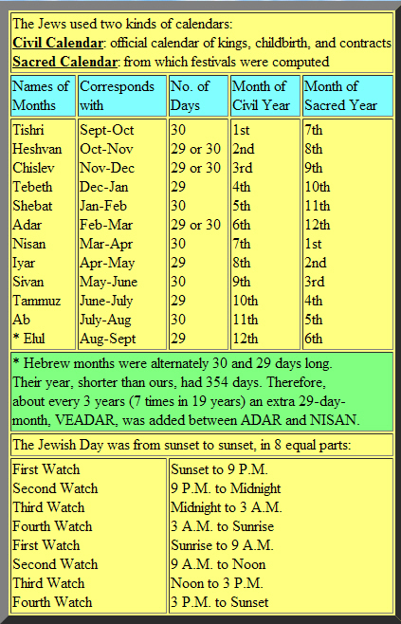
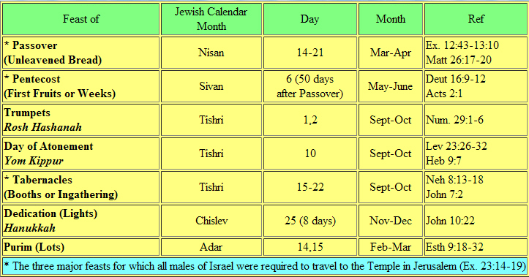
Notes:
Source of these Charts: http://www.bcbsr.com/survey/jcal.html
Another chart (slide 48) shows data from the Spirit of the Reformation Study Bible

Slide 43
The Exodus
God initiates the Passover (Exodus 12)
Instructions for Observance
An annual celebration – a lasting ordinance
At midnight, the plague strikes the firstborn of the Pharaoh, the firstborn of all the Egyptians, the firstborn of their livestock
The Pharaoh finally relents, tells Moses to depart
The fearful people of Egypt help the Israelites prepare to leave
The Exodus begins. The Israelites had been in Egypt 430 years. The year of the Exodus is 1446 BC.
God requires the first-born of Israel (Exodus 13:1,2,11-16)
The Feast of Unleavened bread is initiated by God, a remembrance (Exodus 13:3-10)
God leads Israel by cloud and by fire (Exodus 13:17-22)
Notes:
Exodus 13:17-22 – 17 When Pharaoh let the people go, God did not lead them on the road through the Philistine country, though that was shorter. For God said, "If they face war, they might change their minds and return to Egypt." 18 So God led the people around by the desert road toward the Red Sea. The Israelites went up out of Egypt armed for battle. 19 Moses took the bones of Joseph with him because Joseph had made the sons of Israel swear an oath. He had said, "God will surely come to your aid, and then you must carry my bones up with you from this place." [b]
20 After leaving Succoth they camped at Etham on the edge of the desert. 21 By day the LORD went ahead of them in a pillar of cloud to guide them on their way and by night in a pillar of fire to give them light, so that they could travel by day or night. 22 Neither the pillar of cloud by day nor the pillar of fire by night left its place in front of the people.

Slide 44
The Exodus
God initiates the Passover (Exodus 12)
Instructions for Observance
An annual celebration – a lasting ordinance
At midnight, the plague strikes the firstborn of the Pharaoh, the firstborn of all the Egyptians, the firstborn of their livestock
The Pharaoh finally relents, tells Moses to depart
The fearful people of Egypt help the Israelites prepare to leave
The Exodus begins. The Israelites had been in Egypt 430 years. The year of the Exodus is 1446 BC.
God requires the first-born of Israel (Exodus 13:1,2,11-16)
The Feast of Unleavened bread is initiated by God, a remembrance (Exodus 13:3-10)
God leads Israel by cloud and by fire (Exodus 13:17-22)
Not by the shorter, easier route (Exodus 13:17,18)
Notes:
Exodus 13:17-18 – 17 When Pharaoh let the people go, God did not lead them on the road through the Philistine country, though that was shorter. For God said, "If they face war, they might change their minds and return to Egypt." 18 So God led the people around by the desert road toward the Red Sea. The Israelites went up out of Egypt armed for battle.

Slide 45
The Exodus
God initiates the Passover (Exodus 12)
Instructions for Observance
An annual celebration – a lasting ordinance
At midnight, the plague strikes the firstborn of the Pharaoh, the firstborn of all the Egyptians, the firstborn of their livestock
The Pharaoh finally relents, tells Moses to depart
The fearful people of Egypt help the Israelites prepare to leave
The Exodus begins. The Israelites had been in Egypt 430 years. The year of the Exodus is 1446 BC.
God requires the first-born of Israel (Exodus 13:1,2,11-16)
The Feast of Unleavened bread is initiated by God, a remembrance (Exodus 13:3-10)
God leads Israel by cloud and by fire (Exodus 13:17-22)
Not by the shorter, easier route (Exodus 13:17,18)
Armed for war (Exodus 13:18)
Notes:
Exodus 13:18 – 18 So God led the people around by the desert road toward the Red Sea. The Israelites went up out of Egypt armed for battle.

Slide 46
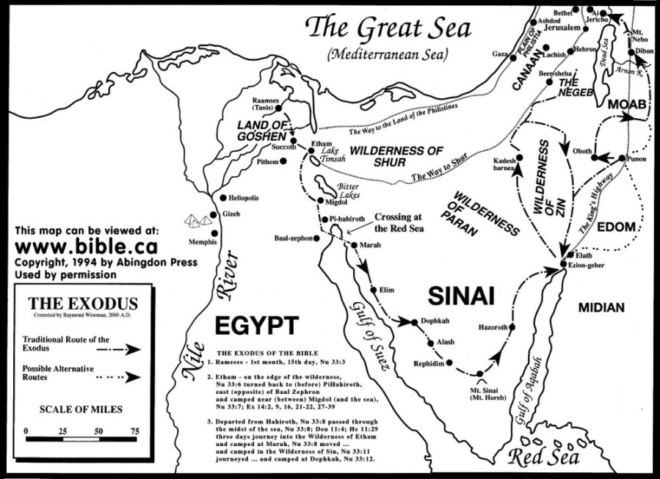
The Exodus
Notes:
From http://www.bible.ca/maps/maps-the-exodus.gif

Slide 47
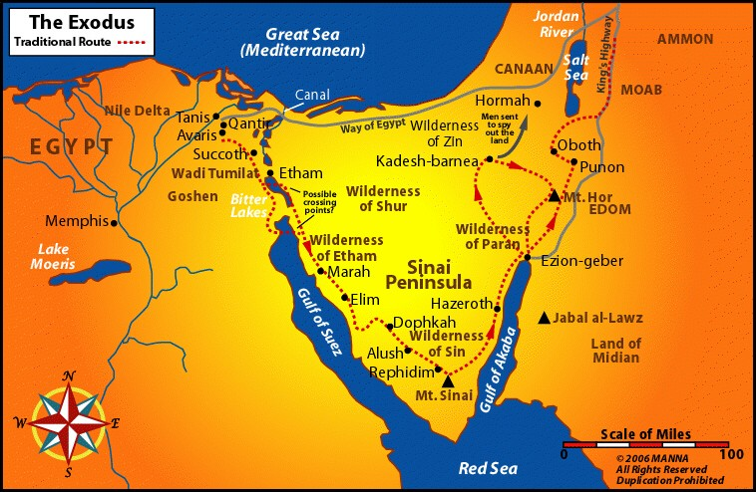
The Exodus
Notes:
Source: http://www.biblemaps.com/onlinemaps/exodus.html Note the location of Marah and Elim where the Israelites were provided water by the Lord (slide 58), and Rephidim where Moses summoned water from “the rock at Horeb” (slide 64)

Slide 48
The Hebrew Calendar
Sacred: | Civil: | Hebrew Name: | Mod. Equiv: | Feasts:
1 | 7 | Abib; Nisan | Mar-Apr | Passover, Unleavened Bread, Firstfruits
2 | 8 | Ziv (lyyar) | Apr-May
3 | 9 | Sivan | May-Jun | Pentecost (Weeks)
4 | 10 | (Tammuz) | Jun-Jul
5 | 11 | (Ab) | Jul-Aug
6 | 12 | Elul | Aug-Sep
7 | 1 | Ethanim (Tishri) | Sep-Oct | Day of Atonement, Tabernacles
8 | 2 | Bul (Marcheshvan) | Oct-Nov
9 | 3 | Kislev | Nov-Dec | Hanukkah
10 | 4 | Tebeth | Dec-Jan
11 | 5 | Shebat | Jan-Feb
12 | 6 | Adar | Feb-Mar | Purim
Notes:
Data on this chart taken from the Spirit of the Reformation Study Bible

Slide 49
The Exodus
Pharaoh’s last pursuit of the Israelites (Exodus 14)
Notes:
Exodus 14:1-18 – 1 Then the LORD said to Moses, 2 "Tell the Israelites to turn back and encamp near Pi Hahiroth, between Migdol and the sea. They are to encamp by the sea, directly opposite Baal Zephon. 3 Pharaoh will think, 'The Israelites are wandering around the land in confusion, hemmed in by the desert.' 4 And I will harden Pharaoh's heart, and he will pursue them. But I will gain glory for myself through Pharaoh and all his army, and the Egyptians will know that I am the LORD." So the Israelites did this.
5 When the king of Egypt was told that the people had fled, Pharaoh and his officials changed their minds about them and said, "What have we done? We have let the Israelites go and have lost their services!" 6 So he had his chariot made ready and took his army with him. 7 He took six hundred of the best chariots, along with all the other chariots of Egypt, with officers over all of them. 8 The LORD hardened the heart of Pharaoh king of Egypt, so that he pursued the Israelites, who were marching out boldly. 9 The Egyptians—all Pharaoh's horses and chariots, horsemen [a] and troops—pursued the Israelites and overtook them as they camped by the sea near Pi Hahiroth, opposite Baal Zephon.
10 As Pharaoh approached, the Israelites looked up, and there were the Egyptians, marching after them. They were terrified and cried out to the LORD. 11 They said to Moses, "Was it because there were no graves in Egypt that you brought us to the desert to die? What have you done to us by bringing us out of Egypt? 12 Didn't we say to you in Egypt, 'Leave us alone; let us serve the Egyptians'? It would have been better for us to serve the Egyptians than to die in the desert!"
13 Moses answered the people, "Do not be afraid. Stand firm and you will see the deliverance the LORD will bring you today. The Egyptians you see today you will never see again. 14 The LORD will fight for you; you need only to be still."
15 Then the LORD said to Moses, "Why are you crying out to me? Tell the Israelites to move on. 16 Raise your staff and stretch out your hand over the sea to divide the water so that the Israelites can go through the sea on dry ground. 17 I will harden the hearts of the Egyptians so that they will go in after them. And I will gain glory through Pharaoh and all his army, through his chariots and his horsemen. 18The Egyptians will know that I am the LORD when I gain glory through Pharaoh, his chariots and his horsemen."

Slide 50
The Exodus
Pharaoh’s last pursuit of the Israelites (Exodus 14)
  Pharaoh’s heart hardened by the Lord, for His glory
Notes:
Exodus 14:1-4 – 1 Then the LORD said to Moses, 2 "Tell the Israelites to turn back and encamp near Pi Hahiroth, between Migdol and the sea. They are to encamp by the sea, directly opposite Baal Zephon. 3 Pharaoh will think, 'The Israelites are wandering around the land in confusion, hemmed in by the desert.' 4 And I will harden Pharaoh's heart, and he will pursue them. But I will gain glory for myself through Pharaoh and all his army, and the Egyptians will know that I am the LORD." So the Israelites did this.

Slide 51
The Exodus
Pharaoh’s last pursuit of the Israelites (Exodus 14)
  Pharaoh’s heart hardened by the Lord, for His glory
  Pharaoh pursues with 600 chariots
Notes:
Exodus 14:5-9 – 5 When the king of Egypt was told that the people had fled, Pharaoh and his officials changed their minds about them and said, "What have we done? We have let the Israelites go and have lost their services!" 6 So he had his chariot made ready and took his army with him. 7 He took six hundred of the best chariots, along with all the other chariots of Egypt, with officers over all of them. 8 The LORD hardened the heart of Pharaoh king of Egypt, so that he pursued the Israelites, who were marching out boldly. 9 The Egyptians—all Pharaoh's horses and chariots, horsemen and troops—pursued the Israelites and overtook them as they camped by the sea near Pi Hahiroth, opposite Baal Zephon.

Slide 52
The Exodus
Pharaoh’s last pursuit of the Israelites (Exodus 14)
  Pharaoh’s heart hardened by the Lord, for His glory
  Pharaoh pursues with 600 chariots
  Moses divides the waters (Exodus 14:15-22)
Notes:
Exodus 14:10-22 – 10 As Pharaoh approached, the Israelites looked up, and there were the Egyptians, marching after them. They were terrified and cried out to the LORD. 11 They said to Moses, "Was it because there were no graves in Egypt that you brought us to the desert to die? What have you done to us by bringing us out of Egypt? 12 Didn't we say to you in Egypt, 'Leave us alone; let us serve the Egyptians'? It would have been better for us to serve the Egyptians than to die in the desert!"
13 Moses answered the people, "Do not be afraid. Stand firm and you will see the deliverance the LORD will bring you today. The Egyptians you see today you will never see again. 14 The LORD will fight for you; you need only to be still."
15 Then the LORD said to Moses, "Why are you crying out to me? Tell the Israelites to move on. 16 Raise your staff and stretch out your hand over the sea to divide the water so that the Israelites can go through the sea on dry ground. 17 I will harden the hearts of the Egyptians so that they will go in after them. And I will gain glory through Pharaoh and all his army, through his chariots and his horsemen. 18The Egyptians will know that I am the LORD when I gain glory through Pharaoh, his chariots and his horsemen."
19 Then the angel of God, who had been traveling in front of Israel's army, withdrew and went behind them. The pillar of cloud also moved from in front and stood behind them, 20 coming between the armies of Egypt and Israel. Throughout the night the cloud brought darkness to the one side and light to the other side; so neither went near the other all night long.
21 Then Moses stretched out his hand over the sea, and all that night the LORD drove the sea back with a strong east wind and turned it into dry land. The waters were divided, 22 and the Israelites went through the sea on dry ground, with a wall of water on their right and on their left.

Slide 53
The Exodus
Pharaoh’s last pursuit of the Israelites (Exodus 14)
  Pharaoh’s heart hardened by the Lord, for His glory
  Pharaoh pursues with 600 chariots
  Moses divides the waters (Exodus 14:15-22)
  The Egyptians confused (Exodus 14:23-25)
Notes:
Exodus 14:23-25 – 23 The Egyptians pursued them, and all Pharaoh's horses and chariots and horsemen followed them into the sea. 24 During the last watch of the night the LORD looked down from the pillar of fire and cloud at the Egyptian army and threw it into confusion.

Slide 54
The Exodus
Pharaoh’s last pursuit of the Israelites (Exodus 14)
  Pharaoh’s heart hardened by the Lord, for His glory
  Pharaoh pursues with 600 chariots
  Moses divides the waters (Exodus 14:15-22)
  The Egyptians confused (Exodus 14:23-25)
  The waters cover the Egyptians (Exodus 14:26-28)
Notes:
Exodus 14:26-28 – 26 Then the LORD said to Moses, "Stretch out your hand over the sea so that the waters may flow back over the Egyptians and their chariots and horsemen." 27 Moses stretched out his hand over the sea, and at daybreak the sea went back to its place. The Egyptians were fleeing toward it, and the LORD swept them into the sea. 28 The water flowed back and covered the chariots and horsemen—the entire army of Pharaoh that had followed the Israelites into the sea. Not one of them survived.

Slide 55
The Exodus
Pharaoh’s last pursuit of the Israelites (Exodus 14)
  Pharaoh’s heart hardened by the Lord, for His glory
  Pharaoh pursues with 600 chariots
  Moses divides the waters (Exodus 14:15-22)
  The Egyptians confused (Exodus 14:23-25)
  The waters cover the Egyptians (Exodus 14:26-28)
  The Israelites pass through the seas on dry land
Notes:
Exodus 14:29-31 – 29 But the Israelites went through the sea on dry ground, with a wall of water on their right and on their left. 30 That day the LORD saved Israel from the hands of the Egyptians, and Israel saw the Egyptians lying dead on the shore. 31 And when the Israelites saw the great power the LORD displayed against the Egyptians, the people feared the LORD and put their trust in him and in Moses his servant.

Slide 56
The Exodus
Moses and the Israelites sing to the Lord (Exodus 15:1-18)
Notes:
Exodus 15:2 – “The LORD is my strength and my song; he has become my salvation. He is my God, and I will praise him, my father's God, and I will exalt him.“ Compare Psalm 118:14 and Isaiah 12:2
Read the Scripture, The Narrated Bible, page 115-116.
Chris’s photos from Israel & Egypt – http://chrislanou.smugmug.com/

Slide 57
The Exodus
Moses and the Israelites sing to the Lord (Exodus 15:1-18)
From the Red Sea to the Desert of Shur (Exodus 15:19-24)
Notes:
Exodus 15:19-21 – 19 When Pharaoh's horses, chariots and horsemen [a] went into the sea, the LORD brought the waters of the sea back over them, but the Israelites walked through the sea on dry ground. 20 Then Miriam the prophetess, Aaron's sister, took a tambourine in her hand, and all the women followed her, with tambourines and dancing. 21 Miriam sang to them:
"Sing to the LORD,
for he is highly exalted.
The horse and its rider
he has hurled into the sea."

Slide 58
The Exodus
Moses and the Israelites sing to the Lord (Exodus 15:1-18)
From the Red Sea to the Desert of Shur (Exodus 15:19-24)
The Lord supplies water at Marah and Elim (Exodus 15:25-27)
Notes:
Exodus 15:25-27 – 25 Then Moses cried out to the LORD, and the LORD showed him a piece of wood. He threw it into the water, and the water became sweet. There the LORD made a decree and a law for them, and there he tested them. 26 He said, "If you listen carefully to the voice of the LORD your God and do what is right in his eyes, if you pay attention to his commands and keep all his decrees, I will not bring on you any of the diseases I brought on the Egyptians, for I am the LORD, who heals you."
27 Then they came to Elim, where there were twelve springs and seventy palm trees, and they camped there near the water.
See slide 47 for location of Marah and Elim.

Slide 59
The Exodus
Notes:
Exodus 15:25-27 – 25 Then Moses cried out to the LORD, and the LORD showed him a piece of wood. He threw it into the water, and the water became sweet. There the LORD made a decree and a law for them, and there he tested them. 26 He said, "If you listen carefully to the voice of the LORD your God and do what is right in his eyes, if you pay attention to his commands and keep all his decrees, I will not bring on you any of the diseases I brought on the Egyptians, for I am the LORD, who heals you."
27 Then they came to Elim, where there were twelve springs and seventy palm trees, and they camped there near the water.
See slide 47 for location of Marah and Elim.

Slide 60
The Exodus
Moses and the Israelites sing to the Lord (Exodus 15:1-18)
From the Red Sea to the Desert of Shur (Exodus 15:19-24)
The Lord supplies water at Marah and Elim (Exodus 15:25-27)
The Lord supplies manna and quail (Exodus 16)

Slide 61
The Exodus
Moses and the Israelites sing to the Lord (Exodus 15:1-18)
From the Red Sea to the Desert of Shur (Exodus 15:19-24)
The Lord supplies water at Marah and Elim (Exodus 15:25-27)
The Lord supplies manna and quail (Exodus 16)
The people grumble against their leaders (Exodus 16:2-3)
Notes:
Exodus 16:1-3 – 1 The whole Israelite community set out from Elim and came to the Desert of Sin, which is between Elim and Sinai, on the fifteenth day of the second month after they had come out of Egypt. 2 In the desert the whole community grumbled against Moses and Aaron. 3 The Israelites said to them, "If only we had died by the LORD's hand in Egypt! There we sat around pots of meat and ate all the food we wanted, but you have brought us out into this desert to starve this entire assembly to death."
Exodus 16:4-12 – 4 Then the LORD said to Moses, "I will rain down bread from heaven for you. The people are to go out each day and gather enough for that day. In this way I will test them and see whether they will follow my instructions. 5 On the sixth day they are to prepare what they bring in, and that is to be twice as much as they gather on the other days."
6 So Moses and Aaron said to all the Israelites, "In the evening you will know that it was the LORD who brought you out of Egypt, 7 and in the morning you will see the glory of the LORD, because he has heard your grumbling against him. Who are we, that you should grumble against us?" 8 Moses also said, "You will know that it was the LORD when he gives you meat to eat in the evening and all the bread you want in the morning, because he has heard your grumbling against him. Who are we? You are not grumbling against us, but against the LORD."
9 Then Moses told Aaron, "Say to the entire Israelite community, 'Come before the LORD, for he has heard your grumbling.' "
10 While Aaron was speaking to the whole Israelite community, they looked toward the desert, and there was the glory of the LORD appearing in the cloud.
11 The LORD said to Moses, 12 "I have heard the grumbling of the Israelites. Tell them, 'At twilight you will eat meat, and in the morning you will be filled with bread. Then you will know that I am the LORD your God.' "

Slide 62
The Exodus
Moses and the Israelites sing to the Lord (Exodus 15:1-18)
From the Red Sea to the Desert of Shur (Exodus 15:19-24)
The Lord supplies water at Marah and Elim (Exodus 15:25-27)
The Lord supplies manna and quail (Exodus 16)
The people grumble against their leaders (Exodus 16:2-3)
Provisions on six days, none on the Sabbath: the Sabbath Rest instituted (Exodus 16:21-26, 29-30)
Notes:
Exodus 16:13-20 – 13 That evening quail came and covered the camp, and in the morning there was a layer of dew around the camp. 14 When the dew was gone, thin flakes like frost on the ground appeared on the desert floor.15 When the Israelites saw it, they said to each other, "What is it?" For they did not know what it was. Moses said to them, "It is the bread the LORD has given you to eat. 16 This is what the LORD has commanded: 'Each one is to gather as much as he needs. Take an omer for each person you have in your tent.' “ NOTE: an omer = about two quarts.
Note: See Spirit of the Reformation study Bible, p. 124, for alternate possibility (comment on v. 16)
17 The Israelites did as they were told; some gathered much, some little. 18 And when they measured it by the omer, he who gathered much did not have too much, and he who gathered little did not have too little. Each one gathered as much as he needed.
19 Then Moses said to them, "No one is to keep any of it until morning."
20 However, some of them paid no attention to Moses; they kept part of it until morning, but it was full of maggots and began to smell. So Moses was angry with them.
Exodus 16:21-30 – 21 Each morning everyone gathered as much as he needed, and when the sun grew hot, it melted away. 22 On the sixth day, they gathered twice as much—two omers for each person—and the leaders of the community came and reported this to Moses. 23 He said to them, "This is what the LORD commanded: 'Tomorrow is to be a day of rest, a holy Sabbath to the LORD. So bake what you want to bake and boil what you want to boil. Save whatever is left and keep it until morning.' "
24 So they saved it until morning, as Moses commanded, and it did not stink or get maggots in it. 25 "Eat it today," Moses said, "because today is a Sabbath to the LORD. You will not find any of it on the ground today. 26 Six days you are to gather it, but on the seventh day, the Sabbath, there will not be any."
27 Nevertheless, some of the people went out on the seventh day to gather it, but they found none. 28 Then the LORD said to Moses, "How long will you refuse to keep my commands and my instructions? 29 Bear in mind that the LORD has given you the Sabbath; that is why on the sixth day he gives you bread for two days. Everyone is to stay where he is on the seventh day; no one is to go out." 30 So the people rested on the seventh day.
NOTE: two omers = four quarts

Slide 63
The Exodus
Moses and the Israelites sing to the Lord (Exodus 15:1-18)
From the Red Sea to the Desert of Shur (Exodus 15:19-24)
The Lord supplies water at Marah and Elim (Exodus 15:25-27)
The Lord supplies manna and quail (Exodus 16)
The people grumble against their leaders (Exodus 16:2-3)
Provisions on six days, none on the Sabbath: the Sabbath Rest instituted (Exodus 16:21-26, 29-30)
The people unwilling to be obedient to the Lord
Notes:
Exodus 16:20 However, some of them paid no attention to Moses; they kept part of it until morning, but it was full of maggots and began to smell. So Moses was angry with them.
Exodus 16:26 Six days you are to gather it, but on the seventh day, the Sabbath, there will not be any." 27 Nevertheless, some of the people went out on the seventh day to gather it, but they found none. 28 Then the LORD said to Moses, "How long will you refuse to keep my commands and my instructions?

Slide 64
The Exodus
Moses and the Israelites sing to the Lord (Exodus 15:1-18)
From the Red Sea to the Desert of Shur (Exodus 15:19-24)
The Lord supplies water at Marah and Elim (Exodus 15:25-27)
The Lord supplies manna and quail (Exodus 16)
The people grumble against their leaders (Exodus 16:2-3)
Provisions on six days, none on the Sabbath: the Sabbath Rest instituted (Exodus 16:21-26, 29-30)
The people unwilling to be obedient to the Lord
An omer of manna for a testimonial (memorial) to the Lord
Notes:
Exodus 16:31-36 – 31 The people of Israel called the bread manna. It was white like coriander seed and tasted like wafers made with honey. 32 Moses said, "This is what the LORD has commanded: 'Take an omer of manna and keep it for the generations to come, so they can see the bread I gave you to eat in the desert when I brought you out of Egypt.' "
33 So Moses said to Aaron, "Take a jar and put an omer of manna in it. Then place it before the LORD to be kept for the generations to come."
34 As the LORD commanded Moses, Aaron put the manna in front of the Testimony, that it might be kept. 35 The Israelites ate manna forty years, until they came to a land that was settled; they ate manna until they reached the border of Canaan.
36 (An omer is one tenth of an ephah.)
Note: The word ‘manna’ (v. 31) means “What is it?”
Note: the implication here (v. 35) is that these words were written after the exodus, after the people arrived in Canaan.
Note: an omer would be about two quarts, or two liters, but the related Arab word means a cupful.

Slide 65
The Exodus
Moses and the Israelites sing to the Lord (Exodus 15:1-18)
From the Red Sea to the Desert of Shur (Exodus 15:19-24)
The Lord supplies water at Marah and Elim (Exodus 15:25-27)
The Lord supplies manna and quail (Exodus 16)
The people grumble against their leaders (Exodus 16:2-3)
Provisions on six days, none on the Sabbath: the Sabbath Rest instituted (Exodus 16:21-26, 29-30)
The people unwilling to be obedient to the Lord
An omer of manna for a testimonial (memorial) to the Lord
At God’s direction, Moses provides water from a rock (Exodus 17:1-7)
Notes:
(map, slide 47) water from “the rock at Horeb,” near Rephidim, west of Mount Sinai.
Exodus 17:1-7 – 1 The whole Israelite community set out from the Desert of Sin, traveling from place to place as the LORD commanded. They camped at Rephidim, but there was no water for the people to drink. 2 So they quarreled with Moses and said, "Give us water to drink." Moses replied, "Why do you quarrel with me? Why do you put the LORD to the test?" 3 But the people were thirsty for water there, and they grumbled against Moses. They said, "Why did you bring us up out of Egypt to make us and our children and livestock die of thirst?“ 4 Then Moses cried out to the LORD, "What am I to do with these people? They are almost ready to stone me."
5 The LORD answered Moses, "Walk on ahead of the people. Take with you some of the elders of Israel and take in your hand the staff with which you struck the Nile, and go. 6 I will stand there before you by the rock at Horeb. Strike the rock, and water will come out of it for the people to drink." So Moses did this in the sight of the elders of Israel. 7 And he called the place Massah and Meribah because the Israelites quarreled and because they tested the LORD saying, "Is the LORD among us or not?“
NOTE: Massah means testing; Meribah means quarreling.

Slide 66
The Exodus
Moses and the Israelites sing to the Lord (Exodus 15:1-18)
From the Red Sea to the Desert of Shur (Exodus 15:19-24)
The Lord supplies water at Marah and Elim (Exodus 15:25-27)
The Lord supplies manna and quail (Exodus 16)
The people grumble against their leaders (Exodus 16:2-3)
Provisions on six days, none on the Sabbath: the Sabbath Rest instituted (Exodus 16:21-26, 29-30)
The people unwilling to be obedient to the Lord
An omer of manna for a testimonial (memorial) to the Lord
At God’s direction, Moses provides water from a rock (Exodus 17:1-7)
The Amalekites defeated; Moses hands upraised for victory
Notes:
The Amelikites attacked the Israelites at Rephidim. Joshua led the troops. While Moses had his hands upraised, the Israelites were wiinning. Whenever he lowered them, they began to lose. So Aaron and Hur found a seat for Moses, and supported his arms so that at nightfall, the Israelites prevailed.
Exodus 17:8-16 – 8 The Amalekites came and attacked the Israelites at Rephidim. 9 Moses said to Joshua, "Choose some of our men and go out to fight the Amalekites. Tomorrow I will stand on top of the hill with the staff of God in my hands." 10 So Joshua fought the Amalekites as Moses had ordered, and Moses, Aaron and Hur went to the top of the hill. 11 As long as Moses held up his hands, the Israelites were winning, but whenever he lowered his hands, the Amalekites were winning. 12 When Moses' hands grew tired, they took a stone and put it under him and he sat on it. Aaron and Hur held his hands up—one on one side, one on the other—so that his hands remained steady till sunset. 13 So Joshua overcame the Amalekite army with the sword.
14 Then the LORD said to Moses, "Write this on a scroll as something to be remembered and make sure that Joshua hears it, because I will completely blot out the memory of Amalek from under heaven.“ 15 Moses built an altar and called it The LORD is my Banner. 16 He said, "For hands were lifted up to the throne of the LORD. The LORD will be at war against the Amalekites from generation to generation."

Slide 67
The Exodus
Notes:
Note the location of Rephidim, near Mount Sinai and the Desert of Sin.

Slide 68
The Exodus
Moses’ family:
Notes:
Exodus 18:1-27 – Moses has a visit from his father-in-law, Jethro, a priest of Midian, who had heard about all the events since Moses had left him. A lesson to young men, who might be well-advised to listen to the words of their wife’s father.

Slide 69
The Exodus
Moses’ family:
  wife Zipporah, daughter of Jethro, priest of Midian (Exodus 2:21)
Notes:
Exodus 18:1-12 – 1 Now Jethro, the priest of Midian and father-in-law of Moses, heard of everything God had done for Moses and for his people Israel, and how the LORD had brought Israel out of Egypt. 2 After Moses had sent away his wife Zipporah, his father-in-law Jethro received her 3 and her two sons. One son was named Gershom, [a] for Moses said, "I have become an alien in a foreign land"; 4 and the other was named Eliezer, [b] for he said, "My father's God was my helper; he saved me from the sword of Pharaoh.“
Note from SOR study Bible p. 126 (v. 2) – Moses seems to have sent his wife and sons away after the events of Ex. 4:24-26 (when Zipporah circumcized Gershom); it may have occurred after the beginning of the exodus.
5 Jethro, Moses' father-in-law, together with Moses' sons and wife, came to him in the desert, where he was camped near the mountain of God. 6 Jethro had sent word to him, "I, your father-in-law Jethro, am coming to you with your wife and her two sons."
7 So Moses went out to meet his father-in-law and bowed down and kissed him. They greeted each other and then went into the tent. 8 Moses told his father-in-law about everything the LORD had done to Pharaoh and the Egyptians for Israel's sake and about all the hardships they had met along the way and how the LORD had saved them.
9 Jethro was delighted to hear about all the good things the LORD had done for Israel in rescuing them from the hand of the Egyptians. 10 He said, "Praise be to the LORD, who rescued you from the hand of the Egyptians and of Pharaoh, and who rescued the people from the hand of the Egyptians. 11 Now I know that the LORD is greater than all other gods, for he did this to those who had treated Israel arrogantly." 12 Then Jethro, Moses' father-in-law, brought a burnt offering and other sacrifices to God, and Aaron came with all the elders of Israel to eat bread with Moses' father-in-law in the presence of God.

Slide 70
The Exodus
Moses’ family:
  Wife Zipporah (Exodus 2:21)
  Son Gershom (“an alien there”) (Exodus 2:22; 4:20, 25-26)
Notes:
Exodus 2:22 Zipporah gave birth to a son, and Moses named him Gershom, saying, "I have become an alien in a foreign land."
Exodus 4:20 So Moses took his wife and sons, put them on a donkey and started back to Egypt. And he took the staff of God in his hand.
Exodus 4:25 But Zipporah took a flint knife, cut off her son's foreskin and touched {Moses'} feet with it. "Surely you are a bridegroom of blood to me," she said. 26 So the LORD let him alone. (At that time she said "bridegroom of blood," referring to circumcision.)

Slide 71
The Exodus
Moses’ family:
  Wife Zipporah (Exodus 2:21)
  Son Gershom (“an alien there”) (Exodus 2:22; 4:20, 25-26)
  Son Eliezer (“my God is helper”)
Notes:
Eliezer is an ancestor of Shelomoth who will be in charge of the sacred gifts dedicated for the maintenance of the Tabernacle in the reign of King David – see I Chronicles 23:15, 17; 26:25
23:15 The sons of Moses:
Gershom and Eliezer.
16 The descendants of Gershom:
Shubael was the first.
17 The descendants of Eliezer:
Rehabiah was the first.
Eliezer had no other sons, but the sons of Rehabiah were very numerous.
26:25 His relatives through Eliezer: Rehabiah his son, Jeshaiah his son, Joram his son, Zicri his son and Shelomith his son.

Slide 72
The Exodus
Moses’ family:
  wife Zipporah (Exodus 2:21)
  son Gershom (“an alien there”) (Exodus 2:22; 4:20, 25-26)
  Son Eliezer (“my God is helper”)
Moses’ father-in-law, Jethro the Midianite, gives good counsel regarding the judging of the people (Exodus 18:13-26)
Notes:
Exodus 18:13 The next day Moses took his seat to serve as judge for the people, and they stood around him from morning till evening. 14 When his father-in-law saw all that Moses was doing for the people, he said, "What is this you are doing for the people? Why do you alone sit as judge, while all these people stand around you from morning till evening?"
15 Moses answered him, "Because the people come to me to seek God's will. 16 Whenever they have a dispute, it is brought to me, and I decide between the parties and inform them of God's decrees and laws."
17 Moses' father-in-law replied, "What you are doing is not good. 18 You and these people who come to you will only wear yourselves out. The work is too heavy for you; you cannot handle it alone. 19 Listen now to me and I will give you some advice, and may God be with you. You must be the people's representative before God and bring their disputes to him. 20 Teach them the decrees and laws, and show them the way to live and the duties they are to perform. 21 But select capable men from all the people—men who fear God, trustworthy men who hate dishonest gain—and appoint them as officials over thousands, hundreds, fifties and tens. 22 Have them serve as judges for the people at all times, but have them bring every difficult case to you; the simple cases they can decide themselves. That will make your load lighter, because they will share it with you. 23 If you do this and God so commands, you will be able to stand the strain, and all these people will go home satisfied."
24 Moses listened to his father-in-law and did everything he said. 25 He chose capable men from all Israel and made them leaders of the people, officials over thousands, hundreds, fifties and tens. 26 They served as judges for the people at all times. The difficult cases they brought to Moses, but the simple ones they decided themselves.
27 Then Moses sent his father-in-law on his way, and Jethro returned to his own country.
End of a Lesson ?? Probably not…
NEXT: the Israelites reach Mount Sinai

Slide 73
The Exodus
The Israelites camped at Mount Sinai (Exodus 19)
Notes:
Three months to the day after leaving Egypt, the Israelites reach Mount Sinai. The year is circa 1445 BC.
Exodus 19:1-2 – 1 In the third month after the Israelites left Egypt—on the very day—they came to the Desert of Sinai. 2 After they set out from Rephidim, they entered the Desert of Sinai, and Israel camped there in the desert in front of the mountain.

Slide 74
The Exodus
The Israelites camped at Mount Sinai (Exodus 19)
God proposes a Covenant, the people agree (Exodus 19:3-9)
Notes:
Exodus 19:3-9 – 3 Then Moses went up to God, and the LORD called to him from the mountain and said, "This is what you are to say to the house of Jacob and what you are to tell the people of Israel: 4 'You yourselves have seen what I did to Egypt, and how I carried you on eagles' wings and brought you to myself. 5 Now if you obey me fully and keep my covenant, then out of all nations you will be my treasured possession. Although the whole earth is mine, 6 you will be for me a kingdom of priests and a holy nation.' These are the words you are to speak to the Israelites."
7 So Moses went back and summoned the elders of the people and set before them all the words the LORD had commanded him to speak. 8 The people all responded together, "We will do everything the LORD has said." So Moses brought their answer back to the LORD.
9 The LORD said to Moses, "I am going to come to you in a dense cloud, so that the people will hear me speaking with you and will always put their trust in you." Then Moses told the LORD what the people had said.

Slide 75
The Exodus
The Israelites camped at Mount Sinai (Exodus 19)
God proposes a Covenant, the people agree (Exodus 19:3-9)
God’s people are consecrated (Exodus 19:10-15)
Notes:
Exodus 19:10-15 – 10 And the LORD said to Moses, "Go to the people and consecrate them today and tomorrow. Have them wash their clothes 11 and be ready by the third day, because on that day the LORD will come down on Mount Sinai in the sight of all the people. 12 Put limits for the people around the mountain and tell them, 'Be careful that you do not go up the mountain or touch the foot of it. Whoever touches the mountain shall surely be put to death. 13 He shall surely be stoned or shot with arrows; not a hand is to be laid on him. Whether man or animal, he shall not be permitted to live.' Only when the ram's horn sounds a long blast may they go up to the mountain."
14 After Moses had gone down the mountain to the people, he consecrated them, and they washed their clothes. 15 Then he said to the people, "Prepare yourselves for the third day. Abstain from sexual relations."

Slide 76
The Exodus
The Israelites camped at Mount Sinai (Exodus 19)
God proposes a Covenant, the people agree (Exodus 19:3-9)
God’s people are consecrated (Exodus 19:10-15)
Moses meets the Lord on the mountain (Exodus 19:16-25)
Notes:
Exodus 19:16-25 – 16 On the morning of the third day there was thunder and lightning, with a thick cloud over the mountain, and a very loud trumpet blast. Everyone in the camp trembled. 17 Then Moses led the people out of the camp to meet with God, and they stood at the foot of the mountain. 18 Mount Sinai was covered with smoke, because the LORD descended on it in fire. The smoke billowed up from it like smoke from a furnace, the whole mountain trembled violently, 19 and the sound of the trumpet grew louder and louder. Then Moses spoke and the voice of God answered him.
20 The LORD descended to the top of Mount Sinai and called Moses to the top of the mountain. So Moses went up 21 and the LORD said to him, "Go down and warn the people so they do not force their way through to see the LORD and many of them perish. 22 Even the priests, who approach the LORD, must consecrate themselves, or the LORD will break out against them."
23 Moses said to the LORD, "The people cannot come up Mount Sinai, because you yourself warned us, 'Put limits around the mountain and set it apart as holy.' "
24 The LORD replied, "Go down and bring Aaron up with you. But the priests and the people must not force their way through to come up to the LORD, or he will break out against them."
25 So Moses went down to the people and told them.

Slide 77
The Exodus
The Israelites camped at Mount Sinai (Exodus 19)
God proposes a Covenant, the people agree (Exodus 19:3-9)
God’s people are consecrated (Exodus 19:10-15)
Moses meets the Lord on the mountain (Exodus 19:16-25)
The Ten Commandments (Exodus 20:1-17)
Notes:
Exodus 20:1-17 – 1 And God spoke all these words: 2 "I am the LORD your God, who brought you out of Egypt, out of the land of slavery. 3 "You shall have no other gods before me. 4 "You shall not make for yourself an idol in the form of anything in heaven above or on the earth beneath or in the waters below. 5 You shall not bow down to them or worship them; for I, the LORD your God, am a jealous God, punishing the children for the sin of the fathers to the third and fourth generation of those who hate me, 6 but showing love to a thousand {generations} of those who love me and keep my commandments. 7 "You shall not misuse the name of the LORD your God, for the LORD will not hold anyone guiltless who misuses his name. 8 "Remember the Sabbath day by keeping it holy. 9 Six days you shall labor and do all your work, 10 but the seventh day is a Sabbath to the LORD your God. On it you shall not do any work, neither you, nor your son or daughter, nor your manservant or maidservant, nor your animals, nor the alien within your gates. 11 For in six days the LORD made the heavens and the earth, the sea, and all that is in them, but he rested on the seventh day. Therefore the LORD blessed the Sabbath day and made it holy. 12 "Honor your father and your mother, so that you may live long in the land the LORD your God is giving you. 13 "You shall not murder. 14 "You shall not commit adultery. 15 "You shall not steal. 16 "You shall not give false testimony against your neighbor. 17 "You shall not covet your neighbor's house. You shall not covet your neighbor's wife, or his manservant or maidservant, his ox or donkey, or anything that belongs to your neighbor."

Slide 78
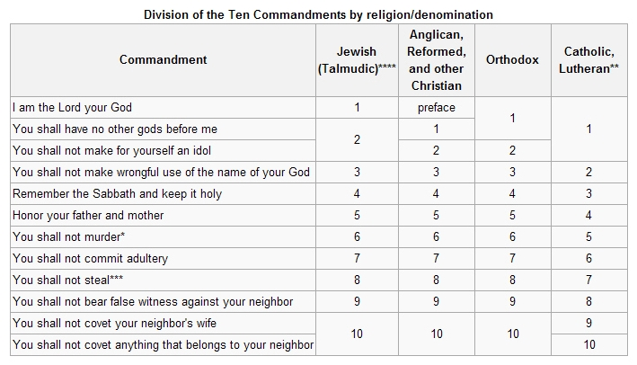
Notes:
Source: http://en.wikipedia.org/wiki/Ten_Commandments
Exodus 20:1-17 – “The Decalogue”
Notice that the Talmudic understanding of the Ten Commandments , and those of various denominations, are somewhat at variance with each other.
Other Biblical references to the Law: Deuteronomy 5:6-21 and Exodus 34:11-27.

Slide 79
The Exodus
The Ten Commandments (Exodus 20:1-17; WLC 91-152)
  Thou shalt have no other gods before me (Q 103)
  Thou shalt not make any graven images (Q 107)
  Thou shalt not take the name of the Lord thy God in vain (Q 111)
  Remember the Sabbath day, to keep it holy (Q 115)
  Honor thy father and thy mother (Q 123)
  Thou shalt not kill (Q 134)
  Thou shalt not commit adultery Q 137)
  Thou shalt not steal (Q 141)
  Thou shalt not bear false witness (Q 143)
Notes:
Westminster Larger Catechism, see Reformation Study Bible, page 2199.
See http://www.opc.org/lc.html for the Larger Catechism; refer to Questions 91-152 in general, and Questions 101-148 specifically.
Exodus 20:18-26 – 18 When the people saw the thunder and lightning and heard the trumpet and saw the mountain in smoke, they trembled with fear. They stayed at a distance 19 and said to Moses, "Speak to us yourself and we will listen. But do not have God speak to us or we will die.“ 20 Moses said to the people, "Do not be afraid. God has come to test you, so that the fear of God will be with you to keep you from sinning.“ 21 The people remained at a distance, while Moses approached the thick darkness where God was.
Idols and Altars
22 Then the LORD said to Moses, "Tell the Israelites this: 'You have seen for yourselves that I have spoken to you from heaven: 23 Do not make any gods to be alongside me; do not make for yourselves gods of silver or gods of gold. 24 " 'Make an altar of earth for me and sacrifice on it your burnt offerings and fellowship offerings, your sheep and goats and your cattle. Wherever I cause my name to be honored, I will come to you and bless you. 25 If you make an altar of stones for me, do not build it with dressed stones, for you will defile it if you use a tool on it. 26 And do not go up to my altar on steps, lest your nakedness be exposed on it.'

Slide 80
The Exodus
The Israelites camped at Mount Sinai (Exodus 19)
God proposes a Covenant, the people agree (Exodus 19:3-9)
God’s people are consecrated (Exodus 19:10-15)
Moses meets the Lord on the mountain (Exodus 19:16-25)
The Ten Commandments (Exodus 20:1-17)
Laws given to the people (Exodus 21:1-23:19)
Notes:
Exodus 21:1 – 23:19 deal with specific laws given by God through Moses to the Israelites. Smith will deal with all such laws from Exodus, Leviticus, Numbers, and Deuteronomy in a single collection organized by subject, in order to avoid the repetition found in the four books.
We continue here as attention turns back to God’s final instructions and the promises which He makes as His part of the covenant with the people of Israel.

Slide 81
The Exodus
The Israelites camped at Mount Sinai (Exodus 19)
God proposes a Covenant, the people agree (Exodus 19:3-9)
God’s people are consecrated (Exodus 19:10-15)
Moses meets the Lord on the mountain (Exodus 19:16-25)
The Ten Commandments (Exodus 20:1-17)
Laws given to the people (Exodus 21:1-23:19)
The nation of Israel to be a theocracy, governed by God Himself
Notes:
Exodus 23:20

Slide 82
The Exodus
The Israelites camped at Mount Sinai (Exodus 19)
God proposes a Covenant, the people agree (Exodus 19:3-9)
God’s people are consecrated (Exodus 19:10-15)
Moses meets the Lord on the mountain (Exodus 19:16-25)
The Ten Commandments (Exodus 20:1-17)
Laws given to the people (Exodus 21:1-23:19)
The nation of Israel to be a theocracy, governed by God Himself
The Covenant confirmed (Exodus 24:1-8) with blood
Notes:
Exodus 24:1-8 – 1 Then he said to Moses, "Come up to the LORD, you and Aaron, Nadab and Abihu, and seventy of the elders of Israel. You are to worship at a distance, 2 but Moses alone is to approach the LORD; the others must not come near. And the people may not come up with him." 3 When Moses went and told the people all the LORD's words and laws, they responded with one voice, "Everything the LORD has said we will do." 4 Moses then wrote down everything the LORD had said.
He got up early the next morning and built an altar at the foot of the mountain and set up twelve stone pillars representing the twelve tribes of Israel. 5 Then he sent young Israelite men, and they offered burnt offerings and sacrificed young bulls as fellowship offerings to the LORD. 6 Moses took half of the blood and put it in bowls, and the other half he sprinkled on the altar. 7 Then he took the Book of the Covenant and read it to the people. They responded, "We will do everything the LORD has said; we will obey."
8 Moses then took the blood, sprinkled it on the people and said, "This is the blood of the covenant that the LORD has made with you in accordance with all these words.“
9 Moses and Aaron, Nadab and Abihu, and the seventy elders of Israel went up 10 and saw the God of Israel. Under his feet was something like a pavement made of sapphire, clear as the sky itself. 11 But God did not raise his hand against these leaders of the Israelites; they saw God, and they ate and drank.

Slide 83
The Exodus
The Israelites camped at Mount Sinai (Exodus 19)
God proposes a Covenant, the people agree (Exodus 19:3-9)
God’s people are consecrated (Exodus 19:10-15)
Moses meets the Lord on the mountain (Exodus 19:16-25)
The Ten Commandments (Exodus 20:1-17)
Laws given to the people (Exodus 21:1-23:19)
The nation of Israel to be a theocracy, governed by God Himself
The Covenant confirmed (Exodus 24:1-8) with blood
Moses called up on the Mountain (Exodus 24:12-18) for 40 days
Notes:
Exodus 24:12-18 – 12 The LORD said to Moses, "Come up to me on the mountain and stay here, and I will give you the tablets of stone, with the law and commands I have written for their instruction."
13 Then Moses set out with Joshua his aide, and Moses went up on the mountain of God. 14 He said to the elders, "Wait here for us until we come back to you. Aaron and Hur are with you, and anyone involved in a dispute can go to them."
15 When Moses went up on the mountain, the cloud covered it, 16 and the glory of the LORD settled on Mount Sinai. For six days the cloud covered the mountain, and on the seventh day the LORD called to Moses from within the cloud. 17 To the Israelites the glory of the LORD looked like a consuming fire on top of the mountain. 18 Then Moses entered the cloud as he went on up the mountain. And he stayed on the mountain forty days and forty nights.

Slide 84
The Exodus
The Israelites camped at Mount Sinai (Exodus 19)
God proposes a Covenant, the people agree (Exodus 19:3-9)
God’s people are consecrated (Exodus 19:10-15)
Moses meets the Lord on the mountain (Exodus 19:16-25)
The Ten Commandments (Exodus 20:1-17)
Laws given to the people (Exodus 21:1-23:19)
The nation of Israel to be a theocracy, governed by God Himself
The Covenant confirmed (Exodus 24:1-8) with blood
Moses called up on the Mountain (Exodus 24:12-18) for 40 days
  Directions for offering and worship (Exodus 25:1-7)
Notes:
Exodus 25:1-7 – 1 The LORD said to Moses, 2 "Tell the Israelites to bring me an offering. You are to receive the offering for me from each man whose heart prompts him to give. 3 These are the offerings you are to receive from them: gold, silver and bronze; 4 blue, purple and scarlet yarn and fine linen; goat hair; 5 ram skins dyed red and hides of sea cows; acacia wood; 6 olive oil for the light; spices for the anointing oil and for the fragrant incense; 7 and onyx stones and other gems to be mounted on the ephod and breastpiece.

Slide 85
The Exodus
The Israelites camped at Mount Sinai (Exodus 19)
God proposes a Covenant, the people agree (Exodus 19:3-9)
God’s people are consecrated (Exodus 19:10-15)
Moses meets the Lord on the mountain (Exodus 19:16-25)
The Ten Commandments (Exodus 20:1-17)
Laws given to the people (Exodus 21:1-23:19)
The nation of Israel to be a theocracy, governed by God Himself
The Covenant confirmed (Exodus 24:1-8) with blood
Moses called up on the Mountain (Exodus 24:12-18) for 40 days
  Directions for offering and worship (Exodus 25:1-7)
  First mention of the Tabernacle (Exodus 25:8-9)
Notes:
Exodus 25:8-9 – 8 "Then have them make a sanctuary for me, and I will dwell among them. 9 Make this tabernacle and all its furnishings exactly like the pattern I will show you.

Slide 86
The Exodus
The Israelites camped at Mount Sinai (Exodus 19)
God proposes a Covenant, the people agree (Exodus 19:3-9)
God’s people are consecrated (Exodus 19:10-15
Moses meets the Lord on the mountain (Exodus 19:16-25)
The Ten Commandments (Exodus 20:1-17)
Laws given to the people (Exodus 21:1-23:19)
The nation of Israel to be a theocracy, governed by God Himself
The Covenant confirmed (Exodus 24:1-8) with blood
Moses called up on the Mountain (Exodus 24:12-18) for 40 days
  Directions for offering and worship (Exodus 25:1-7)
  First mention of the Tabernacle (Exodus 25:8-9)
  Instructions for the Ark of the Covenant (Exodus 25:10-22)
Notes:
Exodus 25:10-22 – 10 "Have them make a chest of acacia wood—two and a half cubits long, a cubit and a half wide, and a cubit and a half high. 11 Overlay it with pure gold, both inside and out, and make a gold molding around it. 12 Cast four gold rings for it and fasten them to its four feet, with two rings on one side and two rings on the other. 13 Then make poles of acacia wood and overlay them with gold. 14 Insert the poles into the rings on the sides of the chest to carry it. 15 The poles are to remain in the rings of this ark; they are not to be removed. 16 Then put in the ark the Testimony, which I will give you. 17 "Make an atonement cover of pure gold—two and a half cubits long and a cubit and a half wide. 18 And make two cherubim out of hammered gold at the ends of the cover. 19 Make one cherub on one end and the second cherub on the other; make the cherubim of one piece with the cover, at the two ends. 20 The cherubim are to have their wings spread upward, overshadowing the cover with them. The cherubim are to face each other, looking toward the cover. 21 Place the cover on top of the ark and put in the ark the Testimony, which I will give you. 22 There, above the cover between the two cherubim that are over the ark of the Testimony, I will meet with you and give you all my commands for the Israelites.
Dimensions are about 45 inches long, 27 inches wide, and 27 inches high.

Slide 87
The Exodus
The Israelites camped at Mount Sinai (Exodus 19)
God proposes a Covenant, the people agree (Exodus 19:3-9)
God’s people are consecrated (Exodus 19:10-15)
Moses meets the Lord on the mountain (Exodus 19:16-25)
The Ten Commandments (Exodus 20:1-17)
Laws given to the people (Exodus 21:1-23:19)
The nation of Israel to be a theocracy, governed by God Himself
The Covenant confirmed (Exodus 24:1-8) with blood
Moses called up on the Mountain (Exodus 24:12-18) for 40 days
  Directions for offering and worship (Exodus 25:1-7)
  First mention of the Tabernacle (Exodus 25:8-9)
  Instructions for the Ark of the Covenant (Exodus 25:10-22)
  Construction of the Table (v. 23-30) and the Lampstand (v. 31-40)
Notes:
Exodus 25:23-40 – The Table 23 "Make a table of acacia wood—two cubits long, a cubit wide and a cubit and a half high. 24 Overlay it with pure gold and make a gold molding around it. 25 Also make around it a rim a handbreadth wide and put a gold molding on the rim. 26 Make four gold rings for the table and fasten them to the four corners, where the four legs are. 27 The rings are to be close to the rim to hold the poles used in carrying the table. 28 Make the poles of acacia wood, overlay them with gold and carry the table with them. 29 And make its plates and dishes of pure gold, as well as its pitchers and bowls for the pouring out of offerings. 30 Put the bread of the Presence on this table to be before me at all times. The Lampstand 31 "Make a lampstand of pure gold and hammer it out, base and shaft; its flowerlike cups, buds and blossoms shall be of one piece with it. 32 Six branches are to extend from the sides of the lampstand—three on one side and three on the other. 33 Three cups shaped like almond flowers with buds and blossoms are to be on one branch, three on the next branch, and the same for all six branches extending from the lampstand. 34 And on the lampstand there are to be four cups shaped like almond flowers with buds and blossoms. 35 One bud shall be under the first pair of branches extending from the lampstand, a second bud under the second pair, and a third bud under the third pair—six branches in all. 36 The buds and branches shall all be of one piece with the lampstand, hammered out of pure gold. 37 "Then make its seven lamps and set them up on it so that they light the space in front of it. 38 Its wick trimmers and trays are to be of pure gold. 39 A talent of pure gold is to be used for the lampstand and all these accessories. 40 See that you make them according to the pattern shown you on the mountain.

Slide 88
The Exodus
The Israelites camped at Mount Sinai (Exodus 19)
God proposes a Covenant, the people agree (Exodus 19:3-9)
God’s people are consecrated (Exodus 19:10-15
Moses meets the Lord on the mountain (Exodus 19:16-25)
The Ten Commandments (Exodus 20:1-17)
Laws given to the people (Exodus 21:1-23:19)
The nation of Israel to be a theocracy, governed by God Himself
The Covenant confirmed (Exodus 24:1-8) with blood
Moses called up on the Mountain (Exodus 24:12-18) for 40 days
  Directions for offering and worship (Exodus 25:1-7)
  First mention of the Tabernacle (Exodus 25:8-9)
  Instructions for the Ark of the Covenant (Exodus 25:10)
  Construction of the Table (v. 23) and the Lampstand (v. 31)
  Layout and construction of the Tabernacle (Exodus 26:1-30)
Notes:
Exodus 26:1-30 – very specific instructions about the layout and construction of the Tabernacle. See Narrated Bible, page 128 ff and Reformation Study Bible, page 138 ff for diagrams.

Slide 89
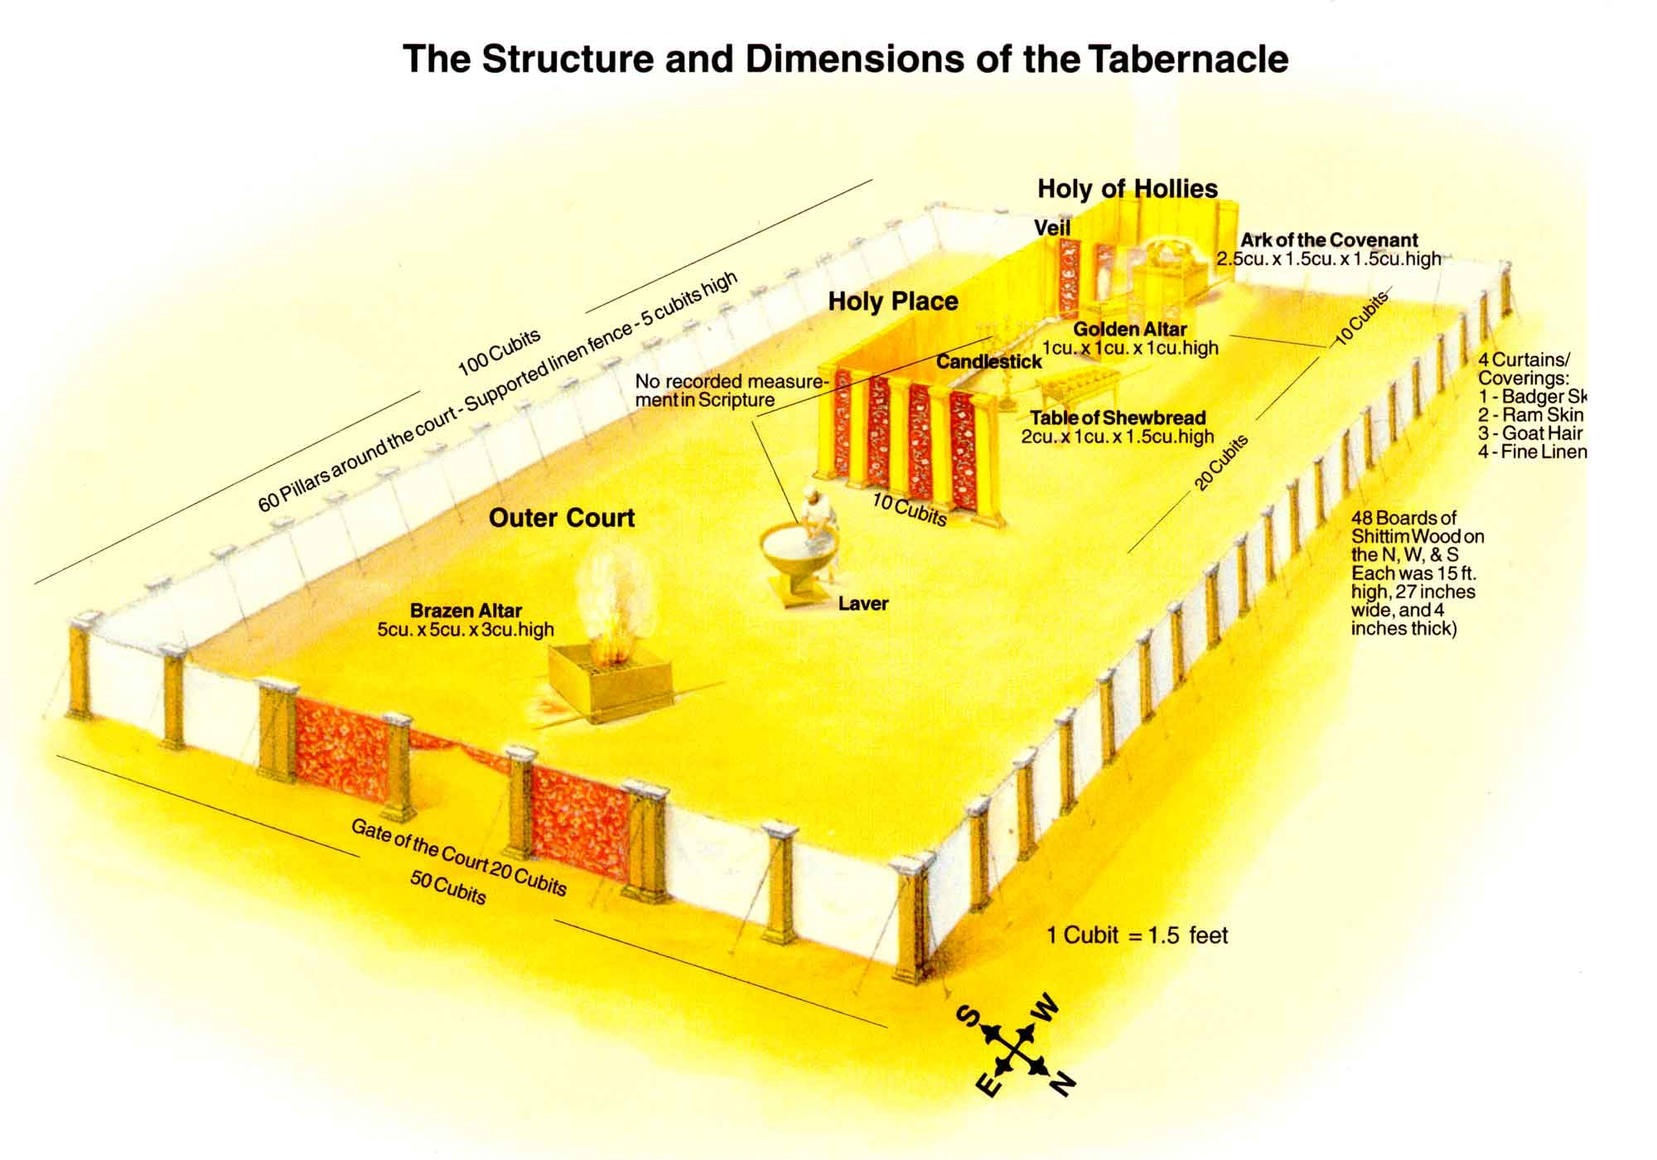
Notes:
Source: http://www.templebuilders.com/tabernacleimages/tabernacle2enlargement.jpg

Slide 90
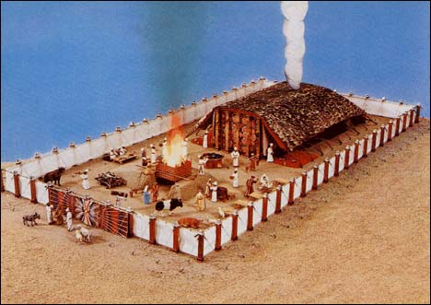
Notes:
Source: http://www.jesuswalk.com/names-god/images/tabernacle_model468x331.jpg and
http://backwoodspresbyterian.wordpress.com/2007/12/05/the-tabernacle-and-the-new-testament-church/

Slide 91
The Exodus
Moses called up on the Mountain (Exodus 24:12-18) for 40 days
  Directions for offering and worship (Exodus 25:1-7)
  First mention of the Tabernacle (Exodus 25:8-9)
  Instructions for the Ark of the Covenant (Exodus 25:10)
  Construction of the Table (v. 23) and the Lampstand (v. 31)
  Layout and construction of the Tabernacle (Exodus 26)
  Design of the Altar of Burnt Offering (Exodus 27)

Slide 92
The Exodus
Moses called up on the Mountain (Exodus 24:12-18) for 40 days
  Directions for offering and worship (Exodus 25:1-7)
  First mention of the Tabernacle (Exodus 25:8-9)
  Instructions for the Ark of the Covenant (Exodus 25:10)
  Construction of the Table (v. 23) and the Lampstand (v. 31)
  Layout and construction of the Tabernacle (Exodus 26)
  Design of the Altar of Burnt Offering (Exodus 27)
  Garments for the Priests (Exodus 28)

Slide 93
The Exodus
Moses called up on the Mountain (Exodus 24:12-18) for 40 days
  Directions for offering and worship (Exodus 25:1-7)
  First mention of the Tabernacle (Exodus 25:8-9)
  Instructions for the Ark of the Covenant (Exodus 25:10)
  Construction of the Table (v. 23) and the Lampstand (v. 31)
  Layout and construction of the Tabernacle (Exodus 26)
  Design of the Altar of Burnt Offering (Exodus 27)
  Garments for the Priests (Exodus 28)
    The Ephod
Notes:
Exodus 28:6-14 – 6 "Make the ephod of gold, and of blue, purple and scarlet yarn, and of finely twisted linen—the work of a skilled craftsman. 7 It is to have two shoulder pieces attached to two of its corners, so it can be fastened. 8 Its skillfully woven waistband is to be like it—of one piece with the ephod and made with gold, and with blue, purple and scarlet yarn, and with finely twisted linen. 9 "Take two onyx stones and engrave on them the names of the sons of Israel 10 in the order of their birth—six names on one stone and the remaining six on the other. 11 Engrave the names of the sons of Israel on the two stones the way a gem cutter engraves a seal. Then mount the stones in gold filigree settings 12 and fasten them on the shoulder pieces of the ephod as memorial stones for the sons of Israel. Aaron is to bear the names on his shoulders as a memorial before the LORD. 13 Make gold filigree settings 14 and two braided chains of pure gold, like a rope, and attach the chains to the settings.

Slide 94
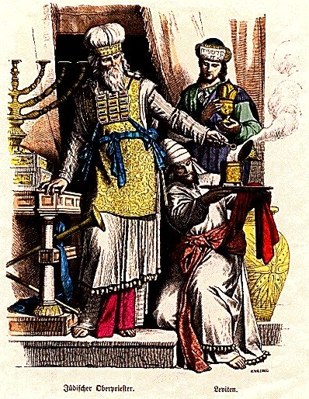
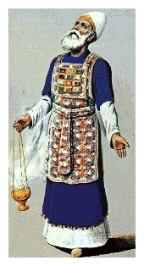
Notes:
Source (left picture) – http://en.wikipedia.org/wiki/File:PLATE4DX.jpg
Source (right picture) - http://calvarypslwomen.com/blog/wp-content/uploads/2008/02/ephod-with-chestpiece.thumbnail.jpg

Slide 95
The Exodus
Moses called up on the Mountain (Exodus 24:12-18) for 40 days
  Directions for offering and worship (Exodus 25:1-7)
  First mention of the Tabernacle (Exodus 25:8-9)
  Instructions for the Ark of the Covenant (Exodus 25:10)
  Construction of the Table (v. 23) and the Lampstand (v. 31)
  Layout and construction of the Tabernacle (Exodus 26)
  Design of the Altar of Burnt Offering (Exodus 27)
  Garments for the Priests (Exodus 28)
    The Ephod
    The Breastpiece with the Umin and Thumin – for decisions
Notes:
Exodus 28:15-30 – 15 "Fashion a breastpiece for making decisions—the work of a skilled craftsman. Make it like the ephod: of gold, and of blue, purple and scarlet yarn, and of finely twisted linen. 16 It is to be square—a span long and a span wide—and folded double. 17 Then mount four rows of precious stones on it. In the first row there shall be a ruby, a topaz and a beryl; 18 in the second row a turquoise, a sapphire and an emerald; 19 in the third row a jacinth, an agate and an amethyst; 20 in the fourth row a chrysolite, an onyx and a jasper. Mount them in gold filigree settings. 21 There are to be twelve stones, one for each of the names of the sons of Israel, each engraved like a seal with the name of one of the twelve tribes. 22 "For the breastpiece make braided chains of pure gold, like a rope. 23 Make two gold rings for it and fasten them to two corners of the breastpiece. 24 Fasten the two gold chains to the rings at the corners of the breastpiece, 25 and the other ends of the chains to the two settings, attaching them to the shoulder pieces of the ephod at the front. 26 Make two gold rings and attach them to the other two corners of the breastpiece on the inside edge next to the ephod. 27 Make two more gold rings and attach them to the bottom of the shoulder pieces on the front of the ephod, close to the seam just above the waistband of the ephod. 28 The rings of the breastpiece are to be tied to the rings of the ephod with blue cord, connecting it to the waistband, so that the breastpiece will not swing out from the ephod. 29 "Whenever Aaron enters the Holy Place, he will bear the names of the sons of Israel over his heart on the breastpiece of decision as a continuing memorial before the LORD. 30 Also put the Urim and the Thummim in the breastpiece, so they may be over Aaron's heart whenever he enters the presence of the LORD. Thus Aaron will always bear the means of making decisions for the Israelites over his heart before the LORD.
Exodus 28:31-43 – 31 "Make the robe of the ephod entirely of blue cloth, 32 with an opening for the head in its center. There shall be a woven edge like a collar around this opening, so that it will not tear. 33 Make pomegranates of blue, purple and scarlet yarn around the hem of the robe, with gold bells between them. 34 The gold bells and the pomegranates are to alternate around the hem of the robe. 35 Aaron must wear it when he ministers. The sound of the bells will be heard when he enters the Holy Place before the LORD and when he comes out, so that he will not die. 36 "Make a plate of pure gold and engrave on it as on a seal: HOLY TO THE LORD. 37 Fasten a blue cord to it to attach it to the turban; it is to be on the front of the turban. 38 It will be on Aaron's forehead, and he will bear the guilt involved in the sacred gifts the Israelites consecrate, whatever their gifts may be. It will be on Aaron's forehead continually so that they will be acceptable to the LORD. 39 "Weave the tunic of fine linen and make the turban of fine linen. The sash is to be the work of an embroiderer. 40 Make tunics, sashes and headbands for Aaron's sons, to give them dignity and honor. 41 After you put these clothes on your brother Aaron and his sons, anoint and ordain them. Consecrate them so they may serve me as priests. 42 "Make linen undergarments as a covering for the body, reaching from the waist to the thigh. 43 Aaron and his sons must wear them whenever they enter the Tent of Meeting or approach the altar to minister in the Holy Place, so that they will not incur guilt and die. "This is to be a lasting ordinance for Aaron and his descendants.

Slide 96
The Exodus
Moses called up on the Mountain (Exodus 24:12-18) for 40 days
  Directions for offering and worship (Exodus 25:1-7)
  First mention of the Tabernacle (Exodus 25:8-9)
  Instructions for the Ark of the Covenant (Exodus 25:10)
  Construction of the Table (v. 23) and the Lampstand (v. 31)
  Layout and construction of the Tabernacle (Exodus 26)
  Design of the Altar of Burnt Offering (Exodus 27)
  Garments for the Priests (Exodus 28)
    The Ephod
    The Breastpiece with the Umin and Thumin – for decisions
  Consecration of the Priests (Exodus 29 – the Levites)
Notes:
Exodus 29:1-44 – Consecration of the Priests – Aaron and his sons – by making sacrifice of a young bull and two rams on their behalf. They are to serve as priests before the Lord. “The priesthood is theirs by a lasting ordinance.” (v. 8) A portion of the offering is to be given to the priests – Exodus 29:28 ”This is always to be the regular share from the Israelites for Aaron and his sons. It is the contribution the Israelites are to make to the LORD from their fellowship offerings.”

Slide 97
The Exodus
Moses called up on the Mountain (Exodus 24:12-18) for 40 days
  Directions for offering and worship (Exodus 25:1-7)
  First mention of the Tabernacle (Exodus 25:8-9)
  Instructions for the Ark of the Covenant (Exodus 25:10)
  Construction of the Table (v. 23) and the Lampstand (v. 31)
  Layout and construction of the Tabernacle (Exodus 26)
  Design of the Altar of Burnt Offering (Exodus 27)
  Garments for the Priests (Exodus 28)
    The Ephod
    The Breastpiece with the Umin and Thumin – for decisions
  Consecration of the Priests (Exodus 29 – the Levites)
  The Altar of Incense (Exodus 30) – atonement money, basin for washing, anointing oil, incense
Notes:
v. 1-10 – Altar of Incense – for Aaron to offer incense to God – a specific, annual, most Holy offering of atonement. Meant to be continued for generations to come.
v. 11-16 – atonement money (ransom money, an offering for the maintenance of the Tent of Meeting, and a memorial for the Israelites)
v. 17-21 – basin for washing (for the priests – Aaron and his sons – to purify themselves before coming into the presence of the Lord)
v. 22-33 – a sacred anointing oil, of a specific, God-given formula, to be used to consecrate all the articles of the Tabernacle
v. 30 – Aaron and his sons to be anointed and consecrated as priests
v. 34-38 – an incense of a specific, God-given formula for use only in front of the Testimony in the Tent of Meeting.
v. 33, 38 – admonition against using these holy oils and incenses for any other purposes than what God prescribes.

Slide 98
The Exodus
Moses called up on the Mountain (Exodus 24:12-18) for 40 days
  Directions for offering and worship (Exodus 25:1-7)
  First mention of the Tabernacle (Exodus 25:8-9)
  Instructions for the Ark of the Covenant (Exodus 25:10)
  Construction of the Table (v. 23) and the Lampstand (v. 31)
  Layout and construction of the Tabernacle (Exodus 26)
  Design of the Altar of Burnt Offering (Exodus 27)
  Garments for the Priests (Exodus 28)
    The Ephod
    The Breastpiece with the Umin and Thumin – for decisions
  Consecration of the Priests (Exodus 29 – the Levites)
  The Altar of Incense (Exodus 30) – atonement money, basin for washing, anointing oil, incense
  Bezalel and Oholiab given special skills by God (Exodus 31:1-11)
Notes:
Specific craftsmen, chosen by God, given their artistic gifts by God, and filled with the Holy Spirit by God

Slide 99
The Exodus
Moses called up on the Mountain (Exodus 24:12-18) for 40 days
  Directions for offering and worship (Exodus 25:1-7)
  First mention of the Tabernacle (Exodus 25:8-9)
  Instructions for the Ark of the Covenant (Exodus 25:10)
  Construction of the Table (v. 23) and the Lampstand (v. 31)
  Layout and construction of the Tabernacle (Exodus 26)
  Design of the Altar of Burnt Offering (Exodus 27)
  Garments for the Priests (Exodus 28)
    The Ephod
    The Breastpiece with the Umin and Thumin – for decisions
  Consecration of the Priests (Exodus 29 – the Levites)
  The Altar of Incense (Exodus 30) – atonement money, basin for washing, anointing oil, incense
  Bezalel and Oholiab given special skills by God (Exodus 31:1-11)
  Sabbath observance reiterated (Exodus 31:12-18)

Slide 100
The Exodus
Moses was on the mountain with the Lord for Forty Days
Notes:
Exodus 31:18 – When the LORD finished speaking to Moses on Mount Sinai, he gave him the two tablets of the Testimony, the tablets of stone inscribed by the finger of God.

Slide 101
The Exodus
Moses was on the mountain with the Lord for Forty Days
The people demanded that Aaron make them a god (Ex 32:1)
Notes:
Read Smith’s account, “The Covenant Broken and Renewed,” p. 135
Exodus 32:1 When the people saw that Moses was so long in coming down from the mountain, they gathered around Aaron and said, "Come, make us gods who will go before us. As for this fellow Moses who brought us up out of Egypt, we don't know what has happened to him." 2 Aaron answered them, "Take off the gold earrings that your wives, your sons and your daughters are wearing, and bring them to me." 3 So all the people took off their earrings and brought them to Aaron. 4He took what they handed him and made it into an idol cast in the shape of a calf, fashioning it with a tool. Then they said, "These are your gods, O Israel, who brought you up out of Egypt."

Slide 102
The Exodus
Moses was on the mountain with the Lord for Forty Days
The people demanded that Aaron make them a god (Ex 32:1)
Aaron makes the golden calf; the people indulge in revelry
Notes:
Exodus 32:5 When Aaron saw this, he built an altar in front of the calf and announced, "Tomorrow there will be a festival to the LORD." 6 So the next day the people rose early and sacrificed burnt offerings and presented fellowship offerings. Afterward they sat down to eat and drink and got up to indulge in revelry.

Slide 103
The Exodus
Moses was on the mountain with the Lord for Forty Days
The people demanded that Aaron make them a god (Ex 32:1)
Aaron makes the golden calf; the people indulge in revelry
God angered, threatens death, Moses argues for the people
Notes:
Exodus 32:7 Then the LORD said to Moses, "Go down, because your people, whom you brought up out of Egypt, have become corrupt. 8 They have been quick to turn away from what I commanded them and have made themselves an idol cast in the shape of a calf. They have bowed down to it and sacrificed to it and have said, 'These are your gods, O Israel, who brought you up out of Egypt.'
9 "I have seen these people," the LORD said to Moses, "and they are a stiff-necked people. 10 Now leave me alone so that my anger may burn against them and that I may destroy them. Then I will make you into a great nation."

Slide 104
The Exodus
Moses was on the mountain with the Lord for Forty Days
The people demanded that Aaron make them a god (Ex 32:1)
Aaron makes the golden calf; the people indulge in revelry
God angered, threatens death, Moses argues for the people
Moses descends from the mountain, breaks the tablets of the Law
Notes:
Exodus 32:11 But Moses sought the favor of the LORD his God. "O LORD," he said, "why should your anger burn against your people, whom you brought out of Egypt with great power and a mighty hand? 12 Why should the Egyptians say, 'It was with evil intent that he brought them out, to kill them in the mountains and to wipe them off the face of the earth'? Turn from your fierce anger; relent and do not bring disaster on your people. 13 Remember your servants Abraham, Isaac and Israel, to whom you swore by your own self: 'I will make your descendants as numerous as the stars in the sky and I will give your descendants all this land I promised them, and it will be their inheritance forever.' " 14 Then the LORD relented and did not bring on his people the disaster he had threatened.
15 Moses turned and went down the mountain with the two tablets of the Testimony in his hands. They were inscribed on both sides, front and back. 16 The tablets were the work of God; the writing was the writing of God, engraved on the tablets.
17 When Joshua heard the noise of the people shouting, he said to Moses, "There is the sound of war in the camp."
18 Moses replied:
"It is not the sound of victory,
it is not the sound of defeat;
it is the sound of singing that I hear."
19 When Moses approached the camp and saw the calf and the dancing, his anger burned and he threw the tablets out of his hands, breaking them to pieces at the foot of the mountain. 20 And he took the calf they had made and burned it in the fire; then he ground it to powder, scattered it on the water and made the Israelites drink it.

Slide 105
The Exodus
Moses was on the mountain with the Lord for Forty Days
The people demanded that Aaron make them a god (Exodus 32:1)
Aaron makes the golden calf; the people indulge in revelry
God angered, threatens death, Moses argues for the people
Moses descends from the mountain, breaks the tablets of the Law
The Levites rally behind Moses; 3000 people killed for their sin
Notes:
Exodus 32:21 He said to Aaron, "What did these people do to you, that you led them into such great sin?"
22 "Do not be angry, my lord," Aaron answered. "You know how prone these people are to evil. 23 They said to me, 'Make us gods who will go before us. As for this fellow Moses who brought us up out of Egypt, we don't know what has happened to him.' 24 So I told them, 'Whoever has any gold jewelry, take it off.' Then they gave me the gold, and I threw it into the fire, and out came this calf!"
25 Moses saw that the people were running wild and that Aaron had let them get out of control and so become a laughingstock to their enemies. 26 So he stood at the entrance to the camp and said, "Whoever is for the LORD, come to me." And all the Levites rallied to him.
27 Then he said to them, "This is what the LORD, the God of Israel, says: 'Each man strap a sword to his side. Go back and forth through the camp from one end to the other, each killing his brother and friend and neighbor.' " 28 The Levites did as Moses commanded, and that day about three thousand of the people died.

Slide 106
The Exodus
Moses was on the mountain with the Lord for Forty Days
The people demanded that Aaron make them a god (Ex 32:1)
Aaron makes the golden calf; the people indulge in revelry
God angered, threatens death, Moses argues for the people
Moses descends from the mountain, breaks the tablets of the Law
The Levites rally behind Moses; 3000 people killed for their sin
The Levites set apart to the Lord (Ex 32:29)
Notes:
Exodus 32:29 Then Moses said, "You have been set apart to the LORD today, for you were against your own sons and brothers, and he has blessed you this day."

Slide 107
The Exodus
Moses was on the mountain with the Lord for Forty Days
The people demanded that Aaron make them a god (Ex 32:1)
Aaron makes the golden calf; the people indulge in revelry
God angered, threatens death, Moses argues for the people
Moses descends from the mountain, breaks the tablets of the Law
The Levites rally behind Moses; 3000 people killed for their sin
The Levites set apart to the Lord (Ex 32:29)
Moses begs God’s forgiveness for the Israelites; God relents
Notes:
Exodus 32:30 The next day Moses said to the people, "You have committed a great sin. But now I will go up to the LORD; perhaps I can make atonement for your sin."
31 So Moses went back to the LORD and said, "Oh, what a great sin these people have committed! They have made themselves gods of gold. 32 But now, please forgive their sin—but if not, then blot me out of the book you have written.“
33 The LORD replied to Moses, "Whoever has sinned against me I will blot out of my book. 34 Now go, lead the people to the place I spoke of, and my angel will go before you. However, when the time comes for me to punish, I will punish them for their sin."

Slide 108
The Exodus
Moses was on the mountain with the Lord for Forty Days
The people demanded that Aaron make them a god (Ex 32:1)
Aaron makes the golden calf; the people indulge in revelry
God angered, threatens death, Moses argues for the people
Moses descends from the mountain, breaks the tablets of the Law
The Levites rally behind Moses; 3000 people killed for their sin
The Levites set apart to the Lord (Ex 32:29)
Moses begs God’s forgiveness for the Israelites; God relents
But God does promise punishment for their sin (Ex 32:33-35) and a plague comes upon them
Notes:
Exodus 32:35 And the LORD struck the people with a plague because of what they did with the calf Aaron had made.

Slide 109
The Exodus
Moses was on the mountain with the Lord for Forty Days
The people demanded that Aaron make them a god (Ex 32:1)
Aaron makes the golden calf; the people indulge in revelry
God angered, threatens death, Moses argues for the people
Moses descends from the mountain, breaks the tablets of the Law
The Levites rally behind Moses; 3000 people killed for their sin
The Levites set apart to the Lord (Ex 32:29)
Moses begs God’s forgiveness for the Israelites; God relents
But God does promise punishment for their sin (Ex 32:33-35) and a plague comes upon them
God orders the people to leave; he will no longer lead them
Notes:
Exodus 33:1 Then the LORD said to Moses, "Leave this place, you and the people you brought up out of Egypt, and go up to the land I promised on oath to Abraham, Isaac and Jacob, saying, 'I will give it to your descendants.' 2 I will send an angel before you and drive out the Canaanites, Amorites, Hittites, Perizzites, Hivites and Jebusites. 3 Go up to the land flowing with milk and honey. But I will not go with you, because you are a stiff-necked people and I might destroy you on the way."
4 When the people heard these distressing words, they began to mourn and no one put on any ornaments. 5 For the LORD had said to Moses, "Tell the Israelites, 'You are a stiff-necked people. If I were to go with you even for a moment, I might destroy you. Now take off your ornaments and I will decide what to do with you.' " 6 So the Israelites stripped off their ornaments at Mount Horeb.

Slide 110
The Exodus
Moses was on the mountain with the Lord for Forty Days
The people demanded that Aaron make them a god (Ex 32:1)
Aaron makes the golden calf; the people indulge in revelry
God angered, threatens death, Moses argues for the people
Moses descends from the mountain, breaks the tablets of the Law
The Levites rally behind Moses; 3000 people killed for their sin
The Levites set apart to the Lord (Ex 32:29)
Moses begs God’s forgiveness for the Israelites; God relents
But God does promise punishment for their sin (Ex 32:33-35) and a plague comes upon them
God orders the people to leave; he will no longer lead them
Moses’ “Tent of Meeting” where he meets with God (Ex 33:7-11)
Notes:
Exodus 33:7 Now Moses used to take a tent and pitch it outside the camp some distance away, calling it the "tent of meeting." Anyone inquiring of the LORD would go to the tent of meeting outside the camp. 8 And whenever Moses went out to the tent, all the people rose and stood at the entrances to their tents, watching Moses until he entered the tent. 9 As Moses went into the tent, the pillar of cloud would come down and stay at the entrance, while the LORD spoke with Moses. 10 Whenever the people saw the pillar of cloud standing at the entrance to the tent, they all stood and worshiped, each at the entrance to his tent. 11 The LORD would speak to Moses face to face, as a man speaks with his friend. Then Moses would return to the camp, but his young aide Joshua son of Nun did not leave the tent.

Slide 111
The Exodus
Moses was on the mountain with the Lord for Forty Days
The people demanded that Aaron make them a god (Ex 32:1)
Aaron makes the golden calf; the people indulge in revelry
God angered, threatens death, Moses argues for the people
Moses descends from the mountain, breaks the tablets of the Law
The Levites rally behind Moses; 3000 people killed for their sin
The Levites set apart to the Lord (Ex 32:29)
Moses begs God’s forgiveness for the Israelites; God relents
But God does promise punishment for their sin (Ex 32:33-35) and a plague comes upon them
God orders the people to leave; he will no longer lead them
Moses’ “Tent of Meeting” where he meets with God (Ex 33:7-11)
Moses prevails on the Lord to accompany them (Ex 33:12-17)
Notes:
Exodus 33:12 Moses said to the LORD, "You have been telling me, 'Lead these people,' but you have not let me know whom you will send with me. You have said, 'I know you by name and you have found favor with me.' 13 If you are pleased with me, teach me your ways so I may know you and continue to find favor with you. Remember that this nation is your people." 14 The LORD replied, "My Presence will go with you, and I will give you rest."
15 Then Moses said to him, "If your Presence does not go with us, do not send us up from here. 16 How will anyone know that you are pleased with me and with your people unless you go with us? What else will distinguish me and your people from all the other people on the face of the earth?"
17 And the LORD said to Moses, "I will do the very thing you have asked, because I am pleased with you and I know you by name."

Slide 112
The Exodus
Moses was on the mountain with the Lord for Forty Days
The people demanded that Aaron make them a god (Ex 32:1)
Aaron makes the golden calf; the people indulge in revelry
God angered, threatens death, Moses argues for the people
Moses descends from the mountain, breaks the tablets of the Law
The Levites rally behind Moses; 3000 people killed for their sin
The Levites set apart to the Lord (Ex 32:29)
Moses begs God’s forgiveness for the Israelites; God relents
But God does promise punishment for their sin (Ex 32:33-35) and a plague comes upon them
God orders the people to leave; he will no longer lead them
Moses’ “Tent of Meeting” where he meets with God (Ex 33:7-11)
Moses prevails on the Lord to accompany them (Ex 33:12-17)
Moses and the Glory of the Lord (Ex 33:18-23)
Notes:
Exodus 33:18 Then Moses said, "Now show me your glory."
19 And the LORD said, "I will cause all my goodness to pass in front of you, and I will proclaim my name, the LORD, in your presence. I will have mercy on whom I will have mercy, and I will have compassion on whom I will have compassion. 20 But," he said, "you cannot see my face, for no one may see me and live."
21 Then the LORD said, "There is a place near me where you may stand on a rock. 22 When my glory passes by, I will put you in a cleft in the rock and cover you with my hand until I have passed by. 23 Then I will remove my hand and you will see my back; but my face must not be seen."

Slide 113
The Exodus
God reveals His character to Moses (Ex 34:1-7)
Notes:
Exodus 34:1 The LORD said to Moses, "Chisel out two stone tablets like the first ones, and I will write on them the words that were on the first tablets, which you broke. 2 Be ready in the morning, and then come up on Mount Sinai. Present yourself to me there on top of the mountain. 3 No one is to come with you or be seen anywhere on the mountain; not even the flocks and herds may graze in front of the mountain." 4 So Moses chiseled out two stone tablets like the first ones and went up Mount Sinai early in the morning, as the LORD had commanded him; and he carried the two stone tablets in his hands. 5 Then the LORD came down in the cloud and stood there with him and proclaimed his name, the LORD. 6 And he passed in front of Moses, proclaiming, "The LORD, the LORD, the compassionate and gracious God, slow to anger, abounding in love and faithfulness, 7 maintaining love to thousands, and forgiving wickedness, rebellion and sin. Yet he does not leave the guilty unpunished; he punishes the children and their children for the sin of the fathers to the third and fourth generation."

Slide 114
The Exodus
God reveals His character to Moses (Ex 34:1-7)
God renews his covenant with the people (Ex 34:8-10)
Notes:
Exodus 34:8 Moses bowed to the ground at once and worshiped. 9 "O Lord, if I have found favor in your eyes," he said, "then let the Lord go with us. Although this is a stiff-necked people, forgive our wickedness and our sin, and take us as your inheritance."
10 Then the LORD said: "I am making a covenant with you. Before all your people I will do wonders never before done in any nation in all the world. The people you live among will see how awesome is the work that I, the LORD, will do for you.

Slide 115
The Exodus
God reveals His character to Moses (Ex 34:1-7)
God renews his covenant with the people (Ex 34:8-10)
God warns his people against treaties with pagans (Ex 34:11-16)
Notes:
Exodus 34:11 Obey what I command you today. I will drive out before you the Amorites, Canaanites, Hittites, Perizzites, Hivites and Jebusites. 12 Be careful not to make a treaty with those who live in the land where you are going, or they will be a snare among you. 13 Break down their altars, smash their sacred stones and cut down their Asherah poles. [a] 14 Do not worship any other god, for the LORD, whose name is Jealous, is a jealous God.
15 "Be careful not to make a treaty with those who live in the land; for when they prostitute themselves to their gods and sacrifice to them, they will invite you and you will eat their sacrifices. 16 And when you choose some of their daughters as wives for your sons and those daughters prostitute themselves to their gods, they will lead your sons to do the same.
Other Instructions from God to Moses:
Exodus 34:17-26 - 17 "Do not make cast idols.
18 "Celebrate the Feast of Unleavened Bread. For seven days eat bread made without yeast, as I commanded you. Do this at the appointed time in the month of Abib, for in that month you came out of Egypt.
19 "The first offspring of every womb belongs to me, including all the firstborn males of your livestock, whether from herd or flock. 20 Redeem the firstborn donkey with a lamb, but if you do not redeem it, break its neck. Redeem all your firstborn sons.
"No one is to appear before me empty-handed.
21 "Six days you shall labor, but on the seventh day you shall rest; even during the plowing season and harvest you must rest.
22 "Celebrate the Feast of Weeks with the firstfruits of the wheat harvest, and the Feast of Ingathering at the turn of the year. [b] 23 Three times a year all your men are to appear before the Sovereign LORD, the God of Israel. 24 I will drive out nations before you and enlarge your territory, and no one will covet your land when you go up three times each year to appear before the LORD your God.
25 "Do not offer the blood of a sacrifice to me along with anything containing yeast, and do not let any of the sacrifice from the Passover Feast remain until morning.
26 "Bring the best of the firstfruits of your soil to the house of the LORD your God.
"Do not cook a young goat in its mother's milk."

Slide 116
The Exodus
God reveals His character to Moses (Ex 34:1-7)
God renews his covenant with the people (Ex 34:8-10)
God warns his people against treaties with pagans (Ex 34:11-16)
The Lord makes new stone tablets (Ex 34:27-28)
Notes:
Exodus 34:27 Then the LORD said to Moses, "Write down these words, for in accordance with these words I have made a covenant with you and with Israel." 28 Moses was there with the LORD forty days and forty nights without eating bread or drinking water. And He wrote on the tablets the words of the covenant—the Ten Commandments.

Slide 117
The Exodus
God reveals His character to Moses (Ex 34:1-7)
God renews his covenant with the people (Ex 34:8-10)
God warns his people against treaties with pagans (Ex 34:11-16)
The Lord makes new stone tablets (Ex 34:27-28)
Moses’ radiant face (Ex 34:29-35)
Notes:
Exodus 34:29 When Moses came down from Mount Sinai with the two tablets of the Testimony in his hands, he was not aware that his face was radiant because he had spoken with the LORD. 30 When Aaron and all the Israelites saw Moses, his face was radiant, and they were afraid to come near him. 31 But Moses called to them; so Aaron and all the leaders of the community came back to him, and he spoke to them. 32 Afterward all the Israelites came near him, and he gave them all the commands the LORD had given him on Mount Sinai. 33 When Moses finished speaking to them, he put a veil over his face. 34 But whenever he entered the LORD's presence to speak with him, he removed the veil until he came out. And when he came out and told the Israelites what he had been commanded, 35 they saw that his face was radiant. Then Moses would put the veil back over his face until he went in to speak with the LORD.

Slide 118
The Exodus
God reveals His character to Moses (Ex 34:1-7)
God renews his covenant with the people (Ex 34:8-10)
God warns his people against treaties with pagans (Ex 34:11-16)
The Lord makes new stone tablets (Ex 34:27-28)
Moses’ radiant face (Ex 34:29-35)
Construction of the Tabernacle (Ex 35:1-40:35)
  God specified the materials
  God called for the skilled workers, and gave them the skill
  Everyone who was willing brought a freewill offering for the work
  The people had to be restrained from giving too much
  All the construction was as God had specified to Moses
  When it was completed, Moses blessed the work
  The Lord ordered the assembly, and anointing of the priests.
  God’s glory filled the tabernacle (Ex 40:34, 35)
Notes:
Read Smith’s notes, “Construction of the Tabernacle,” p. 140

Slide 119
The Exodus
God reveals His character to Moses (Ex 34:1-7)
God renews his covenant with the people (Ex 34:8-10)
God warns his people against treaties with pagans (Ex 34:11-16)
The Lord makes new stone tablets (Ex 34:27-28)
Moses’ radiant face (Ex 34:29-35)
Construction of the Tabernacle (Ex 35:1-40:35)
  God specified the materials
  God called for the skilled workers, and gave them the skill
  Everyone who was willing brought a freewill offering for the work
  The people had to be restrained from giving too much
  All the construction was as God had specified to Moses
  When it was completed, Moses blessed the work
  The Lord ordered the assembly, and anointing of the priests.
  God’s glory filled the tabernacle (Ex 40:34, 35)
The year is ca. 1445 B.C.
Notes:
Note that three months after leaving Egypt, the Israelites arrived at Mount Sinai. Moses was on the mountain forty days receiving the Ten Commandments and other instructions from God. When he came down he had to deal with the sin of idolatry (the golden calf) and then went up on the mountain again, seeing the Glory of the Lord, and was there for another forty days.

Slide 120
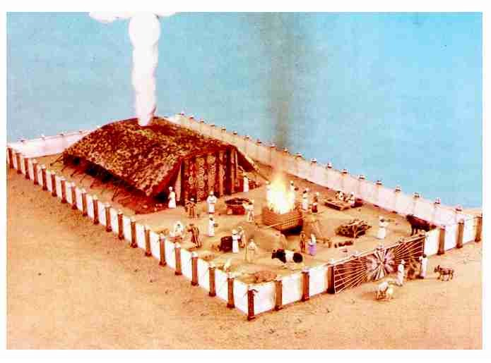
The Tabernacle
Notes:
From http://www.bibletruth.net/florlane/Tabernacle/tabernac.htm

Slide 121
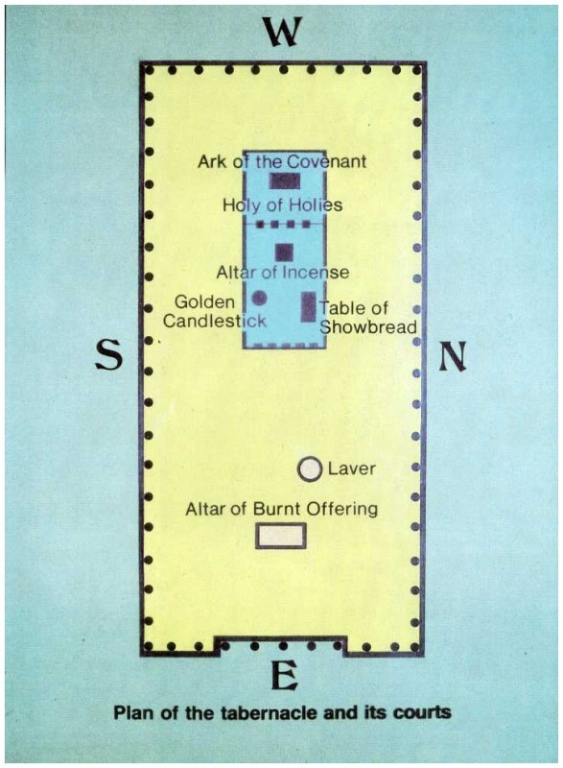
Plan of the Tabernacle
Notes:
From http://www.bibletruth.net/florlane/Tabernacle/tabernacle_graphic_map.htm

Slide 122
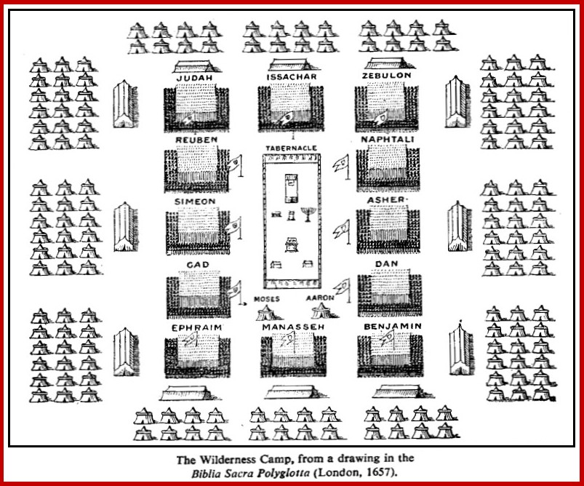
A Wilderness Camp
Notes:
Source: http://www.biblestudy.org/maps/large-map-israel-wilderness-camp-after-leaving-egypt.html

Slide 123
The Exodus
Summarizing the book of Exodus:
  Birth of Moses, his call to lead the Hebrews out of Egypt
  Pharaoh’s heart hardened; the Hebrews work made more difficult
  The Plagues on Egypt
  Passover instituted - to become a lasting ordinance
  Moses up on the mountain - the Ten Commandments given
  Aaron makes the golden calf, an idol (God is not amused)
  The Mosaic covenant, mediated by Moses, the nation committed
  God led his people through the desert
  Blessed for faithfulness, cursed for disobedience
  Directions from God for construction of the tabernacle
  The tabernacle built according to the instructions
Notes:
Exodus 40:34-38 – 34 Then the cloud covered the Tent of Meeting, and the glory of the LORD filled the tabernacle. 35 Moses could not enter the Tent of Meeting because the cloud had settled upon it, and the glory of the LORD filled the tabernacle. 36 In all the travels of the Israelites, whenever the cloud lifted from above the tabernacle, they would set out; 37 but if the cloud did not lift, they did not set out—until the day it lifted. 38 So the cloud of the LORD was over the tabernacle by day, and fire was in the cloud by night, in the sight of all the house of Israel during all their travels.
From the SOTR study Bible: “Israel’s journeys are linked to the guiding presence. The covenant God at last was dwelling amonh His people and would lead them to the land He had promised them.”

