Slide 1
The Life of Christ (Part 1)
Lesson 11
Jesus teaches by the Sea of Galilee
Jesus chooses twelve apostles
The sermon on the mount

Slide 2
Placement of this study in the seventeen period series
Creation
Flood
Scattering of the People
Patriarchs
Exodus
Wandering in the wilderness
Conquest of Canaan
Judges
United Kingdom

Slide 3
Placement of this study in the seventeen period series
Divided Kingdom
Judah alone
Captivity
Return
Years of Silence
Life of Christ
Early Church
Letters to Christians

Slide 4
7 periods of the life of Christ
Years of Preparation
Beginning of Ministry
Great Galilean Ministry
Period of Retirement
Close of Ministry
Last Week
Resurrection
Exaltation
This Quarter – Part 1

Slide 5
Outline
I The Years of Preparation (~30 years)
II The Beginning of Jesus’ Ministry (3 – 6 months)
III The Great Galilean Ministry (18 – 21 months)
IV The Period of Retirement (~6 months)
V The Close of Jesus’ Ministry (~6 months)
VI The Last Week
VII The Resurrection and Exaltation
  (From Bob’s outline on page vii-viii, narrative pages 16-20)

Slide 7
Review and finish Sabbath questions
On the sabbath:
Jesus healed a lame man (John 5)
Disciples pluck grain (Mark 2, Matt 12, Luke 6)
Jesus healed a man with a withered hand healed (Mark 3:1-6, Matt 12:9-14, Luke 6:6-11)
Notes:
Jesus was grieved at their hard hearts. They heard his words and saw his miracles, yet would not believe. Don’t underestimate the power of the god of this world (II Cor 4:4).

Slide 8
Review and finish Sabbath questions
These three examples provide divine commentary on the law of the sabbath from the Lord of the Sabbath:
The law allowed this man to carry his bed on the sabbath (John 5:8)
The law allowed the priests to do on the sabbath what others could not (Matt 12:5, kindle no fire Ex 35:3, blameless as instructed Num 28:2,8)
The law allowed one to pluck and eat on the sabbath as did the disciples (Matt 12:7)
The law allowed an animal to be lifted out of a pit on the sabbath (Matt 12:11)
The law allowed doing well on the sabbath, and healing on the sabbath (Matt 12:12)
Side note: Similarly, we have the leverage of Jesus’ commentary on marriage and divorce in Mark 10:3-5 and Matt 5:31-32 to better understand Deut 24:1-4 (Moses law on marriage and divorce).

Slide 9
Review and finish Sabbath questions
Observations in regard to these three incidents on the sabbath:
Wrong is always wrong (I Jn 3:4, Rom 6:23). Don’t unnecessarily infer that Jesus ever morphed wrong into right, or that we can either.
We may need to grow in our understanding of what is right and wrong (Heb 5:14) just as did the Jews in Matt 12:7.
Jesus never broke God’s law (I Peter 2:22)
And Jesus instructed others to do keep God’s law (Mark 2:28, Mark 1:44)

Slide 10
Outline
III The Great Galilean Ministry (18 – 21 months)
Jesus teaches and heals great multitudes by the Sea of Galilee (Mark 3:7-12; Matt 12:15-21)
After a night of prayer, Jesus selects twelve apostles (Mark 3:13-19; Luke 6:12-16)
The sermon on the mount (Matt 5-7; Luke 6:17-49)
  Matt 5; Luke 6:17-36
  Matt 6
  Matt 7; Luke 6:37-49

Slide 11
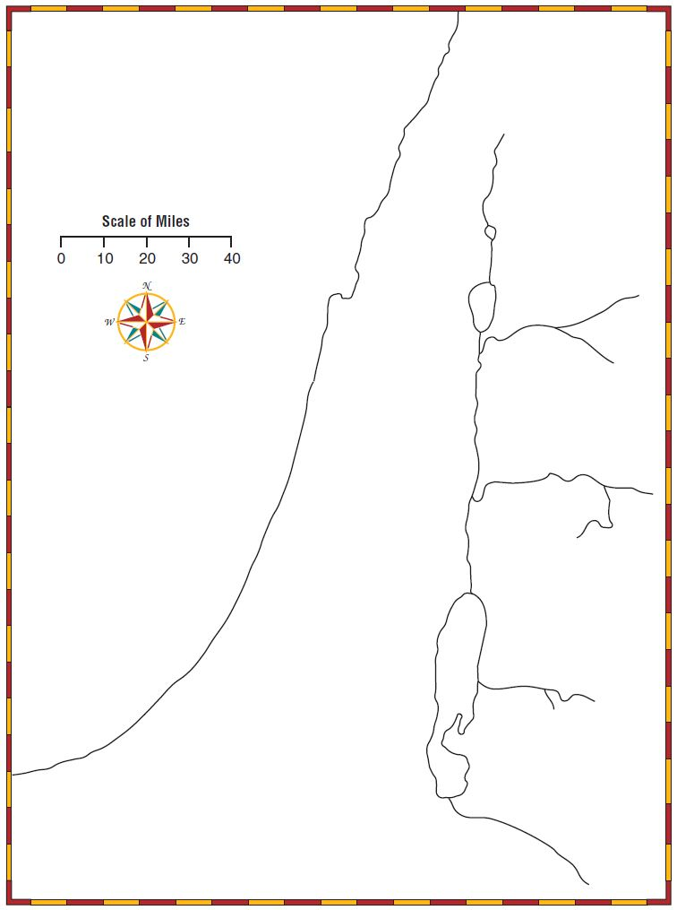
Sidon *
Tyre *
Capernaum
*
Galilee
Sea of Galilee
Nazareth *
Mediterranean Sea
Jordan R
Jerusalem *
Bethlehem *
Judea
Idumea (Edom)
←Egypt

Slide 12
Jesus Teaches and Heals by the Sea
Mark 3:7-12; Matt 12:15-21
Matt 12
15 But when Jesus knew it, he withdrew himself from thence: and great multitudes followed him, and he healed them all; 16 And charged them that they should not make him known: 17 That it might be fulfilled which was spoken by Esaias the prophet, saying, 18 Behold my servant, whom I have chosen; my beloved, in whom my soul is well pleased: I will put my spirit upon him, and he shall shew judgment to the Gentiles. 19 He shall not strive, nor cry; neither shall any man hear his voice in the streets. 20 A bruised reed shall he not break, and smoking flax shall he not quench, till he send forth judgment unto victory. 21 And in his name shall the Gentiles trust.
Mark 3
7 But Jesus withdrew himself with his disciples to the sea: and a great multitude from Galilee followed him, and from Judaea, 8 And from Jerusalem, and from Idumaea, and from beyond Jordan; and they about Tyre and Sidon, a great multitude, when they had heard what great things he did, came unto him. 9 And he spake to his disciples, that a small ship should wait on him because of the multitude, lest they should throng him. 10 For he had healed many; insomuch that they pressed upon him for to touch him, as many as had plagues. 11 And unclean spirits, when they saw him, fell down before him, and cried, saying, Thou art the Son of God. 12 And he straitly charged them that they should not make him known.
Notes:
Matt 12:15 After Jesus knew of the Jew’s plot against him, he left and multitudes of people followed him.
Matt 3:8 I take it from the prophecy of Isaiah (Matt 12:27-21) that some of this number were Gentiles.
Matt 12:15, Mark 3:10 Jesus healed them all, even those possessed with demons.
Side note – the time of demon possession and miraculous spiritual gifts is over

Slide 13
Spiritual Gifts and Evil Spirits
Jesus healed the multitudes and cast out demons. He in turn gave his apostles the power to heal and cast out demons.
One may question whether spiritual gifts and demon possession still exist today.
We meet denominationalists who believe in spiritual gifts today.

Slide 14
Spiritual Gifts and Evil Spirits
Spiritual gifts at the hands of man (healing, prophecy, tongues, etc.) and demon possession ended at the time period of Christ’s first coming, in the first century era.
I Cor 13:8-13 foretells a time at which “tongues… shall cease” – but for time’s sake we will not analyze this passage today
Zechariah 13 pinpoints the time at which spiritual gifts would cease. Even a child can understand the timeframe for the end of these gifts.
1/15/2019
14

Slide 15
Spiritual Gifts and Evil Spirits
Zech 13:2 prophesied that there would be a “day” in which God would cause the “prophets and the unclean spirit to pass out of the land.”
Was the“day” (e.g. time period, see John 8:56) in which prophets and demons would pass from the land the time of Jesus’ second coming as some believe?

Slide 16
Spiritual Gifts and Evil Spirits
The “day” of Zechariah was the timeframe of Jesus’ first coming:
Zech 12:9-10 “in that day… they shall look upon me whom they have pierced” (John 19:37)
Zech 13:1 “in that day there shall be a fountain opened to the house of David and to the inhabitants of Jerusalem for sin and for uncleanness” (Acts 2, illustration - song “there is a fountain filled with blood”)
Zech 13:4-7 “in that day… what are these wounds in thine hands… smite the shepherd, and the sheep shall be scattered” (Matt 26:31)

Slide 17
Spiritual Gifts and Evil Spirits
The “day” of Zechariah was the timeframe of Jesus’ first coming:
Zech 13:2-3 “in that day… also I will cause the prophets and the unclean spirit to pass out of the land. And it shall come to pass, that when any shall yet prophesy, then his father and his mother that begat him shall say unto him, thou shalt not live; for thou speakest lies in the name of the Lord…”
The “day” in which prophets (miraculous spiritual gifts) and demons would pass away would be during the time period in which the “shepherd was smitten” (Jesus’ death) not at the chief shepherd’s second coming. Demons and spiritual gifts passed from this earth almost 2000 years ago.

Slide 18
Jesus Selects Twelve Apostles
Mark 3:13-19; Luke 6:12-16; (Matt 10:2-4)
13 ¶ And he goeth up into a mountain, and calleth unto him whom he would: and they came unto him. 14 And he ordained twelve, that they should be with him, and that he might send them forth to preach, 15 And to have power to heal sicknesses, and to cast out devils: 16 And Simon he surnamed Peter; 17 And James the son of Zebedee, and John the brother of James; and he surnamed them Boanerges, which is, The sons of thunder: 18 And Andrew, and Philip, and Bartholomew, and Matthew, and Thomas, and James the son of Alphaeus, and Thaddaeus, and Simon the Canaanite, 19 And Judas Iscariot, which also betrayed him: and they went into an house.
Notes:
Jesus continued all night in prayer (Luke 6:12) then the next day chose his disciples.
These apostles would be his special ministers and witnesses (Acts 1:1-8)
Recommended list of apostles in Matt 10:2-4

Slide 19
Jesus Selects Twelve Apostles
Mark 3:13-19; Luke 6:12-16; Matt 10:2-4
Peter (Simon)
Andrew his brother
James the son of Zebedee
John his brother
Philip
Bartholomew
Thomas
Matthew the publican
James the son of Alphaeus
Lebbaeus Thaddaeus
Simon the Canaanite
Judas Iscariot
Notes:
These apostles would be his special ministers and witnesses (Acts 1:1-8)
Recommended list of apostles in Matt 10:2-4

Slide 20
The Sermon on the Mount –
Character of Kingdom Citizens
Jesus came preaching the gospel, preaching the kingdom of God (Matt 4:23, Mark 1:14-15).
Jesus was preparing people for a change of law (Matt 5:17-18) and described to them the kind of righteousness expected of kingdom citizens.
The true righteousness that Jesus describes in his sermon is the righteousness that we, kingdom citizens today should have.
The righteousness described in this sermon touches every part of our lives.
Notes:
The multitudes and his disciples were with him when he taught (Matt 5:1, 7:28)
Preparatory teaching:
Describes characteristics of kingdom citizens
Kingdom law for kingdom citizens, still our law today
Good quotes from Page 10-11 of Paul Earnhart’s book describing the kingdom

Slide 21
The Sermon on the Mount -
Preparatory Teaching
In preaching the gospel of the kingdom and preparing his listener for the kingdom, Jesus described doctrines that would later be kingdom law / NT law (the OT was in force until the NT was ratified by his blood, after his death – Heb 8:17)
John 3:5 “Except a man be born of water and of the Spirit, he cannot enter into the kingdom of God.” NT requirement for salvation
Luke 22:19 “And he took bread, and gave thanks, and brake it, and gave unto them, saying, This is my body which is given for you: this do in remembrance of me.” NT practice
Matt 18:17 “And if he shall neglect to hear them, tell it unto the church: but if he neglect to hear the church, let him be unto thee as an heathen man and a publican.” The church did not even exist.
Example: Matt 5:32 is NT law on marriage and divorce, not OT law.
Notes:
Matt 18:17 – describing a NT practice of severing company for the kingdom’s sake (Mark 10:29, II Thess 3:6)

Slide 22
The Sermon on the Mount –
Character of Kingdom Citizens
Jesus describes in Matt 5:
The “beatitudes” are characteristics one should have to be blessed in their deed (James 1:25, Matt 5:3-12). Those who have these traits are “well-off” before God, their soul prospers.
The heart of kingdom citizens (Matt 5:21 “angry…without a cause”, Matt 5:28 “looketh… to lust”, Matt 5:44 “love your enemies… pray for them...”)
The speech of kingdom citizens (Matt 5:22 “thou fool”, Matt 5:34 “swear not at all”, Matt 5:44 “bless them that curse you”)
The actions of kingdom citizens (Matt 5:32 “whosoever shall marry her that is divorced”, Matt 5:44 “love your enemies… do good to them that hate you”)
Notes:
The multitudes and his disciples were with him when he taught (Matt 5:1, 7:28)
Preparatory teaching:
Describes characteristics of kingdom citizens
Kingdom law for kingdom citizens, still our law today
Good quotes from Page 10-11 of Paul Earnhart’s book describing the kingdom
Matt 5:31-32 – Jesus even spoke to kingdom prospects about “marriage and divorce”

Slide 23
The Sermon on the Mount –
Character of Kingdom Citizens
Jesus describes in Matt 6:
Sincerity and hypocrisy in worship (Matt 6:1-18 “do not your alms before men to be seen of them”)
Forgiving others (Matt 6:14-15)
True treasure (Matt 6:19-24 “lay up for yourselves treasure in heaven”)
Worry (Matt 6:25 “take no thought for your life”)
Seeking God’s kingdom first (Matt 6:33)
Notes:
The multitudes and his disciples were with him when he taught (Matt 5:1, 7:28)
Preparatory teaching:
Describes characteristics of kingdom citizens
Kingdom law for kingdom citizens, still our law today
Good quotes from Page 10-11 of Paul Earnhart’s book describing the kingdom

Slide 24
The Sermon on the Mount –
Character of Kingdom Citizens
Jesus describes in Matt 7:
True vs. hypocritical judgment (Matt 7:1-5 “first cast out… then shalt thou see clearly)
Asking, Seeking and Knocking toward God (Matt 7:7-11)
Two gates, two ways, two destinations (Matt 7:13-14)
True service (Matt 7:21 “he that doeth the will of my Father”)
True wisdom (Matt 7:24 “heareth these sayings of mine and doeth them”)
Notes:
The multitudes and his disciples were with him when he taught (Matt 5:1, 7:28)
Preparatory teaching:
Describes characteristics of kingdom citizens
Kingdom law for kingdom citizens, still our law today
Good quotes from Page 10-11 of Paul Earnhart’s book describing the kingdom

Slide 25
The Sermon on the Mount -
The “Beattitudes” (Matt 5:1-16)
Poor in spirit – Not like those of Laodicea in Rev 3:17 who had need of nothing, but like the centurion in Matt 8:8 “I am not worthy… but speak the word…” We recognize that God is all and has all, and that we are nothing before him, but that he has everything we need.
They that mourn – Like Mary in Luke 7:36-48 who washed Jesus feet with her tears, and Jesus said, “thy sins are forgiven”
Meek – Like Moses under fire in Numbers 12:3, like Jesus in I Peter 2:23 who “committed himself to him that judgeth righteously”. Inherit the earth, receive the blessings we need (Matt 6:33b “shall be added”, I Cor 3:22b,”all are yours” Mark 10:30 “hundredfold”)
They that hunger and thirst after righteousness – Matt 7:7 “seek and ye shall find”, John 7:17 “if any man will do his will…”

Slide 26
The Sermon on the Mount -
The “Beattitudes” (Matt 5:1-16)
The merciful – Matt 6:14-15, James 2:13 showing love and concern toward others in spite of what one may think they deserve, just as God showed toward us (Titus 3:1-5)
The pure in heart – II Tim 2:21 we seek to purge our heart and mind from sin and serve him in sincerity (Php 1:10)
The peacemakers – Rom 10:15 “how beautiful are the feet of them that preach the gospel of peace, and bring glad tidings of good things” in this wicked world.
They that are persecuted for righteousness’ sake – I Peter 4:16 “if any man suffer as a Christian”, v.12 “rejoice and be exceeding glad”

Slide 28
The Sermon on the Mount -
Accommodative Language
In preaching the gospel of the kingdom and preparing people for the kingdom, Jesus used accomodative language that his listeners could understand, though he spoke to them about our law.
Matt 18:17 “And if he shall neglect to hear them, tell it unto the church: but if he neglect to hear the church, let him be unto thee as an heathen man and a publican.”
Example: Matt 5:22-26 – we must not be angry with a brother without cause, though Jesus illustrates with a “gift at the altar.”

