Slide 1
CHAPTER 2
WHO IS JESUS CHRIST?
Incarnation: a distinctive sign of the Christian faith
Essential Christian dogma
Truth either divinely revealed or connected with revelation which the Church teaches is binding on all Christian people to accept
Jesus Christ, the Son of God, “assumed a human nature in order to accomplish our salvation in it” (CC, 461)
Word of God took on human flesh from his mother, Mary, by the power of the Holy Spirit
Christians believe that Jesus is fully God and fully human

Slide 2
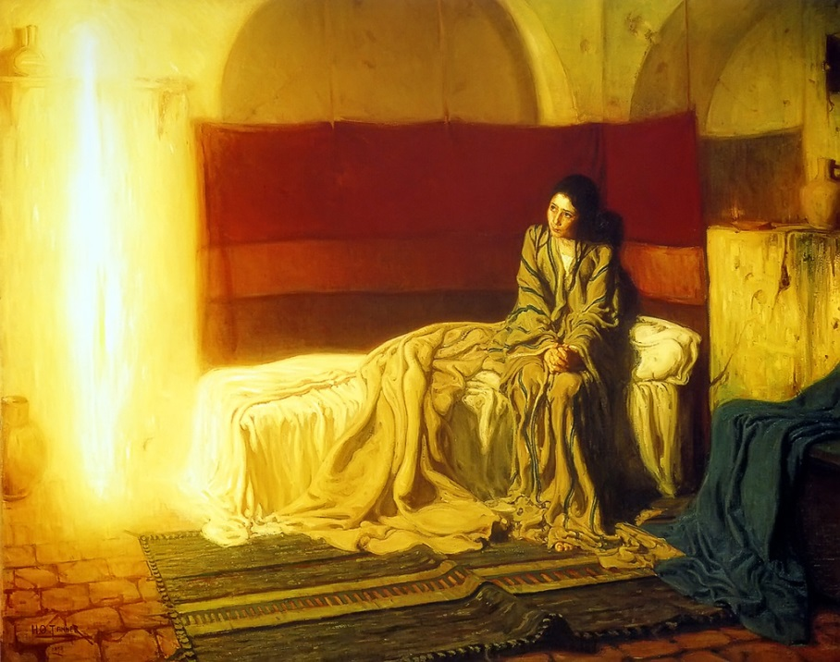
Scriptural Background for the Incarnation
Luke: Annunciation (Gabriel’s announcement to Mary; Name the child “Jesus” which means “Yahweh is salvation”)
Elizabeth conceived a child in
her old age
Mary’s YES: simple, humble
response to allow God’s divine
plan of salvation to move
forward
Matthew: Nativity (Birth of Jesus
9 months after the Annunciation)
Birth in Bethlehem (Predicted by Micah 5:1)

Slide 3
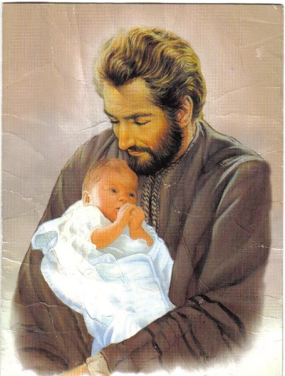
Role of Joseph: Not much is known in the New Testament (No words spoken)
Carpenter; legal father of Jesus; descendent of King David; Nothing in the Gospels about his death
Man of faith; “the just Man’; flexible; gentle; courageous; a man with dreams; trusting; loving

Slide 4
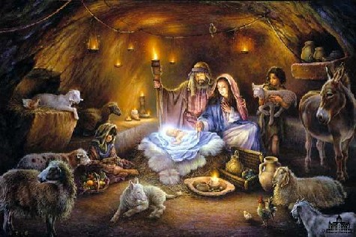
John: Prologue: “In the beginning was the Word, and the Word was with God, and the Word was God. . .” (John 1:1-4; 14)
“Word became flesh” = Jesus became human
Selection of the word “flesh” to counteract a 1st century heresy (Docetism)
Docetism: Jesus only seemed to be real; If Jesus only seemed to be a man, then he only seemed to die and resurrect.
Author of John’s Gospel: Jesus was one of us
Incarnation: literally means that God became flesh (Jesus is God-man)

Slide 5
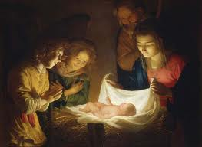
Purpose of the Incarnation
To save us by reconciling us with God
To reveal God’s love to us
To serve as the perfect model of holiness
To allow us to share in God’s nature

Slide 6
Learning About Jesus
Personal Level: Family, teachers, retreats
Tradition of the Church: Sacred Scripture, Gospels, Deposit of Faith, Magisterium
Eyewitnesses: Apostles
Overview of the Jesus of History
Historians with proof of a real man
Jesus bar Joseph: Jesus, Son of Joseph
Jesus, the Carpenter (profession)
Jesus of Nazareth (place of residence)

Slide 7
Palestinian Jew born in Bethlehem
Mother named Mary
Birth date: between 4-6 BC
Born during the rule of King Herod in Palestine; Roman Emperor Caesar Augustus
Hidden life in Nazareth in Galilee
Learned trade of carpentry (Foster father, Joseph)
Observed Jewish law, celebrated feasts, worshipped on the Sabbath
Baptized by John the Baptist (28 AD); began his public ministry (itinerant preacher; prophet)
Central Message: repentance, the coming of God’s Kingdom
Performed miracles

Slide 8

Provocative; asked people to make a clear choice to turn from sin, accept God’s love and believe in him and his teachings
His teachings threatened and angered
authorities; betrayed by his follower;
arrested
Condemned to die by the Roman prefect,
Pontius Pilate
Crucified (30-33 AD)
Claimed to be “King of the Jews”: a crime interpreted under Roman Law as sedition against the Roman Emperor, Tiberius

Slide 9
SYNOPTIC GOSPELS
Four gospels: our primary source of information about Jesus Christ
Synoptics include Matthew, Mark, Luke
Matthew and Luke follow the general outline of Mark’s gospel in reporting the events of Jesus’ life
“Synoptics” (Greek): means “seen together”
Mark: oldest ; Matthew and Luke both “improve” on difficult passages
Originally believed to be an abridged, later version of Mt.

Slide 10
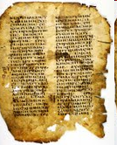
Matthew: well-ordered work with detailed lessons, especially in the area of Christian morality
Became popular in worship services and for teaching new Christians
Emphasizes the fulfillment of Old Testament prophecies, linking the Old Testament
and the New Testament
What Is Meant By “Gospel”?
Oral traditions, lived faith of his own community, and other gospel sources available to him, Mark was the first to write the literary form we call gospel
“Good News”: meaning of the word “gospel”
Life of Jesus: Good news of God’s love for humanity
Preaching about Jesus
Four written versions (unique): under the inspiration of the HS

Slide 11
Papius (2nd century bishop): Claimed that the author of Mark was John Mark (a disciple of Peter)
Date: 67-73 AD shortly before or after the destruction of the Jewish temple by the Romans (70 AD)
In the 80’s AD: Matthew and Luke wrote their gospels using the following sources:
Gospel of Mark
2) “Q” (German – Quelle- source); probably a collection of Jesus’ sayings handed down
“M” and “L” – unique to each of them
Mark’s Unique Sources
Mark
M Matthew Luke L
Q

Slide 12
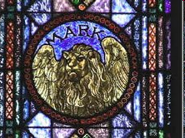
The Gospel of Mark
Author: John Mark, a traveling companion of Paul and Peter
Anonymous author: likely a Christian
(Jewish background)
Written between 65-70 AD
Audience: Gentile Christians who were suffering persecution
Written in Rome after Nero’s persecution of the Christians
Written for Christians in Syria or Palestine to bolster suffering Christians during the First Jewish Revolt against Rome (66-70 AD)
Author drew on oral traditions (Peter’s own testimony), written collections of the parables, miracle stories and other sayings of Jesus, and an outline of Jesus’ passion story

Slide 13
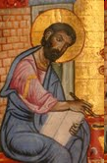
Geographical Framework:
Jesus’ Baptism in the Jordan (1:1-13)
Jesus’ preaching and performing
miracles in Galilee (1:14-9:50)
Jesus’ journey to Jerusalem (10)
Jesus’ preaching, rejection and
crucifixion in Jerusalem (11:1-16:8)
Matthew and Luke with the same general
theme
Theme: readers to remain faithful to Jesus, the Lord, who Himself suffered and died for them
Son of Man: Jesus walked the path of suffering to eternal life. So must His followers undergo suffering before they gain their eternal reward
Messianic Secret: Who is this person? Will you follow Him?

Slide 14
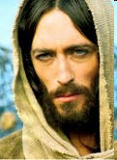
Gospel of Mark
Part I: Mark 1:14-8:26 (Galilee)
Message: Centers on the Kingdom of God at hand (Repent; Jesus is God’s agent in establishing this Kingdom)
Authoritative teacher; healer and worker of miracles
Apostles misunderstand who Jesus is; misunderstand His message

Slide 15
Prologue (Mark 1:1-13)
“The beginning of the gospel of Jesus Christ, the Son of God” (Mark 1:1)
No doubt about Jesus’ identity
Readers knows who Jesus is; Apostles and gospel characters misinterpret and misunderstand Jesus, His teachings, and His way of the cross
Mark wants his readers to know that the good news of the Kingdom is good news simply because of Jesus.
Jesus’ baptism by John the Baptist launches His public ministry
John the Baptist in camel skin ---- Elijah (prophet); Dove (Holy Spirit) descending on Jesus

Slide 16
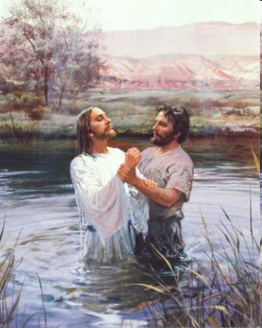
“You are My beloved Son; with You I am well pleased.” (Mark 1:11)
Synoptic gospels ambiguous about who saw the vision
Perhaps only Jesus, though bystanders may have heard the voice
John’s gospel (1:32-34) John the Baptist
also saw the dove, convincing him that
Jesus was the Son of God and enabling
him to proclaim Jesus as the “Lamb of God”
Prologue ends with Jesus’ symbolic
40 day retreat in the desert (tested
by Satan)
Jesus represents a new Israel --- Israel’s
40 years of traveling in the desert

Slide 17
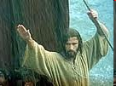
Jesus the Authoritative Teacher
“The people were spellbound with His teaching because He taught with authority, and not like the scribes.”
(Mark 1:22)
Very clear that Jesus taught with authority
Meaning of “authority” (many nuances)
Right to command
Someone with official power
Source of reliable information
Ability to gain the respect of others and influence what they do
Knowledge, skill or experience worthy of respect
Author: “creator or originator of something”

Slide 18
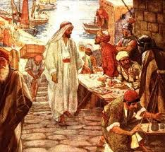
Right To Command: Every teacher needs students.
Call of the First Disciples (Mark 1:16-20)
Simon and Andrew/James and John (sons of Zebedee) dropped what they were doing to become “fishers of men”
Call of Levi (tax collector), Son of Alphaeus
(Mark 2:13-17)
Jesus did the gathering of disciples (learners)
Contrary to the custom of the day when disciples sought out a learned and spiritual leader

Slide 19
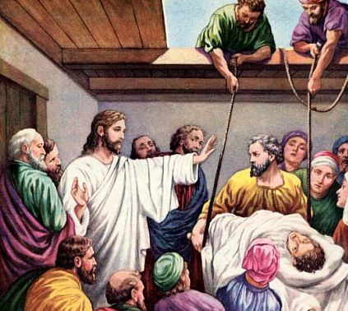
Jesus’ First Major Teaching (Mark 2:1-3:6)
Involves 5 conflicts or controversies
A Paralytic Man Carried By His Four Friends
(Mark 2:1-12)
Jesus claims that He can forgive sin
Statement equal to blasphemy (Jewish point of view)
Jesus shows that He had the power to forgive sin by backing up His teaching with action

Slide 20
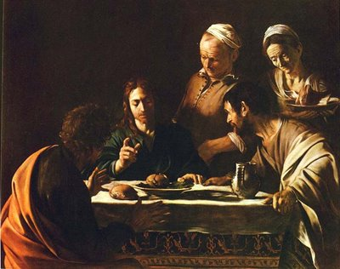
Call of Levi and Jesus’ Table Fellowship With Sinners (Mark 2:13-17)
Conventional Thinking: If you associated with sinners, then you must be a sinner; Respectable and holy people would not think of socializing with outcasts
According to Jesus, God’s Kingdom INCLUDES, not EXCLUDES.
“People who are healthy do not need a doctor; sick people do. I have come to call sinners, not the self righteous.” (Mark 2:17)

Slide 21
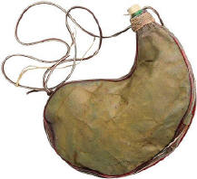
Question of Fasting (Mark 2:18-22)
The third conflict involved Jesus not fasting according to the strict obligations of Jewish law
Mark presents Jesus as the author of a new age
He is the bridegroom who is ushering in God’s Kingdom
Fasting signifies penance
With Jesus, it is a time to rejoice and celebrate
“No one pours new wine into old wineskins. Otherwise, the wine will burst the skins, and both the wine and skins are ruined. Rather, new wine is poured into fresh wineskins.” (Mark 2:22)

Slide 22
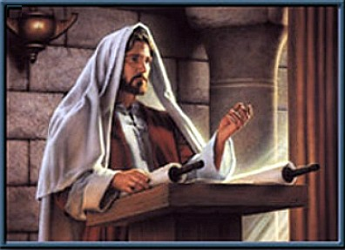
Conflicts Four and Five Involve the Sabbath
Jesus is free to interpret the meaning of eating customs on the Sabbath. Why?
Jesus, the Son of Man, is Lord of the Sabbath.
“The Sabbath was made for man, not man for the Sabbath.”
(Mark 2:27)
Jesus taught that doing good on the Sabbath is always allowed (Mark 3:4)
Hardness of heart of religious authorities who did not want their authority called into question

Slide 23
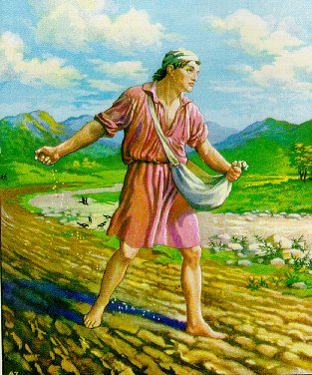
Parables of Jesus
Jesus as a creative, original, influential teacher, won the respect of the people
Four Parables About the Kingdom of God
(Mark 4:1-34)
Kingdom of God is a mystery
Parable of the seed growing by itself (Mark 4: 26-29)
It grows without our knowledge of how it occurs
God is in charge; In His good time, He will bring the Kingdom to fruition
Parable of the Growing Seed
(“The Sower”) (Mark 4:1-20)
There is no stopping God’s Kingdom
At first, there will be apparent failure
in the reception to Jesus’ pronouncement
about the Kingdom

Slide 24
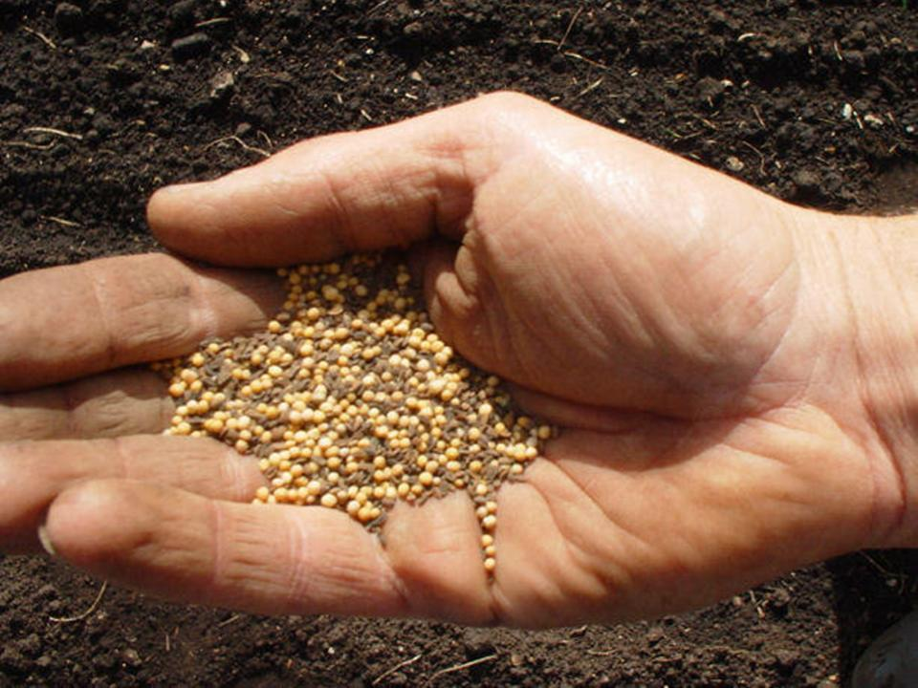
This is to be expected when sowing seeds
Good News: yield will be spectacular when it reaches the people of faith
Parable of the Lamp (Mark 4:21-25)
What remains hidden now will become crystal clear for all to see in the future
Mustard Seed (Mark 4:30-32)
Jesus’ ministry might seem small for now, but God will eventually bring it to fullness
Kingdom starts small Will become so large that it will embrace the whole world

Slide 25
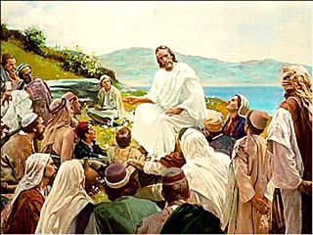
Parables: source of great encouragement to Mark’s audience who were suffering for their faith
May be a struggle now, but the Kingdom will win out
Parables forced listeners (crowds and disciples) to think and interpret
Parables misinterpreted: Seemed like a riddle to Jesus’ opposition
“The mystery of the Kingdom of God has been granted to you.” (Mark 4:11)

Slide 26
Jesus the Healer and Miracle Worker
Includes: healing miracles, exorcisms, nature miracles, a raising from the dead (Jairus’ daughter)
Miracle stories follow a pattern – Use Mark 2:1-12
Introduction: presents setting and situation
Jesus is teaching in a room so crowded that the friends of the paralyzed man lower him through a roof
Display of Faith:
Jesus witnesses this in the friends of the paralyzed man
To forgive man’s sins: angers the scribes who think that Jesus is guilty of blasphemy
“But that you may know the Son of Man has authority to forgive sins on earth” – He said to the paralytic, “I say to you, pick up your mat, and go home.” (Mark 2:8-11)

Slide 27
Jesus’ response to the problem
Jesus cures the man
Result of the miracle
The man got up, picked up his mat, and walked
Reaction to the miracle (Conclusion)
“They were all astonished and glorified God, saying, “We have never seen anything like this.” (Mark 2:12)
Jesus’ miracles in Mark seen as a proclamation of the Kingdom
Jesus’ as God’s Son successfully battling the forces of evil
Jesus with power over Satan, in his unbinding the demon-possessed man from Gerasene (Mark 5: 1-20)

Slide 28
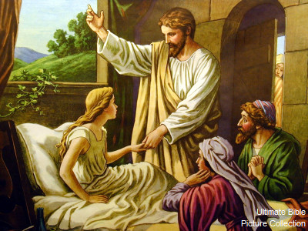
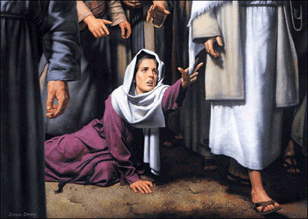
Jesus overpowers sickness and death –The woman with the blood flow and the raising of Jairus’ daughter
(Mark 5:21-43)

Slide 29
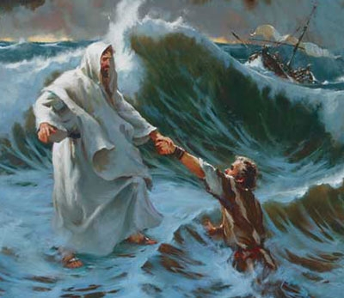
Dynamis (Greek – power): to describe Jesus’ miracles
Power of God had broken into human history
Salvation is taking place right now through Jesus
Themes: power to forgive sin
Faith with a major role; linked to repentance (turning away from sin)
Types of Miracles:
Physical Healings
Nature Miracles
Exorcisms
Raising From the Dead

Slide 30
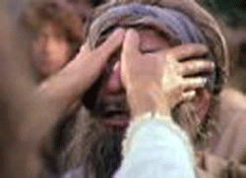
The Messianic Secret
Mark 1:1 Jesus is the Messiah, the Christ
People interpreted the coming of the Messiah in political terms
Jesus’ idea of Messiah is radically different
Mark 8:27-33: Jesus’ words met with confusion and amazement
Disciples slow to comprehend (Mark 8:21 “Do you still not understand?”)
Slowness of disciples symbolized in the cure of the blind man at Bethsaida (Mark 8:22-26)
Symbolic way of saying that people’s faith in Jesus was NOT total
People came to believe only gradually

Slide 31
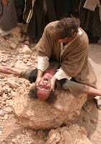
Only the demons recognize who Jesus truly is (supernatural origins)
Jesus would not let them speak (Mark 1:34)
Why this secret?
Jesus did not want to be a sideshow
Jesus is the Suffering Servant prophesied
by Isaiah centuries before. He is the Messiah
who takes up a cross, not a glittering throne.

Slide 32
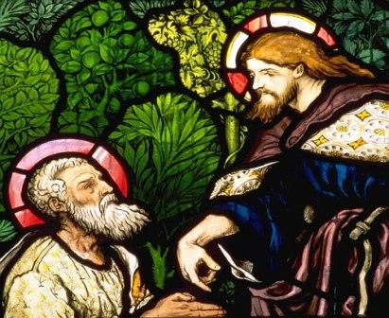
On the road to Caesarea Philippi, Jesus put the question to the apostles concerning his identity. They thought He was a prophet, John the Baptist, or Elijah. Even Peter, leader of the apostles, did not understand the true nature of Jesus’ messiahship.
Jesus rebuked Peter and said, “Get behind me, Satan. You are thinking not as God does, but as human beings do.” (Mark 8:31-33)
Peter judges by the wrong
standards.
Glory comes after Jesus’
suffering and death (way to
salvation)

Slide 33
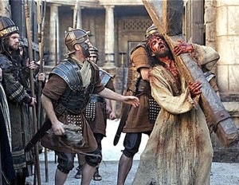
Suffering Servant
Mentioned in Isaiah 52
To encourage the exiled Israelites in Babylon
Redemption comes through suffering
Jesus as the Suffering Servant (in the New Testament)

Slide 34
Son of Man
Used 14 times in Mark
Old Testament Connection:
Jesus emphasizes his ordinary human nature (human like us)
Book of Daniel: supernatural figure; Jesus will usher in the fullness of God’s Kingdom; He is the judge of all humanity

Slide 35
The Way of Discipleship
Mark challenges his readers to accept Jesus as the Messiah, but one who suffers crucifixion before he rises in glory
Jesus’ followers must be prepared to suffer as Jesus himself suffered
Mark 10:42-45 seen as the climax of the gospel
Cure of Bartimaeus (Mark 10: 46-52) Instananeous
If we have faith like Bartimaeus, listen to Jesus with open hearts, and depend on Him as our savior, then we will understand the secret of His Kingdom message.
The challenge of discipleship: The Rich Young Man (Mark 10:17-31)

