Slide 1
Jesus Of Nazareth
Jesus The Christ

Slide 2
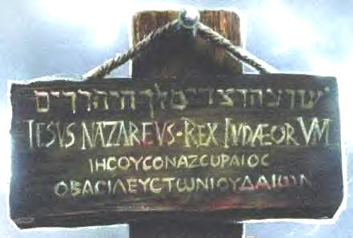
INRI Iesus Nazarenus Rex Judeorum Jesus of Nazareth King of the Jews

Slide 3
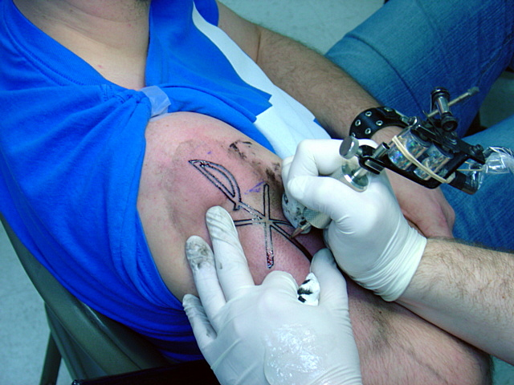
Chi-Ro Greek for Christos

Slide 4
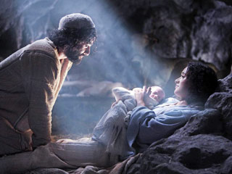
The Incarnation

Slide 5
The Incarnation The Reason for The Season Baby!
Literally means to “take on flesh”
The belief that God’s eternal Son took on human nature and became man in Jesus of Nazareth to save us from our sins
“God with skin on”
South American tribe story

Slide 6
The Incarnation: Why? Four Reasons:
To save us from sin, death, and eternal separation from God
So that we could know God’s true nature and his love for us
To be our role model of how we should live. Ex. WWJD?
To make us sharers in God’s life

Slide 7
Apostles Creed
I believe in Jesus Christ, his only Son, our Lord, who was conceived by the power of the Holy Spirit and born of the Virgin Mary.

Slide 8
Jesus: the Name
From the Hebrew word Yehoshua or Joshua
It means God saves or saviour
A common name
This name was given Mary by the angel Gabriel
From conception God had destined that Jesus would save the world from sin and death
What does your name mean?

Slide 9
Saviour

Slide 10
The Christ: Messiah
The Hebrew word Masiah translates to the Greek word Christos which literally means “anointed one.”
Was first applied to the king of Israel, God’s anointed leader
Throughout history the Jews believed that God would send a king who would represent Yahweh’s love and care for his people

Slide 11
What kind of Messiah was expected?
Most Jews expected a political and military leader who would lead Israel to a great military victory and re-establish Israel as an independent nation
Many Jews expected the coming of the Messiah to be accompanied by an apocalyptic event (dramatic)

Slide 12
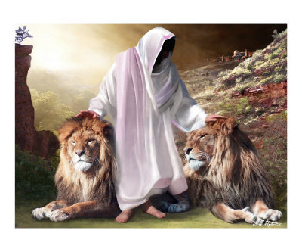
The Messiah

Slide 13
Suffering Servant
Jesus baffled many of the common expectations for the Messiah being a conquering earthly leader
He chose to be a suffering servant who took on the sins of his people
He was truly a man of the people, a model for ultimate leadership
“The Son of Man did not come to be served but to serve and to give his life as a ransom for many” (Matthew 20:28)

Slide 14
The Son of Man
Jesus often used this title. It comes from an Old Testament vision in which Daniel the prophet saw “… one like a son of man coming out on the clouds of heaven.”
The title had two purposes:
To emphasize his connection with humanity
To reveal his role as the judge who will establish his kingdom at the end of time

Slide 15
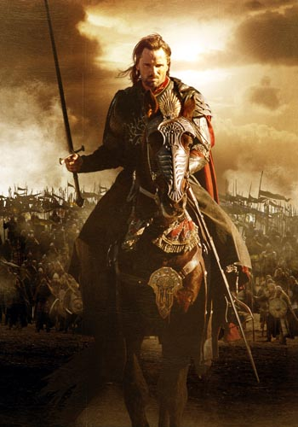
The Return of the King

Slide 16
Son of God
Both at his baptism and transfiguration the Father calls Jesus his “beloved Son”
Jesus says “The Father and I are one” Jn.10:36
Humans are adopted children not genetic children of God
Jesus had God’s DNA

Slide 17
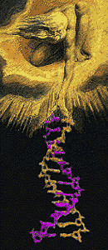
God’s DNA

Slide 18
Lord
Like sir when referring to someone who is a ruler or in power over you
Term referring to authority and divinity
Yahweh “I am”
He is God
Through miracles and resurrection Jesus proves his Divinity

Slide 19
Guru or Master
Lord can also mean master or guru
Disciple means learner, Jesus is the teacher or master as in martial arts
Jesus is the master/guru/sensei of living
Guru (Sanskrit: गुरु), is a term denoting a teacher or guide in the religious or spiritual sense
The disciples believed that Jesus’ way of living was higher and more brilliant than that of the other groups of their time so they felt lured to Jesus’ way.

Slide 20
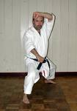
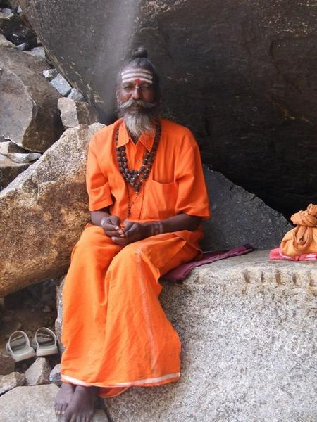
Jesus a Guru/Sensai?

Slide 21
Did He Really Exist?
There are books written about him
Some of these were written by non-believers like the Roman historian Tacitus or the Jewish historian Josephus
Most of what we know about him comes from writings left by his followers in what we call the New Testament

Slide 22
The New Testament
Jesus is the New Testament or New Covenant with all humanity.
Jesus taught three main things using parables or short stories:
God is Abba Father and longs to be close to us
God’s kingdom is in our midst
That we should love our enemies

Slide 23
The Formation of the Gospels
Gospel means “good news”
There are 4 Gospels: Mt, Mk, Lk, Jn
There were 3 stages of formation:
The Historical Jesus: 4/6BC-30/33AD
Oral Tradition: 30/33-50AD
The New Testament Writings: 50-120 AD

Slide 24
What do they tell us?
Jesus’ Early Life (private life)
Jesus’ Public Life

Slide 25
Jesus’ Early Life
Jesus was born in poverty in a Bethlehem cave to a virgin
He was circumcised according to Jewish law
He escaped to Egypt with his parents to escape being slaughtered by King Herod
His family later moved back to Nazareth where he grew up and learned carpentry
He would make visits to the Temple in Jerusalem every year with his parents

Slide 26
Question:
Did Jesus have brothers and sisters? What do you think?
See pg. 52

Slide 27
Apostles Creed
… He suffered under Pontius Pilate, was crucified died and was buried. He descended to hell. On the third day he rose again. He ascended into heaven, and is seated at the right hand of the Father. He will come again to judge the living and the dead.

Slide 28
Jesus’ Public Life
Baptism in the Jordan River
Temptations in the desert
Proclamation of God’s Kingdom
Signs & Miracles
Death
Resurrection
Ascension

Slide 29
Jesus’ Public Life: Baptism
Began at his baptism by John the Baptist
Jesus launched his mission to be God’s suffering servant
John said, “Behold the Lamb of God who takes away the sin of the world”
God said, “That’s my boy!”

Slide 30
Jesus’ Public Life: The Kingdom of God
Is God’s power and active presence, his saving activity on the earth
Jesus’ miracles of healing the spiritual, physical, and psychological illness are signs of his kingdom
Jesus taught that one day his kingdom will slowly transform all of humanity
A revolution of love
Like a little bit of chocolate syrup in a glass of milk
This began to spread with his first followers
Clip from Jesus of Nazareth

Slide 31
Kingdom of God like syrup?!

Slide 32
The First Followers of Jesus
Andrew – follower of John the Baptist, Peter’s brother
Philip – follower of John the Baptist
Matthew – tax collector
Thomas – servant, known for doubting
Peter – fishermen, Andrew’s brother
Judas – scholar, money keeper
Mary – prostitute, business women
Simon – Zealot, converted to Jesus’ group
Nicodemus – Pharisee, followed Jesus, secretly
Joseph of Arimethea – Pharisee, followed Jesus secretly

Slide 33
Jesus’ Public Life: Death
Jesus’ death was a redemption, a ransom.
He took on our guilt by substituting for us, by dying a death we deserve
He did this to buy our freedom with his eternal, divine love
This opened the whole world to God’s presence (the tearing of the temple curtain)
Story of the gang member and his brother
Who killed Jesus?
Story We Find Ourselves In ch.20 windows

Slide 34
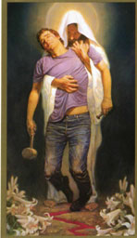

Slide 35
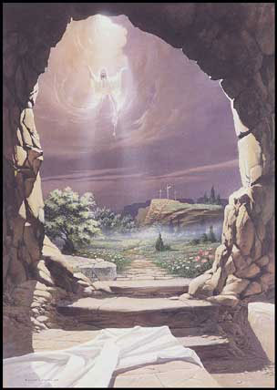
Resurrection

Slide 36
Reflection…
The whole world is upside down. The Jewish people, who should be the most prosperous and triumphant, are at the bottom of the heap, with the idolatrous and immoral Romans over them. And then Jesus, who seems so good and right and compassionate, promises a better way, but he gets betrayed and snuffed out. So the bad guys completely and utterly win. It’s tragic. It’s as if Jesus ignites this glimmer of hope of something up on that higher level and how the hope is smashed under the heel of Caesar’s violence…

Slide 37
Reflection…
And then comes the sign and wonder of the resurrection… And that would mean that even if the worst things happen, even if the worst people remain in power and the best people are killed, don’t be afraid, because God is going to triumph; and Jesus’ approach, his nonviolence, his compassion, his higher perspective—it’s all validated after all. God’s revolution can be resisted, but never defeated. (p.123)

Slide 38
Reflection…
OK, Kerry, and if you believe that, then how are you going to live?
Well, you’ll want to do right, no matter what the odds, and you’ll keep loving and refusing to hate. And you’ll… you’ll trust God no matter what happens, because even though God’s power seems weak—weak enough to be betrayed and tortured and killed—it rises again and promises to win in the end. (p.124)

Slide 39
Jesus’ Public Life: Resurrection
The resurrection of Jesus was a real historical event
His tomb was empty and he appeared to many of the disciples
You can’t find his grave today though some claim it is around along with many other claims since then (p59)
He didn’t really die, his body was stolen, it is a metaphor, etc.

Slide 40
Why is it Important?
What do you think?
It proves Jesus’ divinity and that he is not a liar (he said he would rise)
Jesus’ resurrection proves that there is life after death and that we will get our bodies back
Jesus is no longer limited to space and time and can meet us in prayer, in the Eucharist, and in the poor.
Last point from reflection…

Slide 41
Religious Groups in Jesus’ Time
Sadducees
Pharisees
Essenes
Zealots
Story We Find Ourselves In ch. 22 “The Revolution of God”
Story We Find Ourselves In ch. 23 “Beautiful Music” and ch. 24 “Sent out to play”

Slide 42
Sadducees
Were mostly priests who cared for Temple practices and worship
Cooperated with the Romans
Accepted only the Torah
Died out after the destruction of the Jewish Temple in 70 AD

Slide 43
Pharisees
Means “separated one”
Were common men who believed in strict observance of the Law (10 C’s)
Condemned to hell sinners such as prostitutes and tax collectors
Accepted Prophets and Psalms, Proverbs as inspired
Continued Judaism after destruction of the Jewish Temple in 70 AD

Slide 44
Essenes
Were an apocalyptic group that believed that God would usher in his kingdom through a dramatic event
They were celibates (unmarried) who thought the world was going to hell in a handbasket
They abandoned society and lived in caves near the Dead Sea
They wrote the Dead Sea Scrolls
They dissappeared from history after the destruction of the temple

Slide 45
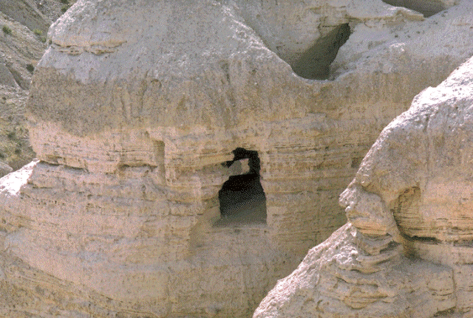
Caves at Qumran

Slide 46
Zealots
An organized revolutionary force which despised Roman rule and would use violent terrorism to overcome it
Much like the Taliban of today against the US
Led two revolts against the Romans the second of which ended in disaster and ended the Zealots forever.

Slide 47
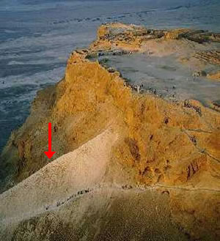

Slide 48
Other People in the NT
Tax Collectors
Jews who collected taxes for the Romans. Were perceived as cheaters and sinners by fellow Jews
Gentiles
Non-Jews. Pious Jews avoided contact with them
Many Gentiles became Christians
As a result Christianity split from Judaism and the Church lost much of its Jewish influence (diet, circumcision)
Women
Were considered inferior to men and as property
Had few political, religious, and marital rights
Main role was motherhood (childless women c/d)
Jesus elevated the role of women

