Slide 1

THE CASE FOR FAITH
Was Jesus’ death and resurrection a hoax?
Are there facts that support the resurrection?
What really happened to Jesus’ body?
Was Jesus seen after His death on the cross?
Wasn’t the Bible just written by men?
Can the stories of Jesus really be trusted?
Is archeology a friend of the Bible?
Presented by
Dr Thomas J Kindell
Founder & President of Reasons for Faith Ministries, Inc.
“Be ready to give an answer to everyone who asks you a reason for the hope that is within you” I Peter 3:15

Slide 2
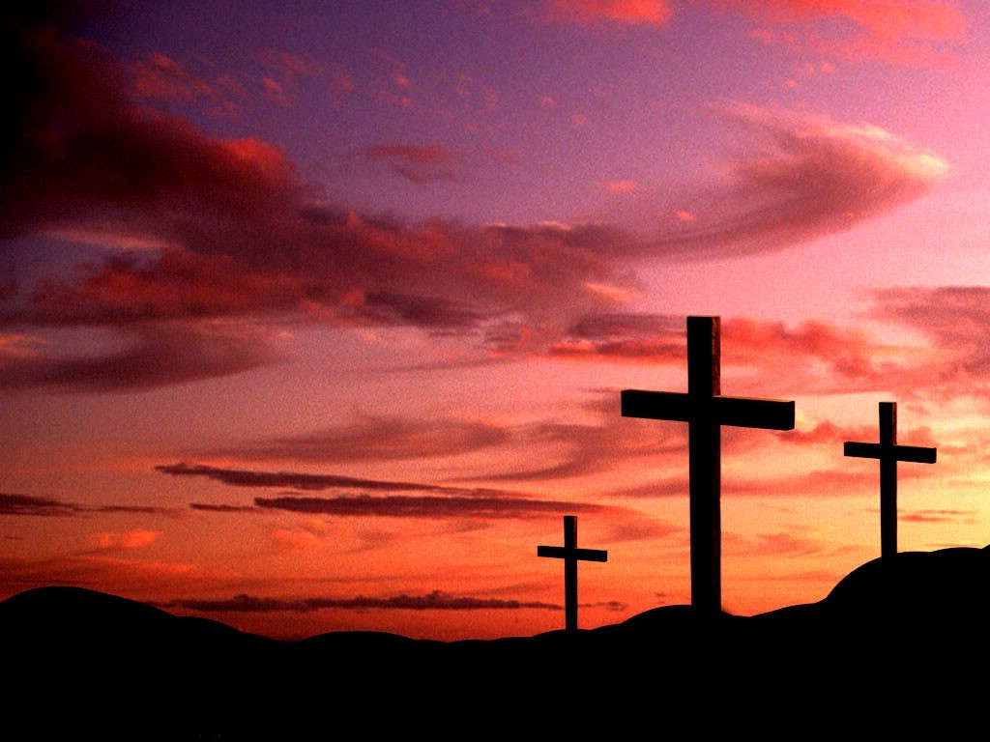

The
Resurrection of
Christ
A PROVEN FACT OF HISTORY!

Slide 3




Slide 4
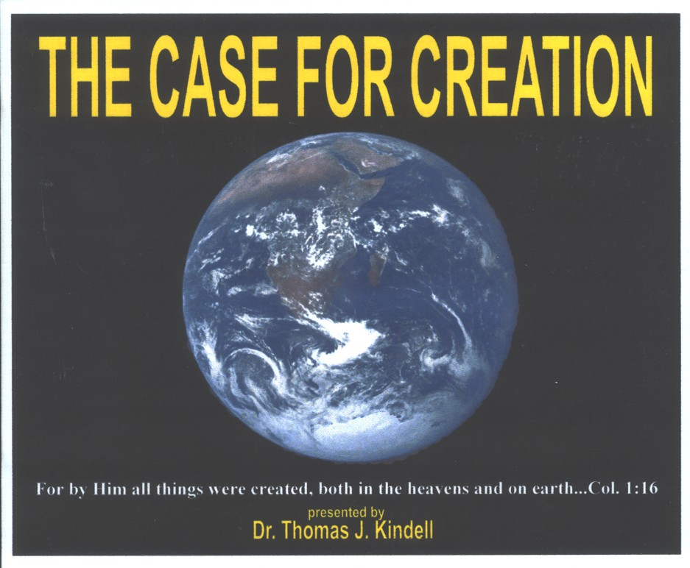

Audio CD Albums

Slide 5
THE RESURRECTION IS:
The most outlandish and heartless
hoax of history
OR
The most significant and meaningful fact of history.

Slide 6
THE ULTIMATE PROOF OF CHRIST’S CLAIMS
John 2:19 – Destroy this temple…I will raise it up
Matt. 12:39 – The sign of the prophet Jonah
Isa. 53 & Dan. 9 – The “Anointed One” would be killed
Psalm 16:10 – The “Holy One” would not corrupt in the grave
Rom. 1:4 – Christ was, “declared to be the Son of God with power…by His resurrection
from the dead

Slide 7
OBJECTION:
The resurrection of Christ is not worthy of consideration because it can’t be proved scientifically.
ANSWER:
The scientific method has limited applications and cannot be used to prove any facts of history.

Slide 8
FACTS OF HISTORY ARE PROVEN NOT BY THE SCIENTIFIC METHOD BUT BY THE LEGAL – HISTORICAL METHOD
The legal historical method depends on three types of testimony:
1. Oral testimony
2. Written testimony
3. Exhibits
Could you prove you were at your job last Wednesday?

Slide 9
WHAT MUST ONE DO
TO REFUTE CHRISTIANITY?
Legitimately refute the historical evidence for the resurrection of Jesus Christ.
If only more people would accept the challenge to refute the historical evidence of Christ’s resurrection – there would be a lot more converts to Christianity.

Slide 10
SOME OF THE WORLD’S GREATEST EXPERTS IN LAW AND HISTORY ACCEPTED THE CHALLENGE TO REFUTE THE RESURRECTION OF CHRIST – AND FAILED!

Slide 11
Lord Littleton & Dr. Benjamin Gilbert West
The book: The Observation of the Evidence Regarding the Resurrection of Christ
From the flyleaf: Reject not until you have examined the evidence
2. Frank Morrison – Lawyer & Rationalist
The book: Who Moved the Stone?
Title of Chapter 1: The Book that Refused to be Written

Slide 12
3. Thomas Arnold - Historian
Qualifications
Professor Arnold was for 14 years the Headmaster of Rugby, author of the three-volume History of Rome, and holder of the chair of modern history at Oxford University. He was certainly well acquainted with
the value of evidence in determining
historical facts.

Slide 13
Professor Arnold testified:
“I have been used for many years to study the histories of other times, and to examine and weigh the evidence of those who have written about them, and I know of no one fact in the history of mankind which is proved by better and fuller evidence of every sort, to the understanding of a fair inquirer, than the great sign which God hath given us that Christ died and rose again from the dead.”

Slide 14
4. Lord Lindhurst – Attorney General
Qualifications
Lindhurst was a Solicitor-General of the British government, Attorney General of Great Britain, three times High Chancellor of England and elected as High Steward of the University of Cambridge. Thus, he
held in one lifetime the highest offices ever conferred upon a judge in the history of Great Britain.

Slide 15
Lord Lindhurst testified:
“I know pretty well what
evidence is; and I tell you,
such evidence as
that for the resurrection
has never
broken down yet.”

Slide 16
5. Dr. Simon Greenleaf – Professor of Law, Harvard
Qualifications
Dr. Greenleaf authored a three-volume set entitled A Treatise on the Law of Evidence, (1842) which was so excellent that it is still considered by many to be the greatest single authority on evidence in the entire history of legal procedure.

Slide 17
Dr. Simon Greenleaf was challenged by his Christian law students to try to refute the eyewitness testimony of the New Testament evangelists.
Dr. Simon Greenleaf became a zealous Christian!

Slide 18
To explain why the testimony of the Gospel accounts was irrefutable from the standpoint of legally admissible evidence,
Dr. Greenleaf authored a book entitled:
An Examination of the Testimony of the Four Evangelists by the Rules of Evidence Administered in Courts of Justice

Slide 19
THE FIVE TESTS OF EYEWITNESSES
“The credit due to the testimony of witnesses depends upon, first, their honesty; secondly, their ability; thirdly, their number and the consistency of their testimony; fourthly, the conformity of their testimony with experience, and fifthly, the coincidence of their testimony with collateral circumstances.”
“Let the evangelists be tried by
these tests!”

Slide 20
In applying the five tests of witnesses Greenleaf found he could not resolve the key issues involved unless the testimony of Christ’s resurrection was true.

Slide 21
GREENLEAF’S THREE MAJOR IRRECONCILABLE ISSUES
1. No motive to lie – whether good or bad men.
2. The number of witnesses and the consistency of their testimony.
a. 1 Corinthians 15:6 – Over five hundred witnesses, most still living.

Slide 22
GREENLEAF’S THREE MAJOR IRRECONCILABLE ISSUES
b. 6 minutes of testimony equals over 50 hours of direct eyewitness confirmation.
c. Consistency of the Apostles testimony never failed despite lifelong persecution & martyrdom.
3. Consistency of the testimony with collateral circumstances.

Slide 23
COLLATERAL CIRCUMSTANCES
1. Buried according to the burial custom of the Jews.
a. 100 lbs of spices used.
b. 115 lb body cast.
2. A very large stone covered the tomb.
a. Parentheses – 20 men could not move the stone.
b. Two Georgia Tech engineers – 1½ to 2 tons.

Slide 24
COLLATERAL CIRCUMSTANCES
3. Roman Security Guard
a. Pilate gave a koustodia – 16 men, 5 weapons each.
b. Roman Military Law – Death penalty.
I. Sleeping while on duty.
II. Leaving post without authorization.
4. The Roman Seal was placed over the tombstone.

Slide 25
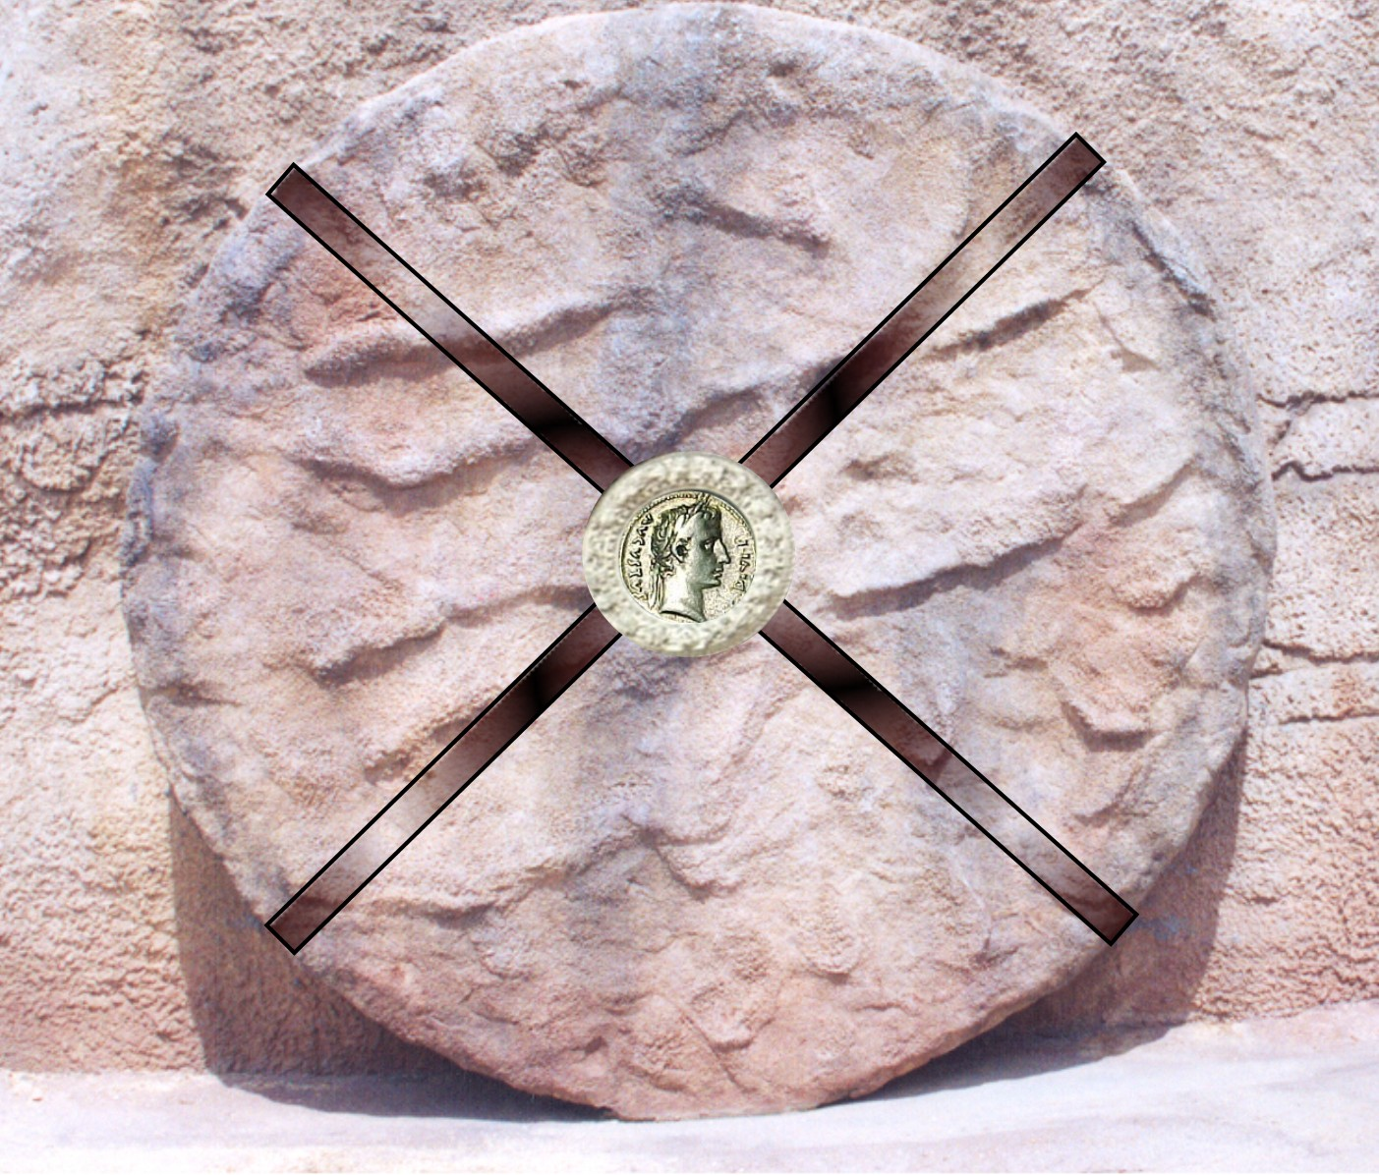

Slide 26
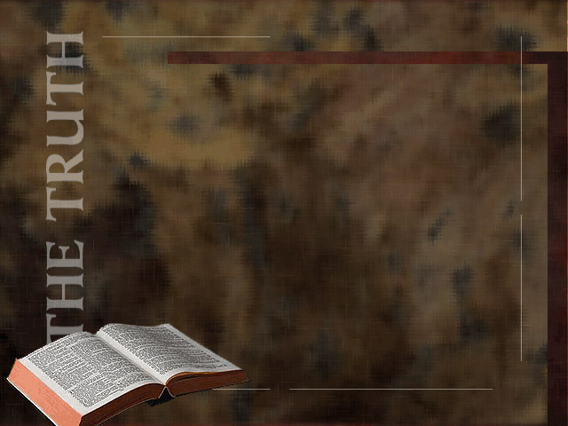
And behold there was a great earthquake; for an angel of the Lord descended from Heaven and came and rolled back the stone, and sat upon it. His appearance was like lightening and his clothing white as snow. And for fear of him the guards trembled and became like dead men.
Matthew 28.2-4

Slide 27
Something happened three days after Christ’s burial resulting
in three facts that must be reasonably explained:
1. The empty tomb
2. The appearances of Christ
3. The permanently transformed lives of the Apostles

Slide 28
If you examine every theory advanced to explain away the three critical facts, your conviction of the truth of the resurrection of Christ will grow stronger than ever.

Slide 29
THEORIES ADVANCED TO REFUTE THE SUPERNATURAL RESURRECTION OF JESUS CHRIST
1. The disciples removed the body while the guards slept.

Slide 30
And behold, there was a great earthquake; for an angel of the Lord descended from heaven and came and rolled back the stone, and sat upon it, his appearance was like lightening and his clothing white as snow. And for fear of him the guards trembled and became like dead men.
Matthew 28:2-4

Slide 31
While they were going, behold, some of the guard went into the city and told the chief priests all that had taken place. And when they had assembled with the elders and taken council, they gave a sum of money to the soldiers and said, “tell people His disciples came by night and stole Him away while we were asleep...

Slide 32
…And if this comes to the governor’s ears, we will satisfy him and keep you out of trouble.” So they took the money and did as they were directed; and this story has been spread among the Jews to this day.
Matthew 28:11-15

Slide 33
THEORIES ADVANCED TO REFUTE THE SUPERNATURAL RESURRECTION OF JESUS CHRIST
1. The disciples removed the body while the guards slept.
a. No one can testify about events that happened while they slept.
b. The guards slept despite the death penalty?
c. The rolling stone failed to wake the guard?
d. Motive Dilemma
2. The authorities moved the body for safe keeping.

Slide 34

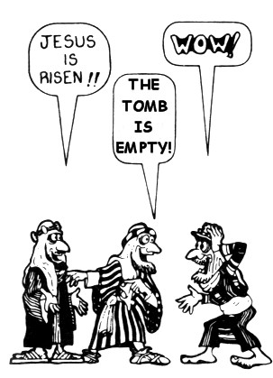

Slide 35
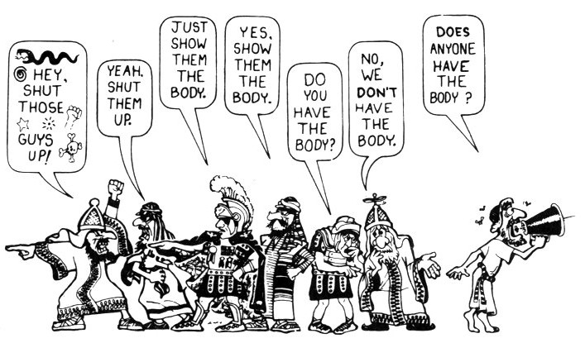

Slide 36
3. The women went to the wrong tomb.
a. The disciples went to the wrong tomb.
b. The Jews went to the wrong tomb.
c. The Romans went to the wrong tomb.
d. Joseph of Aramathea went to the wrong tomb.

Slide 37
4. The Passover Plot
a. The disciples had little money for bribery.
b. The guard would keep the money and kill the disciples.
5. Christ’s Spirit rose but not His body.
a. Even enemies did not dispute the empty tomb.
b. Jesus lied? – “Destroy this temple…” John 2:19

Slide 38
c. Jesus said, “…handle me, and see for a spirit has not flesh and bones as you see that I have.” Luke 24:39
6. The witnesses all had the same hallucinations.
a. Hallucinations are highly subjective.
b. Hallucinations do not persist for only forty days.
c. Hallucinations cannot be touched – Thomas.

Slide 39
7. An identical twin deceived the disciples.
a. Where did the twin come from?
b. The marks of crucifixion? – Thomas
c. No knowledge of previous experiences.
d. No ability to do miracles.

Slide 40
8. Christ only swooned (fainted) on the cross.
a. Christ didn’t die?
I. He sweat great drops of blood.
II. Endured a sleepless night.
III. He was beaten with fists.
IV. A crown of thorns was beaten into His head.
V. Scourged with the Roman flagellum.

Slide 41
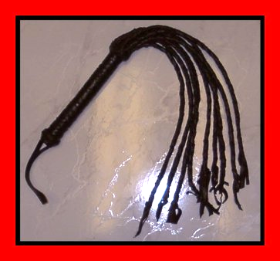

Slide 42
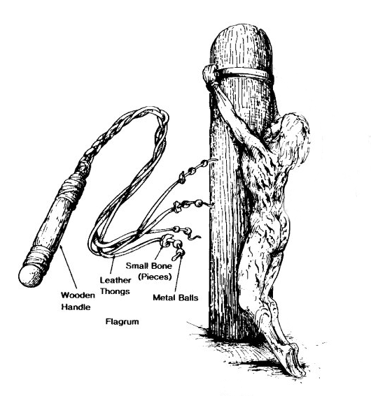
…and having scourged Jesus, delivered Him to be crucified.
Matthew 27:26

Slide 43
VI. He couldn’t carry His cross.
VII. He was crucified with iron spikes.
VIII. A spear was thrust into His heart.
IX. Four professional executioners signed His death certificate.
X. His body was wrapped like a mummy.

Slide 44
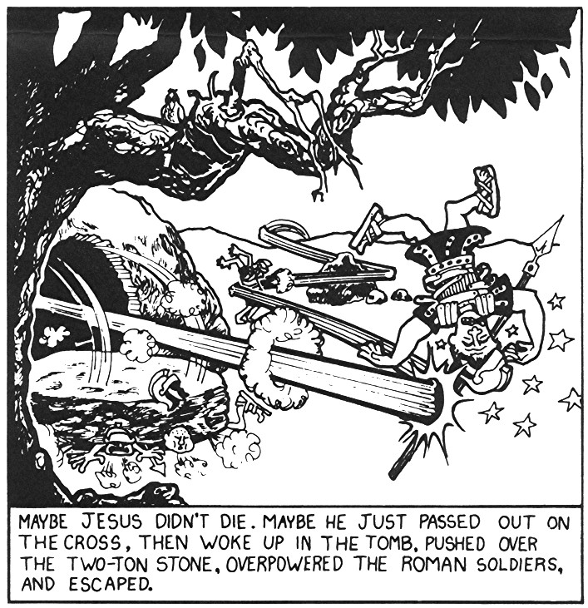

Slide 45
A CRITICAL QUESTION
Would eleven men die for a lie if they knew it was a lie?
Blaise Pascal:
They went through the test of death to determine their veracity.

Slide 46
Dr. Simon Greenleaf concluded:
“If they believed in a future state of retribution, a heaven and a hell thereafter, they took the most certain course, if false witnesses, to secure the latter for their portion. And if, still being bad men, they did not believe in future punishment, how came they to invent falsehoods, the direct and certain…

Slide 47
Dr. Simon Greenleaf concluded:
…tendency of which was to destroy all their prospects of worldly honor and happiness and to insure their misery in this life? From these absurdities there is no escape but in the perfect confidence and admission that they were good men, testifying to that which they had carefully observed and considered and well knew to be true.”

Slide 48
Lord Darling, Former Chief Justice of Great Britain concluded:
“There exists such overwhelming evidence, positive and negative, factual and circumstantial, that no intelligent jury in the world could fail to bring in a verdict that the resurrection story is true!”

Slide 49
WHAT IS YOUR VERDICT?
What reasonable explanation do you have for:
The empty tomb.
The hundreds of eye witnesses.
The permanently transformed
lives of the Apostles.

Slide 50
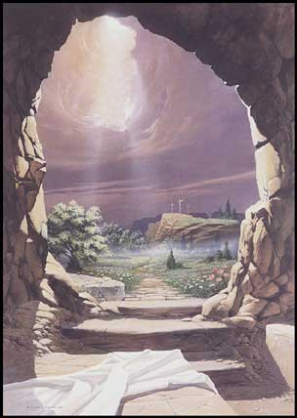
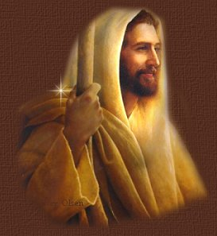
WHAT WILL YOU DO WITH JESUS CHRIST?

