Slide 1
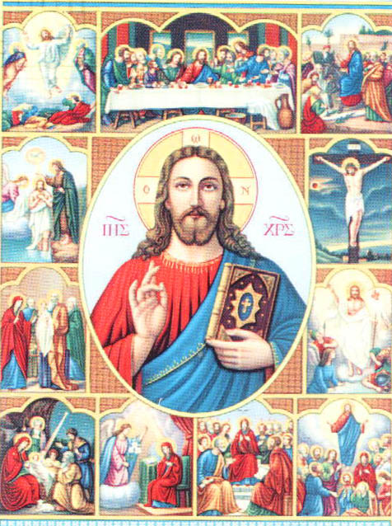
Virgin Birth of Christ

Slide 2
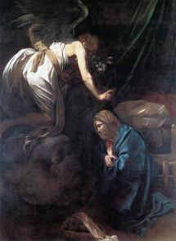
Virgin Birth of Christ
Perpetual Virginity
The Catholic Dogma which teaches that Mary was a virgin before,
during and after
the the conception and birth of her Divine Son.
All Christian’s believe Mary was a virgin before Jesus’ birth.
Many accept the Mary remained a virgin during Jesus’ birth.
Few believe Mary was ever-virgin.

Slide 3
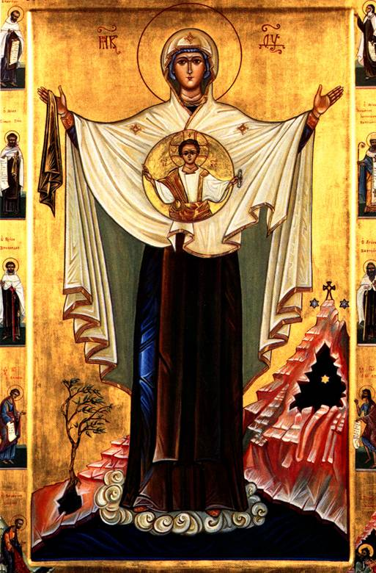
Virgin Birth of Christ
Mother of God,
Spouse of the Holy Spirit,
Mother of the Church, Leader in the battle against evil.
God preserved Mary from all sin to enable her to fulfill these roles perfectly and to give her maximum power against Satan.
Thus she was immaculately conceived.

Slide 4
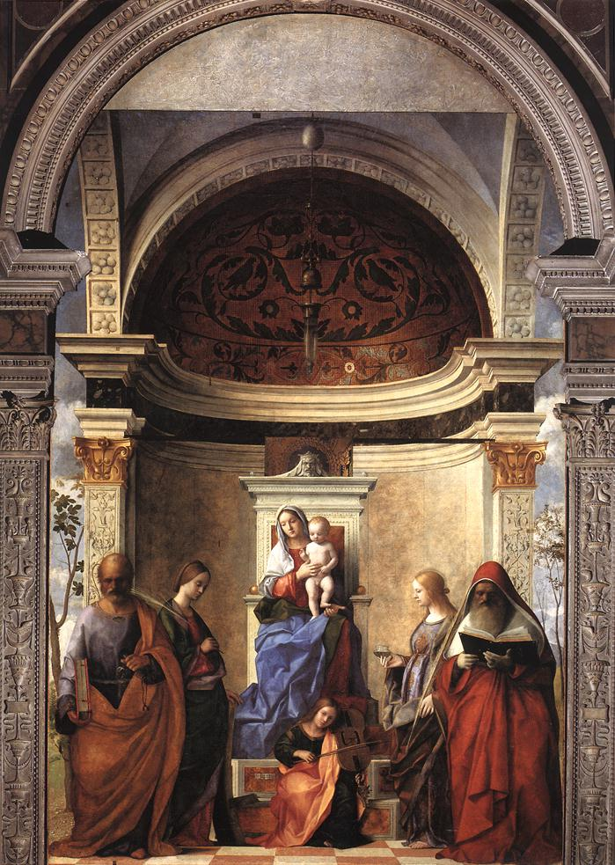
Virgin Birth of Christ
Mary was to have perfect spiritual intactness.
God wanted Mary’s body to reflect this intactness.
That is why God chose to miraculously preserve her virginity when she gave birth to Jesus.
He also kept her body from corruption after death
(the Assumption).
Mary’s body mirrored her spiritual condition.
Mary was fully graced and not subject to death and decay

Slide 5
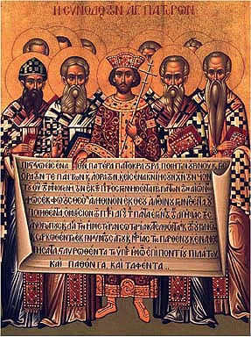
IN CATHOLIC THEOLOGY
The virginity of our Blessed Lady was defined under anathema in the third canon of the Lateran Council held in the time of Pope Martin I,
A.D. 649.
The Nicene-Constantinopolitan Creed, as recited in the Mass, expresses belief in Christ
“incarnate by the Holy Spirit of the Virgin Mary";
The Apostles’ Creed professes that Jesus Christ
"was conceived by the Holy Spirit, born of the Virgin Mary";
the older form of the same creed uses the expression: "born of the Holy Ghost and of the Virgin Mary".
Councils and Creeds

Slide 6
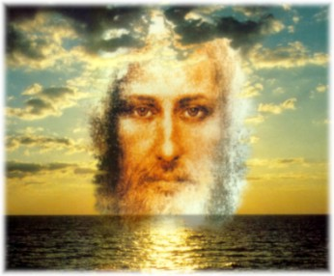
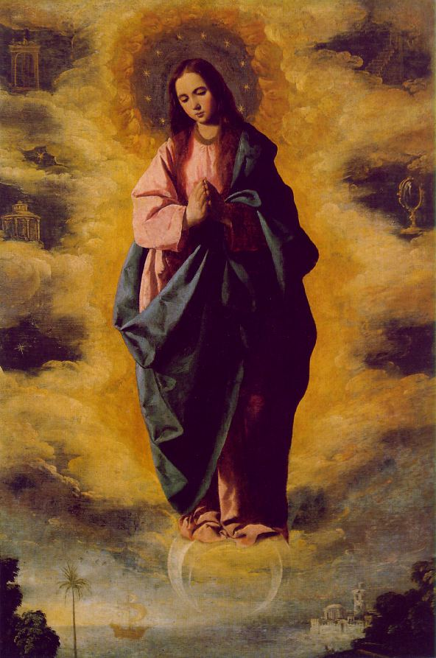
These professions show:
That the body of Jesus Christ was not sent down from Heaven, nor taken from earth as was that of Adam, but that its matter was supplied by Mary.

Slide 7
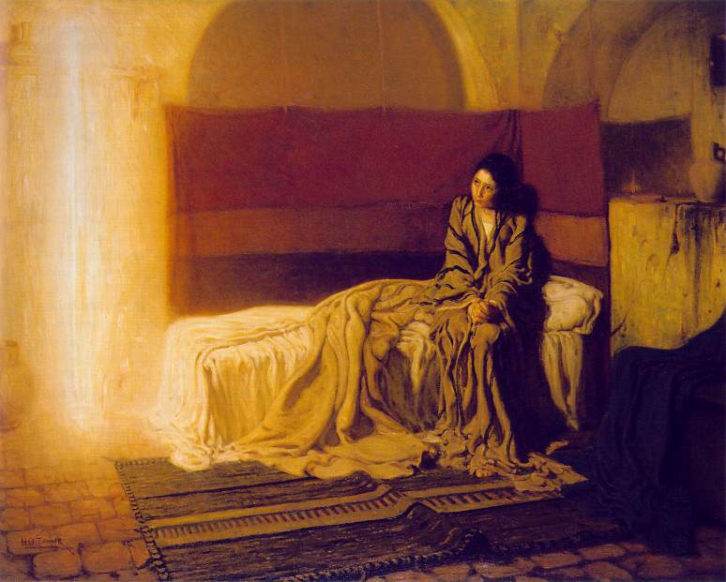
These professions show:
That Mary co-operated in the formation of Christ’s body as every other mother co-operates in the formation of the body of her child.
Since otherwise Christ could not be said to be born of Mary just as Eve cannot be said to be born of Adam;

Slide 8
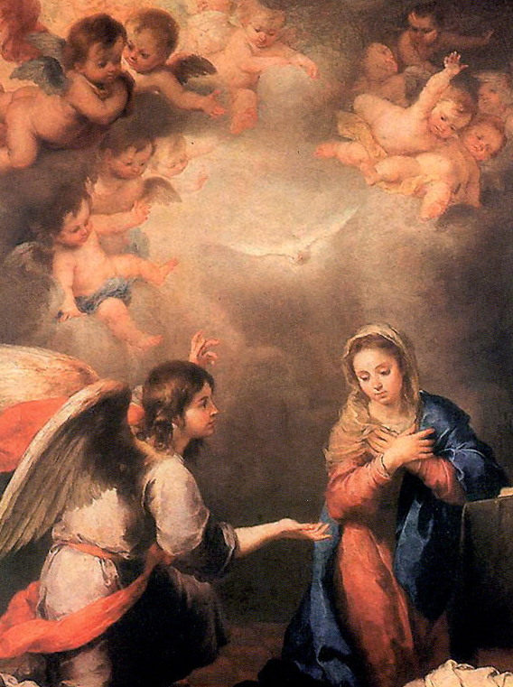
These professions show:
That the germ in whose development and growth into the Infant Jesus, Mary co-operated, was fecundated not by any human action, but by the Divine power attributed to the Holy Spirit.

Slide 9
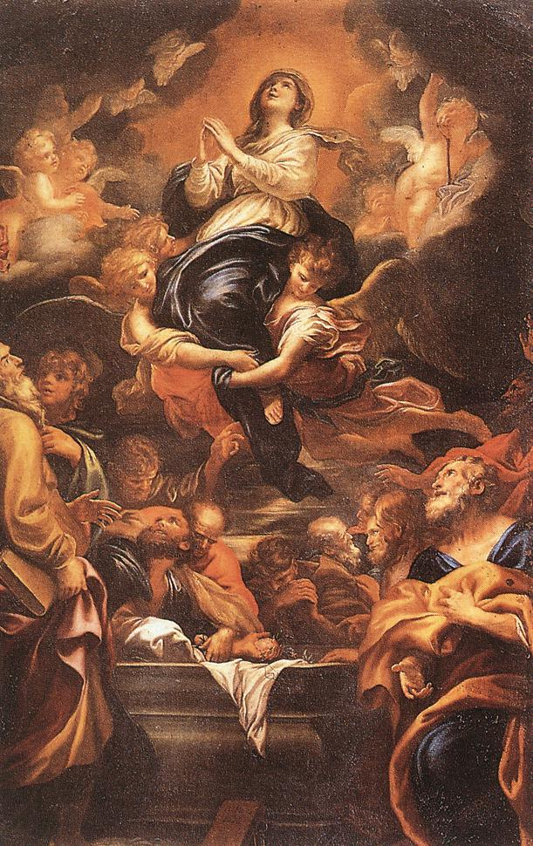
These professions show:
That the supernatural influence of the Holy Spirit extended to the birth of Jesus Christ,
not merely preserving Mary's integrity,
but also causing Christ’s birth or external generation to reflect his eternal birth from the Father in this,
  that "the Light from Light" proceeded from his mother's womb as a light shed on the world;
  that the "power of the Most High" passed through the barriers of nature without injuring them;
  that "the body of the Word" formed by the Holy Spirit penetrated another body after the manner of spirits.

Slide 10
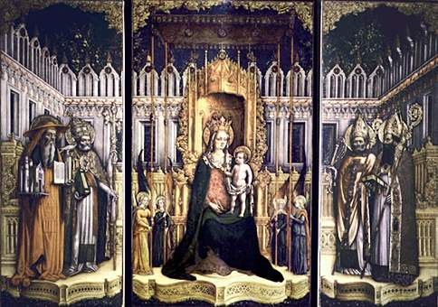
Church Fathers
The perpetual virginity of our Blessed Lady was taught and proposed to our belief not merely by the councils and creeds, but also by the early Fathers.

Slide 11
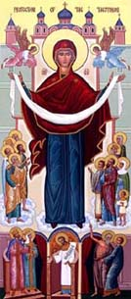
The words of the prophet Isaiah 7:14
are understood in this sense by
St. Irenaeus (III, 21; see Eusebius, H.E., V, viii),
Origen (Adv. Cels., I, 35),
Tertullian (Adv. Marcion., III, 13; Adv. Judæos, IX),
St. Justin (Dial. con. Tryph., 84),
St. John Chrysostom (Hom. v in Matth., n. 3; in Isa., VII, n. 5);
St. Epiphanius (Hær., xxviii, n. 7),
Eusebius (Demonstrat. ev., VIII, i),
Rufinus (Lib. fid., 43),
St. Basil (in Isa., vii, 14; Hom. in S. Generat. Christi, n. 4, if St. Basil be the author of these two passages),
St. Jerome
and Theodoretus (in Isa., vii, 14),
St. Isadore (Adv. Judæos, I, x, n. 3),
St. Ildefonsus (De perpetua virginit. s. Mariæ, iii).
St. Jerome (devotes his entire treatise against Helvidius to the perpetual virginity of Our Blessed Lady (see especially nos. 4, 13, 18).

Slide 12
The contrary doctrine is called:
"madness and blasphemy"
  by Gennadius (De dogm. eccl., lxix),
"madness"
  by Origen (in Luc., h, vii),
“sacrilege"
  by St. Ambrose (De instit. virg., V, xxxv),
"impiety and smacking of atheism"
  by Philostorgius (VI, 2),
"perfidy"
  by St. Bede (hom. v, and xxii),
"full of blasphemies"
  by the author of Prædestin. (i, 84),
"perfidy of the Jews"
  by Pope Siricius (ep. ix, 3),
"heresy"
  by St. Augustine (De Hær. h., lvi).
St. Epiphanius probably excels all others in his invectives against the opponents of Our Lady’s virginity
  (Hær., lxxviii, 1, 11, 23).

Slide 13
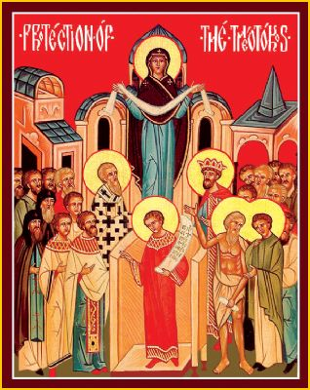
St Athanasius in his Discourses Against the Arians
explicitly calls Mary Ever-Virgin.
He mentions this title as something Christians take for granted.

Slide 14
In the 4th century Helvidius questioned Mary’s perpetual virginity in outrage St. Jerome wrote a scathing defense entitle
The Perpetual Virginity of the Blessed Virgin Mary Against Helvidius,
it condemned his teaching as novel and heretical.

Slide 15
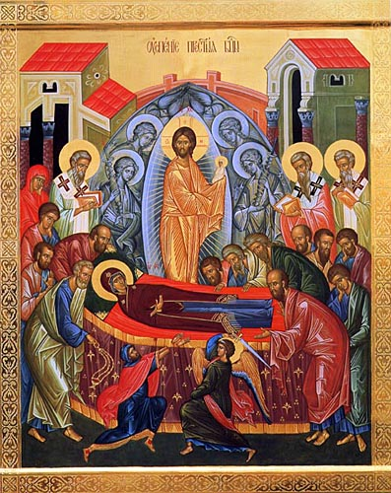
Augustine
calls Mary,
“a Virgin conceiving,
a Virgin
bearing,
a Virgin
pregnant,
a Virgin
bringing forth,
a Virgin
perpetual”

Slide 16
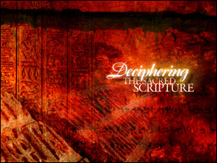

There can be no doubt as to the Church's teaching and as to the existence of an early Christian tradition maintaining the perpetual virginity of our Blessed Lady and consequently the virgin birth of Jesus Christ.
The mystery of the virginal conception is furthermore taught by the third Gospel and confirmed by the first.

Slide 17
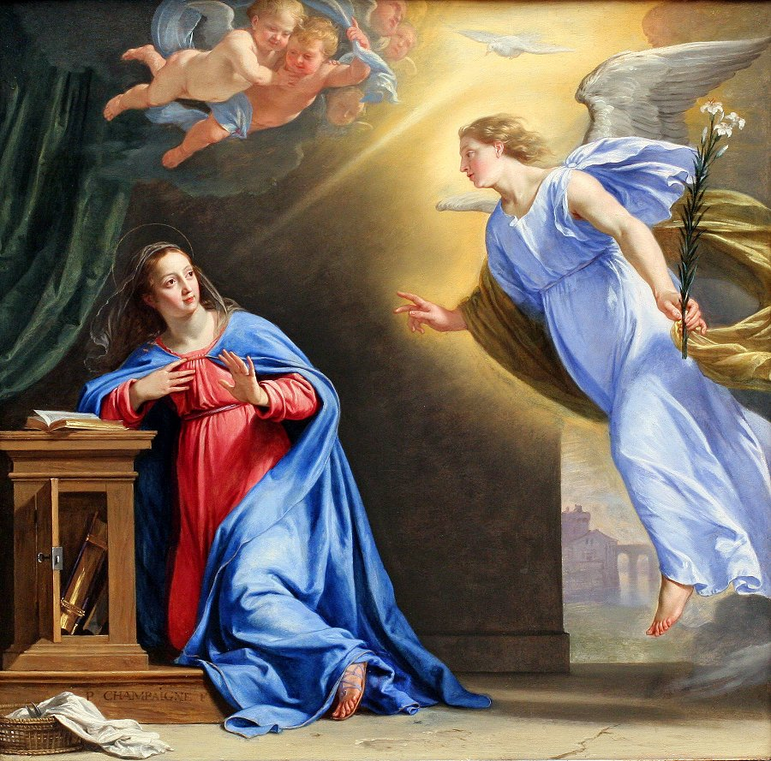
Virgin Birth of Christ
Sacred Scripture
According to St. Luke (1:34-35),
"Mary said to the angel: How shall this be done, because I know not man? And the angel answering, said to her: The Holy Spirit shall come upon thee, and the power of the most High shall overshadow thee. And therefore also the Holy which shall be born of thee shall be called the Son of God."
The intercourse of man is excluded in the conception of Our Blessed Lord.
According to St. Matthew, St. Joseph, when perplexed by the pregnancy of Mary,
is told by the angel:
"Fear not to take unto thee Mary thy wife, for that which is conceived in her, is of the Holy Spirit" (1:20).

Slide 18
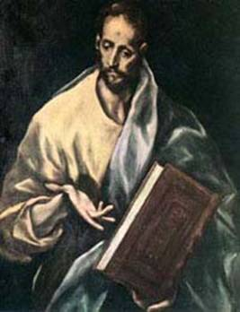
Scripture Often Used to Disprove Mary’s Perpetual Virginity
Scripture Often Used to Disprove Mary’s Perpetual Virginity
It can indicate sibling, relative, friend, or associate
Acts 21:7
Fellow Christians are called brothers
Acts 22:1
Jewish leaders are called brothers.
Gn 14:14
Lot the nephew of Abraham is called his brother
To determine the exact relationship of Jesus’ brothers other scripture passages must be examined.
Matthew 27:56 & Mark 15:40
Tell us that two of these brothers James and Joseph are sons of another Mary, not the mother of Jesus
Jn 19:25
Identifies this Mary as the wife of Clopas.
The word brother is used in many different ways.
Matthew 13:55
James the brother of Jesus and first Bishop of Jerusalem

Slide 19
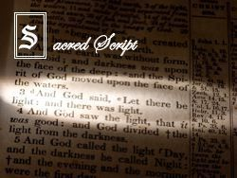
Scripture Often Used to Disprove Mary’s Perpetual Virginity
Matthew 1:24-25
Does not ‘til imply that after Jesus’ birth they had normal sexual relations.
The word ‘til does not imply a later change of condition.
1 Cor 15:25
Christ must reign ‘til he has put all his enemies under his feet does not imply Christ will not reign forever.

Slide 20
Scripture Often Used to Disprove Mary’s Perpetual Virginity
Matthew 1:24-25
Does not firstborn imply their were others born?
Firstborn is a legal term indicating a special privilege or rank
Ps 89:27 calls David his firstborn even though David was his eighth son.
Col 1:15 calls Jesus the firstborn of all creation
Firstborn child and only son are not mutually exclusive Ex 34:20

Slide 21
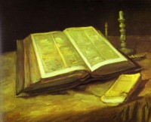
Scripture Used to Prove Mary’s Perpetual Virginity
The “brothers” of Jesus are never called
the “sons of Mary”
Some of these brothers advise and reprimand Jesus
(Jn 7:3-4, Mk 3:21)
In Jewish culture younger brothers never admonish an elder brother.
Mt 15 & Jn 19:27

Slide 22
Scripture Used to Prove Mary’s Perpetual Virginity
Jesus vehemently condemns the Korban rule,
that allowed children to avoid taking care of their parents.
By Hebrew law children had a solemn obligation to take care of their parents.
In Jn 19:26-27 Jesus presents his mother to his disciple John.
Where were his brothers?

Slide 23
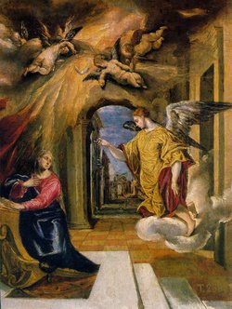
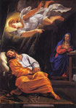
Virgin Birth of Christ
SOURCES OF THIS DOCTRINE
Where did the Evangelists derive their information?
As far as we know, only two created beings were witnesses of the Annunciation,
the angel and the Blessed Virgin.
Later on the angel informed St. Joseph concerning the mystery.
We do not know whether Elizabeth, though
"filled with the Holy Spiritt",
learned the full truth supernaturally, but we may suppose that Mary confided the secret both to her friend and her spouse, thus completing the partial revelation received by both.

Slide 24
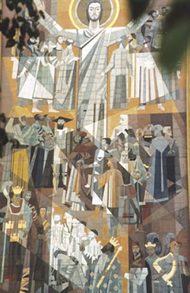
Between these data and the story of the Evangelists there is a gap which cannot be filled from any express clue furnished by either Scripture or tradition.

Slide 25
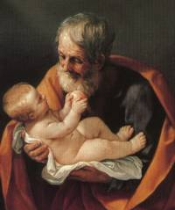
If we compare the narrative of the first Evangelist with that of the third, we find that St. Matthew may have drawn his information from the knowledge of
St. Joseph independently of any information furnished by Mary.

Slide 26
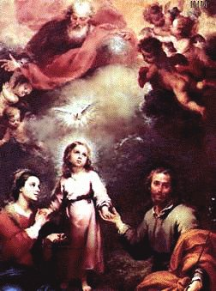
The first Gospel merely states (1:18):
"When as his mother Mary was espoused to Joseph, before they came together, she was found with child, of the Holy Spirit."
St. Joseph could supply these facts either from personal knowledge or from the words of the angel:
"That which is conceived in her, is of the Holy Spirit."

Slide 27
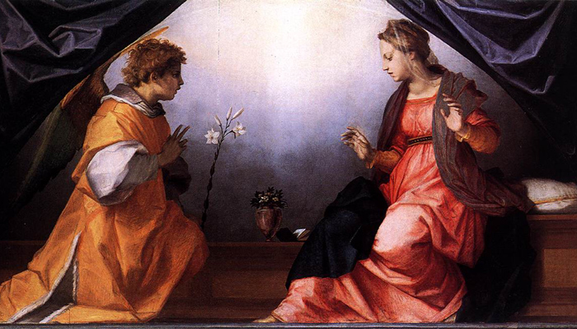
The narrative of St. Luke, on the other hand, must ultimately be traced back to the testimony of Our Blessed Lady, unless we are prepared to admit unnecessarily another independent revelation.
The evangelist himself points to Mary as the source of his account of the infancy of Jesus, when he says that Mary kept all these words in her heart (2:19, 51).

Slide 28
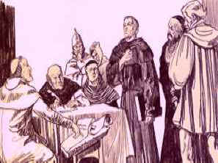
Mary Ever-Virgin
Protestant Reformers
Luther: “It is an article of faith that Mary is Mother of the Lord and still a virgin…Christ we believe came forth from a womb perfectly intact.”
Zwingli: “I firmly believe that Mary, according to the words of the gospel, as a pure Virgin brought forth for us the Son of God and in childbirth and after childbirth forever remained a pure, intact Virgin.”
Calvin: “There have been certain folk who have wished to suggest from this passage (Mt 1:25) that the Virgin Mary had other children than the Son of God, and that Joseph had then dwelt with her later; but what folly this!”
All agreed that the typology of Mary as Ark of the Covenant and God’s insistence that the Ark be without stain or defect would apply even more to Mary who carried the Living Word of God

