Slide 1
ESCHATOLOGY:
The Last Things
© 1985 – 2005, Robert Schihl and Paul Flanagan

Slide 2
Death
Particular Judgment
Heaven
Purgatory
Hell
Parousia
Resurrection of the Dead
General Judgment
Eternity

Slide 3
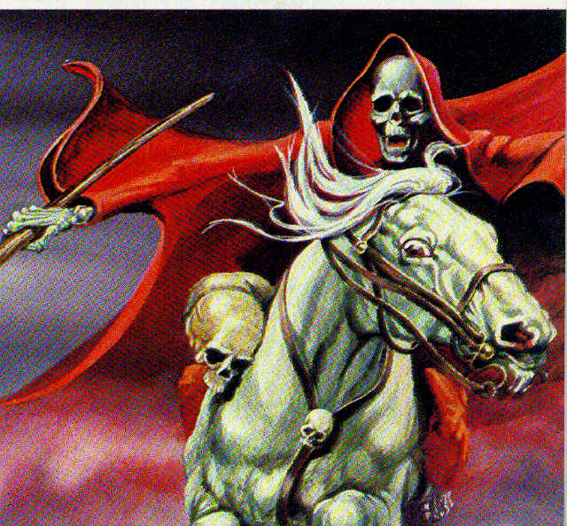
Revelation 6: 8
I looked, and there was a pale green horse. Its rider was
named Death, and Hades accompanied him. They were
given authority over a quarter of the earth, to kill with
sword, famine, and plague, and by means of the beasts
of the earth.

Slide 4
Death
Christians believe that human death closes the state
of human life or the time of probation.
Scripture speaks of death in many ways:
as a return to dirt (Genesis 3:19);
as a departure (2 Timothy 4:6; Philippians 1:23);
to be at home (2 Corinthians 5:8-9);
a discarding of a tent (2 Peter 1: 13-14);
a sleeping (Matthew 9:24, John 11:11-13);
a rest (Revelation 14:13);
a return to God (Ecclesiastes 12:7);
to be with Christ (Philippians 1:23); and
to live with Christ (2 Timothy 2:11).

Slide 5
Ecclesiastes 12:5-7
Because man goes to his lasting home, and mourners
go about the streets; Before the silver cord is snapped
and the golden bowl is broken, And the pitcher is
shattered at the spring, and the broken pulley falls
into the well, And the dust returns to the earth as it
once was, and the life breath returns to God who
gave it.
2 Corinthians 5:1
For we know that if our earthly dwelling, a tent, should
be destroyed, we have a building from God, a dwelling
not made with hands, eternal in heaven.
2 Corinthians 5:4
For while we are in this tent we groan and are weighed
down, because we do not wish to be unclothed but to
be further clothed, so that what is mortal may be
swallowed up by life.

Slide 6
2 Corinthians 5:8
Yet we are courageous, and we would rather leave
the body and go home to the Lord.
2 Timothy 4:6
For I am already being poured out like a libation, and
the time of my departure is at hand.
Philippians 1:21-23
For to me life is Christ, and death is gain. If I go on
living in the flesh, that means fruitful labor for me. And
I do not know which I shall choose. I am caught
between the two. I long to depart this life and be with
Christ, (for) that is far better.
2 Peter 1:13-14
I think it right, as long as I am in this "tent," to stir you
up by a reminder, since I know that I will soon have to
put it aside, as indeed our Lord Jesus Christ has shown
me.

Slide 7
Death
Particular Judgment
Heaven
Purgatory
Hell
Parousia
Resurrection of the Dead
General Judgment
Eternity

Slide 8
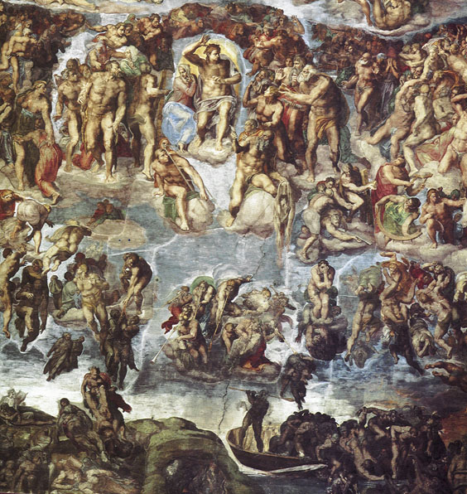
Immediately after Death: Particular Judgment
Catholic Christians and many other Christians believe that
immediately after death the souls of men and women go
either to heaven (or prior to that, purgatory), or to hell
definitively.
Michelangelo's
Last Judgment
Sistine Chapel
Vatican City

Slide 9
Luke 16: 19-36
(Jesus said to them [the Pharisees]:...) "There was
a rich man who dressed in purple garments and fine
linen and dined sumptuously each day. And lying at
his door was a poor man named Lazarus, covered
with sores, who would gladly have eaten his fill of the
scraps that fell from the rich man's table. Dogs even
used to come and lick his sores. When the poor man
died, he was carried away by angels to the bosom of
Abraham. The rich man also died and was buried, and
from the netherworld, where he was in torment, he
raised his eyes and saw Abraham far off and Lazarus
at his side. And he cried out, 'Father Abraham, have
pity on me. Send Lazarus to dip the tip of his finger
in water and cool my tongue, for I am suffering torment
in these flames.'

Slide 10
Abraham replied, 'My child, remember that you received
what was good during your lifetime while Lazarus likewise
received what was bad; but now he is comforted here,
whereas you are tormented. Moreover, between us and
you a great chasm is established to prevent anyone from
crossing who might wish to go from our side to yours or
from your side to ours.' He said, 'Then I beg you, father,
send him to my father's house, for I have five brothers,
so that he may warn them, lest they too come to this place
of torment.' But Abraham replied, 'They have Moses and
the prophets. Let them listen to them.' He said, 'Oh no,
father Abraham, but if someone from the dead goes to
them, they will repent.' Then Abraham said, 'If they will
not listen to Moses and the prophets, neither will they
be persuaded if someone should rise from the dead.'"

Slide 11
Luke 23: 43
He (Jesus) replied to him, "Amen, I say to you, today
you will be with me in Paradise."
2 Corinthians 5: 6-8
So we are always courageous, although we know that
while we are at home in the body we are away from
the Lord, for we walk by faith, not by sight. Yet we are
courageous, and we would rather leave the body and
go home to the Lord.
1 Thessalonians 5:10
(Jesus) died for us, so that whether we are awake or
asleep we may live together with him.
Philippians 1:21-23
For to me life is Christ, and death is gain. If I go on
living in the flesh, that means fruitful labor for me. And
I do not know which I shall choose. I am caught between
the two. I long to depart this life and be with Christ,
(for) that is far better.

Slide 12
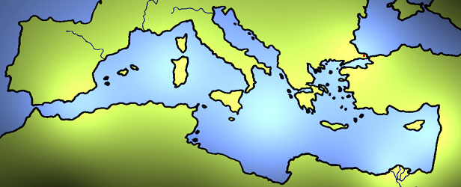
The constant faith of the Church attests to the faith in the
permanency of human death. That faith is best described in
the writings of the Fathers of the Church.
Irenaeus of Lyons (circa 130-200), set forth the
idea of death as the separation of the soul from the body.
The identical idea is found in Tertullian in the third century;
Gregory of Nyssa (circa 330-395) in the fourth.
Irenaeus
Nyssa
Augustine

Slide 13
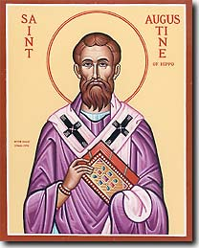
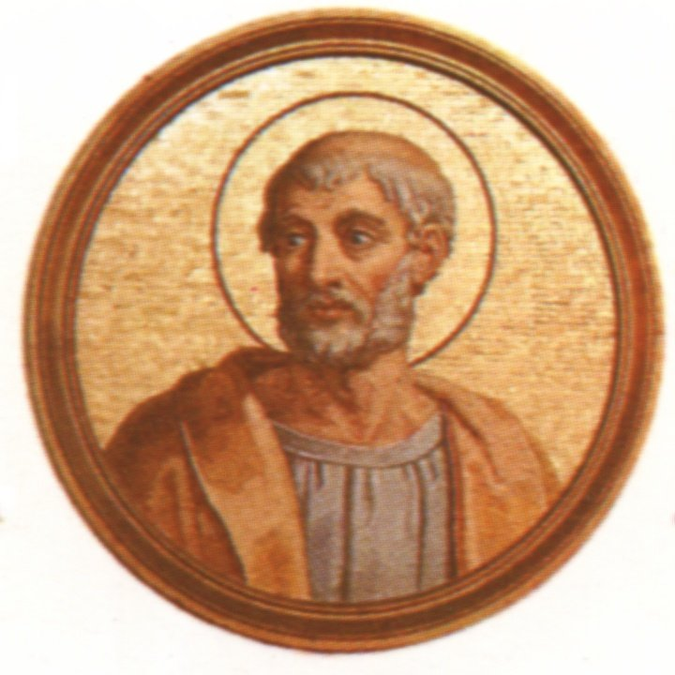
That death as a separation of the soul from the body is
graphically described by Augustine of Hippo (354-439)
in his book, The City of God.
Clement of Rome (d. circa 100) affirmed the permanency of death as separation and the impossibility of meriting or losing meriting after death.

Slide 14
Cyprian of Carthage (cir 200-258) mentions the same
fact several times in his writings.
Later Gregory of Nazianzus (329-389) and
John Chrysostom of Constantinople (347-407) mention
the fact several times.
It also occurs in Gregory the Great in Rome (540-604).
Gregory of Nyssa
Rome
John Chrysostom
Gregory of Nazianzenus
Cyprian

Slide 15
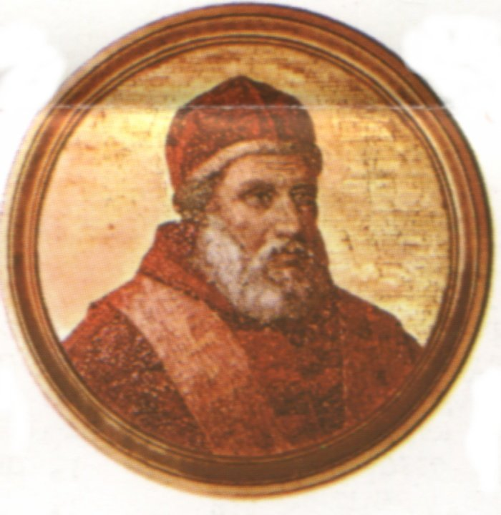
The Magisterium of the Church has confirmed throughout
centuries the eternal lot of all souls, either in heaven, purgatory
or hell is decided once for all at the moment of death.
Benedict XII, Benedictus Deus, January 29, 1336,
"We define that the souls of all the saints who have left this life
soon after individual death are or will be in heaven and have
eternal life; in addition we define that the souls of those dying
in actual mortal sin soon after individual death descend into hell."
(Denzinger 530)

Slide 16
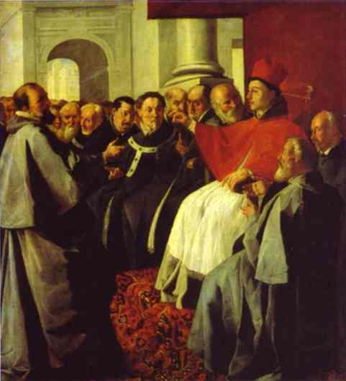
Council of Lyons II, 1274
"We believe...that those truly penitent die in charity before they have done sufficient penance for their sins of omission and commission, their souls are cleansed after death in purgatorial
or cleansing punishments; ... the souls of those who have not
committed any sin at all after they received holy baptism, and
the souls of those who have committed sin, but have been
cleansed, either while they were in the body or afterwards ... are
promptly taken up into heaven. The souls of those who die
in mortal sin or with only original sin
soon go down into hell, but there they
will receive different punishments."
(Denzinger 464)
St. Bonaventure at the Council of Lyons II

Slide 17
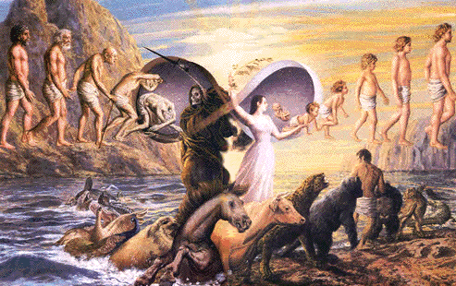
Reincarnation
It is not uncommon that people under the influence of the
New Age Movement and Hollywood movies ask about the
possibility of another or previous life or other lives for the soul.
Catholic Christianity and all orthodox Christian faith communities
have always found in the Word of God clear revelation of the
unique nature of this life, of individual death and a definitive
judgment for the soul.

Slide 18
Matthew 25: 31-41
(Then Jesus told the crowds and his disciples: ...)"When
the Son of Man comes in his glory, and all the angels
with him, he will sit upon his glorious throne, and all the
nations will be assembled before him. And he will
separate them one from another, as a shepherd
separates the sheep from the goats. He will place the
sheep on his right and the goats on his left. Then the king
will say to those on his right, 'Come, you who are blessed
by my Father. Inherit the kingdom prepared for you from
the foundation of the world.' ... Then he will say to those
on his left, 'Depart from me, you accursed, into the eternal
fire prepared for the devil and his angels.'"

Slide 19
2 Corinthians 5:10
For we must all appear before the judgment seat of
Christ, so that each one may receive recompense,
according to what he did in the body, whether good or
evil.
Luke 16: 19-36
(Jesus said to them [the Pharisees]:...) "There was a
rich man who dressed in purple garments and fine linen
and dined sumptuously each day. And lying at his door
was a poor man named Lazarus, covered with sores ..."
Hebrews 9:27-28
Just as it is appointed that human beings die once, and
after this the judgment, so also Christ, offered once to
take away the sins of many, will appear a second time,
not to take away sin but to bring salvation to those
who eagerly await him.

Slide 20
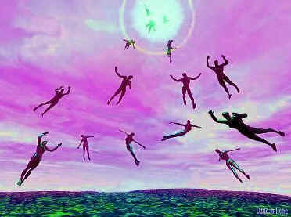
Being Taken Up Into Heaven
The question of those still alive at the time of the end of the
world has always concerned believers. Some evangelical
Christians have developed a teaching on the so-called
"rapture." It is based on a passage from Matthew's Gospel.
Some believe in a rapture before Jesus' second coming. These
teachings began in 1830 in the Plymouth Church in England
from a man named John
Nelson Darby.

Slide 21
Catholic Christians simply accept Christ's explanation of those
still alive at the end of the world.
Matthew 24:36-42
(In reply, Jesus said to them:) "But of that day and hour
no one knows, neither the angels of heaven, nor the
Son, but the Father alone. For as it was in the days
of Noah, so it will be at the coming of the Son of Man.
In (those) days before the flood, they were eating and
drinking, marrying and giving in marriage, up to the day
that Noah entered the ark. They did not know until the
flood came and carried them all away. So will it be
(also) at the coming of the Son of Man. Two men will
be out in the field; one will be taken, and one will be
left. Two women will be grinding at the mill; one will
be taken, and one will be left. Therefore, stay awake!
For you do not know on which day your Lord will come."

Slide 22
Paul says that
the resurrection of the dead will precede the second coming.
According to Paul, the Lord will command those who have
suffered human death to rise. Only then
(2) will those still living at the end of time join the
resurrected dead. Both groups together
(3) will be witnesses to Christ's coming.
1 Thessalonians 4:16-18
For the Lord himself, with a word of command, with the
voice of an archangel and with the trumpet of God, will
come down from heaven, and the dead in Christ will rise
first. Then we who are alive, who are left, will be caught
up together with them in the clouds to meet the Lord in
the air. Thus we shall always be with the Lord.
Therefore, console one another with these words.

Slide 23
Death
Particular Judgment
Heaven
Purgatory
Hell
Parousia
Resurrection of the Dead
General Judgment
Eternity

Slide 24
Heaven
Catholic Christians and all other Christians believe in
the blessedness of heaven realized in the possession of God.
Scripture speaks of heaven in many ways:
as life (Matthew 18:8);
as eternal life (Matthew 25:46);
as the crown of life (James 1:12);
as the tree of life (Revelation 2:7);
as glory (Romans 8:18);
as eternal glory (2 Timothy 2:10);
as the eternal glory of God (1 Peter 5:10);
as rest (Hebrews 4:3, 11);
as the crown of righteousness (2 Timothy 4:8);
as the Kingdom (Matthew 25: 34);
as a dwelling in the heavens (2 Corinthians 5:1);
as paradise (Luke 23:43).

Slide 25
Those who are in heaven will have:
great rewards (Luke 6:23);
treasures (Matthew 6:20);
an imperishable inheritance incapable of fading or defilement (1 Peter 1:4).
In heaven the blessed:
will be with God (Revelation 21:3);
will be with Christ (Mark 16:19);
will be with the angels (Matthew 22:30);
will be in the house of the Father where there are many dwelling places (John 14:2);
are heirs of God, heirs with Christ (Romans 8:17);
will see God face to face (1 Corinthians 13:9-12);
will see God as he is (1 John 3:2).

Slide 26
They will reign forever and ever:
illuminated by God (Revelation 22:3-5);
immortal and physically incorruptible (Revelation 21:4);
with an irreproachable conscience (1 Peter 3:21).
The Magisterium of the Church speaks of heaven in many ways:
as eternal life (Denzinger, 640);
as the eternal fatherland (Denzinger 457);
as heaven (Denzinger 464);
as the kingdom of heaven and celestial paradise (Denzinger 530);
as the vision and fruition of God (Denzinger 530);
as true beatitude (Denzinger 530);
as eternal rest (Denzinger 530);
as eternal beatitude (Denzinger 570);
as the vision of God one and three (Denzinger 693);
as glory (Denzinger 842);
as eternal retribution (Denzinger 836);
as the supernatural end (Denzinger 1669, 1786).

Slide 27
Matthew 13:43
Then the righteous will shine like the sun in the kingdom
of their Father. Whoever has ears ought to hear.
Romans 2:6-7, 10
... who will repay everyone according to his works:
eternal life to those who seek glory, honor, and
immortality through perseverance in good works, ...
But there will be glory, honor, and peace for everyone
who does good.
John 17:3
Now this is eternal life, that they should know you, the
only true God, and the one whom you sent, Jesus Christ.
Matthew 25:21
His master said to him, 'Well done, my good and faithful
servant. Since you were faithful in small matters, I will
give you great responsibilities. Come, share your
master's joy.'

Slide 28
John 14:2-3
In my Father's house there are many dwelling places.
If there were not, would I have told you that I am going
to prepare a place for you? And if I go and prepare a
place for you, I will come back again and take you to
myself, so that where I am you also may be.
Psalms 73:23-25
Yet I am always with you; you take hold of my right hand.
With your counsel you guide me, and at the end receive
me with honor. Whom else have I in the heavens? None
beside you delights me on earth.
Psalms 16:11
You will show me the path to life, abounding joy in your
presence, the delights at your right hand forever.
Psalms 17:15
I am just--let me see your face; when I awake, let me be
filled with your presence.

Slide 29
1 John 3:2
Beloved, we are God's children now; what we shall be
has not yet been revealed. We do know that when it is
revealed we shall be like him, for we shall see him as
he is.
Luke 22:29-30
I confer a kingdom on you, just as my Father has
conferred one on me, that you may eat and drink at
my table in my kingdom; and you will sit on thrones
judging the twelve tribes of Israel.
1 Peter 1:3-5
Blessed be the God and Father of our Lord Jesus Christ,
who in his great mercy gave us a new birth to a living
hope through the resurrection of Jesus Christ from the
dead, to an inheritance that is imperishable, undefiled,
and unfading, kept in heaven for you who by the power
of God are safeguarded through faith, to a salvation that
is ready to be revealed in the final time.

Slide 30
1 Peter 5:4
And when the chief Shepherd is revealed, you will
receive the unfading crown of glory.
Revelation 21:27
... but nothing unclean will enter it (New Jerusalem,
heaven), nor any (one) who does abominable things
or tells lies. Only those will enter whose names are
written in the Lamb's book of life.
Wisdom 5:16
Therefore shall they receive the splendid crown, the
beauteous diadem, from the hand of the Lord- For he
shall shelter them with his right hand, and protect them
with his arm.
2 Corinthians 4:17
For this momentary light affliction is producing for us
an eternal weight of glory beyond all comparison,

Slide 31
The teachings of the Fathers of the Church affirms the
constant understanding of heaven in the history of faith.
Augustine, Confessions, Book 1, Ch. 1
"And man, being a part of your creation, desires
to praise You. You move us to delight in praising
You; for You have made us for Yourself, and our
hearts are restless till they find rest in you."
Augustine, The City of God, Book 11, Ch. 13
"From all this, it will readily occur to any one that the blessedness
which an intelligent being desires as its legitimate object results
from a combination of two things, namely, that it interruptedly
enjoy the unchangeable good which is God; and that it be
delivered from all doubt, and know certainly that it shall eternally
abide in the same enjoyment."

Slide 32
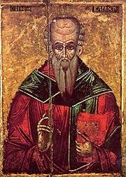
Clement of Alexandria Stromata, Book 7, Ch. 10
"For it is said, "To him that has shall be given" (Mt 25:29;
Lk 19:26): to faith, knowledge; and to knowledge, love; and
to love the inheritance. ... Whence at last ... it is that knowledge
is committed to those fit and selected for it. It leads us to the
endless and perfect end, teaching us beforehand the future
life that we shall lead, according to God, and with gods; after
we are freed from all punishment and
penalty which we undergo, in consequence
of our sins, for salutary purposes."

Slide 33
"After which redemption the reward and the honors are assigned
to those who have become perfect; ... they have become pure
in heart, and near to the Lord, there awaits them restoration to
everlasting contemplation; and they are called by the appellation
of gods, being destined to sit on thrones with the other gods
that have been first put in their places by the Savior."

Slide 34
Death
Particular Judgment
Heaven
Purgatory
Hell
Parousia
Resurrection of the Dead
General Judgment
Eternity

Slide 35
Hell: Reprobation
Christians believe because the Bible is clear that hell exists.
Scripture speaks of hell in many ways:
as a place of torment (Luke 16:28),
as the netherworld (Luke 16:22),
as the abyss (Luke 8:31; Revelation 9:1-2,11; 11:7; 17:8; 20:1,3),
as a fiery furnace (Matthew 13:42, 50),
as a pool of fire (Revelation 20:10, 14),
as a fiery pool of burning sulfur (Revelation 19:20),
as a pool of fire and sulfur (Revelation 20:10; 21:8),
as Tartarus (Greek mythological place of punishment) (2 Peter 2:4),
as Gehenna or as the fire of Gehenna (Mt 5:22, 29; 10:28; 18:9; 23:33).

Slide 36
As a state, Scripture speaks of hell with many words:
as death (Romans 6:21; 8:6; 8:13; 2 Corinthians 2:14-16),
as the second death (Revelation 2:11; 20:6; 21:8),
as eternal ruin (2 Thessalonians 1:9; 1 Tim 6:9),
as outside darkness (Matthew 8:12; 22:11-13; 25:30),
as eternal fire (Matthew 18:8, 25:41; Jude 7),
as eternal punishment (Matthew 25:46),
as destruction (Mathew 7:13; Philippians 1:28; Peter 3:7),
as damnation (Mark 16:16; John 12:25),
as perishing (John 3:16; 10:27; Romans 2:12),
as unquenchable fire (Mark 9:42-47; Luke 3:17),
as fire and sulfur (Revelation 14:9-14),
as thick gloom of darkness (2 Peter 2:17; Jude 13),
as corruption (Galatians 6:8),
as Babylon (Revelation 18; 19:1-3)

Slide 37
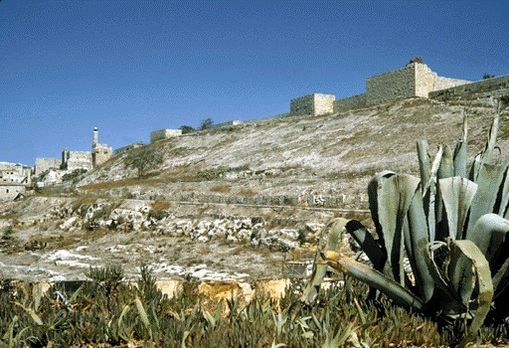
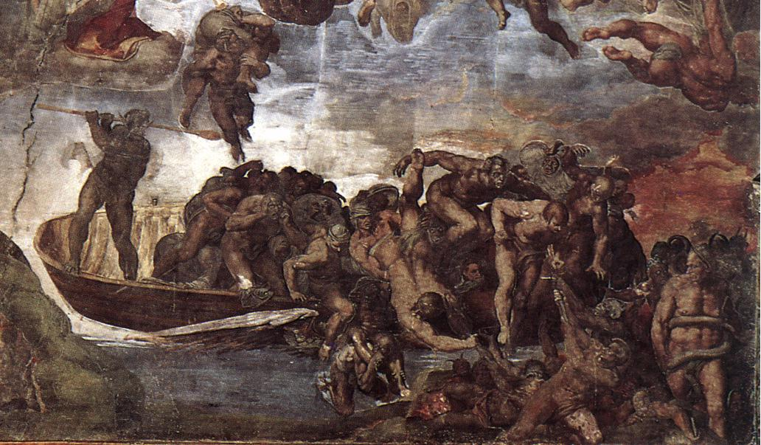
Gehenna
Outside Jerusalem
Michelangelo's Last Judgment
Sistine Chapel
Vatican City

Slide 38
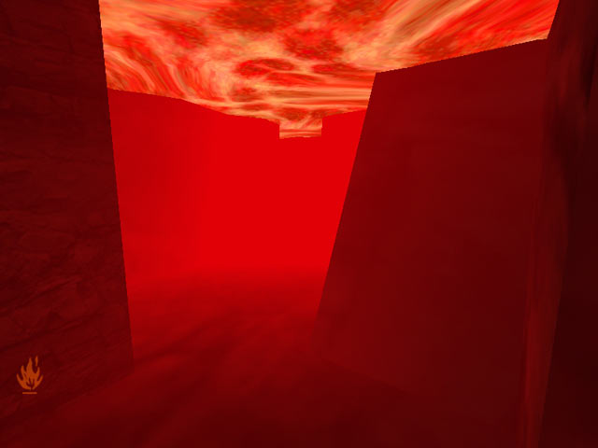
Matthew 25: 31-46
(Then Jesus told the crowds and his disciples: ...) "When
the Son of Man comes in his glory, and all the angels
with him, he will sit upon his glorious throne, and all the
nations will be assembled before him. And he will separate
them one from another, as a shepherd separates the
sheep from the goats. He will place the sheep on his right
and the goats on his left. ... Then he will say to those on
his left, 'Depart from me, you accursed, into the eternal
fire prepared for the devil and his angels.' ... And these
will go off to eternal punishment, but the righteous to
eternal life."

Slide 39
Luke 16: 19-26
(Jesus said to them [the Pharisees]:...) "There was a
rich man who dressed in purple garments and fine linen
and dined sumptuously each day. And lying at his door
was a poor man named Lazarus, covered with sores,
who would gladly have eaten his fill of the scraps that
fell from the rich man's table. Dogs even used to come
and lick his sores. When the poor man died, he was
carried away by angels to the bosom of Abraham. The
rich man also died and was buried, and from the
netherworld, where he was in torment, he raised his
eyes and saw Abraham far off and Lazarus at his side.
And he cried out, 'Father Abraham, have pity on me.
Send Lazarus to dip the tip of his finger in water and
cool my tongue, for I am suffering torment in these
flames.'

Slide 40
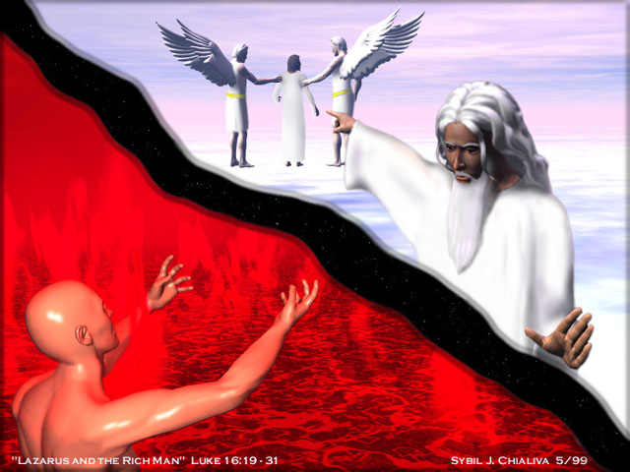
Abraham replied, 'My child, remember that you received
what was good during your lifetime while Lazarus likewise
received what was bad; but now he is comforted here,
whereas you are tormented. Moreover, between us and
you a great chasm is established to prevent anyone
from crossing who might wish to go from our side to
yours or from your side to ours.' "

Slide 41
Mark 9:42-47
(Jesus said in reply ... ) "Whoever causes one of these
little ones who believe (in me) to sin, it would be better
for him if a great millstone were put around his neck and
he were thrown into the sea. If your hand causes you to
sin, cut it off. It is better for you to enter into life maimed
than with two hands to go into Gehenna, into the
unquenchable fire. And if your foot causes you to sin,
cut it off. It is better for you to enter into life crippled than
with two feet to be thrown into Gehenna. And if your eye
causes you to sin, pluck it out. Better for you to enter
into the kingdom of God with one eye than with two eyes
to be thrown into Gehenna ..."
2 Thessalonians 1:9
These will pay the penalty of eternal ruin, separated
from the presence of the Lord and from the glory of
his power, ...

Slide 42
Matthew 13:40-42
Just as weeds are collected and burned (up) with fire,
so will it be at the end of the age. The Son of Man will
send his angels, and they will collect out of his kingdom
all who cause others to sin and all evildoers. They will
throw them into the fiery furnace, where there will be
wailing and grinding of teeth.
John 15:6
Anyone who does not remain in me will be thrown out
like a branch and wither; people will gather them and
throw them into a fire and they will be burned.
Romans 2:6-9
... (he) will repay everyone according to his works: ...
wrath and fury to those who selfishly disobey the truth
and obey wickedness. Yes, affliction and distress will
come upon every human being who does evil, ...

Slide 43
1 Corinthians 6:9-10
Do you not know that the unjust will not inherit the
kingdom of God? Do not be deceived; neither fornicators
nor idolaters nor adulterers nor boy prostitutes nor
practicing homosexuals nor thieves nor the greedy nor
drunkards nor slanderers nor robbers will inherit the
kingdom of God.
John 3:36
Whoever believes in the Son has eternal life, but whoever
disobeys the Son will not see life, but the wrath of God
remains upon him.
John 5:29
(This was Jesus' answer ...) those who have done good
deeds to the resurrection of life, but those who have done
wicked deeds to the resurrection of condemnation.

Slide 44
Revelation 21:27
But nothing unclean will enter it (the new Jerusalem,
heaven), nor any (one) who does abominable things or
tells lies.
Revelation 22:15
Outside (the new Jerusalem, heaven) are the dogs,
the sorcerers, the unchaste, the murderers, the
idol-worshipers, and all who love and practice deceit.
Matthew 10:28
And do not be afraid of those who kill the body but
cannot kill the soul; rather, be afraid of the one who can
destroy both soul and body in Gehenna.
Revelation 21:8
But as for cowards, the unfaithful, the depraved,
murderers, the unchaste, sorcerers, idol-worshipers,
and deceivers of every sort, their lot is in the burning
pool of fire and sulfur, which is the second death.

Slide 45
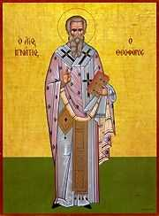
The Fathers of the Church reflect the constant faith of the
Church on the existence and nature of hell.
Ignatius of Antioch, Letter to the Ephesians, Ch. 16:1
"Make no mistake, brethren; the corrupter
of families will not inherit the kingdom of God.
If, then, those are dead who do these things
according to the flesh, how much worse if,
with bad doctrine, one should corrupt the
faith of God for which Jesus Christ was
crucified.
Such a man, for becoming contaminated, will
depart into unquenchable fire; and will any
one who listens to him."

Slide 46
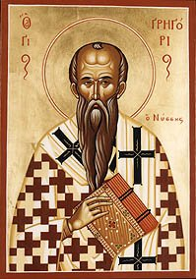
Gregory of Nyssa, The Great Catechism, Ch. 40
"Indeed, the sinner's life of torment presents no equivalent
to anything that pains the sense here. Even if some one of the
punishments in that other world be named in terms that are
well known here, the distinction is still not small. When you
hear the word fire, you have been taught to think of a fire other
than the fire we see, owing to something being added to that
fire which in this there is not; for that
fire is never quenched, whereas
experience has discovered many
ways of quenching this; and there is
a great difference between a fire
which can be extinguished, and
one that does not admit of extinction."

Slide 47
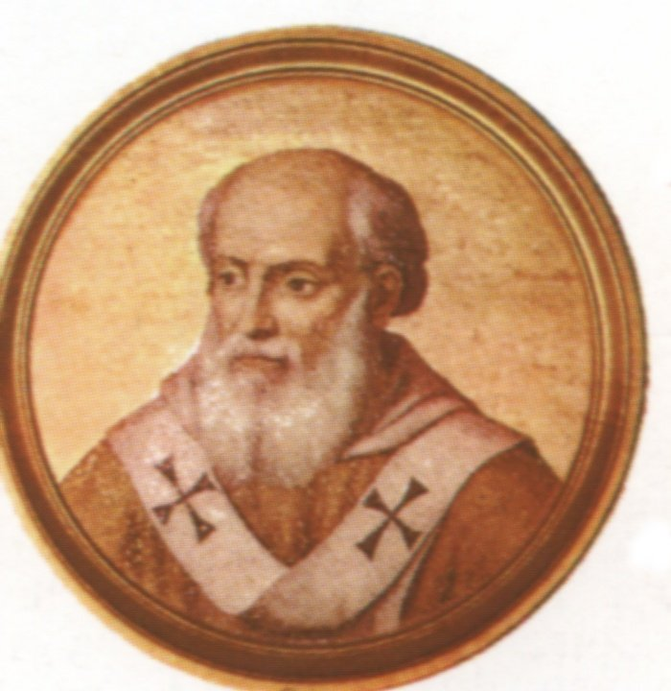
The teaching Magisterium of the Church has also affirmed
the existence and nature of hell.
The Lateran Council IV, 1215 "... the wicked (receive), a perpetual punishment with the devil …"
Pope Innocent IV (1243-1254)
"But if anyone dies unrepentant in the state of mortal sin, he
will undoubtedly be tormented forever in the fires of an
everlasting hell." (Letter to the Bishop of Tusculum, Section 24)

Slide 48
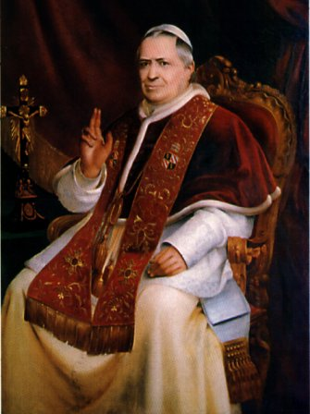
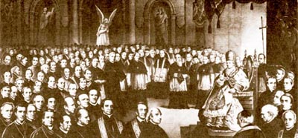
Vatican Council I, 1869-70
"Therefore, all who die in actual mortal sin are excluded from
the kingdom of God and will suffer forever the torments of hell
from which there is no redemption. If anyone says that a man
can be justified even after death; or if he says that the
punishments of the damned in hell will not last forever;
let him be anathema."
Pope Pius IX
Vatican Council I

Slide 49
Death
Particular Judgment
Heaven
Purgatory
Hell
Parousia
Resurrection of the Dead
General Judgment
Eternity

Slide 50
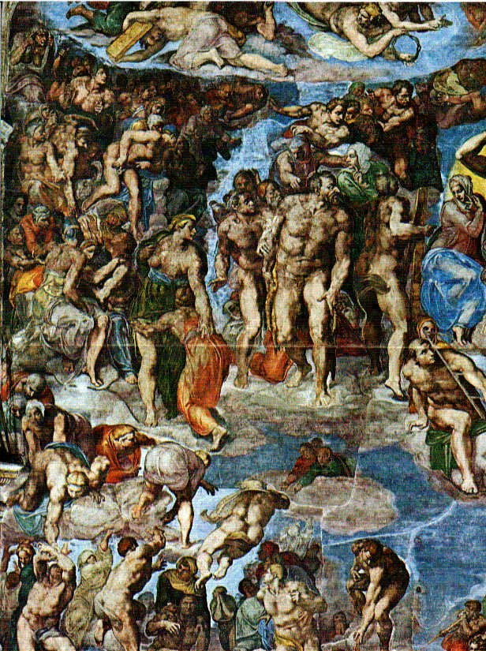
Purgatory
Sacred Scripture and the constant faith of the Church affirm
that heaven and hell, as places, exist. Catholic Christians
and other Christians also profess belief in a state of being,
not a place, called "purgatory."
The term "purgatory" is not found in the Bible; but neither
are other such important Christian beliefs such as "Trinity"
and "Incarnation."

Slide 51
Purgatory is defined as a state of being, the continuing
process of purgation or purification of the soul after human
death.
It is a state of perfection--begun in baptism and faith-
consummated after death, entered into only by those
who are saved. In other words, our transformation in Christ
(Romans 13:14, "Put on the Lord Jesus Christ"), our perfection
in the holiness of the Father (1 Peter 1:16, "Be holy, because I
(am) holy") is not ended at our physical death.
Purgatory is a sign of God's mercy on those who have honestly
sought to know God and to do His will in this life and yet die
in some degree of bondage to sin or the effects of sin.
The Church has only two official teachings concerning purgatory:
it exists, and
our prayers help the souls in purgatory.

Slide 52
God is revealed as perfect interior holiness.
Isaiah 6:3
"Holy, holy, holy is the Lord of hosts!" they (the
Seraphim) cried one to the other.
We are called to that same holiness.
Leviticus 19:2
"Speak to the whole Israelite community and tell them:
Be holy, for I, the Lord your God, am holy."
1 Peter 1:15-16
As he who called you is holy, be holy yourselves in
every aspect of your conduct, for it is written,
"Be holy because I (am) holy."

Slide 53
Who can stand in the face of the holiness of God?
Psalms 15:1
Lord, who may abide in your tent? Who may dwell on
your holy mountain?
Psalms 66:18
Had I cherished evil in my heart, the Lord would not have
heard.
Hebrews 12:14
Strive for peace with everyone, and for that holiness
without which no one will see the Lord.
Ephesians 5:3
Immorality or any impurity or greed must not even be
mentioned among you, as is fitting among holy ones.

Slide 54
Exodus 33:18-20
Then Moses said, "Do let me see your glory!" He
(Yahweh) answered, "I will make all my beauty pass
before you, and in your presence I will pronounce my
name, 'Lord'; I who show favors to whom I will, I who
grant mercy to whom I will. But my face you cannot see,
for no man sees me and still lives."
Revelation 21:27
... but nothing unclean will enter it (the City of God),
nor any (one) who does abominable things or tells lies.
Only those will enter whose names are written in the
Lamb's book of life.

Slide 55
Ephesians 5:25-27
Christ loved the church and handed himself over
for her (the Church) to sanctify her, cleansing her by
the bath of water with the word, that he might present
to himself the church in splendor, without spot or
wrinkle or any such thing, that she might be holy and
without blemish.
We are deprived of the vision of God because of our sinfulness.
But there is a divine purging fire which can heal us.
Hebrews 12:29
For our God is a consuming fire.
Hebrews 12:6,10
For whom the Lord loves, he disciplines; he scourges
every son he acknowledges. ... but he does so for
our benefit, in order that we may share his holiness.

Slide 56
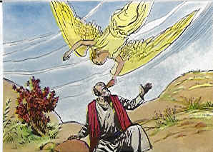
Isaiah 6:5-7
Then I (Isaiah) said, "Woe is me, I am doomed! For
I am a man of unclean lips, living among a people of
unclean lips; yet my eyes have seen the King, the Lord
of hosts!" Then one of the seraphim flew to me, holding
an ember which he had taken with tongs from the altar.
He touched my mouth with it. "See," he said, "now that
this has touched your lips, your wickedness is removed,
your sin purged."

Slide 57
1 Corinthians 3:11-15
For no one can lay a foundation other than the one that
is there, namely, Jesus Christ. If anyone builds on this
foundation with gold, silver, precious stones, wood, hay,
or straw, the work of each will come to light, for the Day
will disclose it. It will be revealed with fire, and the fire
(itself) will test the quality of each one's work. If the
work stands that someone built upon the foundation, that
person will receive a wage. But if someone's work is
burned up, that one will suffer loss; the person will be
saved, but only as through fire.
1 Pet 1:7
The genuineness of your faith, more precious than gold that is perishable even though tested by fire, may prove to be for praise, glory, and honor at the revelation of Jesus Christ.

Slide 58
Jesus implies that our sins can be forgiven in the next world.
Matthew 12:32
And whoever speaks a word against the Son of Man
will be forgiven; but whoever speaks against the holy
Spirit will not be forgiven, either in this age or in
the age to come.

Slide 59
Scripture from the Greek Septuagint, the Old Testament of
Christ, the Evangelists and Paul, and of the councils of Hippo
and Carthage, affirm purgatory.

Slide 60
2 Macabees 12:42-46
Turning to supplication, they prayed that the sinful
deed might be fully blotted out. The noble Judas warned
the soldiers to keep themselves free from sin, for they
had seen with their own eyes what had happened
because of the sin of those who had fallen. He then
took up a collection among all his soldiers, amounting
to two thousand silver drachmas, which he sent to
Jerusalem to provide for an expiatory sacrifice. In doing
this he acted in a very excellent and noble way, inasmuch
as he had the resurrection of the dead in view; for if he
were not expecting the fallen to rise again, it would
have been useless and foolish to pray for them in death.
But if he did this with a view to the splendid reward that
awaits those who had gone to rest in godliness, it was a
holy and pious thought. Thus he made atonement for
the dead that they might be freed from this sin.

Slide 61
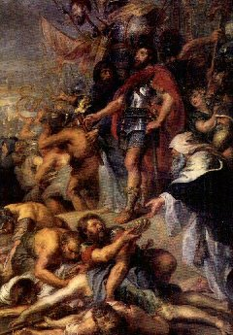
Experience teaches us that there are people who die so
suddenly, they have not had the opportunity to confess
their sins, but are not guilty of serious "death dealing" sin
and separation from God.
Gathering the objects, he 'sent 12,000 Drachmas to Jerusalem to offer a sin offering...' (II Maccabees 12, 39-46).
Peter-Paul Rubens: Judas Maccabaeus praying for the Dead

Slide 62
The constant faith of the Church affirms the belief in purgatory.
From the earliest of times, the Fathers of the Church taught
the existence of purgatory:
Tertullian (Rome, 160-220?), Origen (Alexandria, 185-254?),
Cyprian (Carthage, 200-258), Ambrose (Tier, 340-397),
Augustine (Numidia, 354-430), Basil (Caesarea, 329-379),
Gregory of Nazianzus (in Cappadocia, 329-389),
John Chrysostom (Antioch, 349-407),
Gregory the Great (Rome, 540-604), and many others.

Slide 63
The teaching Magisterium of the Church also affirms
the belief in purgatory.
Council of Lyons II (1274)
We believe ... that the souls, by the purifying compensation
are purged after death.
Council of Florence (1438)
Repeated the Council of Lyons II (1274).
Council of Trent (1545-1563)
We constantly hold that purgatory exists, and that the souls
of the faithful there detained are helped by the prayers of the
faithful.

Slide 64
Catechism of the Catholic Church, Section 1031
The Church gives the name Purgatory to this final
purification of the elect, which is entirely different from the
punishment of the damned.
The Church formulated her doctrine of faith on Purgatory
especially at the Councils of Florence and Trent. The tradition
of the Church, by reference to certain texts of Scripture,
speaks of a cleansing fire. [Cf. 1 Cor 3:15; 1 Pet 1:7.] As for
certain lesser faults, we must believe that, before the Final
Judgment, there is a purifying fire. He who is truth says that
whoever utters blasphemy against the Holy Spirit will be
pardoned neither in this age nor in the age to come. From
this sentence we understand that certain offenses can be
forgiven in this age, but certain others in the age to come.

Slide 65
Catechism of the Catholic Church, Section 1472
To understand this doctrine and practice of the Church, it is
necessary to understand that sin has a double consequence.
Grave sin deprives us of communion with God and therefore
makes us incapable of eternal life, the privation of which is
called the "eternal punishment" of sin. On the other hand every sin, even venial, entails an unhealthy attachment to creatures, which must be purified either here on earth, or after death in the state called Purgatory. This purification frees one from what is called the "temporal punishment" of sin. These two punishments must not be conceived of as a kind of vengeance inflicted by God from without, but as following from the very nature of sin. A conversion which proceeds from a fervent charity can attain the complete purification of the sinner in such a way that no punishment would remain.

Slide 66
Limbo
The word limbo comes from the Latin word limbus which
means a border, a hem, or fringe around the edge of a garment.
The term is associated in common parlance to mean some
in-between state of being.
It is often associated, in a religious context, with some state
of being in neither heaven nor hell, therefore on the fringe
of either. It has been used to refer to the abode for the dead
who were neither capable of committing deadly sin
(1 John 5:16) which excluded the soul from hell nor were
baptized in water and the Holy Spirit (John 3:5) which
excluded the soul from heaven.

Slide 67
There never has been nor is there any official Catholic
doctrinal position or teaching on the existence of or state
of limbo.
It must be stated that the term limbo receives a lot of attention
in pastoral practice when pastors had to explain the mind of
God to distraught parents whose newborn infant has died
without being baptized.

Slide 68
Catechism of the Catholic Church, Section 1261
As regards children who have died without baptism, the
Church can only entrust them to the mercy of God, as she
does in her funeral rites for them. Indeed, the great mercy of
God, who desires that all men should be saved, and Jesus'
tenderness toward children, which caused him to say, "Let the
children come to me, do not hinder them" [Mark 10:14,
cf. 1 Tim. 2:4], allow us to hope that there is a way of salvation
for children who have died without baptism. All the more urgent
is the Church's call not to prevent little children coming to
Christ through the gift of holy baptism.

Slide 69
Death
Particular Judgment
Heaven
Purgatory
Hell
Parousia
Resurrection of the Dead
General Judgment
Eternity

Slide 70
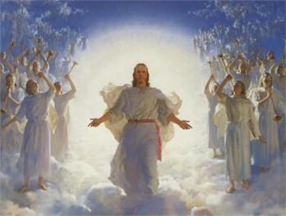
The Parousia: Christ's Second Coming
Catholic Christians have always believed that Jesus Christ
would come back to close the current period of human history
in earth. The time when Jesus will return is given many
names: the Day of the Lord, the Parousia, the end time, and
the Second Coming of Christ.

Slide 71
The Bible describes the events of Jesus' return in apocalyptic
images.
Mark 13:26-27
And then they will see 'the Son of Man coming in the
clouds' with great power and glory, and then he will
send out the angels and gather (his) elect from the
four winds, from the end of the earth to the end of the
sky.
Matthew 16:27
For the Son of Man will come with his angels in his
Father's glory, and then he will repay everyone
according to his conduct.
Acts 1:11
They (two men dressed in white) said, "Men of Galilee,
why are you standing there looking at the sky? This
Jesus who has been taken up from you into heaven
will return in the same way as you have seen him
going into heaven."

Slide 72
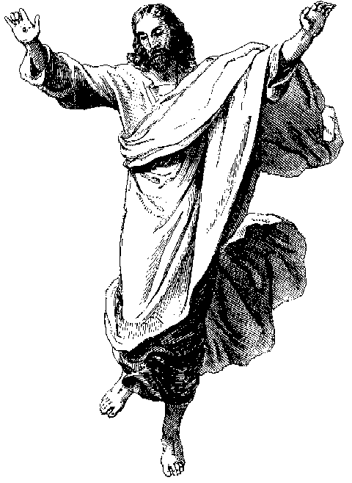
1 Thessalonians 4:16-18
For the Lord himself, with a word of command, with the
voice of an archangel and with the trumpet of God, will
come down from heaven, and the dead in Christ will
rise first. Then we who are alive, who are left, will be
caught up together with them in the clouds to meet the Lord in the air. Thus we shall always be with the Lord. Therefore, console one another with these words.

Slide 73
The parousia will be unmistakable because it will be
accompanied by unprecedented signs.
Matthew 24:27
For just as lightning comes from the east and is seen
as far as the west, so will the coming of the Son of Man
be.
Some signs are general events concerning the evangelization
of the world.
Matthew 24:14
And this gospel of the kingdom will be preached
throughout the world as a witness to all nations, and
then the end will come.

Slide 74
Other signs are more proximate. Mark (Chapter 13), Matthew
(Chapter 24), and Luke (Chapter 21) all describe the
unmistakable signs with apocalyptic images.
2 Timothy 4:1-2
I charge you in the presence of God and of Christ Jesus,
who will judge the living and the dead, and by his appearing and his kingly power, proclaim the word ...
2 Timothy 3:1-5
But understand this: there will be terrifying times in the
last days. People will be self-centered and lovers of
money, proud, haughty, abusive, disobedient to their
parents, ungrateful, irreligious, callous, implacable,
slanderous, licentious, brutal, hating what is good,
traitors, reckless, conceited, lovers of pleasure rather
than lovers of God, as they make a pretense of religion
but deny its power. Reject them.

Slide 75
No one knows exactly when this will occur.
Mark 13:32
(Jesus began his discourse ... ) "But of that day or hour,
no one knows, neither the angels in heaven, nor the
Son, but only the Father."
1 Thessalonians 5:2
For you yourselves know very well that the day of the
Lord will come like a thief at night.
2 Peter 3:10
But the day of the Lord will come like a thief, and then
the heavens will pass away with a mighty roar and the
elements will be dissolved by fire, and the earth and
everything done on it will be found out.

Slide 76
The Catholic Church teaches that we should avoid pointless
speculations about the time, the details of the signs, the nature
of the difficulties, etc. The Church focuses instead on the need
for living the Gospel so as to be prepared for the parousia
whenever it happens.
Mark 13:33,35-37
(Jesus began his discourse ...) "Be watchful! Be alert!
You do not know when the time will come. ... Watch,
therefore; you do not know when the lord of the house
is coming, whether in the evening, or at midnight, or at
cockcrow, or in the morning. May he not come suddenly
and find you sleeping. What I say to you, I say to all:
'Watch!'"

Slide 77
1 Peter 1:13-16
Therefore, gird up the loins of your mind, live soberly,
and set your hopes completely on the grace to be
brought to you at the revelation of Jesus Christ. Like
obedient children, do not act in compliance with the
desires of your former ignorance but, as he who called
you is holy, be holy yourselves in every aspect of your
conduct, for it is written, "Be holy because I (am) holy."

Slide 78
Millennialism: A Thousand Year Reign
There exists among many Evangelical Protestants a dogma
based on some passages in the Bible called millennialism
which means a "thousand year reign." The basis for
millennialism is found in the Book of Revelation.
Revelation 20:1-15
Then I saw an angel come down from heaven, holding
in his hand the key to the abyss and a heavy chain.
He seized the dragon, the ancient serpent, which is
the Devil or Satan, and tied it up for a thousand years
and threw it into the abyss, which he locked over it and
sealed, so that it could no longer lead the nations astray
until the thousand years are completed. After this, it is
to be released for a short time.

Slide 79
Then I saw thrones; those who sat on them were
entrusted with judgment. I also saw the souls of those
who had been beheaded for their witness to Jesus and
for the word of God, and who had not worshipped the
beast or its image nor had accepted its mark on their
foreheads or hands. They came to life and they reigned
with Christ for a thousand years. The rest of the dead
did not come to life until the thousand years were
over. This is the first resurrection. Blessed and holy is
the one who shares in the first resurrection. The second
death has no power over these; they will be priests
of God and of Christ, and they will reign with him
for (the) thousand years.

Slide 80
When the thousand years are completed, Satan
will be released from his prison. He will go out to
deceive the nations at the four corners of the earth,
Gog and Magog, to gather them for battle; their number
is like the sand of the sea. They invaded the breadth of
the earth and surrounded the camp of the holy ones
and the beloved city. But fire came down from heaven
and consumed them. The Devil who had led them
astray was thrown into the pool of fire and sulfur,
where the beast and the false prophet were. There
they will be tormented day and night forever and ever.
Next I saw a large white throne and the one who was
sitting on it. The earth and the sky fled from his presence
and there was no place for them. I saw the dead, the
great and the lowly, standing before the throne, and
scrolls were opened.

Slide 81
Then another scroll was opened, the book of life. The
dead were judged according to their deeds, by what
was written in the scrolls. The sea gave up its dead;
then Death and Hades gave up their dead. All the
dead were judged according to their deeds. Then
Death and Hades were thrown into the pool of fire.
(This pool of fire is the second death. ) Anyone whose
name was not found written in the book of life was
thrown into the pool of fire.

Slide 82
The Magisterium of the Church has never commented on
a thousand year reign of Christ. Rather, as is already clear
from what is covered in these notes, the Church does not
see the Second Coming of Christ at any other time than at
the general judgment of all men and women which is the same
as the resurrection of the dead followed by definitive reward
or punishment for souls.
The Church interprets the expression "a thousand years" not
literally but according to the literature in which it appears-
-prophetic and apocalyptic. In apocalyptic literature, a thousand
years would simply indicate a long period of time, in this case,
the time period before the Second Coming of Christ.
Apocalyptic literature is not to be taken literally.

Slide 83
Death
Particular Judgment
Heaven
Purgatory
Hell
Parousia
Resurrection of the Dead
General Judgment
Eternity

Slide 84
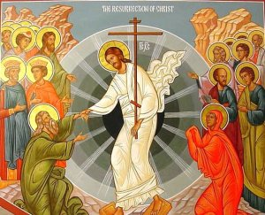
Resurrection of the Dead
All Christians hold firmly to the belief expressed in the Bible
and mirrored in the resurrection from the dead of Jesus of the
resurrection of all men and women.
By "resurrection" Christians do not mean only the return to
life in the body of a dead human being; it means taking on
a completely new existence.
We believe that the souls of all
those who have died will be reunited
to their bodies; but those bodies will
have different characteristics.

Slide 85
We Catholic Christians profess this belief often when we
pray the Apostles Creed: "I believe in ... the resurrection of
the body. "
In the Nicene Creed, we profess: "We look for the resurrection
of the dead. "
Matthew 22:29-32
Jesus said to them in reply, "You are misled because
you do not know the scriptures or the power of God. At
the resurrection they neither marry nor are given in
marriage but are like the angels in heaven. And
concerning the resurrection of the dead, have you not
read what was said to you by God, 'I am the God of
Abraham, the God of Isaac, and the God of Jacob'?
He is not the God of the dead but of the living."

Slide 86
Matthew 5:29-30
(He [Jesus] began to teach them ...) If your right eye
causes you to sin, tear it out and throw it away. It is
better for you to lose one of your members than to have
your whole body thrown into Gehenna. And if your right
hand causes you to sin, cut it off and throw it away. It
is better for you to lose one of your members than to
have your whole body go into Gehenna.
John 11:22-26
Jesus said to her (Martha), "Your brother will rise."
Martha said to him, "I know he will rise, in the resurrection
on the last day." Jesus told her, "I am the resurrection
and the life; whoever believes in me, even if he dies,
will live, and everyone who lives and believes in me
will never die. Do you believe this?"

Slide 87
John 6:40
(Jesus explained to them (the disciples):) For this is
the will of my Father, that everyone who sees the
Son and believes in him may have eternal life, and I
shall raise him (on) the last day.
John 6:51
(Jesus told them:) I am the living bread ... whoever
eats this bread will live forever.
John 6:54
(Jesus told them:) Whoever eats my flesh and drinks
my blood has eternal life, and I will raise him on the
last day.

Slide 88
Catholic Christians believe that the dead will rise with bodies
similar to those they had on earth. Some important evidence
for our resurrected bodies is to read the qualities of the
resurrected body of Jesus:
appeared suddenly then disappeared;
passed through walls;
his body seemed to be the same as it was before death;
but it was also very different;
he even changed his appearance so that his disciples
didn't recognize him (Luke 24).

Slide 89
Church believes we will resurrect the same bodies as we
had on earth by the language of the Bible. The resurrection
will change these bodies into a glorified form. The word
"reawakening" is used in reference to the resurrection.
Catholic scholars have distinguished certain qualities of our
resurrected bodies:
impassability: freedom from physical ills of any kind
(sickness, death, etc.);
subtility: the spiritualization of the body--dominated
by the soul;
agility: the ability of the soul to move the body with
ease and speed;
clarity: freedom from defects--having great beauty
and radiance.

Slide 90
Paul also speaks in language of reawakening instead of
replacement:
1 Corinthians 15:53
For that which is corruptible must clothe itself with
incorruptibility, and that which is mortal must clothe
itself with immortality.
1 Corinthians 15:42-44
So also is the resurrection of the dead. It is sown
Corruptible; it is raised incorruptible. It is sown
dishonorable; it is raised glorious. It is sown weak; it
is raised powerful. It is sown a natural body; it is raised
a spiritual body.

Slide 91
Scripture speaks of the resurrection of both the blessed and
the damned:
John 5:28-29
(Jesus' answer:) Do not be amazed at this, because
the hour is coming in which all who are in the tombs
will hear his voice and will come out, those who have
done good deeds to the resurrection of life, but those
who have done wicked deeds to the resurrection of
condemnation.
Matthew 22:23-32; Mark 12:18-27; Luke 20:27-40
On that day Sadducees approached him (Jesus),
saying that there is no resurrection. They put this
question to him, saying, "Teacher, Moses said, 'If a
man dies without children, his brother shall marry his
wife and raise up descendants for his brother.'

Slide 92
Now there were seven brothers among us. The first
married and died and, having no descendants, left his
wife to his brother. The same happened with the second
and the third, through all seven. Finally the woman
died. Now at the resurrection, of the seven, whose
wife will she be? For they all had been married to her."
Jesus said to them in reply, "You are misled because
you do not know the scriptures or the power of God.
At the resurrection they neither marry nor are given
in marriage but are like the angels in heaven. And
concerning the resurrection of the dead, have you not
read what was said to you by God, 'I am the God of
Abraham, the God of Isaac, and the God of Jacob'?
He is not the God of the dead but of the living."

Slide 93
John 11:22-26
Jesus said to her, "Your brother will rise." Martha said
to him, "I know he will rise, in the resurrection on the
last day." Jesus told her, "I am the resurrection and
the life; whoever believes in me, even if he dies, will
live, and everyone who lives and believes in me will
never die. Do you believe this?"
Acts 23:6
Paul was aware that some were Sadducees and some
Pharisees, so he called out before the Sanhedrin,
"My brothers, I am a Pharisee, the son of Pharisees;
(I) am on trial for hope in the resurrection of the dead."

Slide 94
The Magisterium constantly proclaims the truth of the
resurrection of the body.
Council of Toledo XI, 675 Thus, according to the model of our Head, we profess that
there is a true bodily resurrection of all the dead... we shall
rise in this very body in which we now live and are and move. (Denzinger 287)
Lateran Council IV, 1215
... He (Christ) will come at the end of the world; he will judge
the living and the dead; and he will reward all, both the lost
and elect, according to their works. And all these will rise with
their own bodies which they now have so that they may receive
according to their works, whether good or bad; the wicked, a
perpetual punishment with the devil; the good, eternal glory
with Christ. (Denzinger 429)

Slide 95
Death
Particular Judgment
Heaven
Purgatory
Hell
Parousia
Resurrection of the Dead
General Judgment
Eternity

Slide 96
General Judgment
As we began the study of eschatology, we saw that each
individual person is judged by God immediately after his or
her death. That prompt sentence is called the particular
judgment.
The Bible is very emphatic in asserting that there is also a
general judgment of all mankind at the end of the world.
The particular judgment addresses each of us as individual
and personal; the general judgment will address all of us as
social, members of society. Also, after the resurrection, the
body must also share the judgment of the soul.
The general judgment addresses both the whole human
person, resurrected body reunited with the soul, and the whole
of human society.

Slide 97
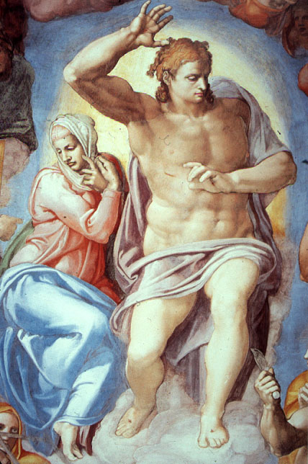
Christians pray and affirm their belief in a general judgment in
the Apostles Creed and the Nicene Creed
Jesus Christ ... sits at the right hand of God the Father
almighty and will come again in glory to judge the living
and the dead.

Slide 98
Scripture is abundantly clear on the point of general judgment
for all people.
Matthew 16:27
For the Son of Man will come with his angels in his
Father's glory, and then he will repay everyone according
to his conduct.
John 5:22-29
Nor does the Father judge anyone, but he has given
all judgment to his Son, so that all may honor the Son
just as they honor the Father. ... And he gave him
power to exercise judgment, because he is the Son
of Man. Do not be amazed at this, because the hour is
coming in which all who are in the tombs will hear his
voice and will come out, those who have done good
deeds to the resurrection of life, but those who have
done wicked deeds to the resurrection of condemnation.

Slide 99
Matthew 25: 31-46
"When the Son of Man comes in his glory, and all the
angels with him, he will sit upon his glorious throne, and
all the nations will be assembled before him. And he will
separate them one from another, as a shepherd
separates the sheep from the goats. He will place the
sheep on his right and the goats on his left. Then the
king will say to those on his right, 'Come, you who are
blessed by my Father. Inherit the kingdom prepared for
you from the foundation of the world. For I was hungry
and you gave me food, I was thirsty and you gave me
drink, a stranger and you welcomed me, naked and you
clothed me, ill and you cared for me, in prison and you
visited me.' Then the righteous will answer him and say,
'Lord, when did we see you hungry and feed you, or
thirsty and give you drink? When did we see you a
stranger and welcome you, or naked and clothe you?

Slide 100
When did we see you ill or in prison, and visit you?'
And the king will say to them in reply, 'Amen, I say to
you, whatever you did for one of these least brothers of
mine, you did for me.' Then he will say to those on his
left, 'Depart from me, you accursed, into the eternal fire
prepared for the devil and his angels. For I was hungry
and you gave me no food, I was thirsty and you gave
me no drink, a stranger and you gave me no welcome,
naked and you gave me no clothing, ill and in prison,
and you did not care for me.' Then they will answer and
say, 'Lord, when did we see you hungry or thirsty or a
stranger or naked or ill or in prison, and not minister to
your needs?' He will answer them, 'Amen, I say to you,
what you did not do for one of these least ones, you did
not do for me.' And these will go off to eternal
punishment, but the righteous to eternal life."

Slide 101
Acts 10:42
(Peter addressed them in these words) ... He (Jesus)
commissioned us to preach to the people and testify
that he is the one appointed by God as judge of the
living and the dead.
Romans 2:15-16
They show that the demands of the law are written in
their hearts, while their conscience also bears witness
and their conflicting thoughts accuse or even defend
them on the day when, according to my gospel, God will
judge people's hidden works through Christ Jesus.
Revelation 20:11-15
Next I saw a large white throne and the one who was
sitting on it. The earth and the sky fled from his presence
and there was no place for them. I saw the dead, the
great and the lowly, standing before the throne,

Slide 102
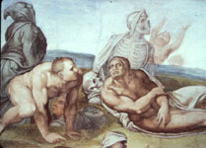
and scrolls were opened. Then another scroll was
opened, the book of life. The dead were judged
according to their deeds, by what was written in the
scrolls. The sea gave up its dead; then Death and
Hades gave up their dead. All the dead were judged
according to their deeds. Then Death and Hades were
thrown into the pool of fire. (This pool of fire is the
second death. ) Anyone whose name was not found
written in the book of life was thrown into the pool of fire.

Slide 103
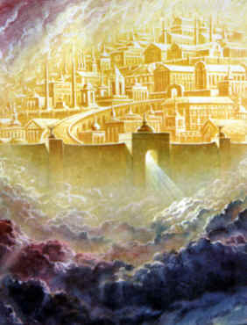
The New Creation
The Bible tells all Christians what life after general judgment
will be like. John wrote of his visions of the New Creation
in his book of Revelation.
Revelation 21:1-8
Then I saw a new heaven and
a new earth. The former heaven
and the former earth had passed
away, and the sea was no more.
I also saw the holy city, a new
Jerusalem, coming down out of
heaven from God, prepared as a
bride adorned for her husband.

Slide 104
I heard a loud voice from the throne saying, "Behold,
God's dwelling is with the human race. He will dwell
with them and they will be his people and God himself
will always be with them (as their God).
He will wipe every tear from their eyes, and there
shall be no more death or mourning, wailing or pain,
(for) the old order has passed away." The one who
sat on the throne said, "Behold, I make all things
new." Then he said, "Write these words down, for they
are trustworthy and true." He said to me, "They are
accomplished. I (am) the Alpha and the Omega, the
beginning and the end. To the thirsty I will give a gift
from the spring of life-giving water. The victor will inherit
these gifts, and I shall be his God, and he will be my
son. But as for cowards, the unfaithful, the depraved,
murderers, the unchaste, sorcerers, idol-worshipers,
and deceivers of every sort, their lot is in the burning
pool of fire and sulfur, which is the second death."

Slide 105
Revelation 5:13
Then I heard every creature in heaven and on earth
and under the earth and in the sea, everything in the
universe, cry out: "To the one who sits on the throne
and to the Lamb be blessing and honor, glory and
might, forever and ever."

Slide 107
Questions or comments?
Email either
Paul Flanagan (pdflan@catholicapologetics.org) , or
Dr. Robert Schihl (rjschihl@catholicapologetics.org)
To Download a Copy of the Text Notes:
www.catholicapologetics.org/CBANotes.pdf
To go to the Text Version of This Chapter:
www.catholicapologetics.org/ap090000.htm
© 1985 – 2005, Robert Schihl and Paul Flanagan
Unless otherwise noted, all Scripture texts are taken from the New American Bible with Revised New Testament and Revised Psalms © 1991, 1986, 1970 Confraternity of Christian Doctrine, Washington, D.C. and are used by permission of the copyright owner. All Rights Reserved. No part of the New American Bible may be reproduced in any form without permission in writing from the copyright owner.

