Slide 1

† The word of God was made flesh
S.D.C.
SOCIETAS
DOCTRINÆ
CHRISTIANÆ
w w w . s d c . m e . u k

Slide 2
THE
HOLY SPIRIT
AND HIS
GIFTS

Slide 3
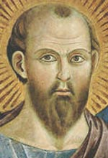
THE WORD OF GOD
From the writings of St Paul:
There is a variety of gifts but always the same Spirit; there are all sorts of service to be done, but always to the same Lord; working in all sorts of different ways in different people, it is the same God who is working in all of them. The particular way in which the spirit is given to each person is for a good purpose.

Slide 4
THE WORD OF GOD
One may have the gift of preaching with wisdom given him by the Spirit; another may have the gift of preaching instruction given him by the same Spirit; and another the gift of faith given by the same Spirit; another again the gift of healing, through this one Spirit….all these are the work of one and the same Spirit, who distributes different gifts to different people just as he chooses.
(1 Cor 12: 4-11)

Slide 5

The Holy spirit and his Gifts
From the Catechism of the
Catholic Church
The moral life of Christians is sustained by the gifts of the Holy Spirit. These are permanent dispositions which make man docile in following the promptings of the Holy Spirit.

Slide 6

From the Catechism of the Catholic Church
They belong in their fullness to Christ.
They complete and perfect the virtues of those who receive them and make them ready to obey divine inspirations.
(para 1830)

Slide 7
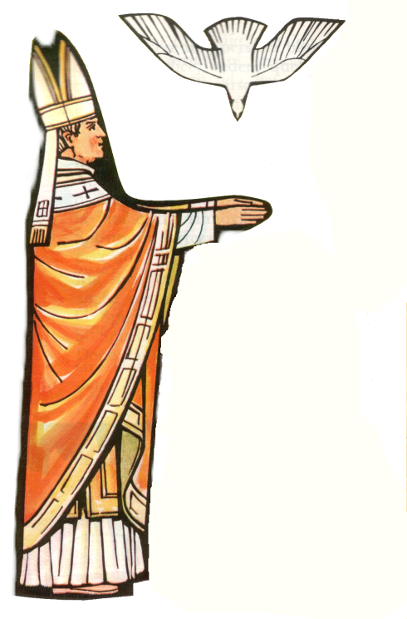
SEVEN GIFTS
UNDERSTANDING
WISDOM
RIGHT JUDGMENT
KNOWLEDGE
COURAGE
REVERENCE
WONDER AND AWE

Slide 8
GIFTS AS TOOLS
Think of the gifts as tools
They don’t do the job for you
They ENABLE you to do something
THE GIFTS of the Holy Spirit are a bit like that. They are there for us to use them but do not change us in any magical way.

Slide 9
UNDERSTANDING
Enables you to grasp the meaning of the Gospel, the Word of God, and to live by it each day.
WHEN?
Lord help me as I try to listen to your Word. Help me to Understand and put it into practice in my life.

Slide 10
WISDOM
Enables your heart to recognize God’s presence. As you listen and speak to God, make room in your heart for him. You will be eager to know God and to do what God is asking.
WHEN?
Lord, give me wisdom to recognize you in everything and to work for justice and all that is right.

Slide 11
RIGHT JUDGEMENT
Enables you to decide how to live as a Christian should, especially at crucial or difficult moments of your life.
WHEN?
Lord help me to make the Right Judgement, whatever the situation… and follow the path that you suggest to my innermost.

Slide 12
KNOWLEDGE
Enables you to understand the meaning of your life with others in the world and to deal with questions about death, suffering and love.
WHEN?
Lord give me Knowledge to find and decide on what is right for me…do not let that I just follow the crowd….

Slide 13
COURAGE
Enables you to make difficult decisions bravely, to overcome all obstacles and, if necessary, to change the direction of your life.
WHEN?
Lord give me Courage…make me strong to face all challenges bravely…even when it is not comfortable to do so.

Slide 14
REVERENCE
Enables you to love God and your neighbour, your parents, your friends, all the people who come into your life.
WHEN?
Lord give me the gift of Reverence to be able to respect all those who I meet everyday…to love them as images of yourself!
Notes:
Also called piety
Check definitions of every gift
Insert box and clipart for every prayer

Slide 15
WONDER AND AWE
Enable you to recognise the divine presence in your life, to pray with all your heart and to offer praise for God’s many wonderful gifts to us.
WHEN?
Lord open my eyes to see how Wonderful you are…how Awesome your creation is … and be thankful for all that you have given me.

Slide 16

BISHOP’S WORDS
My dear friends, in Baptism God our Father gave the new birth of eternal life to his chosen sons and daughters. Let us pray to our father that he will pour out the Holy Spirit to strengthen his sons and daughters with his gifts, and anoint them to be more like Christ, the Son of God.

Slide 17

BISHOP’S PRAYER
All powerful God, Father of our Lord Jesus Christ, by water and the Holy Spirit you freed your sons and daughters from sin and gave them new life. Send your spirit upon them to be their helper and guide. Give them the spirit of wisdom and understanding, the spirit of right judgement and courage, the spirit of knowledge and reverence. Fill them with the spirit of wonder and awe in your presence.

Slide 18
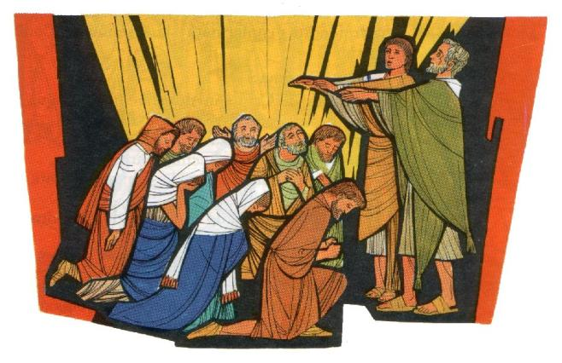
PRAYER
Come, Holy Spirit,
and send out a ray
of your heavenly light.
Come, father of the poor,
Come, giver of gifts, come, light of our hearts.
Come, kindly comforter…..sweet guest of our soul and sweet freshness….rest in hardship, moderation in the heat…relief in pain!
O most blessed light, fill the innermost hearts of those who believe in you…
From ‘Sequence of the Holy Spirit’
Notes:
Check which sequence it is

Slide 19
† The word of God was made flesh
S.D.C.
SOCIETAS
DOCTRINÆ
CHRISTIANÆ
w w w . s d c . m e . u k

