Slide 1
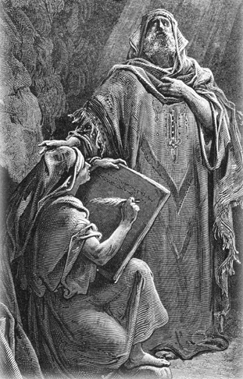
The Prophets
Their message then and now
JEREMIAH

Slide 2
JEREMIAH
Worked for 40 years as prophet, BC 627-587. He was the last before the deportation. At the end he saw Jerusalem destroyed and he saw in the pillage of the temple and the deportation of the people, the sons of the king killed. He was possible 25 and under 30, which was the age when someone could speak in public. And so St Luke said Jesus started his ministry about the age of 30.
Josias became king in 640. Josias died early, 609 BC. He was killed in battle against Egypt, with a javelin. The king that succeeded was not interested in Jeremiah’s prophecies. He was in fact hostile to the preaching and tried to stop him in fact. He was imprisoned, his writing rolls were destroyed.
In 587 the Babylonian armies destroyed the temple and the city. Part of the population was deported to Babylon.

Slide 3
JEREMIAH
605 B.C.
The Babylonian Captivity of Judah took place in a similar way to the captivity of Israel in that it was accomplished in stages. Following the Assyrian Empires overthrow by the Neo-Babylonian Empire under Nabopolassar in 612 B.C. he sent his son Nebuchadnezzar against the Egyptians at Carchemish in 605 B.C. Nebuchadnezzar not only destroyed the Egyptians but also took control of most of Palestine. He entered Jerusalem, removed some of the temple furnishings and took captives to Babylon. Daniel 1:1-4 Jehoiakim king of Judah paid Nebuchadnezzar tribute money to continue ruling in Judah. 2 Kings 24:1
Within a month Jehoiachin King of Judah was also taken into captivity, along with 10,000 citizens and the prophet Ezekiel. Jeremiah 24; 52:31 Generally speaking the exiles enjoyed a peaceful and productive life. Jeremiah 29:4-7 In later years when the exiles were permitted to return in the days of King Cyrus many of them stayed in Babylon and sent their money back to help in the reconstruction of the Temple and wall of Jerusalem. Ezra 1:6; 2:64

Slide 4
JEREMIAH
588 B.C.
Nebuchadnezzar appointed Jehoiachin's uncle, Zedekiah, as King of Judah in 597 B.C. Jeremiah warned him not to plot against Nebuchadnezzar but Zedekiah would not listen. Jeremiah 27-28 Nebuchadnezzar entered Palestine on January 15, 588 B.C. and besieged Judah for three and a half years resulting in the remaining residents being taken into captivity. Jeremiah 34:1-7; 39:1; 2 Kings 25:1
When Nebuchadnezzar broke through the wall of Jerusalem, Zedekiah tried to flee to the Jordan but was captured, forced to witness the killing of his sons and then was blinded. He was then carried off to exile in Babylon. Jeremiah 39:4-7; 2 Kings 25:4-7 Jeremiah recorded that he would see the king of Babylon while Ezekiel prophesied that he would never see the city of Babylon. Ezekiel 12:13 His blindness fulfilled the seeming contradictions of these two prophets.

Slide 5
JEREMIAH
Shortly after the fall of Jerusalem, Nebuzaradan, the captain of the guard, entered the city and burned it, including the temple with the ark and carried off the rest of the furnishings to Babylon. Jeremiah 3:16 The Priest were taken to Riblah and executed. 2 Kings 25:8-21; 2 Chronicles 36:17-21; Jeremiah 39:8-10; 52:12-27
Gedaliah was appointed the new governor of Judah and Jeremiah was to assist him in his administration. Jeremiah 40:1-12 However this new government was interrupted by the murder of Gedaliah by Ishmael. The tiny remnant feared Babylonian retaliation and fled to Egypt taking Jeremiah with them. Jeremiah had warned them against this move but would not be listened to. 2 Kings 25:22-26; Jeremiah 40:13-44
Thus the Kingdom of Judah went into captivity and the land of Palestine was desolate for 70 years. 2 Chronicles 36:21 (650-535 BC) The Jews were permitted to return to rebuild the temple under the decree of Cyrus King of Persia. 535 B.C.

Slide 6
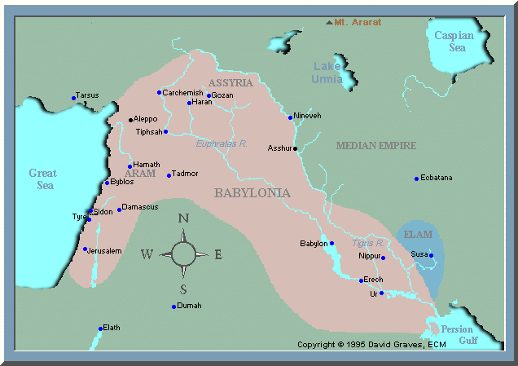
JEREMIAH

Slide 7
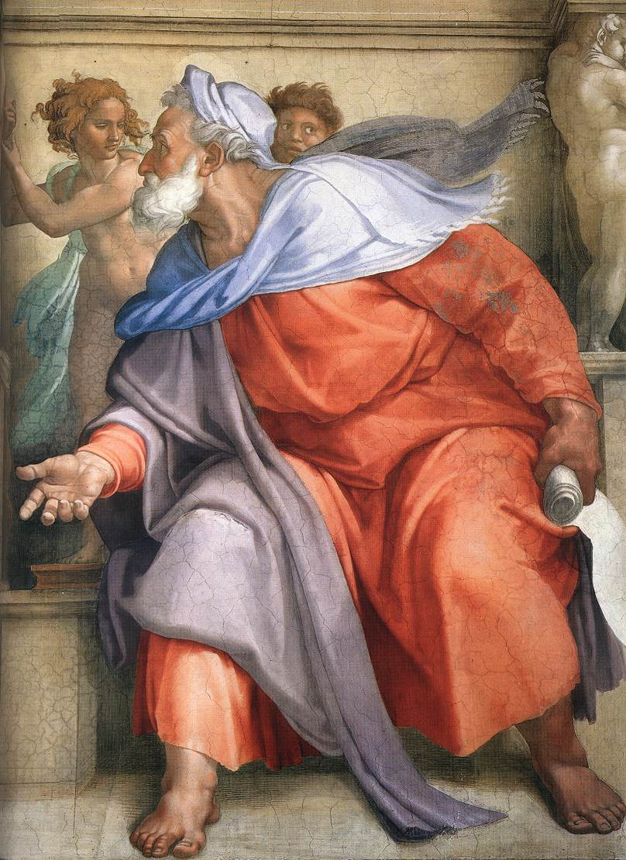
Jeremiah
Detailed exposé of :
Jr 2: 4-13
Jr 16: 1-13
Call of Jeremiah: Jr 1: 5-9

Slide 8
THANK YOU

