Slide 1


Old-Testament Survey:
The Reign of King Saul
The first king of the united kingdom
Notes:
Title Slide: Old Testament Survey—The Reign of King Saul

Slide 2
Desire for a King
Samuel was growing old and his sons were wicked.
Israel wanted a king instead of another judge. (1 Samuel 8:5)
Israel was, in essence, rejecting God!
They wanted to be like “the other nations.”
Samuel told them what a king would do. (1 Samuel 8:10-18) But they demanded a king!

Slide 3
Saul Is Selected
Saul was looking for his father’s lost donkeys when he appeared before Samuel. Samuel told him the animals had been found.
Samuel secretly anointed Saul as king. (1 Samuel 10:1-6)
Saul joined a band of prophets and began prophesying. (1 Samuel 10:9-16)
Samuel told Saul to meet him in Gilgal at the appointed time. (1 Samuel 10:8)
Following a successful battle, Samuel publicly anointed Saul in Mizpah. (1 Samuel 11:2-15)

Slide 4
The Philistine
Oppression of Israel
The Philistines oppressed Israel. They were not even allowed to have blacksmiths.
Samuel confirms Saul as king and calls for obedience. (1 Samuel 12:13-25)
Saul prepares to attack the Philistines at Gilgal. He awaits Samuel’s arrival. (1 Samuel 13:1-4)
Saul goes ahead and offers the sacrifice—a violation of the law--because the people are scattering. (1 Samuel 13:5-12)
Samuel severely rebukes Saul.
(1 Samuel 13:13,14)
Notes:
Under the courageous leadership of Jonathan, his son, Saul was victorious over the Philistines.

Slide 5
Saul and the Amalekites
God’s instructions said the Amalekites were to be totally destroyed. (1 Samuel 15:1-3)
Saul kept the best of sheep and oxen, and the king, alive. (1 Samuel 15:8,9)
Saul blames the people; God rejects him as king. (1 Samuel 15:10-23)
David is secretly anointed to be the next king over Israel. (1 Samuel 16:11-13)
God removes His spirit from Saul. (1 Samuel 16:14,15)

Slide 6
David and Saul
David is chosen to play the harp when Saul’s spirit is troubled. (1 Samuel 16:20-23)
The Philistine giant Goliath challenges Israel.
(1 Samuel 17:1-11)
David goes against Goliath with a sling and five smooth stones. (1 Samuel 17:30-35)
He kills Goliath and cuts off his head.
(1 Samuel 17:42-51)
Israel rallies and defeats the Philistines.
(1 Samuel 17:52-58)

Slide 7
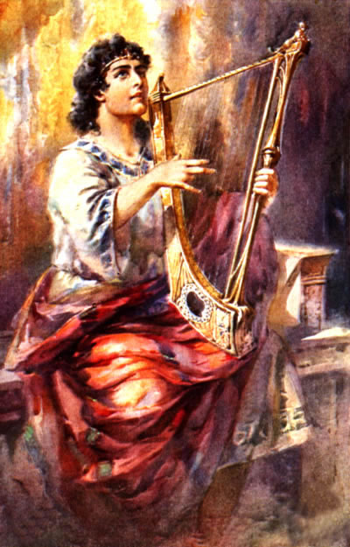
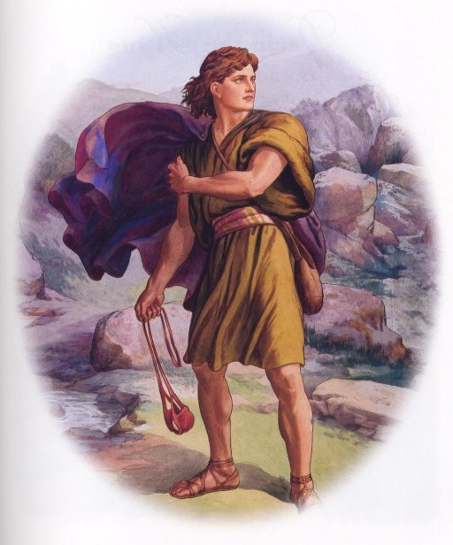

Slide 8
David Gains Favor With the People
David and Saul’s son Jonathan become close friends. (1 Samuel 18:1-4)
Israel elevates David over Saul.
(1 Samuel 18:5-9)
On two separate occasions, Saul attempts to kill David with a spear. (1 Sam.18:10-16; 19:8-10)
Saul even attacks Jonathan when he takes David’s side. (1 Samuel 20:33)
David leaves the Saul’s court and flees for his life. (1 Samuel 20:34-42)

Slide 9
David on the Run
The priests of Nob give David shewbread.
(1 Samuel 21:1-9) Doeg informs Saul.
At Gath, to avoid being killed, David pretends to be mad. (1 Samuel 21:10-15)
He and 400 others hide in the cave of Adullam. (1 Samuel 22:1-5)
Saul slays Ahimelech and the priests of God at Nob. Abiathar, Ahimelech’s son, escapes. (1 Samuel 22:6-19)
David saves Keliah from a Philistine attack . (1 Samuel 23:1-12)

Slide 10
David Again Spares Saul
David hides in a cave at En-gedi. Saul takes a nap in the same cave. David cuts off a piece of Saul’s robe. (1 Samuel 24:1-15)
Saul stops pursuing David. (1 Samuel 24:16-22)
Samuel the judge dies. (1 Samuel 25:1)
David goes to the wilderness of Paran and marries Abigail. (1 Samuel 25:2-43)
David and two soldiers sneak into Saul’s camp and steal a sword and water. (1 Samuel 26:1-13)
David spares Saul, who admits his guilt and stops chasing David. (1 Samuel 26:14-25)

Slide 11
David at Ziklag and Saul’s Death
David travel to Ziklag, a Philistine city, to evade Saul.
(1 Samuel 27:1-12)
Saul consults a medium who brings up Samuel!
(1 Samuel 28)
The Philistines do not permit David to fight with them against Israel. He returns to Ziklag. (1 Samuel 29:1-11)
David finds Ziklag destroyed and the wives and children taken captive. He and his men pursue and defeat the enemy and rescue the captives. (1 Samuel 30)
The Philistines kill Saul’s sons and wound Saul. Saul commits suicide. (1 Samuel 31:1-5)
Saul is beheaded and his body nailed to a wall. Men of Jabesh-gilead capture his body and bury it.
(1 Samuel 31:6-13)

