Slide 1
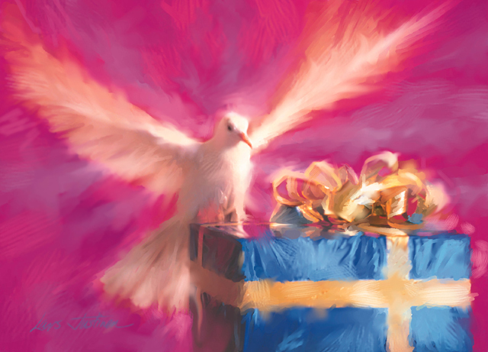
Pentecost
The Descent of the Holy Spirit
& birth of the Church

Slide 2
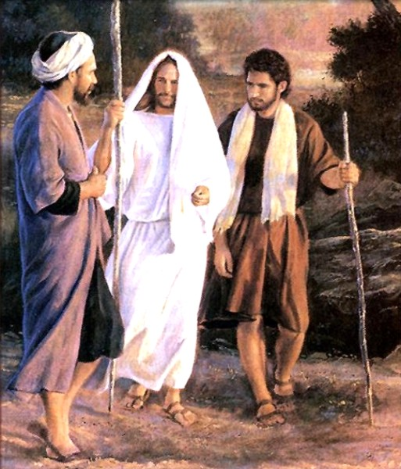
Jesus ascends to heaven
After His Resurrection Jesus appeared to His Apostles and taught them many things about the Kingdom Of God.
40 days after Easter Sunday He ascended into heaven to be with God the Father again. The Ascension is Christ's exaltation and glory after His saving work on earth had been accomplished. He promised the Apostles that He was preparing a place for them in heaven, and He prepares a place for us too.
We celebrate the Ascension on the 20th May 2012.

Slide 3
The Ascension
John 14:2-3
“My Father’s house has many rooms; if that were not so, would I have told you that I am going there to prepare a place for you? And if I go and prepare a place for you, I will come back and take you to be with me that you also may be where I am. “

Slide 4
Jesus promises to send the Holy Spirit
Before Jesus left, He promised to send the Holy Spirit to the Apostles to help them. He told them not to be afraid when He was gone. “But the Advocate, the Holy Spirit, whom the Father will send in my name, will teach you all things and will remind you of everything I have said to you.” (John 14: 26)

Slide 5
Pentecost – the Holy Spirit comes
The Apostles went to the upper room of a house to pray for the coming of the Holy Spirit. Tradition says that they prayed for 9 days (this was the first Novena). Mary was with them too. They were afraid to go out and preach as Jesus had asked them to do.

Slide 6
“And suddenly there came a sound from heaven, as of a mighty wind coming, and it filled the whole house where they were sitting. And there appeared to them parted tongues as it were of fire, and it sat upon every one of them: And they were all filled with the Holy Spirit, and they began to speak with diverse tongues, according as the Holy Spirit gave them to speak.” [Acts 2:2-4]

Slide 7
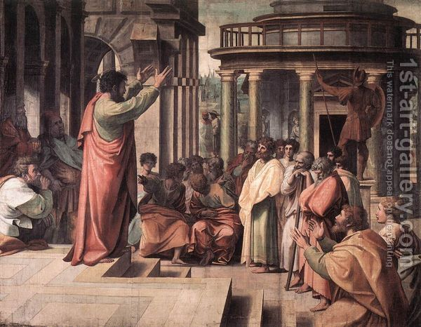
The Apostles proclaim the Gospel
The disciples were suddenly empowered to proclaim the gospel of the risen Christ. They went out into the streets of Jerusalem and began preaching to the crowds gathered in the city. Not only did the disciples preach with boldness and vigour, but by a miracle of the Holy Spirit they spoke in the native languages of the people present, many who had come from all corners of the Roman Empire.
The apostle Peter seized the moment and addressed the crowd, preaching to them about Jesus' death and resurrection for the forgiveness of sins. The result was that about three thousand converts were baptized that day.

Slide 8
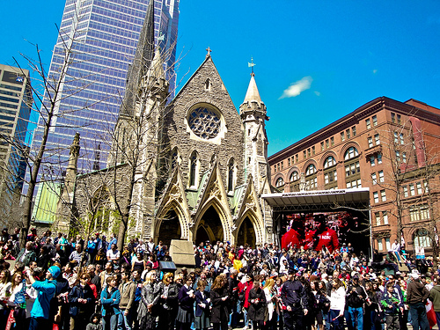
Birth of the Church
Mostly we think of the Church as the building where we go to Mass. The word "church" comes from the Greek "ekklesia" which means "gathering" or "assembly." Therefore, the Church is also the gathering of the believers who come together to participate in fellowship with one another as they worship God. Pentecost is known as the birthday of the Church, because it is the first time the Apostles went out to the people to speak about God in this way, and administered a Sacrament too!

Slide 9
The Early Church
After Pentecost the Apostles went to other countries to tell all nations about God and His love for us. The Holy Spirit they had received gave them the strength and courage for this task.
The “Acts of the Apostles” can be read in the New Testament of the Bible and it tells us a lot of what the Apostles did after Pentecost, in particular St. Peter and St. Paul. Many of the Apostles were imprisoned and martyred (killed) because of their beliefs but greeted their sufferings with joy because they were doing God’s work.

Slide 10
Symbols of the Holy Spirit
“And suddenly there came a sound from heaven as of a mighty rushing wind..”
The Apostles heard the wind in the room at Pentecost. God was breathing new life into the Apostles with His Holy Spirit and breathing life into the Church. God's Holy Spirit is somewhat like the wind. We can't see him, but we know that he is there because we can see the effects of his power in our lives.

Slide 11
Symbols of the Holy Spirit
“..there appeared unto them tongues like as of fire..”
In the Old Testament there are many images of God as fire. Fire brings light and warmth, and the words spoken by the Apostles at Pentecost and after would bring light to those who would hear them.

Slide 12
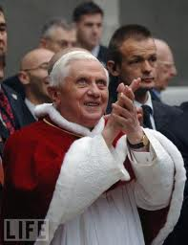
Pope Benedict and the Holy Spirit
Pope Benedict said: “Holy Spirit continues today to act with power in the Church...it is important that each one of us know the Spirit, establish a relationship with Him and allow ourselves to be guided by Him...we must welcome Him as the guide of our souls...He alone can open us up to faith and to allow us to live it each day to the full.”
Just as we receive Jesus every week in Holy Communion, we need to ask the Holy Spirit to fill us often also.

Slide 13
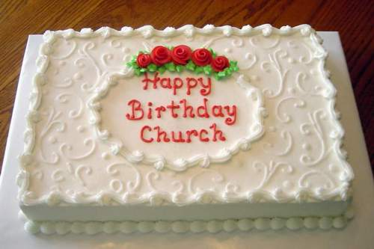
Ideas for Celebrating Pentecost
Read “Acts of the Apostles” chapter 2 to see the full story of Pentecost.
Have a birthday cake and sing “Happy birthday” to the Church!

Slide 14
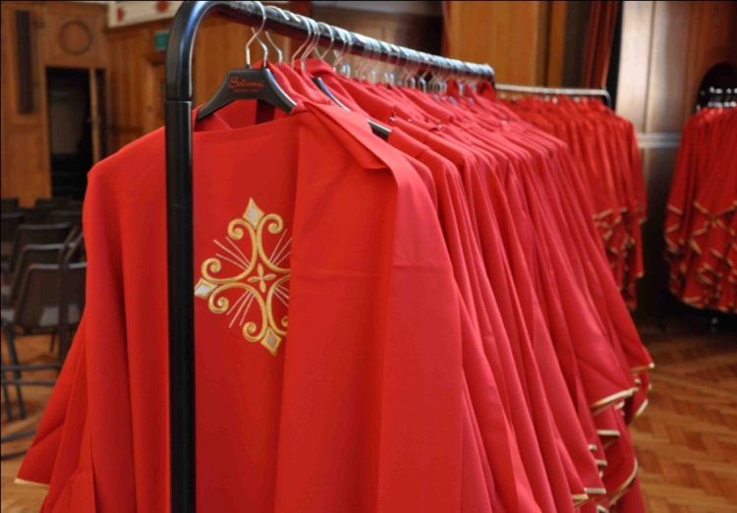
Ideas for Celebrating Pentecost
Wear red to Mass on the 20th May, the day we celebrate Pentecost – it is the colour the priest will wear on that day and reminds us of the tongues of fire that came to rest on the Apostles.
Reflect on how the Holy Spirit lives in you. How do you show this? Are there any ways you can help to spread the message of Jesus as the Apostles did?

Slide 15
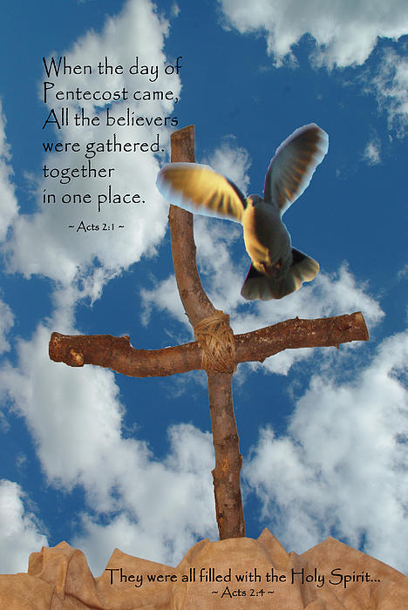
We write Christmas cards and send presents to people when celebrating the coming of Jesus, why not make, decorate and send Pentecost cards to people when we celebrate the coming of the Holy Spirit?

