Slide 1
Messianic Prophecy by Maud G. Lew
Based on
Dr. Michael Rydelnik’s Course
___
Dallas Theological Seminary
Summer 2005

Slide 2
Outline
Three Offices
“Messiah”
What is a Prophet?
What is Prophecy?
4 Types of Fulfillment
Approaches to Messianic Prophecy
OT-NT: Which Lens?
Prophecy & History
Is the Hebrew Bible Messianic?
Text-critical evidence
History of Hebrew Bible
History of Interpretation
Inner biblical evidence
Canonical evidence
Wholistic vs Atomistic Reading
NT evidence
Interpreting Messianic Prophecy + 1 example
Daniel’s Messianic Clock
Jewish eschatology
Christian eschatology
Messianic Expectations
Messianic Portrait

Slide 3
God
Mediation
Message
Kings
Priests
Prophets
Represent men before God
Represent God before men
People
Three Offices: Priest-King-Prophet

Slide 4
“Messiah”
Mashiach means “Anointed” (Greek “Christ”)
= Consecrated for service to God (YHWH)
There are 3 anointed offices in Hebrew Bible
  Priest of Israel (Leviticus 4:3)
  King of Israel (2 Samuel 19:21-22)
  A Pagan King (Isaiah 45:1)
The Unique Eschatological Servant of the Lord
  Prophet – King – Priest
  Like Moses – Son of David – Order of Melchizedek

Slide 5
What is a Prophet?
“Navi” (Hebrew)
= A spokesman for God
“You shall be as my Mouth” (Jer 15:19)
Tests of a true prophet (Deut 18)
  Does not use pagan divination (v. 9-13)
  Speaks only in God’s name (v. 19-20)
  Is completely accurate (v. 21-22)

Slide 6
What is Prophecy? (1)
Forthtelling truth boldly
  Announce & proclaim God’s Message
  Exhort Israel back to covenant faithfulness
    Ethical / moral standards (unlike false prophets who “tickle the ears” with lies: Micah 2:6-11)
    Spiritual faithfulness (A watchman held accountable gives warning: Ezekiel 3:17-33)
    Proper worship and instruction (unlike wicked priests who dishonor the Lord’s table in Malachi 1:6-2:9)
  Expound & explain God’s message (in both immediate and broader “sacred history” context)

Slide 7
What is Prophecy? (2)
Foretelling = predicting a future reality (event or person) which is only knowable by supernatural revelation
Types of Predictions
  Short-term individual (Death of Hananiah - Jer 28:15-17)
  Messianic historical (Birth of Immanuel - Is 7:14, Mt 1)
  Messianic in process (Sits at God’s right hand - Ps 110:1)
  Messianic eschatological (Eternal Kingdom - Is 9:7)
  National historical (Exile - Jer 25:11-12; Ezra 1:1-2)
  National in process (Valley of Dry Bones - Ezekiel 37)
  National eschatological (Messianic Kingdom - Is 35)

Slide 8
4 Types of Fulfillments
(Example: Matthew 2)
Direct fulfillment: v. 5-6
  Bethlehem: birthplace of Messiah (Micah 5:2)
Typical fulfillment: v. 14-15
  “Out of Egypt, I called my son” (Hosea 11:1) Israel is the
  type, Yeshua is the fulfillment. Type is supplied by Scripture.
Applicational fulfillment: v. 16-18
  “Rachel weeping for her children” (Jer 31:15) Rachel
  represents Jewish mothers mourning the loss of children.
  Midrash (rabbinic commentary) principle: “For any ancient
  text, there can be an application for any time and place.”
  Caution: only a true to the text derived principle validates
  spiritual experience.
Summary Fulfillment: v. 23
  “called a Nazarene” (Term of derision: Is 53 “despised”)

Slide 9
Approaches to Messianic Prophecy 1
Fulfillment | Rationale | Meaning
Historical (Collins) | Refers to person living in own time | P Historical
Double (Sherlock) | “sensus plenior” = 2 Meanings → Prophet had no clue? | P Historical Messianic
Typical (Bentzen, France) | Uses pattern as literary device | P Type Antetype
Progressive (Beecher, Kaiser) | Single meaning Intended by author Foreshadowings of Messiah | Pseed → shadows → Messiah

Slide 10
Approaches to Messianic Prophecy 2
Fulfillment | Rationale | Meaning
Relecture (Clements) | NT “fills up” OT historical reading | P Historical Messianic NT
Midrash-Pesher (Longenecker) | Applicational Fulfillment only | P A (OT) (NT)
Direct-Dogmatic (Hengstenberg) | OT read thru NT Neglects literary context of OT | P Messianic NT
Direct-Canonical (Sailhamer) | NT read thru OT Canon shape reveals messianic thread | P OT canon Messianic NT

Slide 11
Which Lens?
OT
NT
Back to the future: Hindsight Revelation only?
  NT is not “the guide” to the OT
  NT is “the goal” of the OT
  NT depends theologically on the OT
OT
NT
Messianic Theme pervades all Scripture
  OT contains the messianic searchlight for the future
  OT order/pattern of Messianic texts has meaning
  Genesis introduces messianic prophecy
  Revelation seals it.

Slide 12
Prophecy & History
Not Just
Visions of the future
Text
Explain Prophet’s vision
Sequence of events
Natural causes
But Also
Visions for the future
Text and commentary
Explain prophet’s explanation of his vision
Interaction of events and texts
Allow supernatural

Slide 13
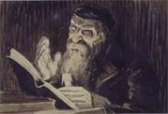
Is the Hebrew Bible Messianic?
Text-critical evidence YES
Inner biblical evidence YES
Canonical evidence YES
N.T. Evidence YES

Slide 14
Text-Critical Evidence
Controversies influence the history of messianic interpretation even as the text develops
  Controversy with rebellious sons (Cain, Edom, Absalom …)
  Controversy with disobedient kings (Saul, Ahab, Ahaz …)
  Controversy with wicked priests (Eli’s sons …)
  Controversy with false prophets (Hananiah, …)
  Controversy with nations (idolatry, enmity with Israel)
  Controversy with the “minim” (“apostates” – term wrongly attributed to Jewish Christians since the 1st century A.D.)
  Controversy with the Anti-Messianic spirit (Antichrist)
History of the Hebrew text is “developed theology”
  From the time of its composition …
  During the process of its canonization …
  Through the final stage of its consolidation.

Slide 15
History of Hebrew Bible 1
Composition 1500 – 400 B.C.
  Proto-Hebrew Text
  Pentateuch (Torah): canon by 622 B.C.
Canon 350 B.C. – 600 A.D.
  Final form: Torah + Prophets +Writings 350 B.C.
  Septuagint LXX (Greek translation) Alexandria 250 B.C.
  Song of Songs added at Jamnia (Yavne) 70 – 132 A.D.
  Qumran Scrolls 250 B.C – 110 A.D.
  “Controversy with the “minim” 70 – 600 A.D.
Consolidation 600 – 1000 A.D.
  Masorah (“tradition”) => Masoretic Text ( + vowel points)

Slide 16
History of Hebrew Bible 2
AUTOGRAPHS
Proto
Masoretic Text
Masoretic
Text = MT
Proto
Hebrew
Text
Pre-Samaritan
Text
Samaritan
Torah
Hebrew
Proto LXX
Greek
LXX
Minim Controversy
Composition Canon 300 B.C. 250 B.C. 150 B.C. 50 AD Consolidation
1500-400 B.C. 350 B.C. 600-1000 A.D.
3 text families compete, LXX, Samaritan & Masoretic
MT = later reception after “minim” controversy closed

Slide 17
History of Interpretation 1
Texts develop theologically not geographically
Controversy with the Minim affected the Masoretes’
reading as they consolidated the Hebrew canon
  Vowel points added make certain MT passages less messianic
  Older manuscripts (LXX, Samaritan, and Q) are more messianic
  Messianic passages tend to have more textual variants
Rashi, Kimchi, Medieval Jewish-Christian disputations
  Peshat: Literal meaning = Historical meaning
  Used peshat to refute Christian messianic interpretations in OT
  Messianic predictions already fulfilled historically
  Historical referents for Messiah: David, Hezekiah, Israel, etc.
Reformation Christian Hebraists read Rabbinic writings
  They often adopt the peshat historical interpretations as true
  They use kabbalah to invoke a mystical sense (double fulfillment)

Slide 18
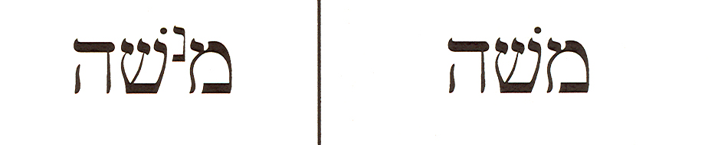
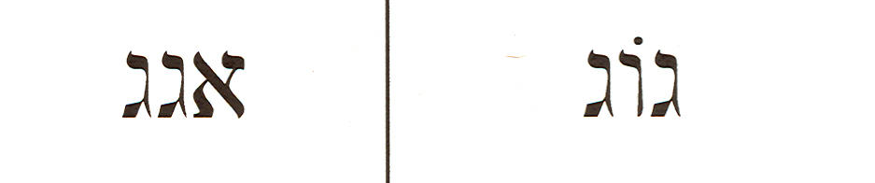
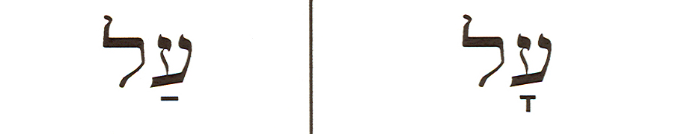
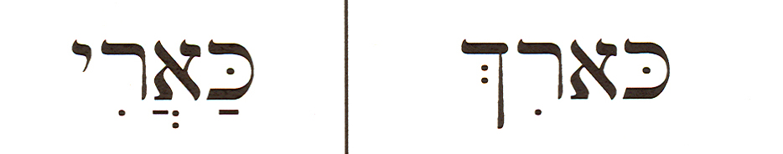
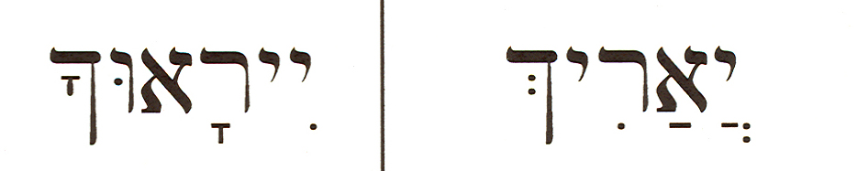
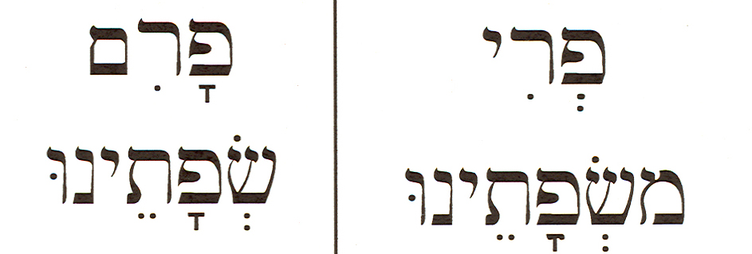
History of Interpretation 2
Verse | MT | Variants | Translations*
Judges 18:30 |  |  | MT Jonathan grandson of MANASSEH LXX Jonathan grandson of MOSES
Numbers 24:7 |  |  | MT His King shall be higher than AGAG LXX-S His King … higher than GOG
2 Samuel 23:1 |  |  | MT David raised up HIGH, the Messiah says LXX David…declares ABOUT the Messiah
Psalm 22:17 (16) |  |  | MT AS A LION LXX-Qumran THEY PIERCED
Psalm 72:5 |  |  | MT THEY will FEAR YOU LXX HE will ENDURE
Hosea 14:2 (3) |  |  | MT the BULLS of our lips LXX the FRUIT of our lips
Older variants (yellow) are also the better readings in each case above.
MT meanings (white) avoid Messianic interpretation or criticism of Moses.

Slide 19
Inner Biblical evidence 1
In-textual
  Words, grammar and syntax within text
  Ex: “shiloh” contraction: “to whom it belongs” (“it” refers to “shevet” the scepter in Gen 49:10)
Inner textual
  Cross-reference from same book or same author
  Israel’s King in Num 24:5-9 = the Lion of Judah in Gen 49:9-10 (Moses is the author of both books)
Inter-textual
  Cross-reference from a different book or author
  “I am going to make a ruin [of Davidic kingship] until He comes to whom it belongs” in Ezekiel 21:25-27

Slide 20
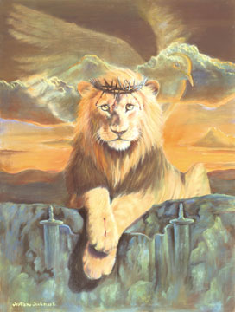
Inner Biblical evidence 2
Checking for Messianic Clues
Broader literary context
  Consistent structure?
  Narrative + Epilogue?
  Poetic seams employ an eschatological phrase?
“In the last days” Gen 49:8ff - Num 24: 14ff - Deut 31:24ff
Nearer narrative context
  Gen 49:1-7 older brothers
  disqualified from birthright
Contents of prophecy
  Judah’s Pre-eminence 49:8
  Power of Judah 49:9
  Prince of Judah 49:10-12
The Lion of Judah Who dares rouse him up? Gen 49:8ff

Slide 21
Canonical Evidence 1
Inclusion
  Each book contributes to the Messianic theme
    Prophets as God’s watchmen for the Messianic Promise recording with ever increasing clarity the messianic hope
    Historical Books as chronicles of Davidic dynasty in connection with messianic promise (each king is compared to David, is he the One?)
    Megillot as messianic narratives for the feasts of Israel which foreshadow Messiah (ex: Passover Lamb)
    Hagiographa (Wisdom Literature) as spirit of Messiah, expressing messianic ethics and messianic hope (ex: “My redeemer lives”)
  Psalter Messianic by authorial intent: David’s last words
    2 Sam 23:1-2 “Thus says David, Son of Jesse, the man raised up
    declares about the Messiah of the God of Jacob, and the Delight
    of the songs of Israel: The Spirit of the Lord spoke by me …”
  Test of canonicity: the Messianic thread is woven through
  book’s composition
    Ex: Pentateuch A single book with a single purpose!

Slide 22
Canonical Evidence 2
Composition of Pentateuch
Literary strategy one story
Creation & primeval history
Preparation of people & land
Promise to/through seed of
Abraham
Postponement of possession
of that land
Narrative blocks linked by single theme of faith with Law arranged around theme of broken faith
Faith forgotten in Egypt
Faith tested in wilderness
Law & Broken faith at Sinai
Need for circumcised hearts
Punctuated by songs/poems carrying central messianic theme (as in a musical)
Gen 49
Num 24
Deut 32
Epilogue: Messianic identification
Moses was great, but not the One
(Dt 34:9) Ezra’s appendix? (Ez 7:10)
Concern: maintain messianic hope in
the Promised One: prophet like
Moses

Slide 23
Canonical Evidence 3
Final Shape (Ezra?) Ezra 7:10
  Messianic seams reveal authorial messianic intent
Torah
Law
MEDITATE
Nevi’im
Prophets
MEDITATE
Ketuvim
Writings
MESSIAH
MESSIAH
Deut 34:10 Josh 1:8
Mal 4 Ps 1
Last word of OT points to first words in NT
  2 Chr 36:23 “Let him go up” is a call for “the one whose God is with him,” who is to build the Temple of Jerusalem.
  Matthew 1 introduces the genealogy of Jesus Christ, Son of David announced by an angel as the Savior with the title Imanuel “God with us” who claims to rebuild the temple in 3 days (see Matt 26:61 and Heb 3:1-6)

Slide 24
Wholistic Reading vs Atomistic Reading
Text | vs | Event
Pentateuch = single book
Allows scripture to interpret scripture (OT can read OT and NT)
Interpreter uses text as main source to derive meaning
Form criticism
Final OT Canon highlights authorial intent as messianic
MT + Variants
Pentateuch = Fragmented (JEDP hypothesis)
Messianic meaning invalid (NT can’t read prophecy into OT which is only history)
Historian recreates events using all available sources
Source criticism
Literal sense = Historical sense only
Primary Reliance on MT

Slide 25
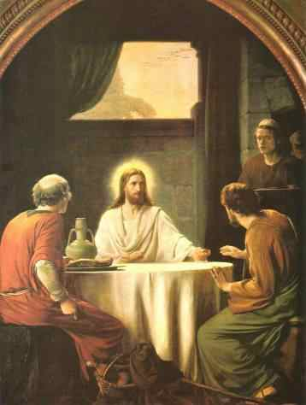
NT Evidence: “all the prophets”
Jesus
  “O foolish ones, and slow of heart to believe all that the prophets have spoken! … And beginning at Moses and all the prophets, He expounded to them in all the Scriptures the things concerning Himself. This is what I spoke to you … that all things must be fulfilled which were written in the Law of Moses and the prophets and the Psalms concerning me.” (Luke 24:25-27; 44-46)
  “There is one who accuses you-Moses, in whom you
  trust. For if you believed Moses, you would believe me,
  for he wrote about me.” John 5:45-47

Slide 26
NT Evidence: “all the prophets”
Peter
  “Concerning this salvation, the prophets, who spoke of the grace that was to come to you, searched intently and with the greatest care, trying to find out the time and circumstances to which the Spirit of Messiah in them was pointing when he predicted the sufferings of Messiah and the glories that would follow. It was revealed to them that they were not serving themselves but you, when they spoke of the things that have now been told you by those who have preached the gospel to you by the Holy Spirit sent from heaven…” 1 Peter 1: 10:12 (recalling Jesus’ words in Matt 13:17, Luke 10:24)
  “These things which God foretold by the mouth of all his prophets, that the Christ would suffer, he has thus fulfilled.” Acts 3:18
  “I want you to recall the words spoken in the past by the holy prophets …” 2 Peter 3:2

Slide 27
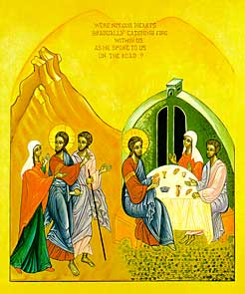
NT Evidence: “all the prophets”
Paul
  “… so I stand here and testify ... I am saying nothing beyond what the prophets and Moses said would happen” Acts 26:22
  “ … From morning till evening he explained … and tried to convince them about Jesus from the Law of Moses and from the Prophets. Acts 28:23
“Now to him who is able to establish you by my gospel and the
proclamation of Jesus Christ, according to the revelation of the
mystery hidden for long ages past, but now revealed and made known
through the prophetic writings by the command of the eternal God, so
that all nations might believe and obey him …” Romans 16:25-26

Slide 28
Interpreting Messianic Prophecy 1
Establish the text (read, examine variants)
  Scripture should be interpreted in it normative, literal sense, except in such instances where a figurative or non-literal interpretation is obviously indicated.
Determine historical context as revealed primarily by the Bible …
  … Rather than extra-biblical sources
  There are many flood narratives, but only one is inspired
Study words, grammar, syntax in context
  The term Messiah is not always present, yet the passage can still be messianic. But is it really? Zec 13:6 is not, but v. 7 is.

Slide 29
Interpreting Messianic Prophecy 2
Be aware of compressed time
  Prophets don’t always see time gaps in the future (Is 61:2)
Harmonize with cross-references
  Explore the 3 levels of inner biblical evidence
Interpret text, not event - wholistic reading
  Revelation is in the text, not the event
  Record of event has a literary structure, theme and purpose within a literary context

Slide 30
Interpreting Messianic Prophecy 3
Single meaning derived from authorial intent
  Derive meaning from the author’s intent, not the characters’ understanding (Ex: what Moses, not Balaam or his donkey sees)
  Allow author to interpret the text in the literary context (meaning is for the present AND future audience)
Allow the supernatural (biblical realism).
  Does the natural sense make sense?
  Ex: How is the virgin birth a “sign”? (Isaiah 7:14)
Ask Questions
  Are there any time clues? What light does the NT shed on it?

Slide 31
Example: Isaiah 7:14
Context
  Alliance of Israel and Syria against Ahaz, King of Judah because he does not join their alliance against Assyria (v.1)
  Isaiah commanded to bring along his son Shear Yashuv and meet the king and his family at the Fullers’ field where he inspects the water reserves in case of a siege. The house of David is alarmed (v. 2-4)
  Attempt to establish the Son of Tabeel on Ahaz’ throne would remove Ahaz, decimate his family and endanger the Davidic line (5-6)
Content
  Isaiah assures Ahaz their attempt will not succeed (7-9)
  Isaiah offers Ahaz a great sign from the Lord and Ahaz refuses out of false piety [he has already sent envoys to Assyria for help] (10-11)
  Isaiah is angry, addresses a long-term prophecy to the house of David [Listen now, O house of David, you (pl.) …]: “The almah is pregnant with a Son, whose title is Imanuel [God is with us] and the 2 kings you (pl.) dread will have been removed when he comes to maturity” (13-15)
  Isaiah shifts to a short-term prophecy addressing Ahaz while pointing to his son: “ Before this child knows good from evil, the Lord will bring the King of Assyria against you (sg.) and they will devastate the land so that people will have to subsist on milk & honey (no crops) …” (16-25)

Slide 32
Isaiah 7: 14 (conclusion)
Controversy
  The Messianic interpretation is that the first prophecy points to the far future Messiah born of a virgin in times of national distress when both Samaria and Aram dynasties are removed. The second prophecy promises hope but also judgment to Ahaz in the near future because of his trusting in the King of Assyria rather than the Lord. That King he trusts in will devastate the land of Judah.
  Rabbinic interpretations say the Hebrew word for virgin is not “almah” but “bethulah.” It refers to Ahaz’ wife or Isaiah’s wife to be soon pregnant. This interpretation sees only one prophecy fulfilled historically, not two. It encounters historical problems as well.
  The instances of Almah in the OT show that it means “unmarried woman.” None refer to a married woman, rather they point to virginity. See Gen 24:43; Ex 2:8; Judges 11:39 ; Psalms 46:1 and 68:26; Prov 30:19; Song of Solomon 1:3 and 6:8. But a “bethulah” could be a child, concubine, or an old widow and so could not always be a virgin.
Conclusion
  Isaiah’s choice of “almah” is appropriate since a pregnant unmarried woman hardly qualifies as a “great sign from heaven.” But a virgin does. The normal usage of almah is a “virgin” past puberty and ripe for marriage, but yet unmarried.
  The birth of Messiah (Matt 1) is a direct fulfillment, not a typical fulfillment of Isaiah 7:14.

Slide 33
Messiah Had to Come Before 70 A.D.
Daniel 9:24-27
  “The Lord has appointed 70 ‘sevens' for your people and your holy city. During that time, acts against God's law will be stopped. Sin will come to an end. And the evil things people do will be paid for. Then everyone will always do what is right. Everything that has been made known in visions and prophecies will come true. And the Most Holy Place in the temple will be anointed.
  Here is what I want you to know and understand. There will be seven ‘sevens.' Then there will be 62 ‘sevens.' The seven 'weeks' will begin when an order is given to rebuild Jerusalem and make it like new again.
  At the end of the 62 ‘sevens,' the Anointed King will come. Jerusalem will have streets and a water system when it is rebuilt. But that will be done in times of trouble. After the 62 'weeks,' the Anointed King will be cut off. His followers will desert him. And everything he has will be taken away from him. The army of the ruler who will come will destroy the city and the temple.” [i.e. Roman Emperor Titus 70 A.D.]
A “seven” is a “week” of years = 7 years (Gen 29:27)
The last “seven” (70th week) has been postponed until the end of
days while Messiah harvests the nations prior to judgment.
During the last 70th week all Israel will recognize Him as He delivers
the nation from the nations intent on destroying it once and for all.
Notes:
Also Sanhedrin 5:1 and Baba Metzia 9:10 confirm the use of “seven as “weeks of years”
A biblical year was reckoned as 360 days (Gen 7:11,24; 8:3-4)
Prophetic evidence for 360 days is found in Dan 7:25; Rev 13:4-7, 12:6.
The order to rebuild Jerusalem could not refer to:
Cyrus’ decree (539 B.C.) described in 2 Chr 36:22-23 and Ezra 1:1-3
Darius’ Decree (519 B.C.) described in Ezra 7:11ff
Artaxerxes’ first decree (457 B.C.) described in Ezra 7:11ff
But it fits Artaxerxes’ second decree (444 B.C.) described in Nehemiah 2:1-8

Slide 34
Daniel’s Messianic Clock
Calculation of the prophecy
    69 x7 = 483 biblical years
    483 x 360 = 173,880 days
    173,880 ÷365.25 = 476 solar years
    - 444 + 476 = 32
    (add 1 since there is no zero year)
    32 + 1 = 33 A.D.
To the year
Nisan 1,
March 5
To the day
Nisan 10,
March 30
69 “weeks” (7-yr periods)
444 B.C.
Nehemiah 2:1-8
173,880 days
A.D. 33 Triumphal Entry Luke 19:42

Slide 35
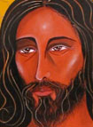
Hour of Messiah’s Visitation
Luke 19:43-45
0
444 B.C. Artaxerxes’ 2nd Decree (Neh 2:1-8)
7 x 7=49 years after decree to rebuild Jerusalem
7th
395 B.C. Jerusalem fully rebuilt as a city
62 x 7 = 428 years after Jerusalem rebuilt
Yeshua crucified 33 A.D.
In the 69th “week” Messiah is cut off →
69th
70 A.D. City & temple destroyed
Time of the Gentiles → postpones 70th week
70th
The last week: End of days

Slide 36
Who Has Believed Our report?
The ‘minim’ (apostates) are those who rejected Messiah
Teaching of Messiah
“Woe to the obstinate children," declares the LORD, "to those who carry out plans that are not mine, forming an alliance, but not by my Spirit, heaping sin upon sin.” Isaiah 30:1
“Woe to the shepherds who are destroying and scattering the sheep of my pasture!" declares the LORD.” Jeremiah 23:1
“Woe to the foolish prophets who follow their own ‘spirit and have seen nothing!’” Ezekiel 13:3
30 A.D.
Messiah
cut off +
resurrected
33 A.D.
Start of Jewish Messianic Persecution
40 A.D.
Titus destroys Temple + Jewish Genealogies are lost
70 A.D.

Slide 37
Who is the true Messiah?
“Woe to you, teachers of the law …! You shut the kingdom of heaven in men's faces. You yourselves do not enter, nor will you let those enter who are trying to… Therefore I am sending you prophets and wise men and teachers. Some of them you will kill and crucify; others you will flog in your synagogues and pursue from town to town. And so upon you will come all the righteous blood that has been shed on earth …” Matt 23:34-36
Titus destroys Temple + Jewish Genealogies are lost
70 A.D.
Yavne Rabbinic Council issues “minim curse” to expel Messianic Jews
You diligently study the Scriptures because you think that by them you possess eternal life. These are the Scriptures that testify about me, yet you refuse to come to me to have life. I do not accept praise from men, but I know you ... I have come in my Father's name, and you do not accept me; but if someone else comes in his own name, you will accept him. How can you believe if you accept praise from one another, yet make no effort to obtain the praise that comes from the only God? John 9:35-44
90 A.D.
Defeat of false messiah Bar-Koziba + Exile
136 A.D.

Slide 38
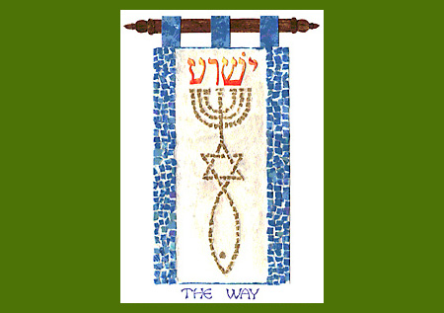
The Desire of the Nations
Covenant with the nations (protection of chosen nation) Job 5:23; Eze 34:25; Hosea 2:18
Revoked Covenant with the nations Zec 11:10 though not completely because of Gen 12:3 and Jer 33:20-25
Flock is scattered after shepherd is stricken Zechariah 11:4-14
Israel many days without kings or priests Hosea 3:4-5
Time of Gentiles Ezekiel 36:16-36; Luke 21:24; Rom 11:25
Hope of the Gentiles Isaiah 11:10
Light for the Gentiles Isaiah 42:6; Isaiah 46:6
Messiah as the desire
of the nations
Haggai 2:6-9
Messiah = Priest-King according to Gentile order of Melchizedek Ps 110: 4-6, Is 42:1-4

Slide 39
Jewish Eschatology
Birthpangs of Messiah
Coming of Elijah
Messiah
Comes
War of Gog & Magog
Deliverance of Nation Israel
Ingathering of the Exiles
Messianic Age = 40 – 1000 years Peace, prosperity, justice, universal knowledge of the Lord
Age to Come: Resurrection, cessation of death, eternal righteousness

Slide 40
Christian Eschatology
1st Advent of Messiah Yeshua - Suffering Servant
Messiah ascends to heaven
Time of Gentiles*
Rapture of the Church & 1st Judgment (Saints)*
Anti-Christ reigns 7 years – Tribulation*
Messiah returns
2nd Advent of Messiah - Millennial Kingdom*
2nd Judgment (wicked)
New Heaven & New Earth
* Christian beliefs concerning duration & order of these events vary.

Slide 41
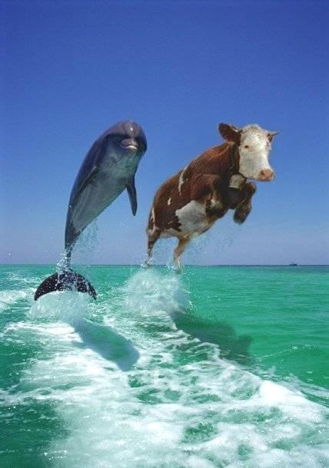
Great Expectations
Look both ways before you cross the street…
Do some have a better radar than others into the future?
Check ahead before you jump!
Ready to jump into the future?
Don’t be like the cow and follow every dolphin that comes around, crying Messiah!
If you want to travel the waters of messianic prophecy, you need the Spirit of Messiah in you to recognize Him when He comes.

Slide 42
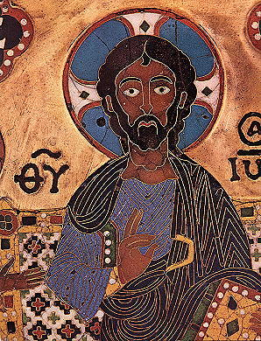
Person of Messiah:
Jewish Messianic Expectations
The Son of David
A Political Deliverer
A Military Leader
Perfectly Holy
Ideal Human Being
Perfect Judge
Greater than Moses
  Lawgiver
  Miracle Worker
But is He more…?

Slide 43
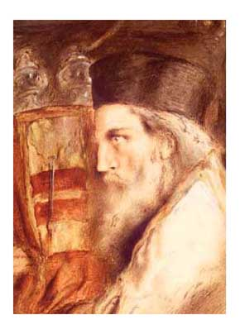
Messianic Speculations 1
Priests and Rabbis are now in disagreement about:
Messiah’s nature: human? Preexistent? Divine?
Messiah’s role: King? Priest? How many Messiahs?
    Messiah Ben Judah (the King)
    Messiah Ben Joseph (suffering Messiah)
    Messiah Ben Levi (the Priest) Testament of Twelve, Testament of Reuben 6:7-12

Slide 44
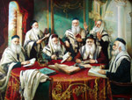
Messianic Speculations 2
Manner of Messiah’s Coming: (Zec 9:9)
  If Israel is worthy He will come “victoriously on clouds”
  If unworthy He will come “humbly on a donkey”
Messiah’s Delay:
    2000 yrs waste + 2000 yrs Torah + 2000 yrs Messiah
    Because the Lord says he will tarry for our sake in Isaiah 30:18, the Talmud comments, “Though he tarry, I will wait for Him”!
“If all Jews observe 2 shabbats in a row faithfully, He will come!”
“He didn’t come 2000 years ago because Israel was unworthy”

Slide 45
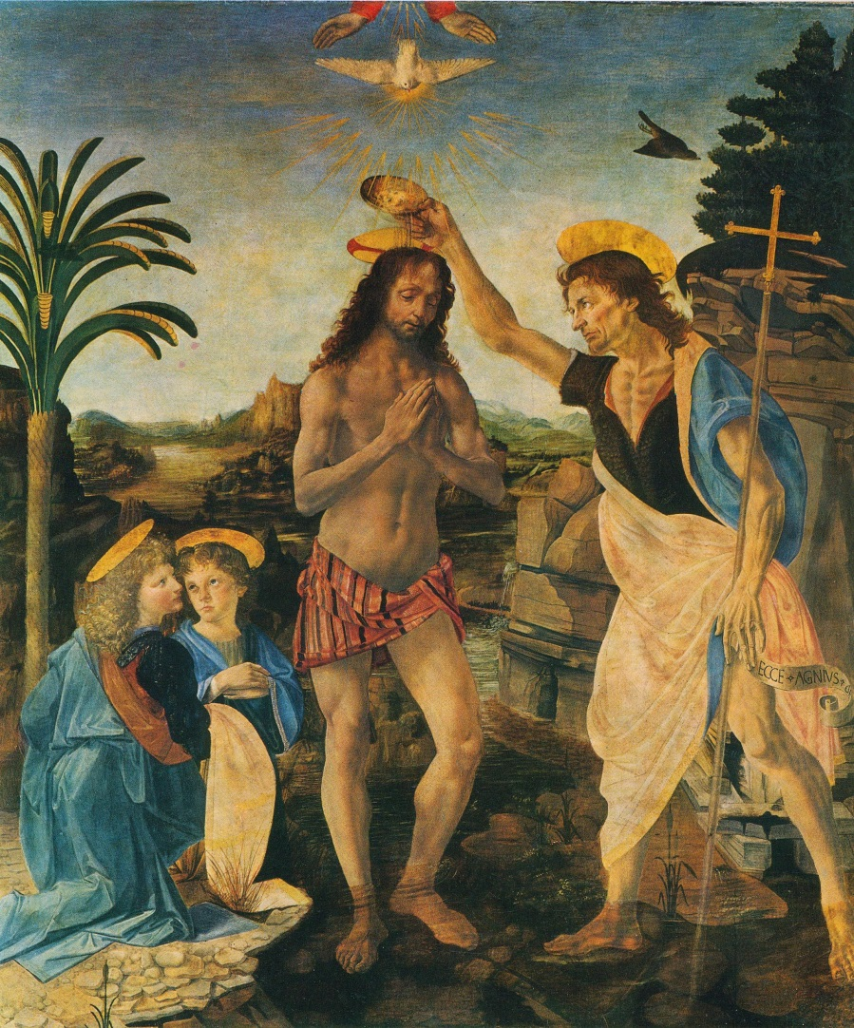
Messianic expectations in OT
The Good Shepherd
Greater than Moses
Wiser than Solomon
Wonderful Counselor
Prince of Peace
Suffering Servant
Savior Redeemer
New Covenant Mediator
Priest-King
Firstborn of the Dead
Eternal Son of God

Slide 46
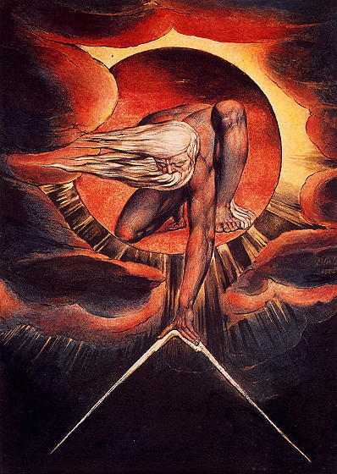
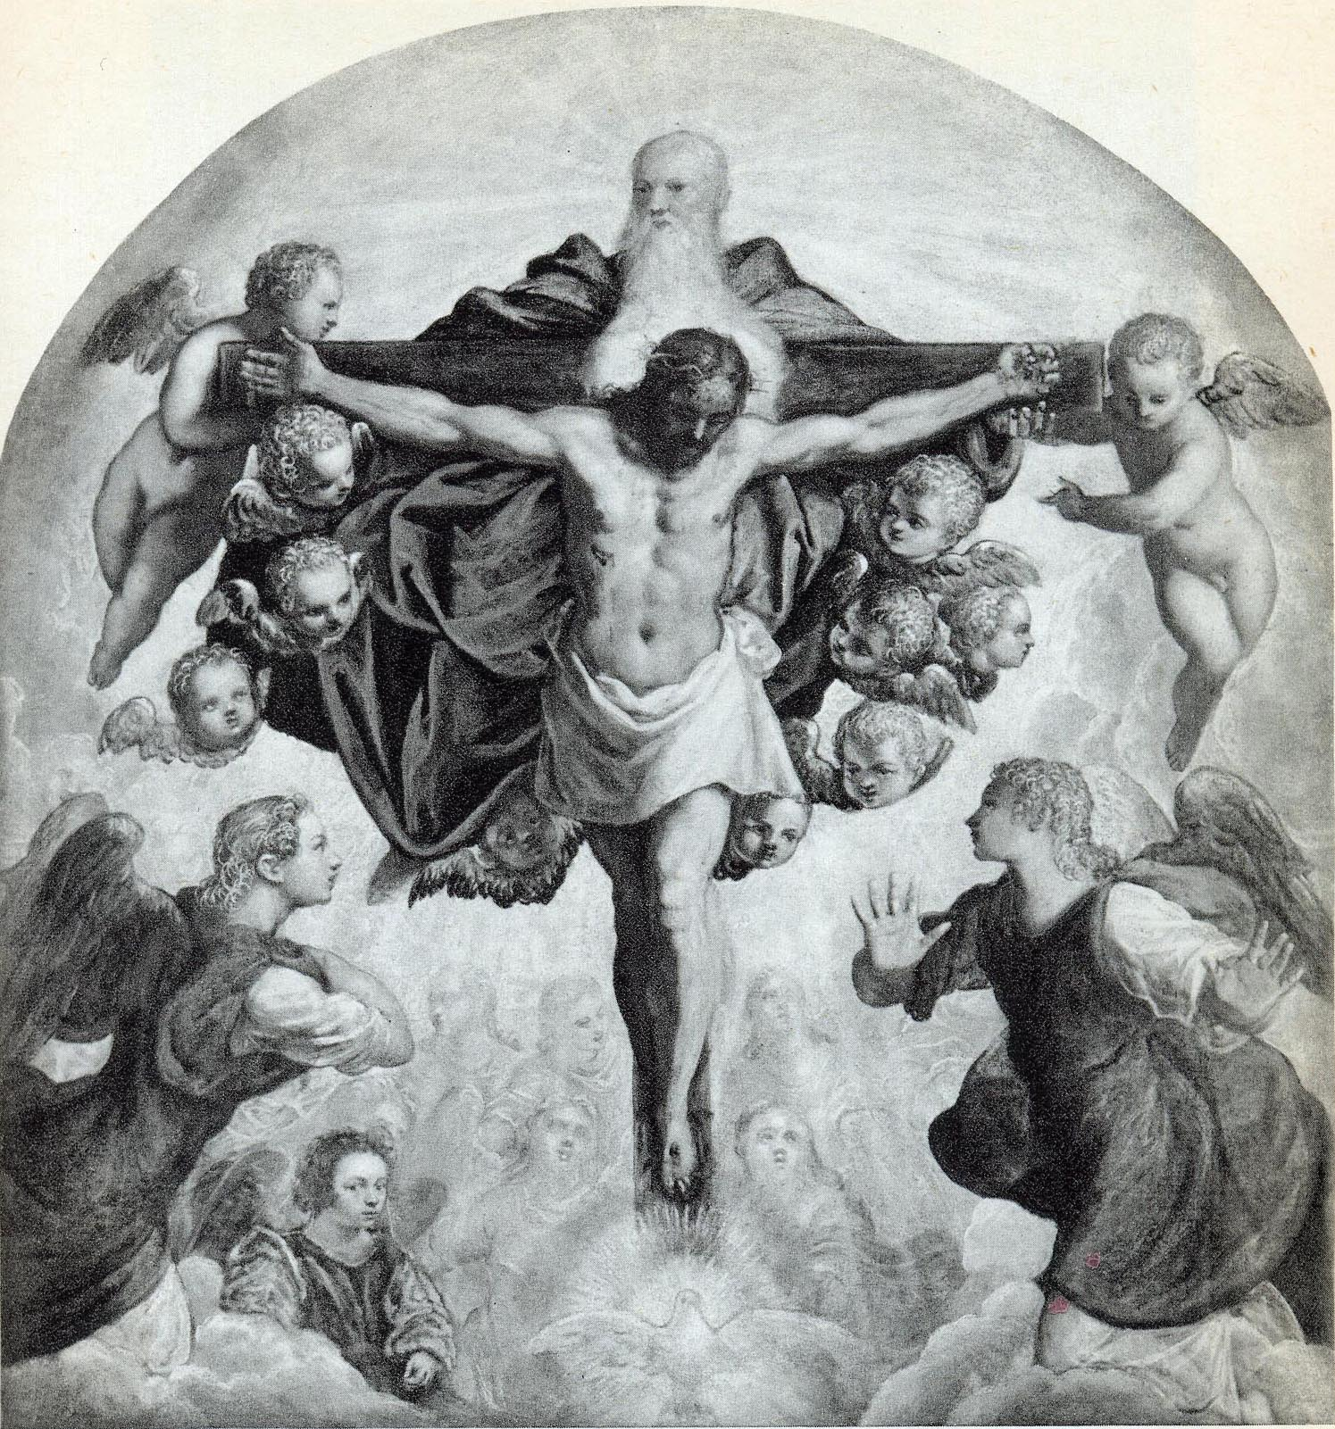
A Messianic Portrait
William Blake, “The Ancient of Days,” 1834, in Sister Wendy’s 1000 Masterpieces (New York: DK, 1999) 40

Slide 47
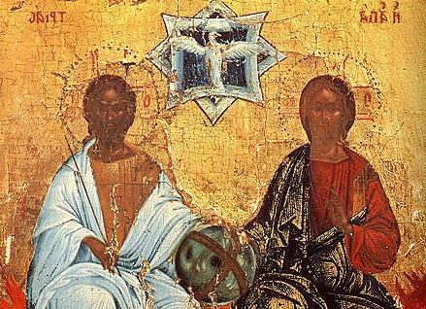
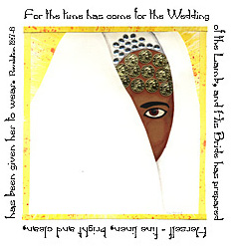
Ideal Human Being
Worshipped Son of Man
Daniel 9:24-27
Companion of the Lord Zec 13:7
Humble & persistent servant
Is 42:1-4
Hears Spiritual Instruction
Is 50:4-5
Trusts God when discouraged
Is 49:4
Trusts the Lord for vindication
Is 50:7-9
Kinsman-Redeemer “Goel”
Job 19:23-27
Exalted among friends and nations Is 52:12-13, Ps 45:7
Bridegroom Ps 40, 45

Slide 48
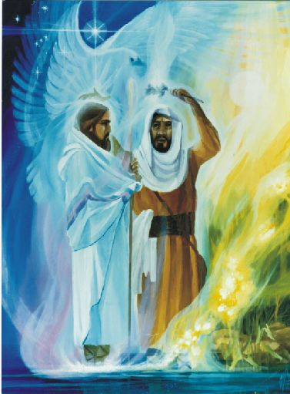
Wonderful Counselor
“Wonderful Counselor” (Performs wonders/miracles) Is 9:6
Proclaims freedom, comfort & healing Is 61: 1-3, Mal 4:2
Spirit of Wisdom rests on Him Is 11:2-3
Wiser judge than Solomon
Is 11:4-5
Teacher of righteousness Joel 2:23
A lamp and a light Ps 132:17, Is 9: 1-2; Is 42:6; Is 49:6; Is 60:1:3; Mal 4:2
Baptism of Yeshua

Slide 49
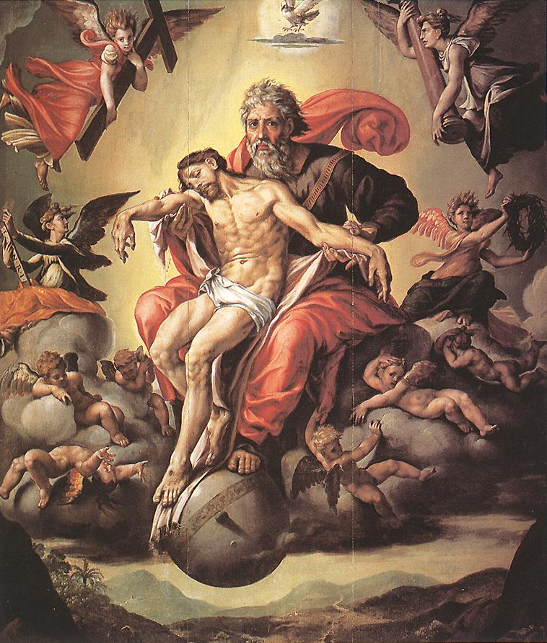
The Suffering Servant
Despised Is 53:3; Ps 22:6
Mocked Ps 22:7-8; 109:25
Hated without cause
Ps 69:4
Betrayed Ps 69:4,25; 109:8;
Zec 11:12-13
Afflicted Is 50:4-9; 52:14;
Ps 69:21
Rejected Is 53:3-4;
Ps 118:22-23
Crucified Ps 22
Pierced Zec 12:10
Cut off, but not for his sins Is 53:6-9, 12; Dan 9:26

Slide 50
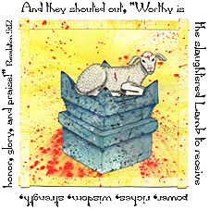
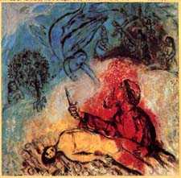
Perfectly Holy
Sinless, Innocent Is 53:9
Obedient unto death Is 53
No bone broken Ps 34:20
Unblemished lamb Is 53:7
Fitting sacrifice (sprinkle nations with His blood) Is 52:15
Victory over Serpent
Gen 3:15
Victory over all evil-doers
Mal 4:3
Victory over Death
Ps 16:8-10; Is 53:10

Slide 51
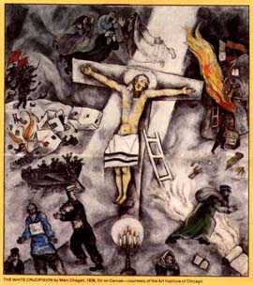
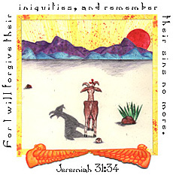
Savior
Salvation “Yeshua” for all Is 49:5-6; Is 51:5
The Arm of the Lord Is 53:1, Is 59:16-20
Cleanses Israel’s sins in one day Zec 3:9; 12:10

Slide 52
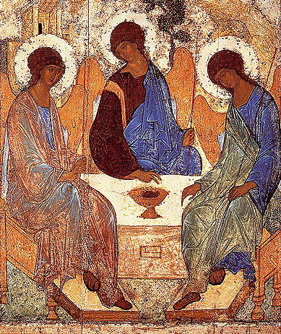
The High Priest
Faithful Priest = Messiah: “His established house will minister (walk) before my Messiah forever” 1 Sam 2:35
Will build a House for God’s Name 2 Sam 7:13
“Messenger of the Covenant” (all of them) Mal 3:1
Mediator of New Covenant Zec 3:8-10, Is 49:8-12
Advocate in heaven Job 16:19-21
The Priest-King Jer 30: 9, 21; Zec 6:9-15
Eternal Priest Ps 110:4
Andrei Rublev, “The Old Testament Trinity,”1410-20,
Tretyakov Gallery, Moscow, in Sister Wendy’s 1000 Masterpeices
(DK, 1999) 406

Slide 53
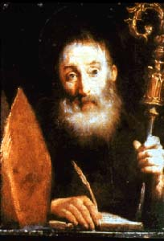
Shepherds His People
The Good shepherd Ezekiel 34:23-31
The stricken shepherd whose flock is scattered
Zec 11:4-14
The Breaker who opens the way out for his sheep Micah 2:12-13
One shepherd great unifier of the Nation (Judah & Israel) Ezekiel 37: 37:15-18
Regathers remnant flock Ezekiel 37:21
Builds up the flock
Micah 5:3-4

Slide 54
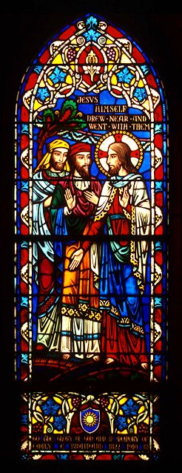
Son of David
Eternal Dynasty 2 Sam 7:16
David’s greater Son Ps 89; 132
Delight of David 2 Sam 23:1
The shoot from stump of Jesse Is 11:1
The tender sprig will grow
Ezekiel 17:22-24
Branch of David Jer 33:15-18
The new (2nd) David
Ezek 34:23; 37:24; Hosea 3:4-5
Has Key to House of David Isaiah 22:22-23
The Raised House of David Amos 9:11-15

Slide 55
King of Kings
The rightful King (Shiloh) Gen 49: 8-10; Ezekiel 21: 22-27
Enthroned Ps 110
The most exalted of the Kings of the earth
Ps 89:26-27
Eternal throne & kingdom 2 Sam 7:16; Ps 89; Ps 132:11-14
Righteous King Ps 72:8-15
The Judge of the earth 1 Sam 2:10; Jer 33:15; Ps 110
Gives peace to all nations Is 9:2; Micah 5:4-5

Slide 56
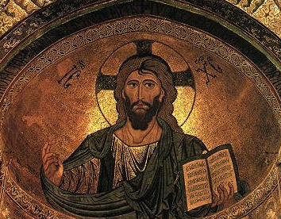
Ruler of All
Coming Ruler Micah 5:1-4;
Anointed Ruler Daniel 9:24-27
Conqueror of nations Ps 2:8-12; Ps 110:5-6; Is 63
Absolute Ruler Zec 10:4
Triumphant Ps 68; Ps 72
Will get rest from enemies 2 Sam 7:11; Ps 100:2
“Christ Pantocrator” [Ruler of All], 1131-66, Cefalu Cathedral, Sicily, in
Helen de Borchgrace,A Journey into Christian Art (Minneapolis: Fortress, 2000) 23

Slide 57
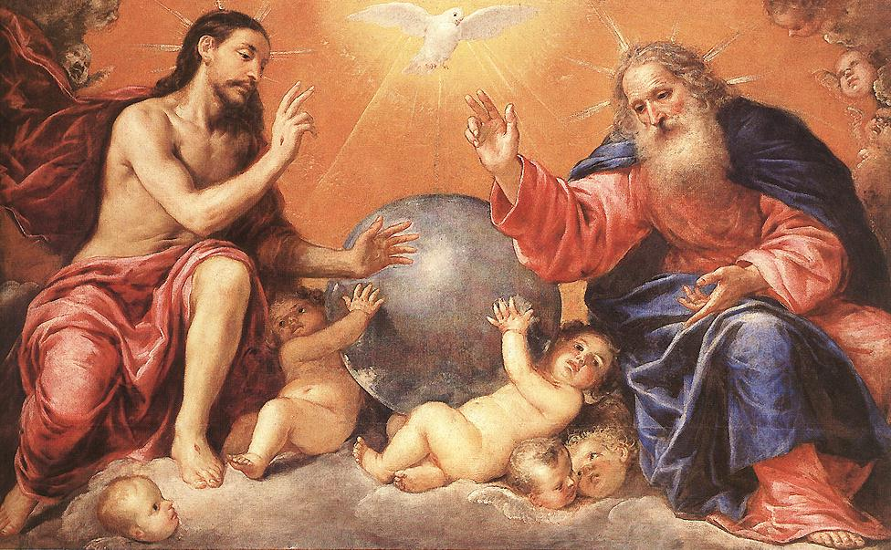
Son of God
God’s Begotten Ps 2:7
My son 2 Sam 7:14
My firstborn Ps 89:26-27
Who knows His son’s name? Prov 30:4
Imanuel “God with Us” Is 7:14
Lord coming into His temple Mal 3:1
Goings forth from everlasting Micah 5:2
Branch of the Lord Is 4:2
David’s Lord Ps 110:1
Sits at the right hand of God Ps 110:5
Eternal Son 1 Chron 17:14
Mighty God Is 9:6
Lord Redeemer Is 48:16-17
“Lord our Righteousness”
Jer 33

