Slide 1


Slide 2
Who is the Holy Spirit?
The Holy Spirit did not just appear at Pentecost!
As God, He always existed!
The Holy Spirit is truly a person, not just a magical force.
He is the life-giving breath of God. He is God’s greatest gift to us: the gift of Himself dwelling within us!

Slide 3
What does the Holy Spirit do?
Safeguards the church from error in matters of faith and morals
Strengthens and matures the gifts we received at Baptism
Acts as our Advocate and our Defender guiding and protecting us
Gives us the light to discover the Truth
Helps us in prayer
Helps us speak God’s word with boldness

Slide 4
What else does the Holy Spirit do?
Comforts and consoles us
Empowers us to overcome sin
Energizes people (Mary at the Annunciation, Jesus at his Baptism, the disciples at Pentecost)
Builds up the Body of Christ, the Church, and makes it holy
THE SPIRIT IS THE POWER OF GOD (GOD HIMSELF) AT WORK IN US!

Slide 5
Titles of the Holy Spirit
Paraclete Consoler
When he proclaims and promises the coming of the Holy Spirit, Jesus calls him the "Paraclete," literally, "he who is called to one's side," "Paraclete" is commonly translated as "consoler," and Jesus is the first consoler.

Slide 6
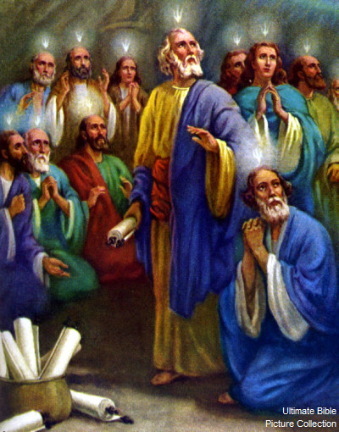
Symbols of the Holy Spirit
Fire
The prayer of the prophet Elijah, who "arose like fire" and whose "word burned like a torch," brought down fire from heaven on the sacrifice on Mount Carmel.

Slide 7
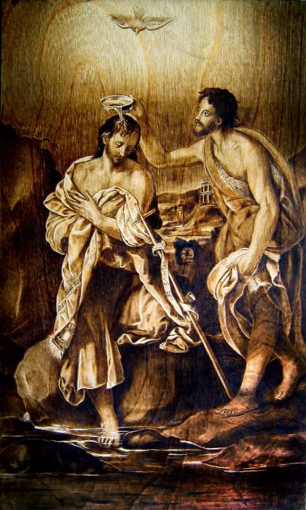
Dove
Christian iconography traditionally uses a dove to suggest the Spirit
Noah
Christ’s Baptism

Slide 8
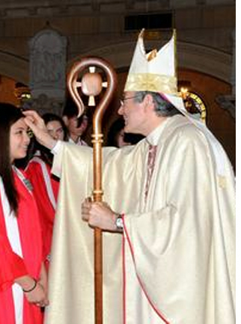
Anointing
The symbolism of anointing with oil also signifies the Holy Spirit, to the point of becoming a synonym for the Holy Spirit.
In Christian initiation, anointing is the sacramental sign of Confirmation

Slide 9
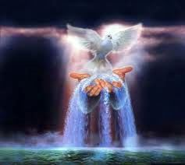
Water
The symbolism of water signifies the Holy Spirit's action in Baptism, since after the invocation of the Holy Spirit it becomes the sacramental sign of new birth.

Slide 10

What the Holy Spirit gives us
Gifts
Fruits

Slide 11
The GIFTS of the Holy Spirit
 WISDOM-helps us to see clearly; helps us to see ourselves & others as God sees us
KNOWLEDGE-ability to see how God is in our life and world
Reverence - respect for the Lord and respect for others

Slide 12
COURAGE - helps us give witness to our faith and stand up for what we know is right; helps us act on our beliefs and persevere in faith.the strength to do the right thing
UNDERSTANDING-helps us grasp the truth and see the world from God’s perspective; leads us to reconciliation and peace in times of conflict.

Slide 13
RIGHT JUDGEMENT -helps us act in morally good ways; often involves asking others for help and offering good advice to others
WONDER & AWE IN THE PRESENCE OF GOD-helps us remain open to the loving presence of God; helps us appreciate the mystery of the Trinity

Slide 14
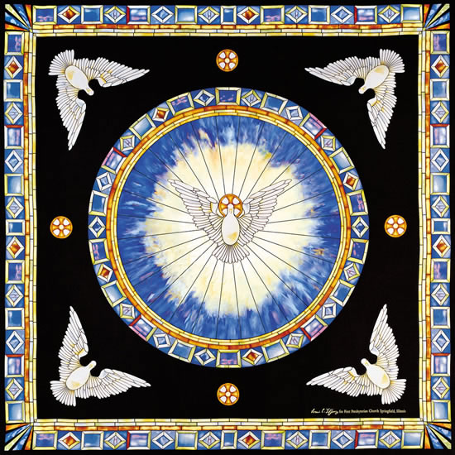
FRUITS OF THE SPIRIT
Patience
Kindness
Gentleness
Joy
Peace
Love
Faithfulness
Generosity
Self-control

Slide 15
The Holy Spirit in Your Life
In what ways is the Holy Spirit present in you and with you?
What aspects of nature help you glimpse the Spirit?
How have you experienced the presence of the Spirit during hard times and suffering?
How do you experience the work of the Spirit in your faith community or your school?

Slide 16
Prayer Reflection
Holy Spirit of God,
Grant us the wisdom to see what is truth.
Help us grow in understanding you, our Creator.
Help us grow in knowledge of all your creation.
Give us right judgement to know what is fair.
Grant us reverence to adore you.
Grant us wonder & awe of the Lord to respect ourselves.
Give us the courage to act as Jesus would.
Amen

