Slide 1
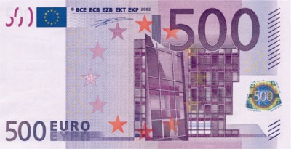
Christian views of poverty and wealth.
Learning Objectives:
This lesson will help you to:
Explain Christian attitudes to wealth and the use of money.
Explain Christian responses to poverty.
Identify and reflect on your own views about issues to do with wealth and poverty.

Slide 2
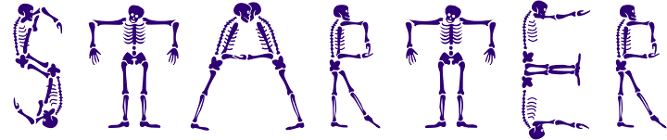
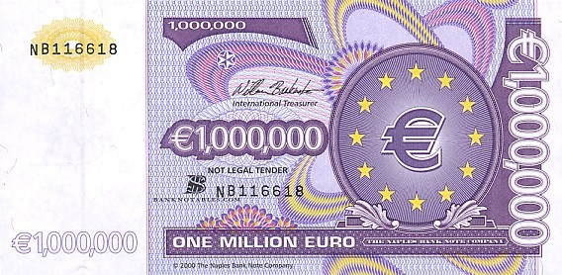
Imagine that you have been selected at random to be one of the first people in the country to receive a €1,000,000 note.
THINK – PAIR -SHARE
In 3 minutes break down quickly how you would use this money.

Slide 3
Write down this statement and answer the question
“Having a million euro would change my life for the better”
Do you agree? Give reasons for your answer and show you have thought about different points of view?

Slide 4

There is a God
“Winning a million euro would change my life for the better”
Totally disagree
(atheist)
Disagree
Agree
Not sure
Where do you stand on the line?

Slide 5



Christian attitudes to wealth and poverty
Matthew 19:24
Again I tell you that it is easier for a camel to go through and eye of a needle than for a rich man to enter the kingdom of heaven.

Slide 6
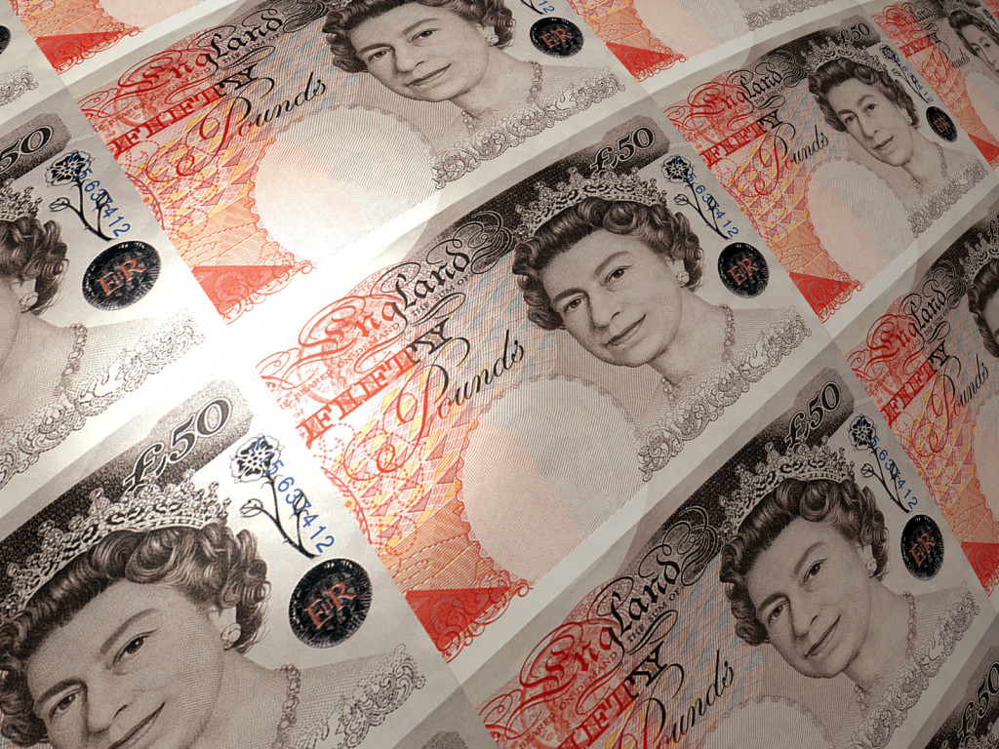
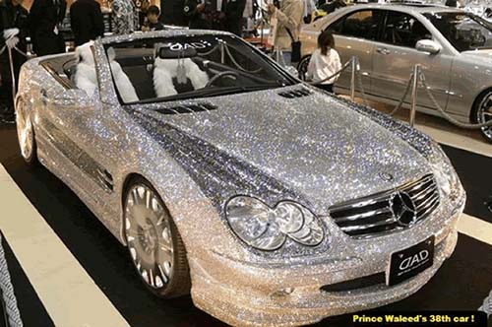

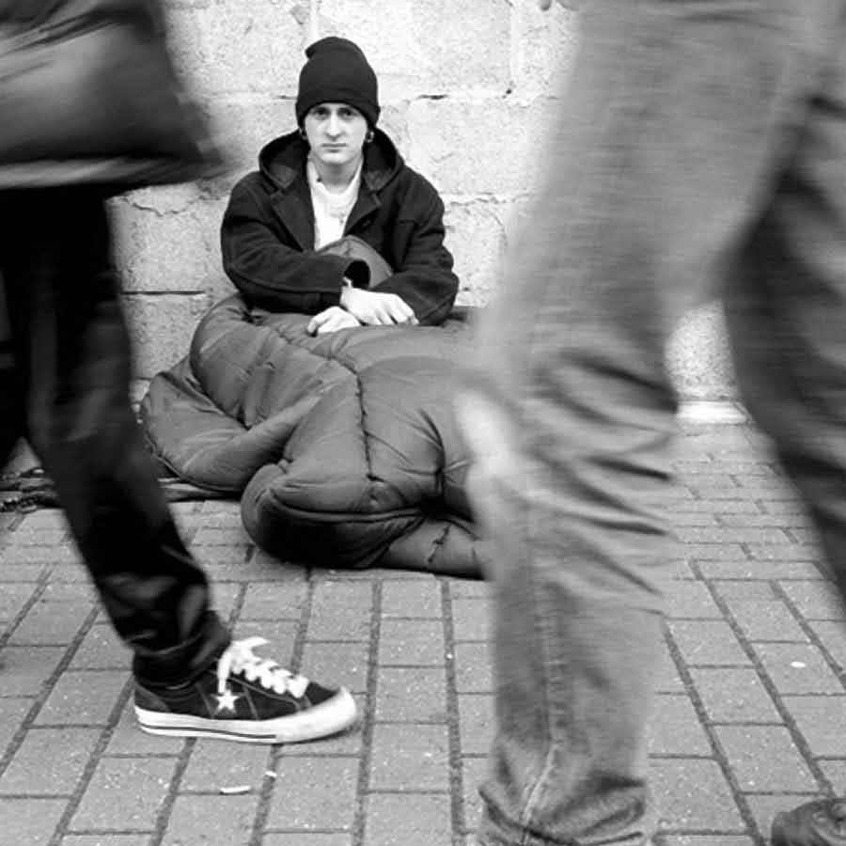

Christian attitudes to wealth and poverty
Many Christians do not have a problem with being wealthy, but they do believe that wealth should be used appropriately. They also believe it is a Christian duty to help people less fortunate the themselves.

Slide 7
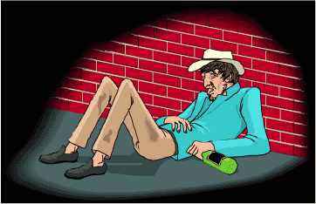
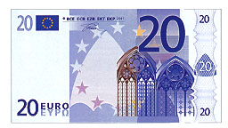
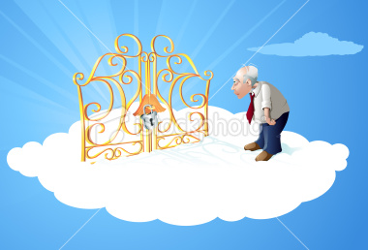
Christian attitudes to wealth and poverty
Some Christians see wealth as a temptation that leads some people to behave in a less Christian manner.
They believe wealth needs to be handled with care.
If wealth is used in an appropriate manner then heaven is still achievable.

Slide 8

Using the following Bible quotes create a mind map explaining what each of the Scriptures is suggesting, and how Christians might interpret these scriptures.

Slide 9




What does the Bible say about
wealth and poverty?
Deuteronomy 15:11. There will always be poor people in the land, therefore I command you to be open handed to your brothers and the poor and needy in the land.
Matthew 6:24. No one can serve two masters. Either he will hate one and love the other. Or he will devoted to one and despise the other. You can not serve both God and money.
Matthew 19:21. If you want to be perfect, go, sell your possessions and give to the poor. Then you will have treasure in heaven.
Proverbs 14:31 He who oppresses the poor shows contempt for their maker, but whoever is kind to the needy honours God
Proverbs 13:11. Dishonest money dwindles away but he who gathers money little by little makes it grow
Throughout the Bible there are teachings about wealth and poverty. People are continuously told to care for the poor

Slide 10

How have some Christians used their wealth?
In Edinburgh in the 1800’s the Nelson’s (a Christian family), built libraries for the use of educating the working classes. They also contributed to building the Royal infirmary.

Slide 11

What do you think society would be like today if their were no philanthropist?
What motivation do you think Christian Philanthropist are driven by?
Can you think of a modern day philanthropist, what have they done with their wealth?
Please write a paragraph for each answer.

Slide 12
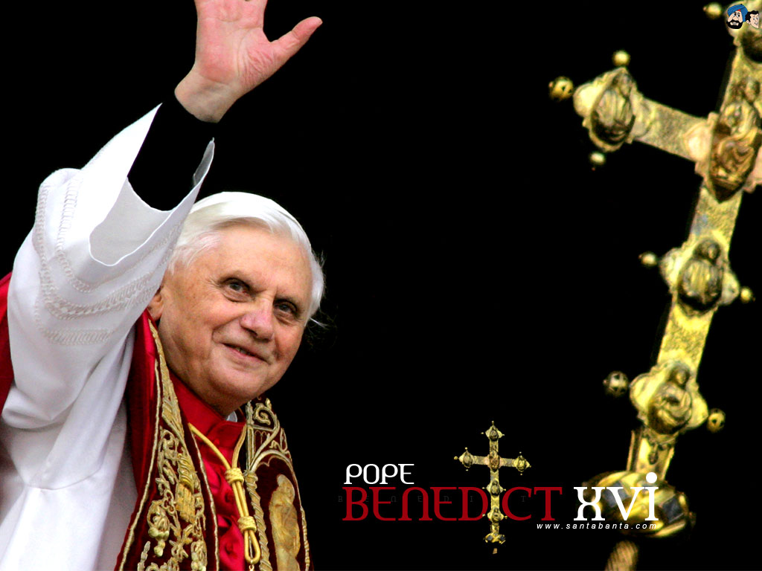
What does the church say about wealth today?
In 2006 the Pope argued that the least economically developed countries should be allowed to trade fairly with more economically developed countries so that they could generate their own wealth and reduce poverty for themselves. He argues that high earners should share their wealth rather than generate more for themselves.

Slide 13

Do you think Christian teachings on wealth and poverty are fair?
How do you feel about the fact that some people have so much money when others are dying through lack of food and clean water?
Please write half a page for each response. Try to extend you answers expressing clearly your own views on the issues.

Slide 14

Research a modern day Philanthropist.
Investigate:
What have they done with their wealth?
How did they accumulate their wealth?
Do you think they have used it wisely.
Please write a least a page for all three responses.

