Slide 1
What would make you no longer want to live?

Slide 2
Euthanasia
Know what euthanasia is
Explain the difference between active and passive euthanasia

Slide 3
Euthanasia
Euthanasia is a word derived from the Greek language.
It means, ‘a good death’. If a person believes in euthanasia, it means that they are in favour of allowing people the right to commit suicide, or be killed by others, usually when a person has an incurable or excruciatingly painful medical condition.
There are two kinds of euthanasia:

Slide 4
Euthanasia
i) Passive Euthanasia
Allowing people who are being kept alive artificially to die. (ie. by switching off a life support machine). In affect they die from their illness or injury.

Slide 5
Euthanasia
ii) Active Euthanasia
Killing someone to end suffering, commiting suicide, or assisting someone to commit suicide. This might be a lethal injection, or overdose.

Slide 6
Euthanasia
In Britain, passive euthanasia is legal. This was established in the High Court when an action by a pressure group against turning of the life support machine of brain-dead Hillsborough victim Tony Bland was thrown out of court. Doctors can decide to switch off life support machines after consulting with relatives.
In Britain, active euthanasia remains illegal. To kill yourself is suicide, this is illegal regardless of motive. It is legal in Holland.

Slide 7
Euthanasia
a person’s body is their own, therefore they should have the right to do with it as they wish.
One of the main aims to life is happiness. If illness and disease mean that there is no happiness, then the point to life is missing and a person may be justified in taking their life.
in many cases euthanasia is a blessing to relatives allowing them to mourn the loss of their loved one, without having to see them suffer.
to assist someone to die is not an act of violence but an act of love.

Slide 8
Euthanasia
in some cases there may be a chance of recovery. A cure might be discovered.
the feelings of family and friends may be upset by a ‘selfish’ decision.
if we allow euthanasia because someone has no quality of life, doctors may allow relatives to kill old people on the grounds that they are unhappy
life is a gift, maybe even a gift from God. No matter how bad the pain is, we must hold on to life at all costs. No one has the right to ‘play God’.

Slide 9
Euthanasia
Turning off a life support machine
Putting a pillow over a mental patient's head (like in one flew over the cuckoos nest)
Stopping doctors from resuscitating a baby
Allowing a brain-dead person to starve to death
Giving a patient a lethal injection of morphine
Drowning an unwanted baby

Slide 10
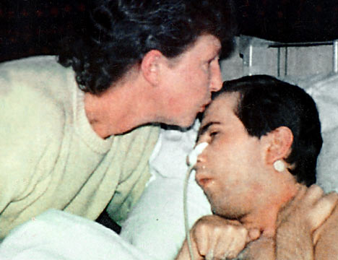
Tony Bland
1989 Hillsborough disaster
PVS
1993 High Court allowed passive Euthanasia
Denied food and water

Slide 11
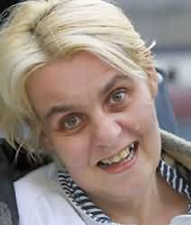
Diane Pretty
Motor Neurone Disease
Asked court for assisted suicide
Refused
Died 2002

Slide 12
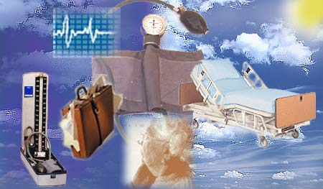
Why are Christians often opposed to euthanasia?
Most Christians are opposed to euthanasia.
Some Christians accept that passive euthanasia is acceptable under certain conditions. A few Christians will accept active euthanasia on the grounds of compassion and love.

Slide 13
Why are Christians often opposed to euthanasia?
1. Human life is a gift from God, only God can take it away. The timing of death should be left to God.

Slide 14
Why are Christians often opposed to euthanasia?
2. In the Bible (1 Corinthians 3:16) St Paul says that the body is the temple of the Holy Spirit. This means that the body is holy and should not be destroyed for any reason.

Slide 15
Why are Christians often opposed to euthanasia?
3. Christians believe in life after death. Because of this they do not accept that ending life prematurely is reasonable. Suffering may be serving some purpose.

Slide 16
Why are Christians often opposed to euthanasia?
4. Most Christians are convinced of the importance of the final stages of life for the dying person and family alike. The Hospice Movement seeks to provide a peaceful and comfortable environment for people to die in.

Slide 17
Why are Christians often opposed to euthanasia?
But, the overriding belief of Christians (following the example of Jesus) could be that an attitude of selfless love towards others is their prime duty.
Many Christians will feel compassion for the terminally ill, and support their efforts in trying to achieve a ‘happier death’.

Slide 18
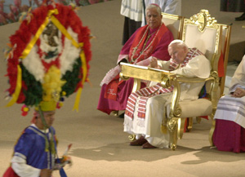
Roman Catholics are opposed to all forms of euthanasia. They believe very strongly in the sanctity of life.

Slide 19
c) “Killing someone is always wrong”
Do you agree?
Give reasons for your answer
And show that you have considered different points of view.
You must refer to Christianity in your answer.
I

Slide 20
a) What do Christians believe about abortion? (8 Marks)
One Side
One Side
Who
Who
Because
Because
And or
but..
And or
but..

Slide 21
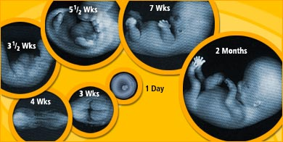
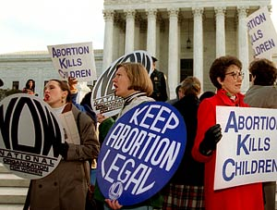
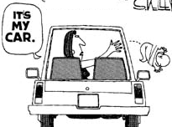
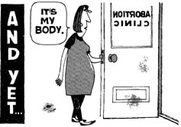
Abortion

Slide 22
Abortion
Church Teachings
In 1140 church law decided that “abortion is murder only when a foetus is formed.” The foetus was believed to be fully formed at 80 days, when the soul entered it.

Slide 23
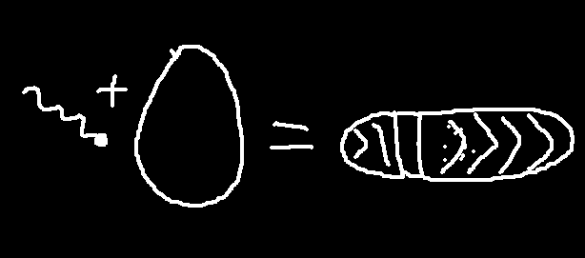
Abortion
In 1869 Pope Pius IX declared that the foetus became “ensouled” at conception and, therefore, all abortions were murder.
In 1917 the new Code of Canon Law declared that for Roman Catholics abortion was a sin at any stage in the pregnancy.

Slide 24
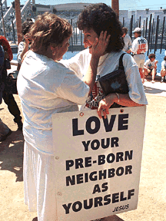
The Roman Catholic Church are against Abortion they believe that life begins when the sperm meets the egg.
In 1930 the Catholic Church decided that abortion was not a sin if it was carried out on a woman suffering from cancer of the womb or an ectopic pregnancy. This was because in both cases, both the foetus and the mother would die if the abortion was not carried out.

Slide 25
“The Anglican view on abortion is that although the foetus is to be specially respected and protected, nonetheless, the life of the foetus is not absolutely sacrosanct if it endangers the life of its mother.”(Church of England report, 1984)
“Circumstances which may justify an abortion are direct threats to the life or health of the mother, or the probable birth of a severely abnormal child.”(Methodist Statement, 1980)

Slide 26
No Christian denomination will bury stillborn or miscarried foetuses.

Slide 27
a) What do Christians believe about abortion? (8 Marks)
One Side
One Side
Who
Who
Because
Because
And or
but..
And or
but..

Slide 28

Fertility Treatment
Helps couples who haven’t been able to conceive naturally

Slide 29
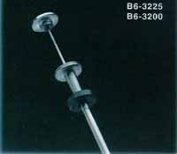
Artificial Insemination (AI)
Fertility Treatment

Slide 30
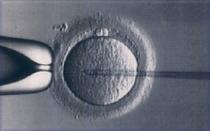
In vitro fertilisation (IVF)
Fertility Treatment

Slide 31
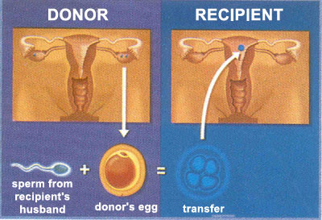
Egg donation
Fertility Treatment

Slide 32
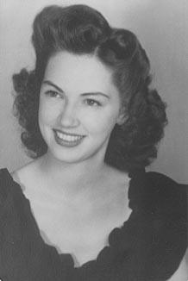
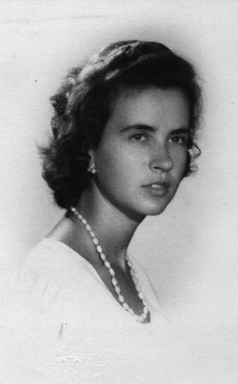
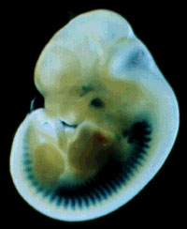
Embryo donation
Fertility Treatment

Slide 33


Surrogacy
Fertility Treatment

Slide 34
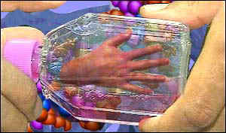
Scientific research on Embryos
Fertility Treatment???

Slide 35
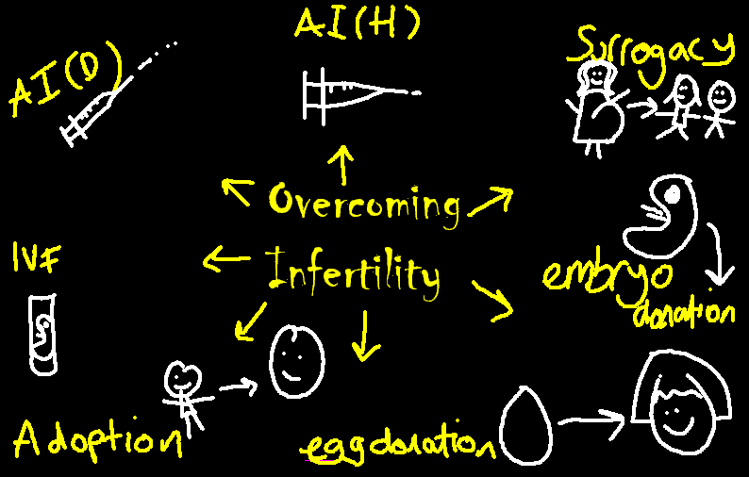

Slide 36
Not all Christians think the same thing about fertility treatment. Some think that it is a form of mechanical adultery and so it is morally wrong. Roman Catholics think this. They also think that if God didn’t want you to have a baby then you shouldn’t try to interfere with his wishes. Quite often there are ‘spare’ embryos formed when IVF is used some think it is wrong to destroy this life as it is a person from the moment of conception.
Other Christians say that as Jesus healed people it is not wrong to try to heal people of their infertility. They say that it is an act of love and Jesus said love your neighbour as yourself.

Slide 37
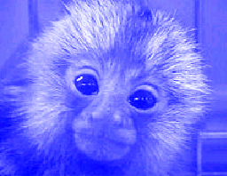
If animals had the same rights as humans.
They would be arrested for indecency and told to put some clothes on.
They would have the right to vote in general elections
They could claim unemployment benefit
If you killed an animal you would serve a life sentence in prison.

Slide 38
If animals had the same rights as humans 2
They would have the right to attend school and if they didn’t show up a truancy officer could come round and fine their mum and dad,
They would have the right to healthcare on the NHS
They would be liable to pay for the upbringing of children under the rules of the CSA.
They would have a autopsy after death and a proper burial.

Slide 39
Christian views
God said in Genesis, ‘I will make humans to have dominion over the fish in the sea, the birds of the air, the cattle, and all the wild animals on the Earth. Humans will spread over the earth and subdue it’.
Dominion means to rule over the earth.
Subdue means to make obedient.

Slide 40
Christian views
Jesus said, ‘Blessed are the meek.’
Meek means gentle.

Slide 41
Christian views
Some Christians say, ‘We are stewards of the earth and therefore we must be responsible.’

Slide 42
Christian views
Pope John-Paul 2 said, ‘Scientists must abandon laboratories and factories of death.’
From ancient times the Church of England has banned its vicars from hunting.
Some Christians say, ‘Animals are part of God’s creation and should be treated with respect.’

Slide 43
Christian views
St Thomas Aquinas said, ‘It doesn’t matter if we treat animals badly because, unlike humans, animals do not have souls.’
The Archbishop of Undine in Italy said, ‘It is no sin to beat a dog to death.’
Some Christians say, ‘It says nothing in the bible about animals so we can do what we like.’

Slide 44
Christian views
Simon Phipps, former Bishop of London said, ‘God is father and we are his children...Animals are part of God’s family. .’
Some Christians say, ‘Although animals are important they are not as important as people because they do not have sanctity of life.’
Sanctity means sacred and special to God.

Slide 45


You are an animal. You have no rights because you have no soul.
But I am a creation of God’s, if you do anything to me you are messing with God’s creation.

Slide 46
a) Describe Christian beliefs about the use of animals in medical research. (8 marks)

Slide 47
a) Describe Christian beliefs about the use of animals in medical research. (8 marks)
Candidate 1
Christians say that killing animals is wrong because God made them.

Slide 48
a) Describe Christian beliefs about the use of animals in medical research. (8 marks)
Candidate 2
Christians say that it is ok to experiment on animals because they haven’t got souls and don’t have rights

Slide 49
a) Describe Christian beliefs about the use of animals in medical research. (8 marks)
Candidate 3
Some Christians say that it is alright to experiment on animals for good reasons. They say this because they believe that human beings are more important as we are sacred. Other Christians might disagree they say that God has made us stewards of the earth so we must look after all the animals so we shouldn’t hurt animals unless we really have to. God made them and he won’t like it if we kill what he made.

Slide 50
a) Describe Christian beliefs about the use of animals in medical research. (8 marks)
Candidate 3.1
Some chrisans think god has made us stewardess of the wolrd so we shold look after all the creetures and should not hurt animals except if we really have to because God made em and he won’t like it if we distroy things he made.
some Chrisans mite think its riht two expement on animals if it is to help peeples, becsue humons our more specal cause we are sacred.

Slide 51
a) Describe Christian beliefs about the use of animals in medical research. (8 marks)
Candidate 4
Some Christians might say that God has granted man dominion over the animals and therefore we can use them as we like. They may argue that Humans are more important than animals because we have sanctity of life. Some Christians believe that because animals don‘t have souls they don‘t have rights. If we are more important then if we allow an animal to die to save a human life it is worth while. Other Christians might disagree. God made the animals they are a part of his creation and should be treated with respect. Jesus himself said that the meek were blessed, some Christians might say that this includes animals. Roman Catholics might agree with pope John Paul 2 who said, ‘Scientists must abandon laboratories and factories of death.’

Slide 52
a) Describe Christian beliefs about the use of animals in medical research. (8 marks)
Candidate 5
Jesus killed fish so killing animals is ok.

Slide 53
a) Describe Christian beliefs about the use of animals in medical research. (8 marks)
Candidate 6
Chrisians worship Ganesh who has a head like an elefant so they wont lick it if you kill an animal. They say God made us stewarts so we have to look after the animals.

Slide 54
a) Describe Christian beliefs about the use of animals in medical research. (8 marks)
Candidate 7
I think it is cruel to kill animals because they should have the same rights as humans.

Slide 55
a) Describe Christian beliefs about the use of animals in medical research. (8 marks)
Candidate 8
Some Christians think vivisection is wrong because God made us stewards of the earth, he said look after the earth and that means don’t abuse your power. Other Christians say that as stewards we could experiment on animals as long as it’s not cruel for no good reason.

