Slide 1

Introduction to Ethical Philosophy, Bioethics, Ethical Theories and Approaches

Slide 2
Outlines
Objectives
Introduction
The meaning of ethics and morality
Types of ethical inquiry and perspectives
Values and moral reasoning (historical review)
Bioethics
Ethical principles
Ethical dilemma
Nursing ethics relationship
Ethical theories and approaches
Conclusion
References

Slide 3
Objectives
Define the terms ethics and morals and philosophical uses of these terms
Discuss systems of moral reasoning as they have been used throughout history
Use a variety of ethical approaches and theories in personal and professional relationships
Define the term of bioethics and its relation to nursing ethics
Identify universal bioethics and approaches to nursing practice
Identify criteria that define an ethical dilemma
Analyze ethical issues in nursing relationships
Use selected models of reflection and decision making in ethical nursing practice

Slide 4
Introduction
Changes in interprofessional roles, advances in medical technology, availability of information online, revisions in patient care delivery systems, and heightened economic constraints, have increased the complexity of ethical issues in the health care setting.

Slide 5
Nurses in all areas of health care routinely encounter disturbing moral issues, yet the success with which these dilemmas are resolved varies significantly. As the complexity of issues intensifies, the role of the advanced practice nurse (APN) becomes particularly important in the identification, deliberation, and resolution of difficult moral problems. Although all nurses are moral agents, APNs are expected to be leaders in resolving moral problems, working to create ethical practice environments, and promoting social justice in the larger health care system.
“We need to develop our hearts as well as our minds” Hope 2004

Slide 6
The meaning of ethics and morality
Ethics
Ethics approach of philosophy, means different things to different people.
Ethics is a systemic approach to understanding, analyzing, and distinguishing matters of right and wrong, good and bad, and admirable and deplorable as they exist long a continuum and as the related to the well-being of and the relationship among sentient beings.
The study of ideal human behavior and ideal ways of being.
Ethics is an active process rather than a static condition.
Even if people believe that ethics is totally subjective, they must be able to justify their positions through logical, theoretical based arguments. E.g.: approaches, and codes of conduct that are developed for professions and religions.

Slide 7
Morals
Specific beliefs ,behaviors, and ways of being derived from doing ethics.
Immorality: person's behavior is in opposition to accepted societal, religious, cultural, or professional ethical standards and principles.
Such as dishonesty, fraud, murder and sexually abusive
Amoral: is a term that people use to refer to actions that are done with a lack of concern for morally good behavior.
Example murder is immoral,
but if a person commits murder with absolutely no sense of remorse or maybe a sense of pleasure it is amoral.
nonmoral : if moral standards essentially do not apply to acts.

Slide 8
Important features of ethics and morals (Billington, 2003)
No one can avoid making moral or ethical decisions because the social connection with others necessitates that people must consider moral and ethical actions
Other people are always involved with one’s moral and ethical decisions. Private morals does not exist.
Moral decisions matter because every decision affect someone else’s life, self-esteem or happiness level.
Definite conclusions or resolutions will never be reached in ethical debates.
People cannot exercise moral judgment without being given a choice
People use moral reasoning to make moral judgments, or to come discover right actions

Slide 9
Types of ethical inquiry
1- Normative ethics
attempt to decide or prescribe values, behaviors, and ways of being that are right or wrong, good or bad, and admirable or deplorable.
How humans should behave,
What ought to be done in certain,
What type of characters One should have ,
How one should be.
The result: Common morality: accepted moral standards and codes.

Slide 10
2-Meta-ethics
Concerned with understanding the language of morality through an analysis of the meaning of ethically related concepts and theories, such as the meaning of good, happiness, and virtuous character.
e.g. what is the meaning of being a good nurse?

Slide 11
3-Descriptive ethics
An approach used when researcher or ethicists want to describe what people think about morality or when they want to describe how people actually behave, that is ,their morals.
Example: research that identifies nurse’s attitude telling patients the truth about their terminal illness.

Slide 12
Ethical perspectives
1- ethical relativism
Is the belief that it is acceptable for ethics and morality to differ among persons or societies.
Types:
1.Ethical subjectivism: people believe that individuals create their own morality.
There are no objective moral truths (only individual opinions or feelings).
what is wrong for one person may not be wrong for another.
2.Cultural relativism: the ethical theory that cannot be separated from the experience , beliefs and behaviors of a particular culture.
what is wrong in one culture may not be so in another.
Example :the act of female circumcision.

Slide 13
2- ethical objectivism
Universal or objective moral principles exist.
Outcomes : ethical theories and approaches.
Examples: deontology, utilitarianism, and natural law theory.

Slide 14
Values and moral reasoning
Value: something of worth
Reasoning: involves thinking for oneself to determine if one’s conclusion are based on good, logical, foundations. Giving things a reason to exist
Moral reasoning: pertains to reasoning focused on moral or ethical issues.

Slide 15
Personal values
Individuals' interpretations and positions on issues are a reflection of their underlying personal value systems. (ethical subjectivism)
Who’s personal values should be concerned during nursing practice?

Slide 16
Professional values
Professional values contained in the code of ethics guide nurses in how they ought to be and behave. (ethical objectivism)
Values and moral reasoning in nursing fall under the domain of normative ethics.
ICN code of ethics and ANA code of ethics..

Slide 17
Moral reasoning strategies
Critical thinking: “thinking about one’s thinking” Fisher(2001)
“self-directed, self-discipline, self-monitored, and self-corrective thinking that requires rigorous standards of excellence and mindful command of their use” Paul and Elder(2006)
“the art of analyzing and evaluating thinking with a view to improve it” Paul and Elder(2006)

Slide 18
Moral reasoning strategies cont’d
Moral imagination: an artistic or aesthetics approach to ethics.
Persons, to be greatly good, must imagine intensely and comprehensively they must put themselves in the place of another and of many others….the great instrument of moral good is the imagination. Percy Byshee Shelley.
Moral imagination is moral decision making through reflection that involves “empathetic projection” and “creatively tapping a situations possibilities” (Fesmire, p.65)
The high hard ground and the swampy low ground.

Slide 19
Moral Reasoning Strategies cont’d
Reflection in nursing practice:
“on action” and “in action”
Gibb’s reflecting cycle

Slide 20
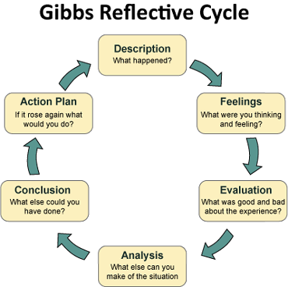

Slide 21
Historical review of moral reasoning
Different value, worldviews, and ways of moral reasoning have evolved throughout history and have different points of emphasis in varying historical periods
“what was old becomes new again”

Slide 22
Western history
Ancient Greece
Socrates: the Socratic method of reasoning
“the unexamined life is not worth living”
Plato (Socrates’ student):
Realms of reality: realm of forms (perfect) and realm of appearance (imperfect)
Tripartite soul:
Faculty of reason->thought and truth->head
Faculty of spirit->eternal life, love, beauty
->chest
Faculty of appetite->human desire and emotions
-- >guts
Allegory of the cave

Slide 23
Ancient Greece cont’d
Aristotle (Plato’s student): more practical approach to reasoning. He believes in the importance of empirical inquiry.
In nichomachean ethics, aristotle (trans,2002) discussed practical wisdom (phronesis) as being necessary for deliberation about what is good and advantageous if people want to move toward their human purpose or desire end goal of eudaimonia (happiness or well-being) aristotle believe that a person needs education to cultivate phronesis, which is intellectual excellence.

Slide 24
Middle Ages
(Dark Ages)
Christianity becomes the dominant religion (monotheistic) while Greece was (polytheism).
Catholic saints, Augustine and Aquinas:
Both men were influenced by the Ancient Greeks.
Augustine(354-430 C.E.) "Plato of the Middle Ages.”:
His belief in a heavenly place of unchanging moral Truth is similar to Plato’s belief in the realm of ideal Forms.
These truth are imprinted by God on the soul of each human being.
He believed in the existence of good .
So evil is present when good is missing.

Slide 25
Middle ages cont’d
Thomas Aquinas (1224-1274):
Christianized version of Aristotle’s ethical teaching.
Believed that people have a desirable end goal or purpose and that practicing excellences of character (virtues) leads to human happiness and good moral reasoning.
Virtue ethics and natural law theory!!

Slide 26
Modern philosophy and the age of enlightenment
The scientific revolution began.
Human moral reasoning based on people being autonomous (self-direction), Rational thinking creatures rather than being influenced and controlled by Church dogma and rules.
Reductionists: hope that after most or all knowledge was discovered the universe and human behavior could be predicted and controlled
A mechanistic approach: is one that focuses one fixing problems as if one is fixing a machine.

Slide 27
Postmodern era
Pence (2000) defined postmodernist as “ a modern movement in philosophy and the humanities that reject the optimistic view that science and reason will improve humanity; it rejects the notion of sustained progress through reason and the scientific method” (p.43)
The postmodern mind is one that is formed by a pluralistic view or a diversity of intellectual and cultural influences.

Slide 28
Care-based reasoning versus justice-based reasoning
Care approach is associated with a feminine way of thinking.
Cure approach is associated with a masculine Enlightenment-era way of thinking
.
Lawrence Kohlberg (1981) defined six stages of moral development ranging from childhood to adulthood. Also he didn’t include any women in his study.
Carol Gilligan ,raised the concern of gender bias.
In her book In a Different Voice (1982),she argued that women’s moral reasoning is different ,but it is not deficient.
Kohlberg's is a male-oriented ethics of justice.
Gilligan’s is a more feminine ethic of care.

Slide 29
Eastern ethics
Ethics in Asian societies has similarities to and important differences from western ethics.
similarities: intertwined with spiritual and religious thinking. Both examined human nature and what is needed for people to move toward well-being.
Differences: the western ethics is generally for people to achieve self-direction and to understand themselves personally.
The eastern ethics often is to understand universal interconnections, to be liberated from the self. Although, eastern ethics is not imposed from outside of a person but is instead imposed from within oneself.

Slide 30
Indian Ethics
Hinduism
The main emphasis in Hindu ethics is cosmic unity.
It originated with writings called the Vedas (c. 2000 to 1000 B.C.E.) that include magical, religious, and philosophical teachings.
People are believed to be stuck in Maya,(an illusory, everyday, impermanent experience).
The quality of one's past actions, karma, influences one's present existence and future incarnations or rebirths.
Therefore, people need to improve the goodness of their actions, which will subsequently improve their karma.

Slide 31
Indian Ethics
Buddhism
Siddhartha Gautama (6th century B.C.E.) was a Hindu prince.
The Buddha's core teachings, are called the Four Noble Truths:
The First is that unsatisfactoriness or suffering (dukkha) exists as a part of all forms of existence.
The Second and Third suggest that the cause of suffering is attachment (clinging or craving).
The Fourth contains the path for transforming suffering into enlightenment or liberation.
This path is called the Eightfold path, and it is composed of eight right
practices: Right View, Right Thinking, right Mindfulness, Right Speech, Right Action, Right Diligence, Right Concentration, and Right Livelihood.

Slide 32
Chinese Ethics
Taoism
Lao-tzu(c,571 B.C.E)who wrote the Taoist guide to life.
Taoist philosophy underscores the flux and balance of nature through yin(dark) and yang(light) elements.
living well or ethically is living authentically, simply, and unselfishly in harmony and oneness with nature.

Slide 33
Chinese Ethics
Confucianism
K’ung Fu-tzu(551 to 497 B.C.E).
Confucian ethics is described through the concepts of li and yi.
Li provides guidance to social orders and how humans should relate to one another.
Yi emphasizes the importance of ones motivations toward achieving rightness rather than emphasizing consequences.
Confucianism is communitarian ethical systems in which social goals, the good of society, and the importance of human relationships are valued.

Slide 34
Bioethics definition
A specific domain of ethics that focused on moral issues in the field of health care.
With the medical advances also came increased responsibilities and distress among health care professionals. Patients who would died in the past begin to have a lingering, suffering existence.
“who lives? who dies? And who decides”

Slide 35
Bioethics principles
why do we need these principles?
World war II Nazi medical experiments and Tuskegee research in US
The principles: (four basic principles)
Autonomy (respect for autonomy)
Veracity
Beneficence
Nonmaleficence
Confidentiality
Role Fidelity
Formal justice

Slide 36
Autonomy
Self-determination
Elements:
The ability to decide.
The power to act on your decisions
A respect for the individual autonomy of others.
Applications to this principle:
1- informed consent
2- patient self-determination act (1990)
Other applications? Maintaining privacy, confidentiality, refusal of treatment and other patient’s rights.
When restrictions can be applied to individual’s autonomy??

Slide 37
Veracity
The duty to tell the truth and not to deceive others (how does it relate to autonomy?)
When faced with situations in which lying seems a rational solution, other alternatives must be sought.
The harm to patient autonomy and the potential loss of practitioner credibility makes lying to patients a practice that in almost all cases should be avoided.

Slide 38
Beneficence and Nonmaleficence
Health care professionals try to do good (beneficence), but if for some reason they cannot do good, they at least do no harm.
Beneficence: The duty to do good and prevent or remove harm.
Nonmaleficence: do no harm (medical futility), (slippery slope argument) & (double effect).
Concepts related to Nonmaleficence: negligence and extraordinary or ordinary treatments.
Principles of Nonmaleficence:
• Do not kill.
• Do not cause needless pain.
• Do not incapacitate others (Beauchamp and Childress, 194).
⇒ The important point to notice is that each of these principles can be
met by doing nothing.

Slide 39
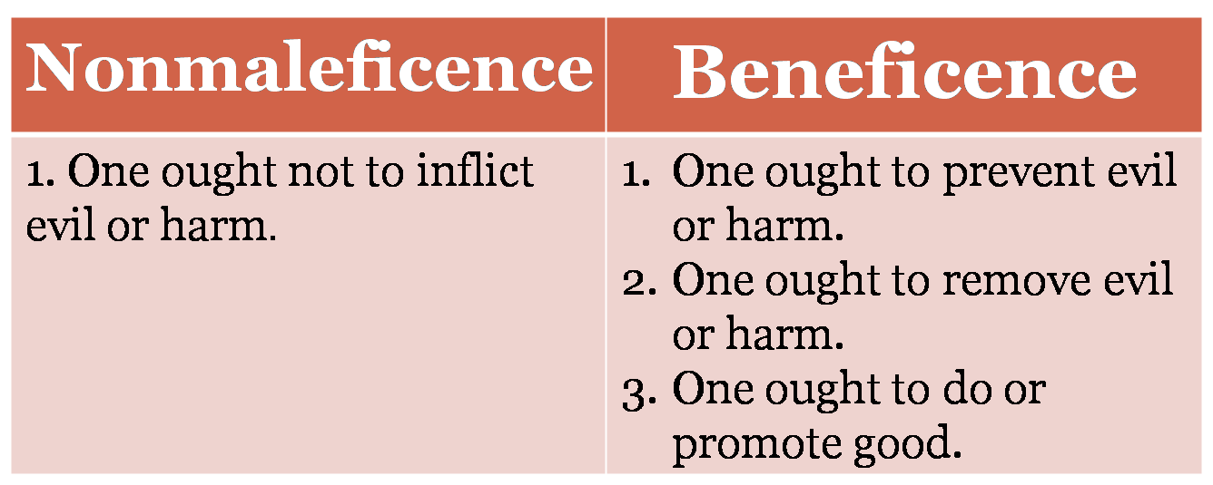

Slide 40
Paternalism
(an ethical conflict)
Medical paternalism is acting without consent or overriding a person’s
wishes, wants, or actions, in order to benefit the patient or prevent
harm to him or her.
• Weak paternalism: acting for the benefit of an incompetent patient, is
justified in some cases in order to restore that person’s competence,
or in order to protect a confused patient from harm.

Slide 41
Strong paternalism
• Strong paternalism:
the overriding of a competent patent’s explicit
wishes, is generally rejected since it violates autonomy; falsely
presumes independent knowledge of what is best for the patient; and
falsely presuppose that there is a clear, objective set of values
governing such decisions. (See AMA Code, 8.08.) As a result,
patients have the right to refuse treatment.
The right to refuse treatment might be limited, however, in court by appeal to
parental obligations or in extreme cases suicide laws (Hall-Ellman, 268
ff.), or in case the autonomy interest at stake is weak in comparison to
the benefit to the patient: raising bed rails against a competent
patient’s wishes (Beauchamp and Childress, 282-83). This sort of
exception would not work for a Jehovah’s Witnesses refusing blood
transfusion, since his or her autonomy interest would be strong.

Slide 42
Justification for paternalism
The lie benefits the person lied to: that is, the lie prevents more evil than it causes for that particular person.
It must be possible to describe the greater good that occurs.
The individual should want to be lied to. If the evil avoided by the lie is greater than the evil caused by it, a person would be irrational not to want to be lied to.
Assuming equal circumstances, we would always be willing to allow the violation of veracity.

Slide 43
Confidentiality
A patient’s basic right to expect the information he gives a health care practitioner to be held undisclosed.
An important aspect of the trust that patient’s place in health care professionals.
When can health care professional override confidentiality?? (Harm Principle)
Child abuse
Contagious disease
STD’s
Wounds caused by guns and knives
Cases in which identifiable third parties would be placed at risk by failure to disclose information.

Slide 44
Role fidelity
The duty to honor commitments
Self-regulation is one of the key elements of profession. Professional code of ethics are important documents in the process of self-regulation.
Under no circumstances may the practitioner place his financial interests above the welfare of his patients.
Gate keeping within role duty and fidelity requires the individual practitioners be responsible not only for their standard of practice but works to protect the community, patients and our specialties from abuse of other practitioners.

Slide 45
Formal Justice
Justice: refers to fairness, treating people equally and without prejudice, and equitable distribution of benefits and burdens.
Social justice: “veil of ignorance” Rawls(1971).
This concept means that if people had a veil to shield them from their own or others’ economics, social, and class standing, each person would be likely to make justice-based decisions from a position that is free from biases.

Slide 46
How are priorities to be determined?
• Medical need must be determined. Which includes: likely benefit to the patient, urgency of need, change in quality of life, duration of benefit.
• Costs of basic goods must be considered when dealing with scarce
resources.
• No society can provide everything that everyone needs, let alone what
everyone wants.
• Economic considerations must be acknowledged to prevent destroying
the economy.

Slide 47
Ethical dilemmas
An ethical or moral dilemma occurs when obligations require or appear to require that a person adopt two or more alternative actions but the person cannot carry out all the required alternatives.
“the ethics of right versus right” Kidder(1995)
Examples???
Moral uncertainty: experiences unease and questions the right course of action.
Moral distress: know the ethically appropriate action but feel constrained from carrying out that action because of institutional obstacles such as lack of time or supervisory support, physician power, institutional policies, or legal constraints

Slide 48
Moral Suffering in Nursing
Moral suffering can be experienced when nurses find themselves in imperfect situations that are morally unsatisfactory or when forces beyond their control prevent them from positively influencing or changing unsatisfactory moral situations. Suffering occurs because nurses believe that situations must be changed or fixed in order to bring well-being to themselves and others or to alleviate the suffering of themselves and others.

Slide 49
Themes of ethical dilemmas
Communication Problems: ethical deliberations helps frame the concerns, and can help parties see the components of the ethical problem rather than be mired in their own emotional responses.)
Multidisciplinary involvement : Health care professionals bring varied viewpoints and perspectives into discussions of ethical issues (Shannon, 1997). These differing positions can lead to creative and collaborative decision making or to a breakdown in communication and lack of problem solving. Thus a multidisciplinary theme is prevalent in both the presentation and resolution of ethical problems
Multiple commitments: ethical dilemma created by multiple commitments and the need to balance obligations to all parties.

Slide 50
Nursing Ethics
Relationships
Nurse-Patient-Family relationships:
Unavoidable trust: (before and after the health care is rendered?)
Human dignity: a person being in a position to use their capabilities.
Three virtues of acknowledge dependence: just generosity, misericordia (giving based on urgent need without prejudice), and truthfulness. McIntyre.
Patient advocacy: identify the unmet needs of the patient and then follow up to address the needs appropriately . (Jameton, 1984)

Slide 51
Nursing ethics relationships cont’d
Nurse-Physician relationship:
Negative relationships:
Superior/subordinate
Avoidance of conflict
Positive relationship:
Communitarian approach
Nurse-Nurse relationship: (moral friends)
Negative relationships:
Covering up
Tall poppy syndrome
Positive relationship:
Sympathetic joy

Slide 52
Ethical Issues Affecting APNs
Primary care issues: situations in which personal values contradict professional responsibilities often confront nurse practitioners (NPs) in a primary care setting. Issues such as abortion, teen pregnancy, patient nonadherence to treatment, childhood immunizations, regulations and law, and financial constraints.
Acute and chronic care: struggle with moral dilemmas involving pain management, end-of-life decision making, advance directives, assisted suicide, and dealing with medical errors.

Slide 53
Ethical Issues Affecting APNs cont’d
Societal issues: The arrival of managed care organizations (MCOs) and ongoing cost-containment pressures in the health care sector have significantly changed the traditional practice of delivering health care. Managed care goals of reduced expenditures and services and increased efficiency may compete with enhanced quality of life for patients and improved treatment and care, creating conflict and tension among nurses, physicians, and employers with diverse goals
Access to Resources and Issues of Justice: Issues of access to and distribution of resources create powerful dilemmas for APNs, many of whom care for underserved populations. Issues of social justice and equitable access to resources present formidable challenges in clinical practice.

Slide 54
Ethical Issues Affecting APNs cont’d
Legal issues: inability to reach agreement among parties have resulted in participants turning to the legal system for resolution. A body of legal precedents has emerged, reflecting changes in society's moral consensus. Ideally, moral rights are upheld or protected by the law. For example, the Patient Self-Determination act.

Slide 55
Ethical theories and approaches western ethics
Virtue Ethics
It emphasized that the excellence of one’s character and considerations of what sort of person one wants to be.
Since the time of ancient Greek virtues have referred to excellences in regard to persons or objects being the best that they can be in accordance with their purpose. Even an inanimate.

Slide 56
Virtue ethics
Virtues for humans :are habitual, excellent traits that are intentionally developed throughout one's life.
Aristotle's approach to virtue ethics is grounded in two categories of excellence:
Intellectual virtues (comes into existence and increases as a result of teaching) and character or moral virtues (results from habituation).
These virtues cannot be distinctly separated.
Most virtues consistent with the extremes of excess and deficiency.
There is a “Golden Mean”
Courage as a virtue, the extremes of rashness and cowardice.
The virtue of truthfulness is the mean between boastfulness and self-deprecation.

Slide 57
Virtue Ethics
Plato designated the four virtues :prudence (wisdom); fortitude (courage), temperance (moderation), and justice as cardinal virtues.
All other virtues hinge on these primary four.
1.Prudence corresponds to Plato's idea of the Faculty of Reason.
2.Fortitude corresponds to the Faculty of Spirit.
3.Temperance corresponds to the Faculty of Appetite.
4.The virtue of justice is an umbrella virtue that encompasses the other three.

Slide 58
Virtue ethics
Hume :believed that virtues flow from a natural human tendency to be sympathetic toward other people.
Virtues are human character traits that are admired by most people and are judged to be generally pleasing.
Virtues are traits of character that useful to other people, to oneself, or to both.
His approach to ethics is associated with utilitarianism.

Slide 59
Virtue ethics
Nietzsche proposed that the best character for people based on a “will to power.“
Strength was praised as virtuous whereas "feminine" virtues, such as caring and kindness, were considered by Nietzsche to be signs of weakness.
Virtue is consistent with hierarchical power over other people. (Adolph Hitler adopted this philosophy).
Nietzsche’s approach to virtue ethics has little place in nursing ethics.

Slide 60
Virtue Ethics
Florence Nightingale: because Nightingale's view of nursing included a virtue of obedience.(Sellman, 1997).
In connecting obedience to practical wisdom, some nurses now understand that Nightingale’s conception was one that approached something akin to intelligent obedience rather than a blind allegiance of nurses to physicians.

Slide 61
Moral Ground Model
(a virtue-based nursing model )
Has it’s foundation in Aristotle’s approach to virtue ethics with a proposed path to moral ground adapted from Eightfold path and immeasurable virtues of Buddhism (alleviation of human suffering).

Slide 62
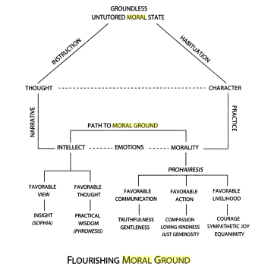

Slide 63
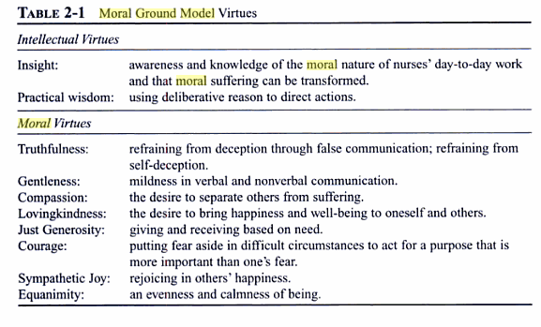

Slide 64
Natural low theory
People believe that the rightness of actions is self-evident because morality is determined by inherent human nature, not by customs and preferences.
The law of reason is implanted in the order of nature (usually thought to be implanted by God), and this law provides the rules or commands for human actions.
Natural law theory is associated with rule-based Judeo-Christian ethics.
Natural law theory is the basis of religious prohibitions against acts that some people consider unnatural, such as homosexuality and the use of birth control.

Slide 65
Deontology
Focused on duties and rules.
The most influential philosopher was the German Immanuel Kant.
Kant defined a person as a rational, autonomous (self-directed) being with the ability to know universal, objective moral laws and the freedom to decide to act morally.
Kantian deontology prescribes that each rational being is ethically bound to act only from a sense of duty.
Each autonomous, self-directed person has dignity and is due respect. (ends in themselves)
One should never act in ways that involve using other people as a means to one's personal ends(Kant believed that people could be harmed).
Example :failure to obtain informed consent from a research participant even though the researcher believes that the research will be beneficial to the participant .

Slide 66
Deontology cont’d
Kant drew a distinction between two types of duties or obligations:
The hypothetical imperative:
optional duties or rules that people ought to observe or follow if certain ends to be achieved.
"if-then“ imperatives(involve conditional or optional actions).
For instance, “if I want to eat tonight, then I should go to the grocery store today”.
the categorical imperative: (where moral actions are concerned)
Duties and laws are absolute and unconditional.
People ought to follow a universal, unconditional framework of maxims, or rules, as a guide to know the rightness of actions and one’s moral duties. Ask the question: "If I perform this action, could I will that it should become a universal law for everyone to act in the same way?“.
Example: suicide is never acceptable.
A person, when committing suicide, cannot rationally wish that all people should feel free to commit suicide or the world would become chaotic.

Slide 67
Question for nurses
Is it more important for a nurse to have a virtuous character or to be dutiful? Why?

Slide 68
Counseqiuentialism
consider consequences to be an importance indication of the moral value of one's actions.
Utilitarianism is the most well-known consequentiality theory of ethics.
Utilitarianism means that actions are judged by their utility, they are evaluated according to the usefulness of their consequences.
Utilitarian’s believe that it is useful to society to achieve "the greatest good for the greatest number" of people who may be affected by a rule at action.
People who use a utilitarian approach to ethics place great emphasis on what is best for collective groups, not individual people, though. each individual's happiness is worthy of equal consideration as compared to every other individual in a group.

Slide 69
Counseqiuentialism
The British philosopher Jeremy Bentham (1748-1832) was an early promoter of the principle of utilitarianism. He went as far as to develop a systematic decision making method of using mathematical calculations. (measures of intensity and duration to allocate pleasure and pain).
Another Englishman, John Stuart Mill (1806-1873), challenged Bentham's views .
Happiness and pleasure are measured by quality and not quantity (duration or Intensity).
Mill's philosophy is focused on ethics and morally right acts that produce the most good in terms of the most happiness.
Example of an application of Mill's utilitarianism: The use of mandatory vaccination laws.

Slide 70
Casuistry
Casuistry is based in Judeo – Christian history.
When people use casuistry, they make decisions inductively based on individual cases.
When people use casuistry, their ethical decision making begins as a bottom-up approach by considering the details of specific cases rather than beginning from the top down by applying absolute rules and principles.
In Catholic history, the practice of persons individually confessing their sins to priests to receive absolution reflects the use of casuistry.
Today, casuistry is often the method used by health care ethics committees to analyze the ethical issues surrounding specific patient cases.

Slide 71
Example
While a principle-based approach might claim that lying is always morally wrong, the casuist would argue that, depending upon the details of the case, lying might or might not be illegal or unethical. The casuist might conclude that a person is wrong to lie in legal testimony under oath, but might argue that lying actually is the best moral choice if the lie saves a life
Abortions?

Slide 72
The Four Topic approach
case-based, casuistry approach used by nurses and other health care professionals.
Cases are analyzed according to four topics (medical indications, patient preferences, quality of life, and contextual features).
All the four fundamental principles are considered in this approach (autonomy, beneficence, Nonmaleficence, and justice).

Slide 73
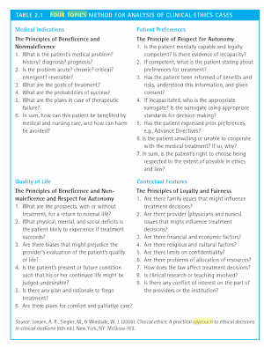

Slide 74
Narrative Ethics
Most people from childhood obtain moral education about character development from stories, such as fairy tales.
Similarities to virtue ethics and casuistry?
How can culture affect the narrative ethics?
“narrative approach to bioethics focuses on the patients themselves: these are the moral agents who enact choices” (Charon & Montello, 2002 p. xi).
No one story should be accepted without critical reflection.

Slide 75
Critical theory
Referred to as critical social theory, is a broad term that identifies theories and worldviews that address the domination perpetrated by specific powerful groups of people and the resulting oppression of other specific groups of people.
Bohman (German philosopher) stated that critical theories can be distinguished from traditional theories because the purpose of critical theories is to ”To liberate human beings from the circumstances that enslave them”

Slide 76
Critical theory cont’d
According to Brookfield , there are three core assumption in critical theory that explain how the world is organized:
1.That apparently open, Western democracies are unequal societies in which economic inequity, racism, and class discrimination are empirical realities.
2. That the way this state of affairs is reproduced and seems to be normal, natural, and inevitable is through the dissemination of dominant ideology.
3. That critical theory attempts to understand this state of affairs as a necessary prelude to changing it.

Slide 77
Feminist Ethics
One critical theory that is widely used by nurses.
Under this broad feminist approach is the ethic of care that originated from the Kohlberg-Gilligan.
Focused on evaluating ethically related situations in terms of how these situations affect women.
An ethic of care is grounded in the moral experiences of women and feminist ethics.
Ethic of care emphasizes the importance of traditionally feminine traits such as love, compassion, sympathy, and concern about the well – being of other people.
The role of emotions in moral reasoning and behavior is accepted as being a necessary and natural compliment to rational thinking.
This position distinguishes an ethic of care from an ethic of justice and duty- based ethics that emphasize the preeminence of reason and minimize the importance of emotion in guiding moral reasoning and the moral nature of one's relationships.

Slide 78
Principle-based theory
In cases of conflict, the principles or rules in contention are balanced and interpreted with the contextual elements of the situation. However, the final decision and moral justification for actions are based on an appeal to principles. In this way, the principles are both binding and tolerant of the particularities of specific cases (Beauchamp & Childress, 2001; Childress, 1994).
The principles of respect for persons, autonomy, beneficence, Nonmaleficence, and justice are commonly applied in the analysis of ethical issues in nursing.
The American Nurses Association's Code of Ethics for Nurses (ANA, 2001) endorses the principle of respect for persons and underscores the profession's commitment to serving individuals, families, and groups or communities.
Appeal to bioethical principles remains the most common ethical “language” used in clinical practice settings.

Slide 79
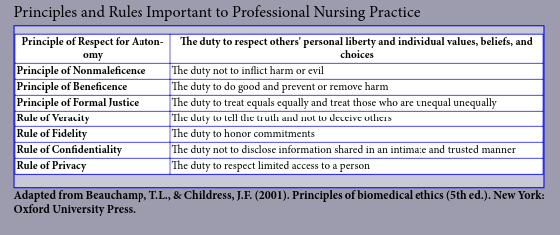

Slide 80
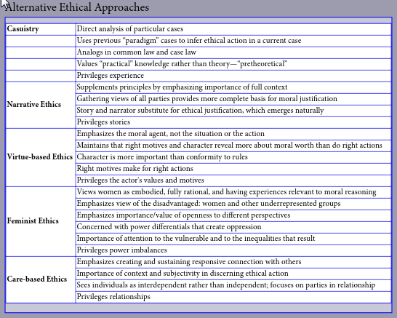

Slide 81
The nurses as a part of a health care team
Though nurses frequently make ethical decisions independently, they also act as an integral part of the larger team of decision makers. This team is called ethics committee.
An organization’s ethics committee usually consists of physicians, nurses, an on-staff Chaplin, a social worker, a representative of the organization’s administrative staff. Also, the involved patient, the patient’s family, or a surrogate decision maker may meet with one or more committee members.

Slide 82
Conclusions
In the world today, discussions about ethical issues in health care are complex. If nurses are able to intelligently participate in a dialogue about health care ethics across populations and disciplines, nurses need to have a broad philosophical basis and rationale for their ethic-related positions and decisions. Therefore, nurses need to have an understanding of historical perspectives of moral reasoning and ethical theories and approaches, and bioethical principles.

Slide 83
References
Janie B. Butts and Karen L. Rich (2007). Nursing ethics across the curriculum and into practice. 2nd edition.
Hamric, A., Spross, J. Hanson, C. (2005). Advanced practice nursing: an integrated approach. 3rd edition.
American Nurses Association. (2001). Code of ethics for nurses with interpretive statements.

