Slide 1
Prehistory
The fight for survival
Roser de Antonio García

Slide 2
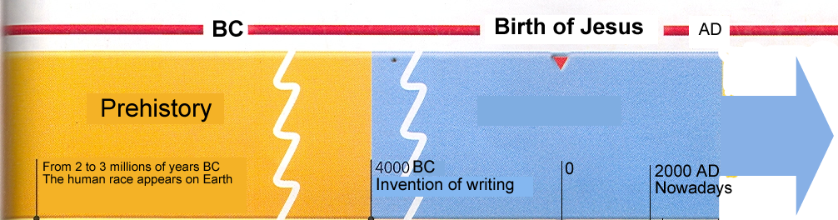

The earliest form of writing appeared around 4000 BC.
We name “Prehistory” the preceding period.
Prehistory is the long period before the invention of writing

Slide 3
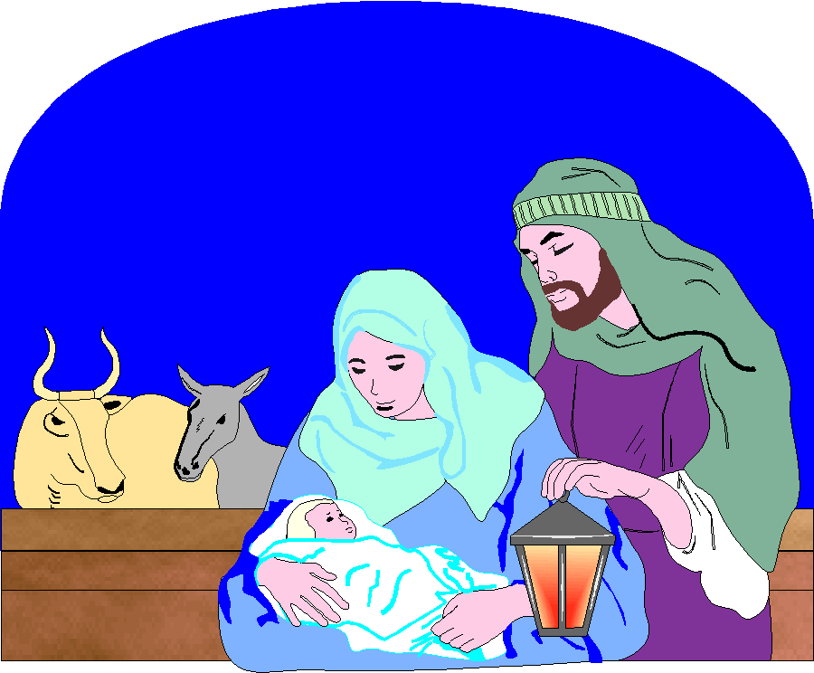
?
Jesus Christ was
born in the year 0
  BC = Before Christ
  THE YEARS BEFORE THE BIRTH OF JESUS CHRIST

Slide 4
?
Jesus Christ was
born in the year 0
  THE YEARS AFTER THE BIRTH OF JESUS CHRIST
  Why AD ?????

Slide 5
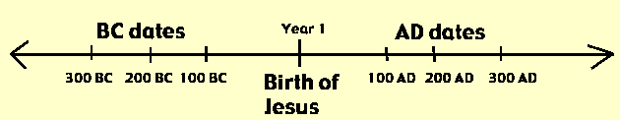
Why AD?
A.D. = Anno Domini (year of our Lord) The number of years since the birth of Jesus Christ.

Slide 6
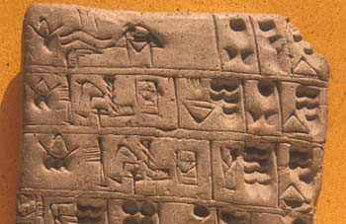

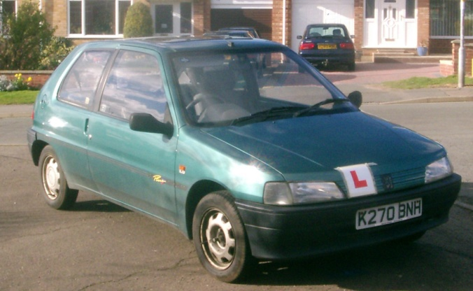
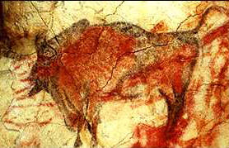


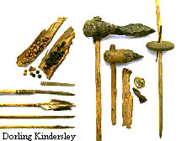
BC or AD?
I bought my car 10 years ago
BC
It was written 6007 years ago
BC
AD
AD
It was painted 1000 years ago
I was born 42 years ago
It was painted 14000 years ago
These tools were made 600 years ago
BC
AD
AD
They arrived to America 515 years ago

Slide 7
HOW MANY YEARS DID THE PREHISTORY LAST?
The Prehistory is a very long period

Slide 8
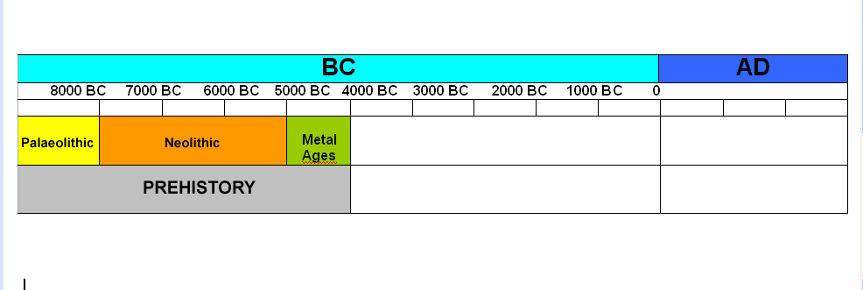
Prehistory along the timeline
It is divided in three periods:

Slide 9
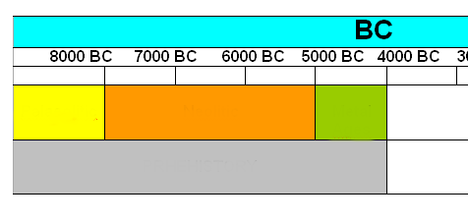
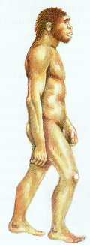
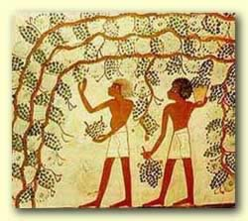
Prehistory along the timeline
THE PALAEOLITHIC
Palaeolithic
Humans started to farm the land 8.000 years ago and...
...Palaeolithic finished
The human race appeared on Earth 2.000.000 or 3.000.000 years ago and...
...Palaeolithic started

Slide 10
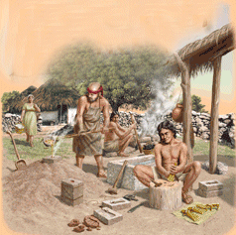
Prehistory along the timeline
THE NEOLITHIC
Palaeolithic
Neolithic
Humans learnt to make metal tools 5.000 years ago and...
Humans discovered
agriculture 8.000 years ago and...
...Neolithic finished
...Neolithic started

Slide 11
Prehistory along the timeline
THE METAL AGES
Palaeolithic
Neolithic
Metal Ages
Humans learnt to make metal tools 5.000 years ago and...
Metal Ages started.
Humans learnt to write 4.000 years ago and...
Metal Ages finished.

Slide 12
Prehistory along the timeline
Palaeolithic
Neolithic
Metal Ages
WHY DOES PREHISTORY FINISH WITH THE INVENTION OF WRITING?

Slide 13
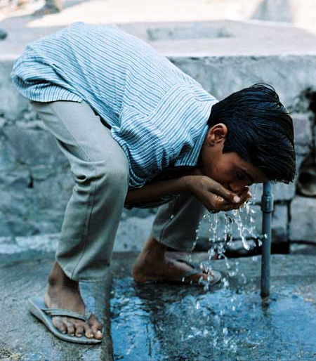

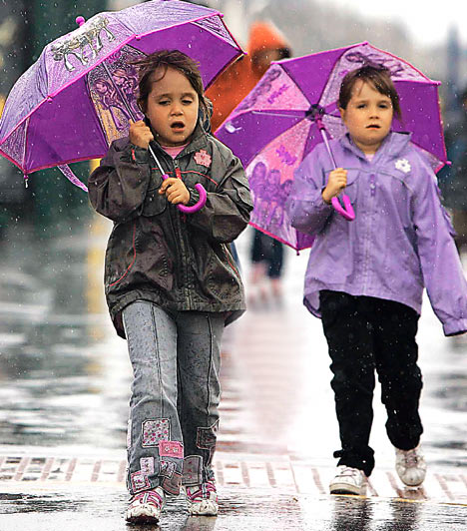
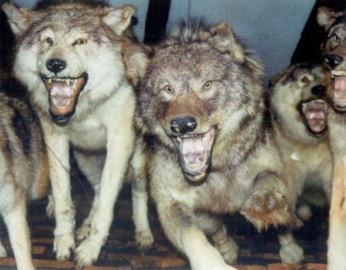
LIFE IN PREHISTORY
The fight for survival
Humans are living creatures.
What do we need to survive?
WATER
FOOD
PROTECTION

Slide 14
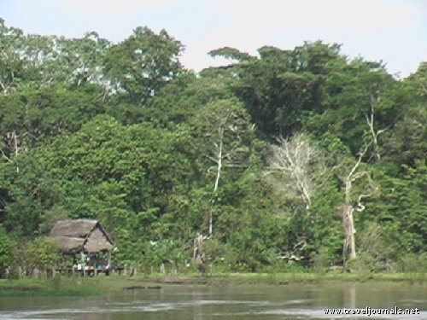
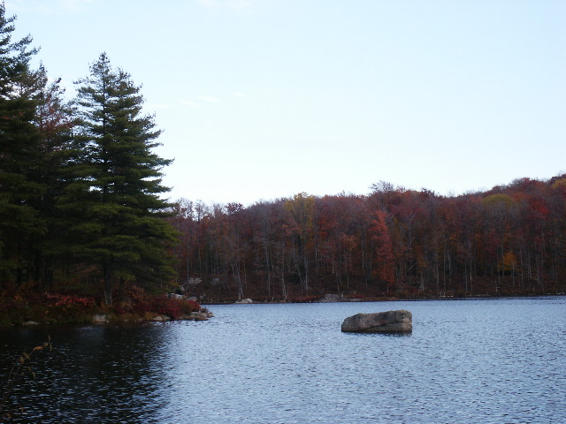
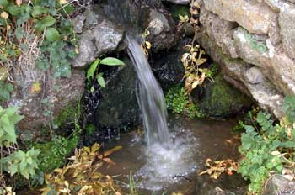
LIFE IN PREHISTORY
The fight for survival
Getting water
They lived next to...
springs
rivers
lakes

Slide 15
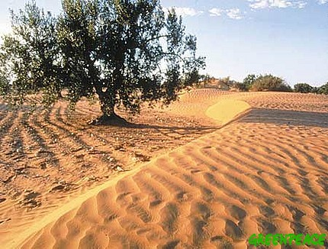
LIFE IN PREHISTORY
The fight for survival
Survival was no easy...
There were a lot of problems!
The storage of water
It’s difficult to find much water during the dry summers

Slide 16
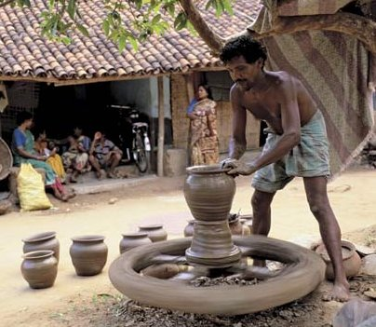
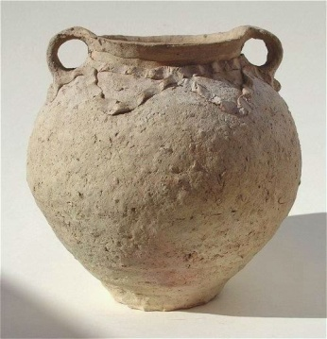
LIFE IN PREHISTORY
The fight for survival
Survival was no easy...
The storage of water?
Solution!
They learnt to make containers that can store water
POTTERY
People learnt how to make pottery…
In NEOLITHIC

Slide 17
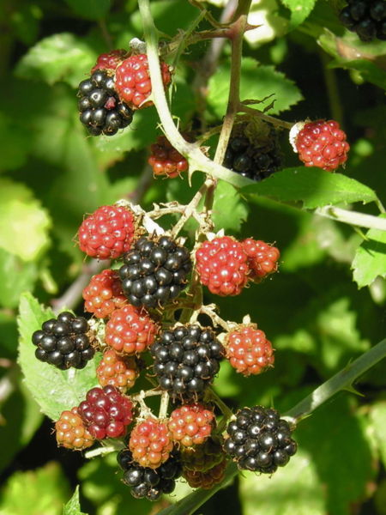
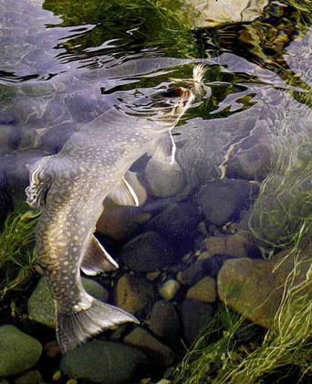
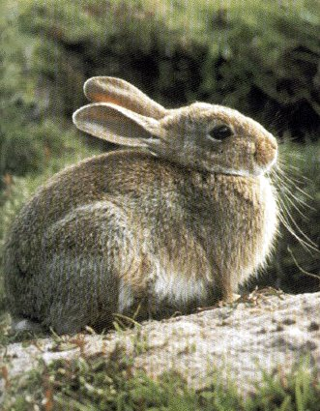
LIFE IN PREHISTORY
Getting food
They had...
fish
meat
wild fruits and vegetables

Slide 18
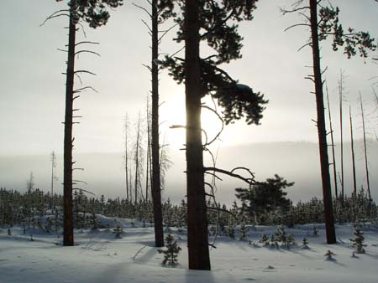
LIFE IN PREHISTORY
The fight for survival
Survival was no easy...
There were a lot of problems!
Is it easy to find always wild fruits and vegetables?
It’s difficult to find wild fruits and vegetables during the cold winters

Slide 19
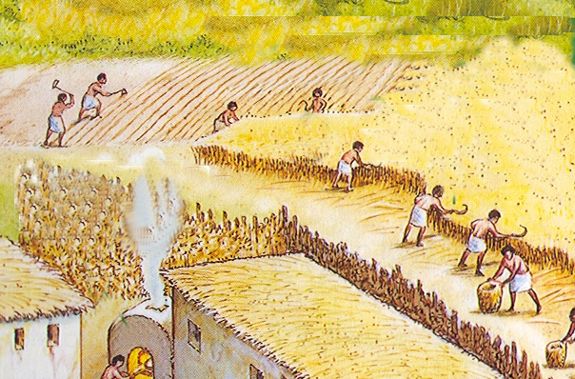
LIFE IN PREHISTORY
The fight for survival
Survival was no easy...
Difficulties to find wild fruits and vegetables during the cold winter?
Solution!
They learnt to farm the land
People learnt to farm the land…
in NEOLITHIC

Slide 20
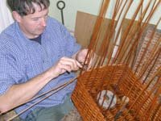
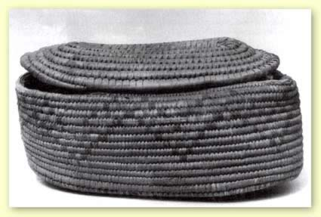
LIFE IN PREHISTORY
The fight for survival
Survival was no easy...
Difficulties to find wild fruits and vegetables during the cold winter?
Solution!
They learnt to make containers that can store food
BASKETS
POTTERY
People learnt to make baskets and pottery…
in NEOLITHIC

Slide 21
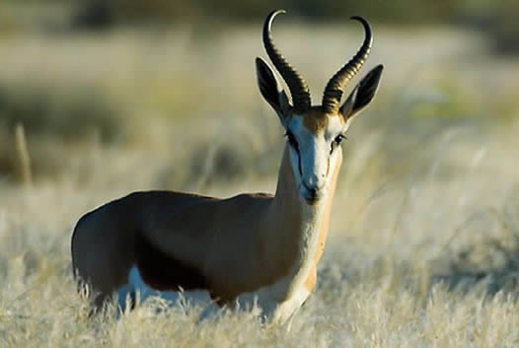
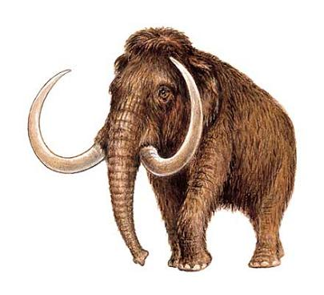
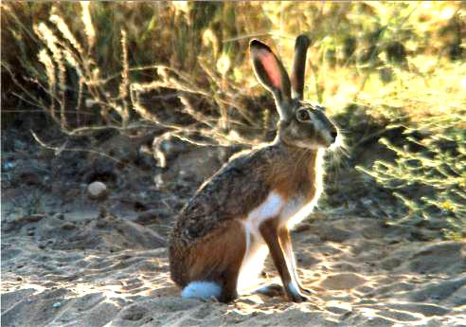
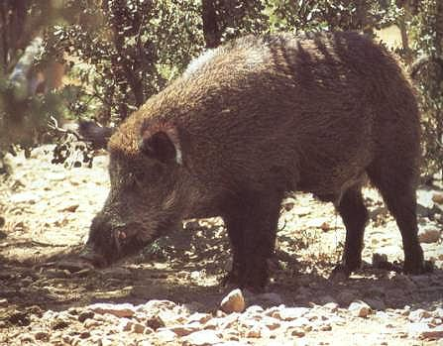
LIFE IN PREHISTORY
The fight for survival
Survival was no easy...
There were a lot of problems!
Hunting was easy?
No, it’s was difficult
Animals are stronger, bigger and faster than men

Slide 22
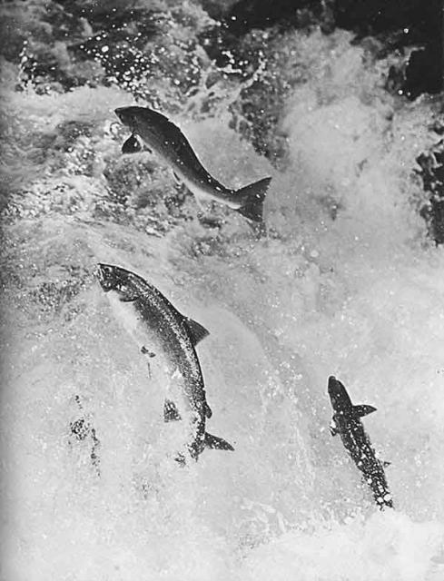
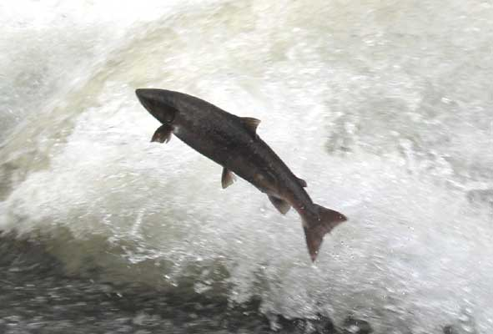
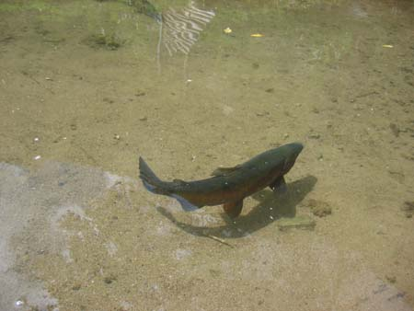
LIFE IN PREHISTORY
The fight for survival
Survival was no easy...
There were a lot of problems!
Fishing was easy?
No, it’s was difficult
Fishers are faster than men

Slide 23
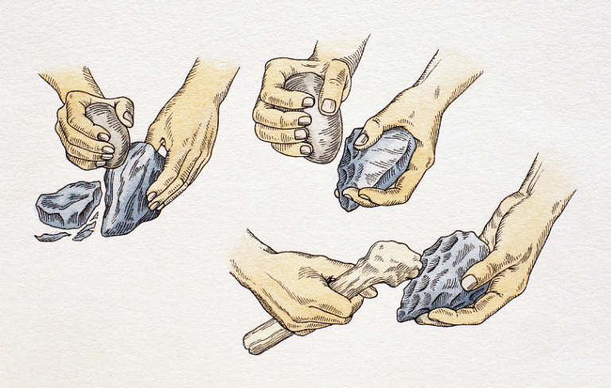
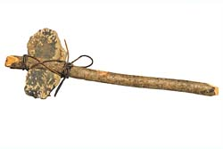
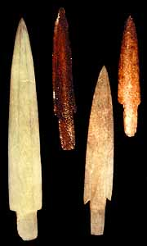
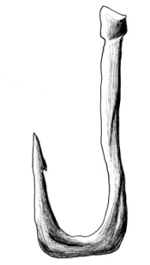
LIFE IN PREHISTORY
The fight for survival
Survival was no easy...
Was hunting difficult? Was fishing difficult?
Solution!
They learnt to shape stones into tools or weapons

Slide 24
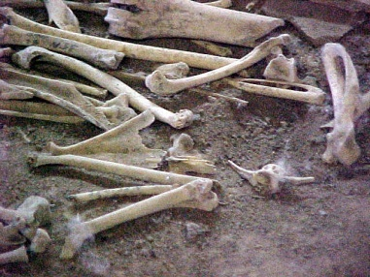
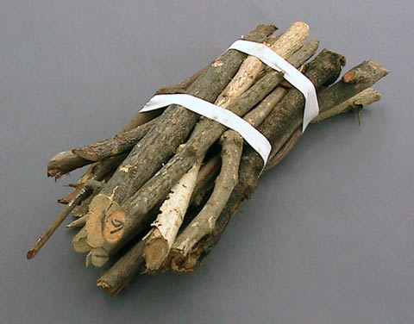
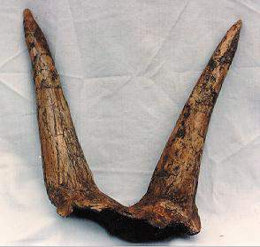
Shaping into tools or weapons
Shaping only stones?
bones
Shaping into tools or weapons
wood
Shaping into tools or weapons
horns

Slide 25
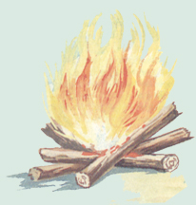
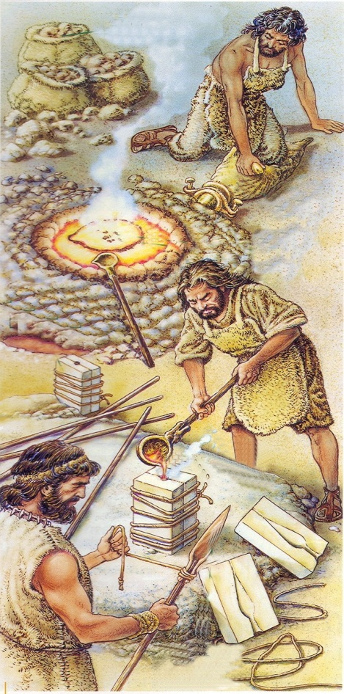
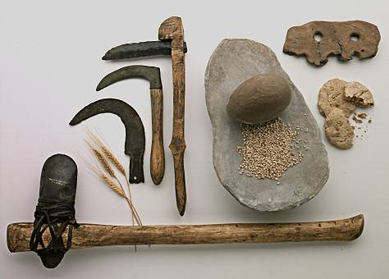
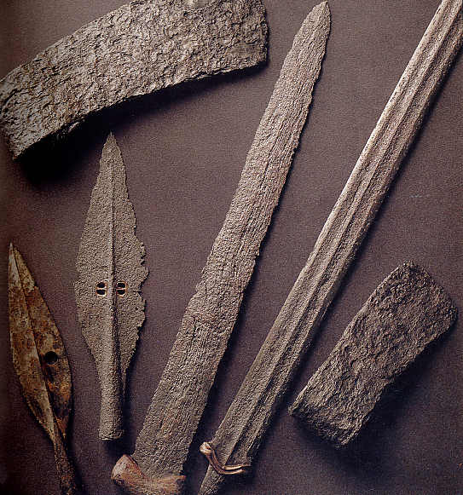
LIFE IN PREHISTORY
More about tools and weapons...
THE USES OF FIRE
THE METAL AGES: Humans learnt how to use fire to make metal tools and weapons.

Slide 26
LIFE IN PREHISTORY
Let’s make a prehistoric tool…
We need…
A stone
A stick
Something to join the stone and the stick

Slide 27
LIFE IN PREHISTORY
The fight for survival
Survival was no easy...
There were a lot of problems!
Could they hunt and fish always?
No, it’s difficult to find animals during the cold winter

Slide 28
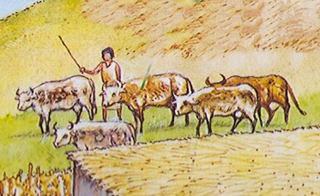
LIFE IN PREHISTORY
The fight for survival
Survival was no easy...
Difficulties to hunt and fish during the cold winter?
Solution!
They learnt to take care of animals
People learnt to take care of animals…
in NEOLITHIC

Slide 29
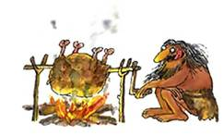

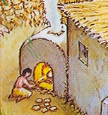
LIFE IN PREHISTORY
More about food...
THE USES OF FIRE
COOKING FOOD: Humans learnt how to use fire to cook, so their diet became healthy and tasty
He is roasting some meat
He is baking bread
The vegetables soup is boiling

Slide 30
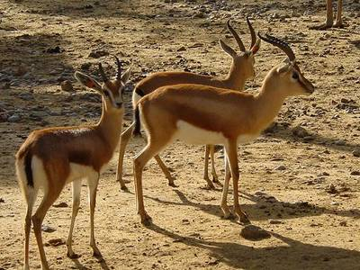

LIFE IN PREHISTORY
The fight for survival
Getting protection
During the Palaeolithic people moved from one place to another...
... looking for food
In Palaeolithic people were NOMADIC

Slide 31



LIFE IN PREHISTORY
The fight for survival
Survival was no easy...
There were a lot of problems!
When the weather is bad or during the nights, people need a shelter

Slide 32


LIFE IN PREHISTORY
The fight for survival
Survival was no easy...
Protection from bad weather, dangers...?
Solution!
They sheltered in caves
People sheltered in caves…
in PALAEOLITHIC

Slide 33


LIFE IN PREHISTORY
The fight for survival
Survival was no easy...
But a cave is not a nice place to live
Solution!
They built huts They lived in settlements
People lived in huts…
in NEOLITHIC

Slide 34
LIFE IN PREHISTORY
The fight for survival
Getting protection
In Neolithic people learnt to farm the land and take care of animals
... so they needed to live always in the same place
In Neolithic people became SEDENTARY

Slide 35

LIFE IN PREHISTORY
The fight for survival
Survival was no easy...
There were a lot of problems!
Sometimes they need to go out for food
It’s very cold outside in winter!

Slide 36





LIFE IN PREHISTORY
The fight for survival
Survival was no easy...
Cold outside?
Solution!
They learnt to make clothes with animal skins
3: She is tanning the skin
2 : … so they get a skin.
1: Men hunt an animal…
3: She is sewing the skin
5: Here you are, a beautiful coat!

Slide 37






LIFE IN PREHISTORY
The fight for survival
Survival was no easy...
Cold outside?
Solution!
In Neolithic people learnt to weave
2 : … so they get wool.
3: She is weaving it.
1 : They take care of animals.
4: They get some fabric
6: Here your are, a beautiful dress!
5: They cut and sew it

Slide 38


LIFE IN PREHISTORY
More about protection...
THE USES OF FIRE
Using fire, humans can...
WARM UP THEMSELVES
LIGHT UP THE CAVES, THE CABINS…
SCARE AWAY PREDATORS

Slide 39

LIFE IN PREHISTORY
The fight for survival
Did humans survive?
YES!
Moreover...

Slide 40






LIFE IN PREHISTORY
The fight for survival
They had got a lot of food
They could make a lot of things

Slide 41

LIFE IN PREHISTORY
So they invented the commerce to sell the surplus products

Slide 42


LIFE IN PREHISTORY
They also discovered…
the wheel
the navigation

Slide 43

LIFE IN PREHISTORY
… and finally they invented the writing.
The Prehistory finishes.
HISTORY STARTS… but it’s in another lesson!

