Slide 1
GENDER, MODERNITY, AND RELIGIOUS FUNDAMENTALISMS

Slide 2
RELIGION AS A CULTURAL SYSTEM
CULTURE:
Historically transmitted patterns of meanings embedded in symbols through which knowledges that guide life are communicated, developed, perpetuated, and transformed.
Different cultures interact and impact each other through continuously multiple flows.
RELIGION:
A historically transmitted system of beliefs with meanings embedded in symbols through which knowledges about power, order, and truth that guide life are communicated, developed, perpetuated, and transformed.

Slide 3
RELIGION, POLITICAL ECONOMY, AND CULTURE
POLITICS: Social relations involving power and authority.
POLITICAL ECONOMY: Social relations involving power and authority always also involve the access to and control of resources.
Religion is cultural.
Culture is political
Religion is political.
Politics involves economics.
Politics, economics, religion, and culture are interrelated and ever interactive.
We are all agents, subjects, performers, etc., constantly interacting in a variety of ways with these structural processes.

Slide 4
2005

Slide 5
RELIGIOUS FUNDAMENTALISM
Initially emerged among American Protestants in the late 1800s, early 1900s.
A reaction to religious “liberalism” or “modernism” which advocated interpretative approaches to the bible to resolve discrepancies between science and scripture.
An aspect of modernity.
There are now fundamentalist movements in:
The Abrahamic faiths including Mormonism
Hinduism
Buddhism

Slide 6
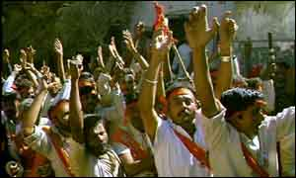
NON-ABRAHAMIC FUNDAMENTALISMS
Scholars argue that fundamentalism is a phenomena exclusive to the Abrahamic faiths.
This is countered by scholars who point out that there are modern Hindu and Buddhist fundamentalist movements.
They are more inclined toward nationalism and separatism than with adhering to literal translations of divinely inspired sacred texts.

Slide 7
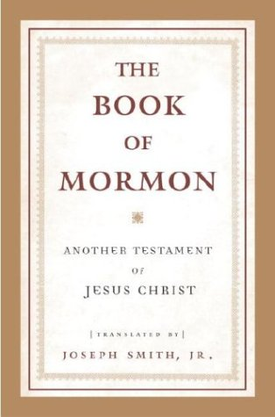
BASIC TENETS OF FUNDAMENTALISM
Sacred texts are divinely inspired.
Sacred texts need to be literally interpreted.
Religious leaders are divinely inspired and guided.
The world’s problems stem from secular influences.
Peace and justice can only be achieved by conforming to the “original” message of the sacred texts.

Slide 8
THE “SCOPES MONKEY TRIAL”
Scopes v. State, Tennessee 1925.
Williams Jennings Bryant, lawyer for the prosecution, and Clarence Darrow, lawyer for the defense.
A legal case testing the Butler Act which outlawed the teaching of any theory that denied divine creation.
High school teacher John Scopes was arrested and tried for teaching Darwinian evolution.
Found guilty, fined $100.
Butler Act repealed in 1967.
DARROW BRYANT

Slide 9
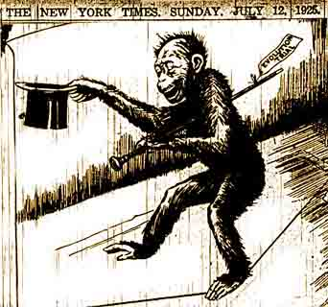
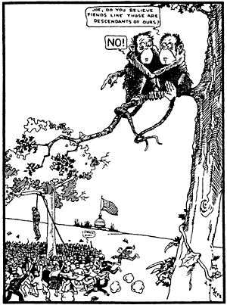

Slide 10
NEOCONSERVATIVES AND THE RELIGIOUS RIGHT
Neoconservatism is a political movement that emerged in reaction to the liberalism of the revolutionary1960s:
Free market
Small government
Nationalistic, separatist, right to defend
national interests abroad.
Large numbers of Christian fundamentalists and/or evangelicals are neoconservatives, and comprise the religious right:
“Traditional” social values
Neoconservatives began rising to political power during the Reagan Presidency.

Slide 11
THE CREATIONIST MUSEUM
27 million dollar museum in Kentucky funded by Christian fundamentalists to promote creationist doctrine over evolution:
The Earth is less than 10,000 years old.
God created the Earth in six 24-hour days.
Opened a few years ago.

Slide 12
SAID’S THEORY OF ORIENTALISM
THREE BASIC PROPOSITIONS:
1) Europeans’ long study of and fascination with the “Orient” serves political ambitions.
2) “Orientalism” is predicated upon false constructions of the “Middle” and “Far” East, including Islamic cultures.
3) European cultures define their identities and self images in relation to these false constructions.

Slide 13
THE “ISLAMIC REVIVAL” FROM AN ETHNOCENTRIC PERSPECTIVE
In the late 1970s an Islamic Revolution occurred in Iran, and the Soviets invaded Afghanistan generating support from the global Muslim community.
Discourses decree that these events foreshadowed what has come to be referred to as the “Islamic Revival.”
This insinuates Islam had been in a fallow period.
This “Revival” is then linked to Islamic fundamentalism in general.

Slide 14
GLOBAL WIDE INDICATORS OF TRANSFORMATIONS AMONG MUSLIMS
Growing number of mosques and prayer houses.
Increasing use of Islamic dress for men and women.
Increasing use of Islamic greetings.
Increase in Muslims excusing themselves for prayer, and attending services at work.
Appearance of new forms of Islamic student activity on university campuses.
Strong popular response to governmental actions considered prejudicial to Muslim communities.
The spread of Islamic banking.

Slide 15
MUSLIM POPULATIONS THROUGHOUT THE GLOBE

Slide 16
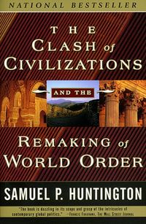
“THE CLASH OF CIVILIZATIONS”
It is my hypothesis that the fundamental source of conflict in this new world will not be primarily ideological or primarily economic. The great divisions among humankind and the dominating source of conflict will be cultural. Nation states will remain the most powerful actors in world affairs, but the principal conflicts of global politics will occur between nations and groups of different civilizations. The clash of civilizations will dominate global politics. The fault lines between civilizations will be the battle lines of the future.”
HE IS REFERRING TO THE “WEST” IN CONTRAST TO PRIMARILY THE “ISLAMIC WORLD,” IN ADDITION TO THE “CONFUSCIAN WORLD.”

Slide 17
CRITIQUING ORIENTALISM
The “West” is perceived as the generator of modern cultural, social, political, and economic “world flows.”
The “Islamic World’s” participation in global movements is invisiblized.
On the other hand, centralizing the “West” as onus awards it precedence through infamy.
TALAL ASAD: The question is not how far Europeans have been guilty and others innocent but how far the criteria by which guilt and innocence are determined have been historically constituted.
LILA ABU LUGHOD: They may be living their realities, but all are, in one way or another, shaped by the interconnections between the parts of the world that the now popular civilizational discourse defines as West and non-West, Judeo-Christian and Muslim. Many of the differences that exist today are products of different but intertwined histories, histories of interaction and reaction. They are products of different circumstances that have been created through our interactions, whether in the era of the Crusades or colonialism, or now the global hegemony of the United States.

Slide 18
CHRISTIAN FUNDAMENTALISM AND GENDER
Grounded in scriptures from the Old and New Testaments that delineate gender roles, duties, and relations.
Men are the heads of households and religious and political leaders.
Women are to be in subjection to their husbands and other male members of their families and religious community.
Some Christian fundamentalists practice polygamy.

Slide 19
JEWISH FUNDAMENTALISM AND GENDER
Orthodox Judaism is the conservative branch of the Jewish faith.
Jewish fundamentalist groups, such as the Haredim, have come to be associated with extreme Zionism.
They adhere literally to the gender roles, duties, and relations as delineated in Jewish sacred texts.
Men are the heads of households and the religious and political leaders.
Women are to be in subjection to their husbands and other male members of their families and religious community.

Slide 20
MORMON FUNDAMENTALISM AND GENDER
Groups that broke off from the LDS Church and revived Mormon doctrine as they believe it was practiced in the 1800s.
Besides the Bible, Mormons have the Book of Mormon, a sacred text Joseph Smith translated from golden plates given to him by the angel Moroni in the late 1820s.
MFs practice plural marriage in which a man’s choice and number of wives is dictated by the holy spirit.
They believe plural marriage is essential for achieving the highest degree of salvation in heaven.
Men are heads and leaders, and women are in subjection to them.

Slide 21
ISLAMIC FUNDAMENTALISM AND GENDER
Grounded in passages from the Koran that delineate gender roles, duties, and relations.
Men are the heads of households and religious and community leaders.
Women are to be in subjection to their husbands and other male members of their families and religious community.
Some Islamic fundamentalists practice polygamy.

Slide 22
FEMINIST ANTHROPOLOGY
A theoretical perspective that focuses on describing and explicating the social, political, cultural, religious, and economic roles of women.
Many branches of feminist theory are critical of the patriarchal gender relations of religious fundamentalisms.

Slide 23
AN EMIC PERSPECTIVE ON FUNDAMENTALISMS AND GENDER
The point of many fundamentalist beliefs about “traditional” gender roles, duties, and relations is that men and women are to respect and honor one another, and interact with modesty and piety.
Men are family, religious, and community leaders, but--for example--the Bible mandates that men are to put the interests of those they are responsible for, such as wives and their children, and the women and children of their communities, above their own interests in all their decisions and actions.

Slide 24
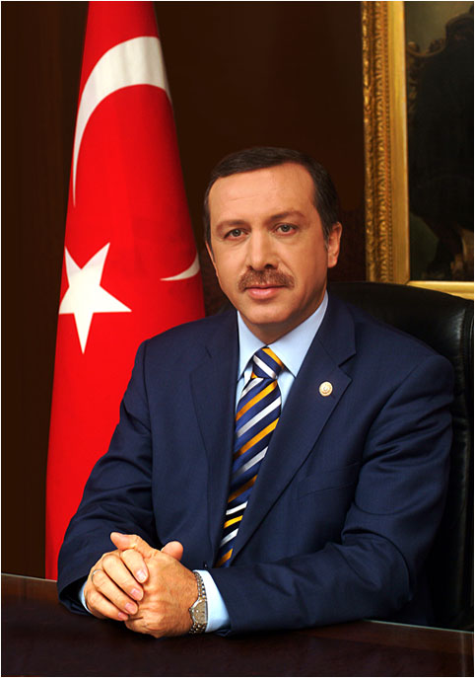
ON THE OTHER HAND, ISSUES ARISE WHEN:
…political/religious/cultural factions use the status of women as a tool to critique or even wage war against other political/religious/cultural factions.
…in secular democracies, religiously fundamentalist and conservative political groups come to governmental power and attempt to impose moral standards and gender roles and relations on the entire population, such as:
Issues over abortion and school prayer in the U.S.
Making adultery and fornication against the law in Turkey.

Slide 25
Islam, Transnationalism, and Social Transformation in Rural Northern Sudan

Slide 26
MIGRANT WORKERS IN SAUDI ARABIA
There are seven million migrant workers in Saudi Arabia, about one-third of the total population.
Migrants account for 67% of the labor force, and hold 95% of the private sector jobs.
There are over one million migrants each from Bangladesh, India, Pakistan, Egypt, Sudan, and the Philippines.
Saudi Arabia is second only to the US as the source of the largest amount of remittance payments in the world.

Slide 27
BERNAL’S MAIN POINTS
The Islamic “revival” is not simply a rejection of modernity and/or the “West,” but a modernist project in its own right.
Northern rural Sudan is an example of how local Islamic beliefs and practices transform in conformation with a foreign, globalizing model of Islam that is viewed as more correct.
Tradition is always reinvented, thus there is no original or authentic tradition.
In Northern rural Sudan, emically, women are associated with tradition and men with modernity, and this generates new forms of gender hierarchy.
Local and global models of Islam are inextricably linked to the “West” – as noted by Asad and Abu Lughod.
As the northern, rural Sudanese confront contradictions between local and global forms, Islamic fundamentalism provides a solution.

Slide 28
STAM ON NEOCONSERVATIVES AND MULTICULTURALISM
MULTICULTURALISM: “The reciprocal relativism of different cultures, once colonialism is excluded.”
Stam analyzes the fields of power and conditions of conflict within which cultural encounters take place.
He links this analysis to projects of political transformation.
Neoconservatives in the U.S. are attempting to impose tenets of a Puritanical fundamentalism both domestically and globally.

Slide 29
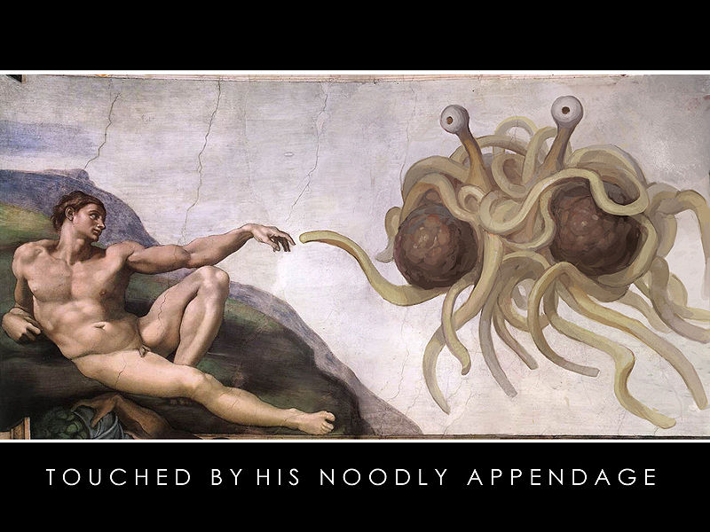
THE FLYING SPAGHETTI MONSTER
(Culture always involves debate, and debate is good for
culture – and satire enhances cultural debates through provocation that instigates thought.)

