Slide 1
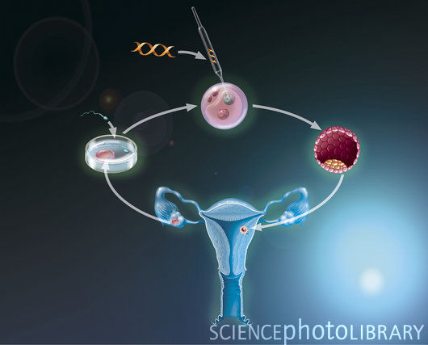
Genetic Engineering
Definition:
The manipulation of the genetic material of an organism.

Slide 2
Some people see genetic engineering as selective breeding (Darwin’s theory of evolution), 21st Century style.
FROM THIS…

Slide 3
…TO THIS
Human genetic engineering has several moral issues and raises fundamental questions about the value of human life.

Slide 4
The moral issues genetic engineering raises:
When does a human life actually begin?
The value of human life.
Some see the use of embryos for research as murder.
There is concern it could be misused eg designer babies or growing ‘spare parts’.
Poorer people in society could be exploited eg being paid for sperm & egg donations.
It could lead to problems in society giving some an unfair advantage over others. E.g. only for the rich or genetic modification being seen as ‘superior’

Slide 5
Views on when a human life begins.
Some people, such as some Christians & Hindus, believe life begins at conception
Others think it is when heart starts beating, or when life is viable (around 24 weeks), or when baby is born
Current Rights of the Embryo
None up to 14 days of development
Limited rights after 14 days
Can be aborted up to the 24th week
After the 24th week it has full human rights as by then it is considered a viable life.

Slide 6
The issue of the rights of the embryo is one of the main points of concern. It raises the following points:
When does an embryo become a person?
If an embryo is seen as a person then it changes its status or its importance.
If it is a person then to kill it is murder.
If it is a person then it is entitled to human rights.

Slide 7
IS GENETIC SELECTION
MEDDLING WITH NATURE & PLAYING GOD?
Altering genetic information is currently only used for treating diseases but could lead to people choosing things like intelligence in the future where some people are valued more than others.
Natural sexual reproduction produces variety; GE may lead to humans (as a species) being too similar who then may not be able to adapt to even the slightest change in the environment.
What responses might Nature make to a genetically modified world; it has a way of levelling things out?
What mistakes might be made in the future?
Should we be allowed to choose our future?

Slide 8
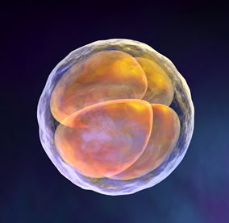
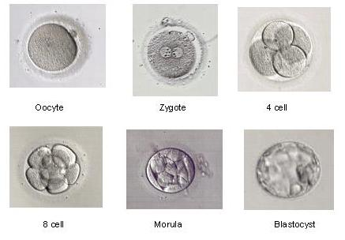
Scientists use embryos in genetic engineering.
An embryo is a fertilised egg up to the 8th week of development.
After this time it is known as a foetus until birth.

Slide 9
At 8 weeks the embryo is about the size of a grape.

Slide 10
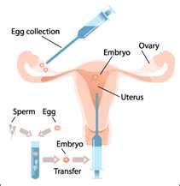
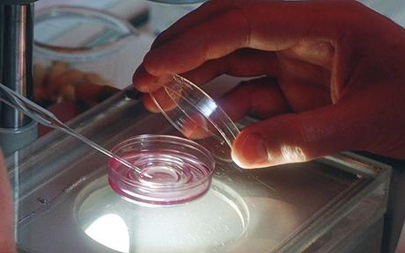
Uses Of Human Embryos (1) IVF
IVF(In Vitro Fertilisation) takes place in a laboratory when a person or a couple cannot conceive naturally.

Slide 11
Benefits of IVF
May allow childless person or couple to have children
Possible risks outweigh the benefits
Criticisms of IVF
Requires drug therapies & surgical procedures
Can be a long, expensive process with many failures which may also cause negative psychological impact
Risk of infection/contamination as fertilisation occurs outside the body
Uses scarce medical resources

Slide 12
Uses Of Human Embryos (2) Stem Cell Research
Cell research has already found treatments for conditions such as cystic fibrosis, diabetes & tissue damage and works on finding treatments and hopefully cures for illnesses such as Alzheimer's disease and cancer.
Stem cells are cells that can be found in embryos, umbilical cords and bone marrow.
Embryonic stem cells are unspecialised or undifferentiated - they can renew themselves and have the potential to change and can usually become any type of cell
Adult stem cells are specialised or differentiated and can only become one type of cell.

Slide 13
Uses Of Human Embryos (3) Genetic Selection
Therapeutic Cloning
Definition: the use of human embryonic stem cells (hES cells) to create identical human tissue of some description.
Properly referred to as somatic cell nuclear transfer (SCNT), this does not create babies but stem cells for therapeutic use.
Therapeutic cloning involves taking a cell from the patient who needs some kind of medical help and fusing it with an 'empty' ovum. This is stimulated and normal growth begins.
The stem cells are taken from the developing embryo and the embryo destroyed. These stem cells can then be used to create any kind of tissue, from skin to brain cells. NOT A WHOLE PERSON
Alternative to EMBRYO use

Slide 14
BENEFITS OF THERAPEUTIC CLONING
Only stem cells from the embryo are used; the embryo is destroyed before the 14 day limit so embryo doesn’t suffer.
Stem cells are no more morally important than other cells.
Using the same DNA as the patient means less chance of transplant rejection
Solves the problem of shortage of organ donors
It could benefit those requiring tissue replacement
Many illnesses we can’t treat at moment may benefit in the research process
It is no different to any other medical technique eg antibiotics

Slide 15
DANGERS OF THERAPEUTIC CLONING
Risks of what could happen eg designer babies, clone farms
There could be medical dangers such as new viruses or mutations
Is illness a way of nature controlling population?
The costs may not be justified; could the money be used for a better reason?
Does a cloned embryo have rights?

Slide 16
Uses Of Human Embryos (2) Stem Cell Research
Reproductive Cloning. Definition: production of individual(s) that is identical to donor plant or animal. DNA from an embryo is removed and replaced with donor DNA.
BENEFITS OF REPRODUCTIVE CLONING
Helps childless couples
Saviour sibling (genetic matching to help ill children)
Replacing a lost child
Source of spare organs
Clone armies for dangerous jobs
Since we have the technology, it should be used to benefit people with illnesses

Slide 17
DANGERS OF REPRODUCTIVE CLONING
Should we ‘play God’?
We could become a society of ‘originals’ v ‘clones’ (eg Gattaca movie)
Is it morally right to ‘harvest’ organs? (eg The Island movie)
Would it only be rich people that could benefit?
Could a couple justify cloning?
Could there be mutations?
How would a cloned child feel? (eg Never Let Me Go movie)

Slide 18
Uses Of Human Embryos (3) Genetic Selection
THREE TYPES OF GENETIC ENGINEERING (Int 2)
Somatic Genetic Engineering (Somatic Gene Transfer Therapy) Definition: Involves altering the DNA structure. Cells with defective genes are removed or a new gene is injected or inhaled. This is currently used to treat illnesses such as diabetes and cystic fibrosis.
BENEFITS OF SOMATIC GENE TRANSFER THERAPY
It is non-invasive (i.e. no surgery)
It is only ‘medicine’ at a genetic level
The altered cells only affect the patient; the new cells cannot be passed on- gene therapy on gametes (sex cells which can be passed on is currently banned)

Slide 19
DANGERS OF SOMATIC GENE TRANSFER THERAPY
Altered viral vectors may mutate and cause unexpected problems – currently viral vectors are modified to prevent this
Its limitations include only treating the symptoms and not the cause – it is not a cure
Only treats the individual sufferer – it doesn’t eradicate (wipe out) the illness

Slide 20
2. Germline Therapy
Definition: Involves altering DNA. Similar to Somatic in that unhealthy genes are changed to healthy ones. The difference is, it is the gametes (sex cells) that are altered and these can be passed on. This treatment is currently banned.
BENEFITS OF GERMLINE THERAPY
It allows genetic disorders to be eradicated (wiped out)
It is relatively safe

Slide 21
DANFERS OF GERMLINE THERAPY
Does anyone have the right to manipulate genetic information without the consent of those who will be affected i.e. future generations?
No-one knows what effect the modified gametes may have on future generations.
Healthy DNA would have to come from a donor; 3 parents?
Many argue it is start of designer babies
Some scientists believe it could be the start of 2 species i.e. genetically modified people v non-modified.

Slide 22
3. Pre-Implantation Genetic Diagnosis and Selection (PGD)
Definition: the use of embryos through IVF (in vitro fertilisation). It can be used in families with known inherited genetic disorders. No manipulation of the embryo is currently allowed so once screened, faulty embryos are discarded. HFEA regulates this process however each case is evaluated on its own merits.
BENEFITS OF PGD
Stops children being born with inherited illnesses
Would cut down on the number of late abortions
Allows the birth of ‘saviour siblings’

Slide 23
DANGERS OF PGD
Can lead to the destruction of embryos, ‘playing God’
Could lead to designer babies
Relies on HFEA deciding which illnesses can be treated; does this devalue people whose illness is not considered worthy enough?
The procedure is complicated and risky
Would a ‘saviour sibling’ feel devalued as it was only born to help ill sibling?
PGD may increase the number of abortions which some believe is wrong

Slide 24
The Law in the UK
Research is only allowed up to 14 days of embryo development
Frozen embryos must be destroyed after 5 years
All licences must come from HFEA
Only therapeutic cloning is allowed
Consequences of breaking the law include fine or prison.
HFEA (Human Fertilisation and Embryology Authority) is the government regulatory body for GE in the UK.
HFEA Guidelines
HFEA states life should be respected at all stages.
Research on embryos is only allowed up to 14 days of development.
Frozen embryos can only be stored for up to 5 years.

Slide 25
Criticisms of HFEA Guidelines
Guidelines are not strict enough
Rules on guidance for developing treatments are too vague
Some believe abuses of GE can still happen
Responses to the criticisms of HFEA
If rules were too strict then research and therefore cures would be limited
The UK could fall behind research in other countries leading to financial loss

Slide 26
IN FAVOUR OF EMBRYO RESEARCH – General Views
Some argue an embryo is not a person so it is morally justifiable to sacrifice it for the benefits of others.
CONCERNED OR AGAINST EMBRYO RESEARCH
Many believe rights begin at conception (when embryo is fertilised by sperm)
We don’t use adults for research without their consent, why should it be okay to use embryos especially as it can’t speak for itself?
Religious people argue that an embryo is a being in the ‘image of God’ and should be given the full protection of the law.
Non-religious people may argue that if we treat embryos differently from all other life forms, we are taking risks with what is morally justifiable.

Slide 27
IS GENETIC SELECTION
MEDDLING WITH NATURE & PLAYING GOD?
The British Humanist Association considers 2 viewpoints:
The rights of an embryo
Does embryo research produce more than harm than good?
They see no problem using embryos for a good purpose that would otherwise be destroyed.
The BHA support the HFEA 14 day limit.
It believes that we have knowledge and capabilities that we are best not to use, ‘knowing how to do something does not mean that we necessarily have to do it.’

Slide 28
VIEWPOINTS
On
Embryo Research
&
Genetic Engineering

Slide 29
MEDICAL SCIENTISTS
ARGUMENTS FOR GE
An embryo is a fertilised egg until 8 weeks so has no feelings
Life does not begin at conception - all that is being destroyed is a collection of cells
It could help get rid of diseases such as cancer, heart disease, Parkinson’s or Alzheimer’s.
RESPONSES
If life begins at conception then it could be seen as murder
Scientists might use GE to create designer babies
Clones might be used simply to provide spare parts
Only the rich would be able to afford it
This will lead to human life being devalued

Slide 30
RELIGIOUS VIEWS
CHRISTIANITY FOR
Teaches compassion towards others; surely allowing a childless couple to have a child is exactly what this means?
Jesus does not want people to suffer so we should use this to find new cures.
Roman Catholic Church: Gene therapy acceptable if of medical benefit
Church of Scotland: Only approves of medical research up to 14 days
CHRISTIANITY AGAINST
Life begins at conception so it is murder
The Bible teaches ‘Do not kill’ (Exodus)
Life is sacred and should only be ended by God (Book of Job)

Slide 31
HINDUISM FOR
Would the atman continue to exist anyway?
Showing compassion and helping others is a
requirement of dharma and karma
HINDUISM AGAINST
All life comes from Brahman only
Brahman is in all things and he should not be killed
The atman enters the embryo at conception
Killing an embryo disrupts samsara
Ahimsa means non-violence; not killing

Slide 32
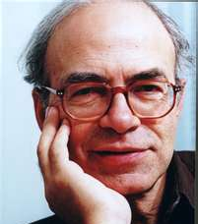
NON-RELIGIOUS (or SECULAR) VIEWS
PETER SINGER – UTILITARIAN
Why not use genetic selection to avoid abortions in cases such as Downs Syndrome.
If we can prevent disease and illness then we should as this is what most people want.
We should not be put off using GE just because someone, somewhere might abuse it.
However
It might lead to the rich being the only ones that can afford this. The government should ensure that the poor also benefit.

Slide 33
BRITISH HUMANIST ASSOCIATION (BHA)
– RICHARD DAWKINS
It is the quality of life that counts not the sanctity of life.
Genetic selection is not good or bad in itself; it depends how it is used.
An embryo up to 14 days old cannot be self-aware; it is just a collection of cells and cannot suffer.
If embryos can be used to cure pain and suffering then quite simply we should.
However
We need to guard against misuse by scientists.

