Slide 1



Life-Work Balance
Achieving the Holy Grail

Slide 2

Our session plan
What is it…?
What’s the reality…?
What’s the benefit…?
What’s my (your) situation…?
Mac’s ten-point plan…?

Slide 3
Work-Life Balance
Work–life balance is a broad concept including proper prioritizing between “work” (career and ambition) on one hand and “life” (Health, pleasure, leisure, family and spiritual development) on the other. Related, though broader, terms include “lifestyle balance” and “life balance”
From Wikipedia,
– the free encyclopaedia

Slide 4
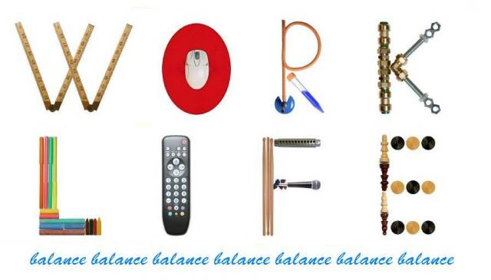
The reality…

Slide 5
5 million people…
7.2 hours a week worth £5402 each
The number of people working 'extreme' unpaid overtime of more than ten hours a week increased by 14,000 to nearly 900,000 last year, according a new analysis of official statistics published by the TUC to mark Work Your Proper Hours Day (WYPHD).

Slide 6


Work is about a search for daily meaning as well as daily bread, for recognition as well as cash, for astonishment rather than torpor, in short, for a sort of life – rather than a Monday through Friday sort of dying…”
Studs Terkel

Slide 7
Poor Work-Life Balance
Higher rates of absenteeism
Higher rates of staff turnover
Reduced productivity
Decreased job satisfaction
Rising healthcare costs
Lower levels of organisational commitment and loyalty
= Poor customer service

Slide 8
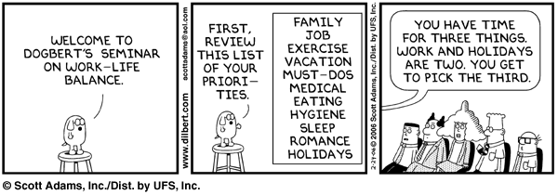

Slide 9
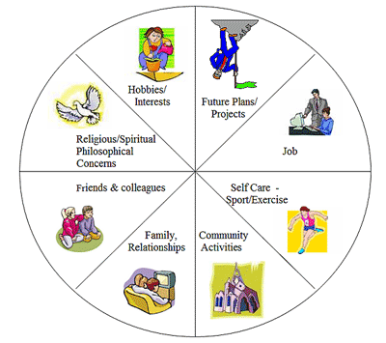
A larger slice of the cake

Slide 10
Your ‘chuffed chart’
Think back 5 years…
  what have you achieved?
☺
✓
✓
✓
✗
✗
☹
5 years ago
Today

Slide 11

What’s been important?
Achievement
Issue
Home / family…
Development…
Modest purchase...
‘You time’…
What you know…
Social / community
  Personal – non work
  Career
  Material wealth
  Health
  Learning
  Spiritual / Cultural

Slide 12


Slide 13

What will be important?
Issue
  Personal – non work
  Career
  Material wealth
  Health
  Learning
  Spiritual / Cultural
12 month goals
Plan finances…
Speed of Trust…
Chez Nous…
‘Protect the core’…
French conversation…
Village concert…

Slide 14
Mac’s 10-point plan
Talent transfer
Get focused
Set a reasonable pace
Call time-out
Share goals
Blur the boundaries
Manage expectations
Keep a clear head
Show your humanity
Set challenging goals

Slide 15
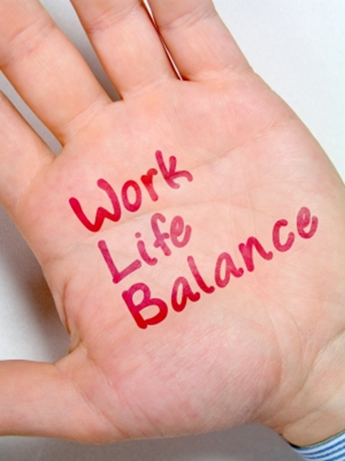
Life-Work Balance
mac@daw.co.uk
Achieving the Holy Grail
… it’s in your hands!

