Slide 1
FARM BUSINESS MANAGEMENT
TRI – CO. YOUNG FARMER ORGANIZATION

Slide 2
INTRODUCTION
UPON COMPLETION OF THIS COURSE, PARTICIPANTS WILL BE ABLE TO:
DISCUSS BUSINESS & FAMILY GOALS
UTILIZE A FINANCIAL MANAGEMENT SYSTEM
DISCUSS GOVERNMENT PROGRAMS
UTILIZE RISK MANAGEMENT STRATEGIES

Slide 3
TOPICS OF DISCUSSION
GOAL SETTING
RECORD KEEPING
FINANCIAL STATEMENTS
CASH FLOW STATEMENT
HOUSEHOLD BUDGETS
ENTERPRISE BUDGETS
TAX MANAGEMENT
LEASING VS. BUYING
WILLS & ESTATE PLANNING

Slide 4
TOPICS CONTINUED
AG. BUSINESS AGREEMENTS
RISK MANAGEMENT
GOVERNMENT PROGRAMS
SOURCES OF FARM CREDIT
QUALIFICATIONS NEEDED FOR LOANS
COMPUTER RECORD KEEPING
MARKETING STRATEGIES

Slide 5
WHAT IS A SUCCESSFUL FARM MANAGER?
ADAPTS TO CHANGES IN MARKETS
EXPLORES NEW IDEAS
OPERATES AS A RESOURCE MANAGER

Slide 6
TWO FARMERS - TRUE STORY
A true story of two farmers is helpful in illustrating certain
characteristics of successful management. These two farmers
were approximately the same age and they started farming
at about the same time. Mr. Brown acquired in marriage a
good farm free of debt. Mr. Johnson started with very little
capital as a tenant. At the end of his career, Mr. Brown had
lost his farm and was working for Mr. Johnson, who by that
time owned his own farm. Mr. Brown had descended the
agricultural ladder while Mr. Johnson was climbing up.
WHAT HAPPENED?

Slide 7
Mr. Brown was serious and hard working. He was an excellent
employee. He was superior to Mr. Johnson as a mechanic. He
understood the feeding and care of livestock better than Mr.
Johnson. To the superficial observer he was a better farmer than
Mr. Johnson. His machinery was in better repair. His livestock
always looked good, sometimes almost too good. Why, then,
did he fail when Mr. Johnson succeeded? The answer lies in
one of the most important concepts in being a successful farm
manager. Mr. Johnson was more flexible. Whereas Mr. Brown
kept the same enterprises throughout his career. Mr. Johnson
adapted his operations to changing economic conditions. When
crop prices were low, he selected cattle enterprises that utilized
cheap feed; he was quick to adopt new farming methods that
held promise of reducing costs.
Successful farm management decisions must “pay off over the
long haul”.

Slide 8
TRUE STORY OF TWO FARMERS (FLEXIBILITY)
MR. BROWN
GOOD FARM – DEBT FREE
HARD WORKER
MASTER MECHANIC
LIVESTOCK ALWAYS LOOKED GOOD
MR. JOHNSON
ADAPTED TO CHANGES IN MARKETS
MADE GOOD LONG RANGE DECISIONS

Slide 9
FARM MANAGEMENT
CONCERNED WITH THE DECISIONS THAT AFFECT THE PROFITABILITY OF THE FARM BUSINESS

Slide 10
MANAGEMENT
THE CONTROL, MANIPULATION, OR DIRECTION OF FACTORS TO REACH A GOAL

Slide 11
FACTORS OF PRODUCTION
LAND – Natural resources
LABOR – Human effort
CAPITAL – “Tools” tractors, buildings, etc
MANAGEMENT – The direction of factors

Slide 12
GOALS ARE BROAD STATEMENTS THAT SHOW WHERE YOU WANT TO BE AFTER SOME PERIOD OF TIME.

Slide 13
OBJECTIVES ARE THE STEPS THAT MUST BE TAKEN IN ORDER TO REACH GOALS.

Slide 14
ADVANTAGES TO SETTING GOALS
Shows where you are going – provides a “road map”
Makes it easier to get where you are going
Prepares you to meet the future
You can see the big picture and can focus on critical relationships
Gives purpose and direction
Relieves some worries and uncertainties

Slide 15
DISADVANTAGES OF SETTING GOALS
Takes time to decide on goals
Sometimes difficult because of conflicting goals
Lack of confidence in trying to determine priorities
Some see as a waste of time

Slide 16
FOR GOAL SETTING TO BE SUCCESSFUL – THEY SHOULD BE:
W –written so a record is kept
R – realistic in view of existing conditions
O – original to one’s situation
T – timed and able to be tested
E – easily compatible with other goals

Slide 17
THREE TYPES OF GOALS
SHORT TERM – GOALS THAT YOU WOULD LIKE TO ACCOMPLISH WITHIN THE NEXT YEAR
INTERMEDIATE TERM – GOALS TO ACCOMPLISH WITHIN ONE TO TEN YEARS
LONG TERM – GOALS THAT REQUIRE MORE THAN TEN YEARS TO ACCOMPLISH

Slide 18
WHAT ARE YOUR GOALS FOR YOUR FARMING OPERATION?
SHORT TERM:
INTERMEDIATE TERM:
LONG TERM:

Slide 19
RECORD KEEPING
“WITHOUT RECORD KEEPING, THE CHANCES OF MANAGING A SUCCESSFUL BUSINESS ARE POOR”

Slide 20
WHY SHOULD WE KEEP GOOD RECORDS?
For better decision making
To determine our progress or lack of progress
To file income taxes
To participate in government programs
To qualify for loans
To aid in transfer of real estate
To establish value of our assets

Slide 21
THERE ARE TWO GENERAL KINDS OF RECORDS
Financial records – Include receipts and expenses and will give the net worth statement, income statement, and cash flow summary.
Physical records – Show the production of crops and livestock and the usage of inputs. Ex. Crop yields, livestock births, acres planted, bushels harvested, etc.

Slide 22
THERE ARE FOUR RECORD SUMMARIES THAT ARE USED IN FARM BUSINESS MANAGEMENT
CASH FLOW SUMMARY
NET WORTH STATEMENT
INCOME STATEMENT
DETAILED ENTERPRISE ANALYSIS

Slide 23
CASH FLOW SUMMARY – A historical record of monthly cash inflows and outflows usually for one year.

Slide 24
NET WORTH STATEMENT – Shows the financial condition of a business at a particular point in time. Lists all assets, values of assets, and liabilities of the business. Also known as the balance sheet, financial statement, or statement of financial condition.

Slide 25
INCOME STATEMENT – The financial record that reflects the profitability of the business over an accounting period, usually one year. Also known as a profit and loss statement or operating statement.

Slide 26
DETAILED ENTERPRISE ANALYSIS – Identifies the factors that affect the profitability and efficiency of the individual enterprises.

Slide 27
THERE ARE THREE LEVELS OF RECORD KEEPING SYSTEMS:
INCOME TAX PURPOSES ONLY
INCOME TAXES PLUS SOME BUSINESS ANALYSIS
COMPLETE FARM BUSINESS ANALYSIS

Slide 28
INCOME TAX PURPOSES ONLY – A record of cash receipts, cash expenditures, and depreciation of farm machinery, equipment, breeding livestock and buildings. Meets requirements for cash method of reporting income.

Slide 29
INCOME TAXES PLUS SOME BUSINESS ANALYSIS – Records are organized for taking a complete inventory and for recording labor and production information.

Slide 30
COMPLETE FARM BUSINESS ANALYSIS – Provides a record of cash transactions, physical quantities, inventory, depreciation, and all the information necessary to complete all tax and financial statements.

Slide 31
THERE ARE TWO ACCOUNTING SYSTEMS USED IN FINANCIAL MANAGEMENT
DOUBLE ENTRY SYSTEMS
SINGLE ENTRY SYSTEMS

Slide 32
DOUBLE ENTRY SYSTEMS
Keeps a balance in financial transactions. Each credit transaction must be balanced by a debit transaction.

Slide 33
SINGLE ENTRY SYSTEMS
Lists the receipts and expenses without any effort to maintain a current balance between them on paper. Usual system used by farmers.

Slide 34
THERE ARE TWO METHODS OF REPORTING INCOME AND EXPENSES
CASH METHOD
ACCRUAL METHOD

Slide 35
CASH METHOD – Records income and expenses based on the actual cash transactions. Does not use an inventory to keep track of unsold products or unused supplies. (The cost of items purchased for resale are not deductible until the year the item is sold.)

Slide 36
ACCRUAL METHOD – Reports income and expenses in the time period they occur. Uses an inventory to match income and expenses. Inventory items must be recorded at values approved by the IRS. Requires detailed and complex records.

Slide 37
COMMON TERMS USED IN GENERAL FARM RECORD KEEPING
Assets
Liabilities
Variable Cost
Fixed Cost
Net Worth (owner equity)
Liquidity
Solvency
Receipts
Expenses
Capital assets
Depreciation
Accounts receivable
Accounts payable
Personal or family living expenses

Slide 38
DEVELOPING AND USING BUDGETS
A budget is a plan for action by the business. Budgets include projections for income and expenses for all or part of the business. Should be written.

Slide 39
WHY DO WE NEED TO DEVELOP AND USE BUDGETS?
Helps you plan for the useful life of assets.
Excellent device for organizing.
Useful in loan application process.
Allows experimentation before action.
Identifies cost and income items that might otherwise be overlooked.

Slide 40
THERE ARE FOUR COMMON TYPES OF BUDGETS
ENTERPRISE BUDGETS
PARTIAL BUDGETS
WHOLE FARM BUDGETS
FAMILY BUDGETS

Slide 41
ENTERPRISE BUDGET – Projected costs and returns associated with one production process.

Slide 42
PARTIAL BUDGET – Projected costs and returns associated with some change in the farming business. Ex. Comparing a possible change from custom harvesting to ownership of combine equipment.

Slide 43
WHOLE FARM BUDGET – Physical and financial plans for the entire farming business for a specific period of time. The total of all production processes.

Slide 44
FAMILY BUDGET – Projected family income and family expenses.

Slide 45
DETERMINING MONTHLY INCOME AND EXPENSES FOR THE FAMILY
THE PRESENT CONDITION
DETERMINE INCOME PER MONTH

Slide 46
WHAT IS “NET SPENDABLE INCOME”?
THAT PORTION OF INCOME AVAILABLE FOR FAMILY SPENDING
SOME INCOME DOES NOT BELONG TO THE FAMILY AND THEREFORE CANNOT BE SPENT
TITHES
TAXES
RETIREMENT
PAYROLL DEDUCTIONS FOR INSURANCE

Slide 47
NET SPENDABLE INCOME = GROSS INCOME MINUS TITHE AND MINUS TAXES.

Slide 48
CATEGORIES FOR NET SPENDABLE INCOME
HOUSING EXPENSES | DEBTS | MEDICAL EXPENSES
FOOD EXPENSES | RECREATION | MISC.
AUTOMOBILE EXPENSES | CLOTHING | SCHOOL & CHILD CARE
INSURANCE | SAVINGS | INVESTMENTS

Slide 49
UNALLOCATED SURPLUS INCOME
INCOME FROM UNBUDGETED SOURCES (GARAGE SALES, GIFTS, ETC.)
KEEP IN CATEGORY FOR TRACKING AND TAX PURPOSES

Slide 50
INCOME VS. EXPENSES
IF INCOME IS GREATER THAN EXPENSES
CONTROL SPENDING TO MAXIMIZE SURPLUS
IF EXPENSES ARE GREATER THAN INCOME
A DETAILED ANALYSIS OF SPENDING IS NEEDED.

Slide 51
PERCENTAGE GUIDE FOR FAMILY INCOME
(FAMILY OF FOUR)

Slide 52
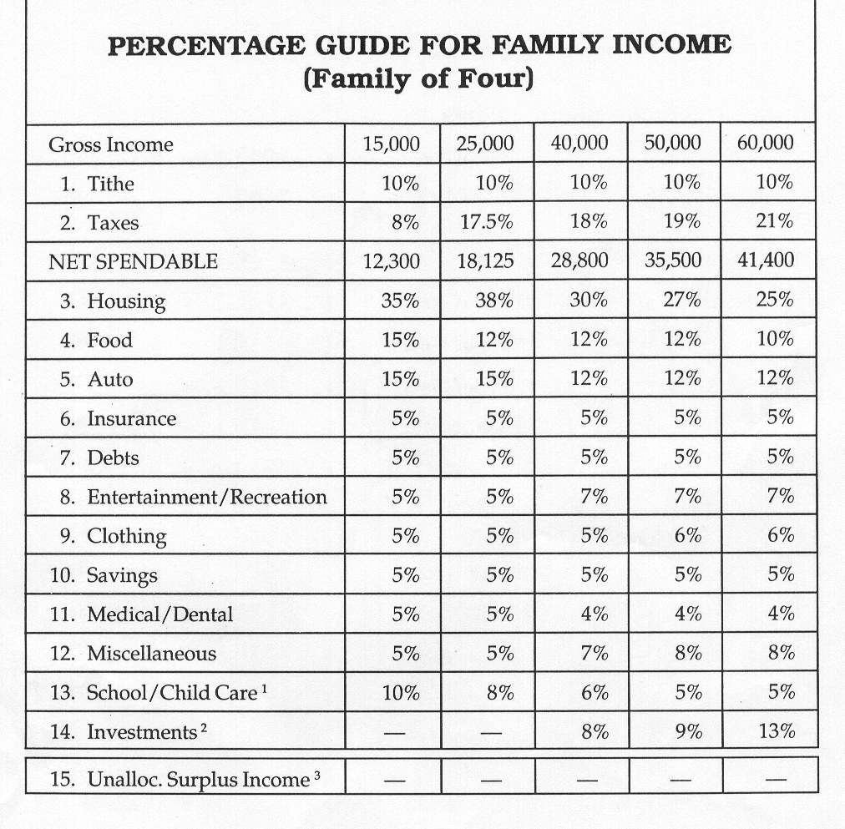

Slide 53
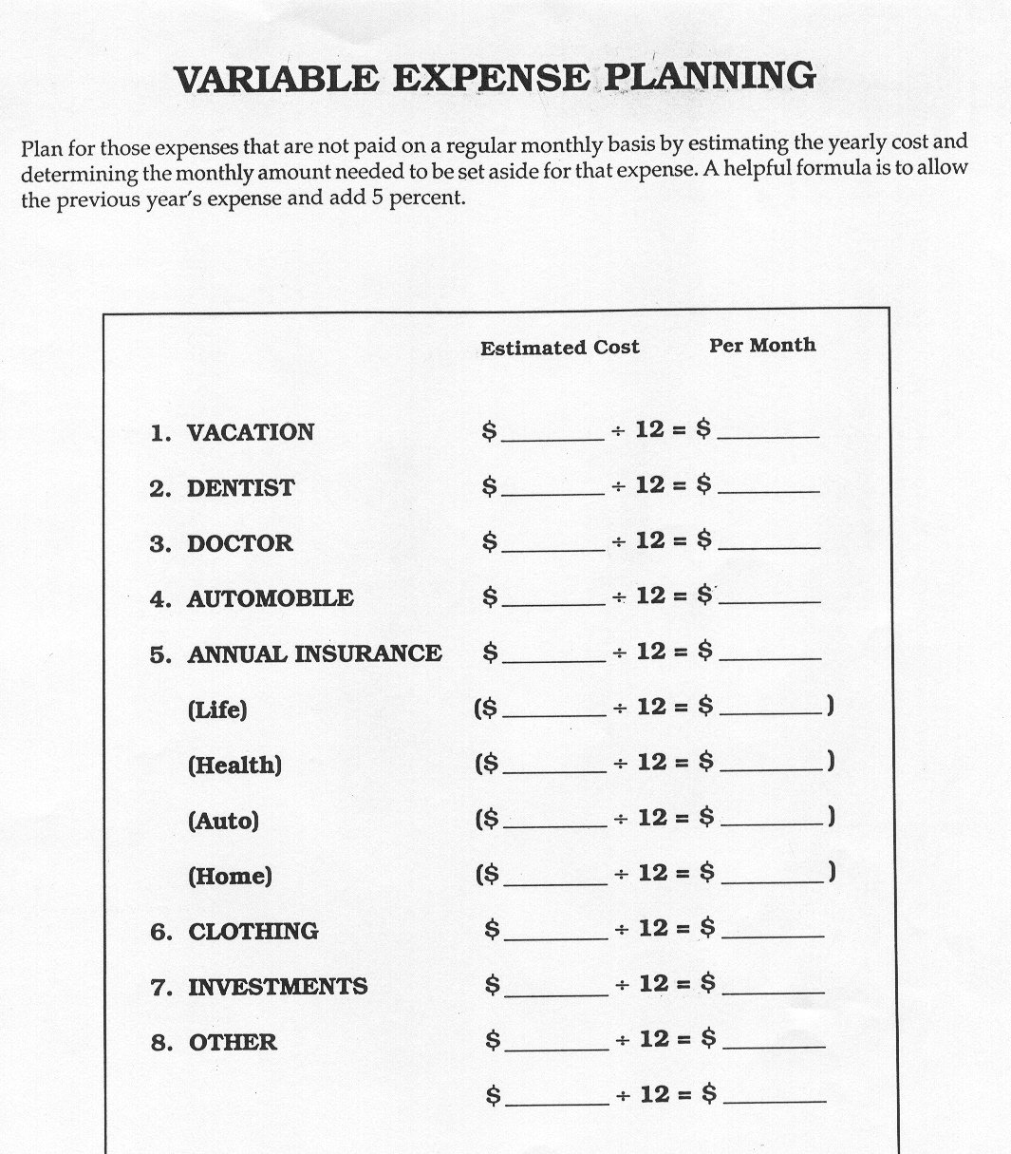

Slide 54
