Slide 1
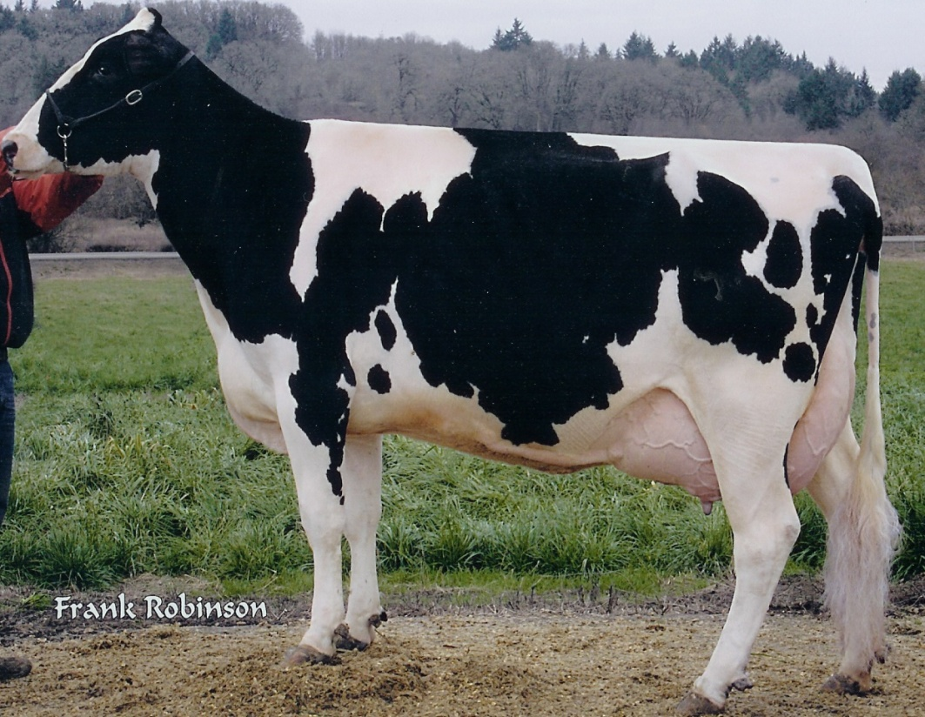
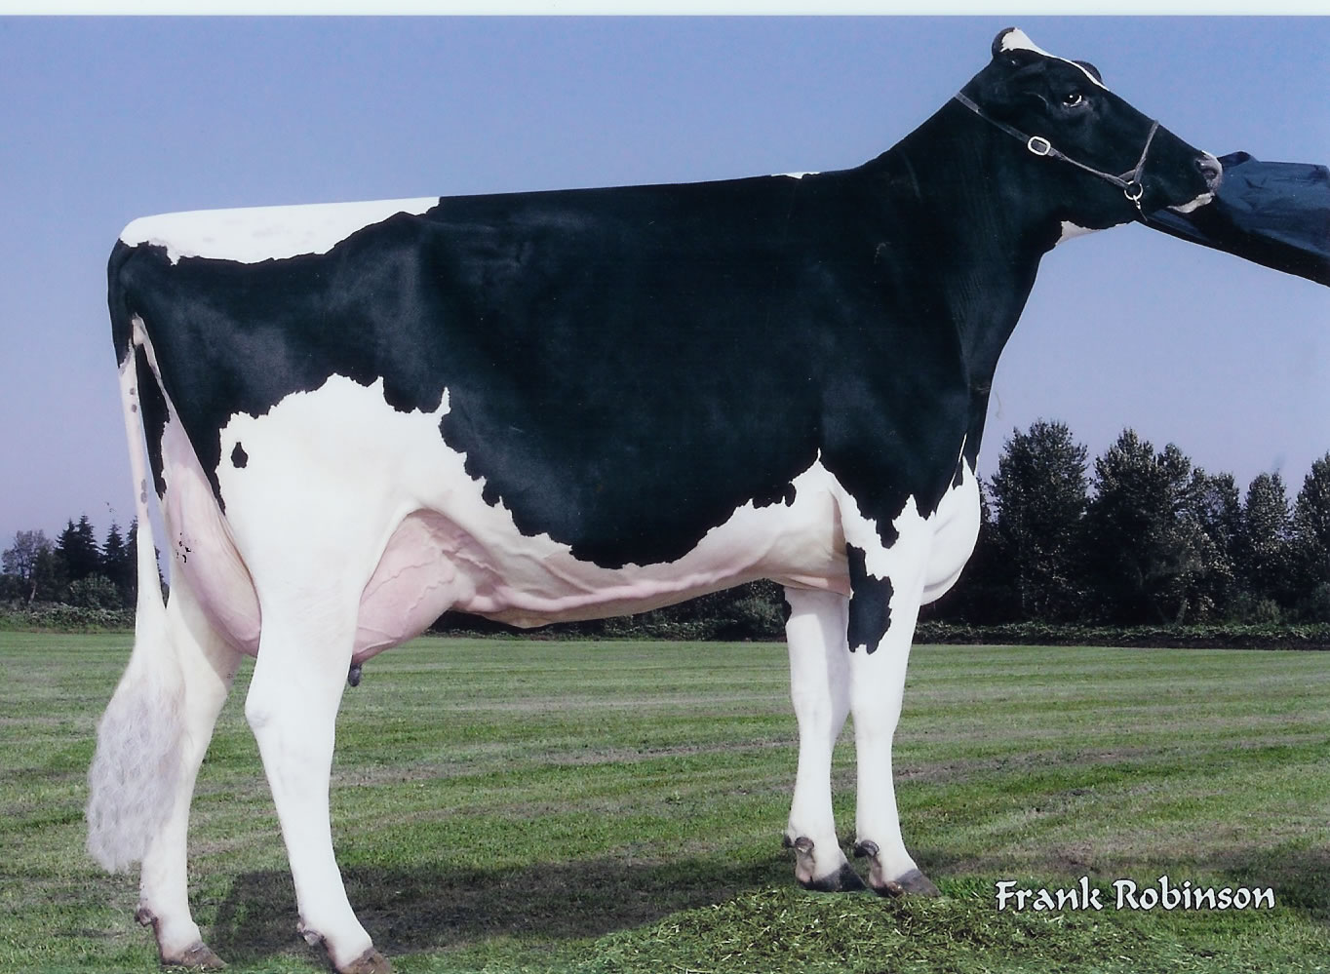
FEEDING DAIRY CATTLE
AG 310 - D

Slide 2
I. Terms and definitions
A. Hay--Dry forage; 10%-25% moisture content
Silage--Fermented forage plants usually ensiled at 60%-67% moisture content
Haylage--Low moisture silage made from legumes and/or grasses; 35%-50% moisture content
High moisture grain--Grain containing between 24%-40% moisture and stored in an air-tight silo
Pre-mix--Feed purchased already combined in set amounts to provide a specified nutritional content
TDN--Total digestible nutrients
Carbohydrate--Nutrient supplying most of the energy needs for animals; usually easily digested and absorbed
Fiber--Carbohydrate with a digestibility of less than 50%
Lignin--Non-digestible portion of fiber that provides the "bulk" necessary for dairy animals
Protein--Nutrient made up of chains of amino acids which contain nitrogen; "building blocks" of muscles
Palatability--Flavor of the feed

Slide 3
NE--Net energy or energy left in feeds after energy used in digestion has been subtracted
NElac--Net energy value used for maintenance and milk production in lactating cows
N. Milk fat--Fat found in milk composed of short-chain fatty acids; contains
vitamin A
O. Colostrum--First "milk" of a cow after calving, high in nutrients and antibodies
P. Antibody--Protein substance in the blood that protects against disease
Q. Ketosis--Dairy disease caused by high milk production in which cow is forced to use body fat to supply production demands; this fat breakdown creates an oversupply of ketones
R. Longevity--Length of time a cow remains in herd
S. Lactating--Secreting milk
T. Replacement heifers--Young females being raised to remain in the herd as cows
U. Milk fever--A nutritional disease occurring at calving caused by a calcium-phosphorus imbalance

Slide 4
II. Nutritional areas of concern in balancing a dairy ration
A. Dry matter intake
B. Crude protein
C. TDN
D. Calcium
E. Phosphorus
F. Fiber
G. Trace mineral salt

Slide 5
III. Advantages of pastures for feed
A. Lowers feed costs
B. Lessens chance of nutritional deficiencies
C. Lessens disease spread
D. Lowers building costs
E. Increases flexibility
F. Improves reproduction
G. Provides outlet for manure

Slide 6
IV. Disadvantages of pastures for feed
A. Increases land requirements
B. Limits expansion
C. Does not provide enough dry matter and therefore energy to maintain high production
D. Decreases feed efficiency
  Cows must use more energy obtaining feed.
E. Increases variability in production and growth
F. Increases worm problems

Slide 7
V. Advantages of feeding hay
A. Provides relatively inexpensive nutrients
B. Is important in maintaining proper digestion
C. Maintains proper rumen function
D. Maintains milk fat levels

Slide 8
VI. Characteristics of good hay
Good hay has over 15% protein and less than 30% fiber.
A. Cut at an early maturity--1/10 bloom
B. Leafy
C. Bright green
D. Free from mold or dust
E. Pleasant aroma

Slide 9
VII. Effects of poor hay quality on lactating cows
A. Lowers milk production
B. Lowers hay consumption
C. Increases grain requirements

Slide 10
VIII. Comparison of high quality hay and corn silage
Forty pounds of silage fed with 20 pounds of hay per day has proven to be a good balance for a dairy ration.
A. Corn silage has 11% more TDN than hay on a dry matter basis
B. Corn silage has a little over 1/4 the protein of alfalfa hay on a dry matter basis
C. Feeding 3 pounds of corn silage is approximately equivalent to feeding 1 pound of hay on an as-fed basis
  This is due to the much higher moisture content of silage figured at 70% in this case.

Slide 11
IX. Advantages of using silage
A. Retains over 85% of crop feed value
B. Allows maximum utilization of land in feed production
  Corn can produce more TDN per acre as silage than any other crop.
C. Can be harvested in relatively wet weather
  This means it can also be harvested over a longer period without losing quality.
D. Requires less storage space per pound of TDN than hay
E. Improves utilization of by-products and other feeds with low palatability
F. Can be stored with very little loss

Slide 12
X. Merits of corn versus grass silage
A. Corn silage
  1. Generally yields better
  2. Easier to produce high quality silage consistently
  3. More palatable
  4. Higher in TDN
B. Grass silage
  1. Higher in protein
  2. Can be produced in shorter and cooler growing seasons
  3. Can be used for summer feeding by ensiling first cutting grass

Slide 13
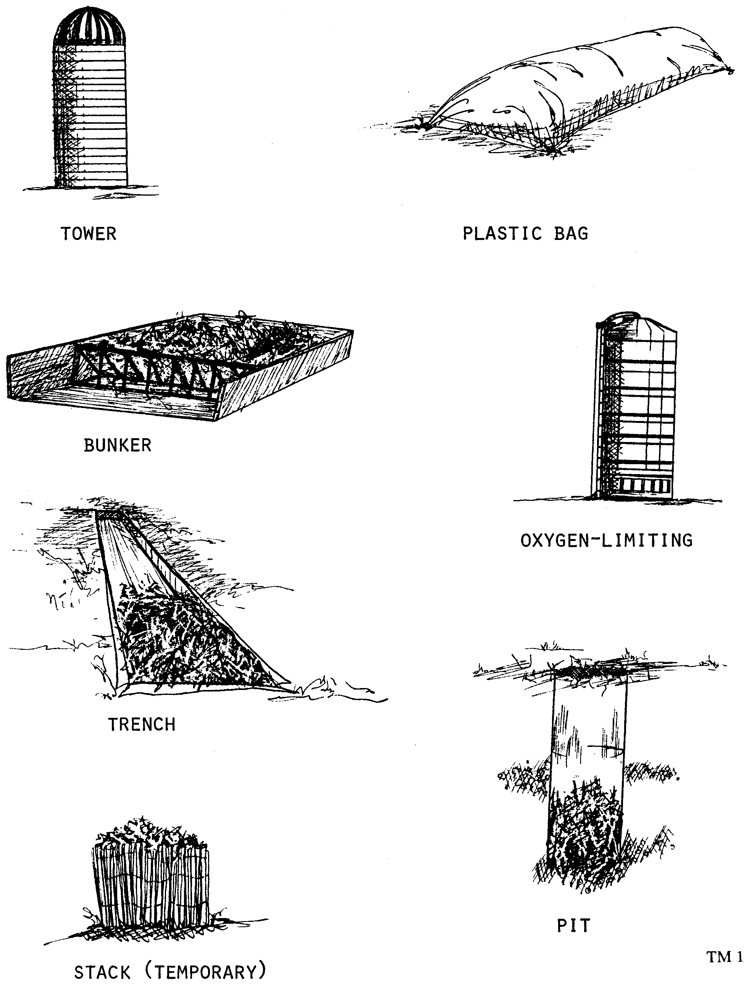
XI. Types of silos
A. Tower
B. Oxygen-limiting
C. Pit
D. Horizontal
  bunker types which are above ground
  trench types which are below ground
E. Temporary
  These include stack type and plastic tubes.

Slide 14
XII. Most common grains for dairy cattle
A. Corn
B. Barley
  This is the most common grain fed in Idaho and the western states and has about 90% of the TDN of corn.
C. Oats
D. Three-way mix--Wheat, barley and oats
  This mixture has been used extensively in the Magic Valley area.

Slide 15
XIII. Most common protein supplements for dairy cattle in the western United States
A. Soybean meal
B. Cottonseed meal
C. Whole soybean
D. Whole cottonseed
  Whole soybeans and cottonseeds supply oil and increase the energy level of the supplement.
E. Alfalfa
  Urea is a nitrogen source that ruminants can use to manufacture protein. It can be used in limited quantities in dairy feed.

Slide 16
XIV. Reasons for taking precautions when feeding by-products
A. Widely varying nutrient value
B. Possible pesticide contaminations
C. Possible low palatability
D. Possible presence of toxic substances

Slide 17
XV. Feeding methods for minerals
A. Free choice
B. Mixed with ration

Slide 18
XVI. Most common minerals for dairy cattle
A. Salt
  A trace mineral salt is often used to insure an adequate supply of trace minerals.
B. Calcium
C. Phosphorus

Slide 19
XVII. Vitamin A
Vitamin A is most likely to be deficient in dairy cattle
  A pre-mix can be helpful in preventing vitamin deficiencies since vitamins in feeds are easily destroyed.

Slide 20
XVIII. Necessary information for balancing rations
Ration formulation by computer is available through private companies and the universities, but the following information must still be available.
  A. Feeds available
  B. Nutrient values of feeds
  C. Feed costs
  D. Nutritional levels needed to meet production goals
  E. Other requirements or limitations such as minimum fiber

Slide 21
XIX. Alternative ways to process grain
A. Fine grinding
  This method is generally not as satisfactory as it reduces palatability because of the powdery texture and dust.
B. Coarse grinding
C. Steam rolling
D. Pelleting
  This method increases consumption, but slightly lowers butterfat content.

Slide 22
XX. Effects of cubed and finely ground hay on dairy cattle
A. Cubed hay--May increase production and does not affect butterfat content
B. Finely ground and pelleted hay--Lowers fat content in milk; increases digestion problems

Slide 23
XXI. Minimum requirements for roughage and fiber for a lactating cow
These amounts are necessary for proper digestive function.
  A. 1 to 1 1/2 lbs of roughage per 100 lbs of body weight
  B. 17% crude fiber

Slide 24
XXII. Rule of thumb
For determining concentrate levels to feed large dairy breeds--Feed 1 lb of grain for each 2 lbs of milk above a base of 20-30 lbs of milk
  Jerseys and Guernseys should have 1 lb of grain for each 1 1/2 lbs of milk above a base of 15-20 lbs.

Slide 25
XXIII. Phase feeding
Each phase would represent a different energy requirement and therefore a different ration.
A. Phase 1
  1. First 10 weeks after calving
  2. Rapidly increasing milk production
  3. Cow is usually not able to eat enough and draws on body reserves to maintain production
B. Phase 2
  1. Second 10 weeks after calving
  2. Maximum level of feed intake reached
C. Phase 3
  1. Last half of lactation
  2. Milk production is decreasing
D. Phase 4
  1. Dry period of 7 to 8 weeks
  2. Time for feeding calf and restoring body reserves

Slide 26
XXIV. Challenge feeding
A. Cow is "challenged" to produce more milk by increasing concentrates before freshening
B. Grain amounts are then increased until production no longer increases
C. Grain amounts are then adjusted according to milk production
  Maximum production may not always be the most economical, especially on cows that are not real efficient feed converters or when grain prices are high. A cow's response to challenge feeding is best early in lactation.

Slide 27
XXV. Group feeding
A. Cows are divided into groups based on production
  Number of groups will vary with size of herd and type of operation.
B. Cows are fed in groups in some type of feed bunk
C. Little or no grain is fed in milking parlor

Slide 28
XXVI. Timing of feeding different feeds
  Consumption is increased as number of feedings are increased. Many dairies are using "total rations" where all the feeds are fed together.
A. Hay--Generally free choice at all times
  Waste can be controlled by feeding smaller amounts several times a day.)
B. Silage--Once or twice a day depending on labor; fed after milking
C. Grain--Twice a day
  High producing cows need additional grain outside of the milking parlor since they are not there long enough to eat sufficient amounts.
D. Water--Always readily available

Slide 29
XXVII. Feeding dry cows
A. Roughages, especially grass or oat hay, should be the main feed to restore digestive system
B. Corn silage can help maintain a proper phosphorus to calcium ratio
C. Weight gain is desirable to recondition cows
  Caution: Cows must not be fat at calving, however.
D. Grain should be started or increased 2 weeks prior to calving to condition digestive system; this should be limited to not more than 1% of body weight

Slide 30
XXVIII. Advantages of proper dry cow feeding
A. Increased milk production
  It has been estimated that 1 lb of gain will result in an increase of 25 lbs of milk during lactation.
B. Better conception rate
C. Fewer calving problems
D. Healthier calves
E. Increased herd longevity

Slide 31
XXIX. Feeding replacement heifers
A. Under 6 months or 400 lbs
  1. High quality forage
  2. 3 to 5 lbs of supplemental grain
  3. Very limited high-moisture forage if at all
B. Six months to breeding age
  1. Adequate forages
  2. Grain 2 weeks before breeding

Slide 32
XXX. Sample rations for dairy cows at different stages
A. Cows in early lactation averaging 65 lbs of milk
  21.5 lbs of alfalfa; 16.9 lbs of corn; 4.6 lbs of 44% protein supplement; .47 lb of 20-24% Ca/18% P; .25 lb of trace mineral salt
B. Cows in mid-lactation averaging 50 lbs of milk
  26.3 lbs of alfalfa; 13.2 lbs of corn; .28 lb of 20-24% Ca/18% P; .19 lb of trace mineral salt
C. Cows in late lactation averaging 35 lbs of milk plus replenishing body reserves
  27 lbs of alfalfa; 10 lbs of corn; .25 lb of 20-24% Ca/18% P; .125 lb of trace mineral salt
D. Dry cows
  10 lbs of alfalfa; 15 lbs of cornstalks; 2.6 lbs of corn; 1-1.5 lbs of 20-24% Ca/18% P; 1 lb of trace mineral salt

Slide 33
XXXI. Feeding colostrum
Colostrum can be frozen to feed later, but only the first milking colostrum should be fed at the first feeding. Freezing colostrum in ice cube trays and then putting it in bags speeds thawing and warming.
A. Feed at least 1 quart within 2 hours
B. Feed one gallon within 24 hours
C. Calves are born without natural defenses against disease
D. Colostrum contains antibodies which can be readily absorbed only during the first 24 hours of life

Slide 34
XXXII. Calf feeding program
A. Day 1--Allow calf to nurse
B. Day 1-4--Feed colostrum
  This can be done by either letting the calf nurse or by milking and feeding.
  Caution: If scouring occurs, colostrum should be diluted by mixing half and half with water.
C. Day 5-30--Feed milk replacer or milk
  Extra colostrum can also be fed during this time, but should be diluted with equal amounts of water to prevent scouring.
D. Day 10--Start good, leafy hay and a calf starter with 80% TDN and 21% protein
E. Day 21--Start to wean and increase calf starter
F. Months 1-5--Feed calf starter and hay free choice
G. Month 5--Switch to a starter ration with 75% TDN and 14% protein

