Slide 1
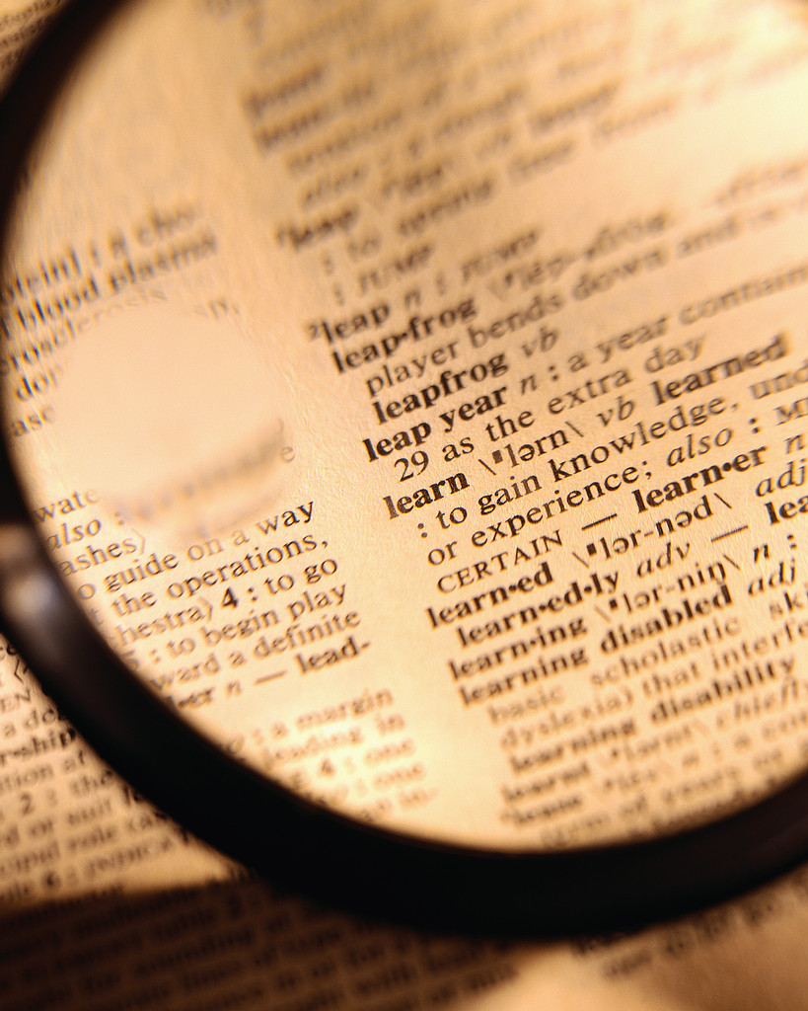
How do we find words in a dictionary?

Slide 2
Look at the first page of the dictionary in front of you.
What do you notice about the words?
You should have seen that all the words start with the letter A

Slide 3
How many pages of words beginning with A are there in the dictionary?
Can you find the page where the words start with B ?

Slide 4

DICTIONARY LAYOUT
Discuss with the person sitting next to you how the page is set out.
Be ready to share your thoughts with the rest of the class.

Slide 5
Features of Dictionaries
The words are in columns
The word you want is in bold or in colour
The word has it’s meaning written next to it

Slide 6
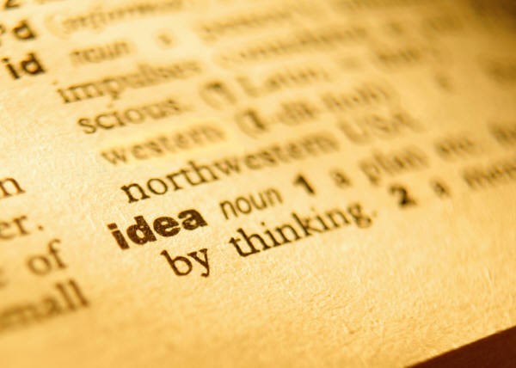
Features of Dictionaries
Look through the pages of the dictionary now. What do you notice?

Slide 7
Features of Dictionaries
You should have noticed that all the words are in
alphabetical order

Slide 8
Can you put these words into alphabetical order?
Elephant
Apple
Zebra
Carrot
Apple
Carrot
Elephant
Zebra

Slide 9
Can you put these words into alphabetical order?
Lorry
Caravan
Party
Money
Sunshine
Caravan
Lorry
Money
Party
Sunshine

