Slide 1
Introduction to Floriculture
Advanced Plant Sciences: Horticulture and Forestry
Sutherlin High School AST
W. Crawford

Slide 2
Floriculture
What does floriculture include?
  Floral design
  Flower and plant care and identification
  Proper use of chemicals and tools
  Selling and marketing floral products

Slide 3
Floriculture
For this unit we will:
  Learn principles of design
  Identify floral plants, pests, and tools
  Prepare floral centerpieces, boutonnieres, and corsages
  Unit Evaluation: written test OR participate in district floriculture CDE

Slide 4
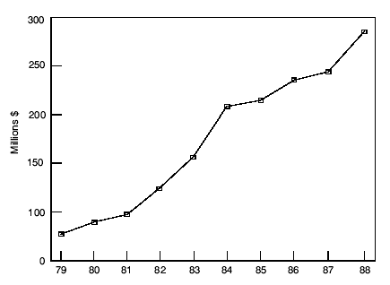
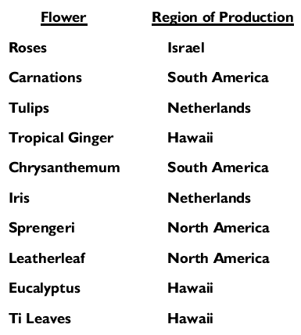
The Flower Industry
Most flowers imported from other countries
  90% of carnations
  89% of chrysanthemums
  71% of roses
Growth of Sales in the Cut Flower Market

Slide 5
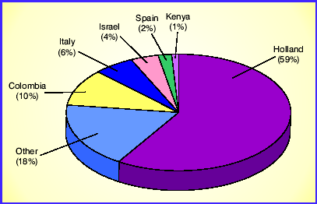
The Flower Industry
Most are grown in the Netherlands
  In hydroponic greenhouses
  20 years ahead of most countries in production systems
Other countries
  Colombia
  Latin America
Percentage of World Cut Flower Exports by Country

Slide 6
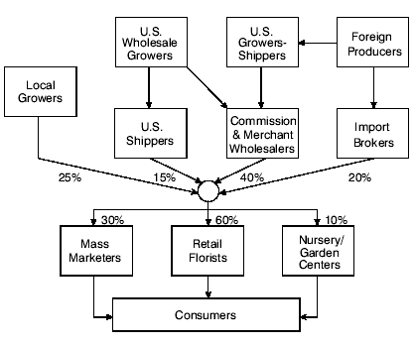
The Flower Industry
How do they get to you?
  Colombian carnations, Hawaiian tropical flowers, Israeli roses, and other cut flowers are air shipped to Holland flower auctions by exporters
  Inspected by and sold to buyers from around the world, who ship them to their home countries
  Arrive to wholesalers who distribute to retailers/etc

Slide 7
The Flower Industry
http://video.pbs.org/video/1283843915

Slide 8
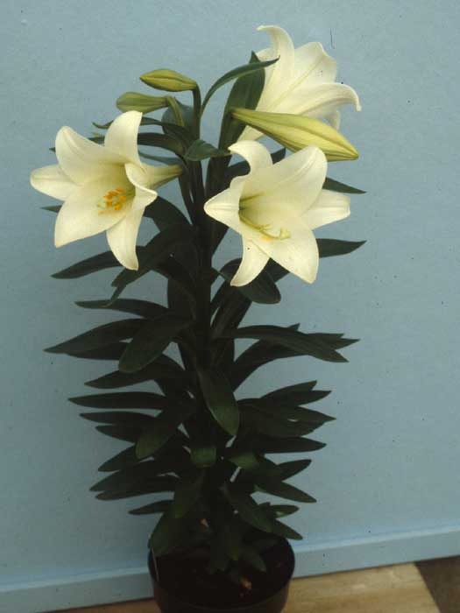
The Flower Industry
Oregon’s Role
  Oregon produces mostly horticulture and nursery plants, not cut flowers for arrangement products
  But almost all Easter Lilies in US are produced on southern Oregon coast

Slide 9
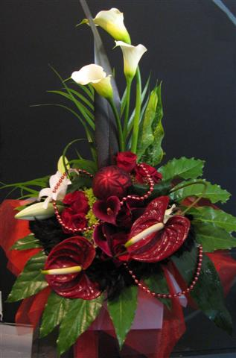
Floral Design: the Basics
Floral design – (aka arranging); the art of organizing the design elements inherent in plant materials and accessories according to principles of design art

Slide 10
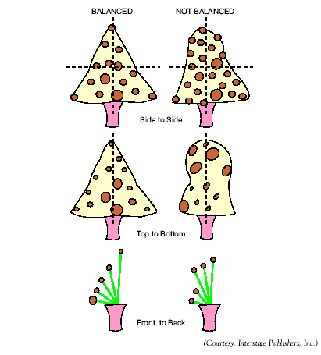
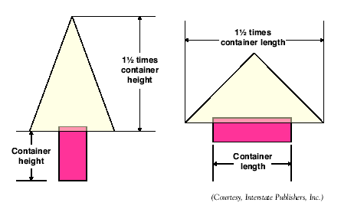
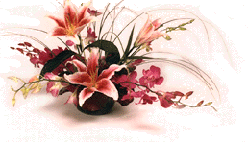
Floral Design: the Basics
Principles of design – rules and guidelines used by the floral designer to create a beautiful composition

Slide 11
Principles of Design
Proportion is the pleasing relationship between size and shape among objects and parts of objects
How do you achieve proportion?
  The design should be 1 ½ times the size of the container’s greatest dimension (height/width)
    Some exceptions
  Container is the
  primary factor
    Dimensions
    Color
    Texture/material
    Shape

Slide 12
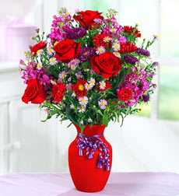
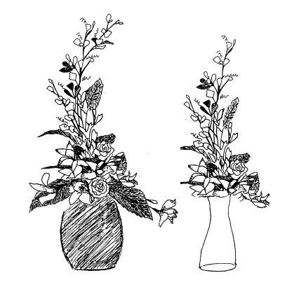
Principles of Design
How do you achieve proportion?
  Solid, dark colored containers can support taller arrangements
  Clear glass is better for shorter arrangements

Slide 13
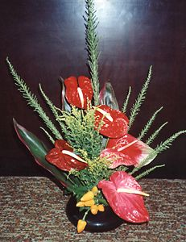
Principles of Design
Balance in a flower arrangement refers to the arrangement’s equilibrium and equality in weight, both physical and visual
How do you achieve balance?
  Physical balance: actual stability of plants in arrangement
  Visual balance: perception of
  the arrangement being
  balanced–being equal in
  weight on both sides of the
  central axis

Slide 14
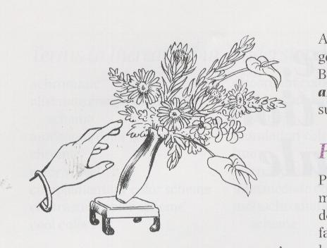
Principles of Design
How do you achieve balance?
  Visual balance should
  be evident from three
  views:
    side to side
    top to bottom
    front to back

Slide 15
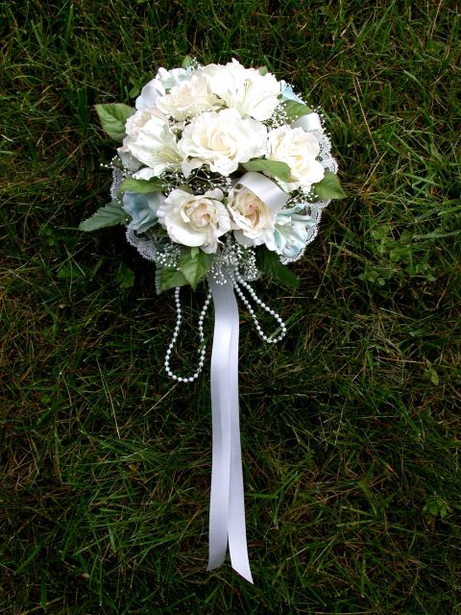
Principles of Design
Rhythm is the orderly organization of a design elements to create a visual pathway
How do you achieve rhythm?
  Regular, repeated rhythm is present when materials are repeated at regular intervals from the top to the bottom of an arrangement
  Free, variable rhythm is an unstructured style with subtle flowing movements created with unstructured materials

Slide 16
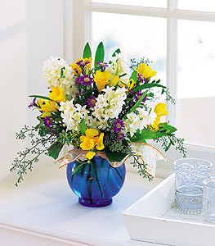
Principles of Design
How do you achieve rhythm?
  Five principles help with rhythm:
    Radiation is the design element that makes it look as if all stems are coming from one point
    Repetition is repeating the use of floral design elements to create unity in the work
    Transition is the smooth gradual change from one material or element to another
    Variation is the diverse assortment of materials, stimulating interest
    Contrast describes objects arranged with a striking difference, stimulating interest

Slide 17
Principles of Design
Dominance in a design means that one design element is more prevalent or noticeable, thereby capturing interest of the viewer
How do you achieve dominance?
  Dominance can be achieved by:
    Using dominant plant material
    Using an emphasized design element
    Using a distinct style of design
    Using a theme
    Using a focal point – the center of interest of the design, visually tying it together; all arrangements should have some sort of focal point

Slide 18
Principles of Design
How do you achieve dominance?
  A focal point is done by:
    Use of large flowers
    Use of special form flowers such as orchids
    Employing dark shades
    Variation of concentration of plant material
    Use of framing materials
    Use of strong color
    contrast
    Radiation of plant
    materials to a particular
    area
    Use of accessories

Slide 19
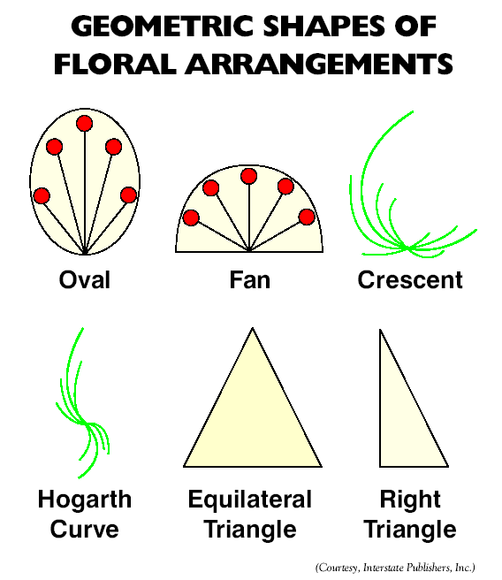
Other Considerations
Shape and Form
  Shape is the 2-dimensional outline
  Form is the 3-dimensional aspect
    Geometric
    Naturalistic
    Free form

Slide 21
Other Considerations
Shape and Form
  Line – visual movement between two points in the arrangements
    Line materials – create definite vertical, horizontal, diagonal, or curvilinear lines
    Form flowers – have distinctive shapes (lillies, tropicals)

Slide 22
Other Considerations
Shape and Form
  Line – visual movement between two points in the arrangements
    Mass flowers – round solid flowers like carnations/mums
    Filler flowers – airy, light flowers like baby’s breath

Slide 23
Other Considerations
Color
  Primary – red, yellow, blue
  Secondary – green, orange, purple
  Tertiary – blue-green, yellow-orange, etc.

Slide 24
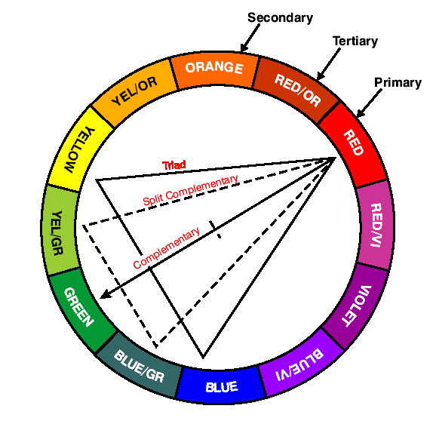

Slide 25
Other Considerations
Color Schemes
  Monochromatic – all the same color, lighter/darker
  Analagous – color scheme with colors next to one another on the color wheel
  Complimentary – colors opposite from one another on the color wheel

Slide 27
Proportion – is the proportion correct?
Balance – is it balanced?
Rhythm – how does your design have rhythm?
Dominance – what is the focal point?

