Slide 1
How a Flower is Pollinated
The purpose of all flowers is to be pollinated and produce seeds

Slide 2
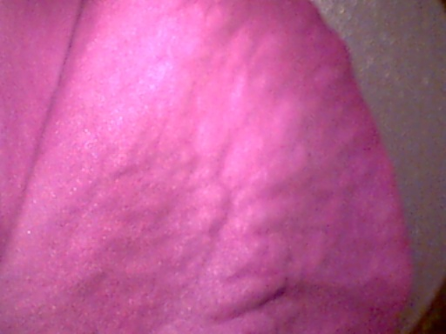
What do petals do?
Partly used to protect the male and female parts of the plant
Some plants use wind to blow the pollen and they have small leaves
Plants which use insects to transfer the pollen usually have large petals which smell and are brightly coloured

Slide 3
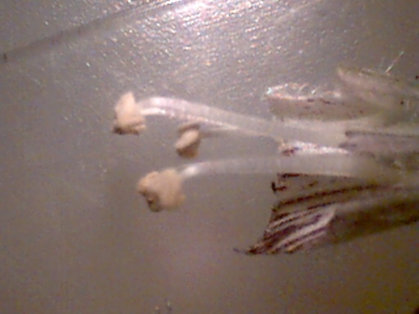
What is the male part?
The male part of the flower is called the stamen
It has a long stalk called the filament
At the top of the filament is the anther

Slide 4
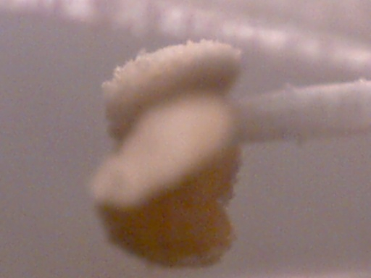
What is the anther?
The anther produces pollen

Slide 5
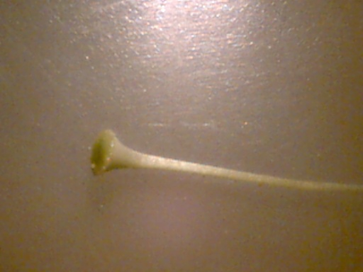
What is the female part?
Carpels are the female parts
They are made up of a stigma, style and ovary

Slide 6
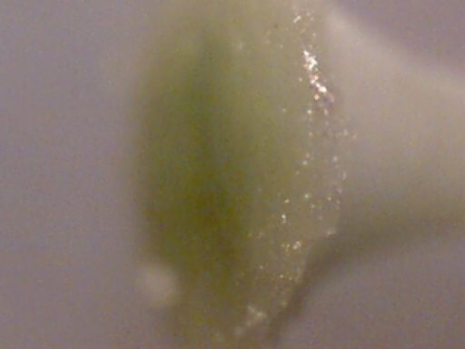
What is the stigma?
It is at the top of the carpel
It is sticky which helps catch pollen grains

Slide 7
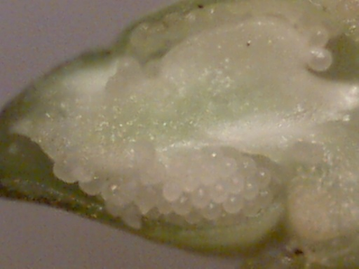
What are the ovaries?
The ovaries are where the eggs are made

Slide 8
How does pollination take place?
Pollen grains brush against the insect, it flies to another plant, the grains rub on the stigma
The grain of pollen grows a tube, which goes down the style until it reaches the ovary
The male part joins with the female part to form a seed. This is called fertilisation.
After fertilisation the petal drop off because they are no longer needed

